Slide 1

assimilation of measurements from hydrologicAl observatories FOR BETTER terrestrial system model predictions: EXPERIENCES AND CHALLENGES
14 JUNI 2023 I harrie-jan hendricks-franssen, F. Li, L. STREBEL, H. ZHAO, H. BOGENA, H. VEREECKEN
¹Institute of Bio- and Geosciences (IBG-3, Agrosphere), Forschungszentrum Jülich, Jülich, Germany
²Centre for High-Performance Scientific Computing in Terrestrial Systems (HPSC-TerrSys), Geoverbund ABC/J, Jülich, Germany

Slide 2

introduction
Predictions with terrestrial system simulation models are affected by random and systematic errors.
Remote sensing data are exhaustive, but affected by larger errors, and sometimes at very coarse resolution. In situ data from (hydrological) measurement sites are sparse, but more precise.
Model-data fusion methods like data assimilation can result in a better characterization of terrestrial system states. Can it also improve characterization of difficult to observe fluxes like ET?
Overview of data assimilation activities at highly equipped measurement sites.

Slide 3
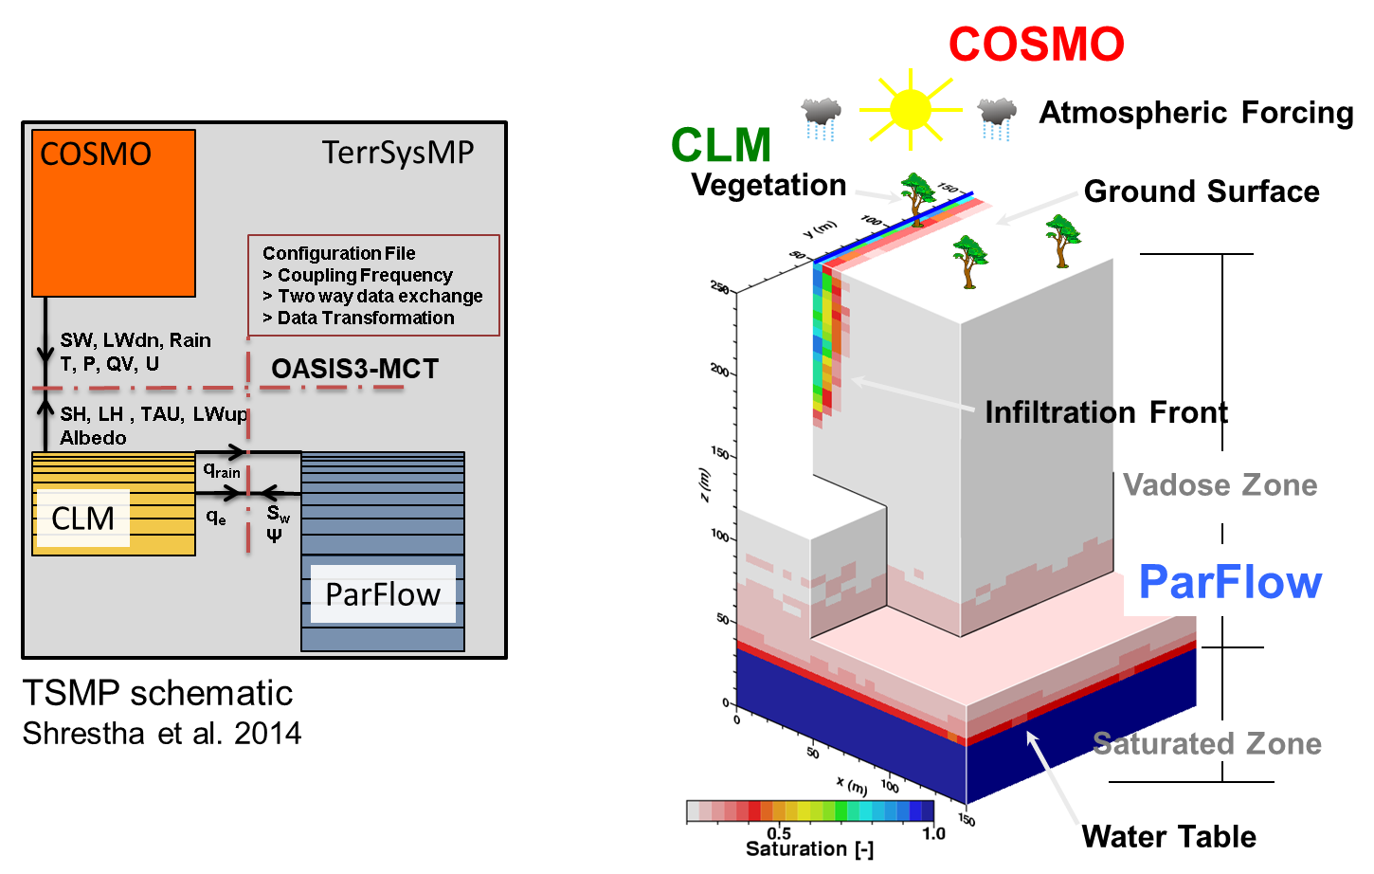
tsmp
ICON
CLM5/
eCLM
ParFlow GPU

Slide 4
Tsmp-pdaf
PDAF (Nerger and Hiller, 2013) coupled to TSMP. COSMO, CLM, ParFlow and PDAF in parallel.
DA system is fully integrated (no I/O, no model reinitializations).
Data which can be assimilated: soil moisture (in situ, e.g. from cosmic ray neutron sensors; remote sensing, e.g. SMAP), groundwater levels, brightness temperature, river stages, land surface temperature (development), air temperature (branch).
Joint state-parameter updating, e.g. saturated hydraulic conductivity.

Slide 5
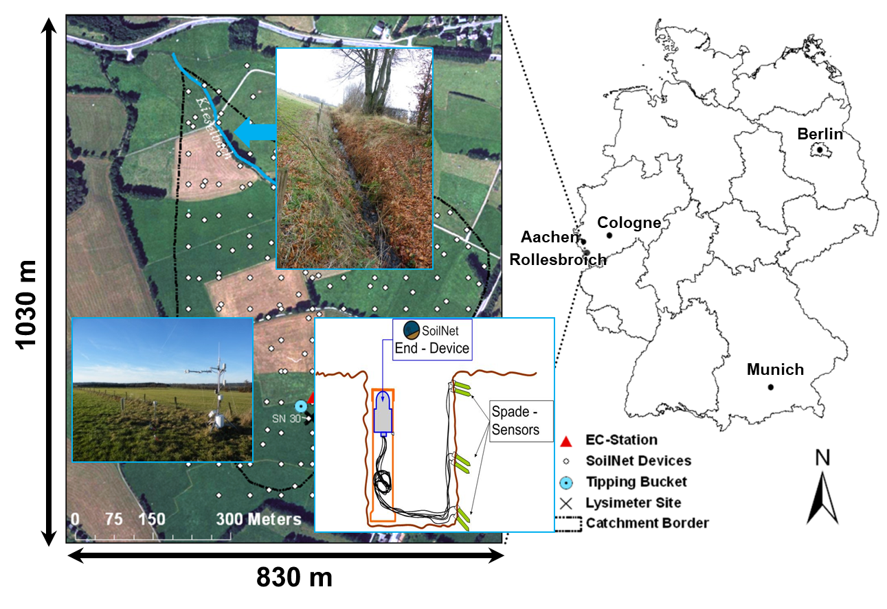
Real-world case rollesbroich, eifel, germany
CLM-ParFlow-PDAF
128 x 112 grid cells, 10m x 10m resolution; 20 layers
Daily soil moisture assimilated from 61 sensors (5, 20 & 50cm)
128 ensemble members: precipitation stochastic and 3D heterogeneous soil parameters
May 2011- December 2011

Slide 6
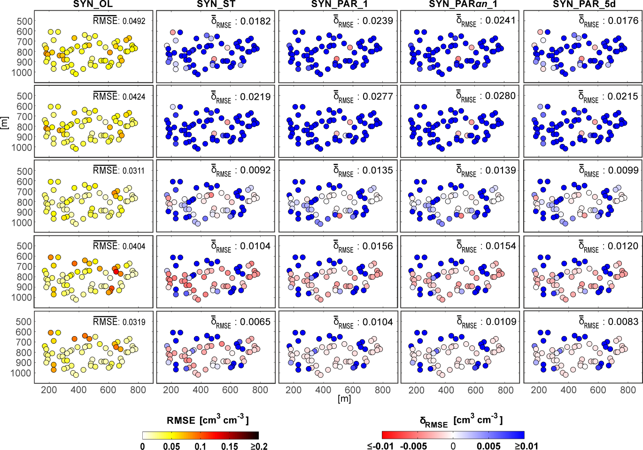
Real-world case rollesbroich, eifel, germany
-33 % -46% -46% -35%
Only soil moisture was assimilated, not discharge!
Real-world case, characterization of discharge:
  NSE: +0.49 (OL) and +0.67 (DA+par est)
  Bias: +65% (OL) and -24% (DA+par est)
  RMSE: 15.8 m³/h (OL) to 9.2 m³/h (DA+par est)
ET-characterization not improved (no water limitation)
Gebler et al., 2019, WRR

Slide 7
Our further da studies and ET estimation
For a synthetic CLM model for the Rur catchment (~2.000 km²) BT assimilation combined with soil parameter estimation improved ET characterization considerably (~40%) (Han et al., 2014, WRR).
For a synthetic CLM-ParFlow model mimicking SW Germany (~50.000 km²) assimilation of soil moisture data and/or groundwater level data improved soil moisture and groundwater level characterization, also between measurement sites, but hardly improved ET characterization (1% RMSE reduction) (Hung et al., 2022, WRR).
For the Rur catchment GWL assimilation did not improve ET characterization while CRNS assimilation improved ET characterization somewhat (up to 15% RMSE reduction).
For North-Rhine-Westphalia (22.500 km² model domain) assimilation of SMAP data improved soil moisture characterization, but ET only slightly (4 EC-stations, year 2018).

Slide 8
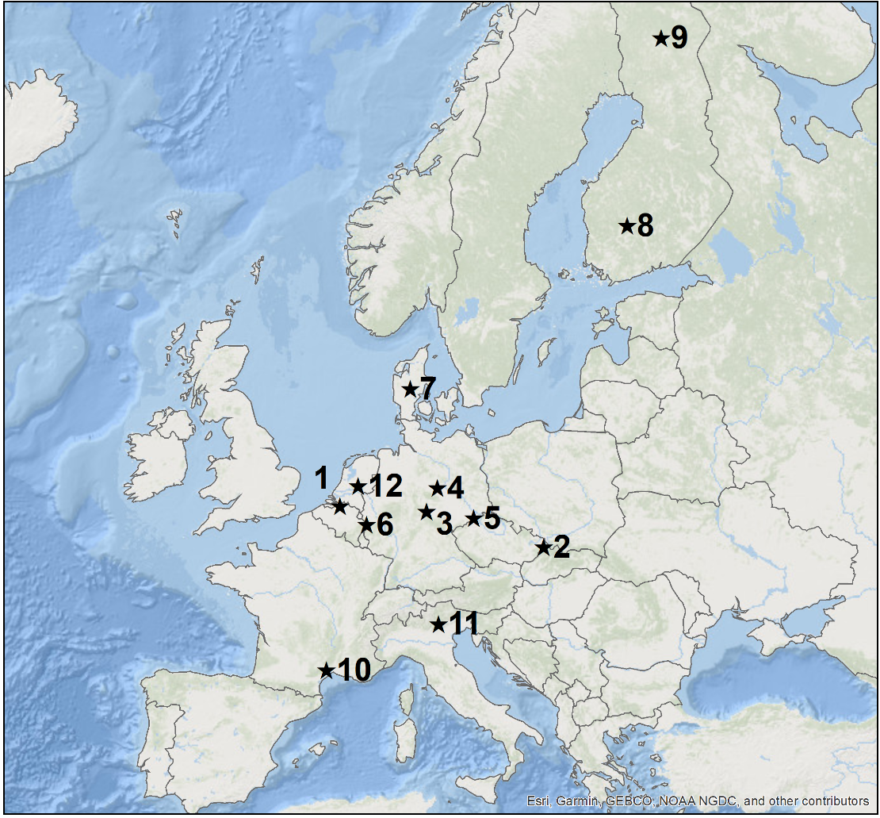





DATA
In-situ data for soil water content and evapotranspiration from FLUXNET, eLTER, ICOS, TERENO for 2009 to 2018
ID | Site name | Country | ID | Site name | Country
1 | Brasschaat | Belgium | 7 | Gludsted | Denmark
2 | Bily Kriz forest | Czech Republic | 8 | Hyytiälä | Finland
3 | Hainich | Germany | 9 | Sodankylä | Finland
4 | Hohes Holz | Germany | 10 | Puéchabon | France
5 | Oberbärenburg | Germany | 11 | Lavarone | Italy
6 | Wüstebach | Germany | 12 | Loobos | Netherlands
CLM5: https://www.cesm.ucar.edu/
PDAF: http://pdaf.awi.de
TSMP: https://www.terrsysmp.org/
Slide 2

Slide 9
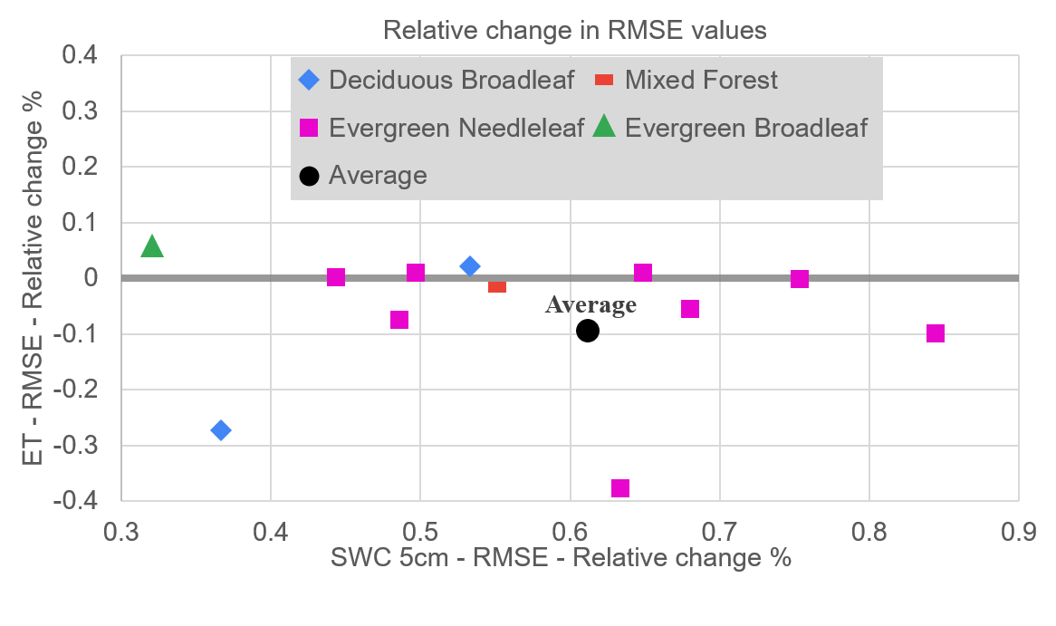
Simulation results - SWC vs ET
The average over all sites shows an improvement of 61% for the SWC RMSE but a detriment for the ET RMSE of 9.4%.
Overall 8 of the sites show detriments and 4 show improvements for ET estimation related to SWC assimilation.
Relative change between Open Loop and DASHP RMSE of soil water content and evapotranspiration for each site
CLM5: https://www.cesm.ucar.edu/
PDAF: http://pdaf.awi.de
TSMP: https://www.terrsysmp.org/
Slide 5

Slide 10
What about the ET verification data?
EC data affected by energy balance closure problem so verification data is also uncertain, and lysimeter data could be better alternative.

Slide 11
What about the ET verification data?
EC data affected by energy balance closure problem so verification data is also uncertain, and lysimeter data could be better alternative. Or not?

Slide 12
conclusions
Data assimilation improves terrestrial system state estimation (soil moisture, groundwater level) at measurement and verification sites, but ET is hardly improved.
LSM improvements, for example to better represent drought stress, are important.
Role hydrological observatories: provide more data to better constrain LSM at highly equipped measurement sites: in situ precise LAI, sapflow, pressure, rooting depth, deep soil moisture, more info on soil properties.
Role hydrological observatories: ET verification data are needed with <5% error. Too much focus on uncorrected EC-measurements now. Lysimeters could be helpful.

