Slide 1
Assessing and Monitoring Surface Soil Properties Over Southern Italy
by: Bar Efrati, Prof. Eyal Ben-Dor Prof. Nunzio Romano, PhD Paolo Nasta
June 2023
Notes:
* An ongoing collaboration between TAU and Naples Uni * Assembly the Campania SSL – predict essential soil properties and apply the lab-based models to AVIRIS NG NASA airborne data * present a site-based calibration for AVIRIS NG from lab measurements

Slide 2
Study objectives
1
2
Predict the soil texture content (clay, sand), and soil organic carbon (SOC) from reflectance spectra
Implement the spectral-based model to NASA’s AVIRIS-NG data
Notes:
* Assembly the Campania SSL and predict: soil texture, SOC * apply the model to AVIRIS

Slide 3
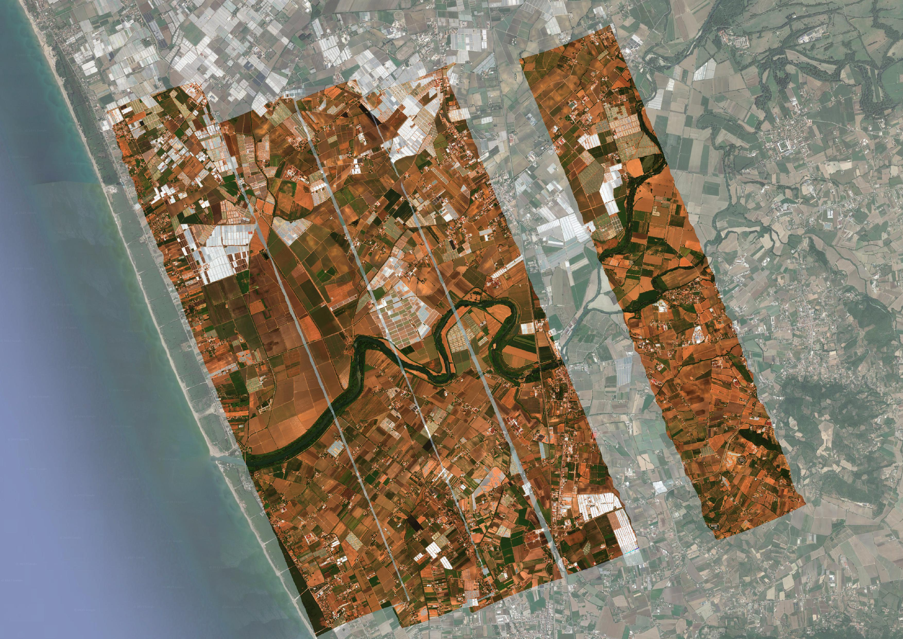
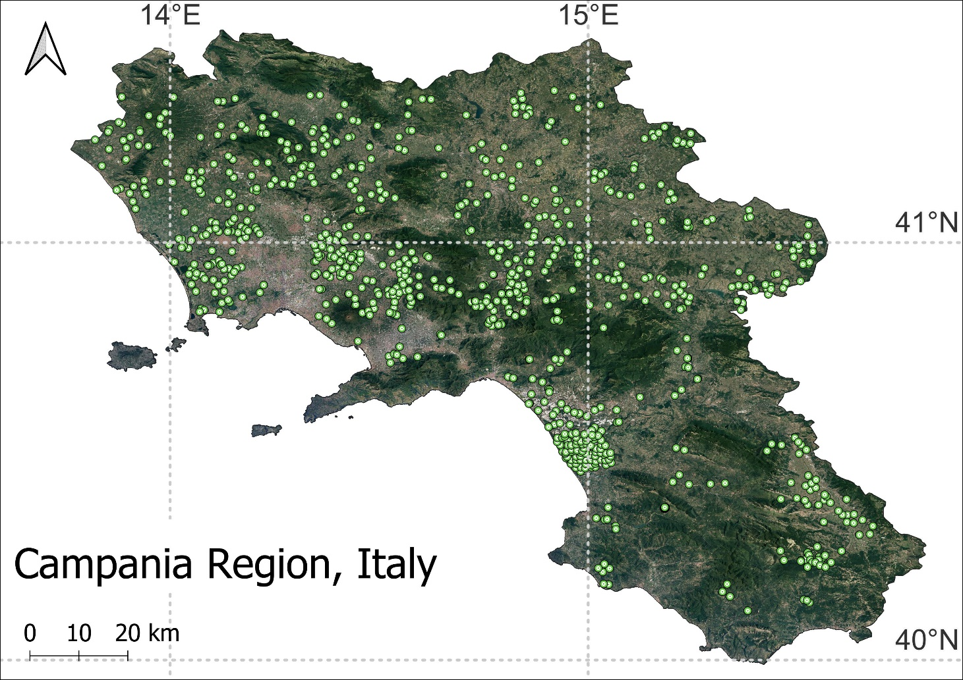
Research Area
AVIRIS cover
Notes:
The research took place in all the Campania region, and the AVIRIS cover recorded the Sele-River area

Slide 4
3
Methods

Slide 5
Campania Soil Spectral Library (SSL) Features
Chemical and physical properties
Texture classification
Soil texture content (sand, silt, clay %)
Bulk density (BD g/cm^3)
Soil organic carbon (SOC %)
CaCO3 (%)
Carbon stock (%)
pH
GPS location
Spectra (400-2500 nm)
Dependent
Independent
Notes:
Predict soil properties by the spectra
Map the clay and sand with AVIRIS NG

Slide 6
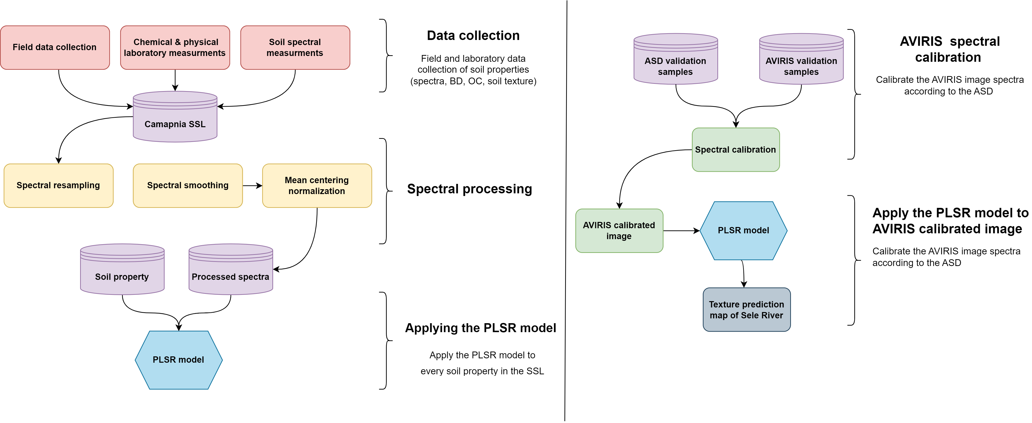
Campania SSL Framework
Notes:
Collect the samples
Wet laboratory analysis
Spectra acquisition
Spectral pre-processing
PLSR
AVIRIS calibration
Apply PLSR to AVIRIS image

Slide 7
The Concept of SSL
The SSL goals
Prediction of soil properties by spectra
Apply the spectral model to UAV, airborne sensor, or satellite
Selecting the modeling approach
Number of samples – determines the model type (PLSR, RF, ANN etc.), curse of dimensionality, overfitting.
Orientation to the final goal of the project
Notes:
Two case studies: different soil security.. Different spectral processing, addressing differently
Generating a prediction model based on spectral libraries requires considering two key factors: the number of samples available and the final goal of the project. With few samples, it is important to avoid complex models that may lead to over-fitting (e.g., artificial neural network), and instead opt for linear methods such as PLSR, linear regression, or principal component analysis.
Additionally, the processing of the spectral data should be oriented to the specific objective of the project, such as applying the model to aerial or satellite imagery.
The lab spectral processing was confined to the limitations of the AVIRIS image, which is subjected to atmospheric attenuation and spectral noise.
Therefore, common spectral pre-processing such as 1st derivative, cannot be applied later on to the AVIRIS NG spectra. Moreover, as the spectra were acquired by different methods, sensors, and conditions, additional calibration was essential for aligning the AVIRIS NG data.

Slide 8
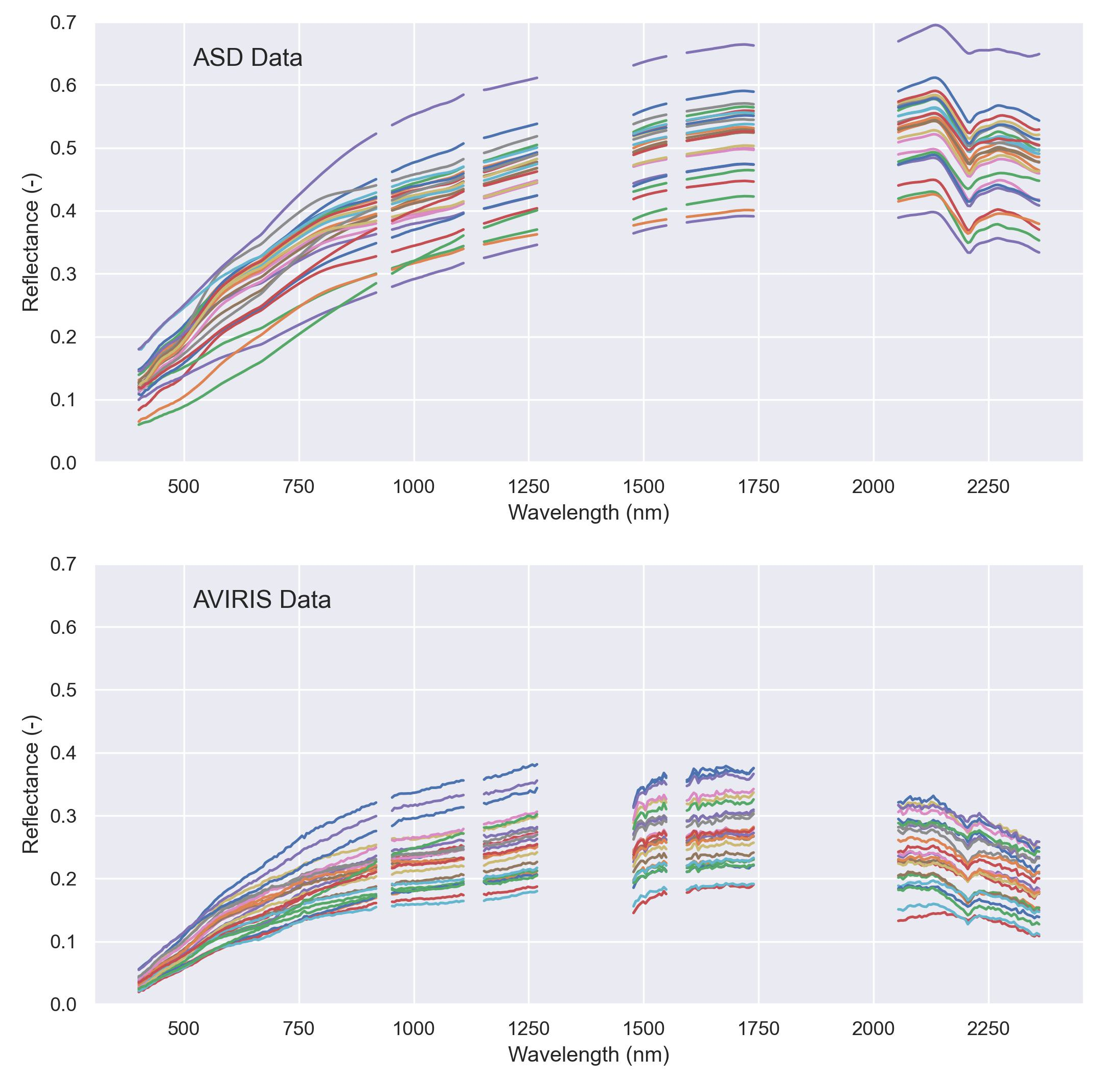
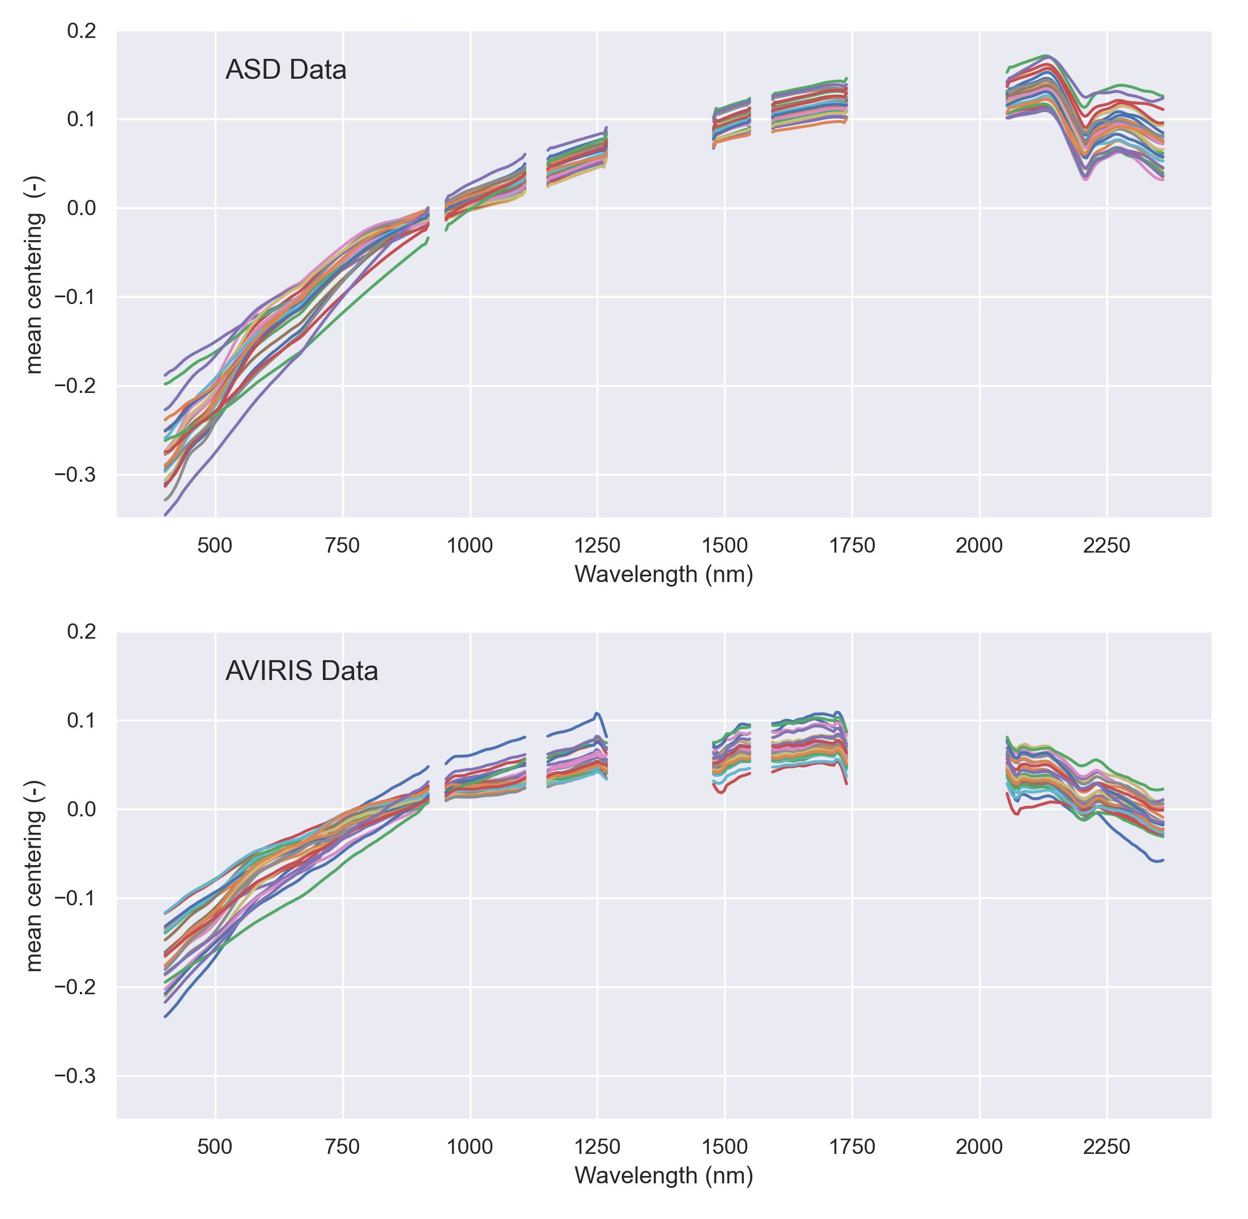
Spectral Pre-processing
Spectral resampling
Noise reduction
Smoothing
Mean-centering normalization
Notes:
Spread out (asd vs aviris), noise (1st derv) , removing essential bands (a minus)
Removing band
spectral resolution
smoothing
normalization
The lab spectral processing was confined to the limitations of the AVIRIS image, which is subjected to atmospheric attenuation and spectral noise.
Therefore, common spectral pre-processing such as 1st derivative, cannot be applied later on to the AVIRIS NG spectra. Moreover, as the spectra were acquired by different methods, sensors, and conditions, additional calibration was essential for aligning the AVIRIS NG data.

Slide 9
3
Results

Slide 10
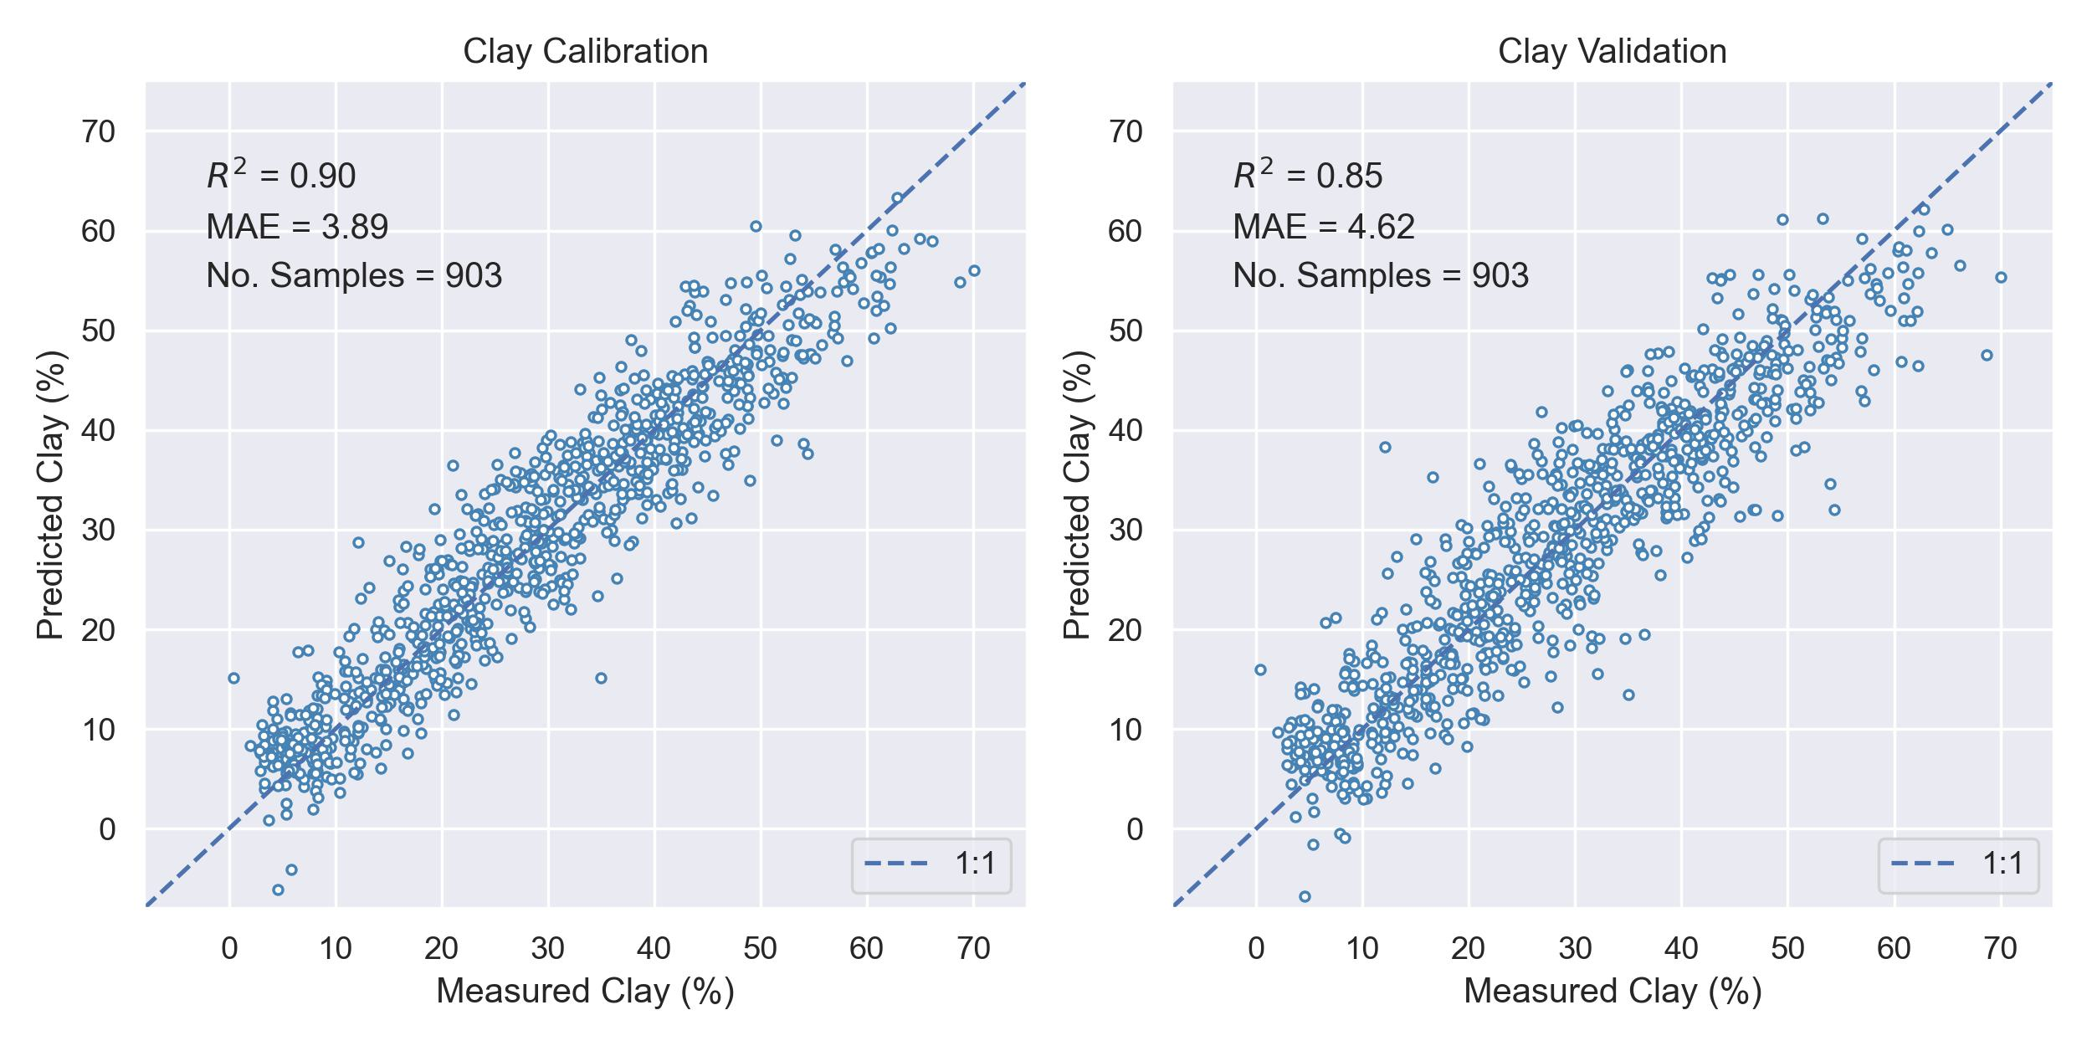
Lab Clay Prediction
Notes:
Clay is a first-related property to the spectra with a unique absorbance at 2200 nm – a result of OH group in the clay mineral structure
Clay prediction models are also used as quality assurance for both the chemical analysis and the spectra accuracy

Slide 11
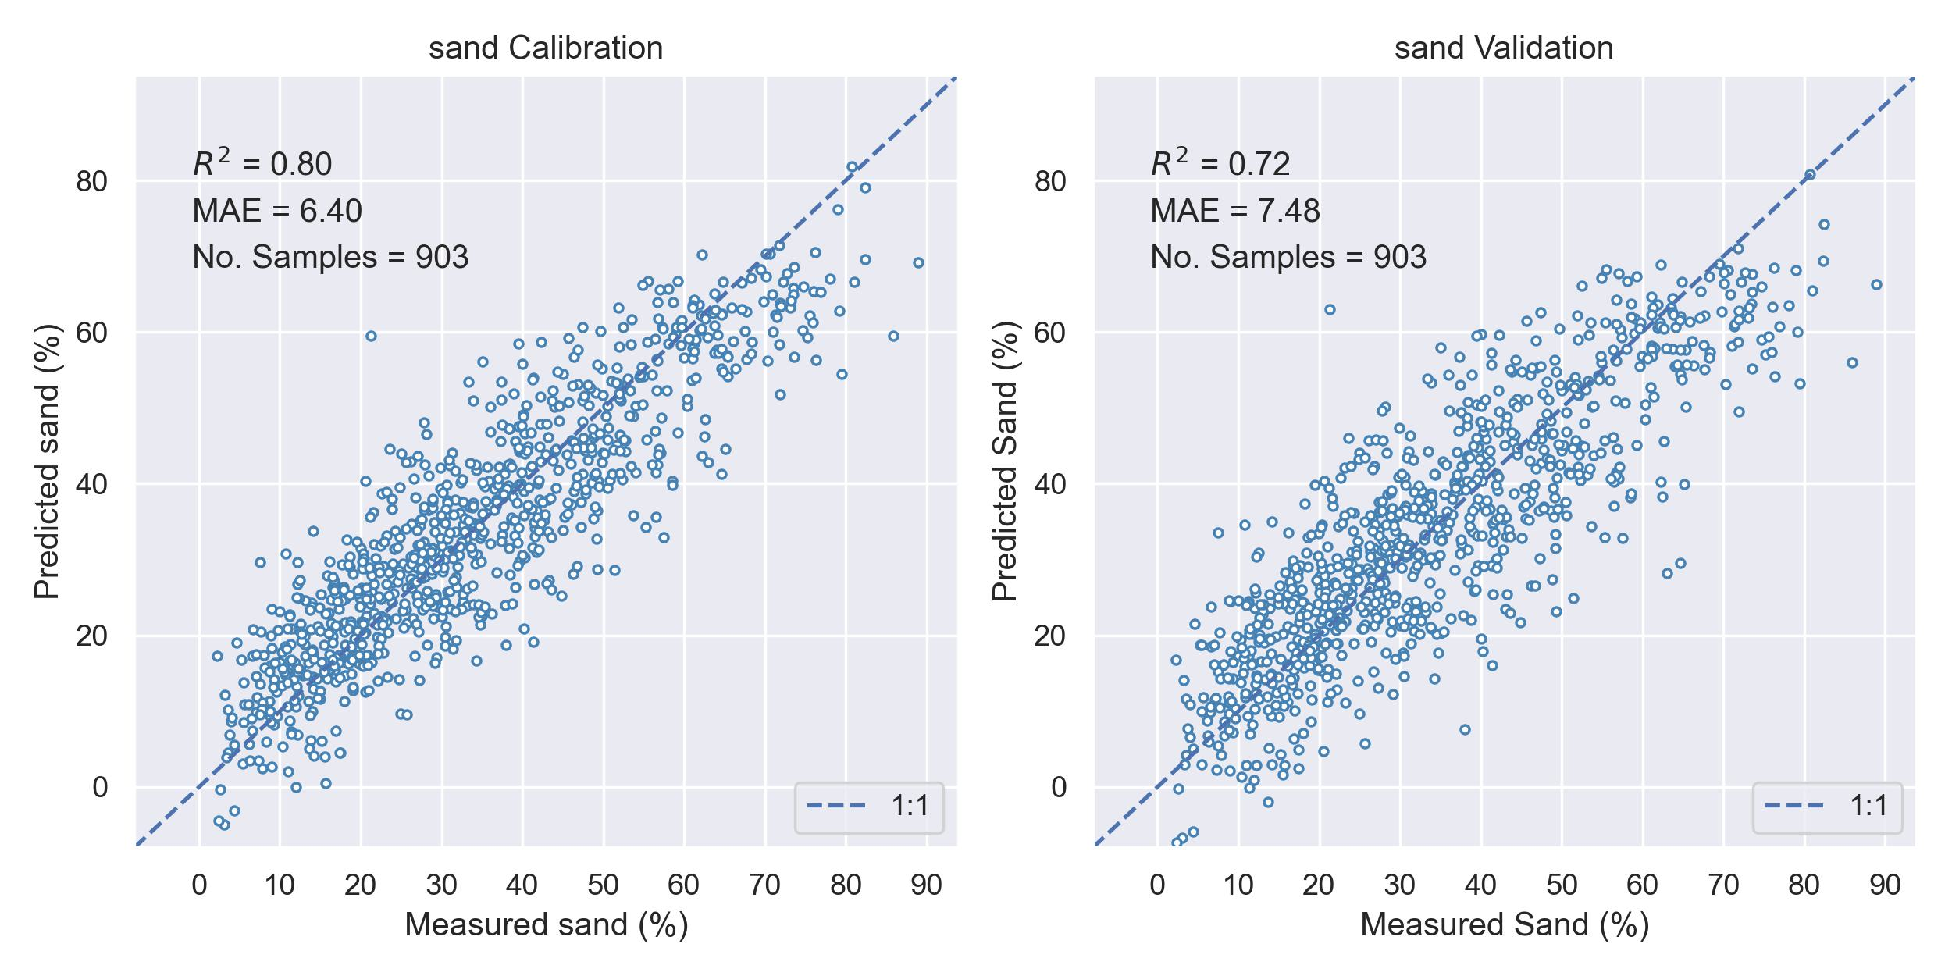
Lab Sand Prediction
Notes:
Sand is composed mostly of silica, which doesn’t utter spectral features in the optic range (it does in the thermal), but the fact that it is a complementary component in the soil texture –can still be predicted with high accuracy.

Slide 12
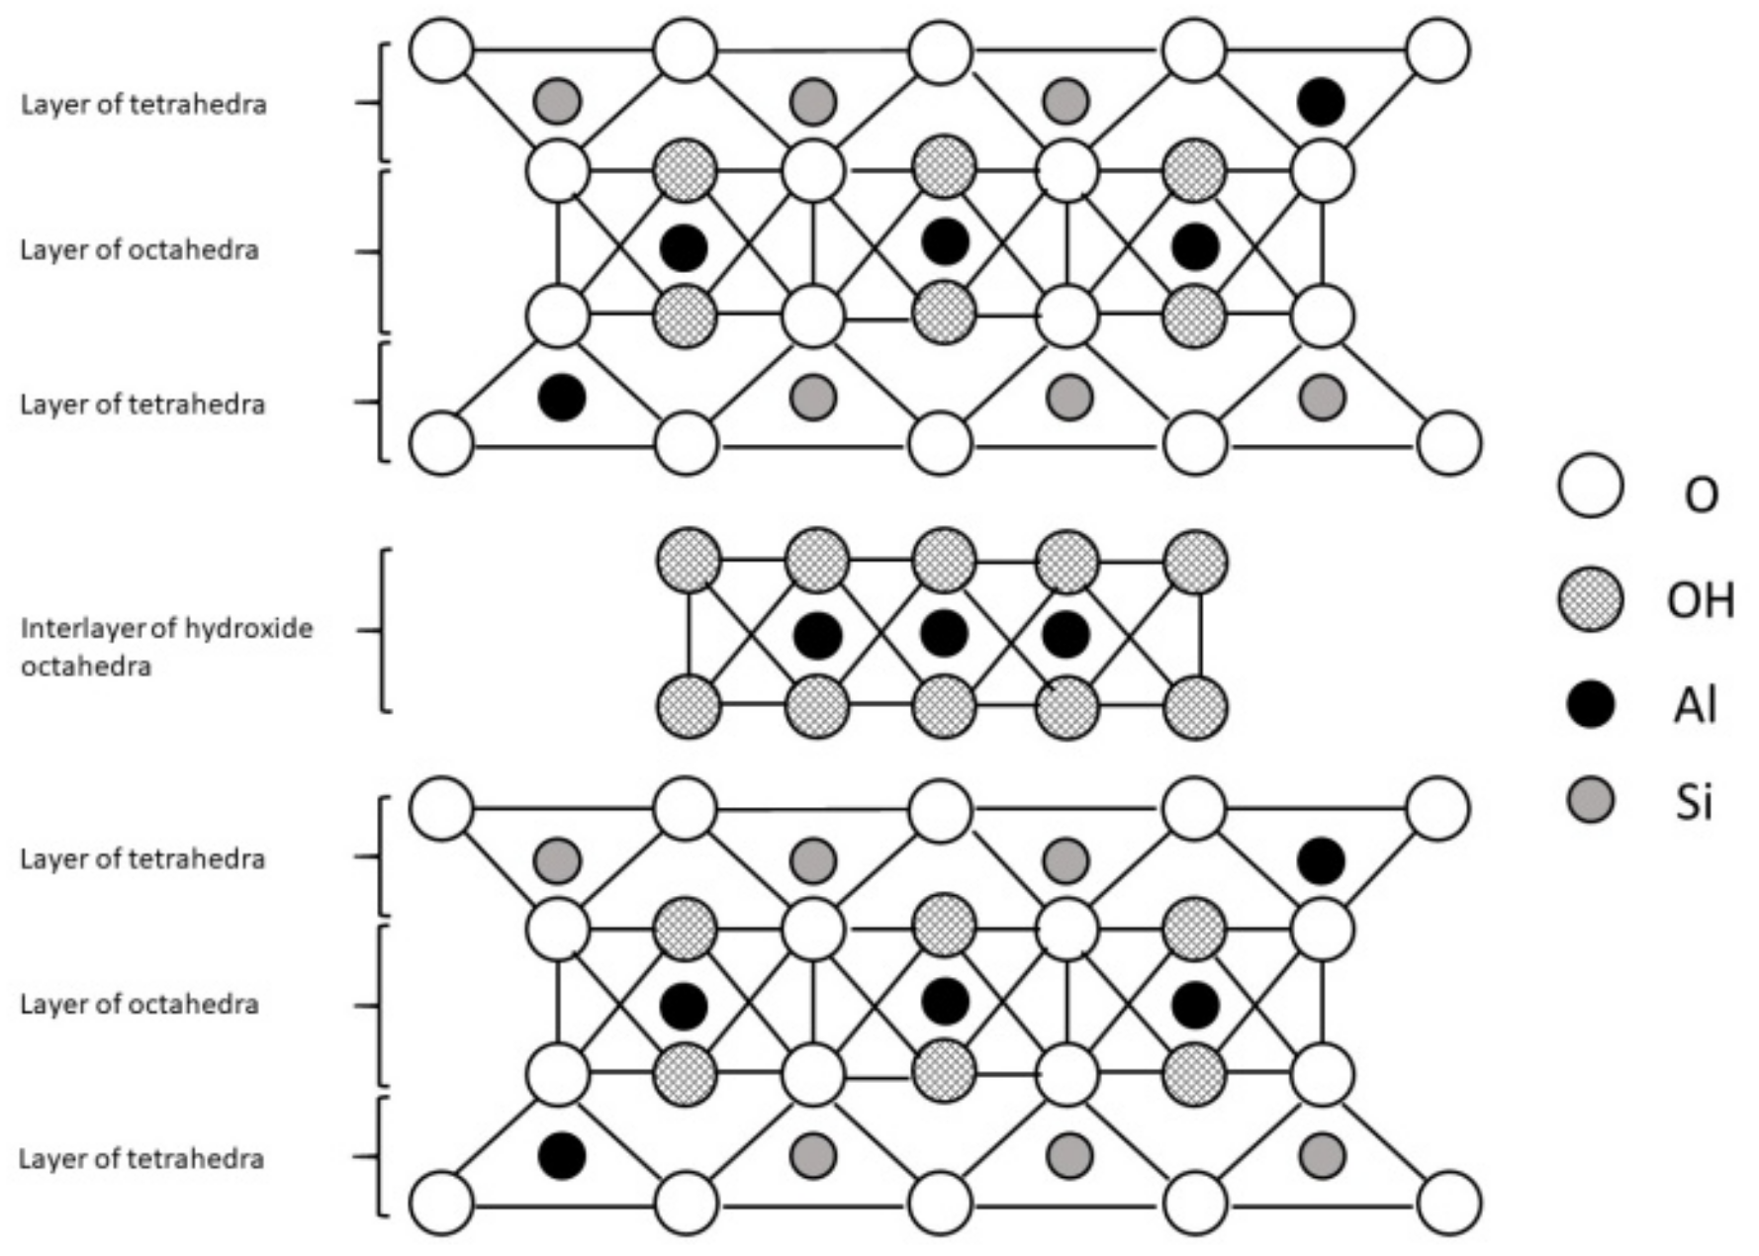
Soil Texture Prediction
The spectral features of clay minerals in the VNIR-SWIR range are related to functional groups present in the infrared region. In this range, the only group that exhibits spectral activity is the hydroxyl group (OH)
Notes:
https://www.mdpi.com/2076-2615/9/10/714
https://www.researchgate.net/publication/226488049_Non-destructive_infrared_analyses_A_method_for_provenance_analyses_of_sandstones/figures?lo=1

Slide 13
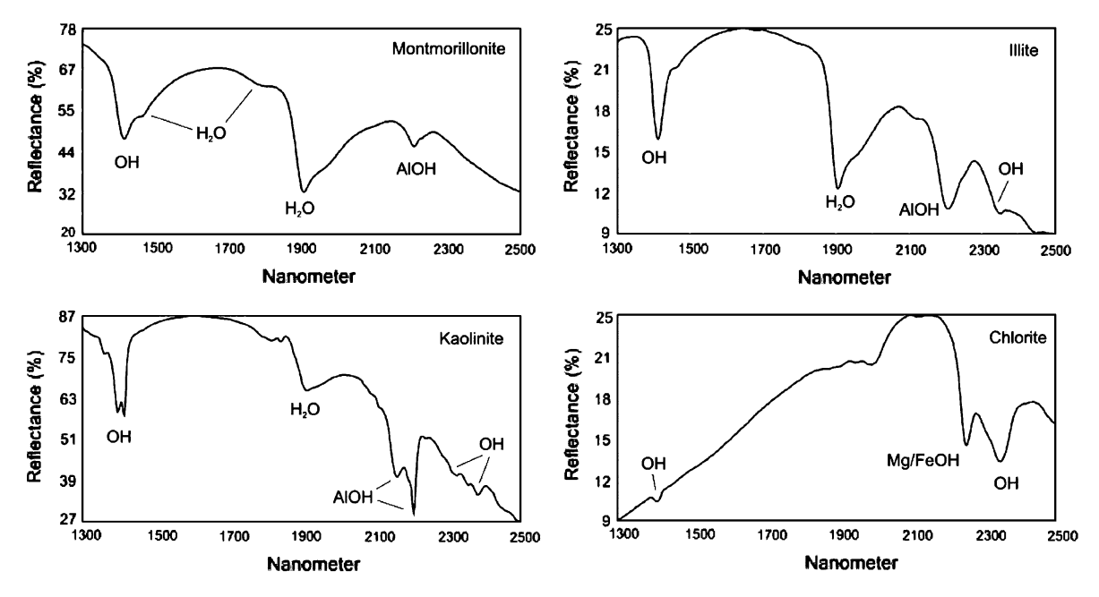
Soil Texture Prediction
The reverse trend between clay and sand is a result of a distinguishable spectral signature of clay minerals at 2200 nm and high water retention capacity that reflects at 1400 nm and 1900 nm.
Notes:
The spectral features of clay minerals in the VNIR-SWIR range are related to the overtones and combination modes of fundamental vibration frequencies of functional groups present in the infrared region. In this range, the only group that exhibits spectral activity is the hydroxide group (OH), which is either present in the mineral structure or attached to the mineral surface as a part of water molecules, either directly or indirectly (Ben-dor et al, 1999). The low water retention of sand and its inverse correlation tendency along the VNIR range (Fig 4.1) indicates that these properties can be separated spectrally by the PLSR model for high prediction accuracy
https://www.mdpi.com/2076-2615/9/10/714
https://www.researchgate.net/publication/226488049_Non-destructive_infrared_analyses_A_method_for_provenance_analyses_of_sandstones/figures?lo=1

Slide 14
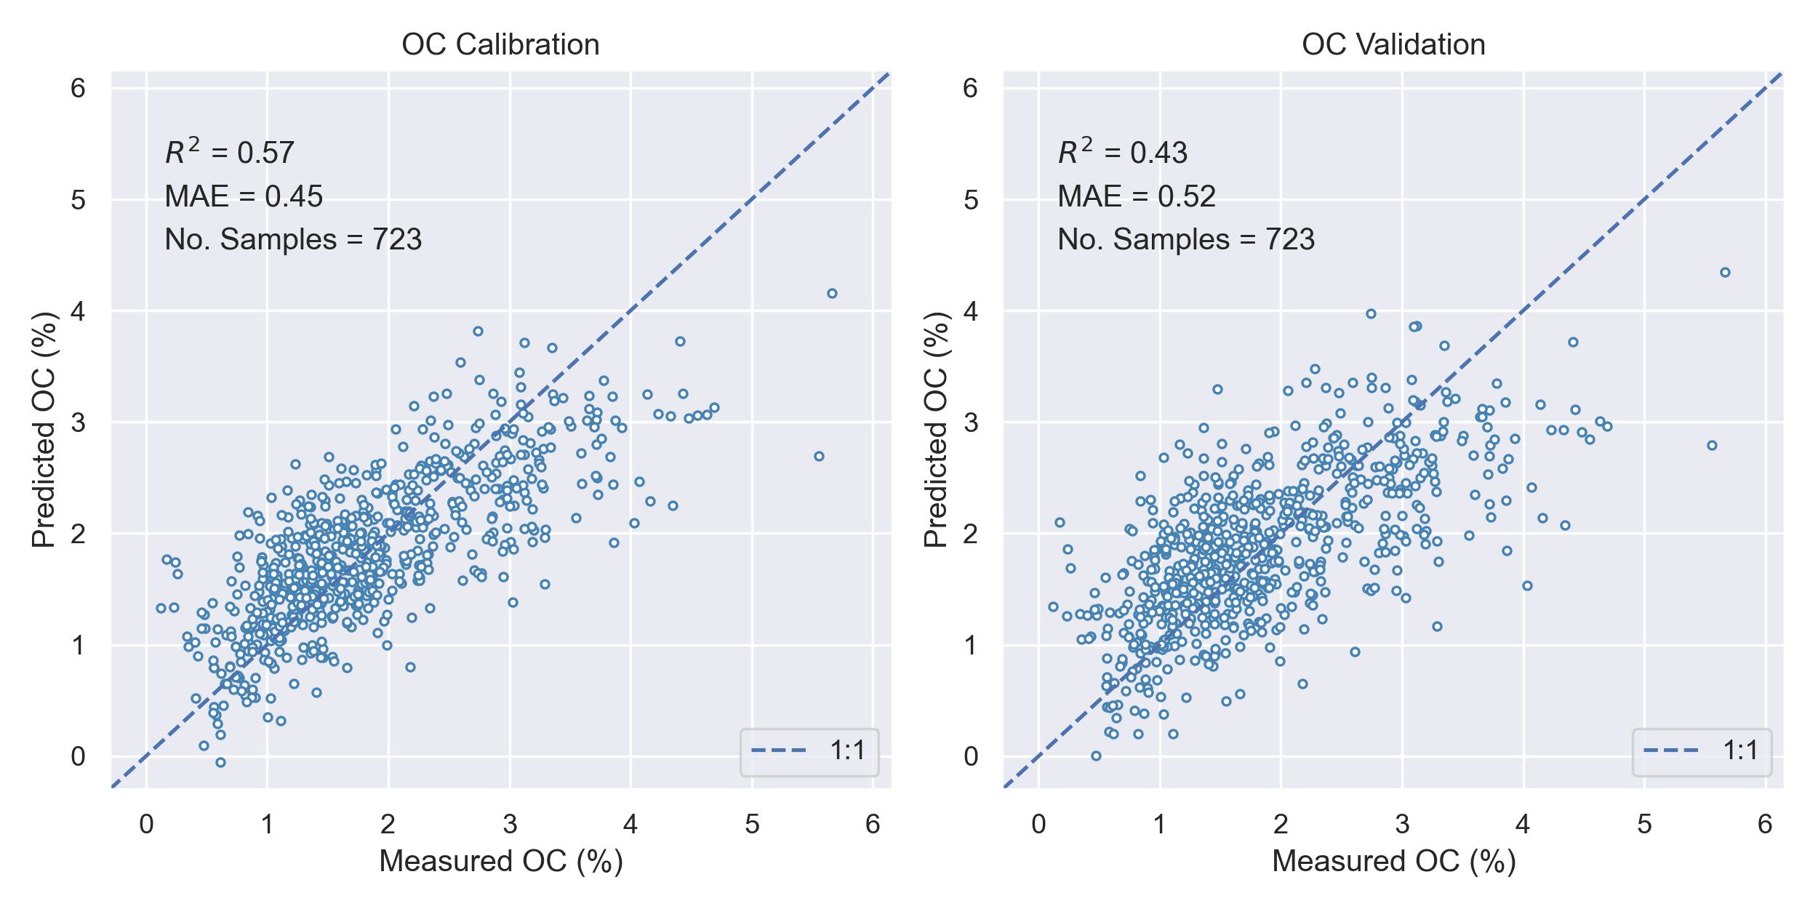
Lab SOC Prediction
Notes:
Soc is a challenging property for prediction – no presented features at a low percentage (5% approx.), it might mask other elements such as iron oxide. in addition, SOC is a fraction of organic matter that can be found in many degradation stages and therefore, appears in different locations along the optic range.
The real challenge is to create a generic model that is not biased to a specific homogeneous location. this prediction suggests that Additional information, such as grain size, CN ratio, and climate factors, are required for better estimation of SOC .

Slide 15
Campania SSL Framework
Notes:
AVIRIS calibration

Slide 16
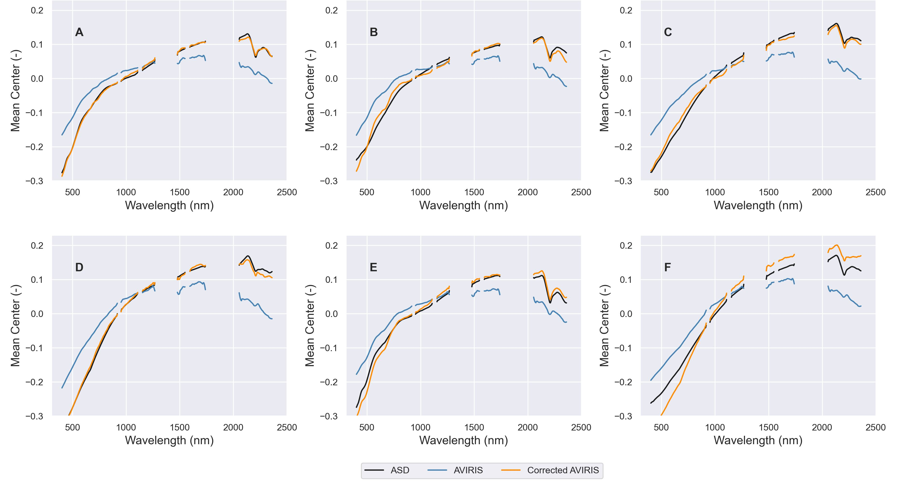
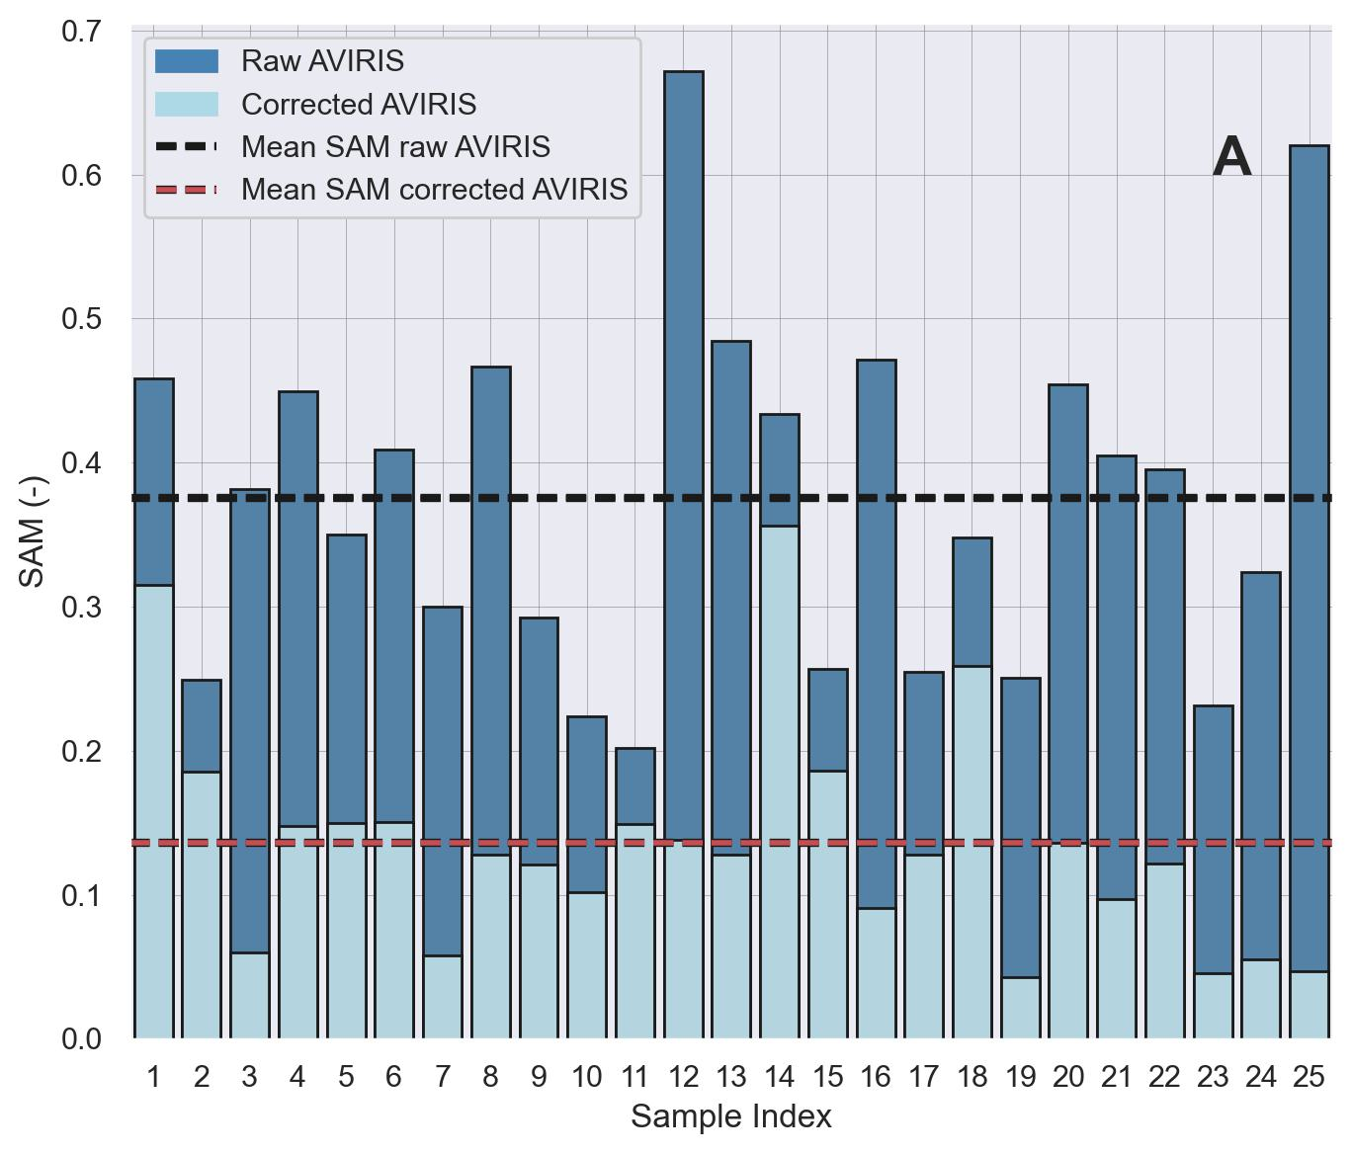
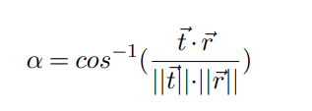
Lab (ASD) – AVIRIS Calibration
where α is the angel between the two vectors (spectra) ⃗t and ⃗r
Notes:
before applying the lab model directly to the AVIRIS image, we compared 25 corresponding spectra that were measured in the lab and that were extracted from the AVIRIS cover. unfortunately but not surprisingly, the spectra had some spectral differences in terms of noisr, albedo and absorption depth.
Therefore we had to implement additional calibration in which we calculated the mean of each data set – per wavelength, find the ratio between the two sensors (again per wavelength), and multiplied the AVIRIS spectra by this factor. The result is an aligned and accurate spectrum relative to ASD laboratory measurements.
according to the SAM index, which measures the resemblance between a reference spectrum and its correspondent sample, we manage to increase the resemblance by 3. And only now we are able to apply the model, pixel by pixel to the AVIRIS image.
The lab spectral processing was confined to the limitations of the AVIRIS image, which is subjected to atmospheric attenuation and spectral noise.
Therefore, common spectral pre-processing such as 1st derivative, cannot be applied later on to the AVIRIS NG spectra. Moreover, as the spectra were acquired by different methods, sensors, and conditions, additional calibration was essential for aligning the AVIRIS NG data.
resulted in more aligned and accurate spectra relative to ASD laboratory measurements. Despite the biased correction, influenced by the research area, it reduced the atmospheric noise, smoothed the spectra, and adjusted the albedo

Slide 17
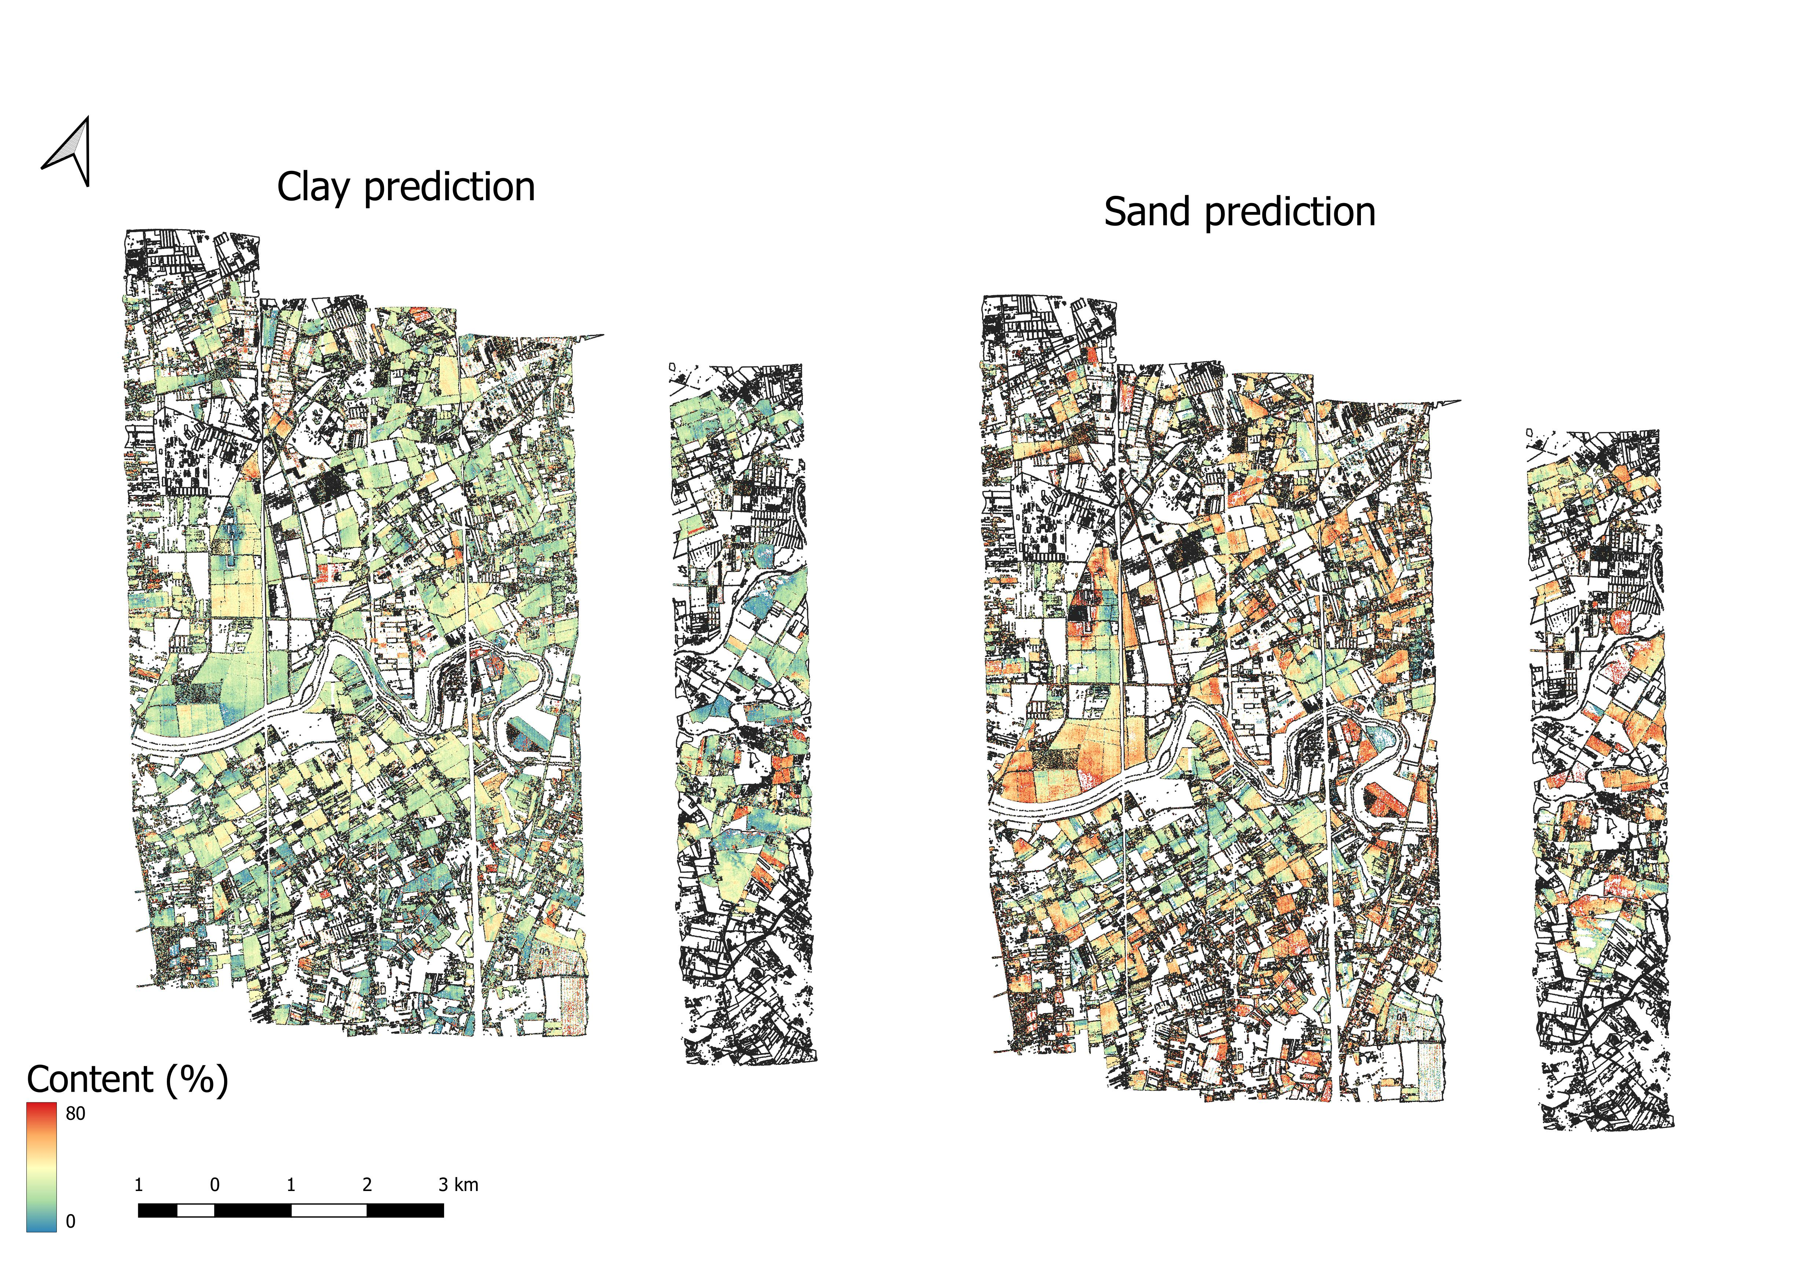
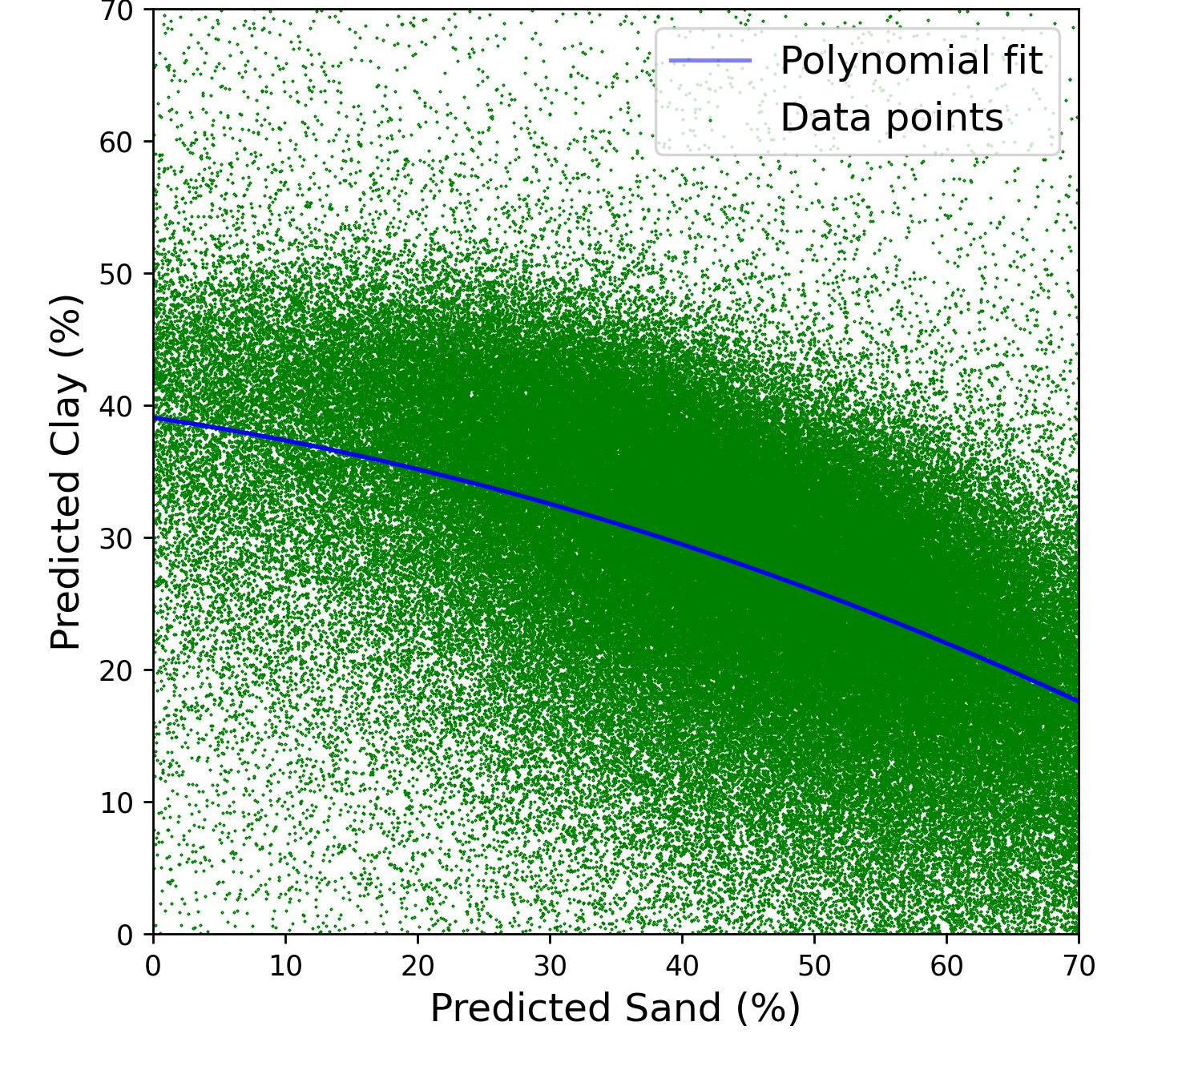
Soil Texture Prediction by AVIRIS
Notes:
The AVIRIS NG soil texture validation map presents a correlative trend, where low areas of clay correspond with high sand content and vice versa
To the right, we can see a scatter plot prediction of sand vs clay content of 180 thousand pixels. The correlation between the two shows a partial linear trend, due to the missing complementary silt component
The AVIRIS validation managed to predict an accurate trend, where clay, sand, and silt are complementary components of 100% soil texture content
After masking out the vegetation and water bodies -

Slide 18
4
Conclusion

Slide 19
Main Conclusions Campania SSL
1
Texture properties can be separated spectrally by the PLSR model for high prediction accuracy.
2
Additional information, such as grain size, CN ratio, and climate factors, are required for better estimation of SOC.
3
Successful laboratory models can be applied to external airborne data with high credibility.

Slide 20
Thank you for your attention
Notes:
it’s an ongoing project and we still have some data to process and add to the model. The number of samples that fell inside the AVIRIS cover is too low for validation. We have some more data that we are processing and hopefully will be used for validation

