Slide 1
TEMBO Africa: New sensors and geo-services for water management and agriculture
Nick van de Giesen, Hessel Winsemius, Frank Annor,Tomáš Fico, Eugenio Realini, Remko Uilenhoet, and Salvador Peña-Haro
TEMBO Africa: The work leading to these results has received funding from the European Horizon Europe Programme (2021-2027) under grant agreement n° 101086209. The opinions expressed in the document are of the authors only and no way reflect the European Commission’s opinions. The European Union is not liable for any use that may be made of the information.

Slide 3
TEMBO Africa: Seven sensors
Atmosphere | 1.1 Commercial Microwave Links for rainfall estimates (WP5, ≥1 contract)
 | 1.2 X-Band radar for spatial rainfall estimates (WP5, ≥1 station)
 | 1.3 Intervalometers for rainfall detection and typification (WP5, ≥50)
Land Surface | 1.4 Cost-effective neutron counters for large scale soil moisture (BLOSM) (WP6, 20 operational)
 | 1.5 Low cost GPS/GNSS receivers for mapping and multiple additional applications (WP7, 10 operational)
Open Water | 1.6 Camera-based river discharge measurements (WP7, 10 operational)
 | 1.7 UAVs, fish-finders, and GNSS (WP3, 7, ≥10 water management systems)

Slide 4
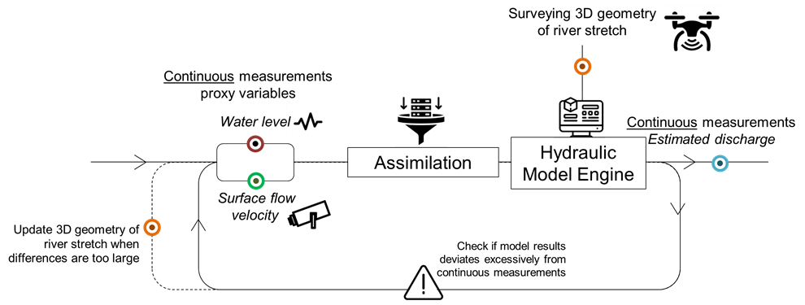
TEMBO Africa: Five products
Rainfall Maps
Soil Moisture Maps
Open Water
River discharge
Floodplain Mapping & Bathymetry
GEOSS

Slide 5
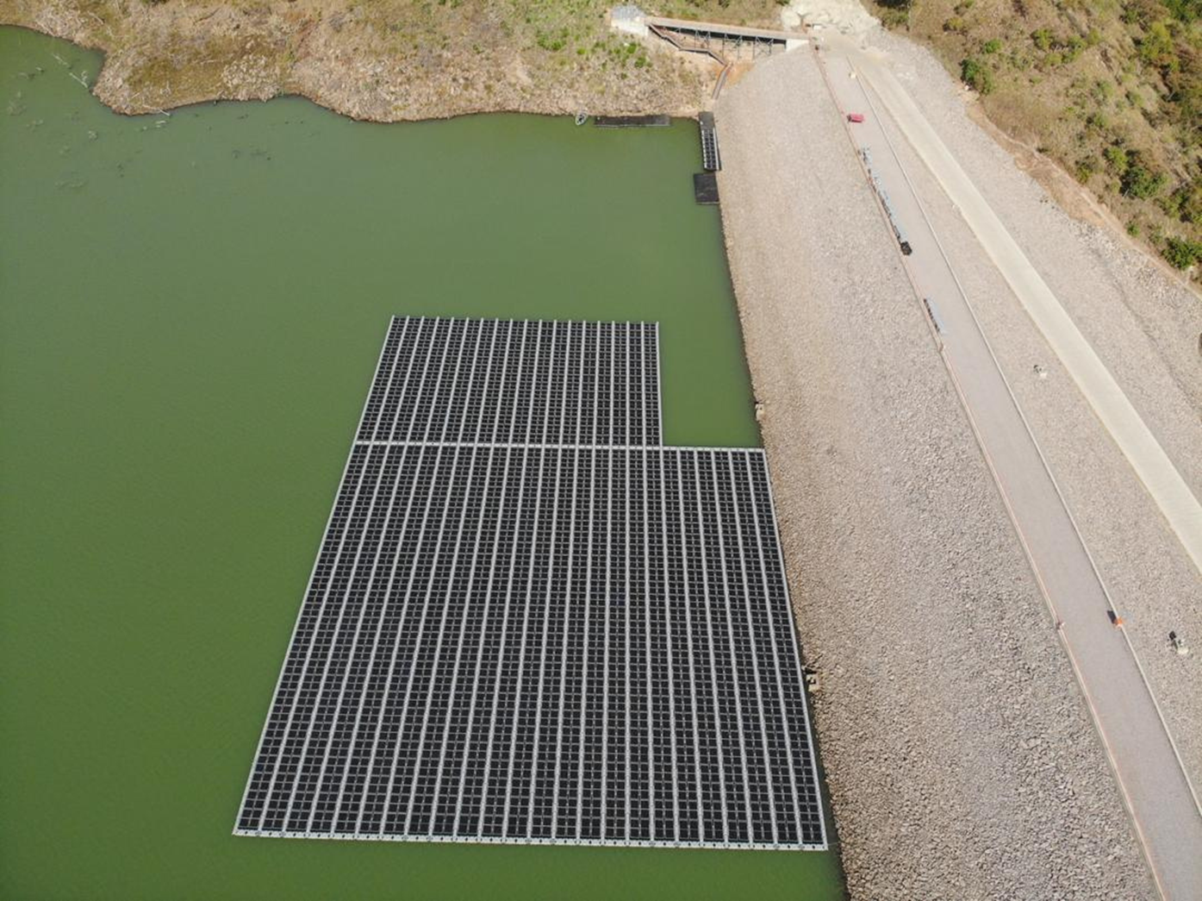
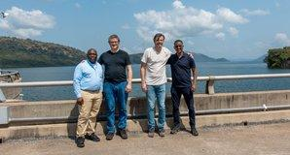
3 Services
TEMBO Africa: Three services
Flood Early Warning Systems
Reservoir Management
Agriculture Insurance

Slide 6
TEMBO Africa: BLOSM
Soil moisture
Edward van Amelrooij
Cosmic rays

Slide 7
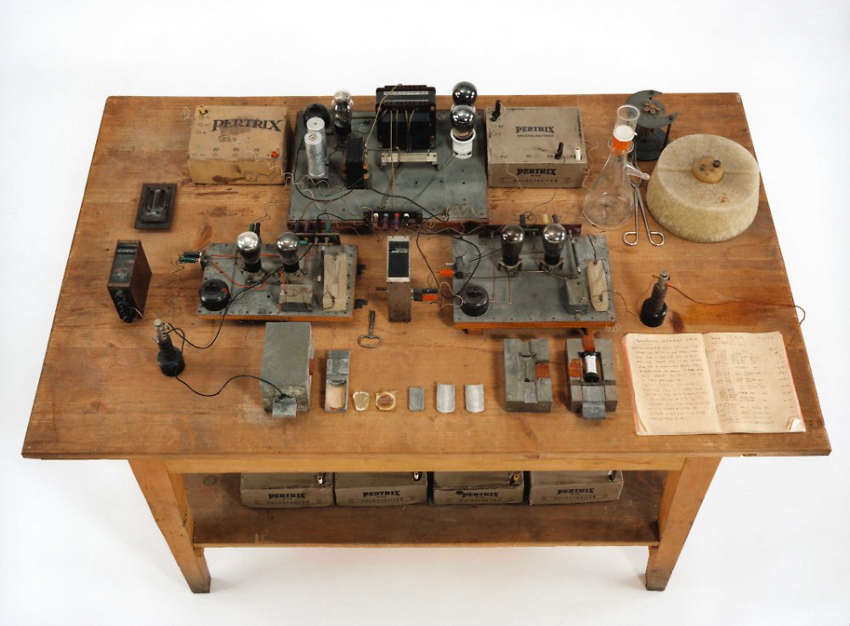
TEMBO Africa: BLOSM
Soil moisture
Cosmic rays:
Fast (20,000 km/s)
Thermal (200 km/s)

Slide 8
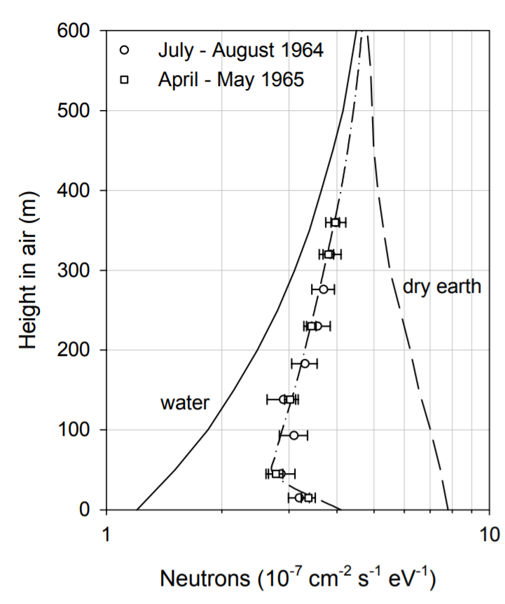
TEMBO Africa: BLOSM
Soil moisture
Cosmic rays:
Fast (20,000 km/s)
Thermal (200 km/s)
Hendrick and Edge (1966)

Slide 9
TEMBO Africa: BLOSM
Soil moisture
Cosmic rays:
Large radius (300m)
$\frac{n_{fast}}{n_{thermal}}∝θ$

Slide 10
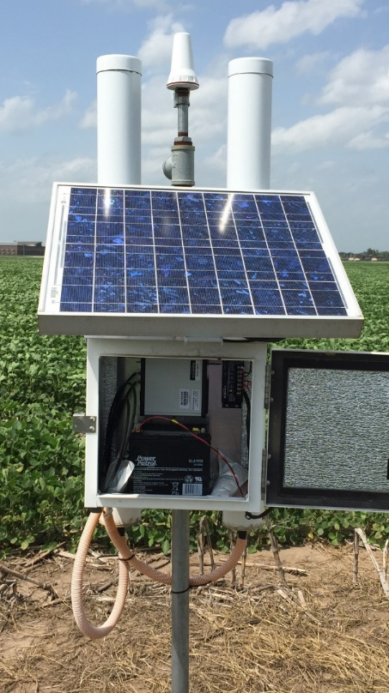
TEMBO Africa: BLOSM
Soil moisture
COSMOS (r=300m): ³He

Slide 11
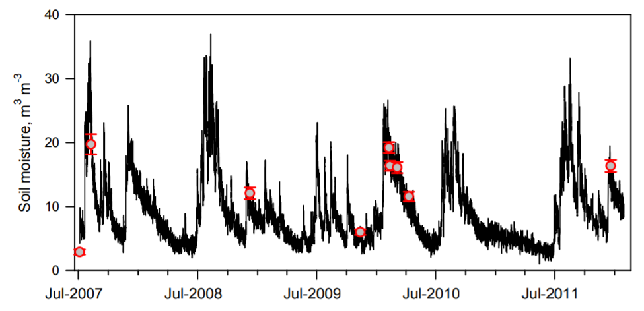
TEMBO Africa: BLOSM
Soil moisture
Cosmic rays:
Fast (20,000 km/s)
Thermal (200 km/s)
Zreda et al. (HESS, 2012)

Slide 12
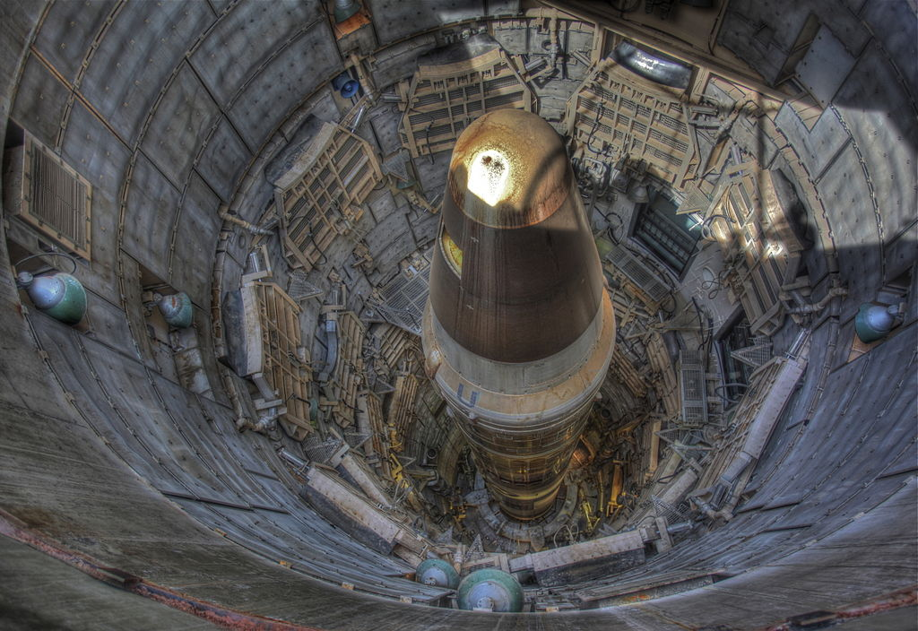
TEMBO Africa: BLOSM
³He

Slide 13
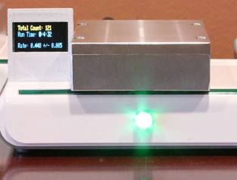
TEMBO Africa: BLOSM
$100 muon detector (Spencer Axani, MIT)

Slide 14
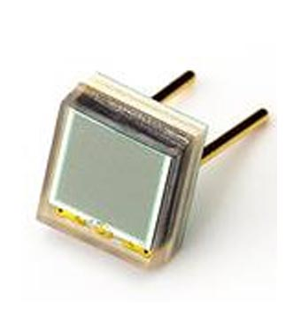
TEMBO Africa: BLOSM
Silicon Photon Multiplier (SiPM)
$100 muon detector (Spencer Axani, MIT)

Slide 15
TEMBO Africa: BLOSM
Boron: 20% ¹⁰B !!!

Slide 16
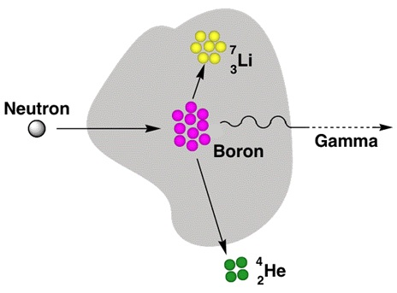
TEMBO Africa: BLOSM
BN
Alpha particle

Slide 17
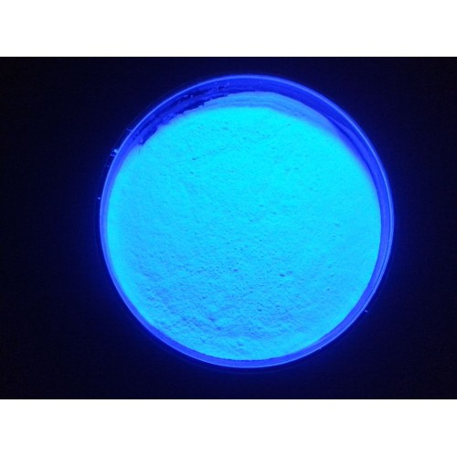
TEMBO Africa: BLOSM
ZnS(Ag)
Fluoresces

Slide 18
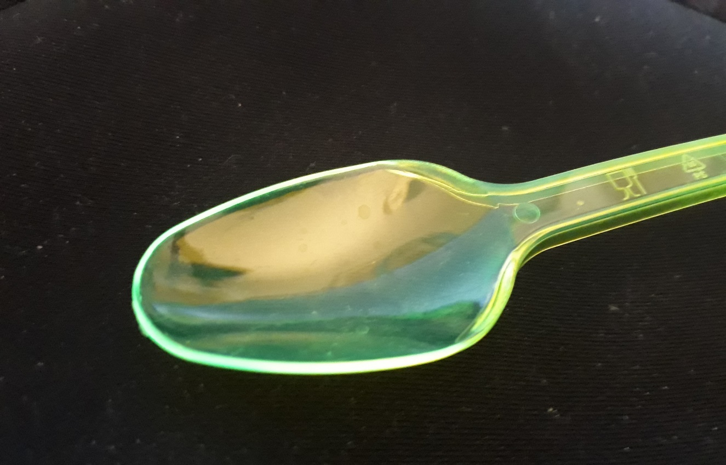
TEMBO Africa: BLOSM
BLOSM, dicula

Slide 19
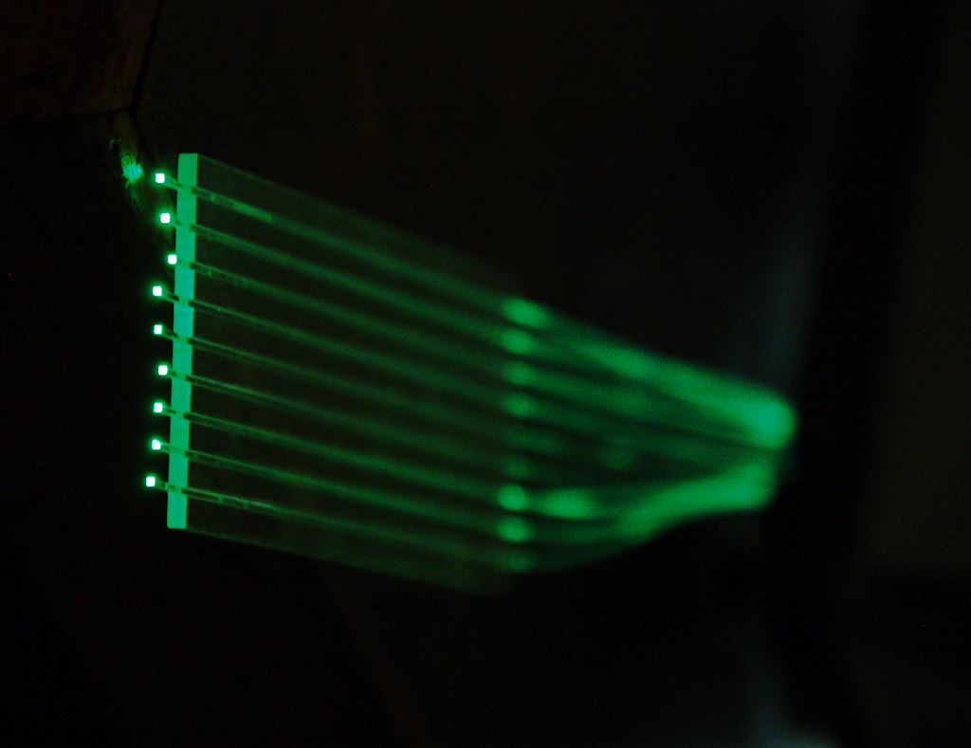
TEMBO Africa: BLOSM
Wavelength Shifting
Fibers
Kuraray

Slide 20
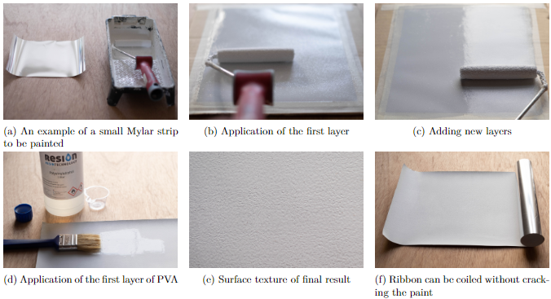
TEMBO Africa: BLOSM
“Paint”

Slide 21
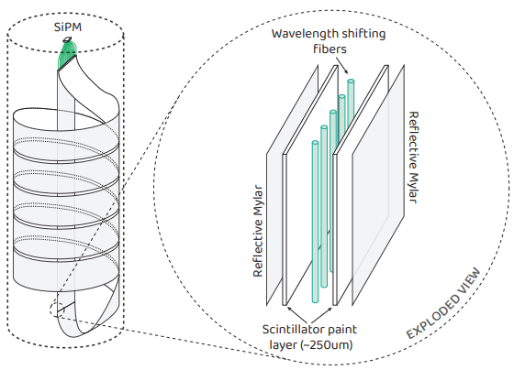
TEMBO Africa: BLOSM
Sandwich

Slide 22
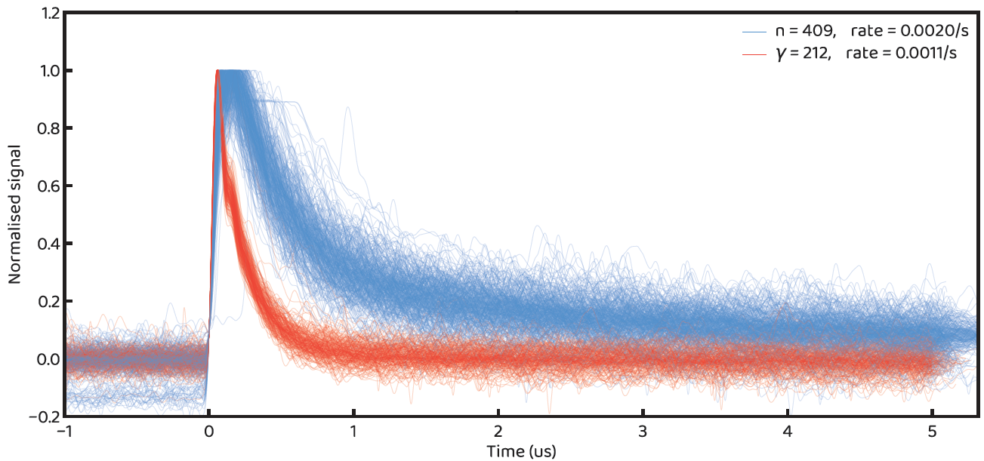
TEMBO Africa: BLOSM
First results
Boron: ¹⁰B₅ + ¹n₀ → ⁴He₂ (α)+⁷Li₃ + 2.38 MeV

Slide 23
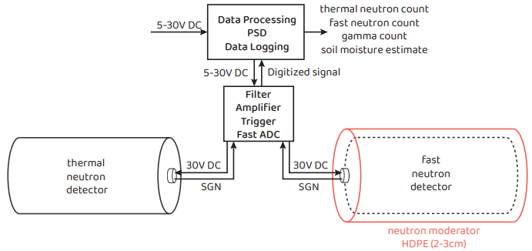
TEMBO Africa: BLOSM
System

Slide 24
TEMBO Africa: BLOSM
Moderated Bare

Slide 25
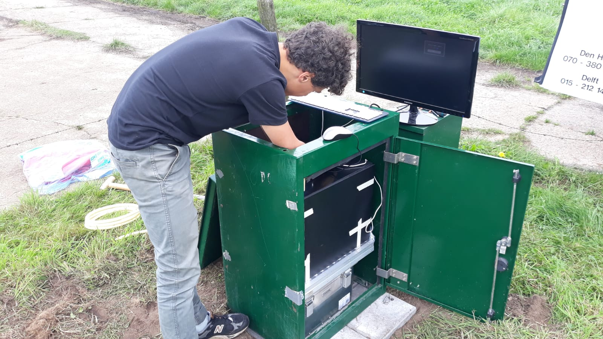
TEMBO Africa: BLOSM
Soil moisture
Field

Slide 26
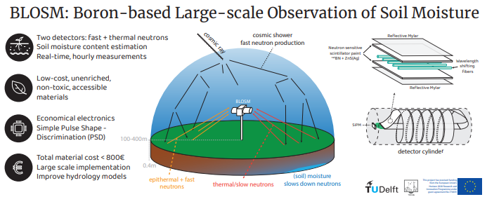
TEMBO Africa: BLOSM
Validation

Slide 27
Nick van de Giesen
n.c.vandegiesen@tudelft.nl
YOU ARE INVITED!

