Slide 1
First multi-year cosmic-ray neutron sensing (CRNS) cluster: insights from three years of soil water storage observations across depths and scales at an agricultural research site in North-East Germany
Lena Scheiffele, Katya Dimitrova-Petrova, Maik Heistermann, Till Francke, Daniel Altdorff and Sascha Oswald
GC8-Hydro, Naples, Italy
12th June 2023

Slide 2
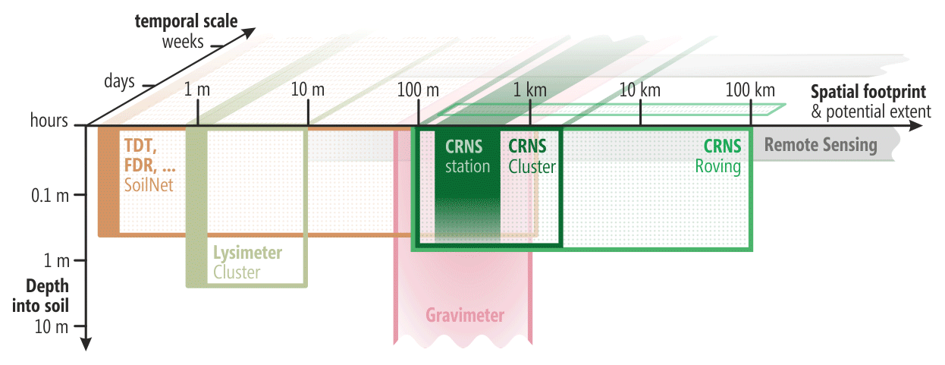
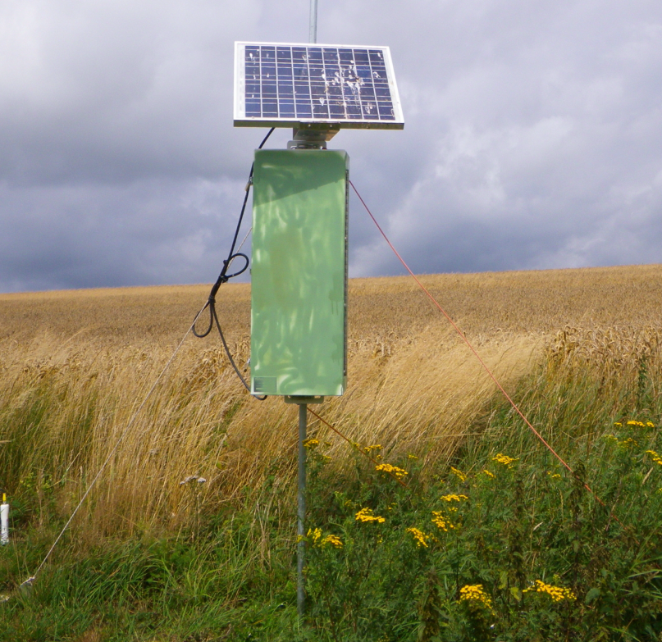
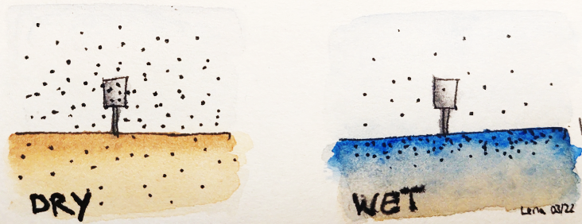
Cosmic ray neutron sensors (CRNS)
CRNS sensor
Count rates of detected neutrons in dry vs wet conditions.
By Lena Scheiffele
From Heistermann et al., 2022, ESSD

Slide 3
Closing the gap in soil moisture observation
From Heistermann et al., 2022, ESSD

Slide 4
The Marquardt cluster: what is unique about it?
Complete coverage by high density of 8 CRNS/10 ha
Time span: covers a wide range of conditions
Land use: agriculture with diverse management
Representativeness: for many sites in northern Central Europe
Wealth of other water storage measurements – to study processes in the vertical
Range of hydrological events and processes - irrigation, drought, heavy rainfall, snow
By Lisa Angermann

Slide 5
Study site
P_{ann} 584 mm/y
T_{avg}= 9.3 ºC
Climate: Cfb - Dfb (temperate continental to cold)
Unconfined aquifer

Slide 6
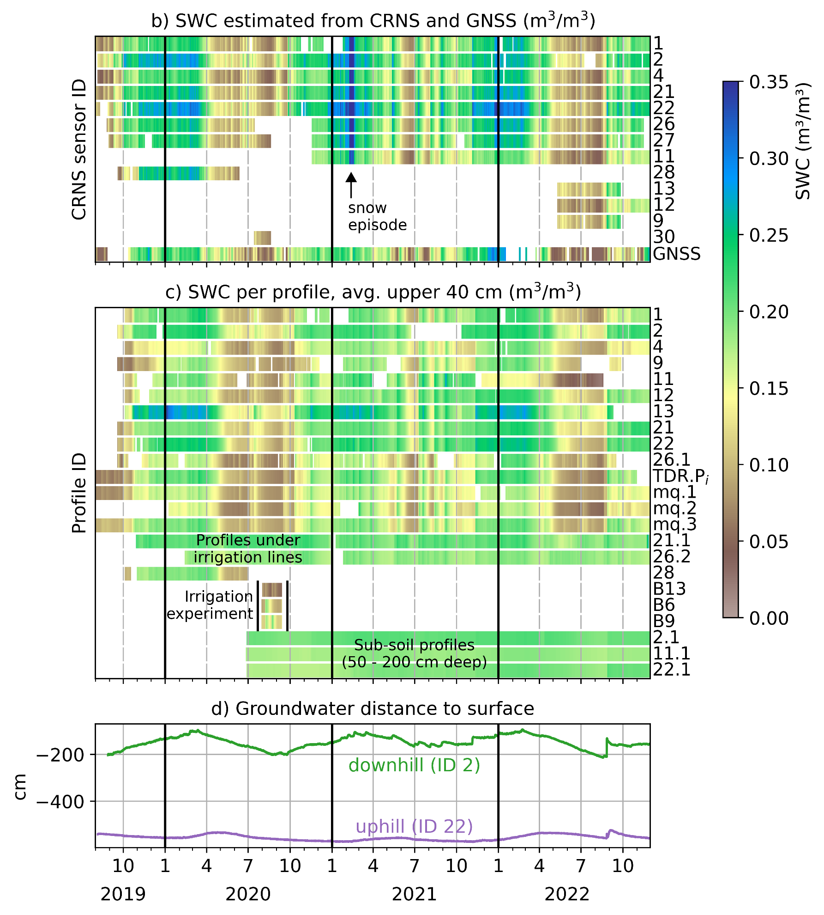
Data availability – highlights: continuous
3 years of continuous measurements by:
8 stationary CRNS (different manufacturers) + GNSS-R
27 vertical SWC profiles
2 tensiometer + gw level measurements

Slide 7
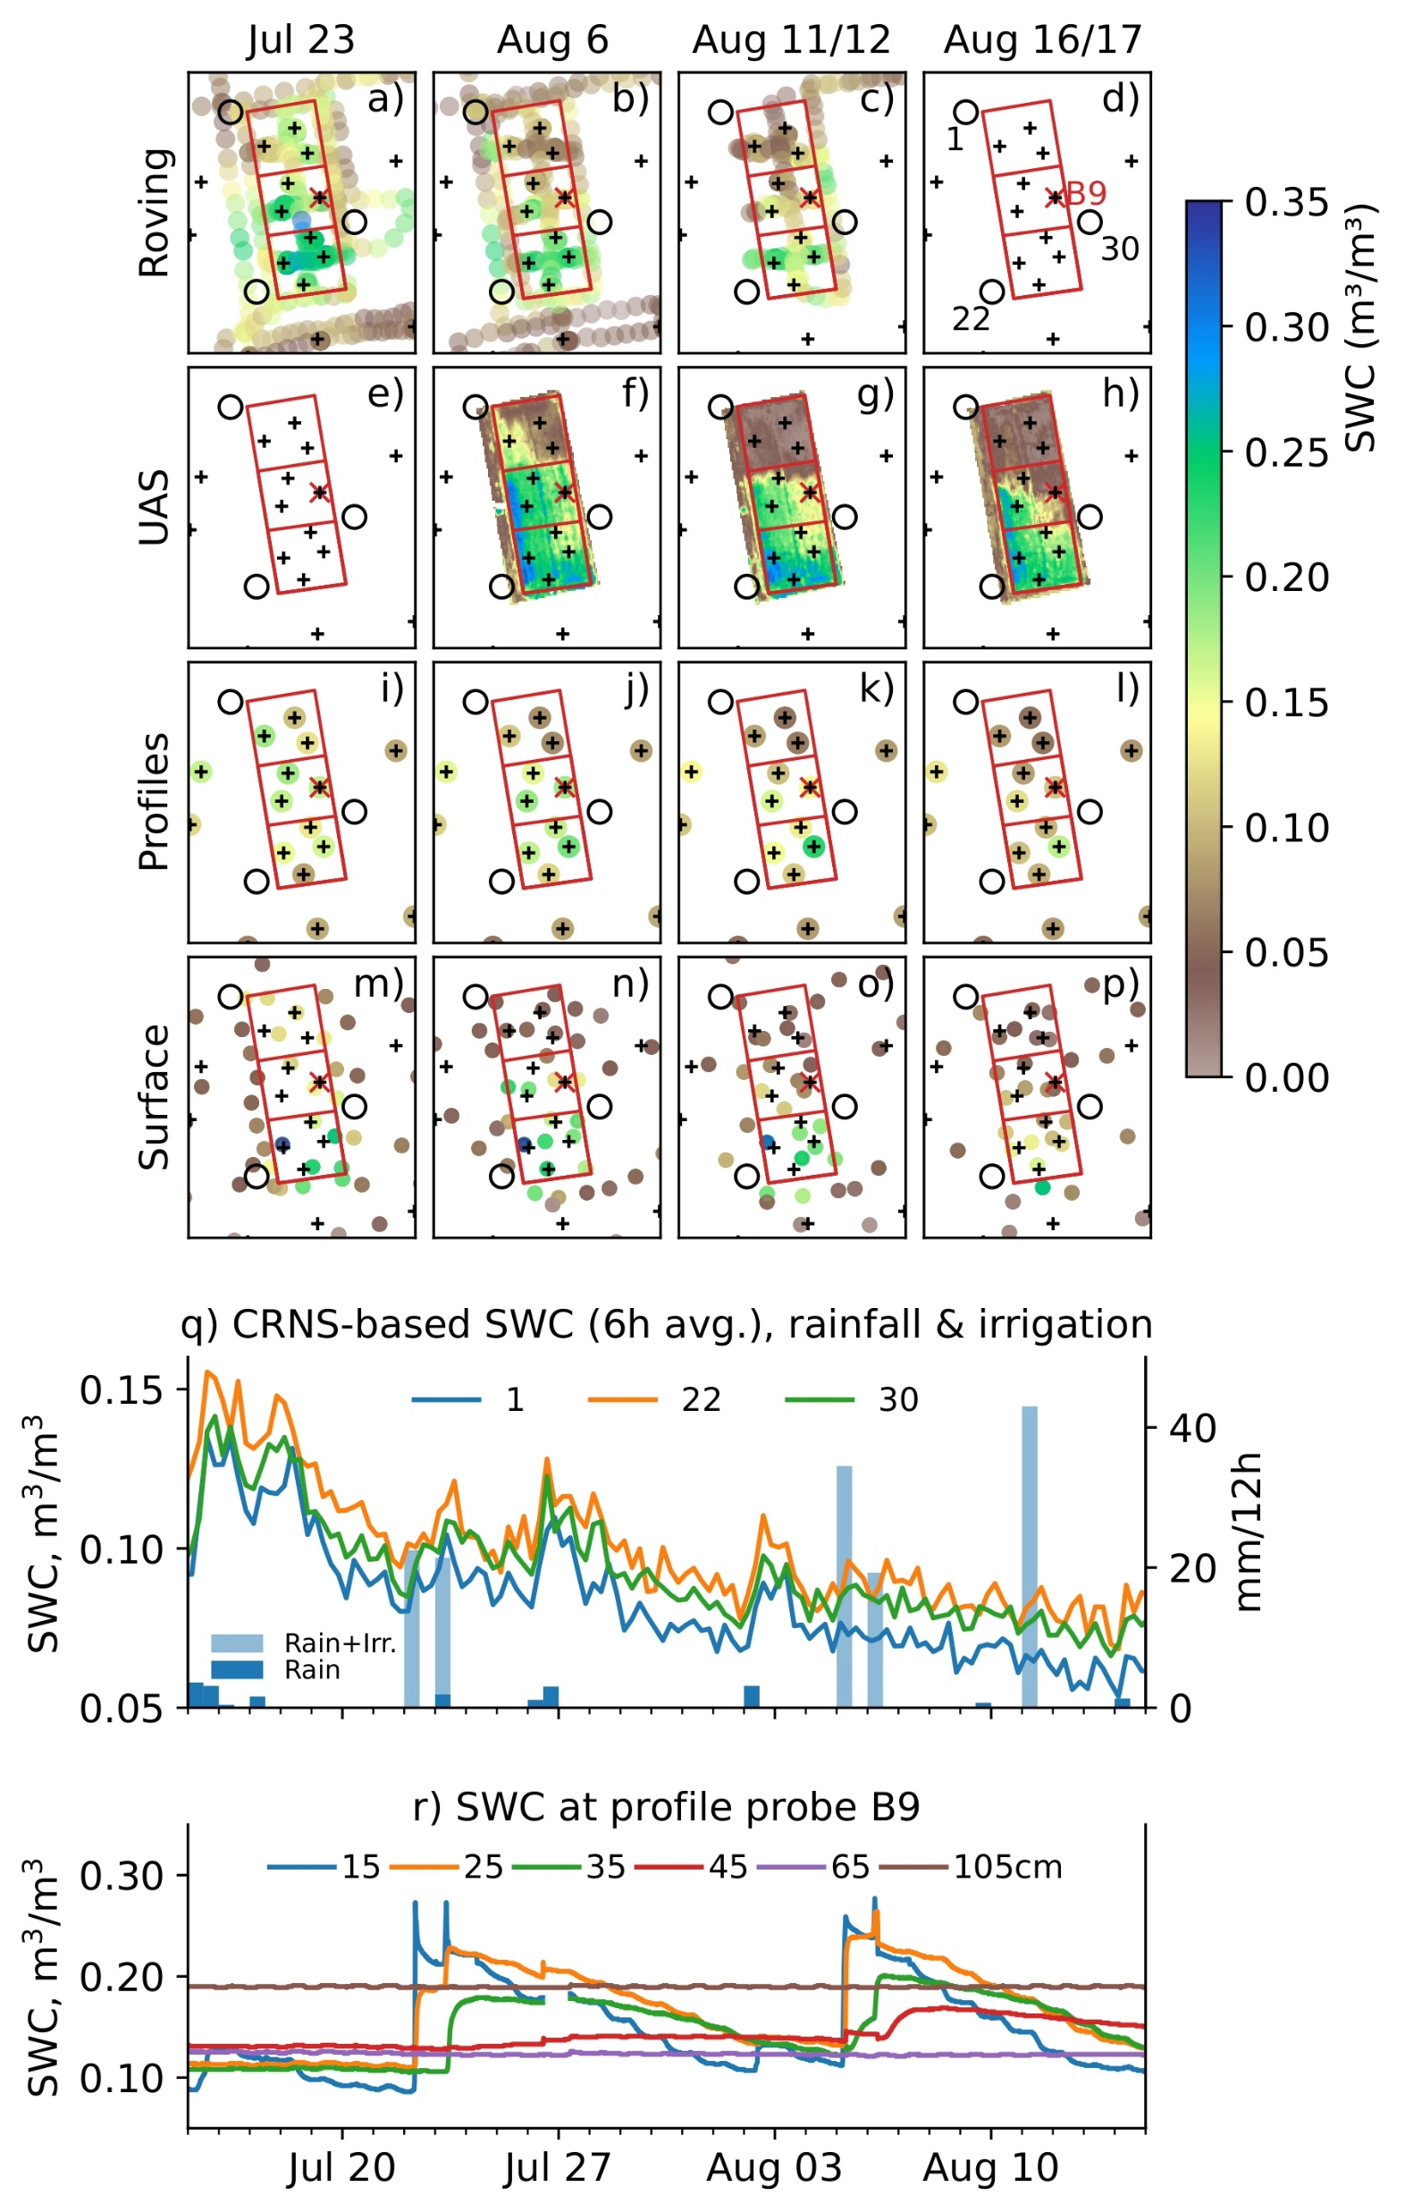
Data availability – highlights: Irrigation
July – August 2021 to observe response of various sensors to pronounced SWC contrast
3 CRNS
9 campaigns of manual near-surface SWC measurements
4 CRNS roving campaigns
4 UAS flights
4 LAI measurement campaigns

Slide 8
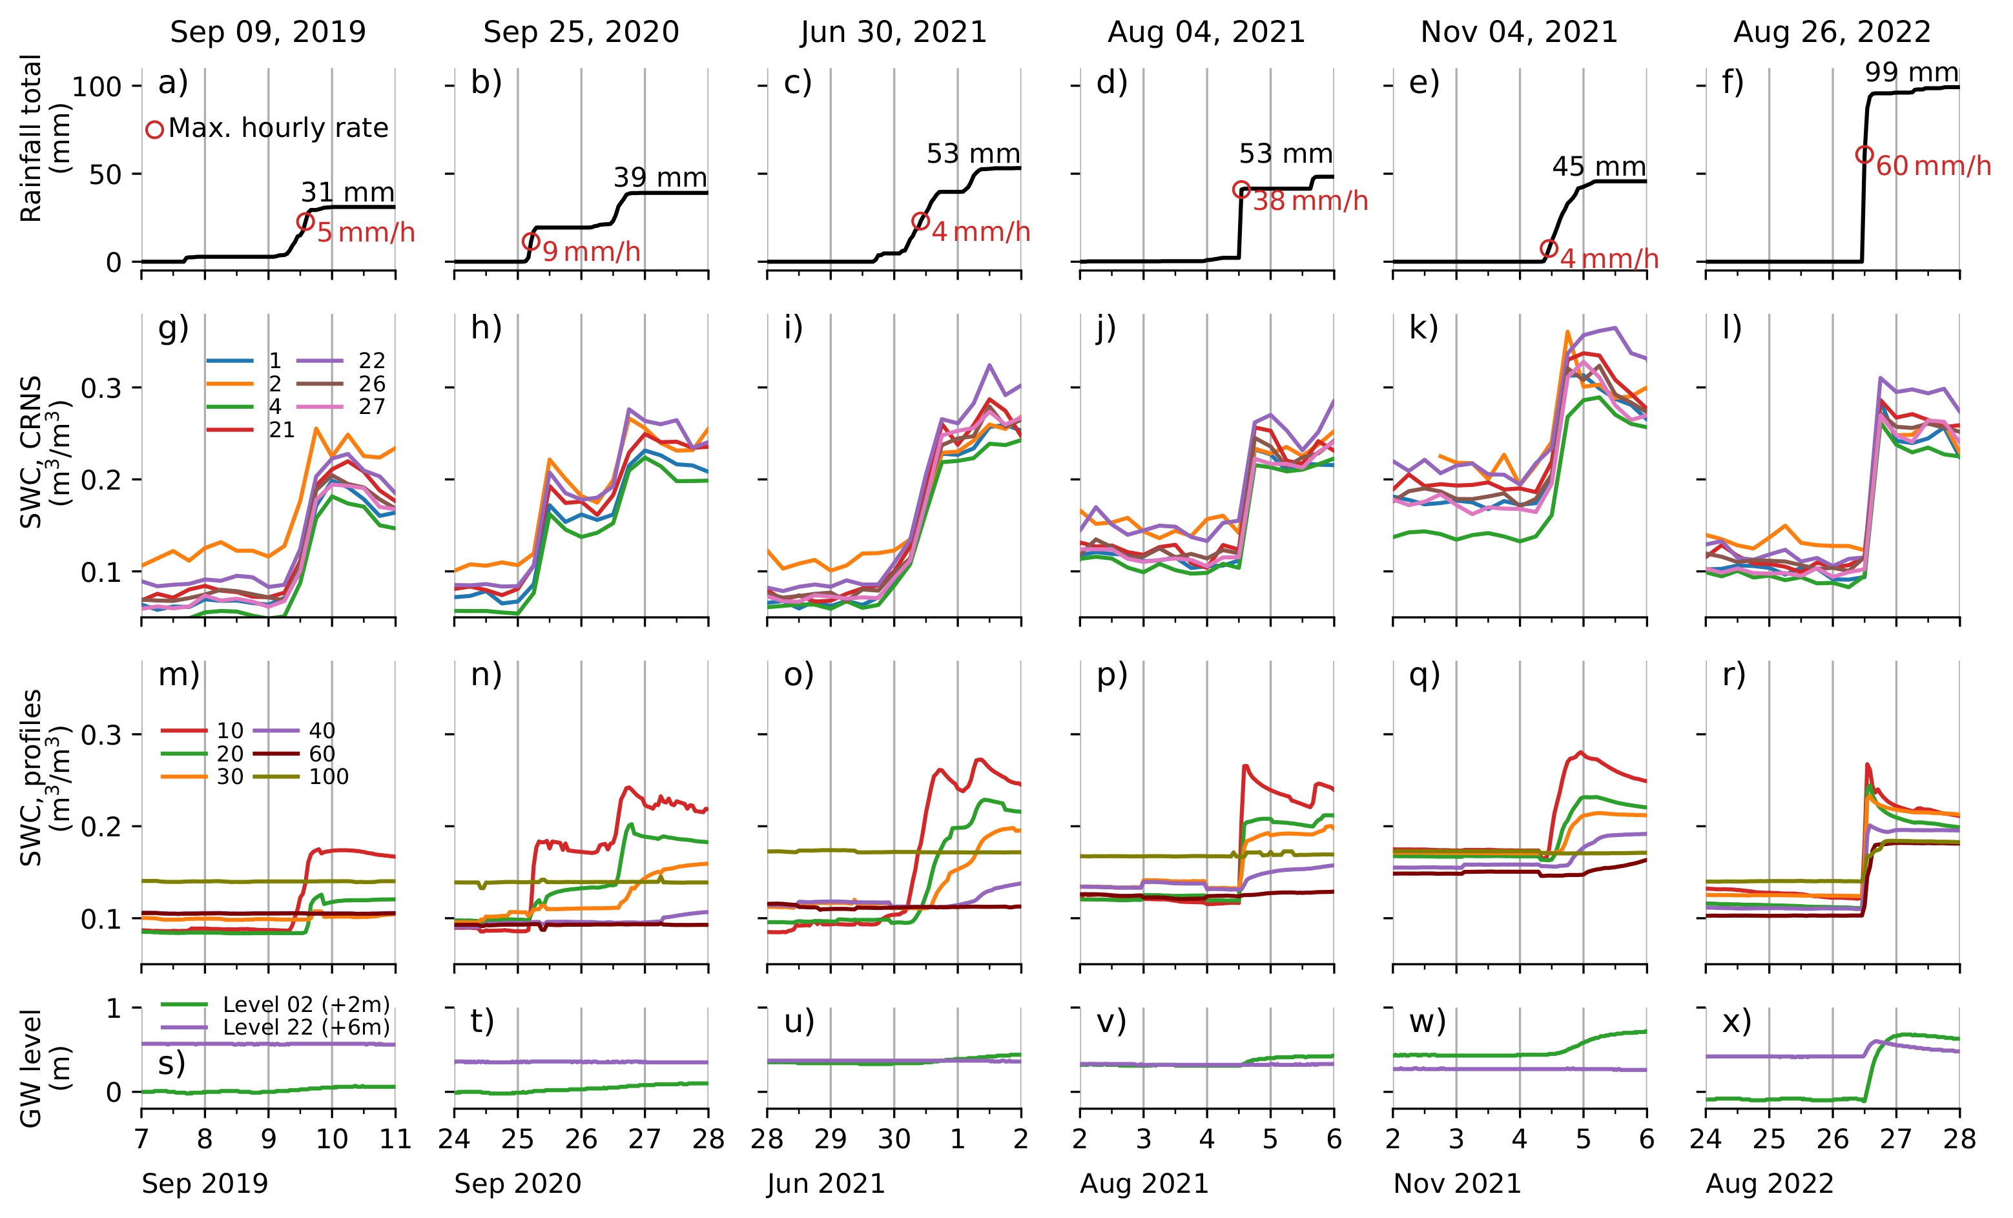
Heavy rainfall: closer look at processes
6 heavy rainfall events
Daily totals >30 mm
Value of combination of measurements

Slide 9
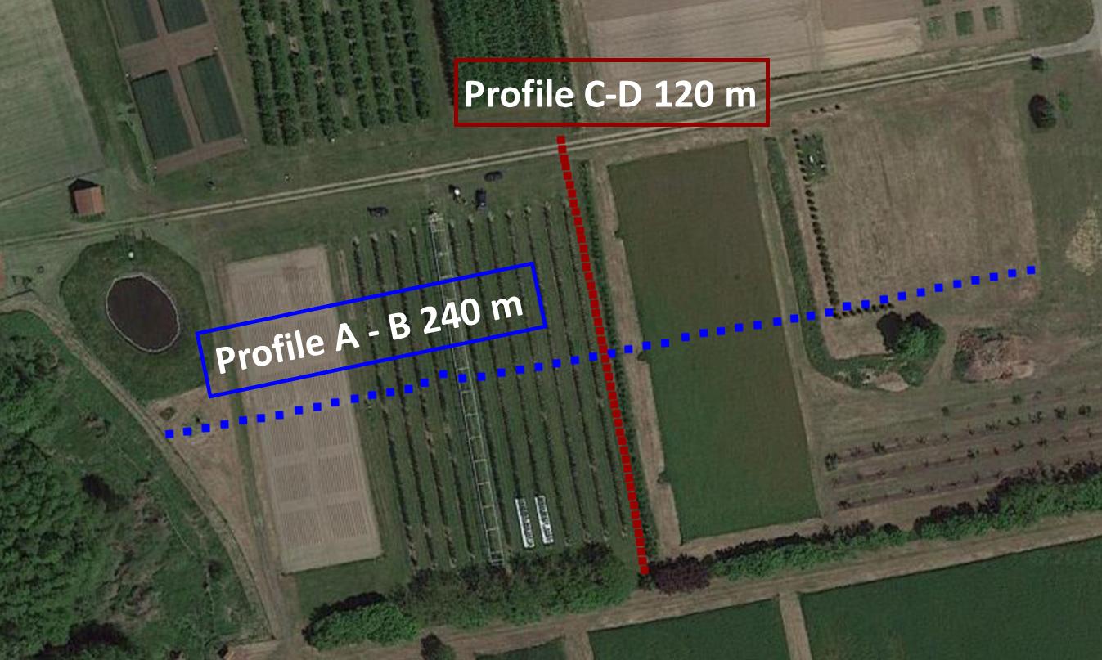
Next step: groundwater recharge estimation
CRNS water storage changes
Shapes of soil water content profiles
Geophysics transects for a deeper look at the subsurface, again in November 2022
Groundwater level changes
1D-simulations of vertical water fluxes (Hydrus)
2D and 3D simulations?
Stable isotope measurements
Profile C-D 120 m

Slide 10
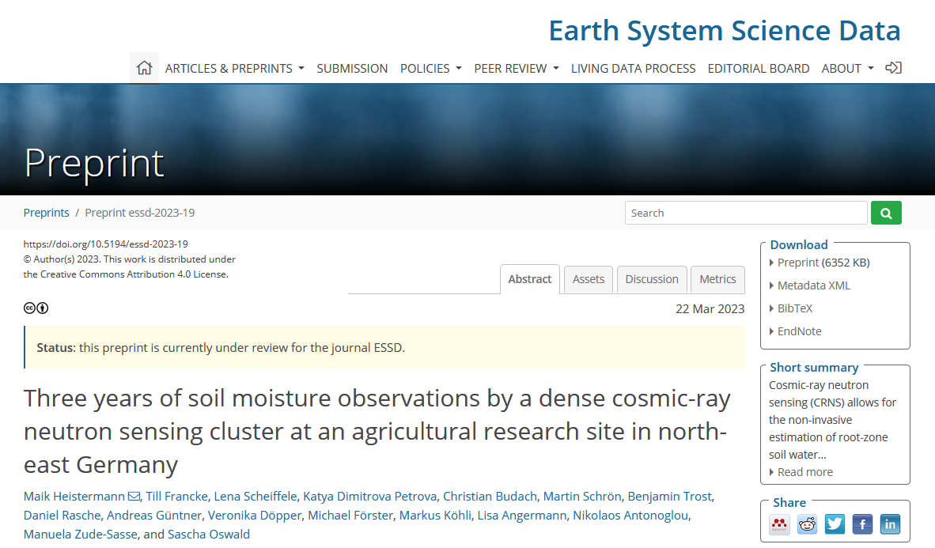
Thank you!
This data is now available
Want to know what’s the latest in the Marquardt cluster? → next presentation
Check the accepted preprint here
https://doi.org/10.5194/essd-2023-19

Slide 11
Data availability – highlights: Irrigation
July – August 2021 to observe response of various sensors to pronounced SWC contrast
3 CRNS
9 campaigns of manual near-surface SWC measurements
4 CRNS roving campaigns
4 UAS flights
4 LAI measurement campaigns

Slide 12
CRNS sensors types

