Slide 1
Assessing causes of recent sea level budget misclosure
Mike Croteau, Brian Beckley, Bryant Loomis, Richard Ray, Frank Lemoine
Geodesy and Geophysics Laboratory, NASA GSFC

Slide 2
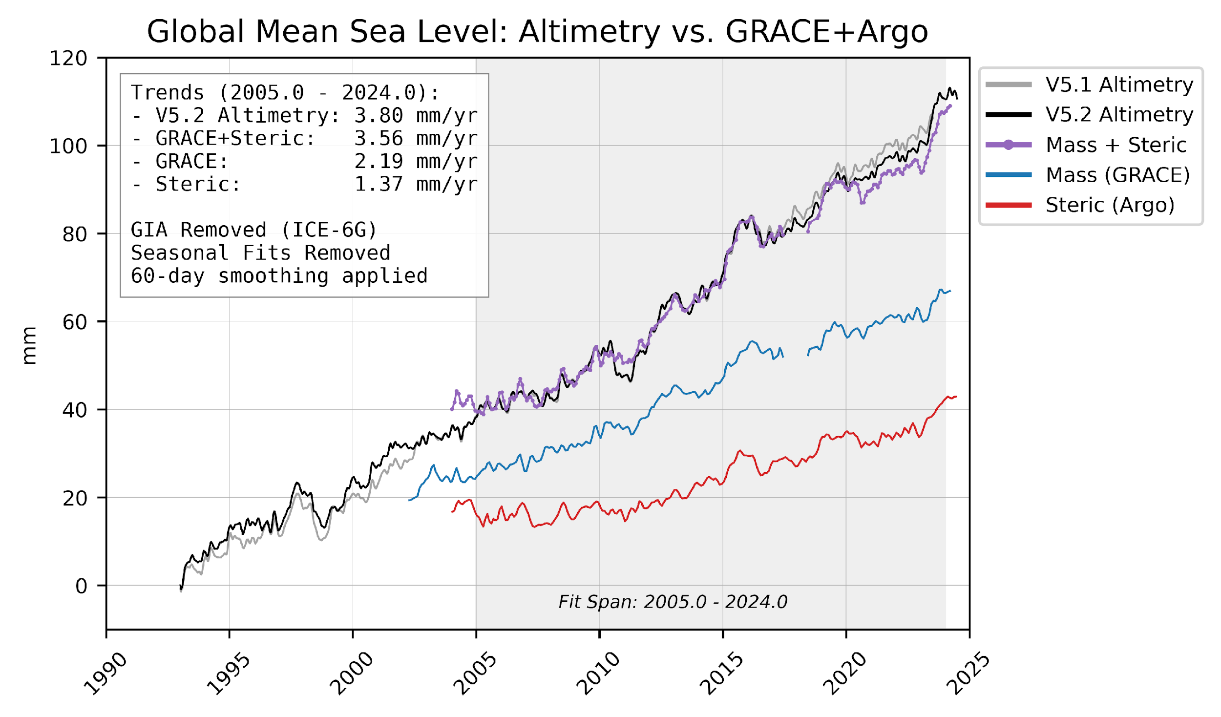
Overview and Motivation
Good closure of the sea level budget during GRACE mission has not continued
Misclosure began 2018-2020 and trends since do not agree
Updates to Altimetry wet troposphere modelling helped, but differences remain
What is causing this?
Sea Level Budget:
Δ Ocean Height (Altimetry) = Δ Ocean Mass (Gravity) + Δ Ocean Salinity & Temperature (Argo)

Slide 3
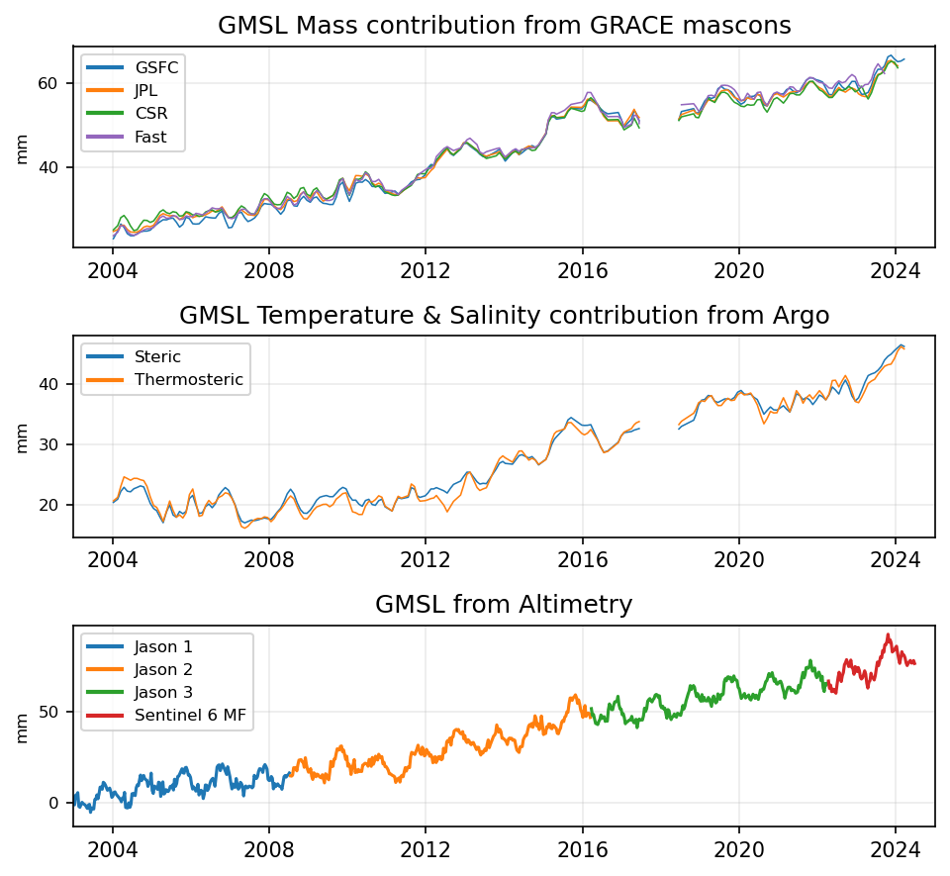
Data Overview
GRACE/GRACE-FO (2002 – present):
Mascons: GSFC RL06v02, JPL RL06.1v03 CRI, CSR RL06.3
Fast Mascons: from ITSG-Grace2018 spherical harmonics
Argo (2004 – present):
Monthly grids: SIO RG Argo Climatology
Temperature & Salinity profiles (0-2000 m depth) converted to 1-deg steric & thermosteric grids
Altimetry (1993 – present):
Along-track SLA heights: Jason 1-3 and Sentinel 6 MF
Data from Radar Altimetry Database System (RADS)
Unifying Spatial Domains:
Bin all products into GSFC mascon space to ensure as close to a 1-to-1 comparison as possible
Ensure masks cover similar extents

Slide 4
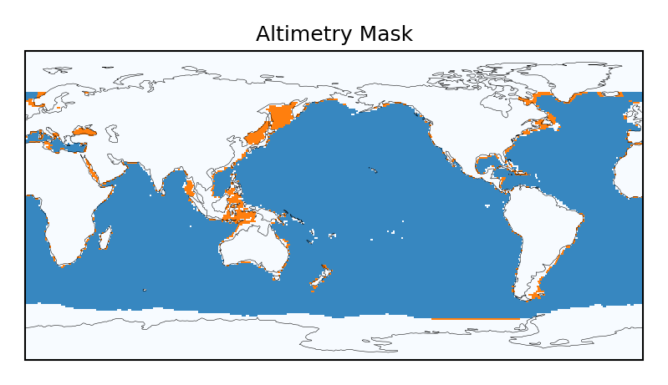
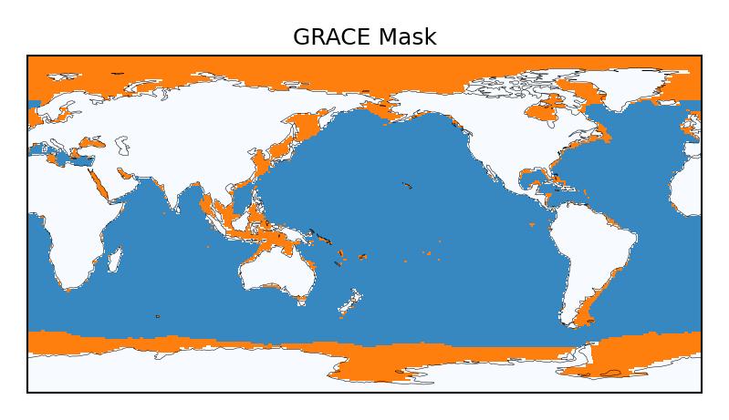
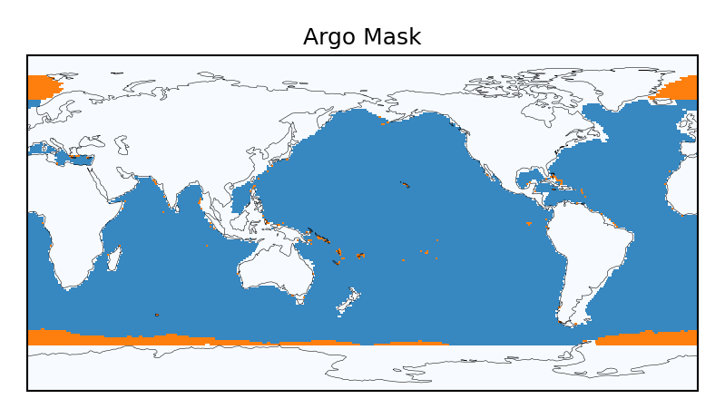
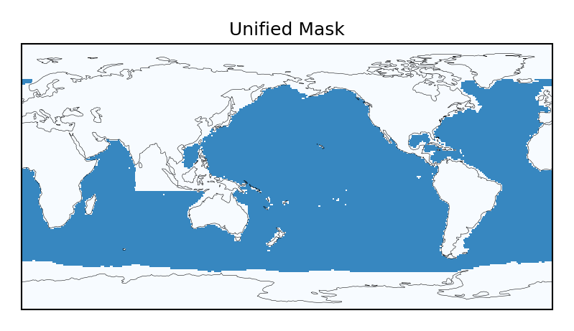
Comparing and Unifying Masks

Slide 5
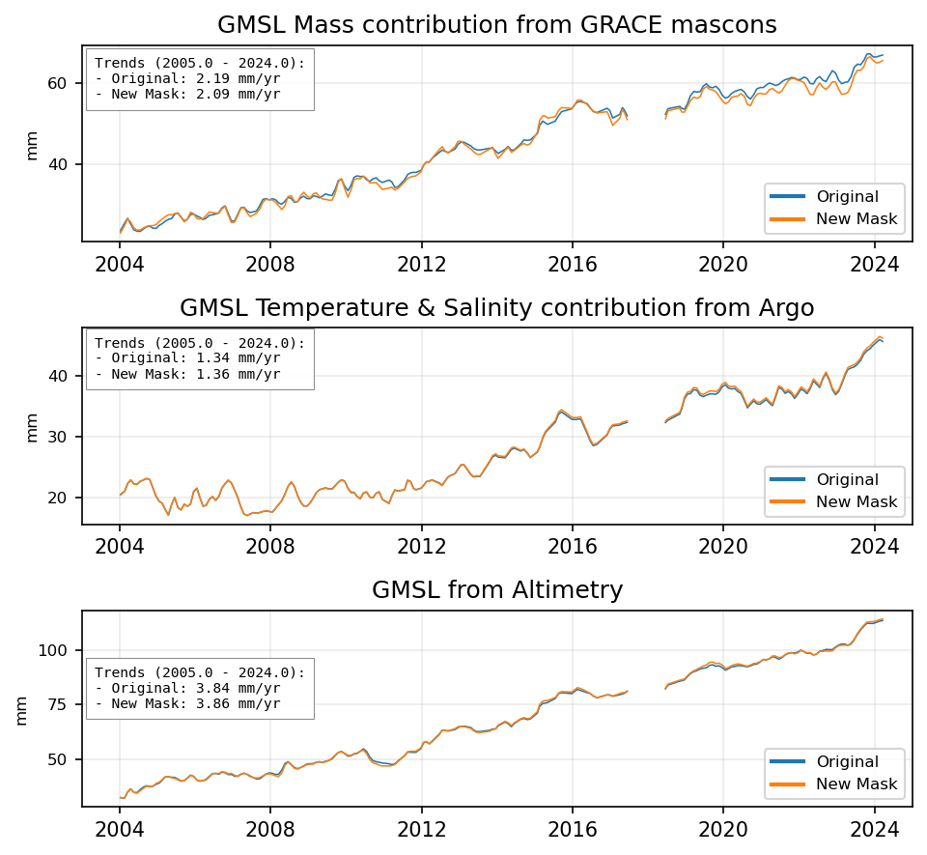
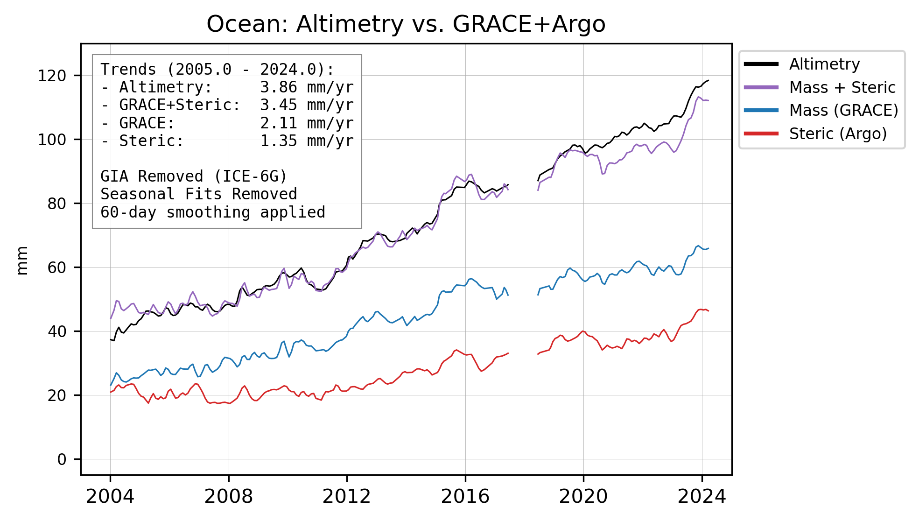
Updated GMSL Budget with Unified Mask
~5% decrease
~1.5% increase
~0.5% increase

Slide 6
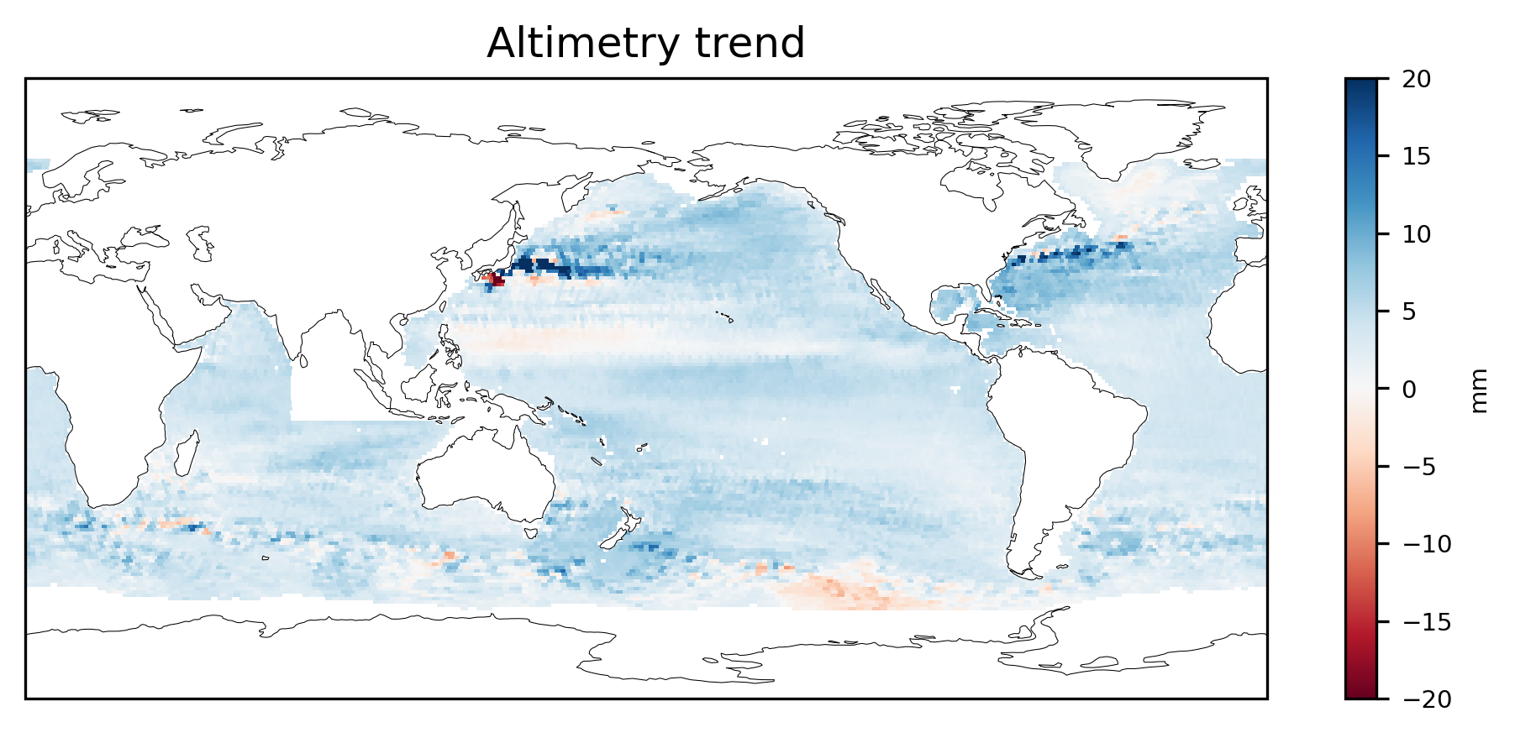
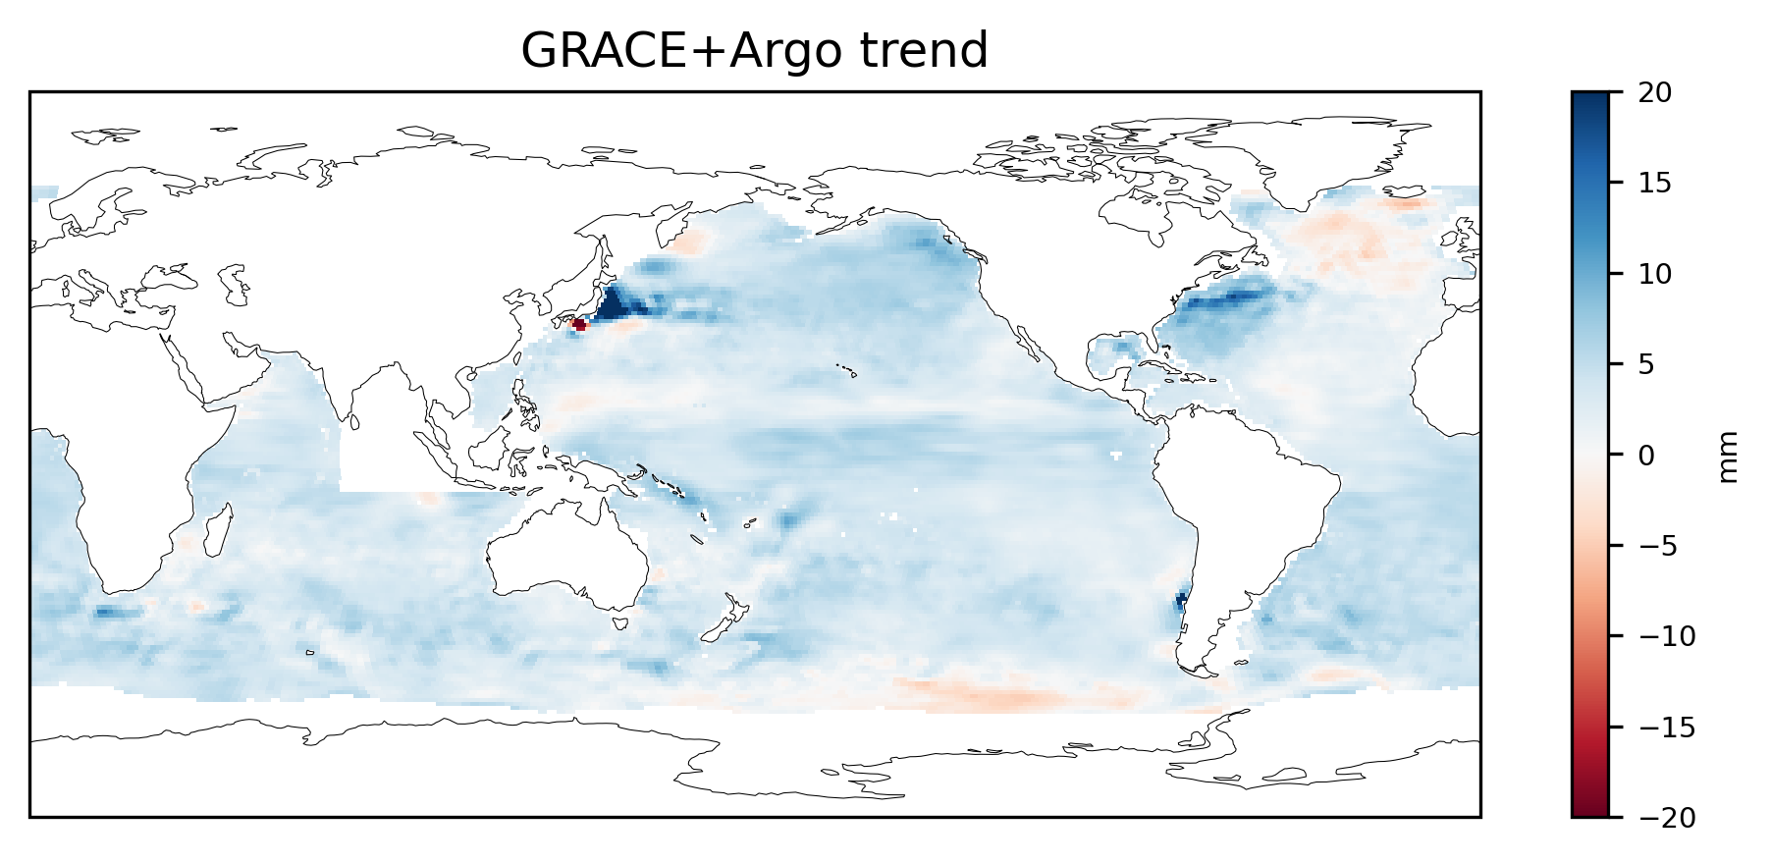
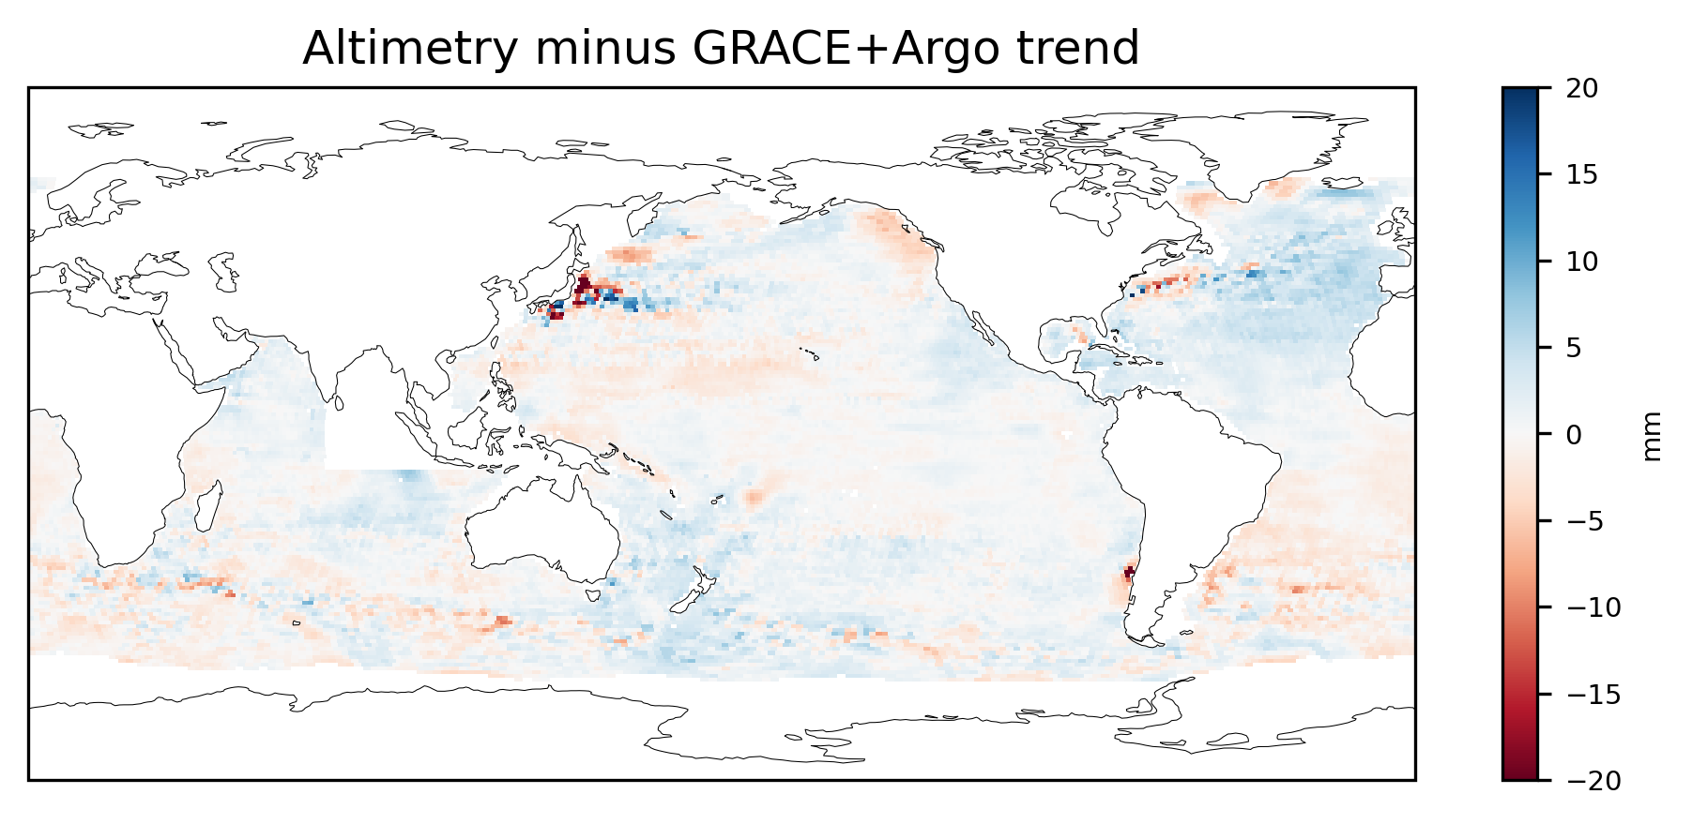
Comparing Sea Level Rise Trends

Slide 7
Comparing long-wavelength signals in Datasets

Slide 8
Comparing Long-Wavelength Signals
We can relate the gravitational potential of an area due to a uniform surface water layer of height H (cm) to spherical harmonics* by:
Ocean maps of GRACE and of Altimetry-minus-Argo represent just this.
We can therefore compute the Ocean contribution to each spherical harmonic by accumulating this for each harmonic over the ocean
We can then compare ocean-driven differences in all ΔC_{lm} & ΔS_{lm} coefficients for GRACE and Altimetry-minus-Argo
(*Note that this is how GSFC mascons are computed)

Slide 9
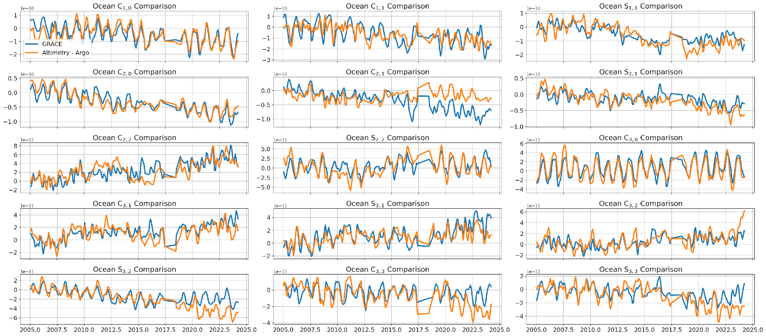
Comparing Ocean Contributions to SHCs

Slide 10
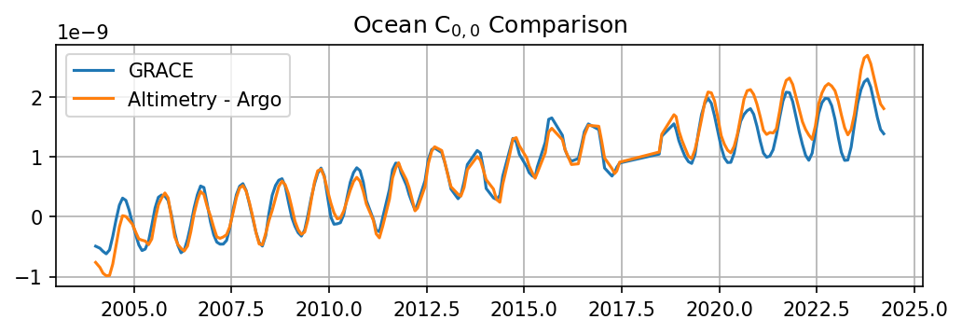
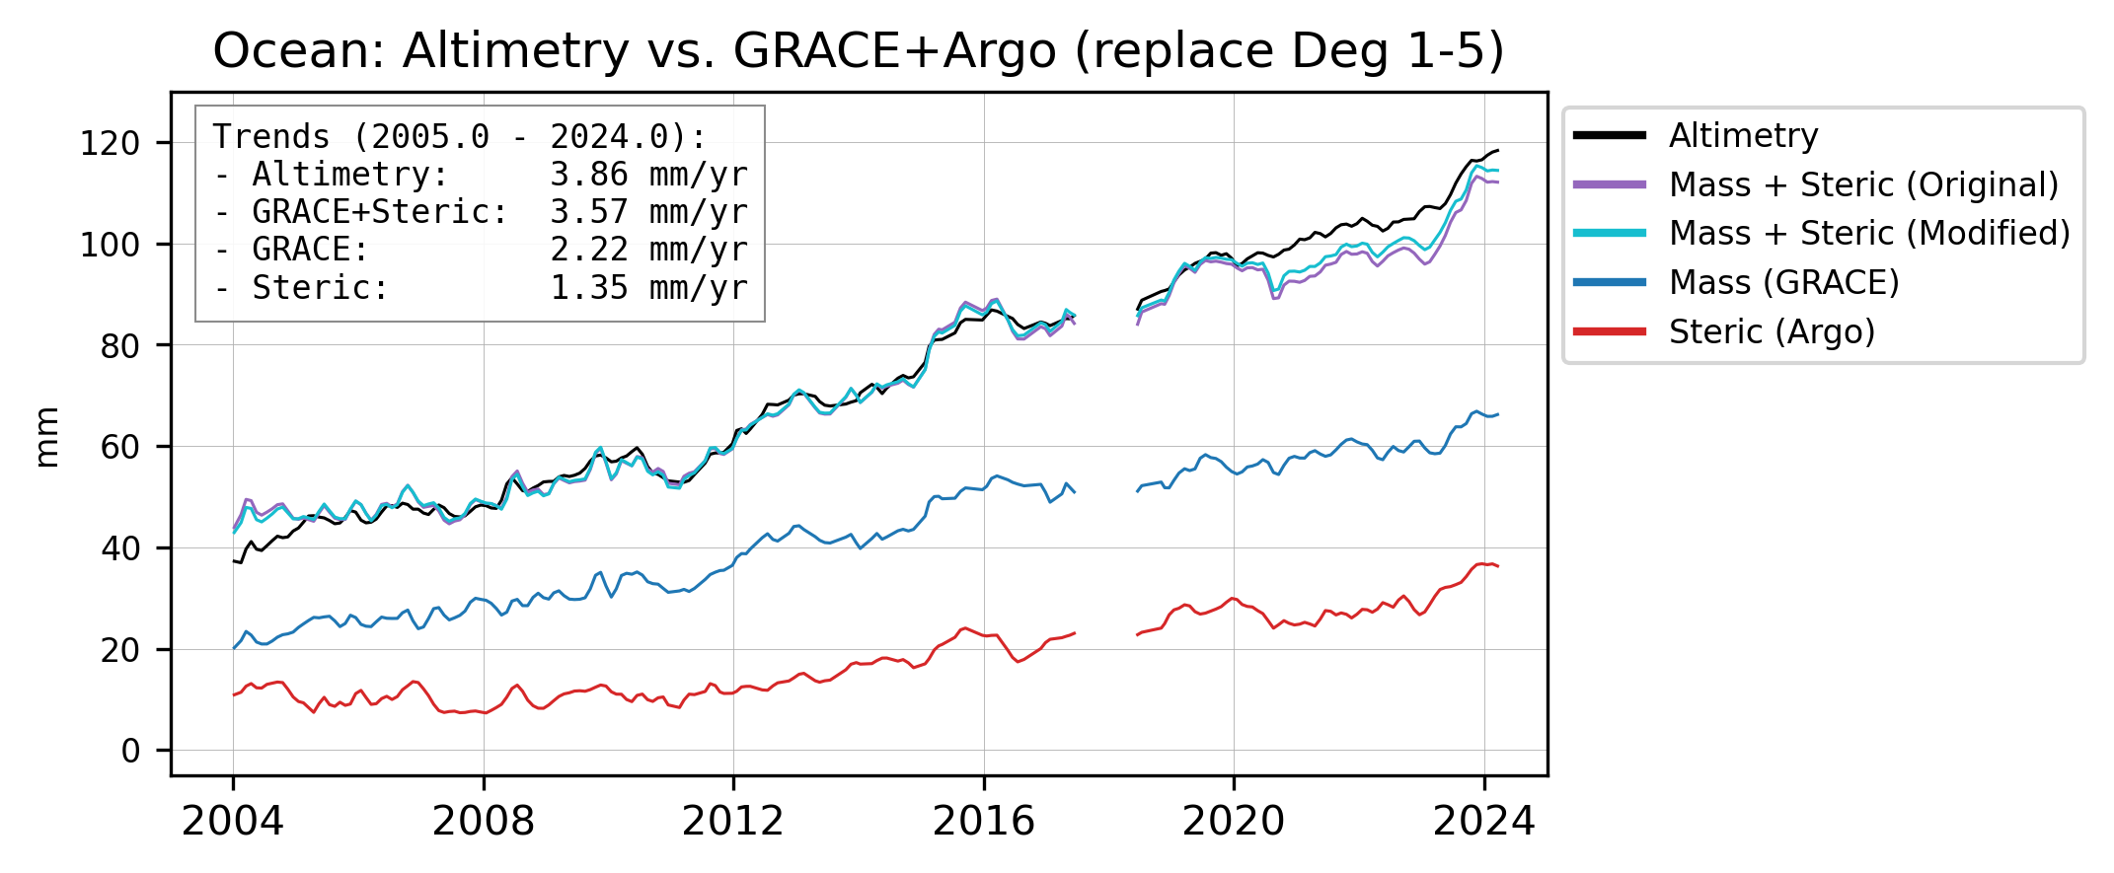
Comparing Ocean Contributions to SHCs
However, most of the total mass change difference is (predictably) captured by C₀₀
No combination of harmonics for deg 1 and higher closes the sea level budget
In other words, we need to modify this experiment so that changes in total mass (C₀₀) are equal

Slide 11
Comparing Ocean Contributions to SHCs
However, most of the total mass change difference is (predictably) captured by C₀₀
No combination of harmonics for deg 1 and higher closes the sea level budget
In other words, we need to modify this experiment so that changes in total mass (C₀₀) are equal
If Altimetry-minus-Argo is correct:
The difference in Ocean Mass must have come from somewhere:
Assume it is over land
Force the global differences in C₀₀ to be zero
Ocean mass change is then captured by other harmonics

Slide 12
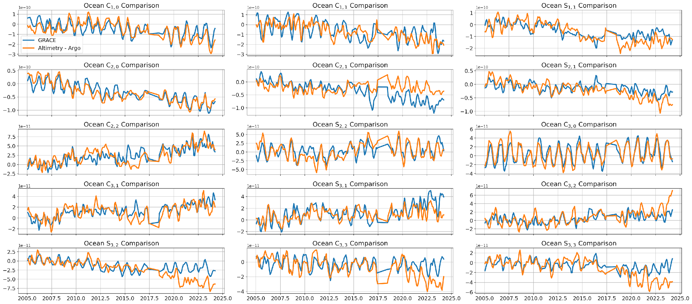
Ocean Contributions to SHCs (modified)

Slide 13
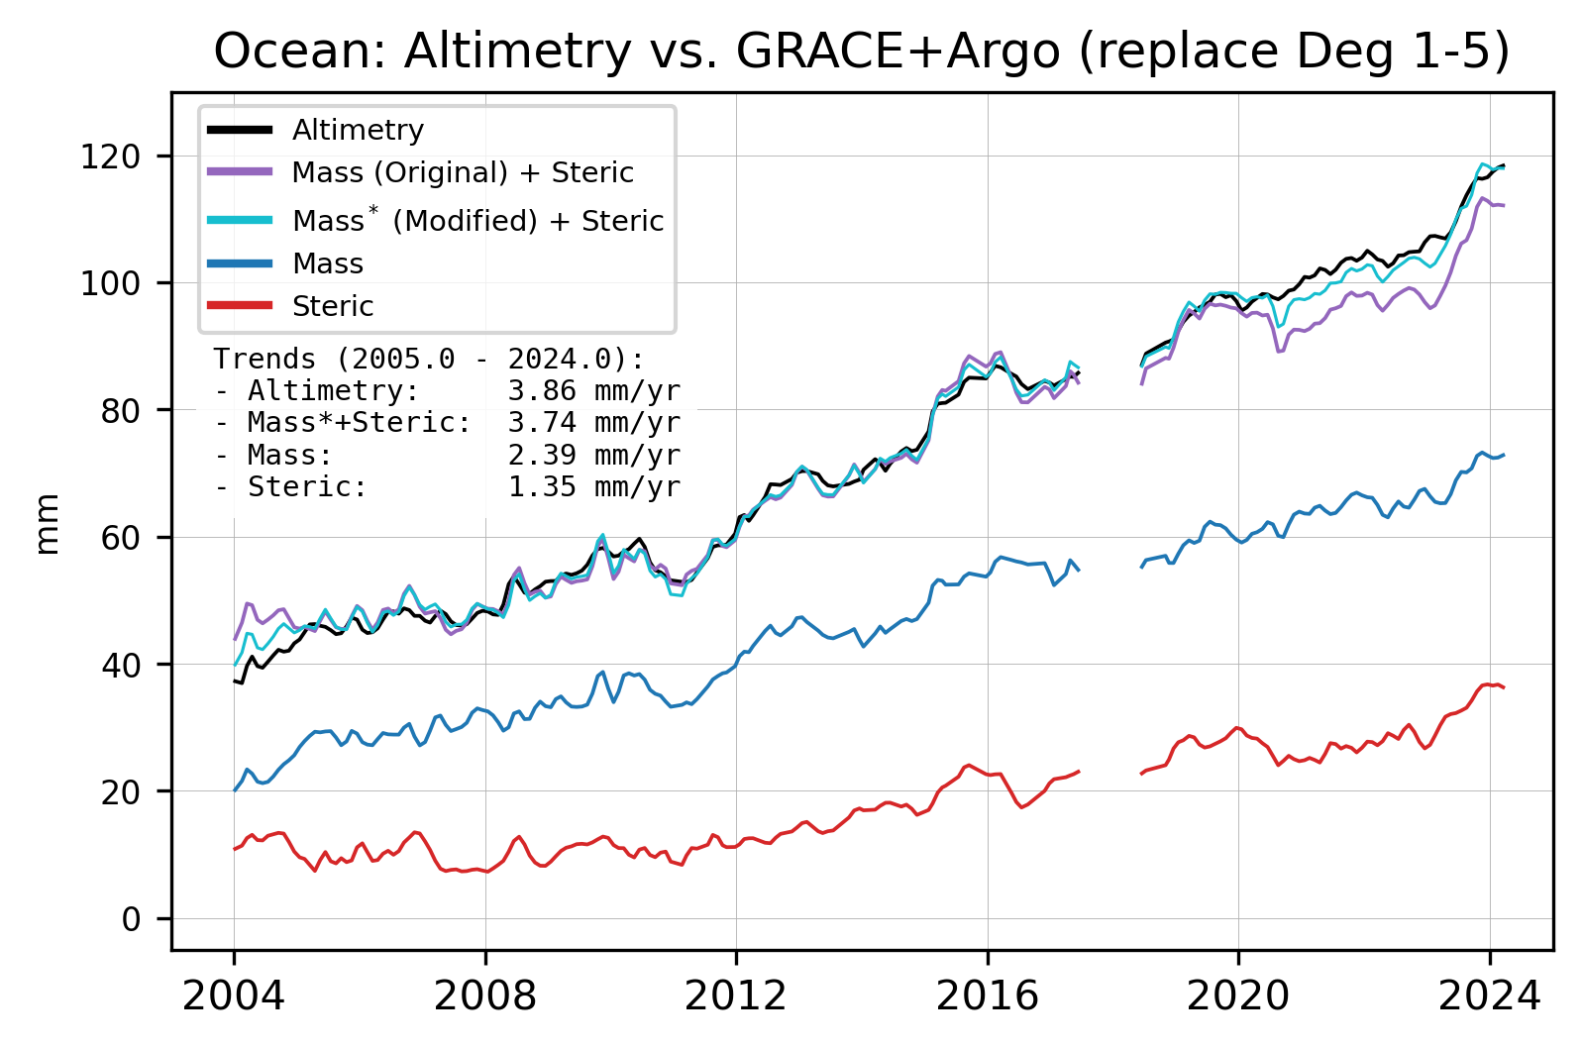
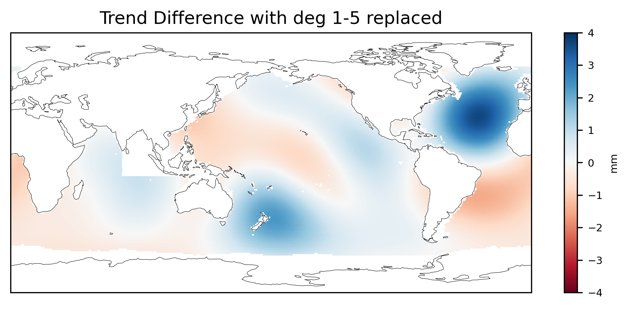
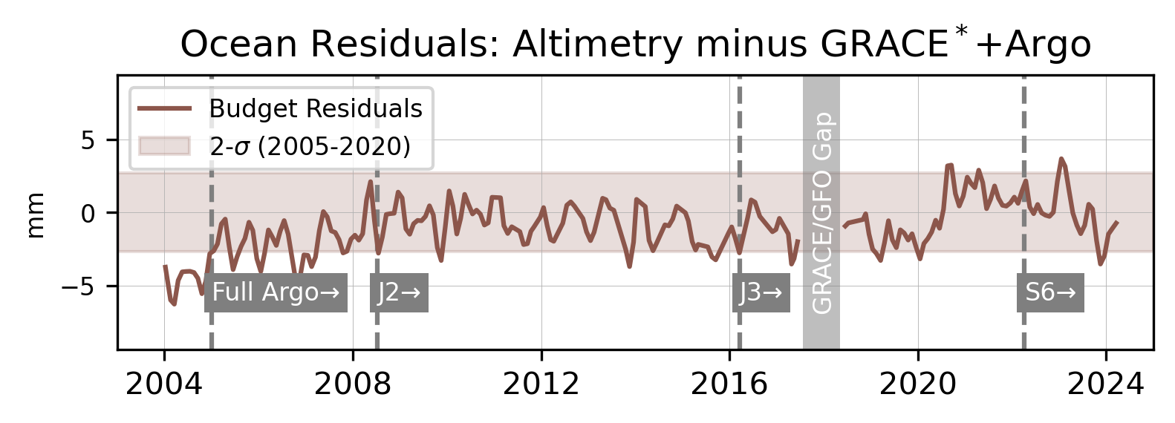
Updated GMSL Budget
Cumulative trend difference by SH degree
Deg | Trend diff (mm/year)
1 | 0.054
2 | 0.005
3 | 0.072
4 | 0.091
5 | 0.062

Slide 14
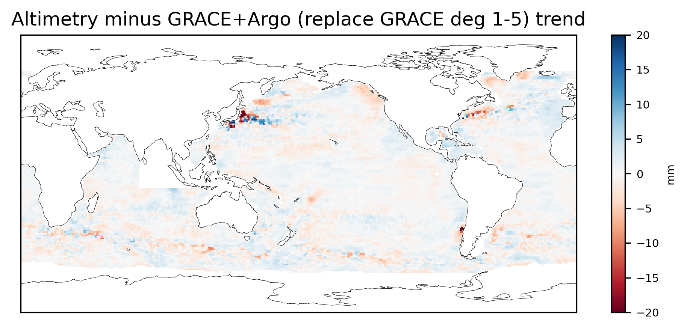
Remaining Trend Differences
−
=

Slide 15
Concluding Thoughts
Global sea level rise from Altimetry, GRACE(-FO), and Argo show increasing disagreement, globally after 2018-2020 but regionally throughout timespan
Unification of masks across all three missions does have small effects on recovered GMSL, but does not resolve misclosure
Most of the misclosure can be attributed to long-wavelength spatial differences, but measuring this is hard
Misclosure cannot be attributed to individual gravity coefficients or degrees alone (i.e., geocenter motion, C₂₀, etc. are not the primary culprit)
Contact: michael.j.croteau@nasa.gov

Slide 16
Thank you!
michael.j.croteau@nasa.gov

