Slide 1
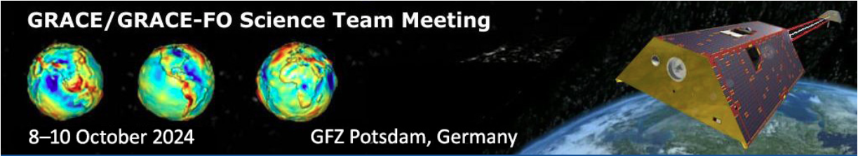

Increasing Nonstationarity in Water Storage Across Global Basins
Previous title: Global river basin water storage fluctuations and their connection to precipitation
Speaker: Yulong Zhong^{1,2}
With Yingying Wang¹, Jürgen Kusche², Yunlong Wu¹
1. China University of Geosciences (Wuhan)
2. University of Bonn
October, 2024

Slide 2
Main Content
1. Background
2. Methods
3. TWSA Nonstationarity in Global Large Basins
4. Influencing Factors of TWSA Nonstationarity
5. Conclusions
Outline

Slide 3
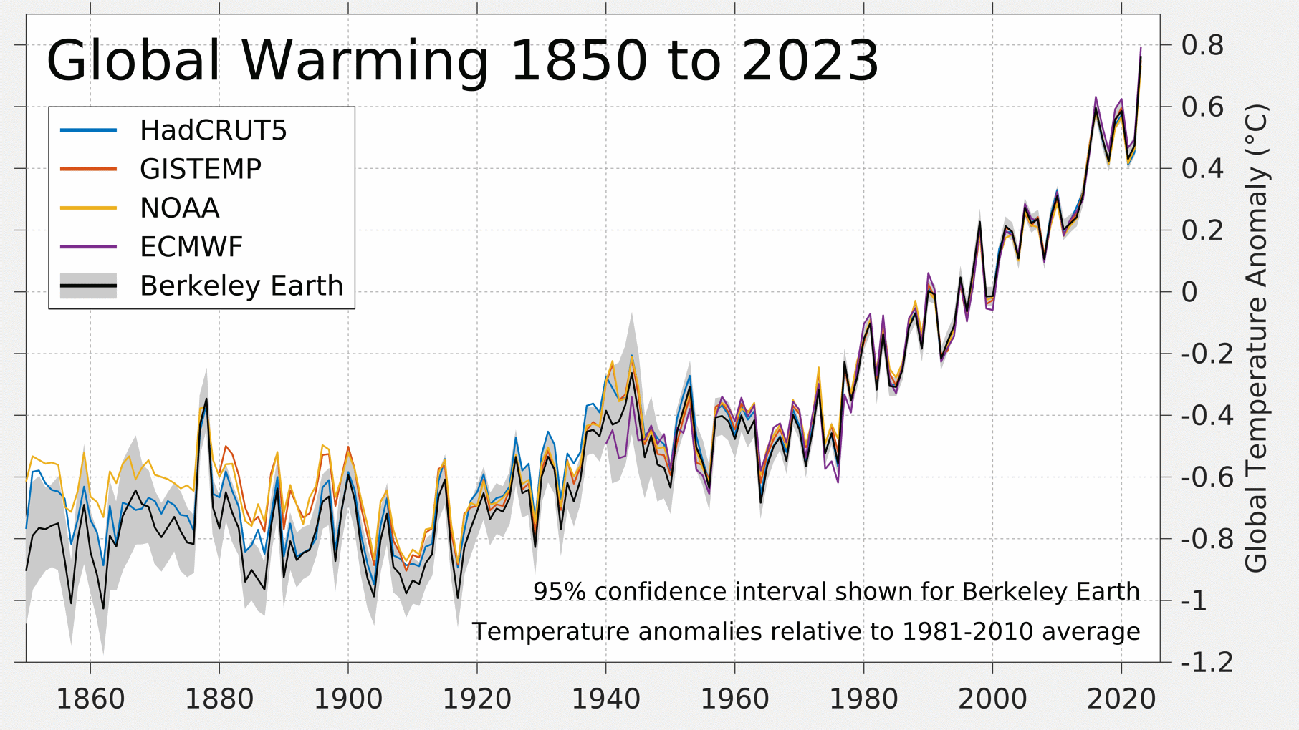
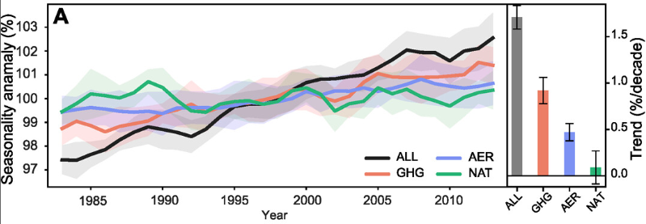
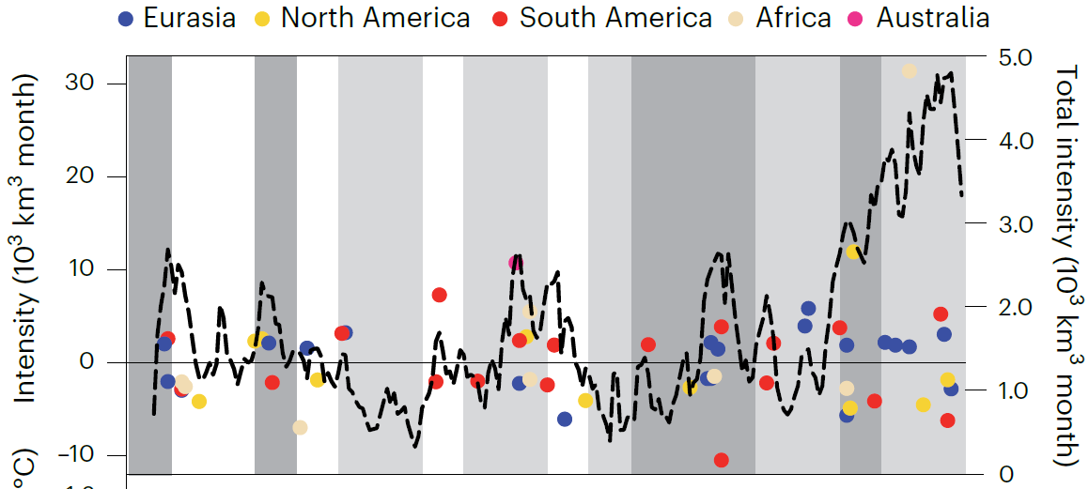
1. Background
Precipitation Seasonality Amplifies as Earth Warms.
Global Temperature
Precipitation seasonality under different forcings (1982-2014)
Wang et al, 2024
2002–2021
Rodell et al, 2023
Changing intensity of hydroclimatic extreme events
Notes:
Intensity (10³ km³ month) of the global top 30 most intense wet (positive values) and top 30 most intense dry (negative values) events (dots colour coded by continent) as a function of the month of maximum/minimum TWS anomaly.

Slide 4
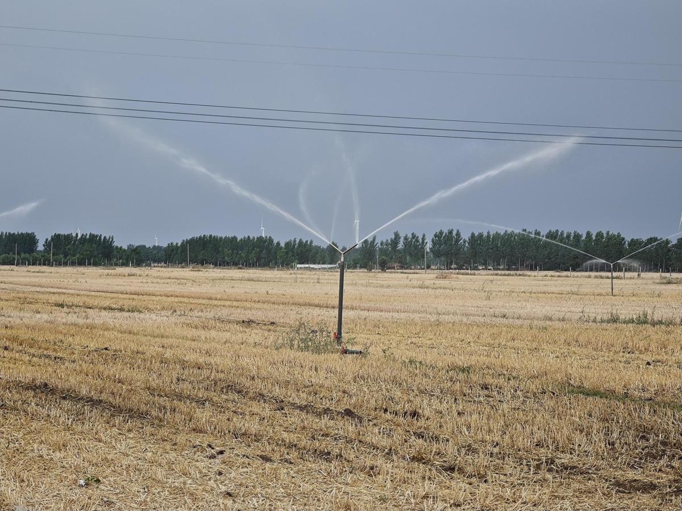
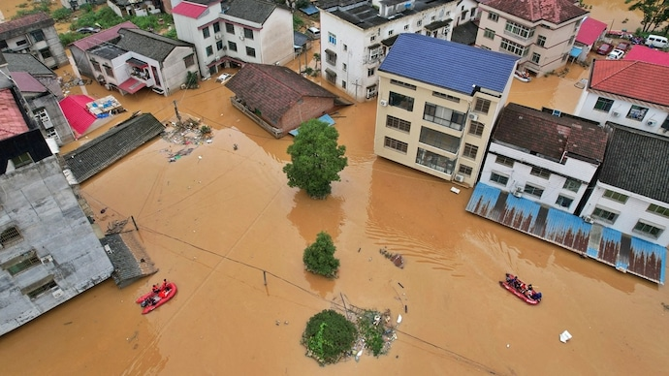
1. Background
Drought one year and floods the next seem to be the new normal,
even drought and flood turn rapidly
Henan province in China in this summer
These frequent hydroclimatic extremes will amplify variabilities in TWSA.
Drought in June, 2024
Flood in July, 2024
Notes:
Henan province issued an orange alert for drought on Wednesday, as 72 national meteorological centers in 16 cities recorded severe heat for 10 consecutive days, the Henan Meteorological Center said.
The left It is implementing water-saving measures for irrigation
A small town in China's Henan province experienced an unprecedented deluge as it received nearly a year's worth of rain in just 24 hours.

Slide 5
2. Methods
We define the variabilities in TWSA as nonstationarity.
TWSA time series decomposition
TWSA_{interannual}+TWSA_{subseasonal}
=
Quantification of nonstationarity in TWSA
High variabilities
High (red) and low (blue) variabilities in TWSA
Low variabilities
Hereafter: STD_{TWSA}=nonstationarity in TWSA
Notes:
TWSA time series is decomposed into the seasonal term (TWSA_{seasonal}), trend term (TWSA_{trend}) and residual term (TWSA_{residuals}) using the least squares fitting method.
The interannual and subseasonal components in GRACE-based terrestrial water storage anomalies (TWSA) are typically treated as residuals and used for error estimation. The interannual and subseasonal components in TWSA are also used to characterize the droughts and floods.
Standard deviation (STD) reflects the dispersion of a data distribution from the mean.
A simple schematic diagram demonstrates the High (red) and low (blue) variabilities in TWSA.

Slide 6
2. Methods
Study periods
TWSA is detrended and deseasonalized from April 2002 to December 2022.
Precipitation and temperature anomalies (PA and TA) from ERA5 are also calculated.
Division of different periods
STD estimate is calculated every 5 years,
i.e.,
We then get 17 sets of STD_{TWSA} estimates.
Numbered global 40 large basins
STD_{PA} and STD_{TA} are also estimated similar to STD_{TWSA}
Notes:
Trend of STD are estimated based on Mann-Kendal Trend Analysis

Slide 7
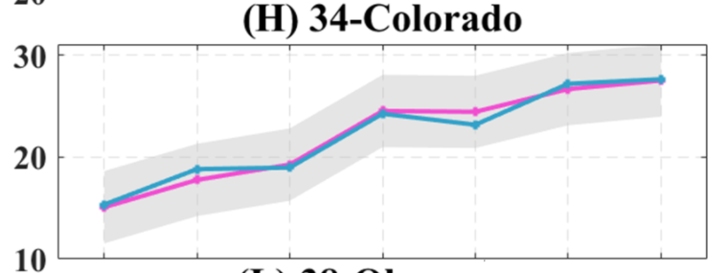
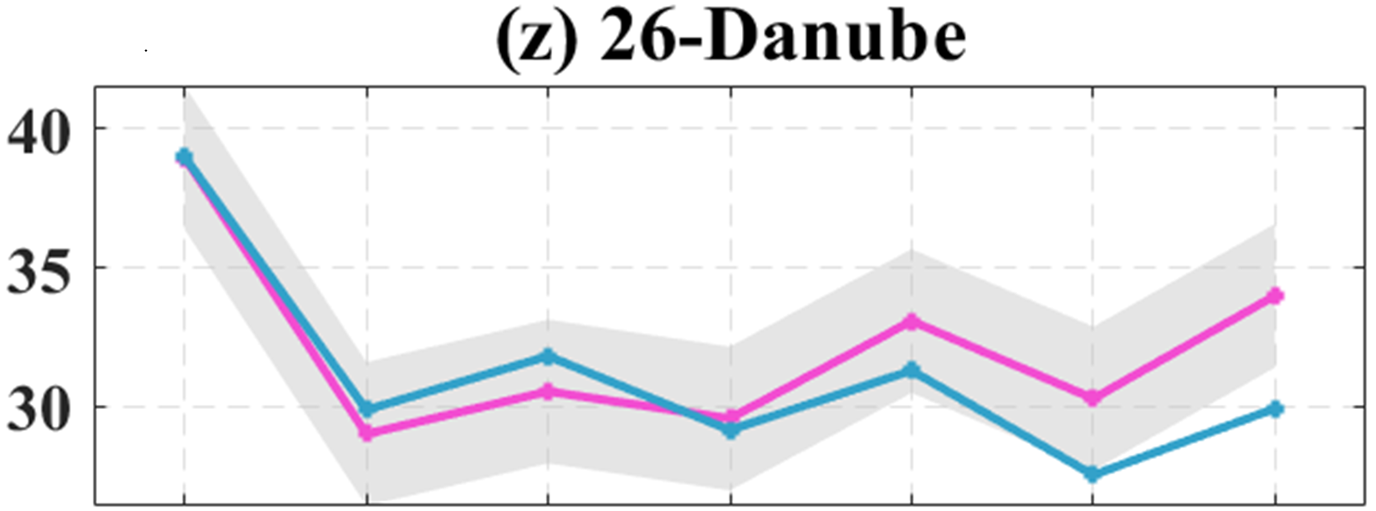

3. TWSA Nonstationarity
Global Grid-Scale Trends in STD_{TWSA} based on CSRM
Notable positive trend: 55.7%
Significant negative trend: 2.2%
Southeast of Danube exist an obvious negative trend in STD_{TWSA}
Trend of 17 sets of STD_{TWSA} estimates during 2002-2022
α < 0.05 is used to assess the significance of estimated trend.
Notes:
STD_{TWSA} exhibit a notable positive trend (i.e., red color) in the middle and low latitudes of the Northern Hemisphere, South America, and northeastern Russia, which accounts for 55.7% of global grids, and more than half of global land regions.
These grids with decreasing trend only account for 2.2% of global land grids.
The grey shading indicates that the trend does not pass the significance test. It should be noted that the unit is expressed as 10⁻¹mm, considering the small trend term.

Slide 8
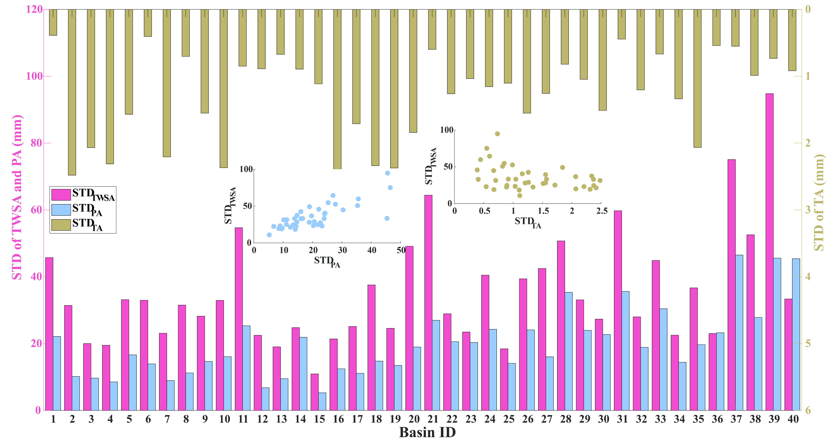
3. TWSA Nonstationarity
Histograms of STD_{TWSA}, STD_{PA}, and STD_{TA} estimates for 2002-2022
Largest STD_{TWSA}: Sao Francisco Basin
Tocantins
Small STD_{TA} usually corresponds to large STD_{TWSA},
since Large STD_{TA} and small STD_{TWSA} usually appear in high-latitude basins
Large STD_{PA} will generally result in large STD_{TWSA}
Notes:
STD_{TA} are relatively small in basins with large STD_{TWSA}, and STD_{TA} are larger in basins with small STD_{TWSA}
Interestingly, the Brahmaputra River Basin (ID: 40) shows the third largest STD_{PA}, while with relatively small STD_{TWSA}, it may result from the offset contribution of glacier variations.
Large STDTA usually appear in high-latitude basins, however, they generally have small STDTWSA.

Slide 9
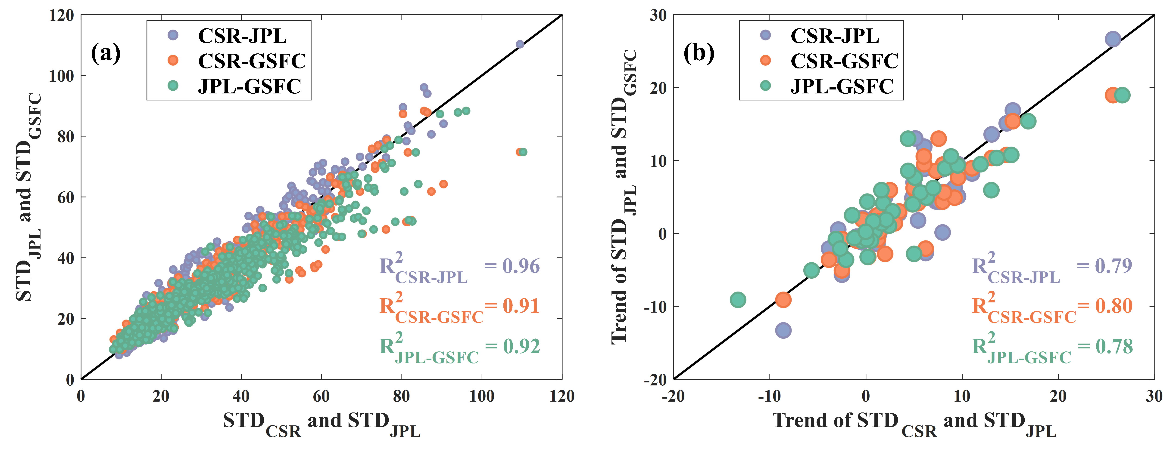
3. TWSA Nonstationarity
Comparison of STD_{TWSA} estimates from three GRACE Mascon solutions
STD_{TWSA} estimates are robust
Notes:
The STD_{TWSA} estimates show good consistency among the three solutions; the R² are all exceed 0.9, especially for STD_{CSR} and STD_{JPL} (R²=0.96). The trends of STD_{TWSA} also show satisfying consistency from the three solutions, with R² estimates exceeding 0.78 (Figure 8b).

Slide 10
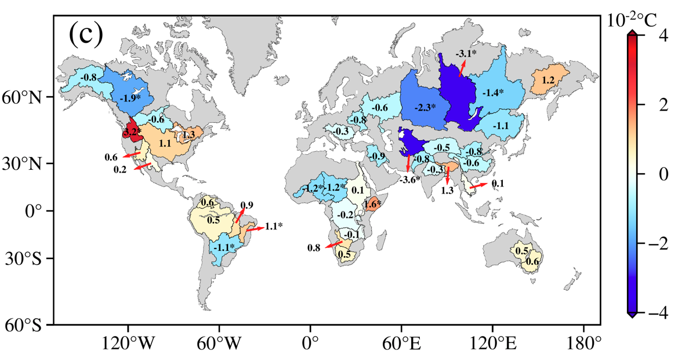
4. Influencing Factors of TWSA Nonstationarity
Trends of STD estimates in 40 global river basins
STD_{TWSA}
STD_{TA}
STD_{TWSA} and STD_{PA} show similar spatial patterns.
STD_{PA}
Notes:
Since the trend term is relatively small, the corresponding values in (a), (b), and (c) are expressed as 10⁻¹, 10⁻¹, 10⁻² respectively.
Asterisk ‘*’ indicates the trend passing the significance test.

Slide 11
4. Influencing Factors of TWSA Nonstationarity
Correlation between 17 sets of STD_{TWSA} and STD_{PA} (a)/STD_{TA} (b)
STD_{TWSA} and STD_{PA} exhibit a positive correlation in most of global large basins (36 in 40)
Basin-scale Pearson correlation coefficients
(a) STD_{TWSA} vs STD_{PA}
(b) STD_{TWSA} vs STD_{TA}
Only in a few basins at low latitudes show significant positive correlation

Slide 12
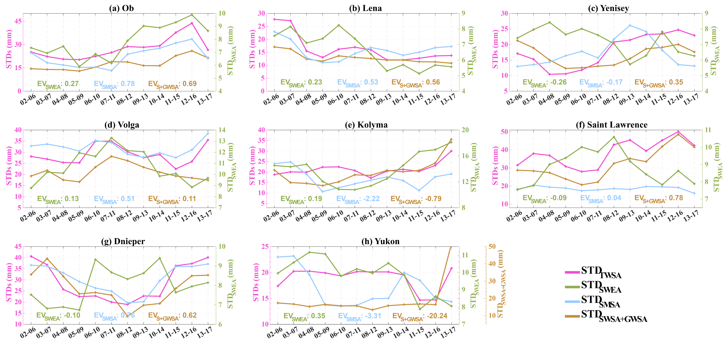
4. Influencing Factors of TWSA Nonstationarity
Contributions of snow water equivalent (ESA) and soil moisture storage (GLDAS v2.1 Noah) in Arctic basins
EV: Explained Variance
Notes:
Snowfall is a primary contributor to glacial mass balance or water storage in polar regions.
However, snow water equivalent can only explain a small part of variabilities in TWSA,
In four basins, Ob, Lena, Volga, and Dnieper, soil moisture can explain most of the STD_{TWSA}.

Slide 13
5. Conclusions
A novel and straightforward metric (STD) is proposed to analyze the nonstationarity in TWSA during 2002-2022.
More than half (55.7%) of global land grids exhibit a significant increase in TWSA nonstationarity.
About half of global large basins (17/40) exist a statistically significant correlation between TWSA and precipitation anomalies nonstationarity.

Slide 14
Thank you!
Contact: zhongyl@cug.edu.cn

