Slide 1
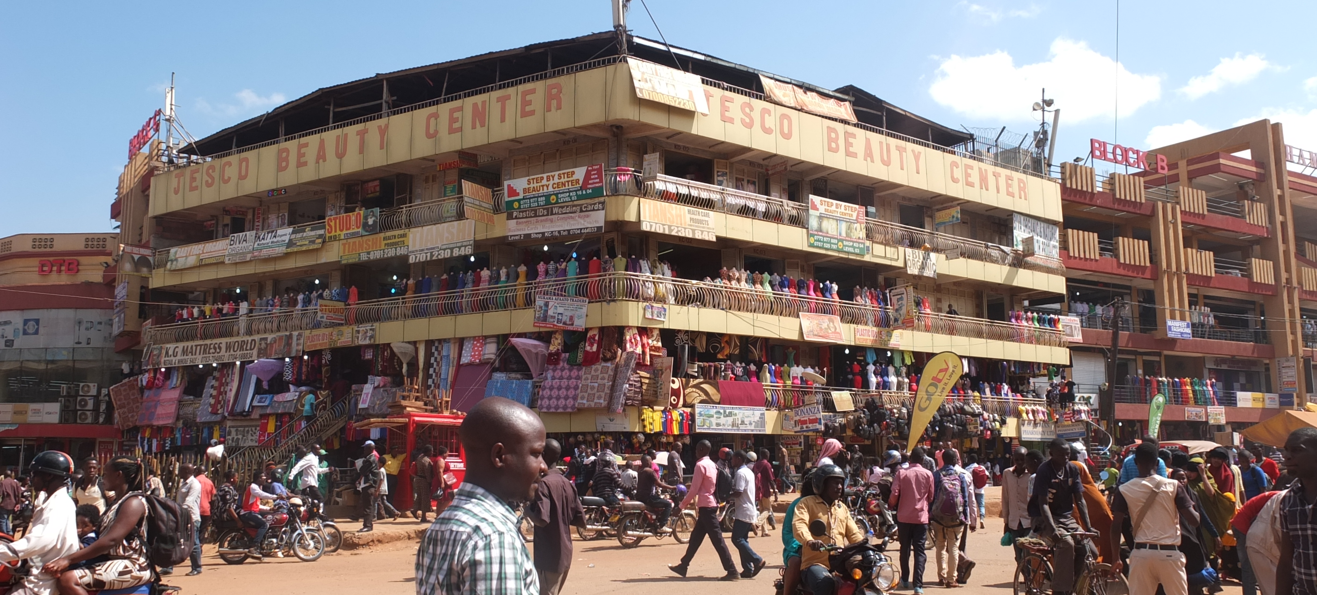

Climate and health around Lake Victoria Preliminary outcomes of a scoping review on temperature driven risks
Modelling the impact of urban climates on health
Bartlett’s School of Environment, Energy and Resources
Institute of Environmental Design and Engineering
ICUC12, July 2025
Brousse O., Morakinyo A., Simpson C., Mukwaya P., Davies M., Heaviside C.
Notes:
Image: Generated using Adobe Firefly

Slide 2
Ice breaker Thursday morning jokes
Do you know who’s hard like concrete and comes back to save the urban climate universe?
Notes:
One of the places in the world expected to be greatly impacted by climate changes
High vulnerability of local populations
Many health hazards driven by climate covariates
But lack of research so need to understand what has been done already and how
Image: LandScan Global 2019

Slide 3
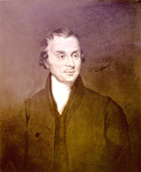


Ice breaker Thursday morning jokes
Luke How(h)ard
Notes:
One of the places in the world expected to be greatly impacted by climate changes
High vulnerability of local populations
Many health hazards driven by climate covariates
But lack of research so need to understand what has been done already and how
Image: LandScan Global 2019

Slide 4
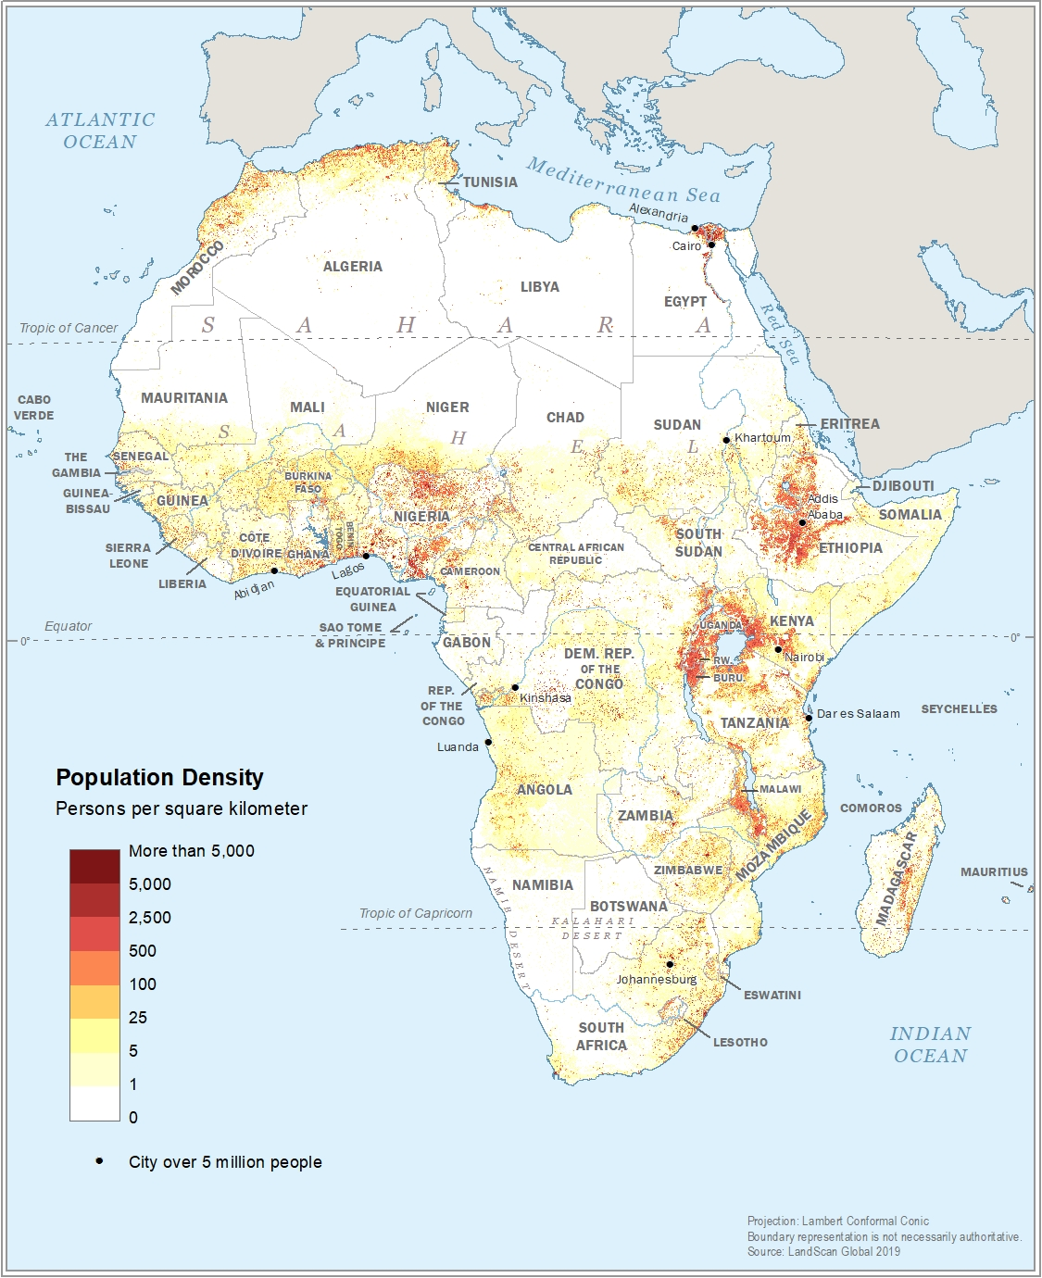
Introduction Motivation for the review
One of the highest population density in the world
Fast and uncontrolled urbanization
Unique topography and changing regional climate
Tropical and bi-modular wet seasons
Limited data availability preventing research
Many climate-driven health hazards
Notes:
One of the places in the world expected to be greatly impacted by climate changes
High vulnerability of local populations
Many health hazards driven by climate covariates
But lack of research so need to understand what has been done already and how
Image: LandScan Global 2019

Slide 5
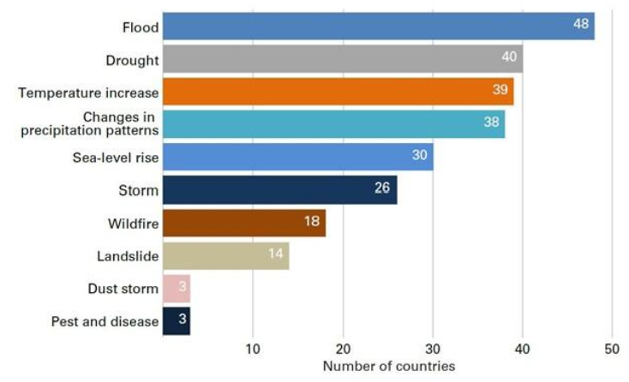
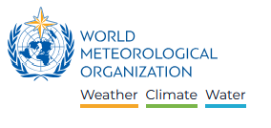
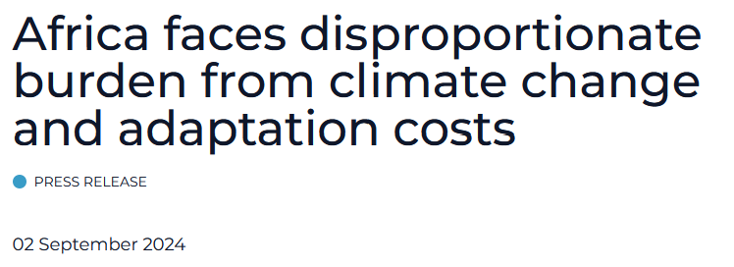
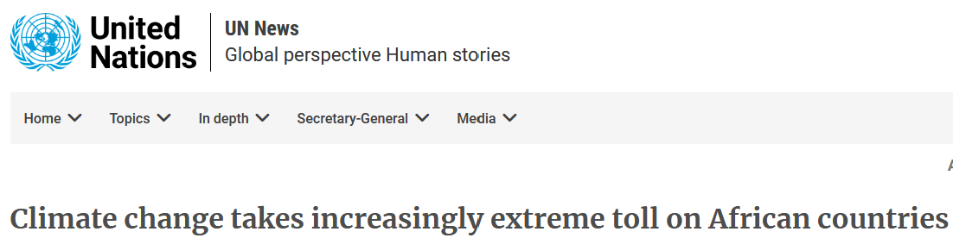

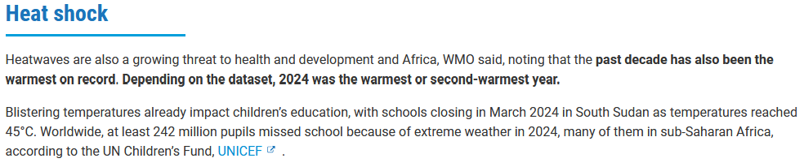
Introduction Rationale justifying the review
Notes:
Climate is changing and we need to understand how these changes impact the health hazards
Image: WMO (Press Release, 2024, online)

Slide 6
Introduction Rationale justifying the review
Little is known on how these changes impact health in cities of (east) Africa
Notes:
Climate is changing and we need to understand how these changes impact the health hazards
Image: WMO (Press Release, 2024, online)

Slide 7
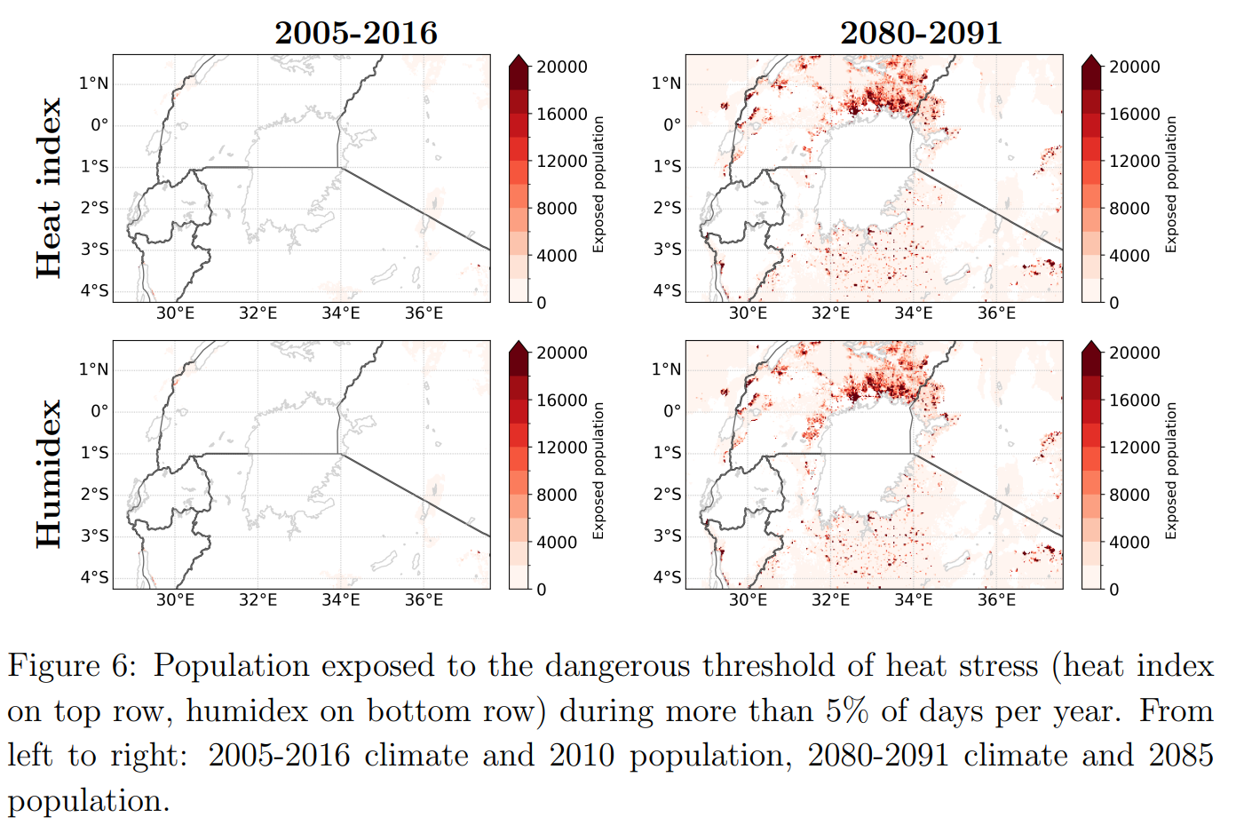
Introduction Rationale justifying the review
Notes:
Population and climate changes are expected to lead to higher exposures to dangerous heat-stresses around the Lake Victoria
Image: Ramon et al. (2025, in review)

Slide 8
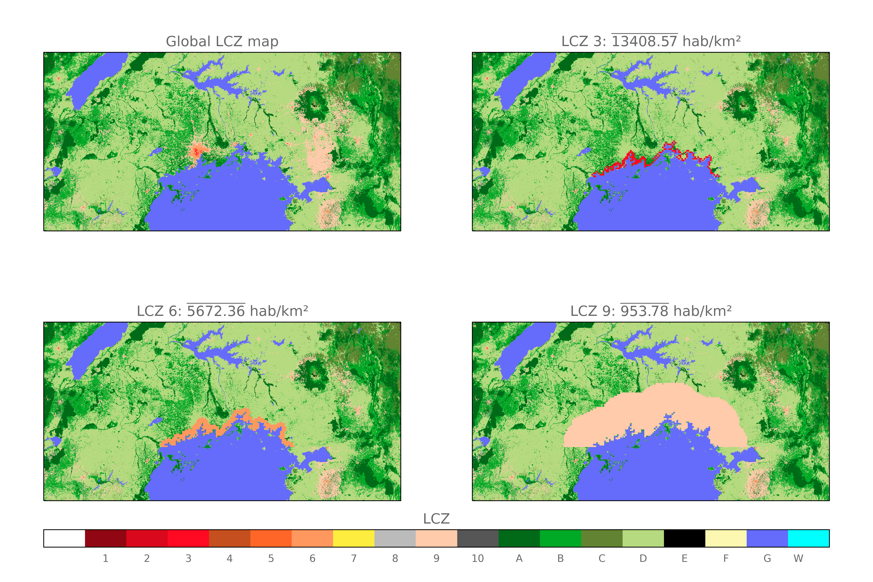
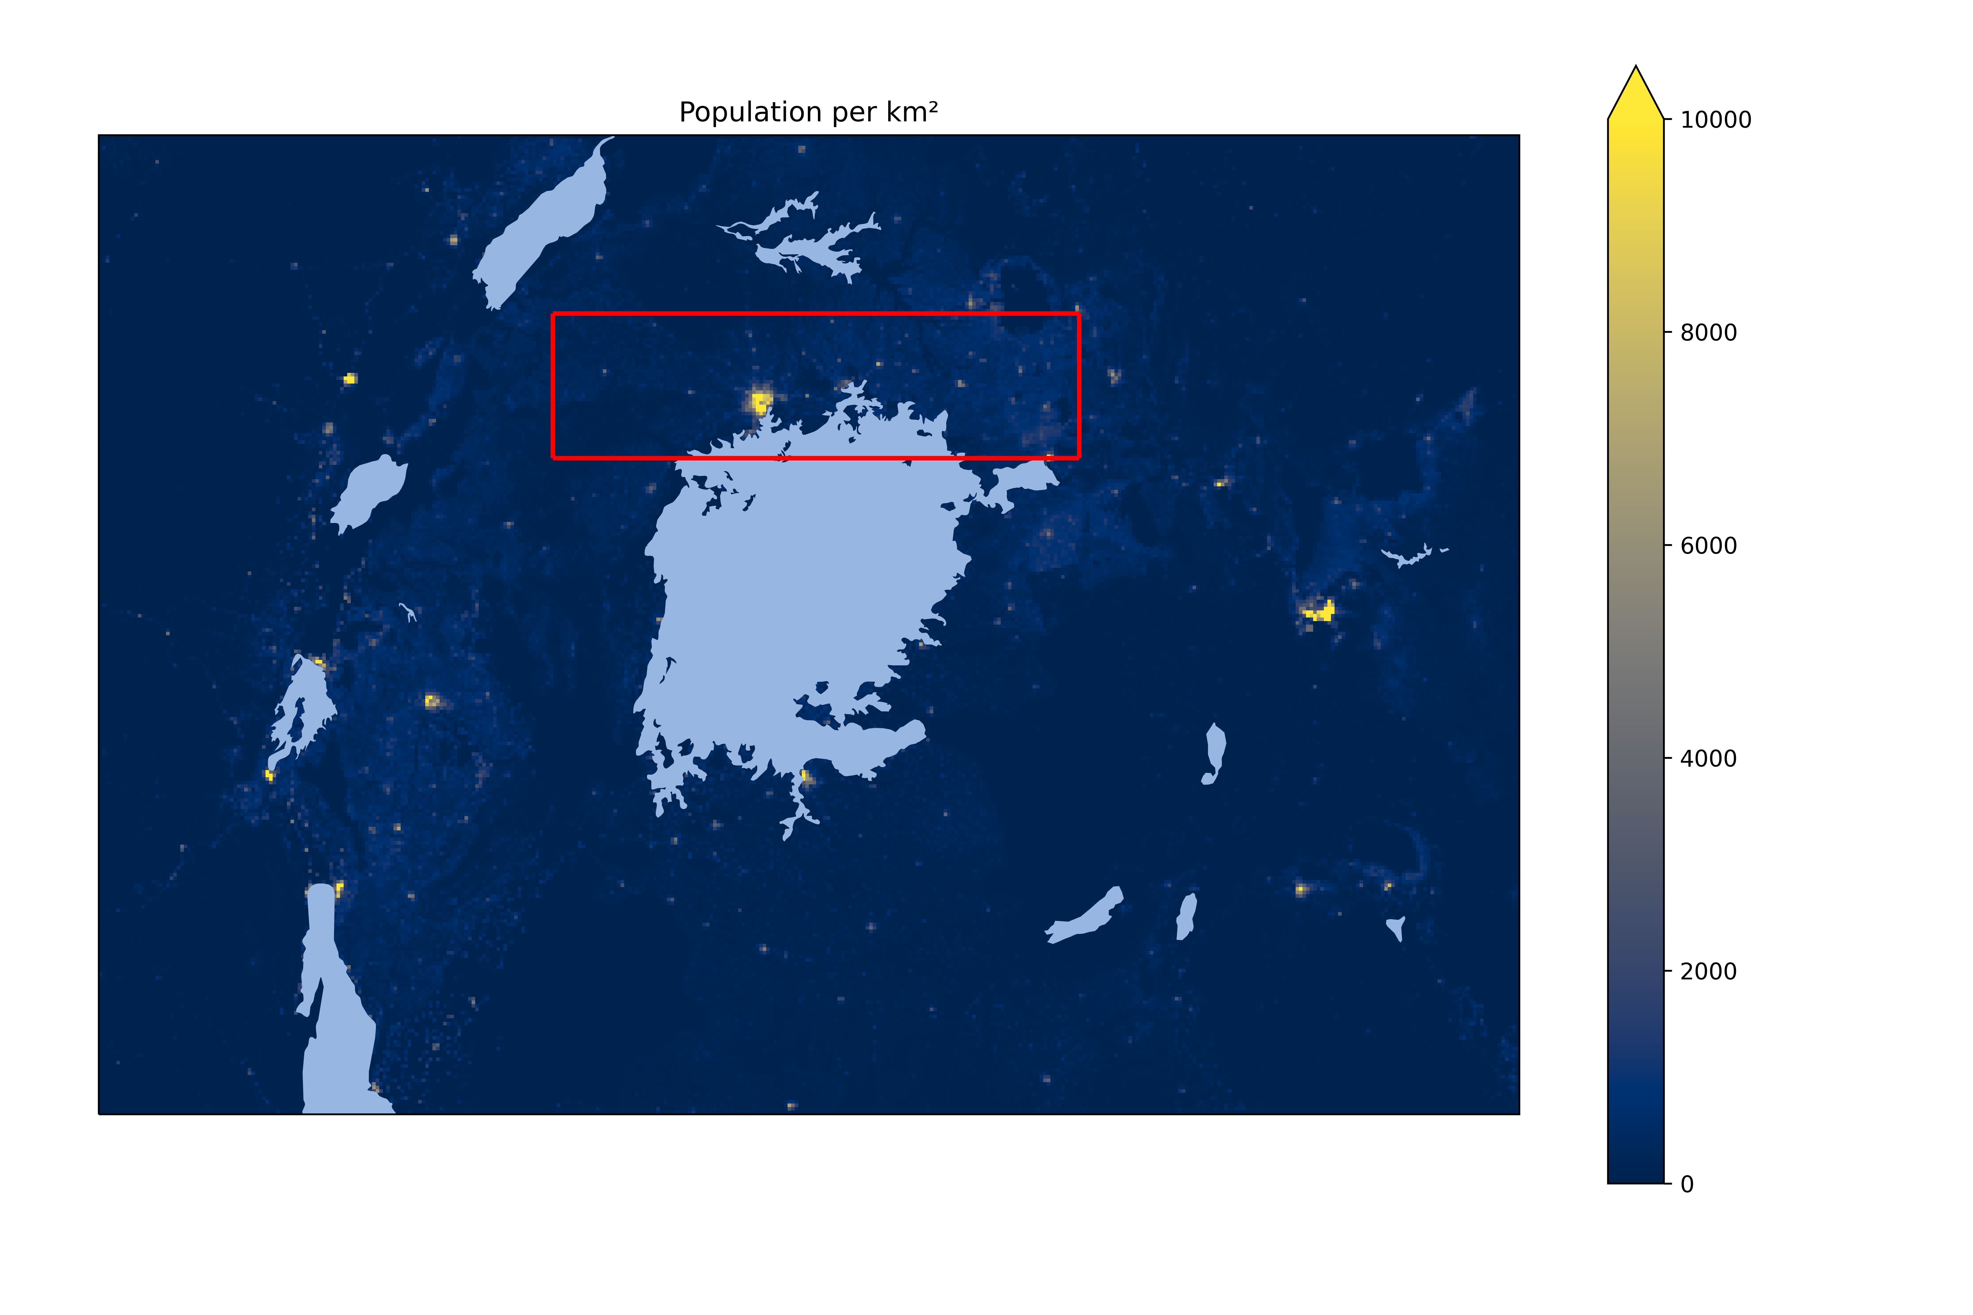
Introduction Rationale justifying the review
Notes:
Climate is changing and we need to understand how these changes impact the health hazards
Image: WMO (Press Release, 2024, online)

Slide 9
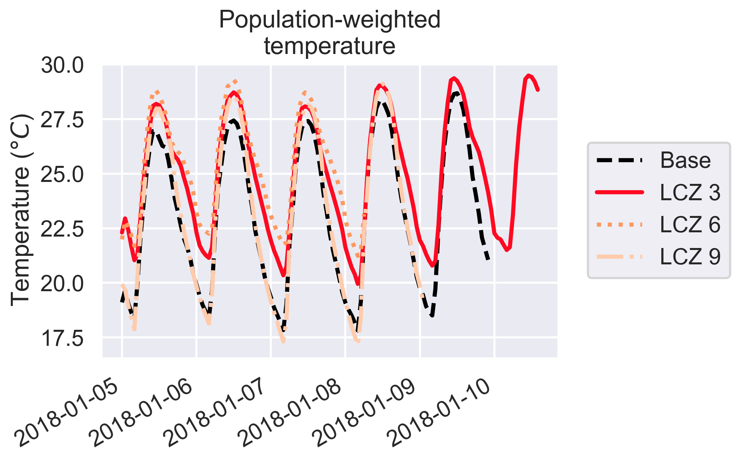
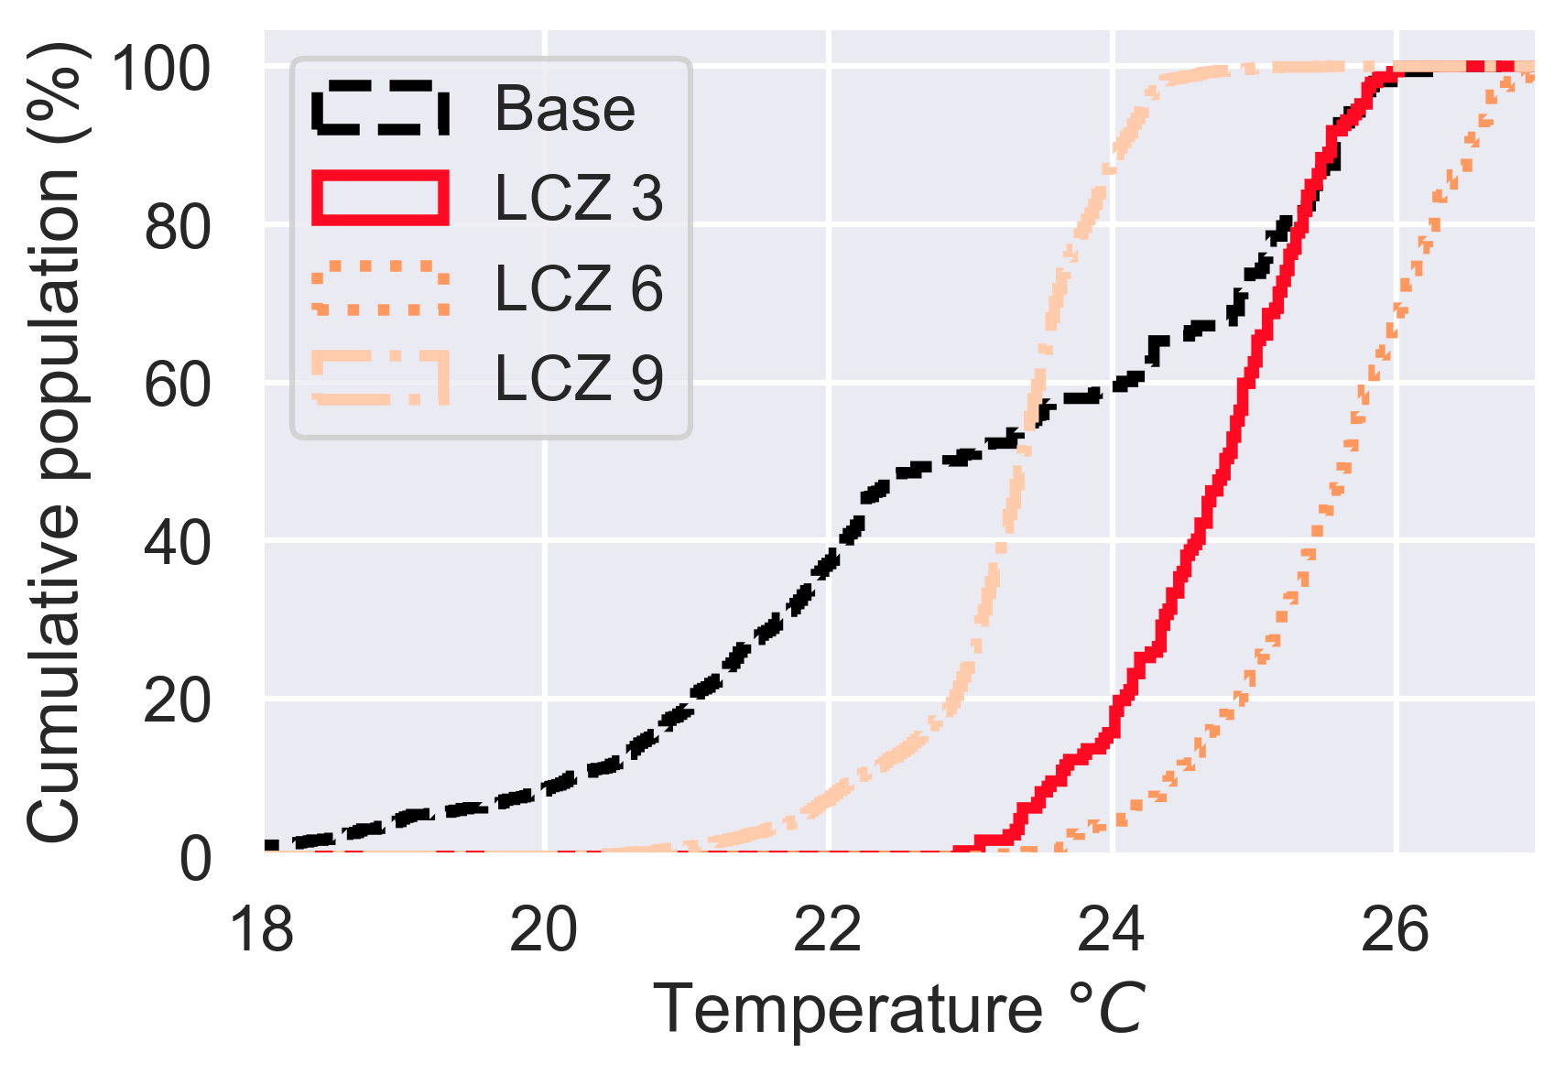
Introduction Rationale justifying the review
Notes:
Increase in temperatures accompanied by a decrease of water vapor, an increase in PBLH and stronger wind from the Lake
Depending on urban morphology different risks of exposure to higher temperatures
Call for climate-sensitive designs!
Image: Brousse et al. 2023 (ICUC 11 oral)

Slide 10
Introduction Rationale justifying the review
Calls for climate-sensitive designs that prevent maladaptation
Notes:
Increase in temperatures accompanied by a decrease of water vapor, an increase in PBLH and stronger wind from the Lake
Depending on urban morphology different risks of exposure to higher temperatures
Call for climate-sensitive designs!
Image: Brousse et al. 2023 (ICUC 11 oral)

Slide 11
Methods Scoping review framework
Search terms in Web of Sience and Scopus including papers until May 2024
AB=(city OR cities OR urban) AND
AB=(africa OR african OR Uganda OR Tanzania OR Kenya) AND
AB=(heat OR "heat stress" OR "heat island" OR temperature OR climate) AND
AB=(health OR mortality or disease)
469 papers on WoS and 592 in Scopus result in a total of 658 manuscripts
Rayyan to screen in double blinded and remove duplicates
Notes:
Image: LCZ Generator (Unnat More, 2024)

Slide 12
Methods Scoping review framework
Inclusion criteria remained opened :
Every paper that relates temperature or climate and health in at least one African city is included
Screening performed based on title and abstract
~ 85 % of agreement between the two reviewers
134 manuscripts included after discussion
107 papers
(excluding opinions, books, reviews, conference, non-traceable, non-English)
Notes:
Talk about climate and health meaning that it should talk about how and temperature influence a health outcome

Slide 13
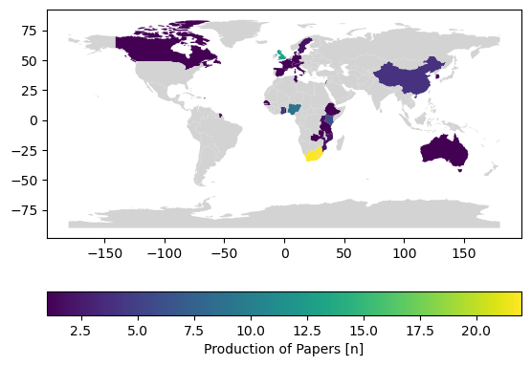
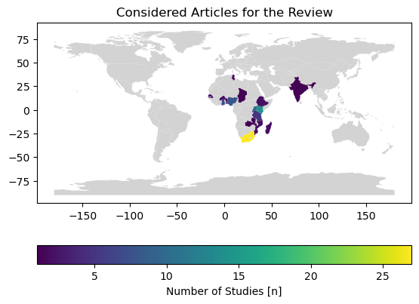
Preliminary results Who studies climate and health in Africa, and where?
Notes:
First author affiliation country
Country in which the city is embedded

Slide 14
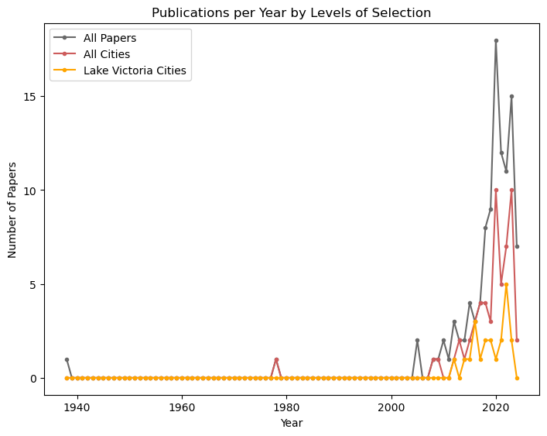
Preliminary results Does east Africa follow continental trends of publications?
107
No global or regional
Max. 10 cities
57
Only around Lake Victoria Basin
21
Notes:
Recent increase in papers looking at climate and health across Africa

Slide 15
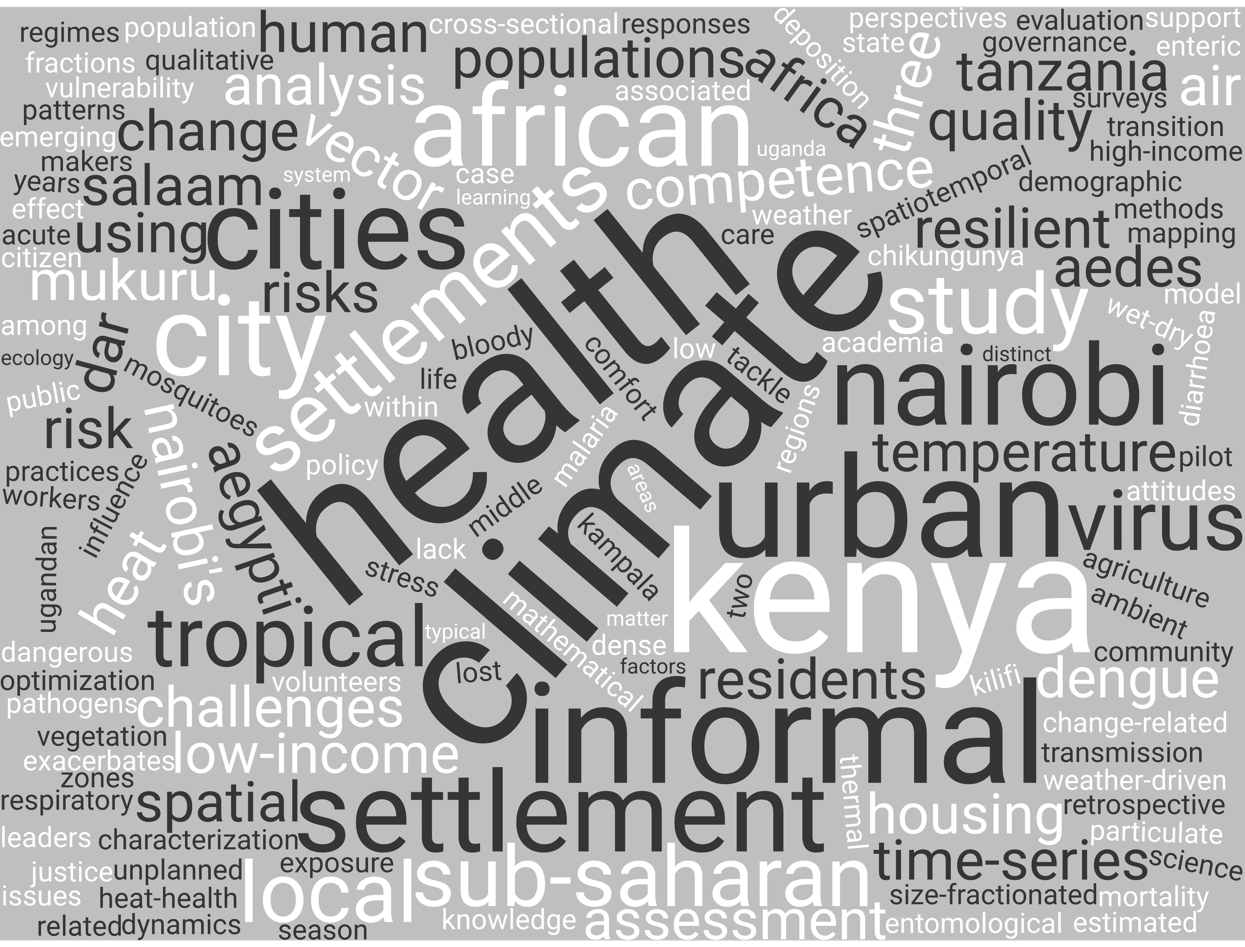
Preliminary results Keyword from titles
21 titles
Max. occurrence = 7
Notes:
Generated using co-pilot

Slide 16
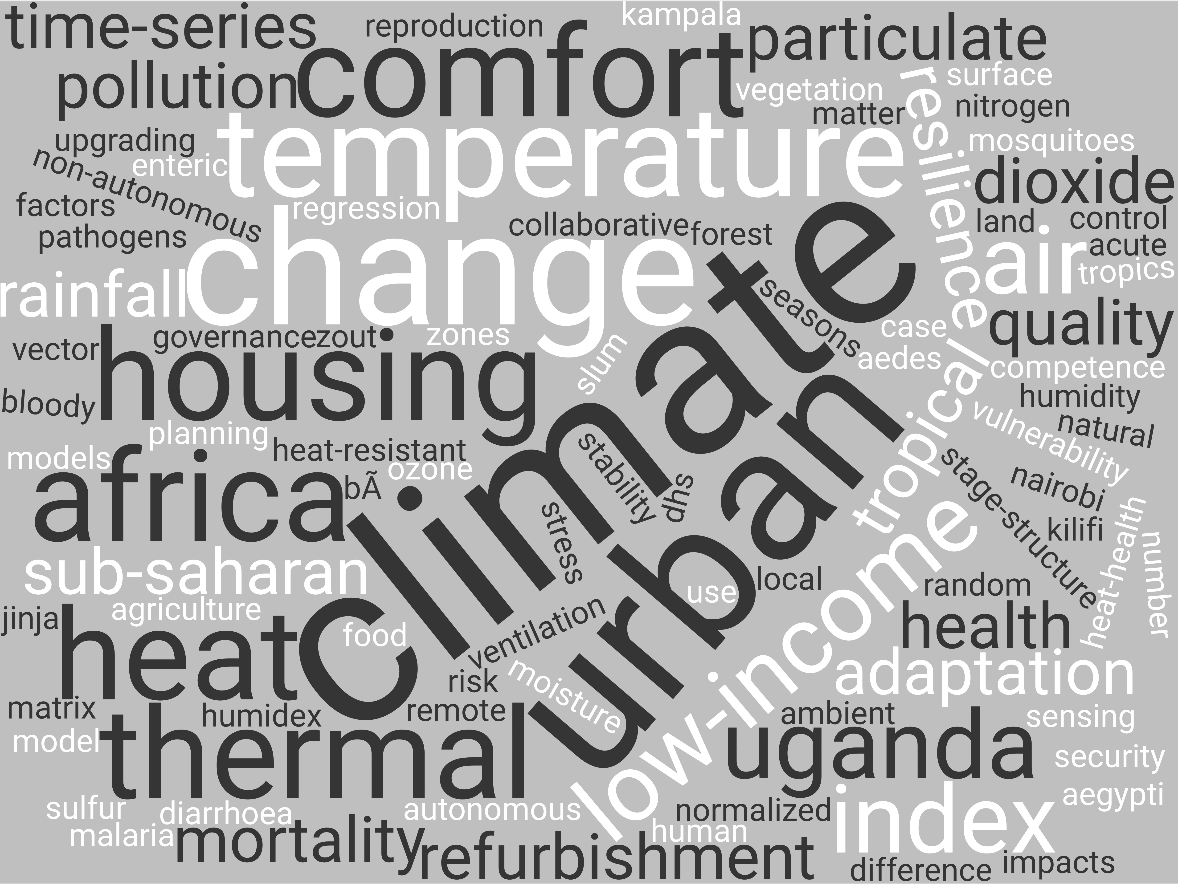
Preliminary results Keyword from authors
13 studies with author keywords
Max. occurrence = 9
Notes:
Generated using co-pilot

Slide 17
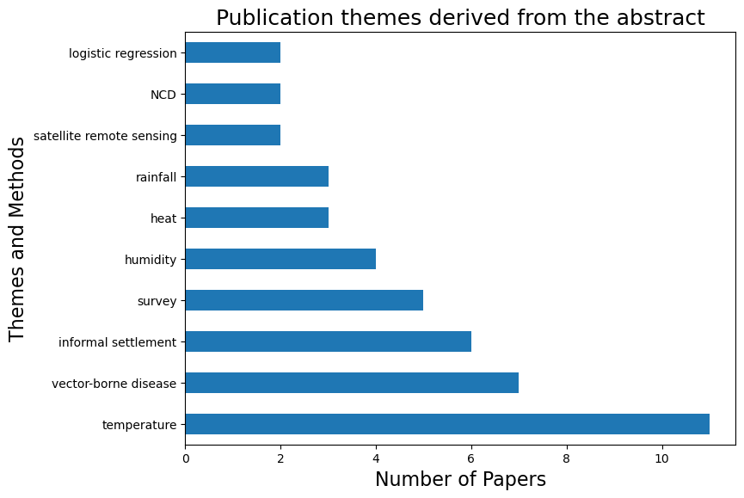
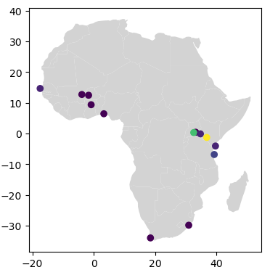

Preliminary results Main themes, location and methods covered in the papers
Notes:
Major focus on vector-borne disease and informal settlement
Look at temperature from thermal comfort and mortality perspective
Temperature influences vector-borne diseases and infectious diseases
Major part of the knowledge comes from Nairobi and Kampala only
Some comparison to other countries outside Lake Victoria Basin

Slide 18
Preliminary results Main themes, location and methods covered in the papers
Air temperature | Rainfall | Vector-borne diseases | Climate adaptation | Air quality | Research methods
Mortality (children and 50 +) | Flooding | Malaria, dengue, chikungunya | Informal settlement | Particulate matter composition | Climate data analysis
Thermal discomfort | Infectious disease | Vector competence | Climate awareness | Climatology | Urban climate and building energy models
Indoor vs Outdoor | Diarrhoea | Vector density | Urban greening and agriculture | Non-communicable diseases (NCD) | Survey
Vector competence | Food security |  | Building efficiency |  | Remote sensing
Infectious disease |  |  | Water management |  | Regression, machine learning
Non-communicable diseases (NCD) |  |  | Population behaviour |  | Distributed lag model
Pneumonia |  |  | Co-benefits
Notes:
Major focus on vector-borne disease and informal settlement
Look at temperature from thermal comfort and mortality perspective
Temperature influences vector-borne diseases and infectious diseases
Major part of the knowledge comes from Nairobi and Kampala only
Some comparison to other countries outside Lake Victoria Basin

Slide 19
Perspectives On the importance to remain geographically bounded
Countries leading research outside Africa and prevalence of South Africa
Lake Victoria basin poorly studied as a whole (reliant on Kampala and Nairobi)
Heat stress, air pollution and vector-borne diseases as main focus
No guidelines provided, work remains explorative
Focusing on temperature already shows opportunities to prevent maladaptation
Notes:
Avoid falling in the trap of willing to study directly at the continent level
Better to map out local geographies and work a sub-regional levels to try to frame research accordingly
Absence of data and research should encourage us to get involved

Slide 20
Perspectives On the importance to remain geographically bounded
Countries leading research outside Africa and prevalence of South Africa
Lake Victoria basin poorly studied as a whole (reliant on Kampala and Nairobi)
Heat stress, air pollution and vector-borne diseases as main focus
No guidelines provided, work remains explorative
Focusing on temperature already shows opportunities to prevent maladaptation
Need to continue explorative work to respond to the urgency
Notes:
Avoid falling in the trap of willing to study directly at the continent level
Better to map out local geographies and work a sub-regional levels to try to frame research accordingly
Absence of data and research should encourage us to get involved

Slide 21
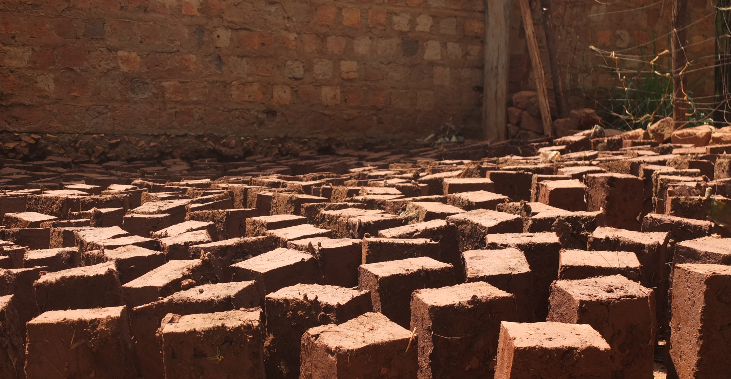
Time for questions
Notes:
Google Images

