Slide 1







Gaps and linkages between biometeorological research across the Global South: a call for new efforts to advance biometeorology in the Global South
Peter Crank, Ariel Prinsloo, Claire Gallacher, Ifeoluwa Balogun, Shreya Banerjee
ICUC12, Rotterdam, The Netherlands - July 11, 2025

Slide 2

Why focus on the Global South?
Historically, environmental sciences have been focused on the Global North or extractive studies of the Global South (Haelewaters et al., 2021)
Scientific research advances remain relegated to the Global North with little mutually beneficial collaboration and often under-represents contributions by the Global South (Molosi-France & Makoni, 2020; Hughes et al., 2023).
Barriers of non-English speakers (Amano et al., 2023)
Disproportionate lack of scientific funding
2

Slide 3
Why focus on the Global South?
IJBM has been dominated by Global North
Until the late 2000s the editor of IJBM has been either located in Europe or East Asia (Sheridan and Allen, 2017).
Among all field editors (24) / advisory board (58), only 6 represent the Global South.
Conference hosting in Global North countries over the past years
ICUC was last in the Global South in 1993 (ICUC2 - Dhaka)
ISB has never been outside of Europe, Canada, US, Israel, Japan
3

Slide 4
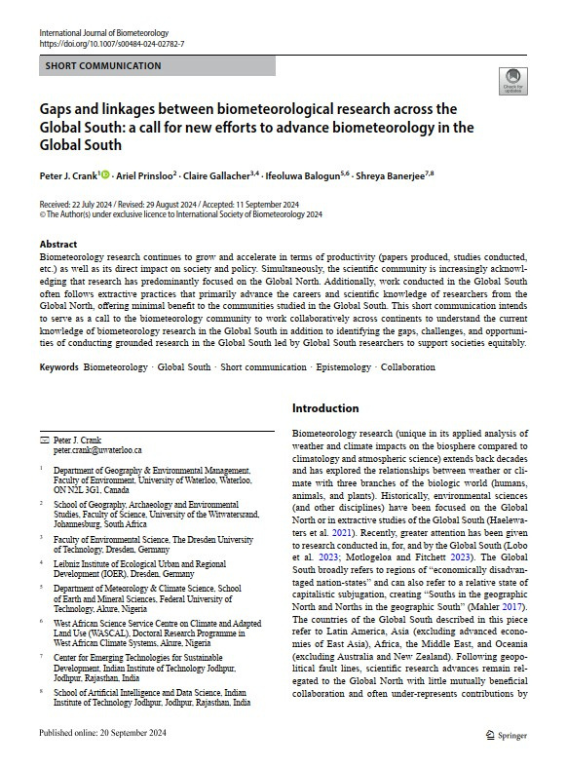
Our aim
To demonstrate the need to assess biometeorological research across the Global South and point the community toward new directions that elevate Global South biometeorology research knowledge, tools, and innovative solutions to improve human, animal, and plant wellbeing everywhere. - Crank et al., 2024
4

Slide 5
“Nothing about us without us” (Pfeifer, 2022)
5

Slide 6
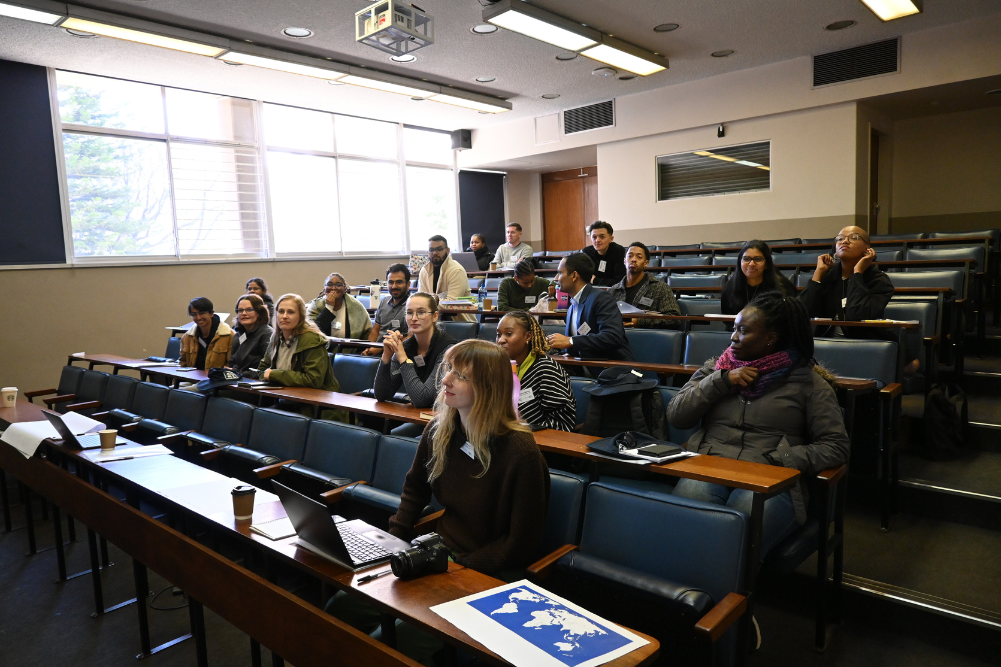
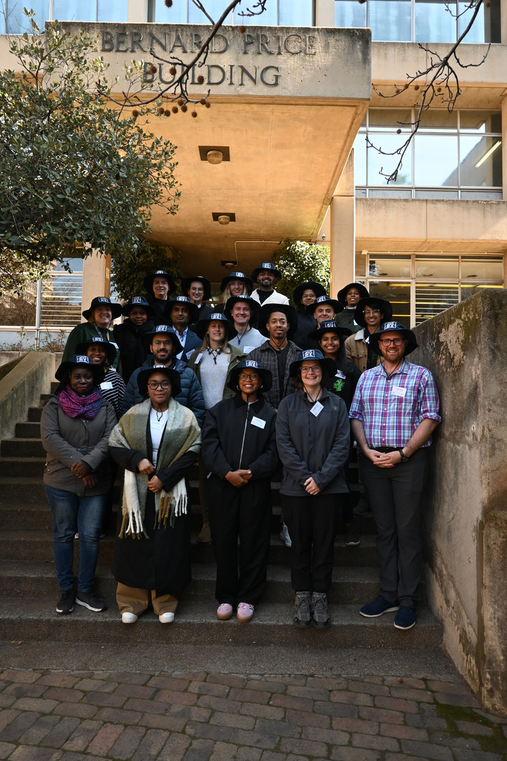
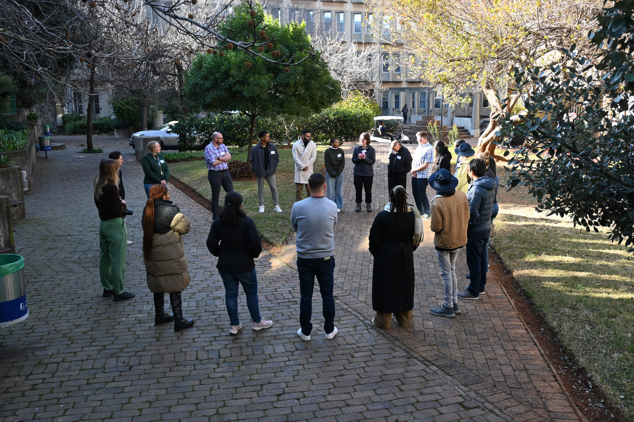
Workshop in Johannesburg, South Africa as a first step
6

Slide 7
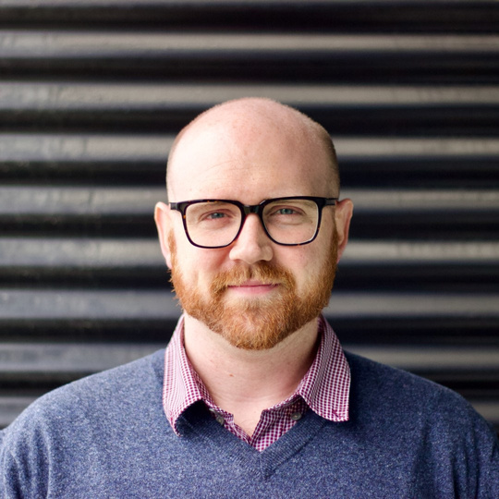

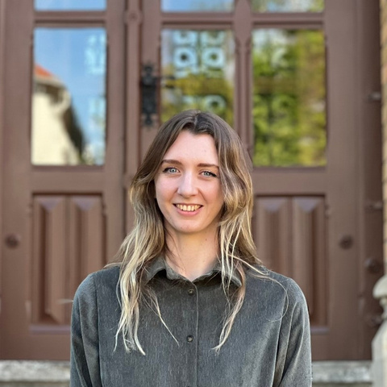
The International Society of Biometeorology Students and New Professionals (ISB SNP) exec team
Peter Crank
Ariel Prinsloo
Claire Gallacher
Chair
Secretary
Communications
7

Slide 8
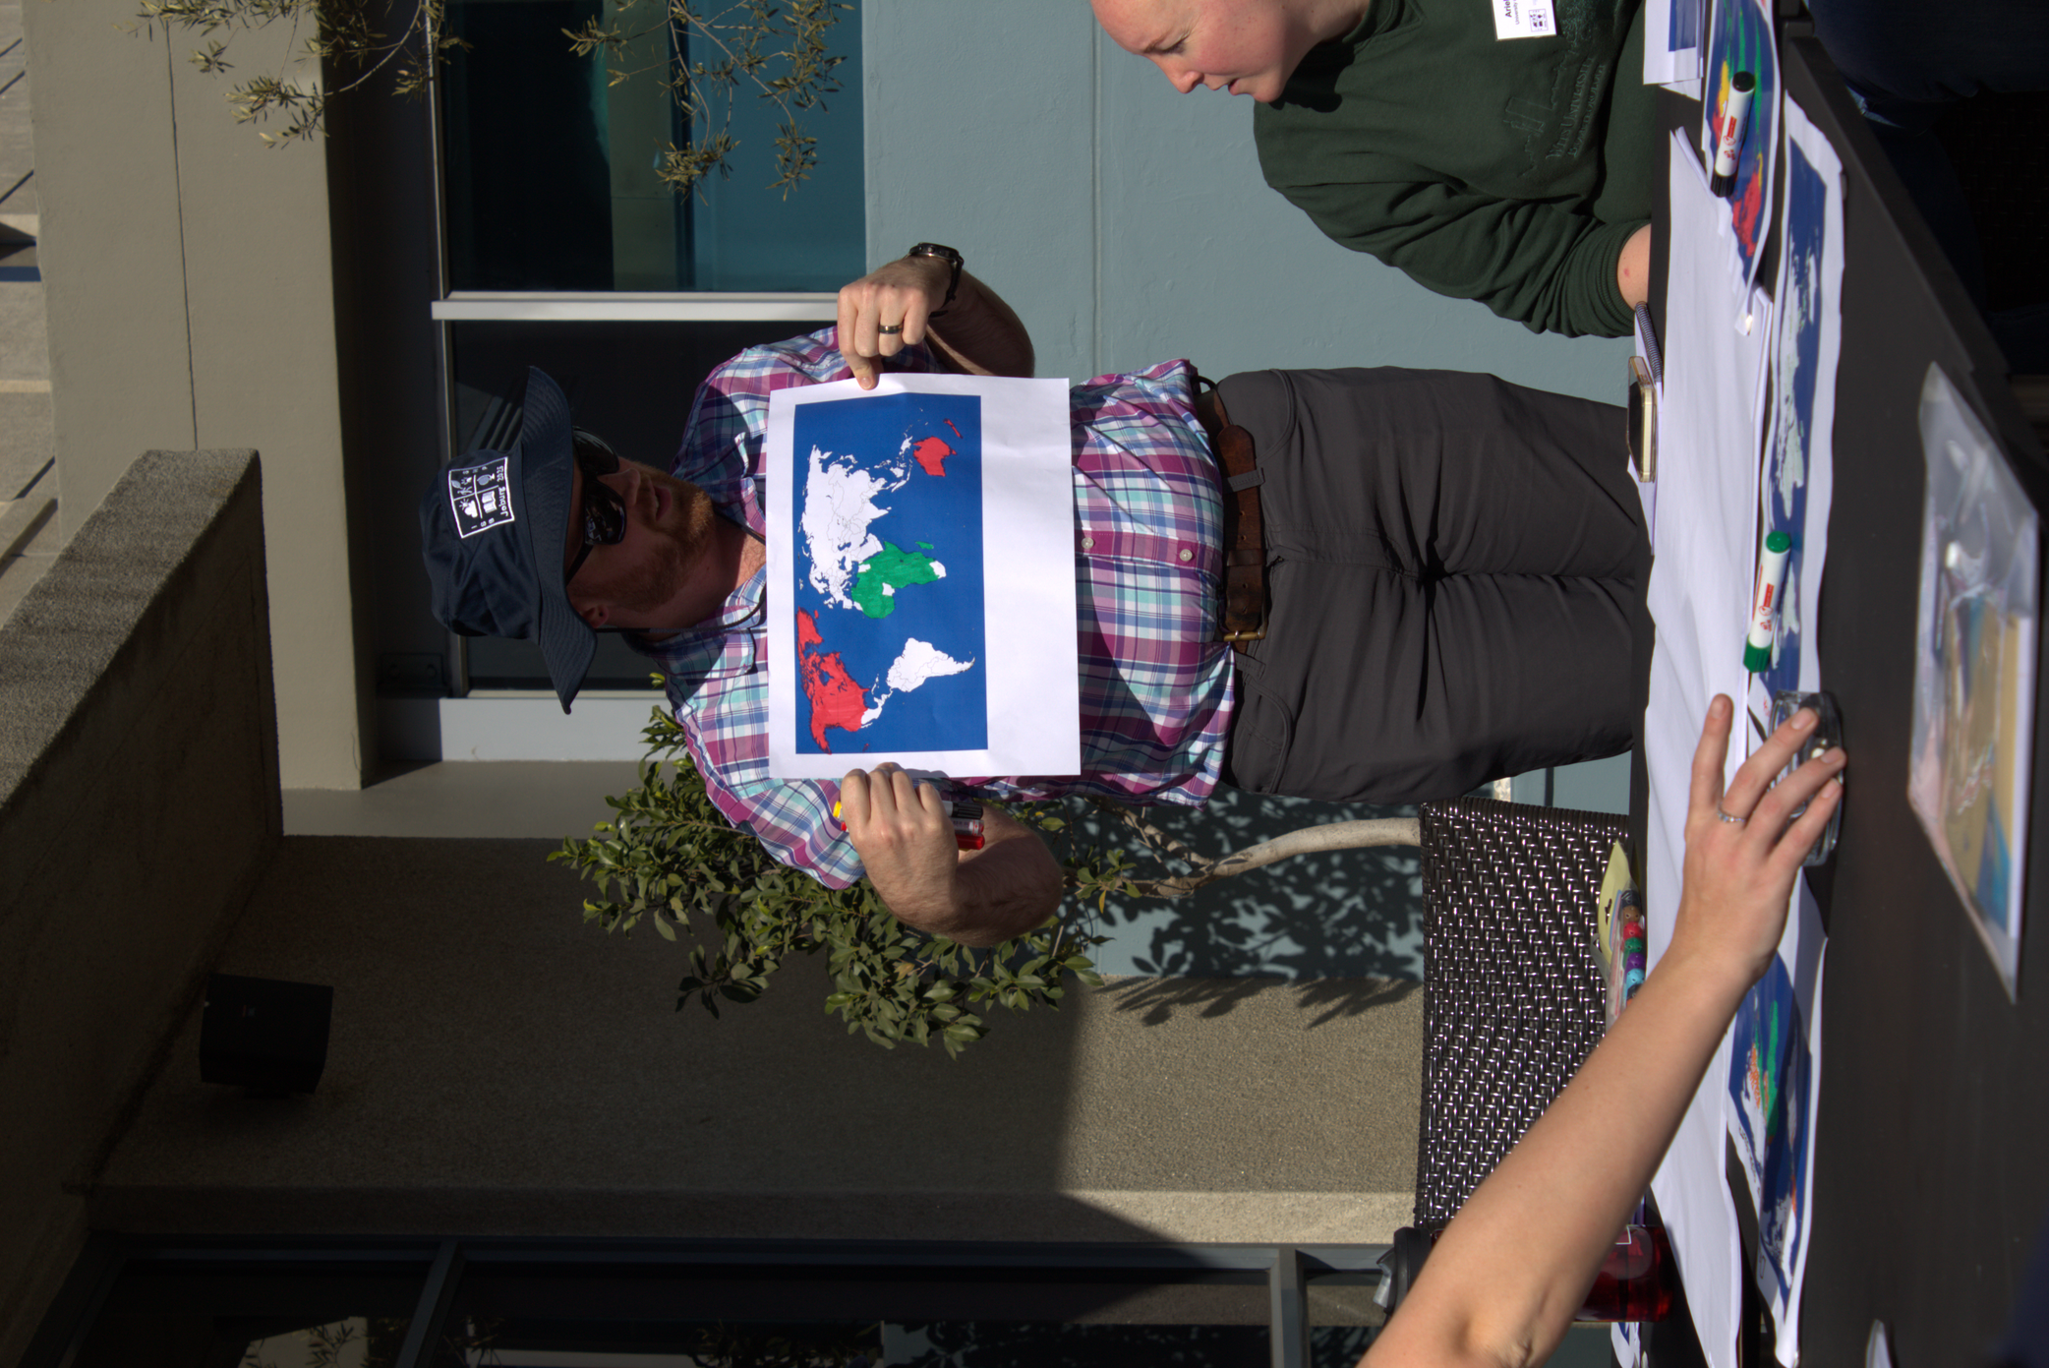
What even is the Global South?
“economically disadvantaged nations”
Can also refer to a relative state of capitalistic subjugation, creating “Souths in the geographic North and Norths in the geographic South” (Mahler, 2017)
Everyone is going to have their own definition of the Global South
*Not the final map.
8

Slide 9
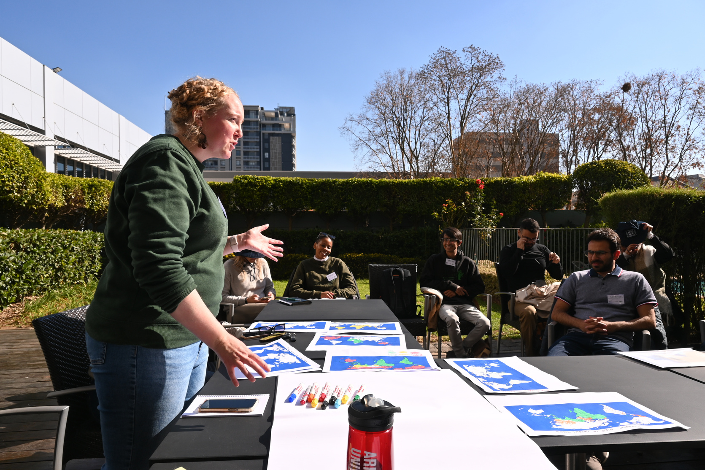
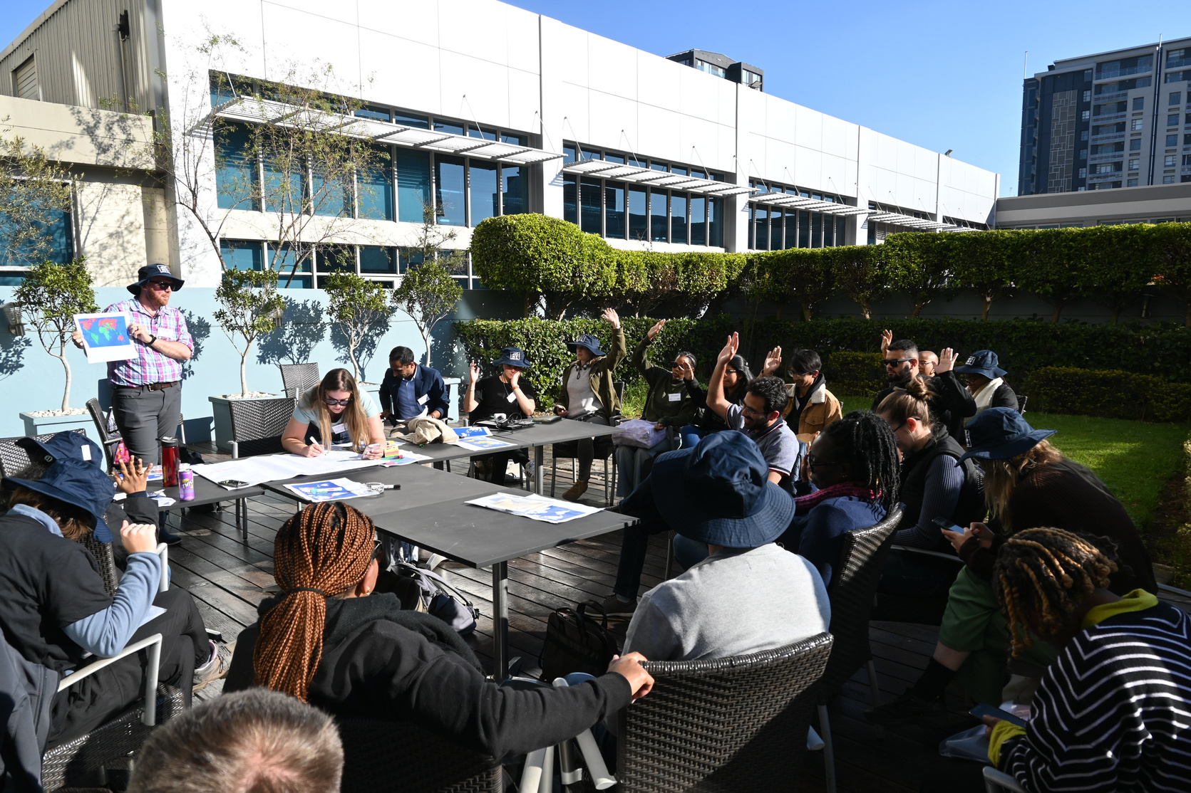
Voting process for disputed countries
9

Slide 10
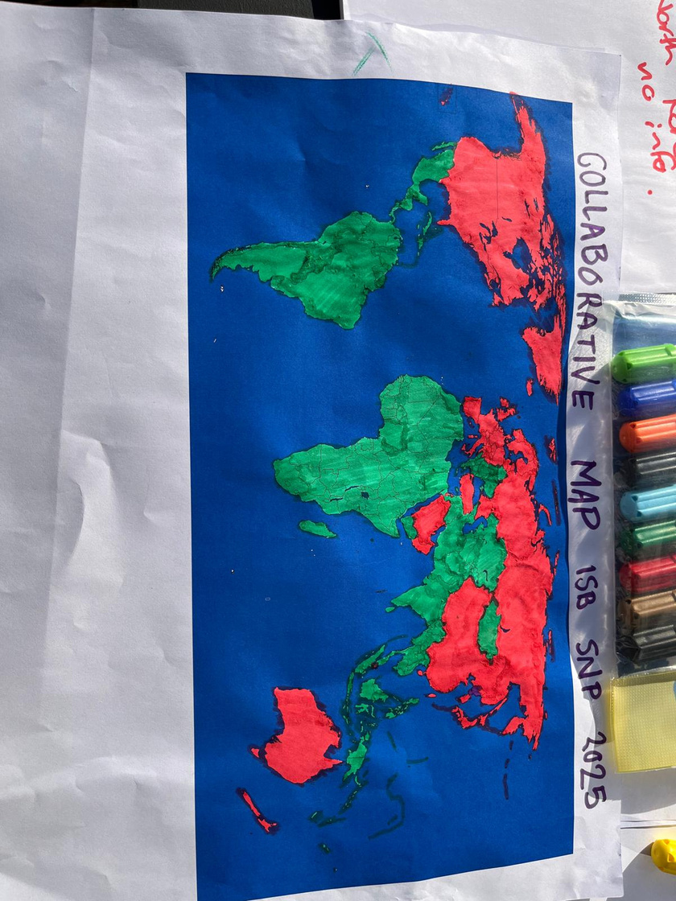
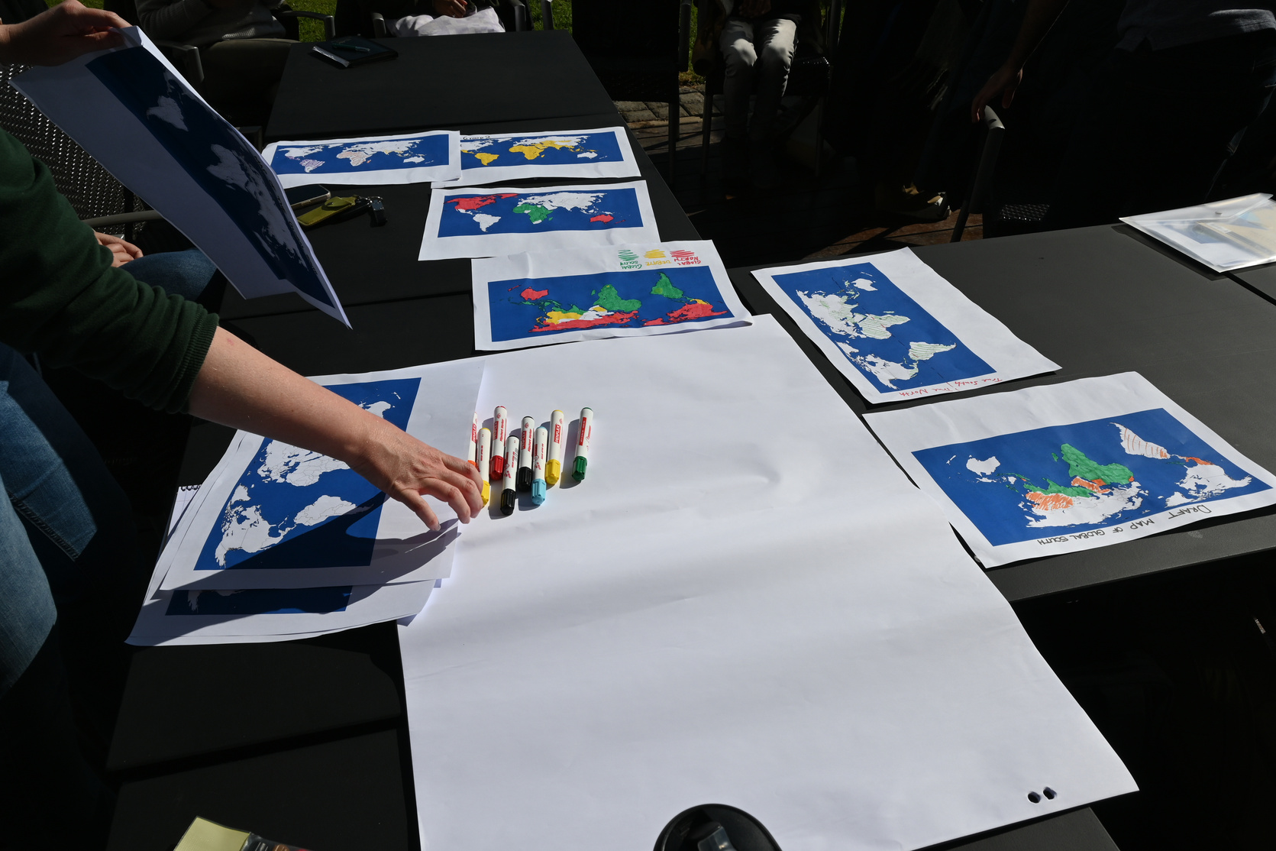
Map colouring
*Not the final map.
10

Slide 11
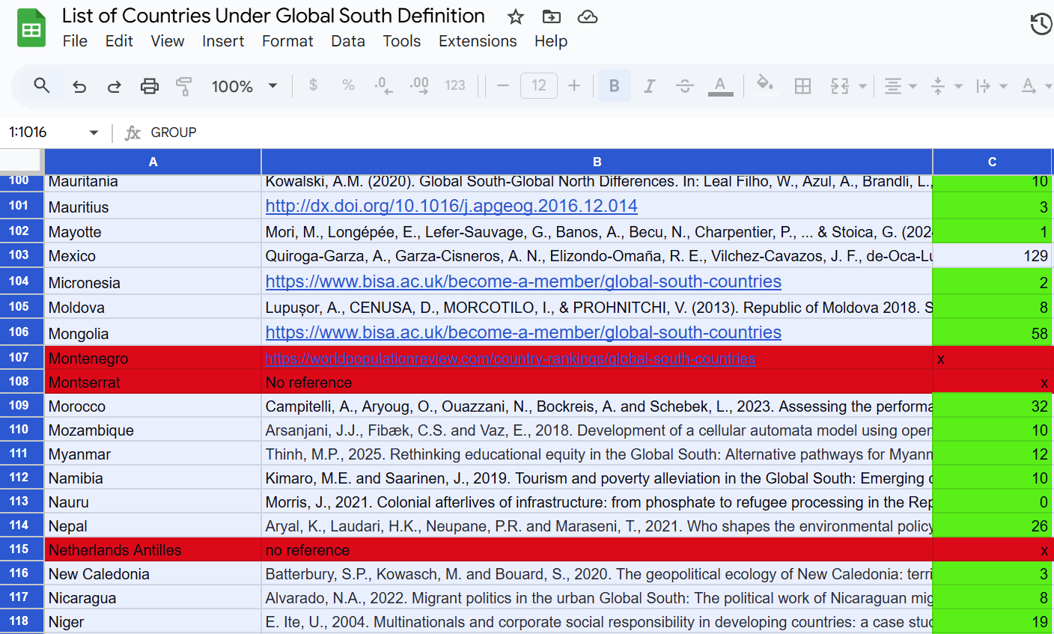
*Not the full list.
11

Slide 12
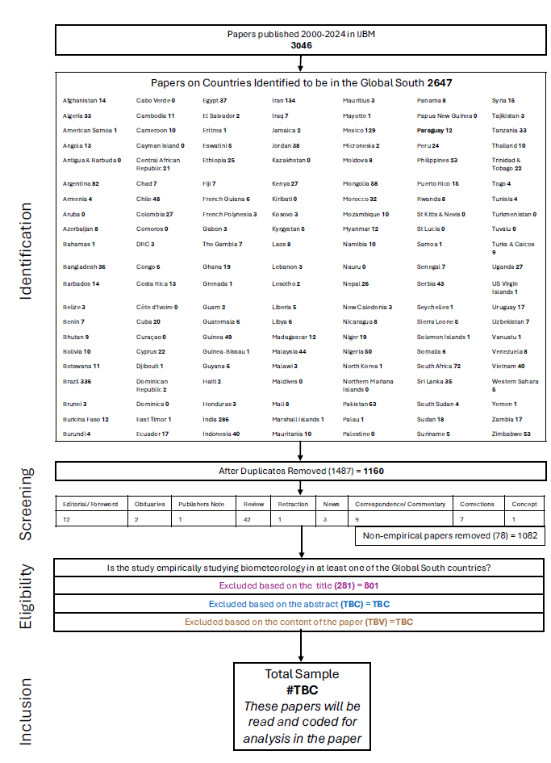
Next Steps
Continued screening of paper titles, abstracts, and manuscript
Detailed annotation of the type of research in the Global South
Case study, city whole country, region, etc.
Biometeorology sub-discipline
Local researchers vs. “parachuting research”
12

Slide 13
Future directions
Determined effort should be undertaken to conduct thorough consideration of biometeorological research in the Global South.
Identification of the current knowledge, barriers, obstacles and limitations to existing biometeorological research in the Global South.
13

Slide 14
Future directions
Awareness of bias and tendencies to use these opportunities for individual gain and career advancement, leading to new forms of extractive research.
Global South researchers and institutions as leaders of proposal thorugh funding and beyond is essential (Makoni, 2020).
Recognition from the Global North that alternative epistemologies are not inherently less than (or better than) traditional academic and scientific epistemology.
14

Slide 15
Future directions
Call for Global North researchers and scientific bodies to dedicate time, energy and resources to collaboratively learn the context and lived experiences
Call for collaboration with Global South researchers to train Global South early career researchers
Dedicated resources and instrumentation to be used and established permanently with Global South researchers.
15

Slide 16
References
“Souths in the geographic North and Norths in the geographic South” - Mahler AG (2017) Global South. Oxford Bibliographies. https://doi. org/10.1093/OBO/9780190221911-0055
Themrise Khan, Seye Abimbola, Catherine Kyobutungi, Madhukar Pai - How we classify countries and people—and why it matters: BMJ Global Health 2022;7:e009704. https://doi.org/10.1136/bmjgh-2022-009704
Haelewaters D, Hofmann TA, Romero-Olivares AL (2021) Ten simple rules for global north researchers to stop perpetuating helicopter research in the Global South. PLoS Comput Biol 17:e1009277. https://doi.org/10.1371/journal.pcbi.1009277
Molosi-France K, Makoni S (2020) A partnership of un-equals: Global South–North Research Collaborations in higher education institutions. ModAfr 8:9–24. https://doi.org/10.26806/modafr.v8i2.343
Hughes AC, Than KZ, Tanalgo KC et al (2023) Who is publishing in ecology and evolution? The underrepresentation of women and the Global South. Front Environ Sci 11. https://doi.org/10.3389/fenvs.2023.1211211
Amano T, Ramírez-Castañeda V, Berdejo-Espinola V et al (2023) The manifold costs of being a non-native English speaker in science. PLoS Biol 21:e3002184. https://doi.org/10.1371/journal.pbio.3002184
Sheridan SC, Allen MJ (2017) Sixty years of the International Journal of Biometeorology. Int J Biometeorol 61:3–10. https://doi.org/10.1007/s00484-017-1366-5
Pfeifer W (2022) From nothing about us without us to nothing without us. https:/www.ndi.org/our-stories/nothing-about-us-without-us-nothing-without-us. Accessed 14 Feb 2024
Mahler AG (2017) Global South. Oxford Bibliographies. https://doi.org/10.1093/OBO/9780190221911-0055
16

Slide 17



Thanks!
Peter Crank
peter.crank@uwaterloo.ca
17
Notes:
Thank you to the Tromp Foundation, the International Society of Biometeorology, the South African National Research Foundation and the University of the Witwatersrand.
Thank you for listening and would love to discuss how the urban climate community might consider this call to action.

