Slide 1
Supplementary material for
“Assimilating crowdsourced weather data into urban climate models: a fast geostatistical framework using scalable Gaussian processes”
Zachary D. Calhoun, Mike Bergin, David Carlson

Slide 2
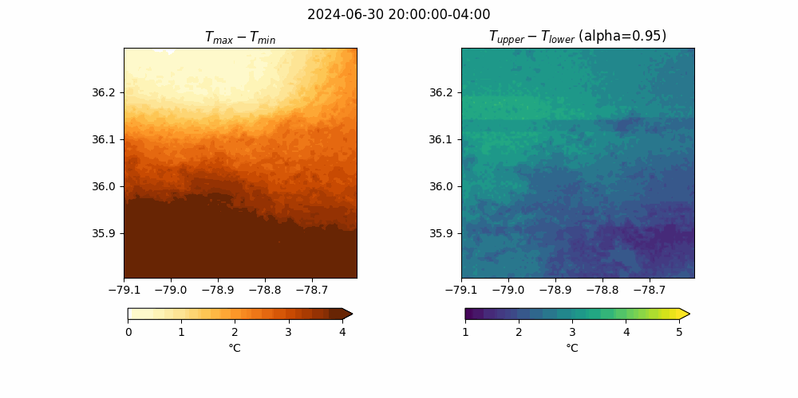
Here, we demonstrate the model estimates in July 2024, which was the month with most variability.

Slide 3
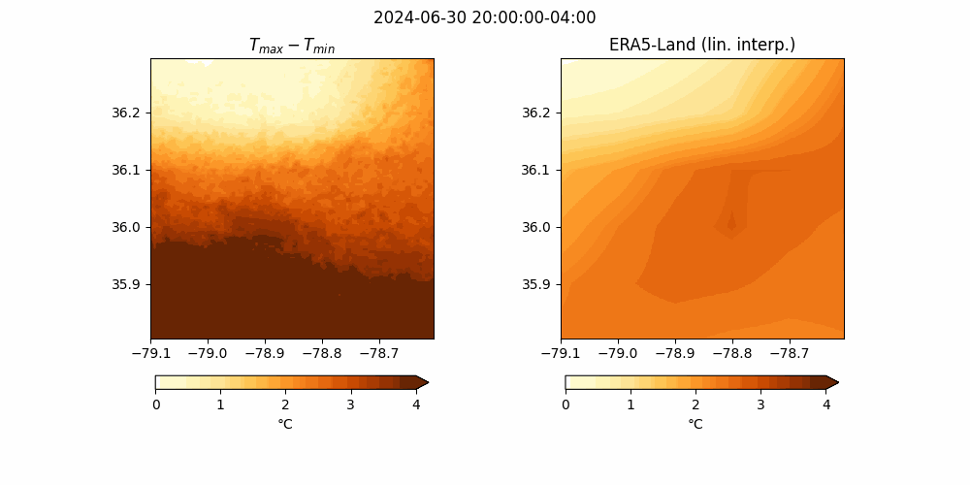
We show the difference between the learned model and the base ERA5-Land data.

Slide 4

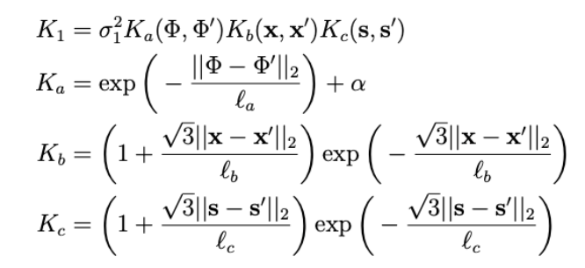
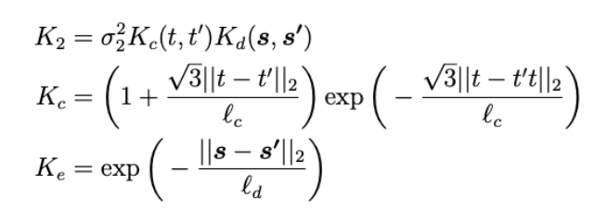
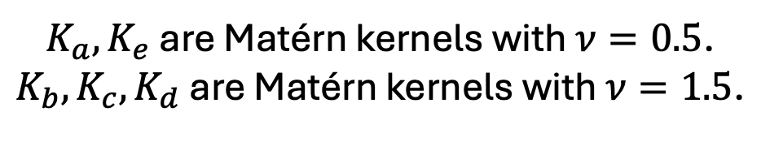
Details on kernel definition
$K_{a}, K_{e}$ are Matérn kernels with $ν=0.5$.
$K_{b}, K_{c}, K_{d}$ are Matérn kernels with $ν=1.5$.

Slide 5
Overview of sparse variational Gaussian processes with PLL loss
With 1000s of points, we approximate the function and noise using a set of 10 inducing points.
PLL loss allows us to model heteroscedasticity (standard does not).
Probabilistic model learned using variational inference.

Slide 6
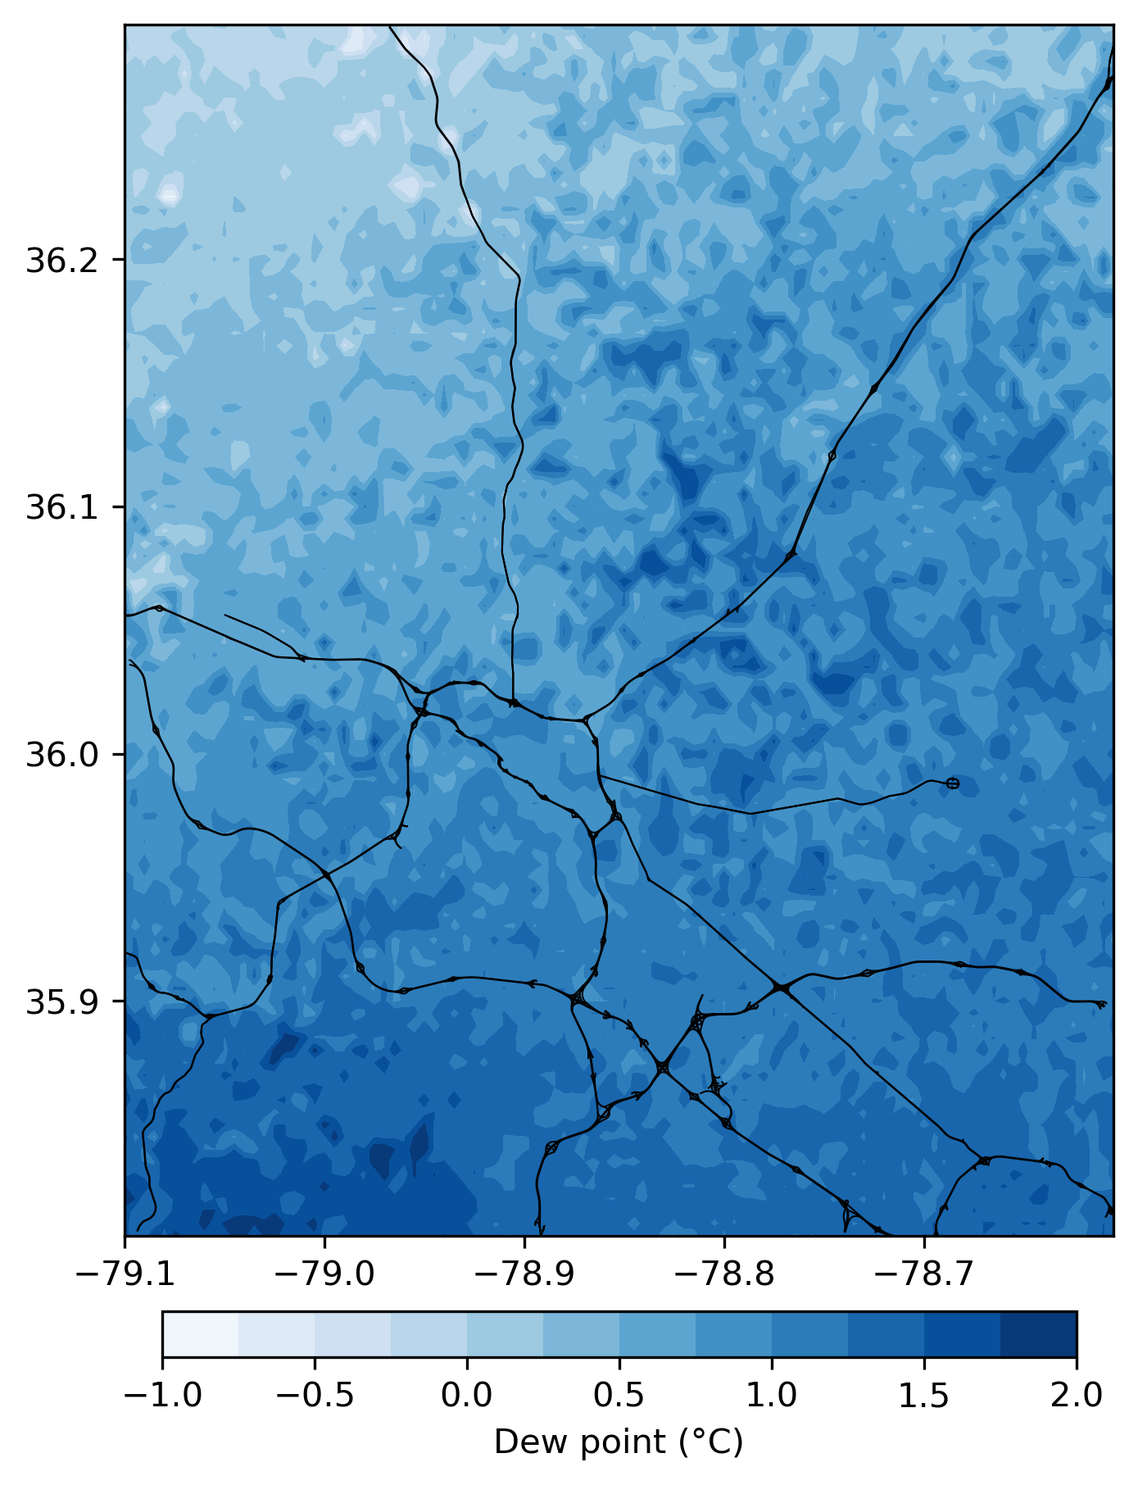
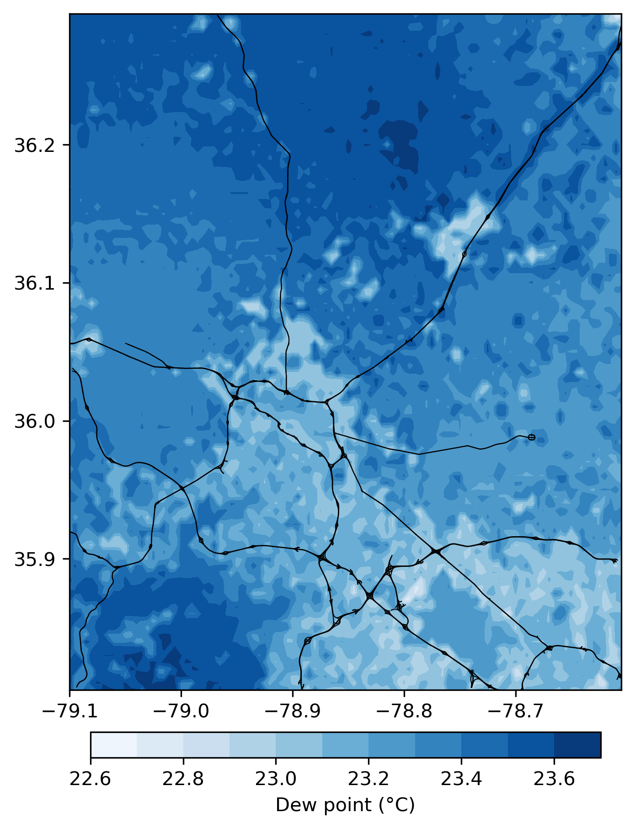
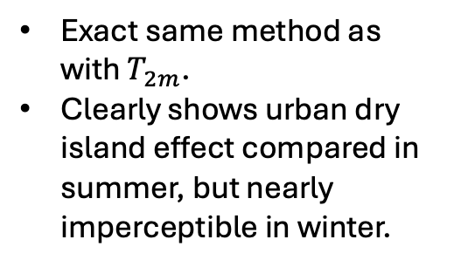
Application to Dew Point
January mean dew point
July mean dew point
Exact same method as with $T_{2m}$.
Clearly shows urban dry island effect compared in summer, but nearly imperceptible in winter.

