Slide 1
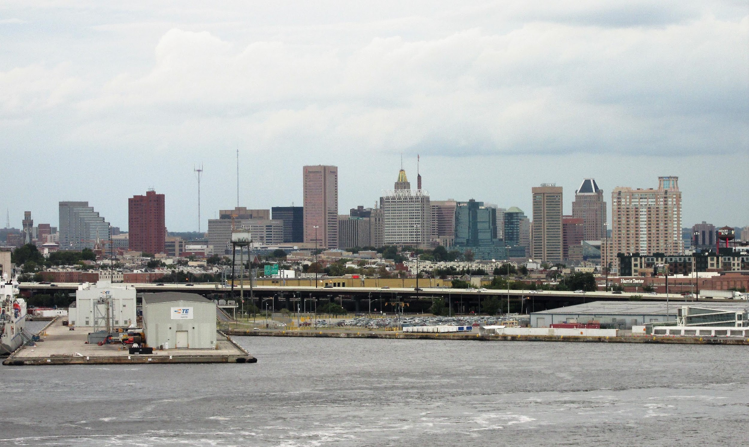




CoURAGE! The Coast-Urban-Rural Atmospheric Gradient Experiment
ICUC12-507
Kenneth Davis and the CoURAGE Science Team
CoURAGE website: https://arm.gov/research/campaigns/amf2024courage
Coastal-Urban Climate & Weather Processes
12th International Conference on Urban Climate Rotterdam, The Netherlands
7 to 11 July 2025

Slide 2
The CoURAGE science team…an actively evolving list.
Kenneth Davis, The Pennsylvania State University, Principal Investigator
Benjamin Zaitchik, Benjamin Ahlswede, Akua Asa-Awuku, Sunil Baidar, John Bilberry, Elie Bou-Zeid, Christopher Boxe, W. Alan Brewer, Sen Chiao, Richard Damoah, Peter DeCarlo, Belay Demoz, Russ Dickerson, Eliott Foust, Marco Giometto, Jorge Gonzalez-Cruz, Jason Horne, Michael Jensen, Gill-Ran Jeong, Chongai Kuang, Katia Lamer, Kelly Lombardo, Xiaowen Li, Julie Lundquist, Benjamin Nault, Dev Niyogi, Edward Strobach, Ying Pan, Sandip Pal, Jean Carlos Pena, Kaitlyn Potucek, Heath Powers, Nicholas Prince, Juarez Viegas Silva, Madhusmita Swain, Paul Walter, Darryn Waugh, Jie Zhang
Johns Hopkins University, The Pennsylvania State University, University of Maryland, National Oceanographic and Atmospheric Administration, Lawrence Livermore National Lab, Princeton University, Howard University, Morgan State University, University of Maryland Baltimore County, Columbia University, University at Albany, University of Texas, Brookhaven National Laboratory, Texas Tech University, St. Edward’s University

Slide 3
My objectives for this presentation:
Publicize and describe CoURAGE.
CoURAGE is in progress - we are just over half way through a year-long field campaign.
Seek collaborators and data users.
We actively seeks investigators who want to join our science team. This is how the US DOE ARM program designs their mobile facility deployments.
The data set will (we believe) be remarkable.
The data set is open to the public.
International collaboration would be most welcome.

Slide 4
Outline
Background information
A description of the CoURAGE campaign
Some preliminary results
Information about how you can get involved

Slide 5
Outline
Background information
A description of the CoURAGE campaign
Some preliminary results
Information about how you can get involved

Slide 6
What is CoURAGE?

Slide 7
CoURAGE: The Coast-Urban-Rural Atmospheric Gradient Experiment
A deployment of DOE’s Atmospheric Radiation Measurement Mobile Facility to Baltimore.
A complement to the Baltimore Social-Environmental Collaborative (BSEC), a DOE Urban Integrated Field Laboratory (UIFL).
Davis et al., 2024. Published science plan.
https://www.arm.gov/publications/programdocs/DOE-SC-ARM-24-016.pdf

Slide 8
This raises more questions…
What is the Baltimore Social-Environmental Collaborative (BSEC)?
Why Baltimore?
What is the US Department of Energy’s (DOE) Atmospheric Radiation Measurement Mobile Facility (AMF)?
How does a DOE AMF deployment work?

Slide 9
This raises more questions…
What is the Baltimore Social-Environmental Collaborative (BSEC)?
Why Baltimore?
What is the US Department of Energy’s (DOE) Atmospheric Radiation Measurement Mobile Facility (AMF)?
How does a DOE AMF deployment work?
This is complex even for a US scientific audience in normal times.

Slide 10
This raises more questions…
What is the Baltimore Social-Environmental Collaborative (BSEC)?
Why Baltimore?
What is the US Department of Energy’s (DOE) Atmospheric Radiation Measurement Mobile Facility (AMF)?
How does a DOE AMF deployment work?

Slide 11
What is BSEC?
The U.S. Department of Energy requested proposals for integrated urban observation and modeling systems that will inform solutions that can strengthen community-scale climate resilience.

Slide 12

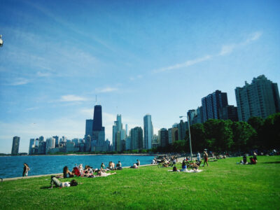
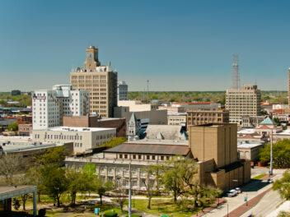
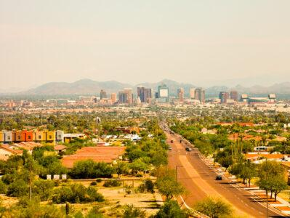
What is BSEC?
Baltimore was selected, along with three other urban areas
Baltimore
Chicago
Beaumont - Port Arthur
Phoenix -Tucson - Flagstaff
These were conceived as 5-year investigations. We are in year 3.

Slide 13
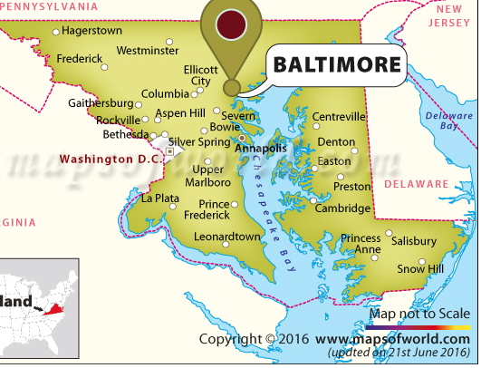
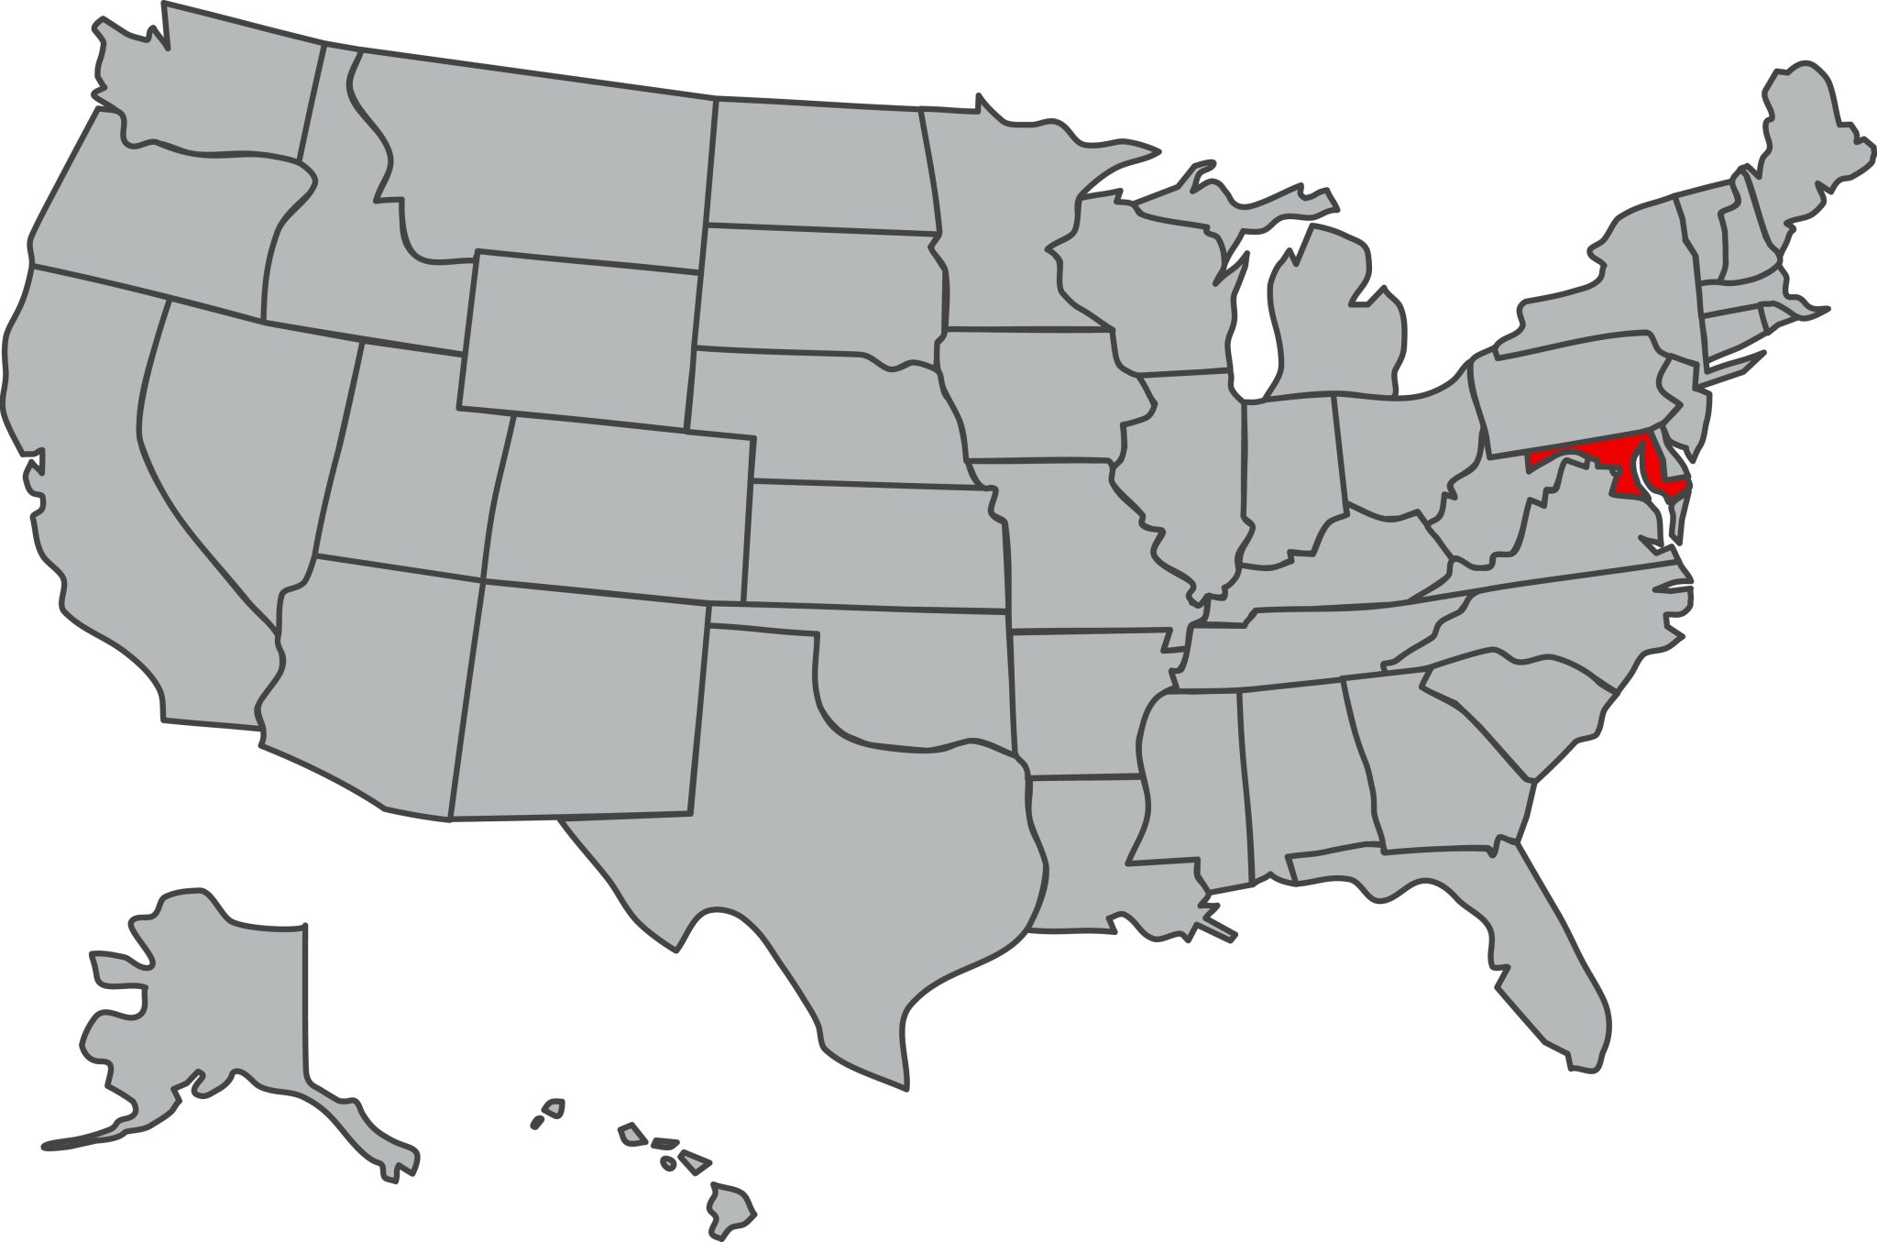
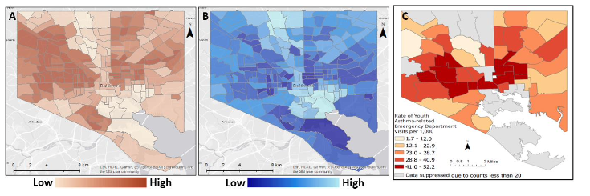

Why Baltimore?
Challenges indicative of many eastern cities in the USA: Flat or declining population, severe economic constraints, segregation and inequity, aging infrastructure, increasing wet and hot climate extremes.
Maryland
% Minority Income Asthma Rates
Opportunities: A time of reinvestment and reinvention, space for new initiatives, energy to create new models of urbanism.
Baltimore Social-Environmental Collaborative Urban Integrated Field Lab
https://21cc.jhu.edu/research/bsec

Slide 14
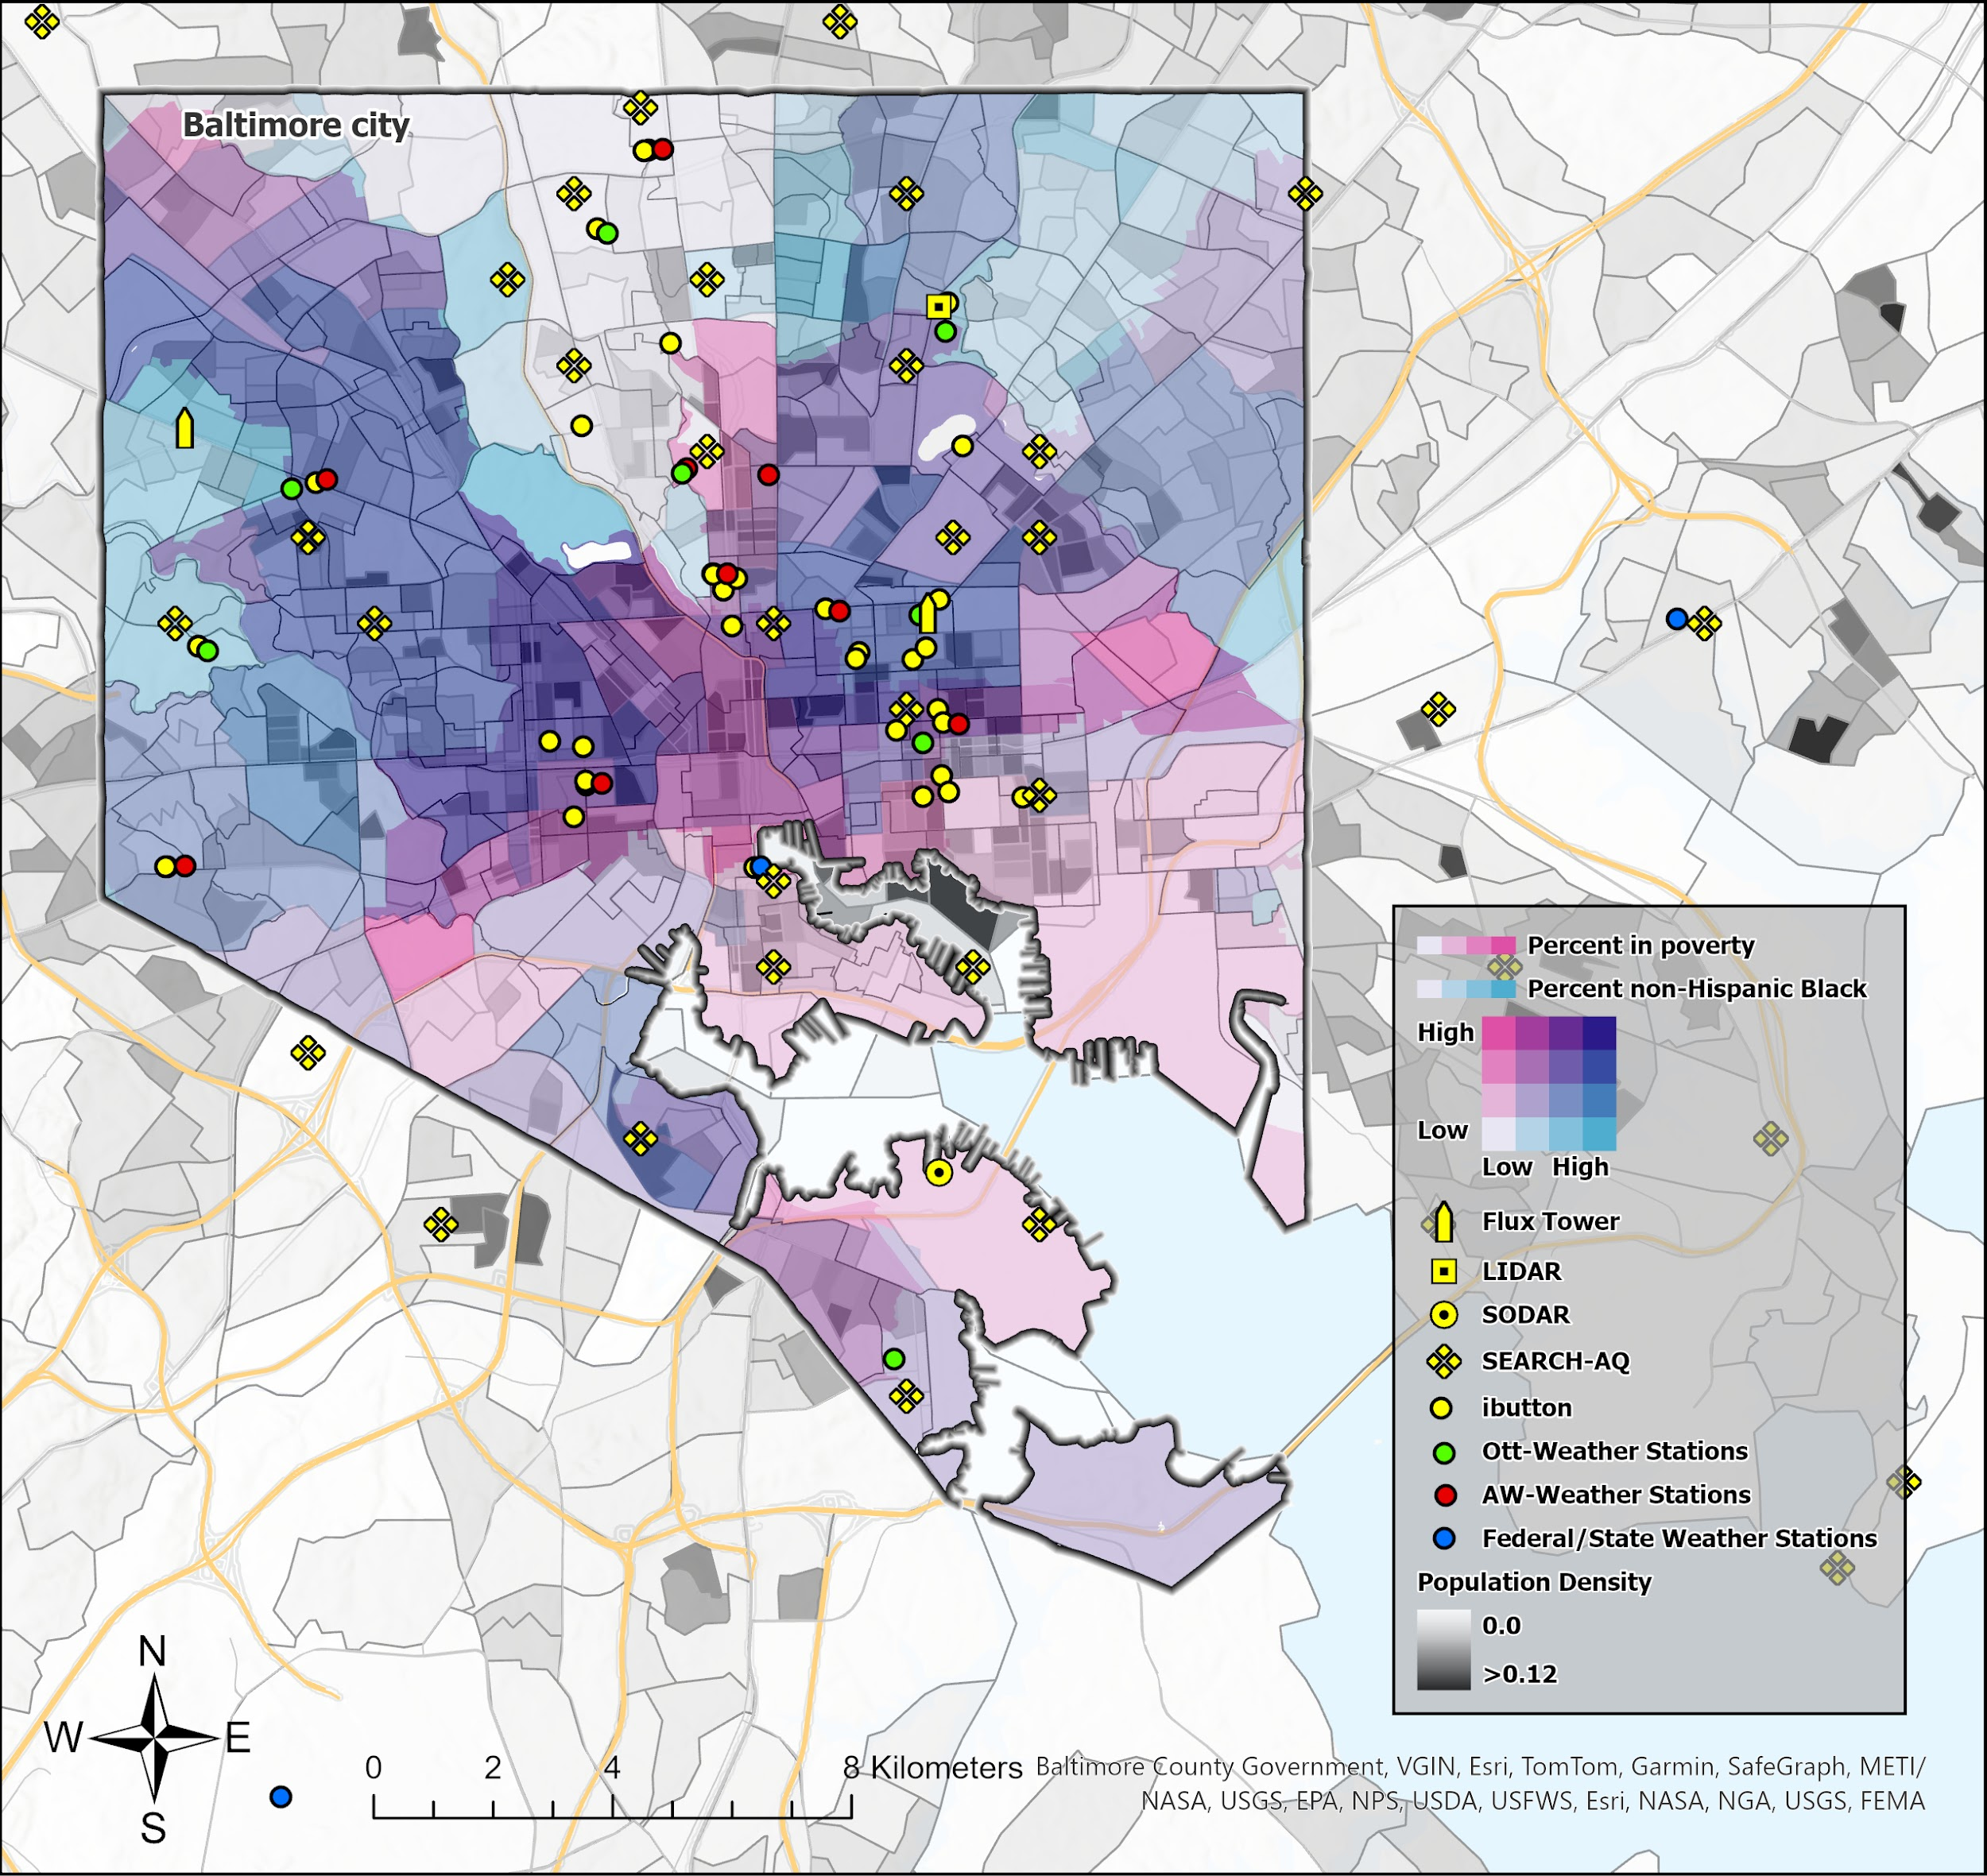
BSEC is powerfully interdisciplinary
BSEC science themes
Air Quality
Atmospheric Dynamics
Buildings & Energy
Decision Science
Biogeochemistry
Health
Transportation
Vegetation & Soils
Water & Water Quality
Map credit: Jason Horne
Baltimore Social-Environmental Collaborative Urban Integrated Field Lab
https://21cc.jhu.edu/research/bsec

Slide 15
The BSEC Mission
The Baltimore Social Environmental Collaborative will generate the science needed for informed pathways to energy security and extreme weather resilience in Baltimore
Ben Zaitchik, Johns Hopkins University, Principal Investigator
zaitchik@jhu.edu
Baltimore Social-Environmental Collaborative Urban Integrated Field Lab
https://21cc.jhu.edu/research/bsec

Slide 16
BSEC presentations at ICUC12
The Baltimore Social-Environmental Collaborative integrated urban observing system
Kenneth Davis and the Baltimore Social-Environmental Collaborative Science Team
Presented by W. Eliott Foust
Mon, 07 Jul, 12:15-12:30 (CEST) | Room Leeuwen 1
CoURAGE! The Coast-Urban-Rural Atmospheric Gradient Experiment
Kenneth Davis and the CoURAGE Science Team
Tue, 08 Jul, 09:10–09:25 (CEST) | Room Penn 2
What Is the Impact of Turfgrass on Urban Carbon Dioxide Fluxes?
Jason Horne et al
Tue, 08 Jul, 09:45–10:00 (CEST) | Room Leeuwen 1
Evaluating an Atmospheric Dynamic Downscaling Approach from Mesoscale to the Neighborhood Scale Using Large-Eddy Simulations
Jason Horne, Ying Pan, and Kenneth Davis
Wed, 09 Jul, 16:15–16:30 (CEST) | Room Rotterdam 1

Slide 17
More BSEC presentations at ICUC12
A Realistic Approach to Urban Climate Mitigation with WRF: Modeling Local and Practical Solutions
W. Eliott Foust et al
Thu, 10 Jul, 09:15–09:30 (CEST) | Room Rotterdam 1
The Baltimore community-based weather station network: Filling the urban measurement desert
Darryn Waugh and the BSEC Science Team
Thu, 10 Jul, 12:30–12:45 (CEST) | Room Mees 2
The Baltimore Social-Environmental Collaborative (BSEC): Equitable solutions for climate adaptation in Baltimore City
Benjamin Zaitchik and Darryn Waugh and the BSEC Science Team
Thu, 10 Jul, 14:00–14:15 (CEST) | Room Penn 2
Estimating and evaluating roughness length and displacement height in heterogeneous urban environments
Jason Horne, Ying Pan, and Kenneth Davis
Thu, 10 Jul, 14:15–14:30 (CEST) | Room Mees 2

Slide 18
This raises more questions…
What is the Baltimore Social-Environmental Collaborative (BSEC)?
Why Baltimore?
What is the US Department of Energy’s (DOE) Atmospheric Radiation Measurement Mobile Facility (AMF)?
How does a DOE AMF deployment work?

Slide 19
The US DOE’s Atmospheric Radiation Measurement facilities…
Have been deployed on all seven continents and five oceans,
Include three permanent and three mobile facilities, and
Provide primarily ground-based, in situ and remote sensing observations of the atmosphere - including clouds, radiation, precipitation, atmospheric composition and boundary layer processes.
Their objective: Understand and improve modeling of cloud-climate feedbacks across the globe.
https://www.arm.gov

Slide 20
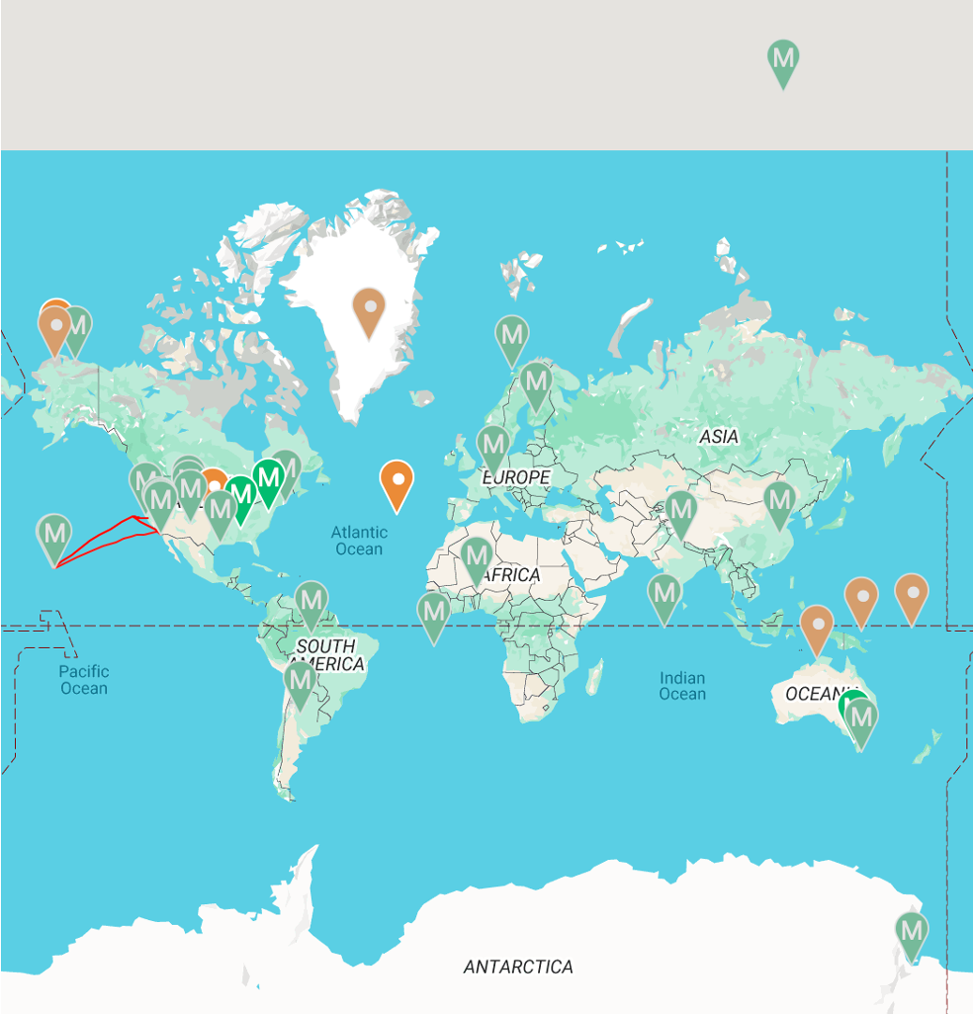
US DOE
ARM Facility deployments.
Orange = long-term
Green M = mobile
Bright = current.
Faded = past
Two deployments have been urban: Houston (TRACER) and Baltimore (CoURAGE).

Slide 21
This raises more questions…
What is the Baltimore Social-Environmental Collaborative (BSEC)?
Why Baltimore?
What is the US Department of Energy’s (DOE) Atmospheric Radiation Measurement Mobile Facility (AMF)?
How does a DOE AMF deployment work?

Slide 22
How does a DOE AMF deployment work?
A base of scientific capacity must exist (e.g. BSEC).
A proposal for deployment is solicited and a response is selected.
US DOE ARM deploys and operates the instruments and delivers data.
US DOE Atmospheric Systems Research (ASR) solicits proposals to work with the data.
The science team is asked to generate additional research interest in the observations to expand the utility of the observations.

Slide 23
Outline
Background information
A description of the CoURAGE campaign
Some preliminary results
Information about how you can get involved

Slide 24
CoURAGE: The Coast-Urban-Rural Atmospheric Gradient Experiment
A deployment of DOE’s Atmospheric Radiation Measurement Mobile Facility to Baltimore.
A complement to the Baltimore Social-Environmental Collaborative (BSEC), a DOE Urban Integrated Field Laboratory (UIFL).
Davis et al., 2024. Published science plan.
https://www.arm.gov/publications/programdocs/DOE-SC-ARM-24-016.pdf

Slide 25
BSEC is observing Baltimore’s boundary layer, the surface climate and urban air quality
CoURAGE measures the coupled land-ABL-cloud-radiation-atmospheric composition-precipitation system in the city of Baltimore.
And explores how Baltimore’s atmospheric environment depends on its complex surroundings.

Slide 26
Four Nodes of CoURAGE
AMF1 Main Facility in Baltimore. Urban focus area.
Ancillary sites that measure critical boundary environments for the city of Baltimore:
AMF1 Ancillary site at Mt. Airy – Rural background to the northwest
AMF1 Ancillary site on Kent Island – Chesapeake Bay to the southeast
Howard/MDE site in Beltsville – urban background to the southwest

Slide 27
Why Baltimore?
Challenges indicative of many eastern cities in the USA: Flat or declining population, severe economic constraints, segregation and inequity, aging infrastructure, increasing wet and hot climate extremes.
Maryland
% Minority Income Asthma Rates
Opportunities: A time of reinvestment and reinvention, space for new initiatives, energy to create new models of urbanism.
Baltimore Social-Environmental Collaborative Urban Integrated Field Lab
https://21cc.jhu.edu/research/bsec

Slide 28
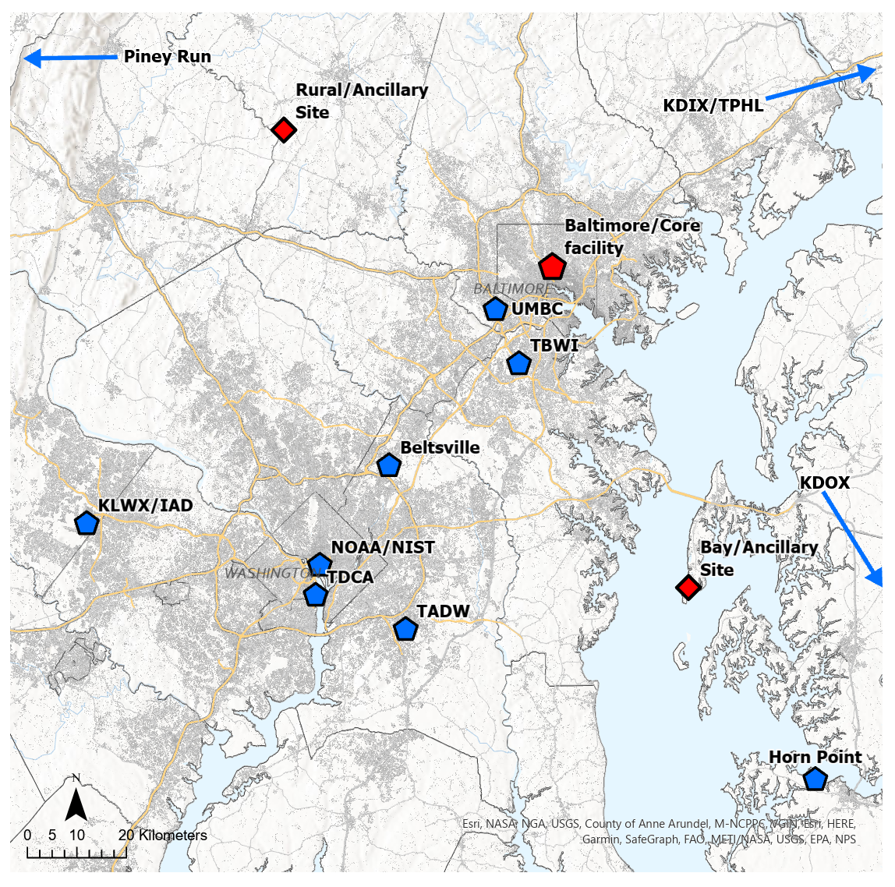
Circled locations are the 4 nodes of CoURAGE.
ARM ENHANCES measurements within Baltimore, especially clouds, radiation, and precipitation.
ARM CREATES rural and bay ancillary observations.
Red = ARM MF
Blue = BSEC or other existing observations.
December, 2024 – November, 2025.
TBS
Figure courtesy Jason Horne, Penn State

Slide 29
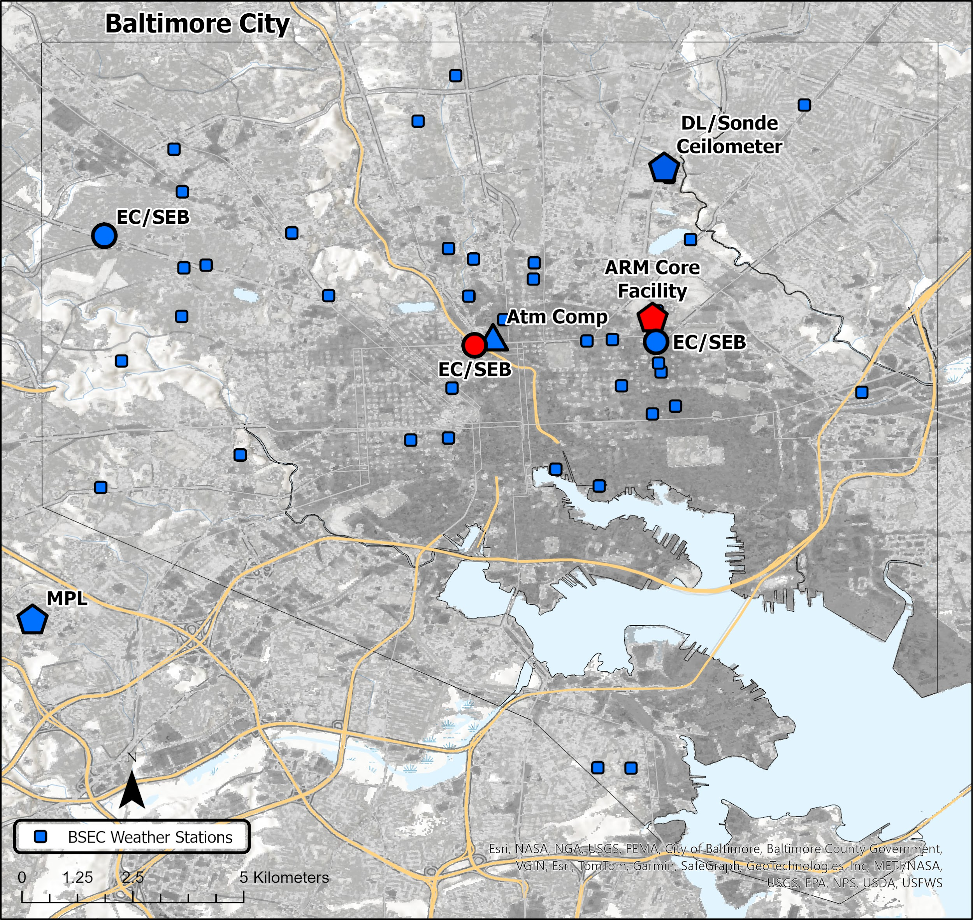
BSEC and AMF1 urban observation sites.
ARM Core facility is at Lake Clifton.
Two ARM flux towers are located on building tops to the west of the core facility.
Gray scale denotes fraction of impervious surface.
Blue = BSEC; Red = DOE-ARM
Figure courtesy Jason Horne, Penn State

Slide 30
CoURAGE objectives
Determine the dependence of Baltimore’s atmospheric environment (thermodynamics, cloud properties, surface radiation, aerosols and atmospheric composition, winds, precipitation) on the urban system vs. the environments surrounding the city. Specifically:
1. Quantify and understand the relative importance of upwind conditions and mesoscale flows vs. urban land-atmosphere interactions on Baltimore’s ABL properties.
2. Quantify and understand the relative importance of urban land-atmosphere interactions and pollutant emissions vs. upwind boundary conditions and mesoscale flows on Baltimore’s atmospheric composition and aerosols.
3. Quantify and understand the impact of urban atmospheric composition, aerosol characteristics and ABL development in the coast-urban-rural system on urban ABL cloud cover and radiation.
4. Quantify and understand the impact of the coast-urban-rural landscape on the characteristics of urban precipitation.

Slide 31
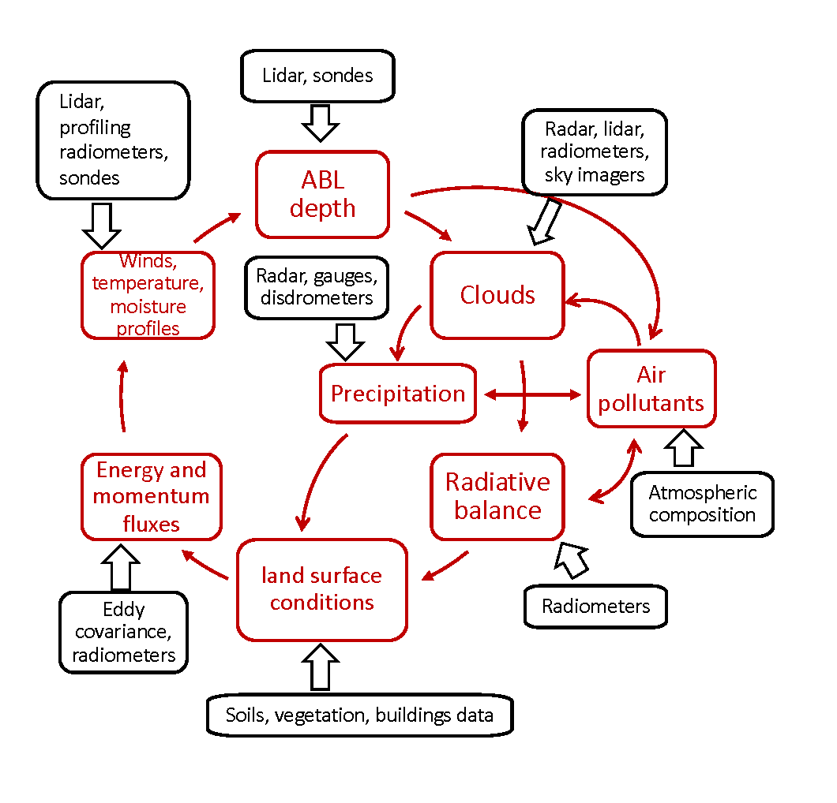
Land-atmosphere interactions to be studied by CoURAGE
Figure 4.1. ARM-MF and collaborator observations (black) will observe all components of the surface - ABL - cloud - atmospheric composition - radiation interactive system (red). These multi-state observations will enable a uniquely comprehensive study of how Coast - Urban - Rural Gradients in the Baltimore region interact to form the Baltimore atmospheric environment.

Slide 32
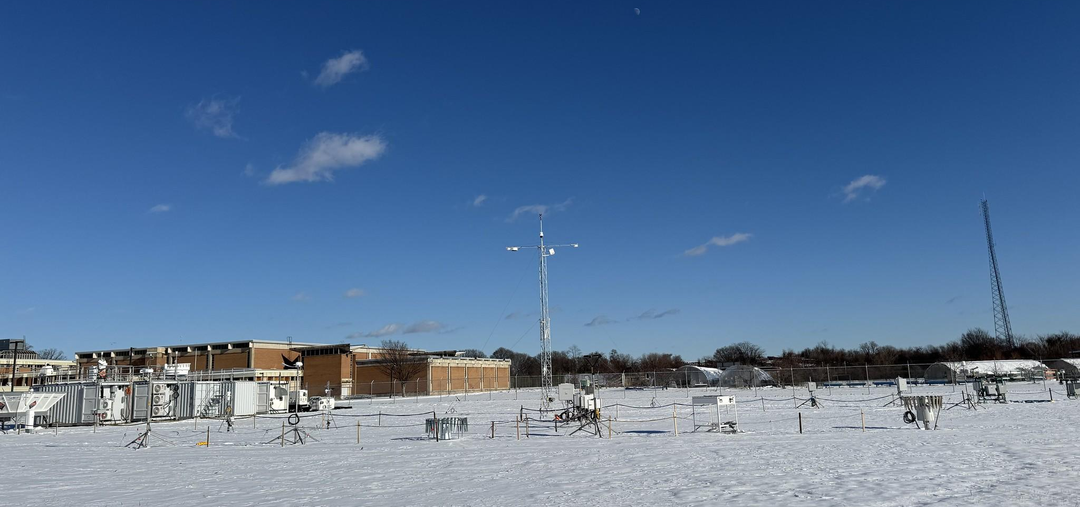
CoURAGE! The AMF1 main facility at Lake Clifton, Baltimore
Image courtesy of the U.S. Department of Energy Atmospheric Radiation Measurement (ARM) user facility.

Slide 33
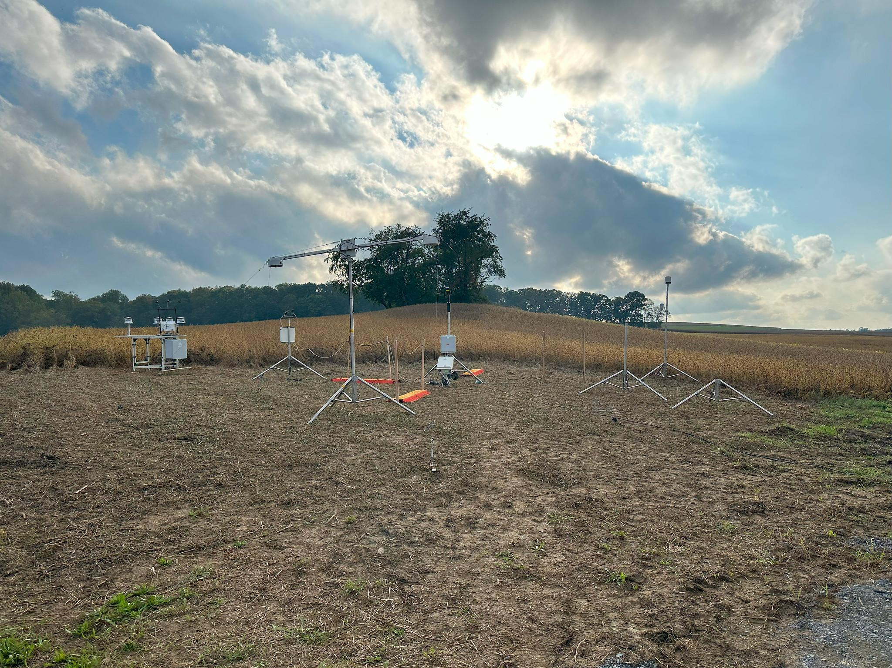
CoURAGE! The Rural ancillary site near Mt. Airy, Maryland.
Image courtesy of the U.S. Department of Energy Atmospheric Radiation Measurement (ARM) user facility.

Slide 34
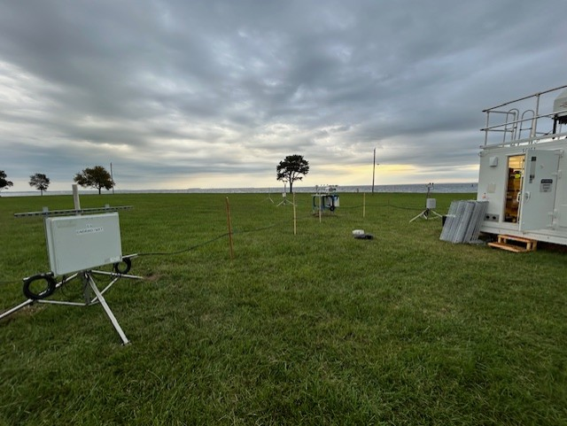
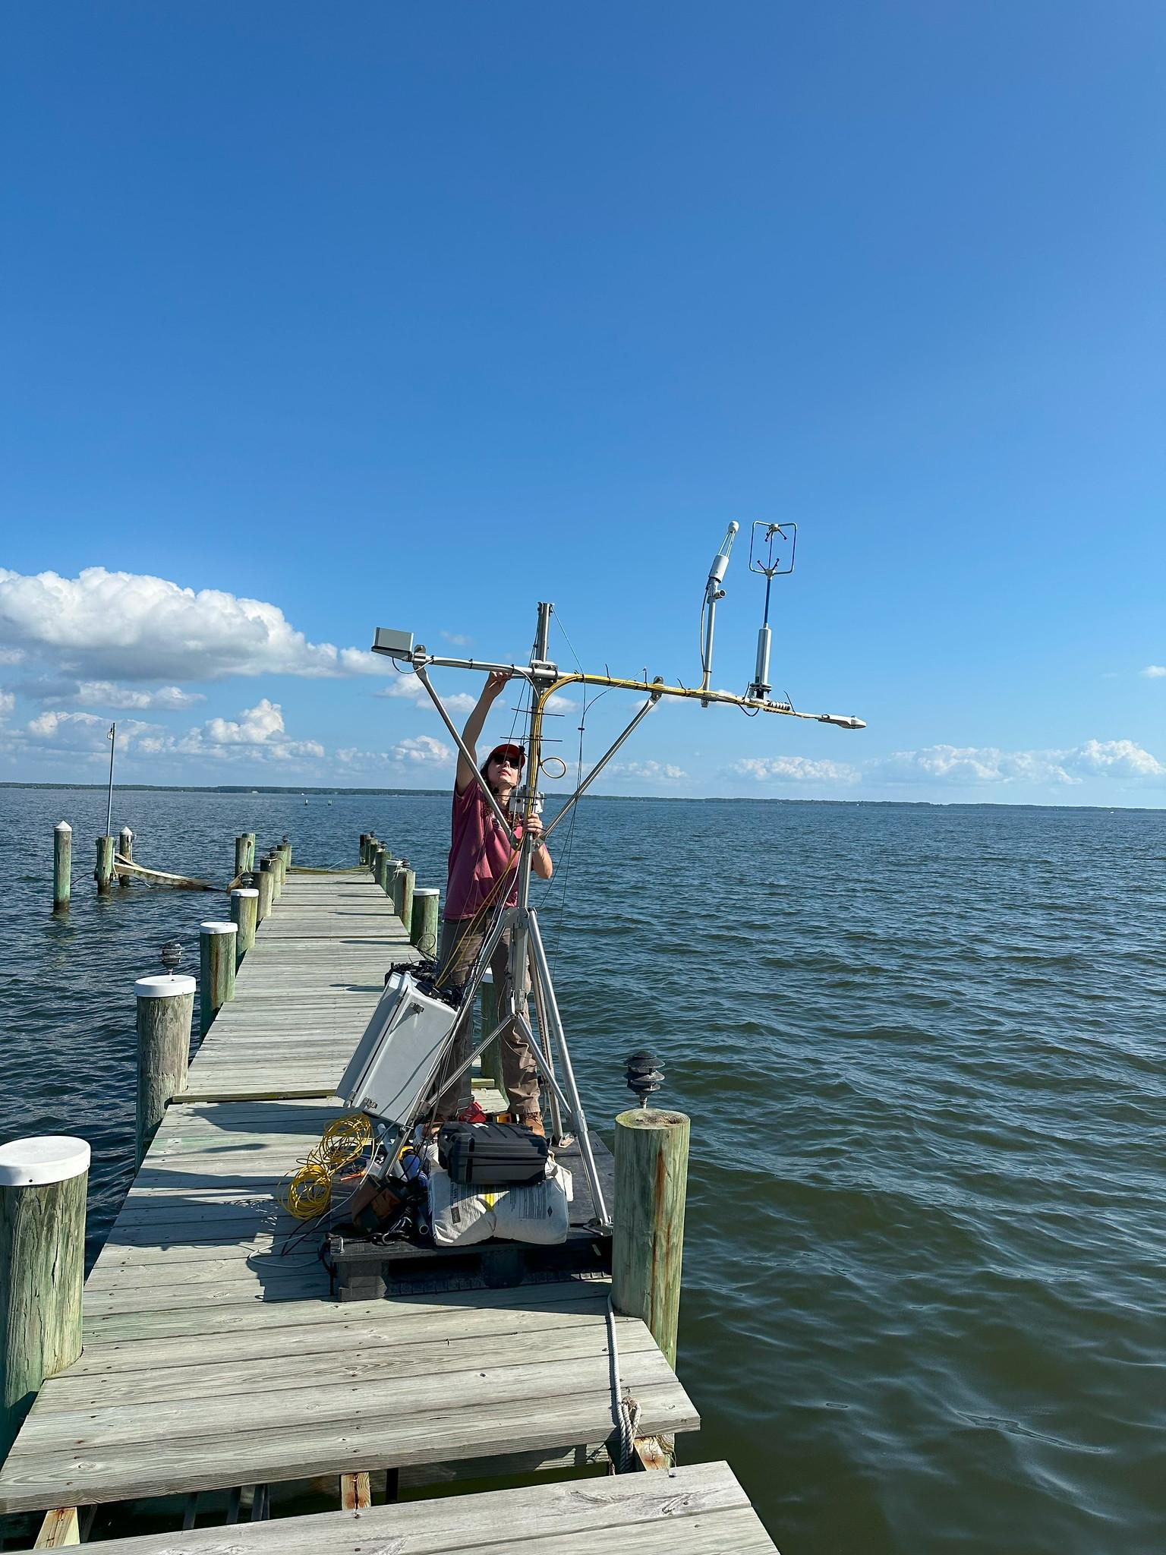
CoURAGE! The Bay ancillary site at the south end of Kent Island, Maryland.
Image courtesy of the U.S. Department of Energy Atmospheric Radiation Measurement (ARM) user facility.

Slide 35
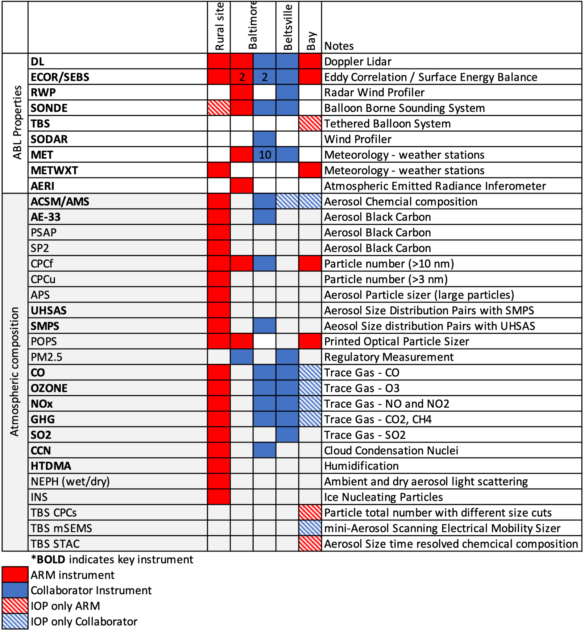
CoURAGE ABL measurements
Each node is well-equipped to measure ABL dynamics and land-atmosphere interactions.
Four IOPs! One for each season.
Two IOPs! One summer, one winter.

Slide 36
CoURAGE
Atmospheric Composition
Baltimore (BSEC instruments) and the Rural ARM site are the primary atmospheric composition observatories.
Beltsville is also fairly well instrumented and we’ll try to instrument the Bay for the summer IOP.
x

Slide 37
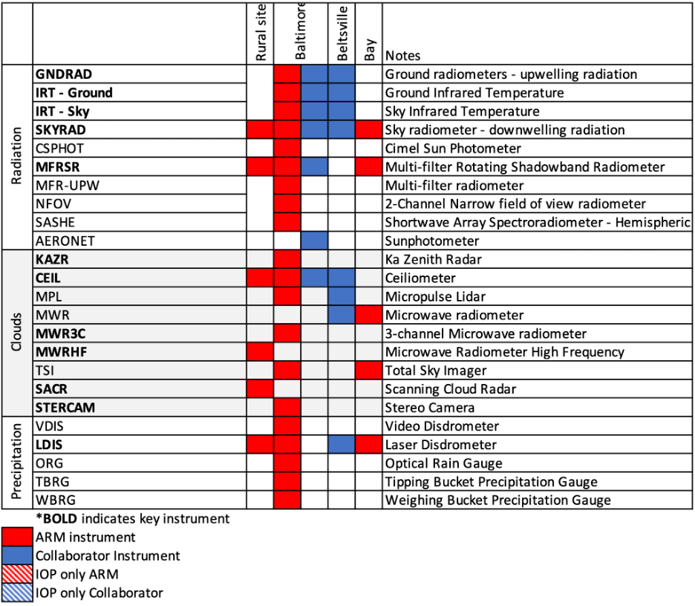
CoURAGE radiation measurements
Baltimore is the primary radiation observatory.
But recall that SEBS is deployed with ECOR at all three ARM nodes. All sites have substantial radiation data.

Slide 38
CoURAGE Clouds and Precipitation
Baltimore is the primary cloud and precipitation observatory.
But all of the ancillary sites are also well instrumented.

Slide 39
Outline
Background information
A description of the CoURAGE campaign
Some preliminary results
Information about how you can get involved

Slide 40
Some CoURAGE observations to date…
In CoURAGE we have already observed:
Continuous, direct measurements of the surface fluxes that create the urban heat island.
More elusive evidence of rural-urban differences in atmospheric boundary layer turbulence and depth driven by these surface flux gradients.
Persistent differences in urban vs. rural aerosol concentrations and composition.
Persistent rural-urban differences in boundary layer cloud cover, perhaps linked to aerosol composition and ABL depth differences.
Moderately frequent low level jets and bay breezes, sure to influence both urban air quality and urban climate.

Slide 41
Some CoURAGE observations to date…
In CoURAGE we have already observed:
Continuous, direct measurements of the surface fluxes that create the urban heat island.
More elusive evidence of rural-urban differences in atmospheric boundary layer turbulence and depth driven by these surface flux gradients.
Persistent differences in urban vs. rural aerosol concentrations and composition.
Persistent rural-urban differences in boundary layer cloud cover, perhaps linked to aerosol composition and ABL depth differences.
Moderately frequent low level jets and bay breezes, sure to influence both urban air quality and urban climate.
Example from late May, 2025

Slide 42
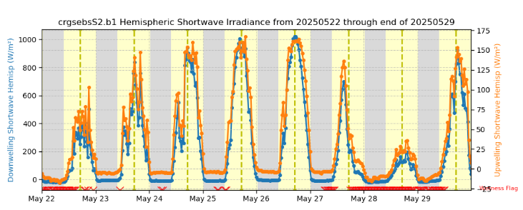
Incoming radiation:
Sunny conditions midweek

Slide 43
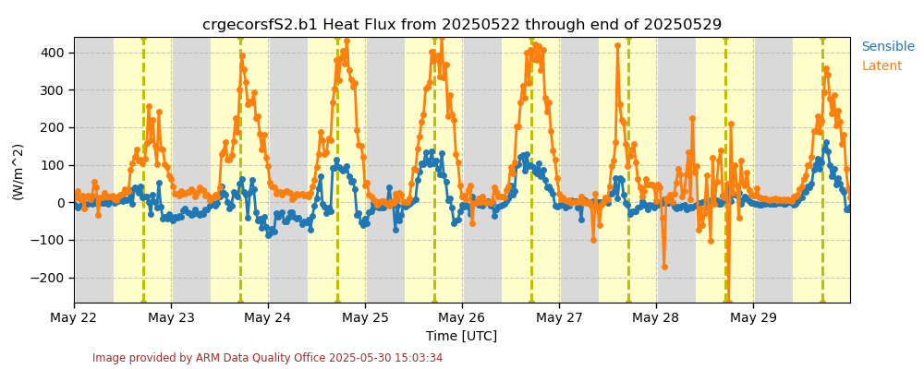
Rural energy fluxes. Bowen ratio about ¼.
Latent heat flux is large, sensible heat flux is small.

Slide 44
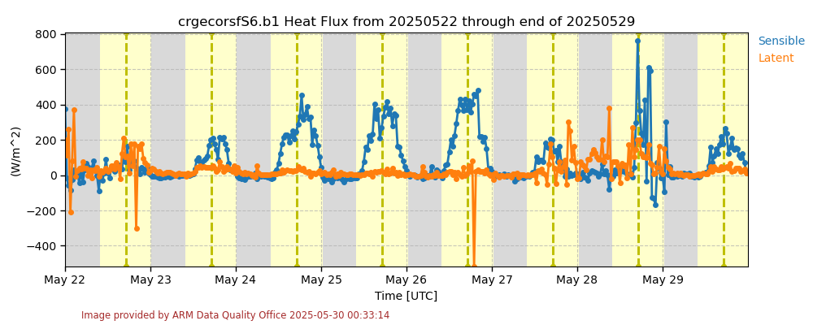
Urban energy fluxes. Bowen ratio >> 1.
Mostly sensible heat fluxes. Almost no latent heat flux.

Slide 45
Some CoURAGE observations to date…
In CoURAGE we have already observed:
Continuous, direct measurements of the surface fluxes that create the urban heat island.
More elusive evidence of rural-urban differences in atmospheric boundary layer turbulence and depth driven by these surface flux gradients.
Persistent differences in urban vs. rural aerosol concentrations and composition.
Persistent rural-urban differences in boundary layer cloud cover, perhaps linked to aerosol composition and ABL depth differences.
Moderately frequent low level jets and bay breezes, sure to influence both urban air quality and urban climate.
Example from 10 May, 2025

Slide 46
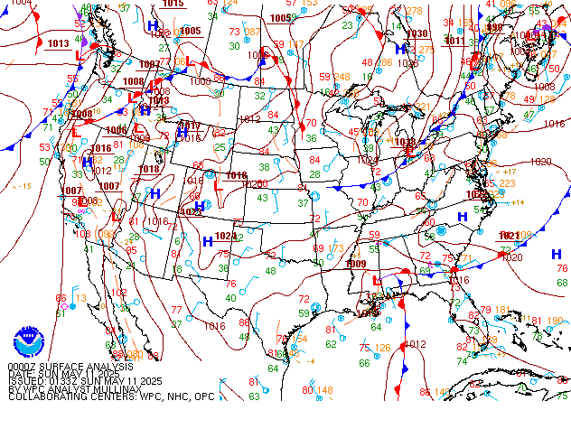
0Z 11 May.
No isobars.
High pressure.
Beginning of wind shift.

Slide 47
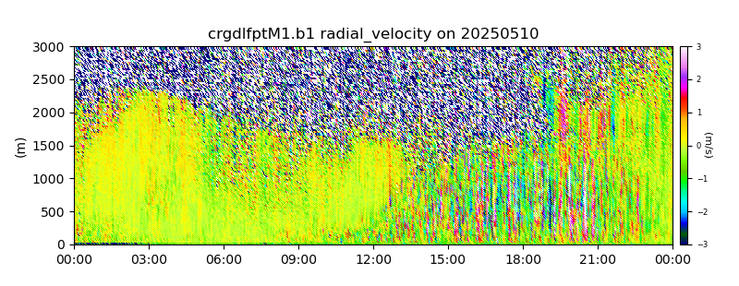
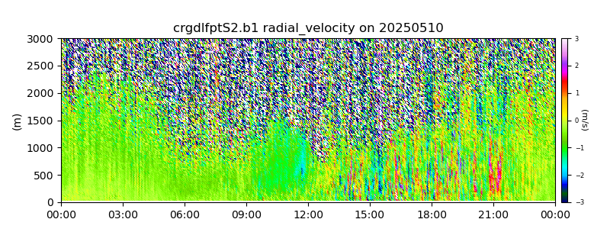
Urban daytime turbulence is stronger and deeper than in the country on a clear spring day!
Plots show vertical velocities from the Doppler lidars.
Boxed areas are turbulent boundary layer regions.
CITY
COUNTRY

Slide 48
Some CoURAGE observations to date…
In CoURAGE we have already observed:
Continuous, direct measurements of the surface fluxes that create the urban heat island.
More elusive evidence of rural-urban differences in atmospheric boundary layer turbulence and depth driven by these surface flux gradients.
Persistent differences in urban vs. rural aerosol concentrations and composition.
Persistent rural-urban differences in boundary layer cloud cover, perhaps linked to aerosol composition and ABL depth differences.
Moderately frequent low level jets and bay breezes, sure to influence both urban air quality and urban climate.
Winter 2024-2025 average

Slide 49
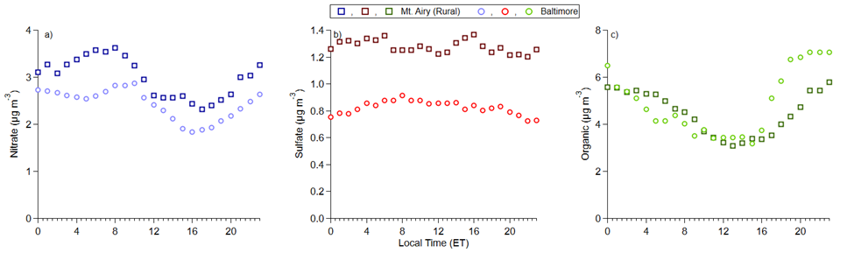
Substantial differences exist in speciated aerosols - country vs. city.
Deeper urban ABL and higher urban emissions
Deeper urban ABL
Differences in both emissions and ABL depth are likely needed to explain these differences in aerosol concentrations.
Benjamin Nault, preliminary observations and analyses.

Slide 50
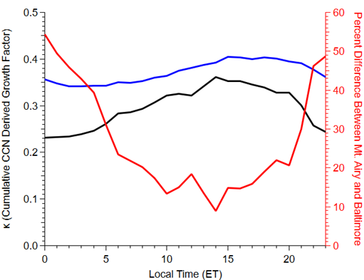
And this leads to differences in hygroscopicity
Benjamin Nault, preliminary observations and analyses.

Slide 51
Some CoURAGE observations to date…
In CoURAGE we have already observed:
Continuous, direct measurements of the surface fluxes that create the urban heat island.
More elusive evidence of rural-urban differences in atmospheric boundary layer turbulence and depth driven by these surface flux gradients.
Persistent differences in urban vs. rural aerosol concentrations and composition.
Persistent rural-urban differences in boundary layer cloud cover, perhaps linked to aerosol composition and ABL depth differences.
Moderately frequent low level jets and bay breezes, sure to influence both urban air quality and urban climate.
Example from 4 January, 2025

Slide 52
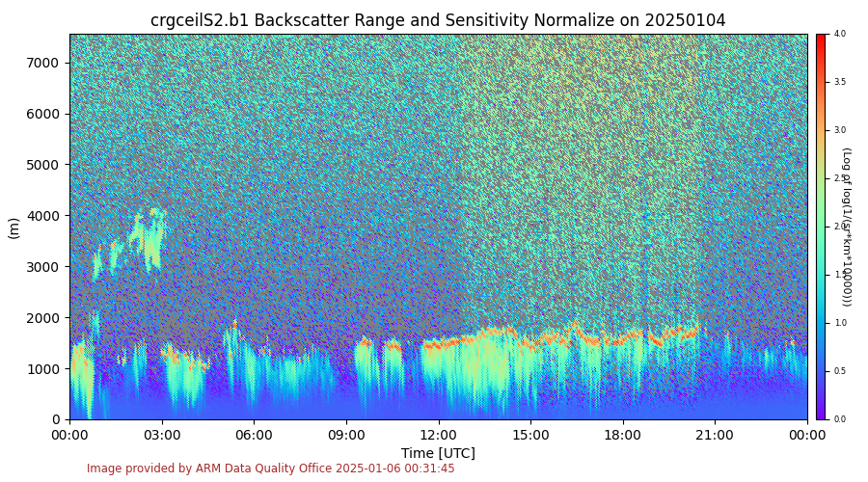
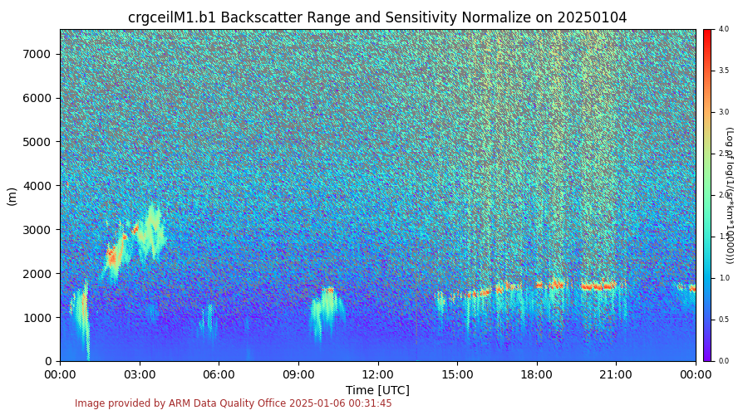
Differential ABL cloud cover potentially caused by the differences in aerosol hygroscopicity, urban vs. rural
Rural (top)
Urban (bottom)
This has been observed on many ‘fair weather’ winter days.
Ceilometer backscatter data.

Slide 53
Some CoURAGE observations to date…
In CoURAGE we have already observed:
Continuous, direct measurements of the surface fluxes that create the urban heat island.
More elusive evidence of rural-urban differences in atmospheric boundary layer turbulence and depth driven by these surface flux gradients.
Persistent differences in urban vs. rural aerosol concentrations and composition.
Persistent rural-urban differences in boundary layer cloud cover, perhaps linked to aerosol composition and ABL depth differences.
Moderately frequent low level jets and bay breezes, sure to influence both urban air quality and urban climate.
Examples from 11 May and 15 April, 2025

Slide 54
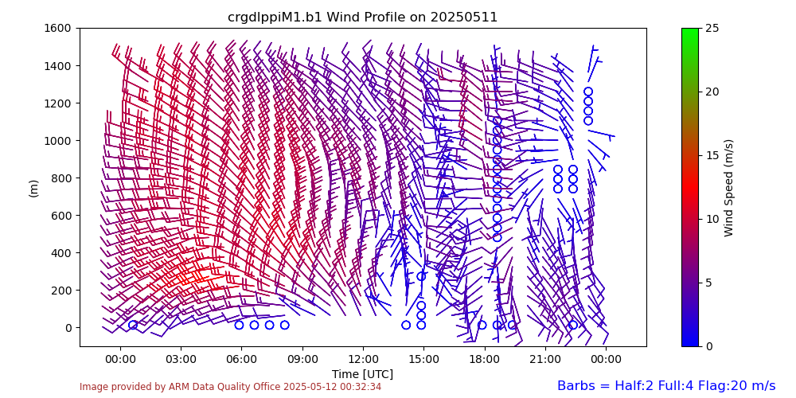
Bay breeze!

Slide 55
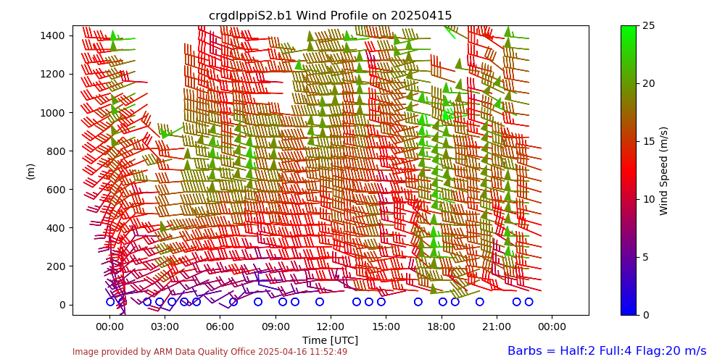
Rural site LLJ.

Slide 56
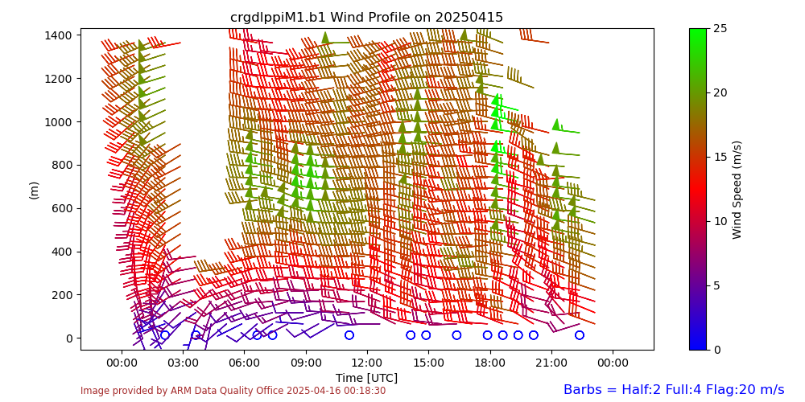
Jet also exists in the city

Slide 57
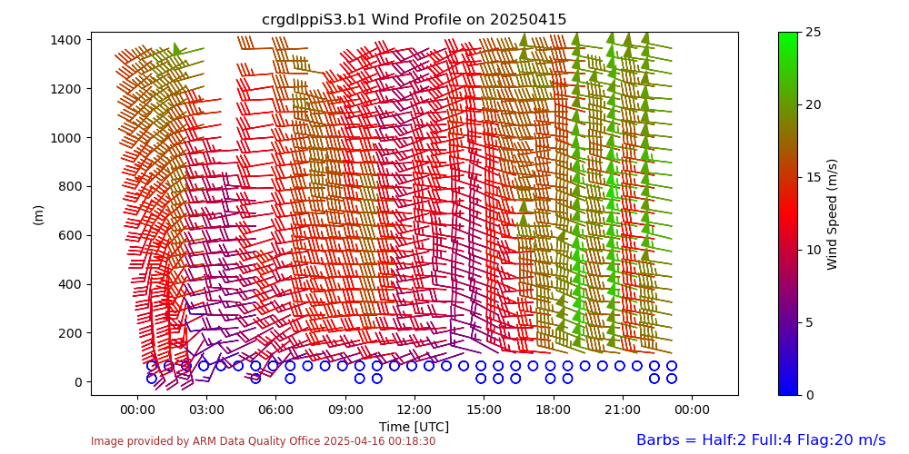
But no clear jet over the Bay.

Slide 58
Outline
Background information
A description of the CoURAGE campaign
Some preliminary results
Information about how you can get involved

Slide 59
BSEC and CoURAGE data are open
We welcome its use.
We invite collaboration.
Data locations:
CoURAGE: https://adc.arm.gov/discovery/#/results/site_code::crg
BSEC: https://msdlive.org/projects/bsec/info
Baltimore Social-Environmental Collaborative Urban Integrated Field Lab
https://21cc.jhu.edu/research/bsec

Slide 60
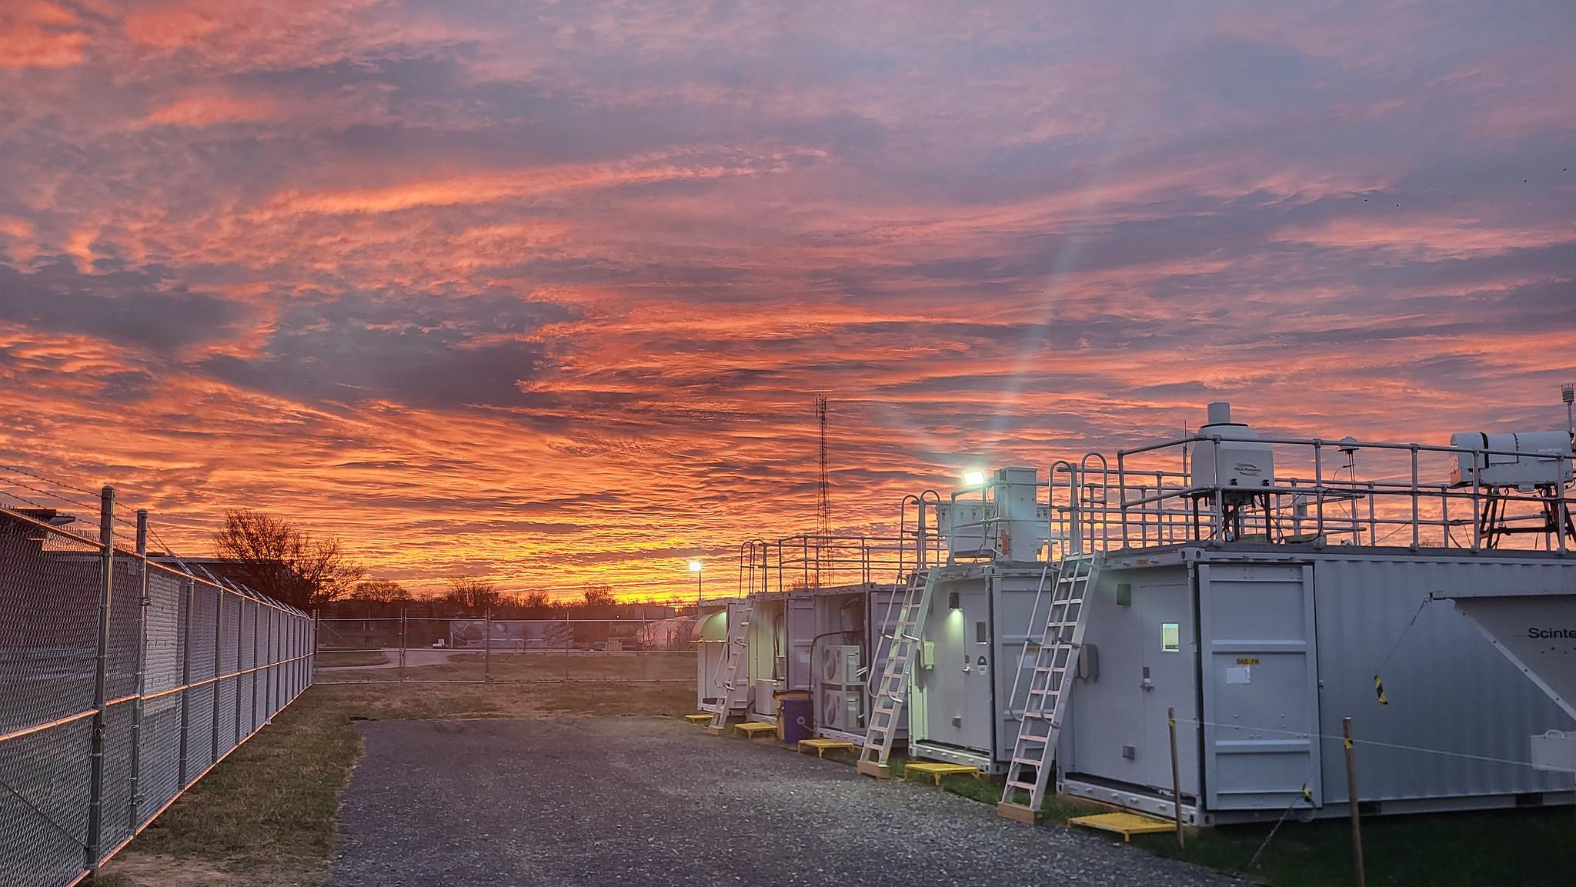
And all are welcome to join the CoURAGE science team.
Monthly science team meetings.
Weekly data reviews. Fridays, 2pm US eastern.
ABL, precipitation and atmospheric composition working groups.
To join: kjd10@psu.edu
Thank you!
Image courtesy of the U.S. Department of Energy Atmospheric Radiation Measurement (ARM) user facility.

