Slide 1
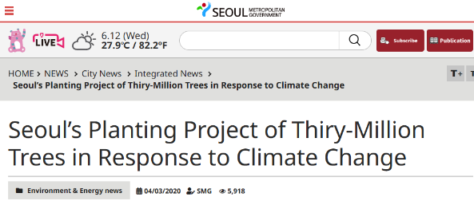
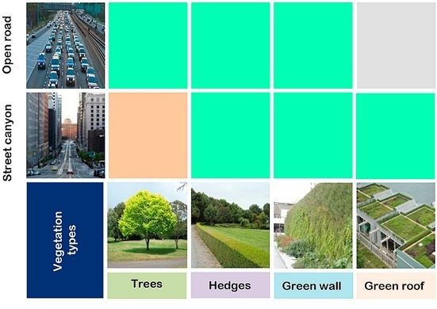
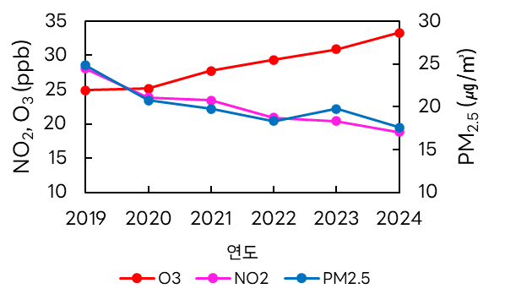
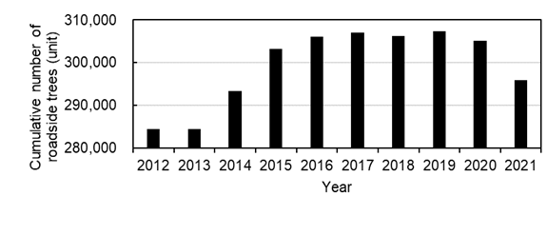
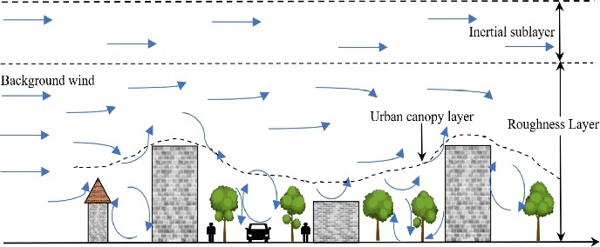
Effect of tree in urban area
Abhijith et al., 2017
Year
Seoul metropolitan government(2023)
Nithya et al.(2021)
Many local governments are using trees to improve air quality in urban, so their effects need to be considered.
Over the past few years, the concentrations of most air pollutants have shown a decreasing trend, but O₃ is the only one that has increased in Seoul.
O₃ is not directly emitted into the atmosphere, but is formed through photochemical processes involving NOₓ, VOCs, etc. → O₃ cannot be reduced by controlling a single emission source.
BVOCs have 3 ~ 4 times higher O₃ forming potential than anthropogenic VOCs.
To effectively manage O₃ in urban, it is essential to consider complex wind patterns and the effects of urban trees.

Slide 2
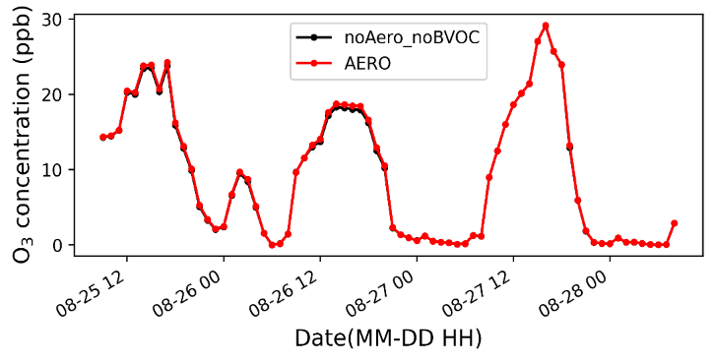
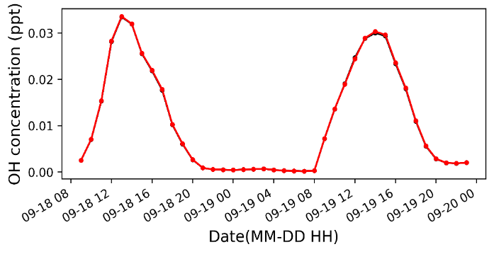
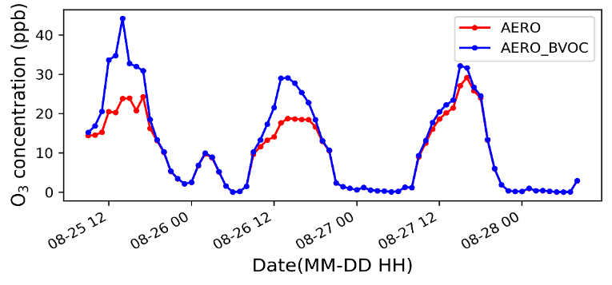
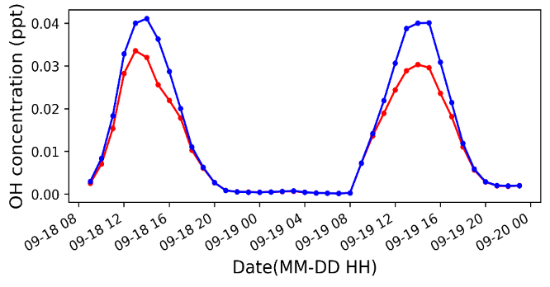
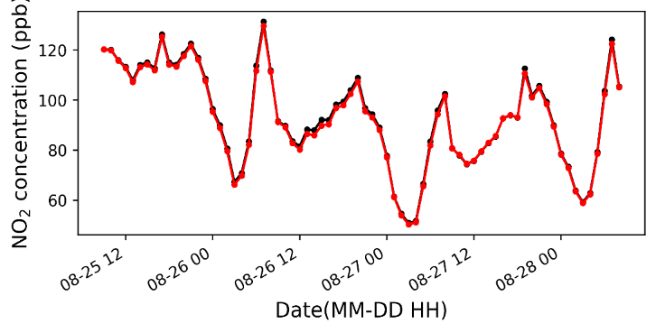
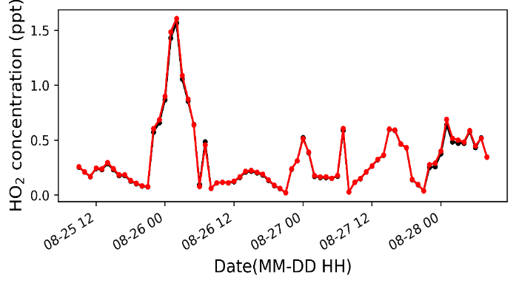
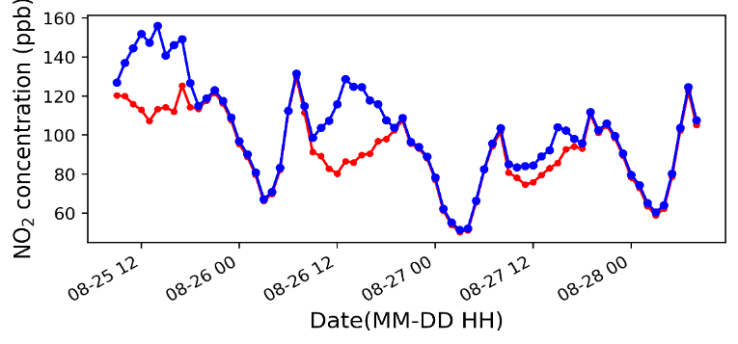
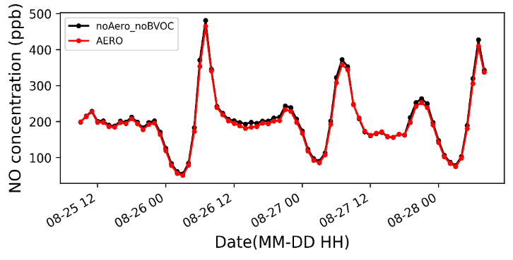
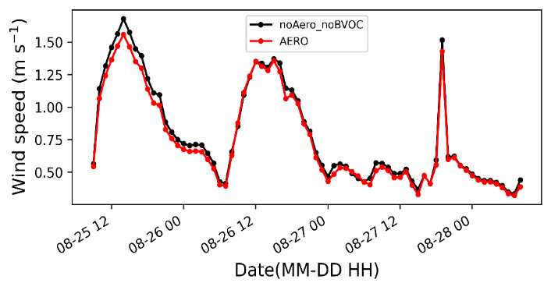
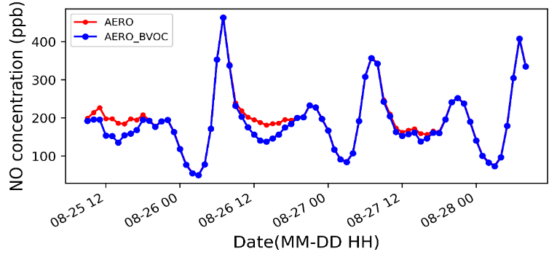
Result : pollutant concentration by tree effect
Aerodynamic effect (at 1.5 m height, domain average)
BVOCs emission (at 1.5 m height, domain average)
BVOCs emissions significantly increase O₃ levels by enhancing the following reactions: RO₂ + NO → NO₂ + HO₂, HO₂ + NO → OH + NO₂
Although the aerodynamic effects of vegetation reduced wind speed, concentrations of NO and NO₂ decreased. This is attributed to radical-driven reactions, which also contributed to changes in O₃ concentrations.
Notes:
We examined the aerodynamic effects of Trees and BVOC emissions using time series analysis.
The time series plots represent domain-averaged values at a height of 1.5 meters.
First, the aerodynamic effects of trees reduced wind speed, which in turn led to an increase in ozone (O₃) concentration.
Interestingly, the concentrations of NO and NO₂ decreased.
This is likely due to enhanced radical reactions rather than accumulation by wind speed.
Second, BVOC emissions from trees further promoted ozone formation by increasing the concentrations of OH and HO₂ radicals.
So, changes in radical chemistry—especially OH and HO₂—played a key to ozone concentration changes.
? Specifically, BVOCs enhanced reactions such as RO₂ + NO → NO₂ + HO₂ and HO₂ + NO → OH + NO₂, leading to a significant increase in O₃ and a reduction in NOₓ

Slide 3
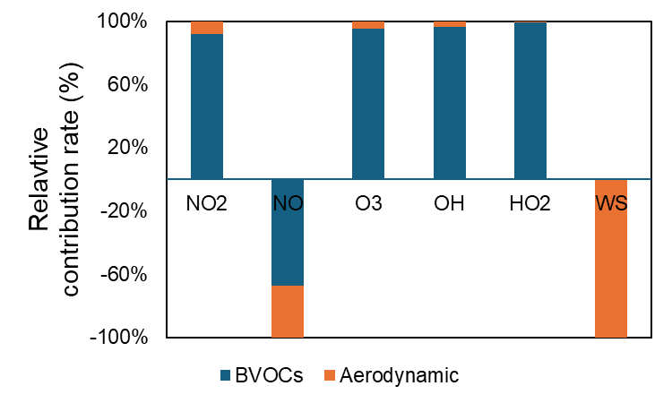
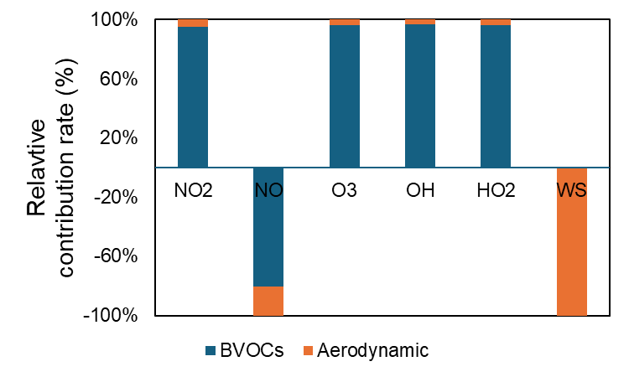
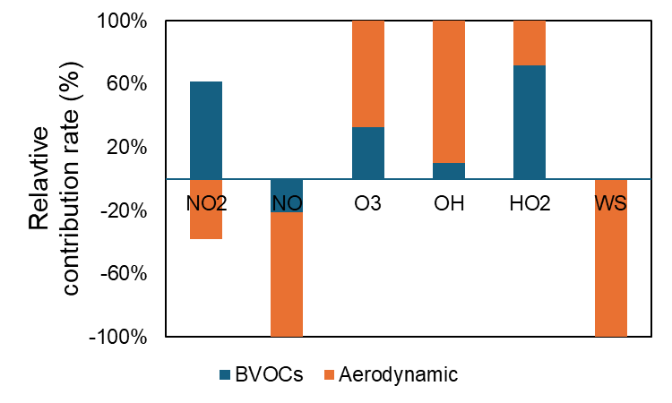
Supplement : comparison of the relative contributions of tree effects
Relative contribution ratio = Change rate of each effect / Sum of change rates of both effects → This allows us to assess which of the two tree-related effects contributes more significantly.
All time
Day time (6~18 LST)
Night (19~5 LST)
NO
NO
NO
All species except NO showed positive contributions.
Among them, the contribution from BVOCs emission was dominant.
During the daytime, the contribution was predominantly driven by BVOCs emissions.
At night, the aerodynamic effect was dominant for all species except NO₂.
Relative contribution ratio = 상대 기여율 : 각 효과의 변화율 / 두 효과 변화율의 합 즉, 수목의 두 효과 중 어느 효과가 더 기여했는지를 볼 수 있음.
Notes:
[슬라이드 11] We calculated the relative change rate due to the effect of trees, dividing the analysis into daytime, nighttime, and the full period.
Overall, BVOC emissions had a greater impact than aerodynamic effects, especially for OH, HO2, and O3.
But, NO showed a negative response from both effects, likely due to titration and reaction with O3. During the day, BVOCs emitted from the trees increased radical concentrations, resulting in higher O3 formation.
At night, when photochemistry slow down, aerodynamic effect dominated due to stagnant air and reduced dispersion.
Meanwhile, wind speed (WS) was almost entirely influenced by aerodynamic effects, indicating that trees significantly reduced local air dispersion.
The change in wind speed was almost completely due to the aerodynamic effect of trees. This shows that trees can really change how air moves around in the local area.

Slide 4
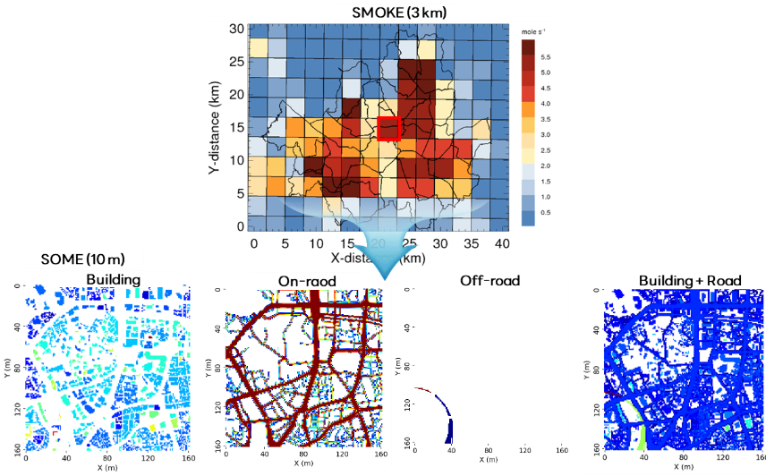
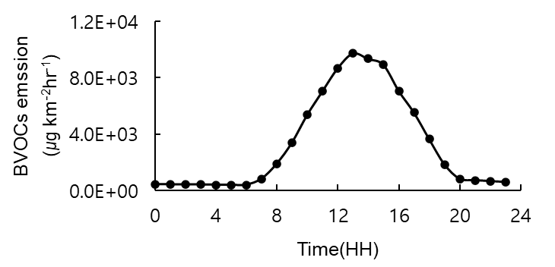
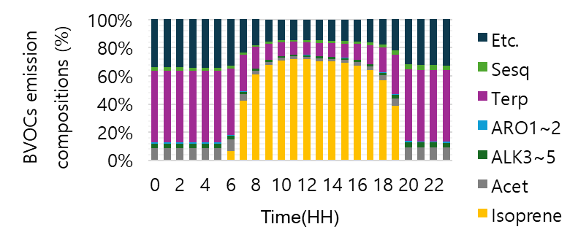
Supplement : Effect of tree within CFD-SAPRC model
■ Anthropogenic emissions
■ Biogenic Volatile Organic Compounds emission
The emissions calculated by the existing SMOKE (Sparse Matrix Operator Kernel Emissions) model are not suitable for detailed models.
The SOME (Source Object-based Model for Emissions) model redistributed the object's activity data to the detailed scale size (~m).
BVOCs emissions are calculated using the MEGAN (The Model of Emissions of Gases and Aerosols from Nature) model.
The solar irradiance and temperature data required for calculation are from ASOS data close to the simulated area.
Notes:
The emissions in the SOME model are the same as those in the SMOKE model. They are redistributed from the total SMOKE emissions by considering object-specific characteristics.

Slide 5
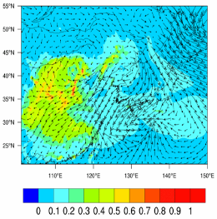
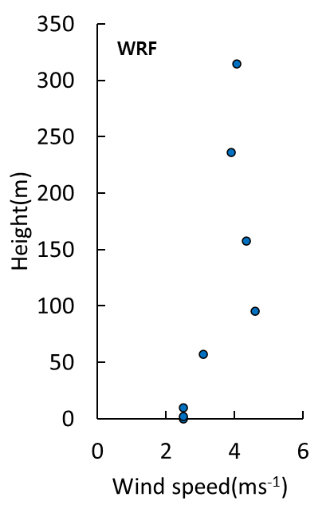
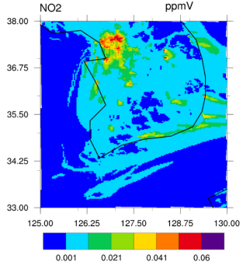
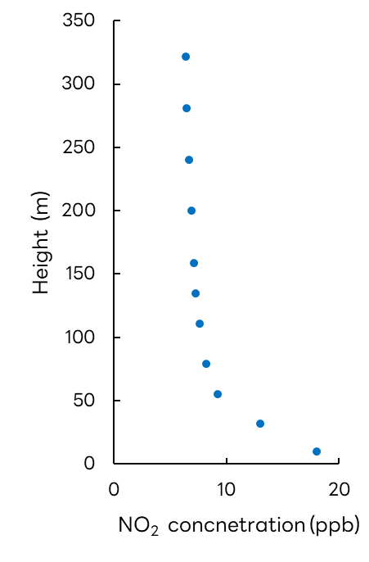
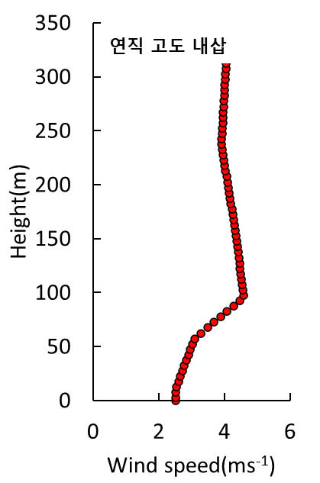
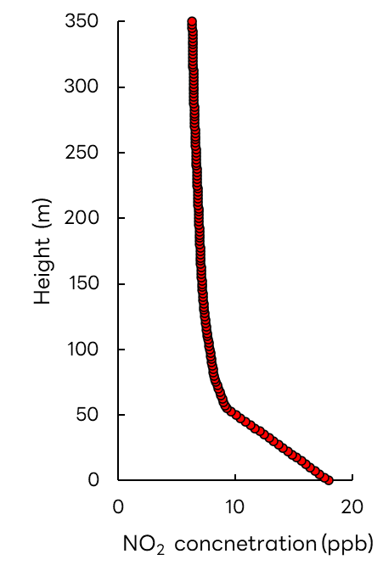
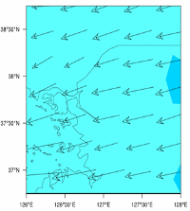
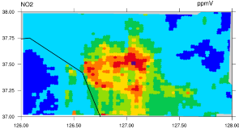
Supplement : Effect of tree within CFD-SAPRC model
■ Meteorology : WRF model
■ Background : CMAQ model
CMAQ
연직 고도 내삽
Model | WRF Ver. 4.3
Domain | D01 | D02 | D03
Horizontal grid size (km) | 27 | 9 | 3
PBL scheme | Yonsei University scheme
Cumulus parameterization | Kain-Fritsch scheme
Microphysics | WSM6
Model | CMAQ Ver. 5.3.2
Domain | D01 | D02 | D03
Horizontal grid size (km) | 27 | 9 | 3
Gas chemical mechanism | SAPRC07
Aerosol chemical mechanism | AERO6
$u$, $v$ wind component, temperature(Air, surface)
88 types of pollutants (NO,NO₂, O₃, etc.), photolysis rate(JPROC)
Use forecast fields for 24 to 48 hours
Apply temporal and vertical interpolation before use
Notes:
I configured the WRF model as follows for the simulation. The data from this model were vertically interpolated and used as input for the CFD model.

Slide 6
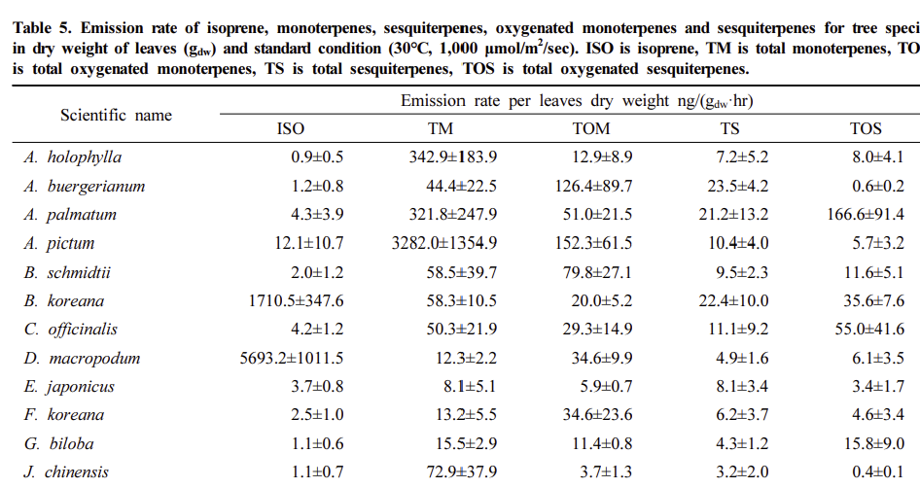
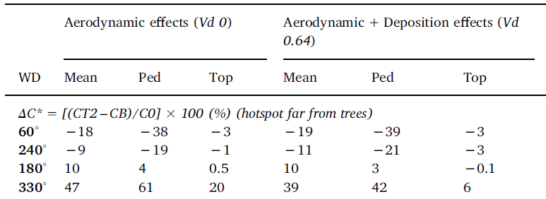
Supplement : How can we plant trees in urban?
■ Chang et al. (2024)
■ Buccolieri et al. (2018)
In areas where wind flows are perpendicular to buildings or slope-induced, trees can increase pollutant concentrations by more than 10%(Buccolier et al., 2018; Jeanjean et al., 2017; Jin et al., 2024; Kim et al., 2025)
Tree species with high BVOC emissions Korean pine, Mongolian oak, willow
Tree species with low BVOC emissions Horse chestnut, snowbell tree
Notes:
What should be prioritized when planting urban trees? I think the most important thing is to choose tree species that emit low BVOCs, since those can really increase ozone levels.
Also, even though it’s not part of this study, other research suggests we should avoid planting trees near buildings where there's a lot of vertical or slope-driven wind, because that can trap pollutants and make air quality worse.

