Slide 1



Optimizing Carbon Credit Strategies for Low-Energy-Efficient Buildings: Greener Alternatives for a Sustainable Future
Nasim Eslamirad^{*a, b}, Mehdi Golamniaª, Francesco Pillaª
ª School of Architecture Planning and Environmental Policy, University College Dublin, Ireland
^{b} Department of Architecture and Urban Studies, Tallinn University of Technology
*Presenter, email: nasim.eslamirad@ucd.ie

Slide 2
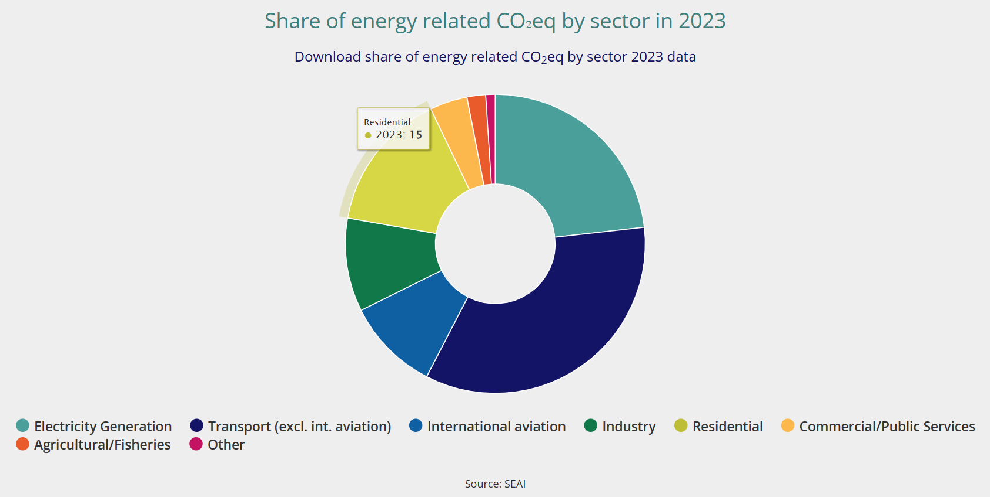
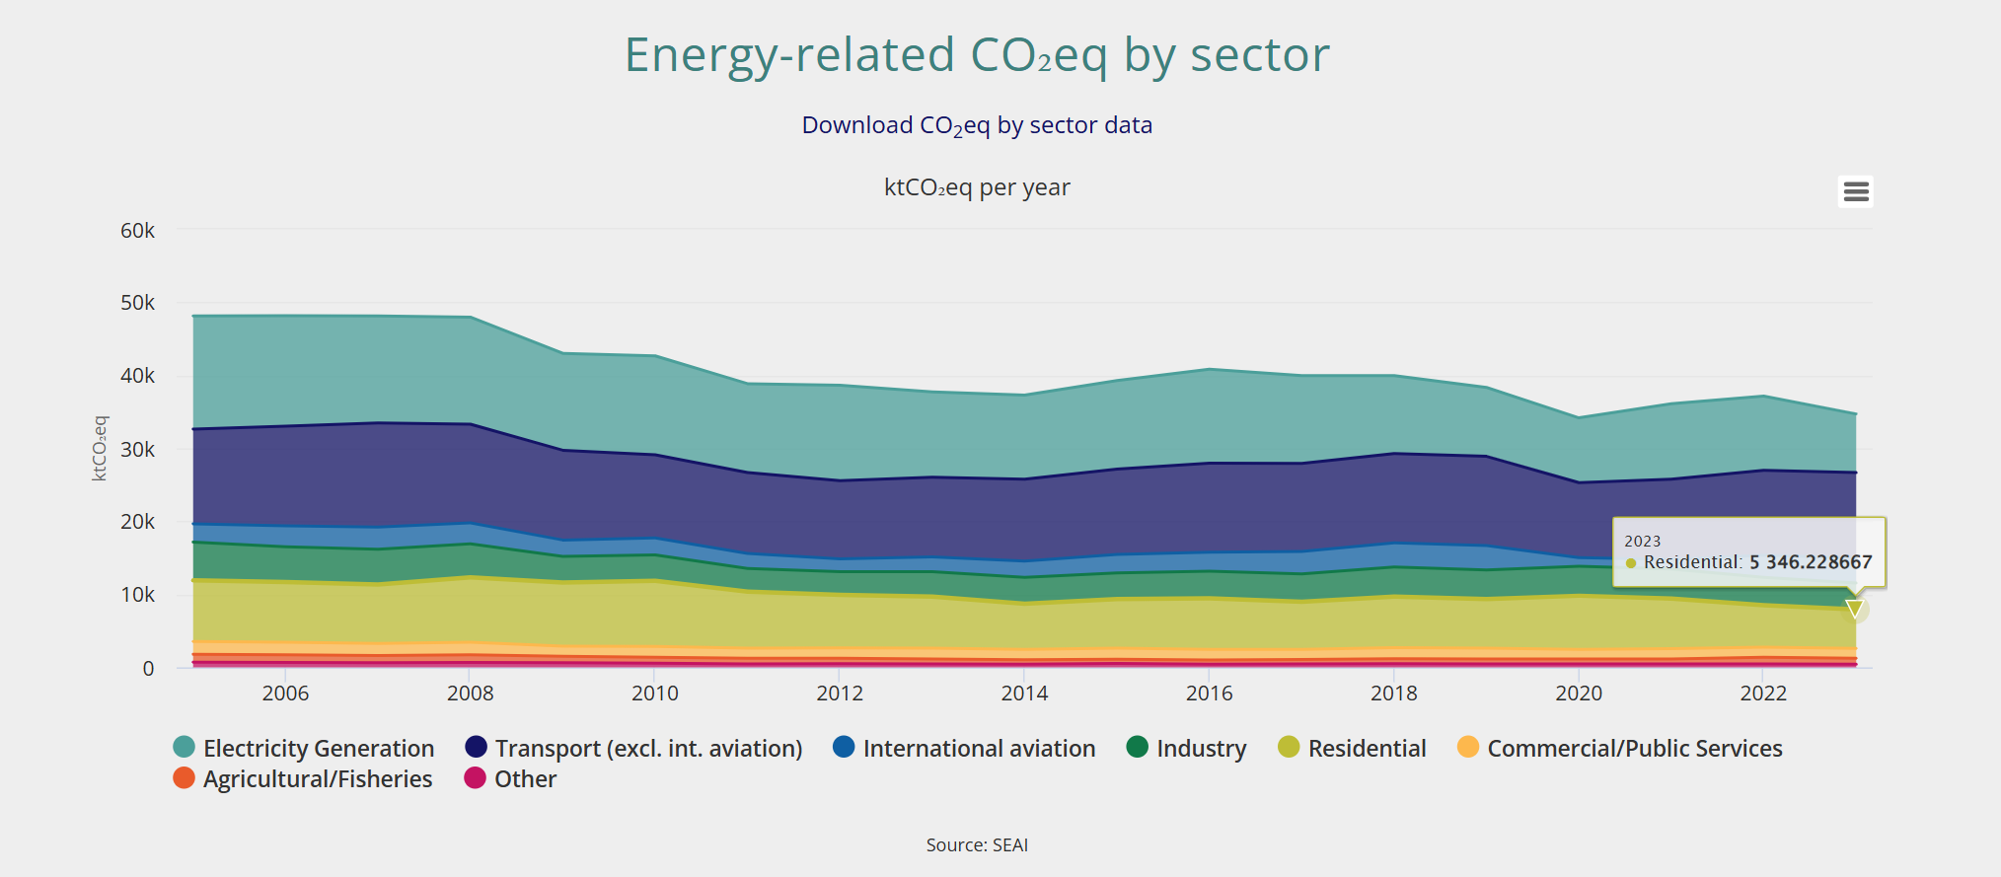
Motivation
Global and national goals:
Ireland must reduce building emissions to meet 2030 and 2050 targets.
Ireland’s 2030 climate goal is to cut emissions by 51% from 2018 levels.
The residential sector plays a pivotal role in Ireland’s climate strategy, accounting for around 15% of national CO₂ emissions.
Many Dublin homes are F or G BER-rated (CO₂ emissions up to 34 kg/m²/yr).
Prioritizing fossil fuel replacement over strict “fabric-first” retrofits can accelerate emissions cuts.
Figure 1. Share of energy-related CO₂ equivalent emissions by sector in Ireland for the year 2023.
Figure 2. Trends in energy-related CO₂ equivalent emissions by sector in Ireland from 2005 to 2023.
Notes:
National and EU goals.
But current policies fall short, especially regarding heat-related reductions.
3. The share of residential sector in co2 emission is more than the industrial sector.
4. A 300 m² G-rated house can emit over 510 tons CO₂ in 50 years.
5. crucial for F/G-rated homes and cost-sensitive households.

Slide 3
Study Objectives
Evaluate retrofit strategies for typical Dublin homes in terms of emissions, comfort, cost, and energy performance.
Compare fossil fuel replacement and fabric-first approaches using Urban Building Energy Modeling (UBEM) aligned with national climate targets.
Provide policymakers with data-driven insights to support cost-effective, low-carbon retrofits for old building types in Ireland.

Slide 4
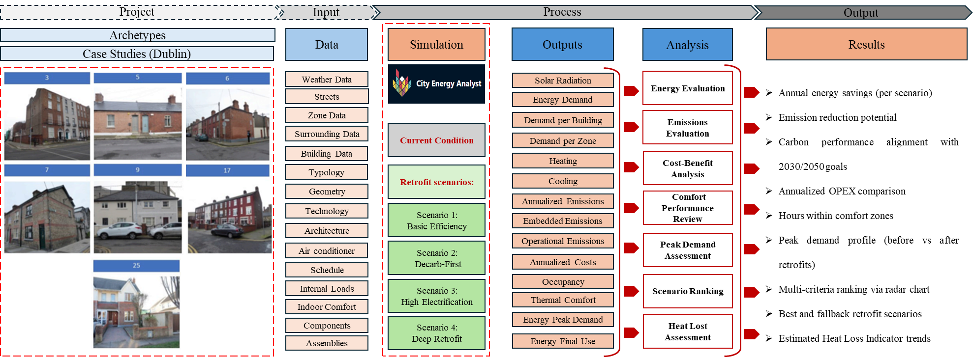
Methodology
Notes:
The CEA, an open-source UBEM tool, is employed to simulate energy flows and carbon impacts at the building level of different scenarios. The simulation process generates outputs including:
Heating and Cooling Loads
Annualized Operational and Embodied Emissions
Thermal Comfort and Occupancy
Peak Energy Demand and End Use Profiles
Energy Evaluation: Total and disaggregated energy consumption across end uses.
Annualized Operational Expenditure (OPEX)

Slide 5
Methodology
Building Archetypes
Type | Construction Period | Wall | Roof | Windows | Energy Rating (KWh/m2/yr) | BER
3 Terraced house | Pre-1900 | Uninsulated brick 325/225mm thick | Front pitched with 100mm mineral wool in joists / Rear pitched roof no insulation | Single glazed, wooden frames | 352 | F
5 Bungalow | 1900-1929 | Uninsulated brick, 325mm thick | Pitched roof with 50mm mineral wool in ceiling joists | Single glazed, wooden/steel frame | 624 | G
6 End of terrace | 1900-1929 | Brick facade, block to side/rear, 225mm thick | Pitched roof with 50mm mineral wool in joists | Single glazed, wooden/steel frame | 458 | G
7 Terraced house | 1900-1929 | Uninsulated brick walls, 325mm thick | Pitched roof with 50mm mineral wool in joists | Single glazed, wooden/steel frame | 624 | G
9 Terraced house | 1930-1949 | Solid mass concrete | Pitched, insulation between joists | Single glazed, metal frame | 458 | G
17 Terraced house | 1978-1982 | 300mm walls, partially filled | Pitched, insulation between joists | Double-glazed, metal frame, 6mm gap | 311 | E2
25 Terraced house | 1994-2004 | Cavity walls, partially filled | Pitched, insulation between joists | Double glazed, PVC/wood, 12mm gap | 458 | D1
38 Apartment block | 1994-2004 | Block with part cavity wall insulation | Flat roof with insulation | Double-glazed, air-filled windows, 12mm gap, wood/steel frames | 145 | C2
39 Apartment block | 2005-2010 | Reinforced concrete externally insulated | Flat roof with insulation | Double-glazed, air-filled, 16mm gap | 175 | C3

Slide 6
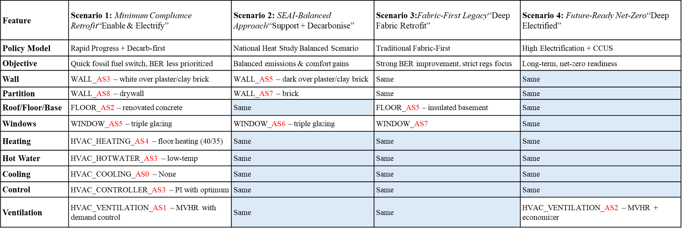
Methodology
Retrofit Scenarios
Basic Efficiency
Decarbonization-first
Deep Fabric
Deep Retrofit
Notes:
CCUS stands for Carbon Capture, Utilization, and Storage.
It refers to a suite of technologies designed to:
Capture CO₂ emissions from sources like power plants, industrial facilities, or even directly from the air (Direct Air Capture – DAC),
Utilise the captured CO₂ in products such as building materials, synthetic fuels, or chemicals,
Store it safely underground in geological formations (like depleted oil and gas fields or deep saline aquifers).
As7, double Window

Slide 7
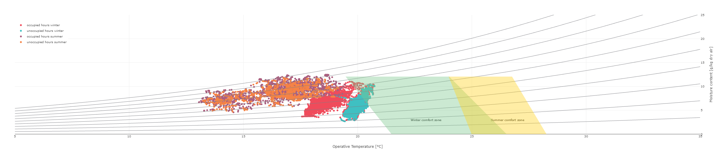
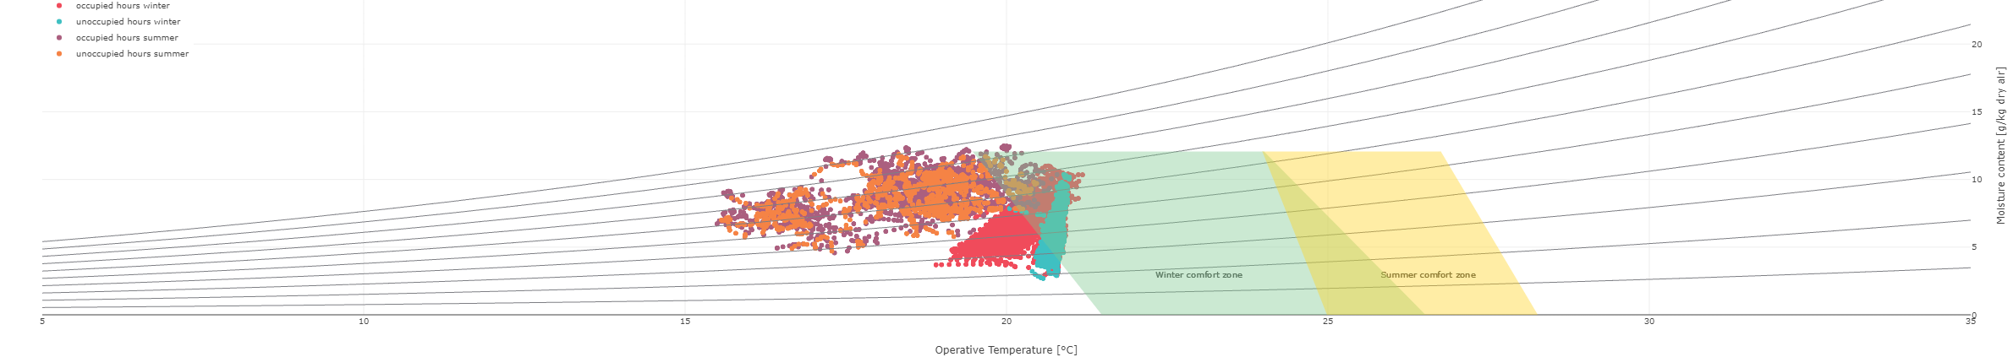
Results
Comprehensive analysis linking retrofit performance to specific building features, providing insights into how retrofit strategies can be optimized for each archetype.
Maximizes energy efficiency, occupant comfort while minimizing intervention costs and emissions
a
b
Figure 3.Thermal Comfort Comparison for Case Study of Archetype 3; (a) Current condition (b) Retrofit Scenario 3 (High-Efficiency Upgrade)
Notes:
Current condition: Significant deviations from the thermal comfort zone, especially during winter occupied hours (red spots) , indicating underperformance in maintaining indoor comfort. (b) Retrofit Scenario 3 (High-Efficiency Upgrade)

Slide 8
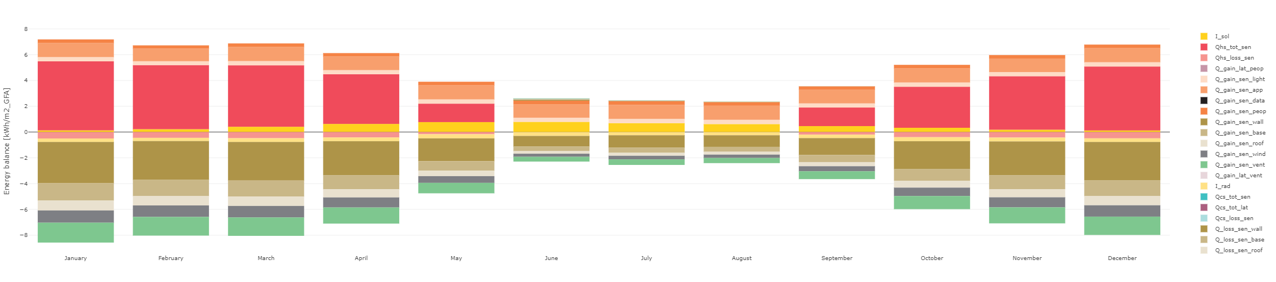
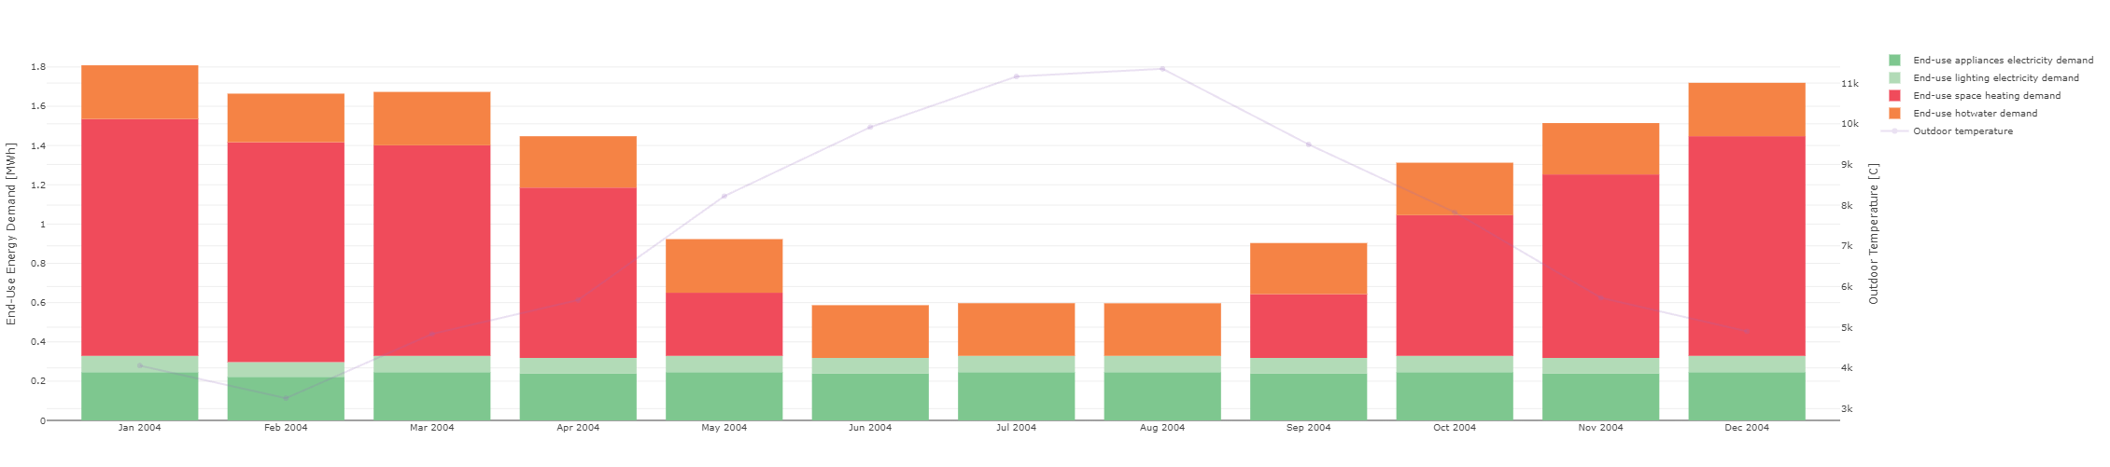
Results
Figure 4. Energy balance for Building - Scenario 4 Case Study of Archetype 3
Figure 4. Load Curve for Building B1003 (monthly) - Scenario 4 Case Study of Archetype 3

Slide 9
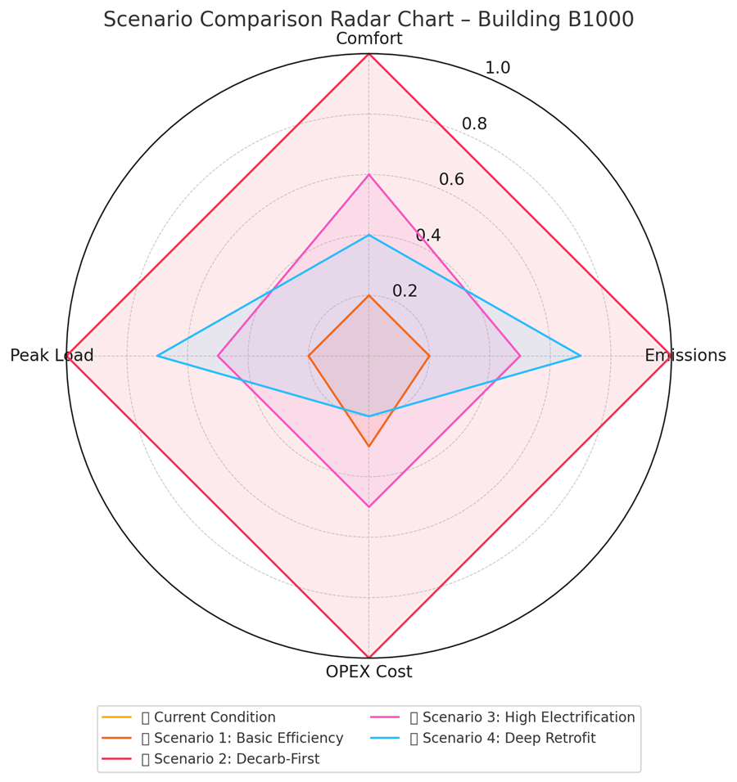
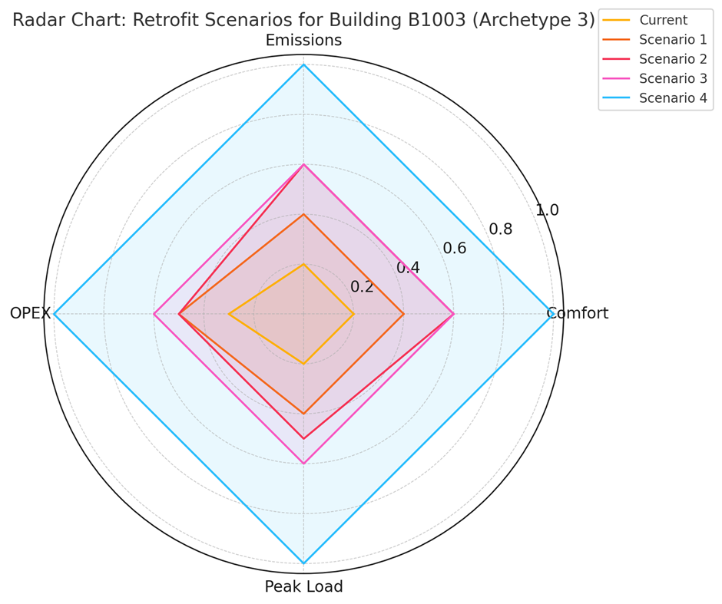
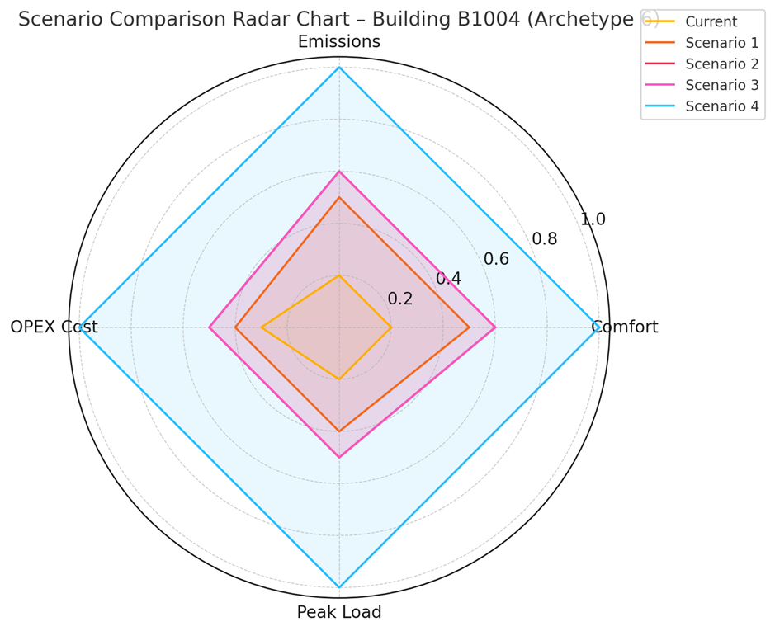
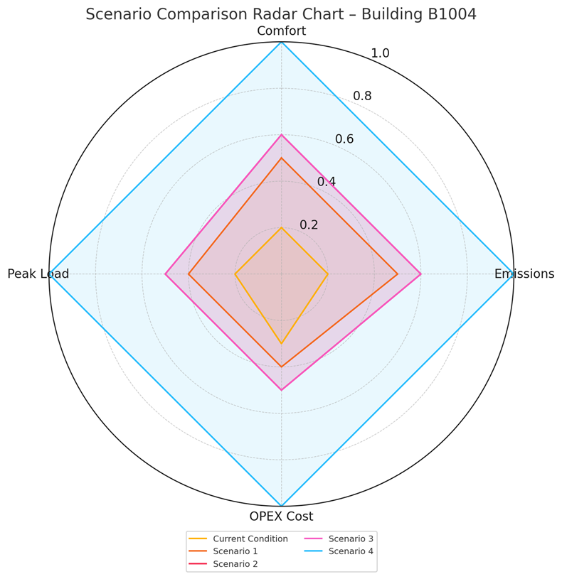
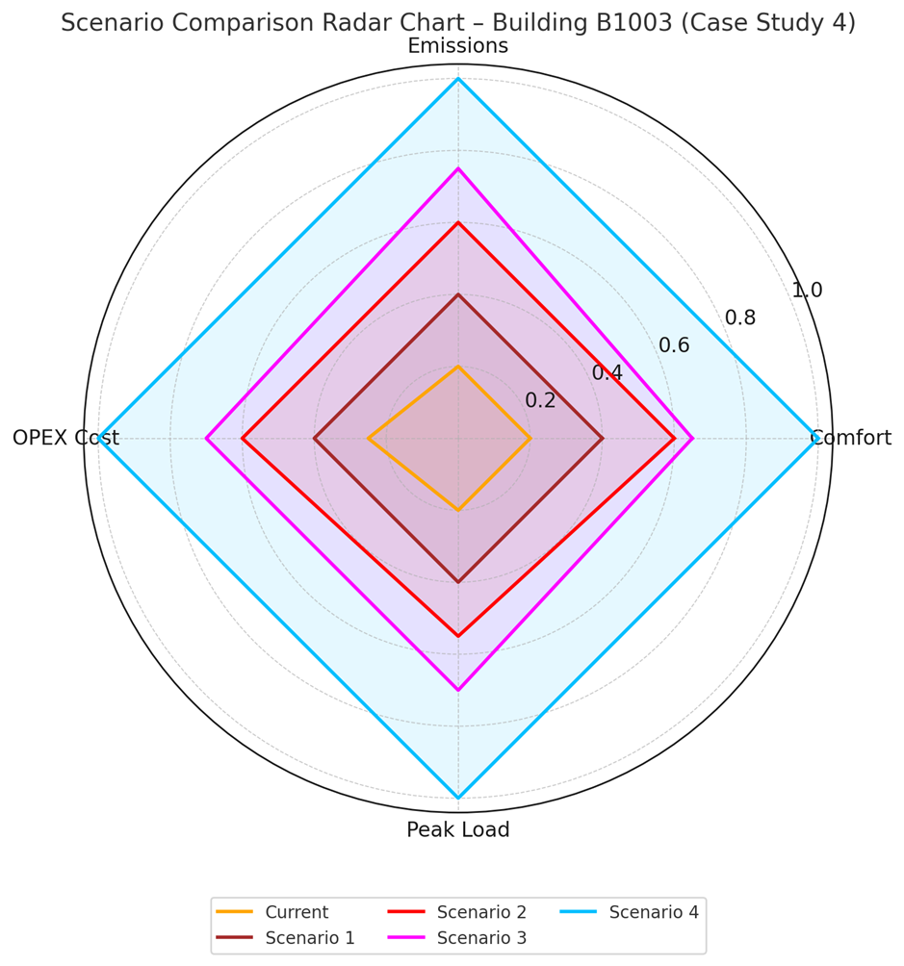
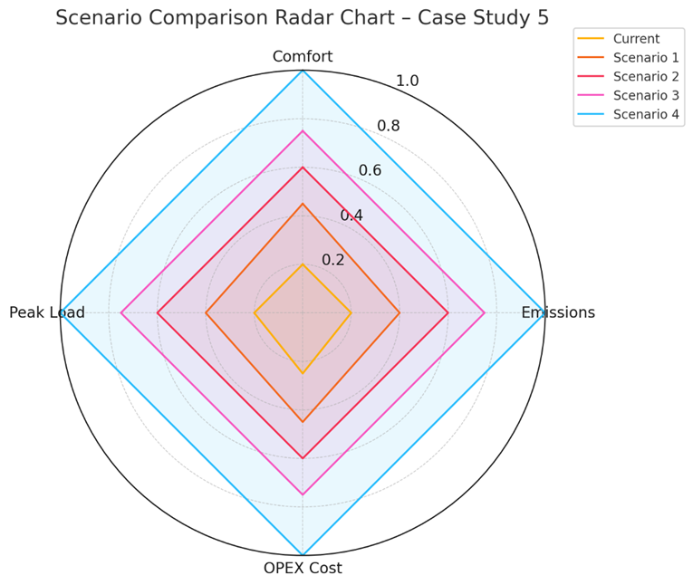
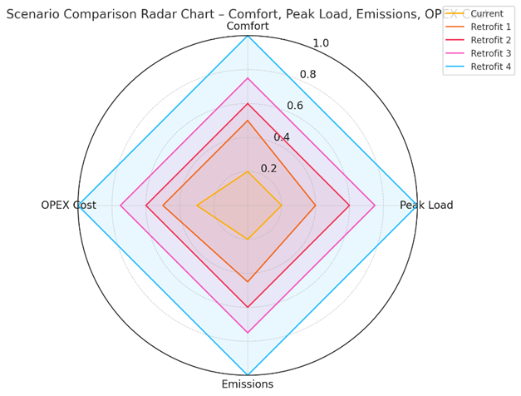
Results
Case study 1, Archetype 9
Case study 2;Archetype 3
Case study 3, Archetype 5
Case study 4, Archetype 6
Case study 5; Archetype 7
Case study 6; archetype 17
Case study 7; Archetype 25

Slide 10
Results
Comfort: All retrofit scenarios improved comfort, with Scenario 4 achieving nearly 100% compliance with comfort standards.
CO₂ Emissions: Reductions ranged from 35% in Scenario 1 to 82% in Scenario 4, aligning with national climate targets.
Peak Load: Deep retrofit minimized peak heating demand by 60% (Scenario 4), aiding grid stability.
OPEX Cost: Scenario 4 demonstrated the lowest operating costs over time, outperforming others on long-term savings despite higher initial investment.

Slide 11
Conclusions
Key Archetype-Based Retrofit Insights
Cost-Performance Trade-Offs
A tiered intervention strategy (low, medium, deep) can match archetypes to retrofit actions without over-investing.
Deep retrofits should target only high-emission, low-comfort archetypes to conserve funds and maximize impact.
Comfort Outcomes Align with Scenario Investment
Scenarios 3 & 4 consistently improve comfort across all seasons and reduce winter discomfort most effectively.
Scenario 1 leaves many older homes with unresolved thermal discomfort unless paired with zoning or controls.

Slide 12
Conclusions
Scenario | Approach | Best For | Strengths | Weaknesses
Scenario 1 | Basic Efficiency | Partially insulated homes | Low-cost, good for BER F-G | Limited savings for poorly insulated homes
Scenario 2 | Decarbonization-first | Mass concrete / mid-century homes | Big emissions drop, fast system upgrade | May not reach comfort targets alone
Scenario 3 | High Electrification | Pre-1900 or well-zoned homes | Avoids complex retrofits, improves emissions and comfort | High electricity costs, grid impact
Scenario 4 | Deep Retrofit | High-loss archetypes | Best energy and comfort results | High cost, long disruption

Slide 13
Conclusions
Archetype | Construction Period | Wall/Roof Type | BER & Energy Intensity (kWh/m²/yr) | Best Scenario | Rationale
Archetype 5 | 1990s | Cavity wall, partial insulation | F–G (~499) | Scenario 1: Basic Efficiency | Already some insulation—basic upgrades yield high impact at low cost.
Archetype 25 | 1990s |  | F–G (~499) |  | Existing envelope + minor upgrades deliver value; not worth full electrification yet.
Archetype 9 | 1930–1949 | Solid mass concrete | G (>450) | Scenario 2: Decarb-First | Structural mass benefits from heat pump retrofit; less fabric needed. Good balance of emissions and cost.
Archetype 17 | 1978-1982 | Uninsulated walls, partially filled, Pitched | D1(276)
Archetype 3 | Pre-1900 | Uninsulated solid brick, timber floors | G (~350) | Scenario 3: High Electrification | Avoids invasive façade upgrades. Electrification offers operational savings and comfort without excessive costs.
Archetype 4 | 1994–2004 | Filled cavity wall, pitched roof | G (~360–380) |  | Moderate envelope with basic insulation allows clean electrification; low disruption and good return.
Archetype 6 | 1900–1929 | Brick façade/block | G (~458) | Scenario 4: Deep Electrified | High heat loss, exposed end walls require fabric-first plus electrification; high comfort achieved.

Slide 14
Conclusions
Framework for Archetype-Based Retrofit Strategy
Archetype Characteristics | Recommended Scenario | Justification
Solid brick, poor ventilation, high losses (Pre-1940s) | Scenario 3 or 4 | Requires ventilation, envelope insulation, and heat source change
Mass concrete, thermal mass (1950s) | Scenario 2 | Switch to efficient systems leverages thermal stability
Cavity wall, moderate insulation (1990s+) | Scenario 1 | Quick wins with low disruption
Exposed end walls, partial insulation | Scenario 4 | Deep retrofit required to manage loss and comfort
Electrically zoned or high ceilings (heritage types) | Scenario 3 | Heat pump/electrification avoids aesthetic/structural disruption
Notes:
Envelope Determines Strategy Depth
and Construction Era Influences Retrofit Sensitivity
Pre-1940s buildings are highly sensitive to thermal bridging and ventilation—requiring deep retrofits.

Slide 15
Future Direction
Expansion of Case Studies and Dataset:
Incorporate more samples across all archetypes to strengthen the empirical foundation of the study.
Build a comprehensive, city-scale dataset to support machine learning models, archetype clustering, and reliable extrapolation of results in a data-driven retrofit framework.
Data-Driven Archetype Targeting
Utilize Building Energy Rating (BER), construction type, and material data from OpenStreetMap (OSM) and GeoDirectory to spatially map retrofit strategies by archetype, establish a typology-based framework to classify and compare retrofit needs across the urban building stock.
Automated Retrofit Recommendation Tools
Develop predictive tools (e.g., ML classifiers or rule-based engines) integrated into GIS platforms to recommend retrofit strategies by location, archetype, and energy performance.
Enable real-time, area-wide impact assessments for planners and energy consultants.
Policy Integration and Incentive Alignment
Align local and national emissions targets with retrofit scenarios where the greatest returns on carbon and comfort are achieved.

Slide 16
Thanks for your Attention!
Any Question?!
Acknowledgment: Science Foundation Ireland (SFI) under the NexSys SFI/21/SPP/3756 program, University College Dublin (UCD), and Tallinn University of Technology (TalTech).
Nasim Eslamirad E-mail: nasim.eslamirad@ucd.ie
NexSys Staff - NexSys Next Generation Energy Systems (nexsys-energy.ie)
Nasim Eslamirad - Google Scholar
www.linkedin.com/in/nasimeslamirad

