Slide 1
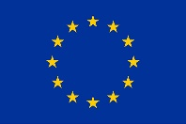











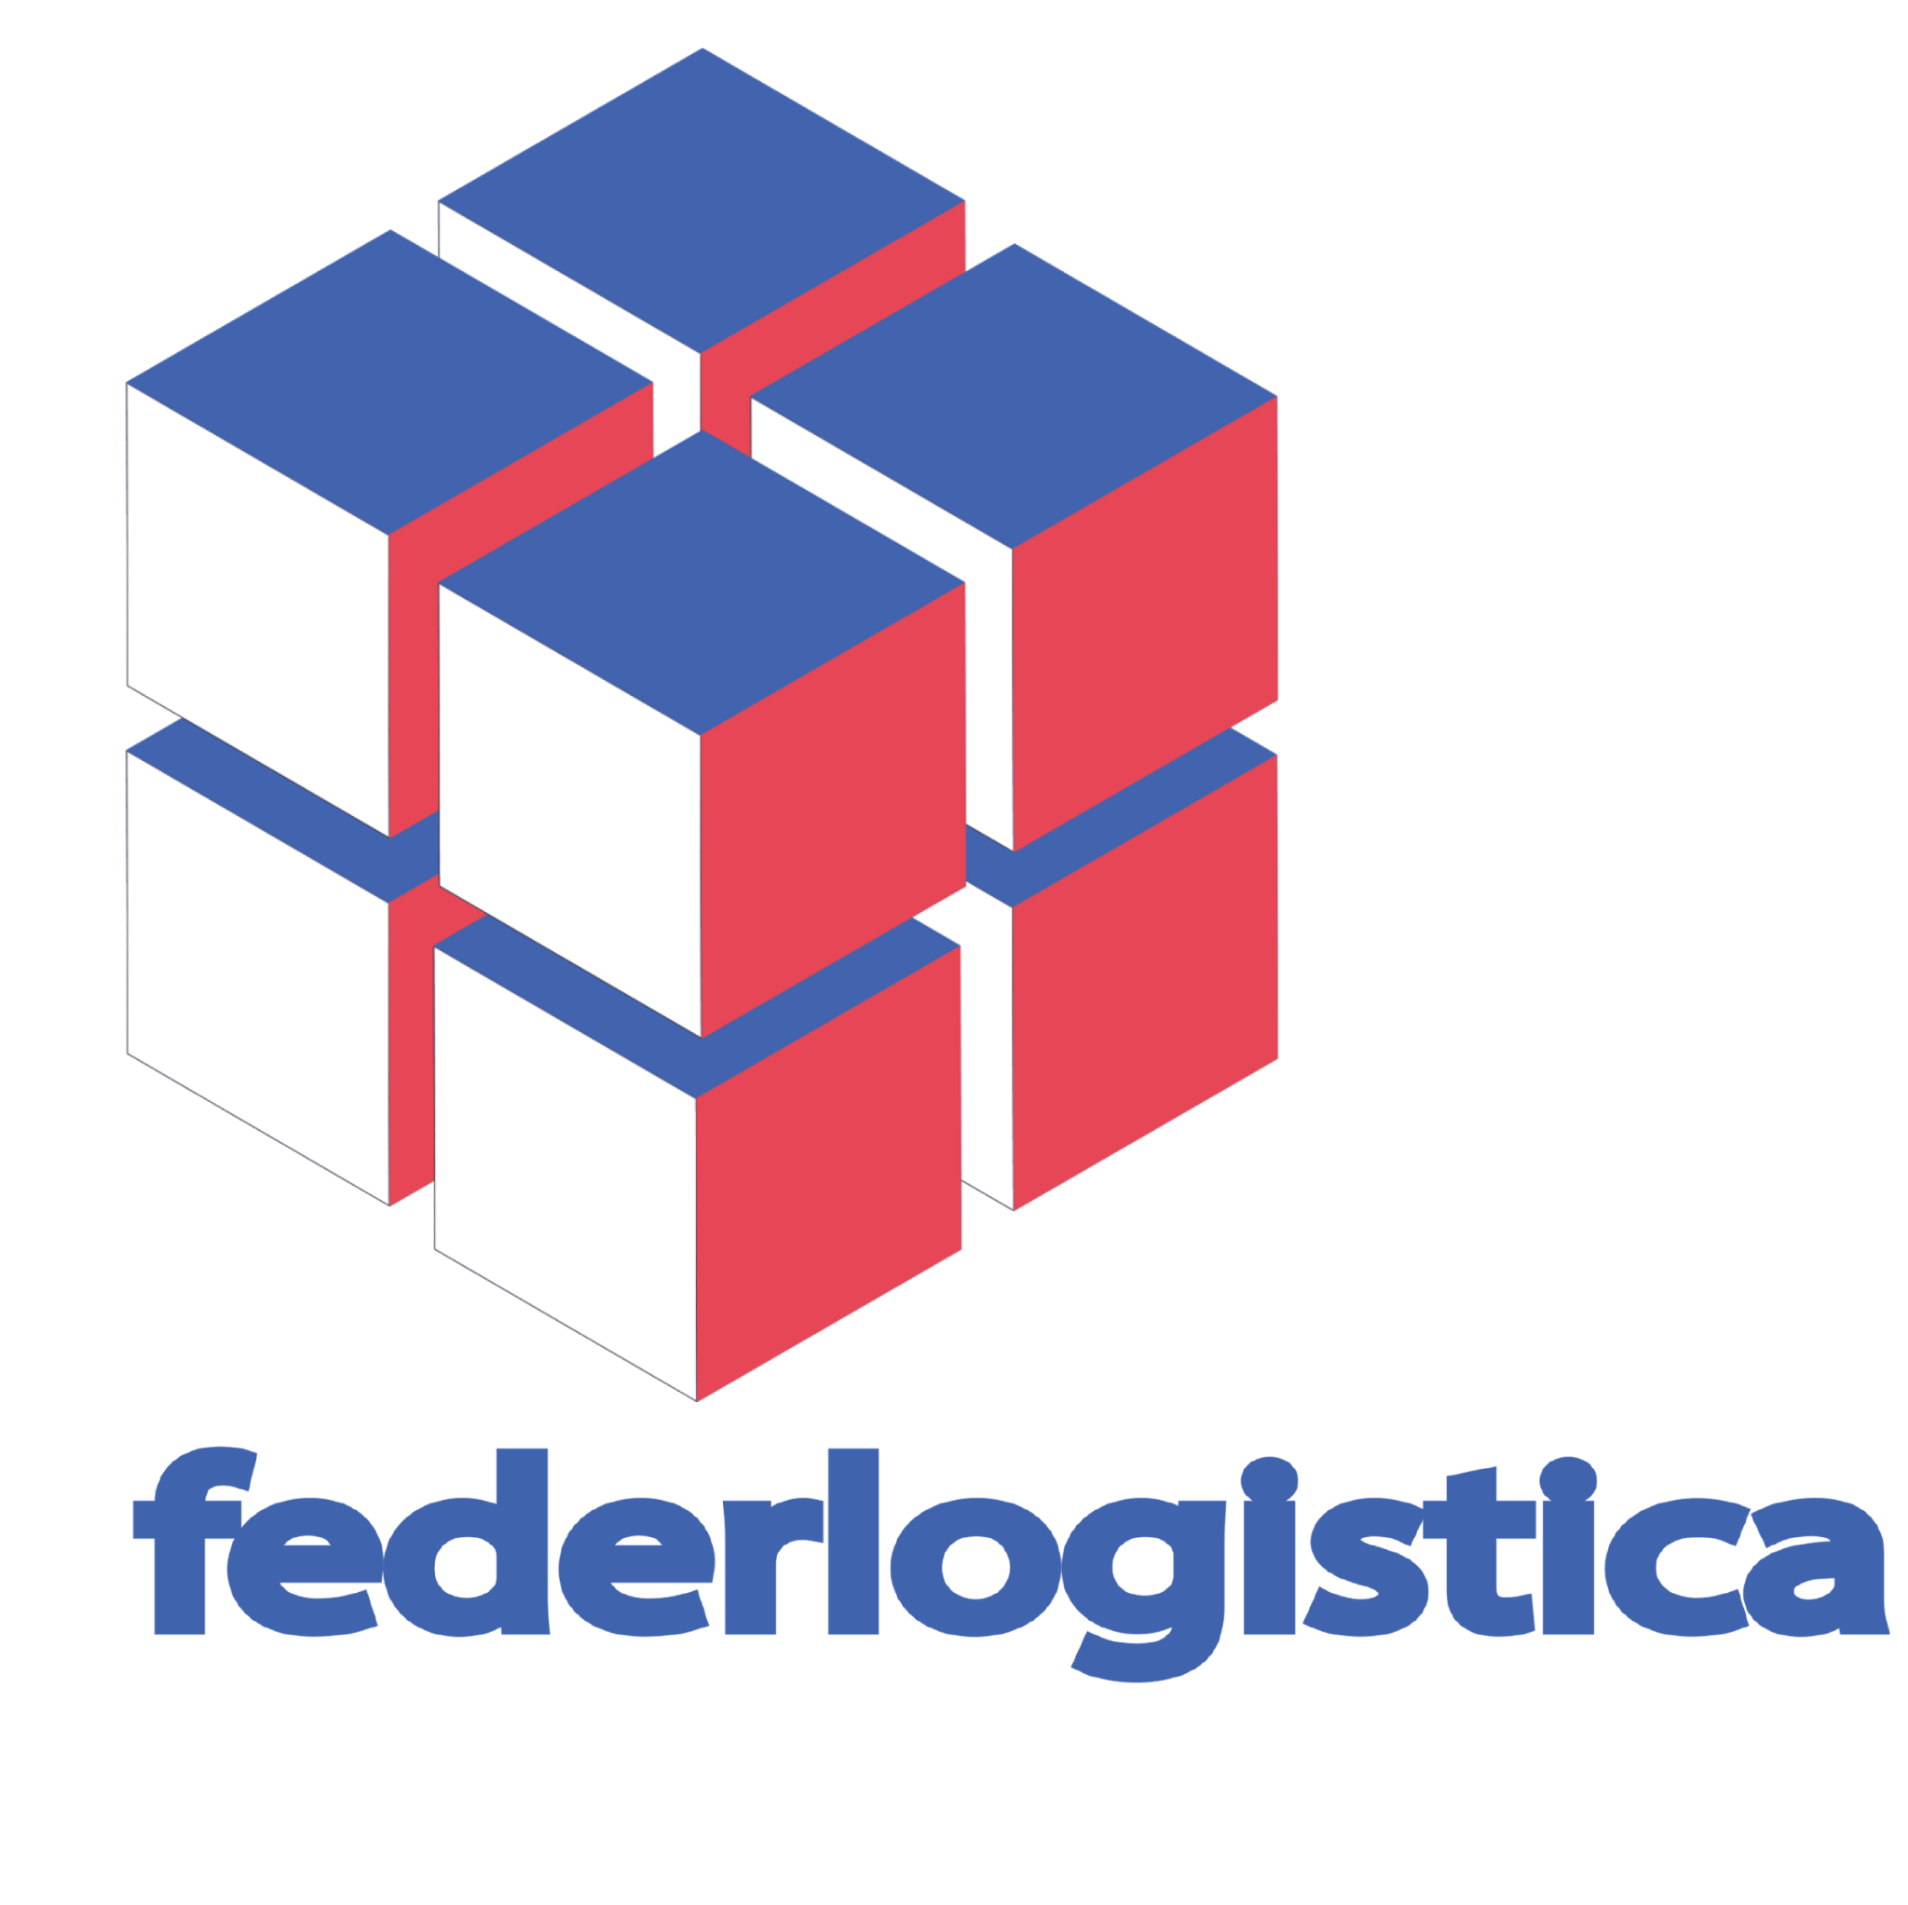







Toward a broad scale climate service for coastal adaptation to sea-level rise in Europe: the CoCliCo project
This project has received funding from the European Union's Horizon 2020 research and innovation program under grant agreement No 101003598
Gonéri Le Cozannet¹, Angélique Melet², Paul Sayers³, Arjen Luijendijk⁴, Iñigo Losada⁵, Melisa Menendez⁵, Robert J. Nicholls⁶, Alexandra Toimil⁵, Elco Koks⁷, Athanasios Vafeidis⁸, Jochen Hinkel⁹, Daniel Lincke⁹, Susana Romao¹⁰, Etienne Kras⁴, Vincent Bascoul¹, Rémi Thiéblemont¹, and the CoCliCo team
1: BRGM, France; 2 : Mercator Ocean, France; Sayers & Partners, United Kingdom ; 4: Deltares, The Netherlands; 5: IHCantabria, Spain; 6: University of East Anglia, United Kingdom, 7: Vrije University Amsterdam, The Netherlands; 8: University of Kiel, Germany; 9: Global Climate Forum, Germany; 10: Vizzuality, Spain.

Slide 2
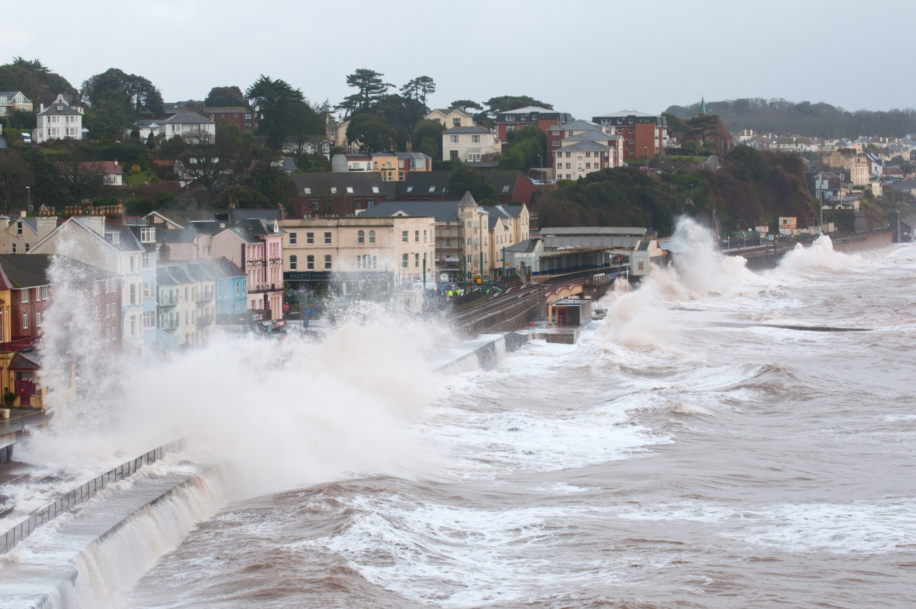
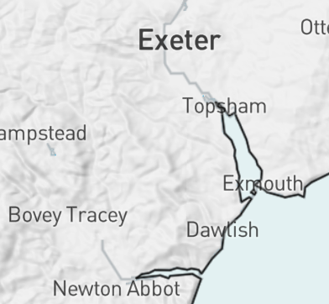
Devon UK, 2014
Mean and extreme sea levels are on the rise, exposing more people and assets, and coastal adaptation takes time

Slide 3
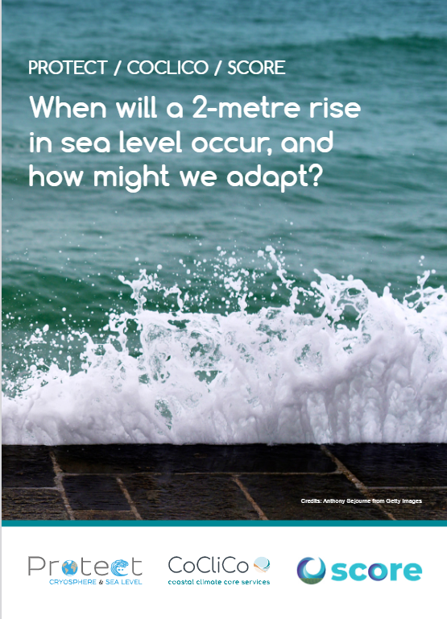
Policy brief
Key messages:
A 2-metre rise in sea level is almost inevitable
What is uncertain is the timing ([100-2000]yrs)
→ Fundamental changes of European coastal zones
Coastal adaptation: ongoing process, involves short-term actions, long-term planning and strategic thinking.
Le Cozannet et al., 2023

Slide 4
Policy brief
Key messages:
To limit losses, damages and lock-ins, 3 urgent actions:
Massive and immediate reductions of greenhouse gas emissions
Engagement in adaptation for sea-level rise
Support science and climate service development to reduce uncertainties in future sea-level rise, assess risks and associated adaptation options and provide useable information and climate services to coastal adaptation stakeholders
Le Cozannet et al., 2023

Slide 5
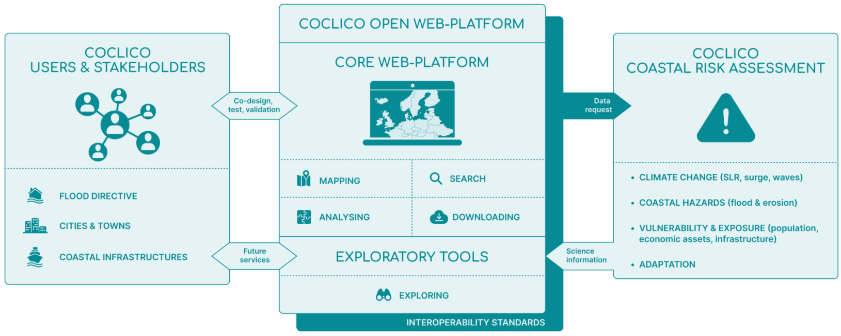
CoCliCo’s objectives and concept
Objective: improve decision-making on coastal risk management & adaptation, by developing an integrated core service for coastal adaptation to sea-level rise.
Target resolution: 25-to-100m, zooms up to 1m where available (e.g., France)
Deliverable: open source web-platform informing users on present day & future coastal risks in Europe

Slide 6
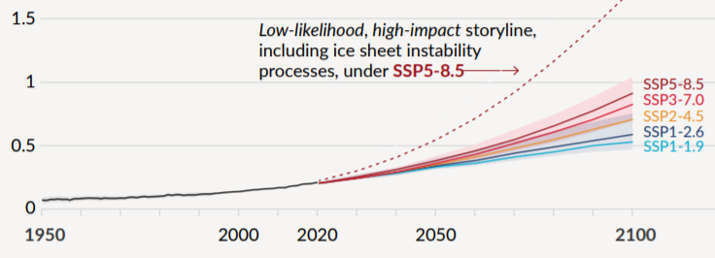
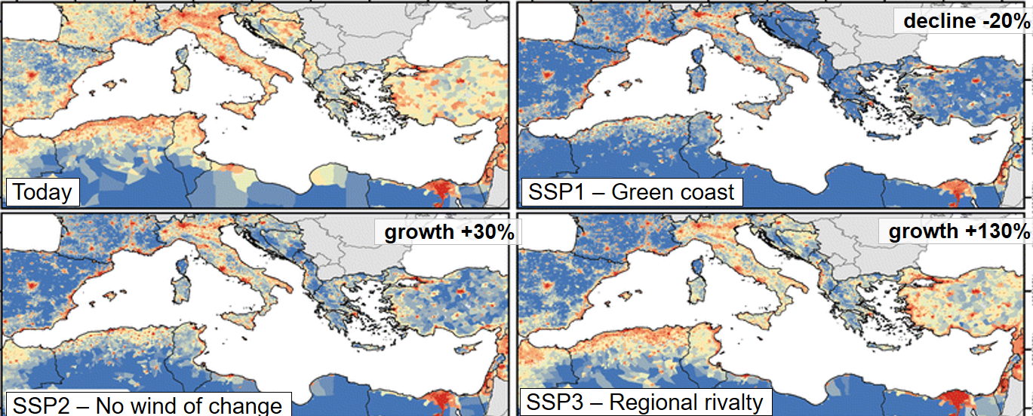
Integrated scenarios
Exploring parameters space:
Time horizons: 2010, 2030, 2050, 2100 (2150)
Return periods: annual, centennial, black swan (1:1000) events
Exploring future scenarios space:
Climate change and linked socio-economic scenarios:
  SSP1-2.6 (+1.8°C global warming 1850-1900 vs 2081-2100)
  SSP2-4.5 (+2.7°C)
  SSP5-8.5 (+4.4°C)
  SSP5-8.5 and high-end SLR
Adaptation options, based on costs benefit analysis:
  Relocation
  Protection
  Accomodation
AR6 WG1 SPM; Reiman et al., 2017
User benefit: a comprehensive and consistent set of scenarios to help prepare for diverse potential futures

Slide 7
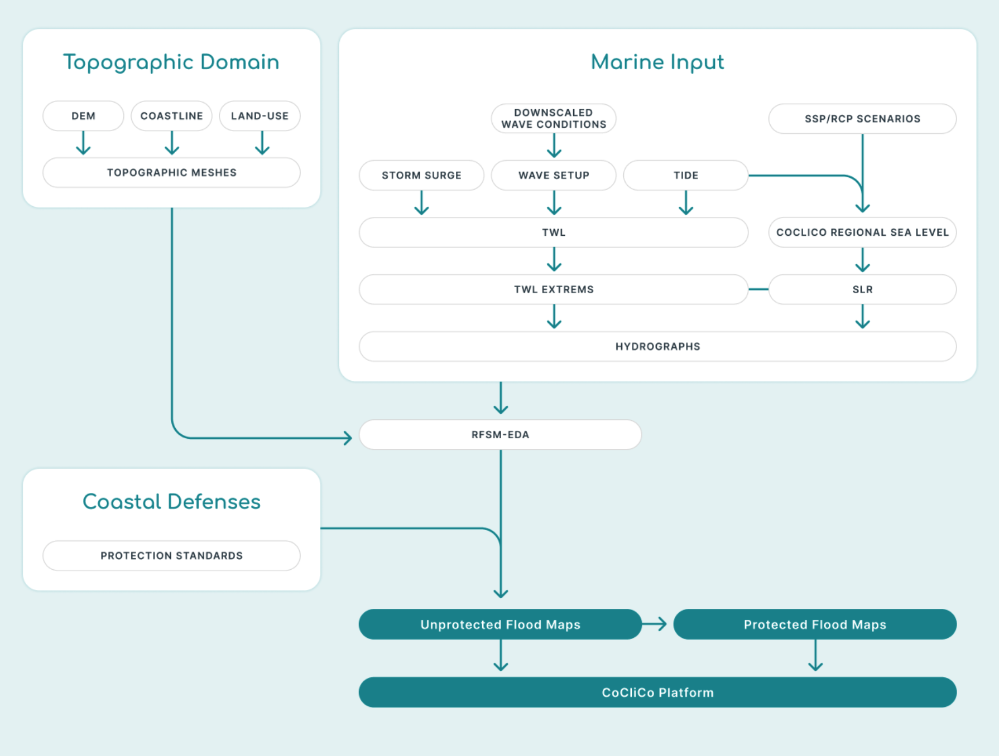
Future extreme water levels
"I need to see extreme water levels information now and in the future for different climate change scenarios, so I can do a broad-scale preliminary evaluation of risks.”

Slide 8
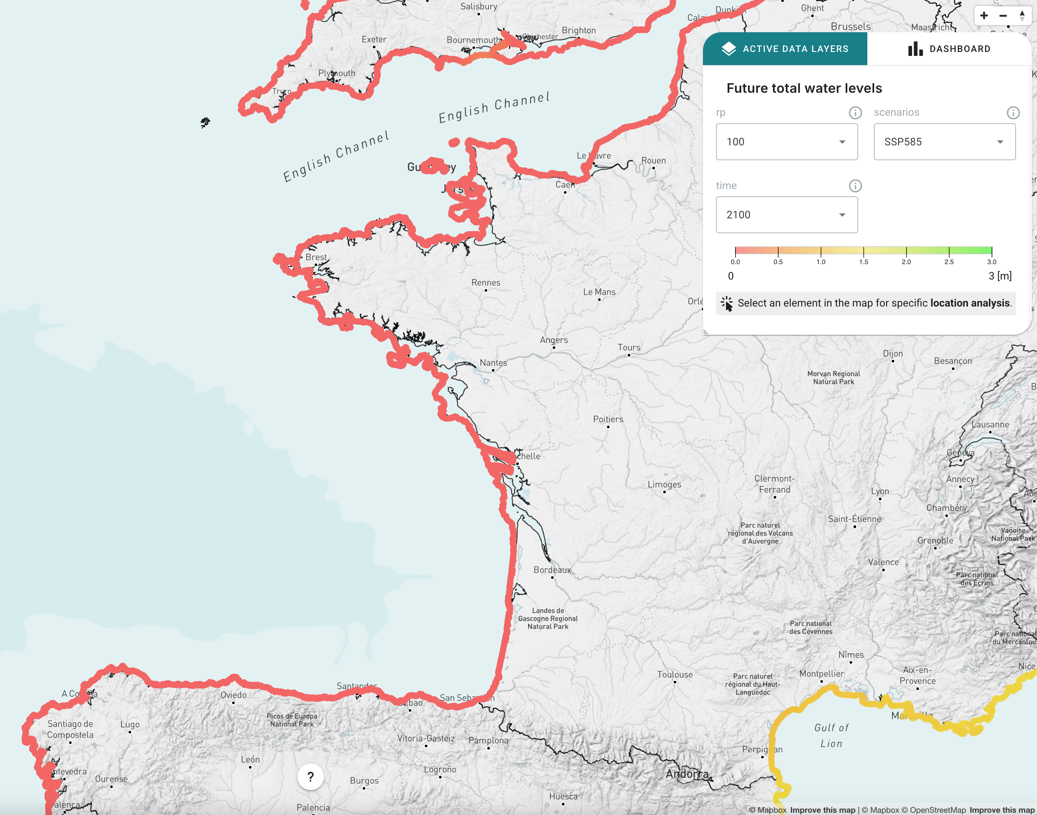
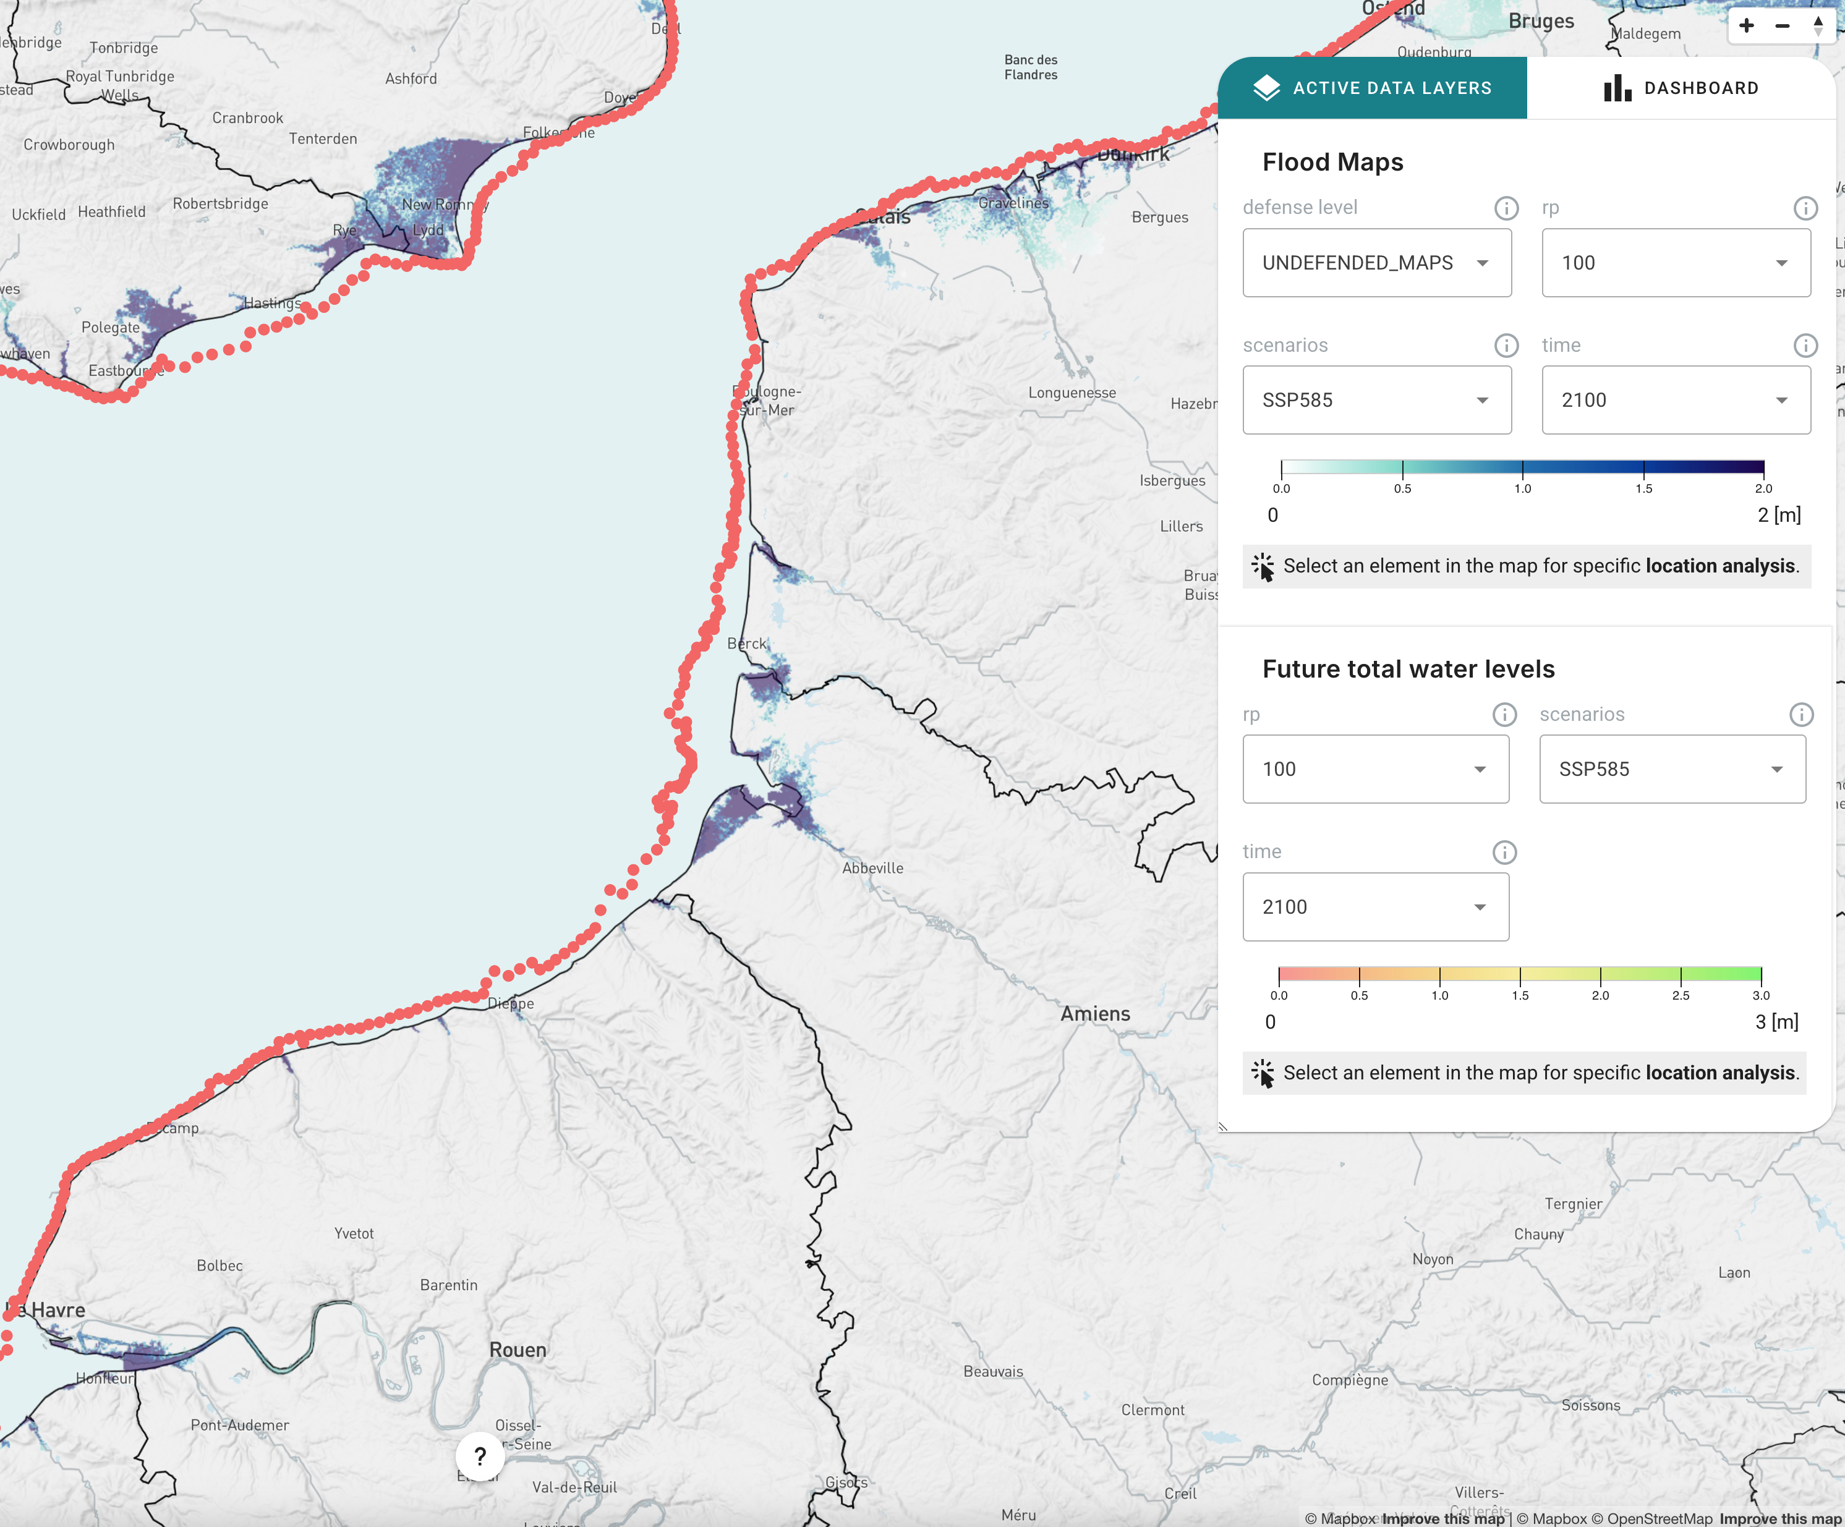
Future extreme water levels
"I need to see extreme water levels information now and in the future for different climate change scenarios, so I can do a broad-scale preliminary evaluation of risks.”

Slide 9
Future extreme water levels
"I need to see extreme water levels information now and in the future for different climate change scenarios, so I can do a broad-scale preliminary evaluation of risks.”

Slide 10
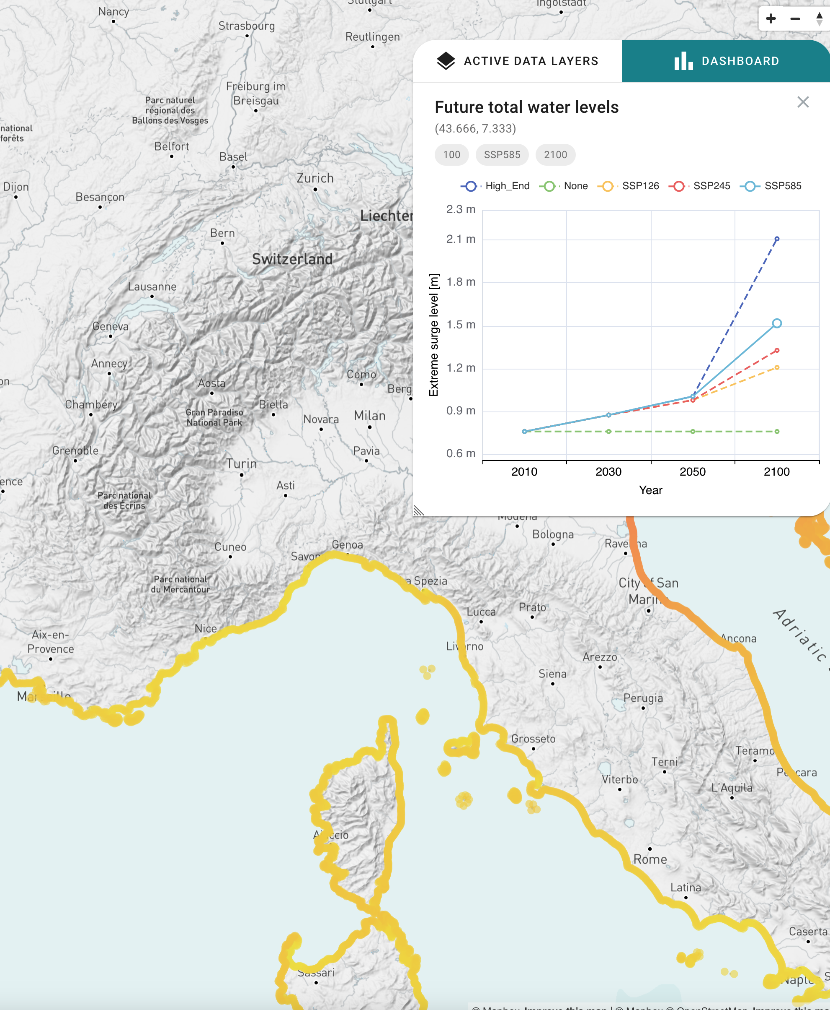
Future extreme water levels
"I need to see extreme water levels information now and in the future for different climate change scenarios, so I can do a broad-scale preliminary evaluation of risks.”

Slide 11
Future flooding
"I need to see flood extent and depth maps for different relative sea-level rise and storm scenarios so I can assess coastal flood risks and identify vulnerable areas across Europe."

Slide 12
Future flooding
"I need to see flood extent and depth maps for different relative sea-level rise and storm scenarios so I can assess coastal flood risks and identify vulnerable areas across Europe."

Slide 13
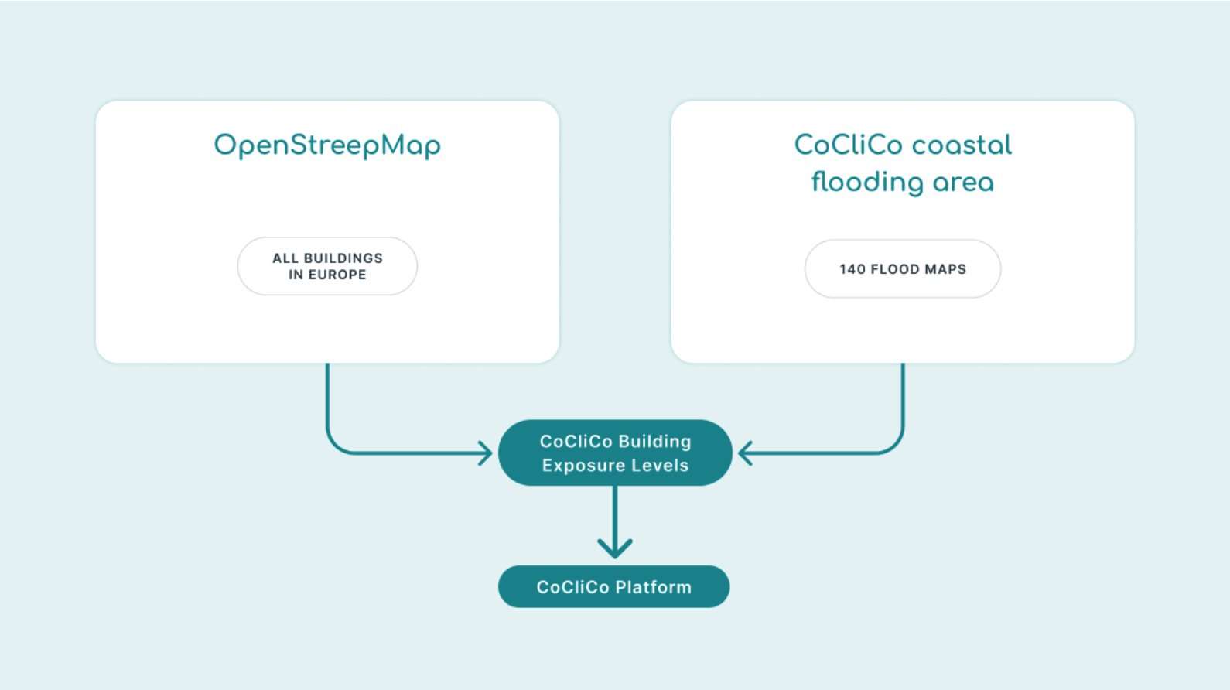
What is at risk from sea level rise in Europe?
"I need to see building exposure now and in the future for different climate change scenarios, so I can better understand the potential risk hotspots."

Slide 14
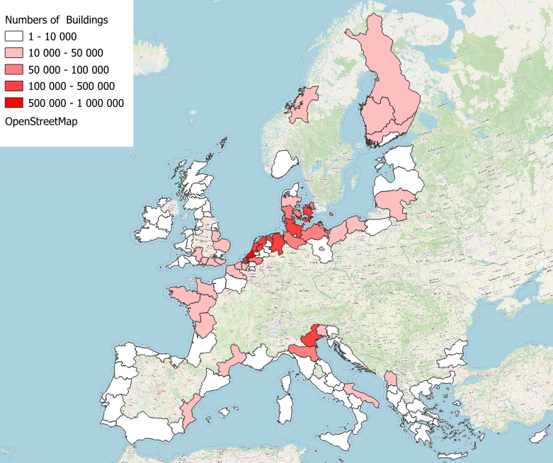
What is at risk from sea level rise in Europe?
"I need to see building exposure now and in the future for different climate change scenarios, so I can better understand the potential risk hotspots."
Event: 1-in-100-yr
Scenario: SSP5-8.5 (very high emissions)
Time horizon: 2100
! This map assumes no coastal defenses
Communication is sensitive: e.g. in Mediterranean France results may be used to promote large investments on coastal protection at the expense of tourism revenue & ecosystem losses and financial costs

Slide 15
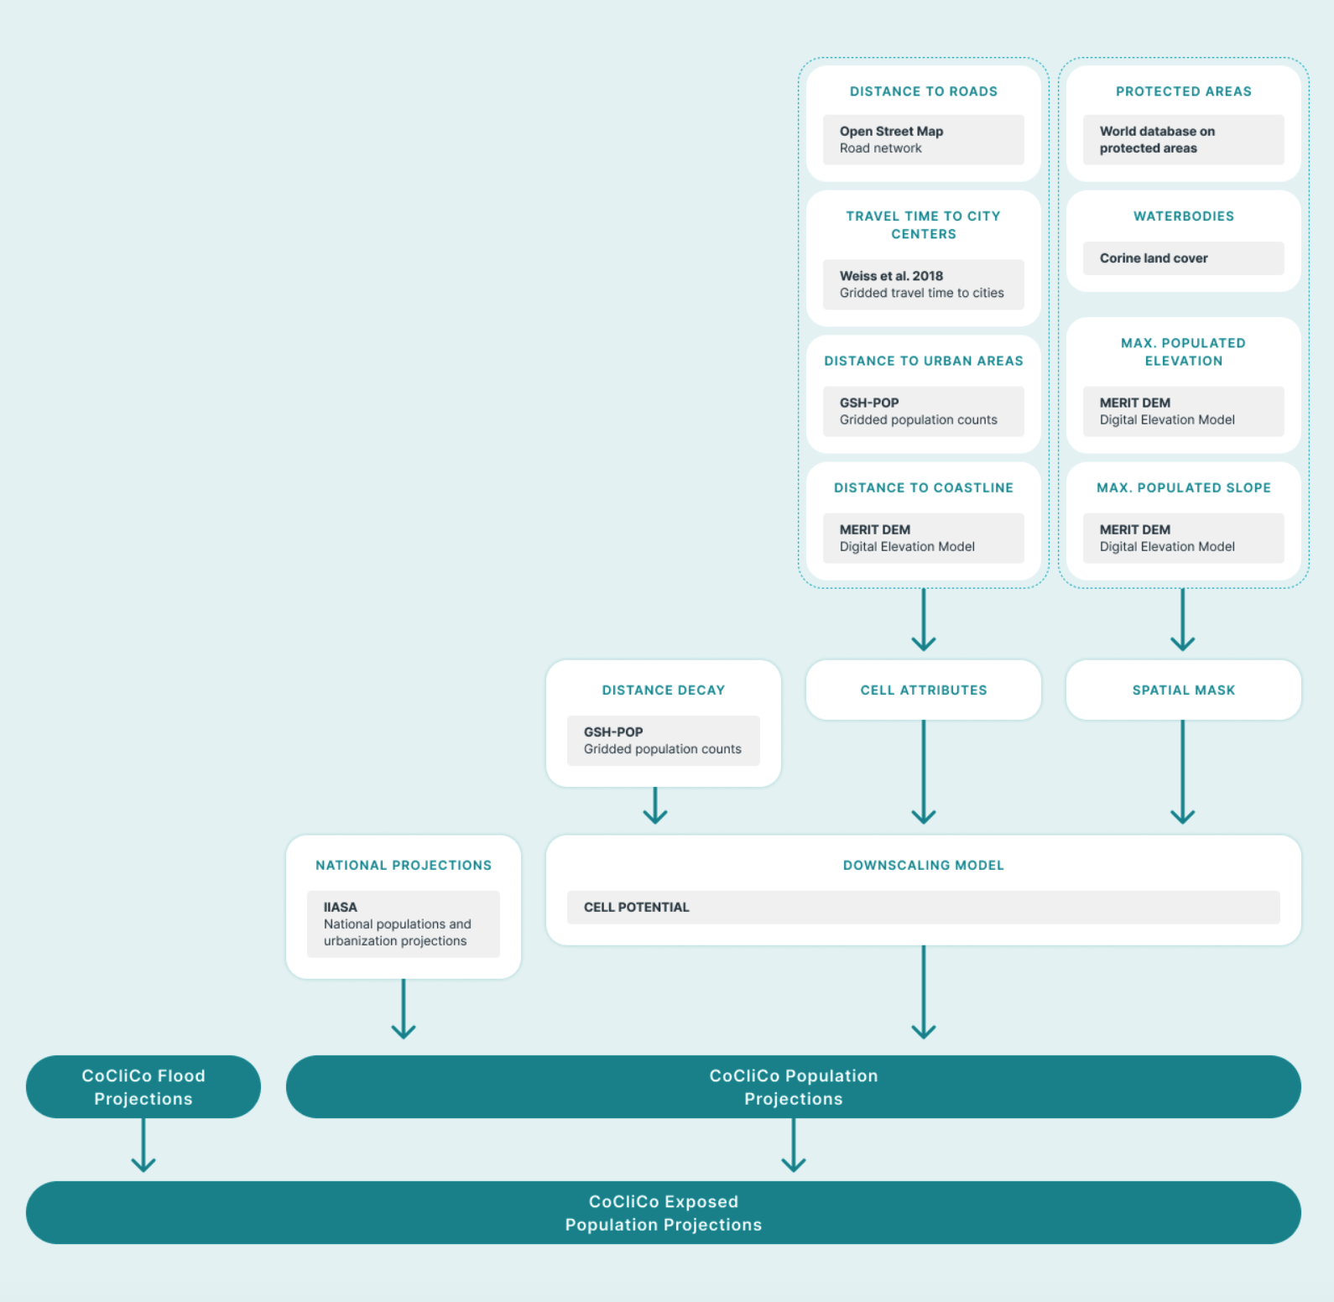
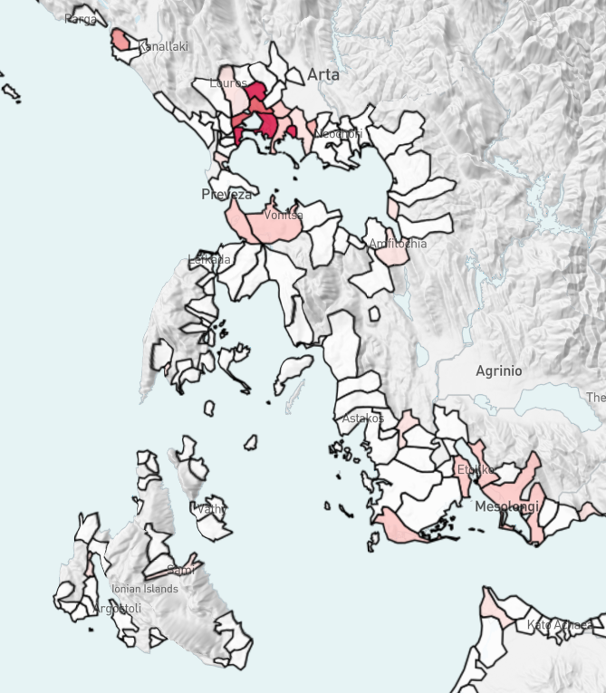
What is at risk from sea level rise in Europe?
"I need information of the development of exposed population in the future for different combinations of climate and socioeconomic scenarios on a regional to national scale, so I can preliminary assess exposure to coastal flooding."

Slide 16
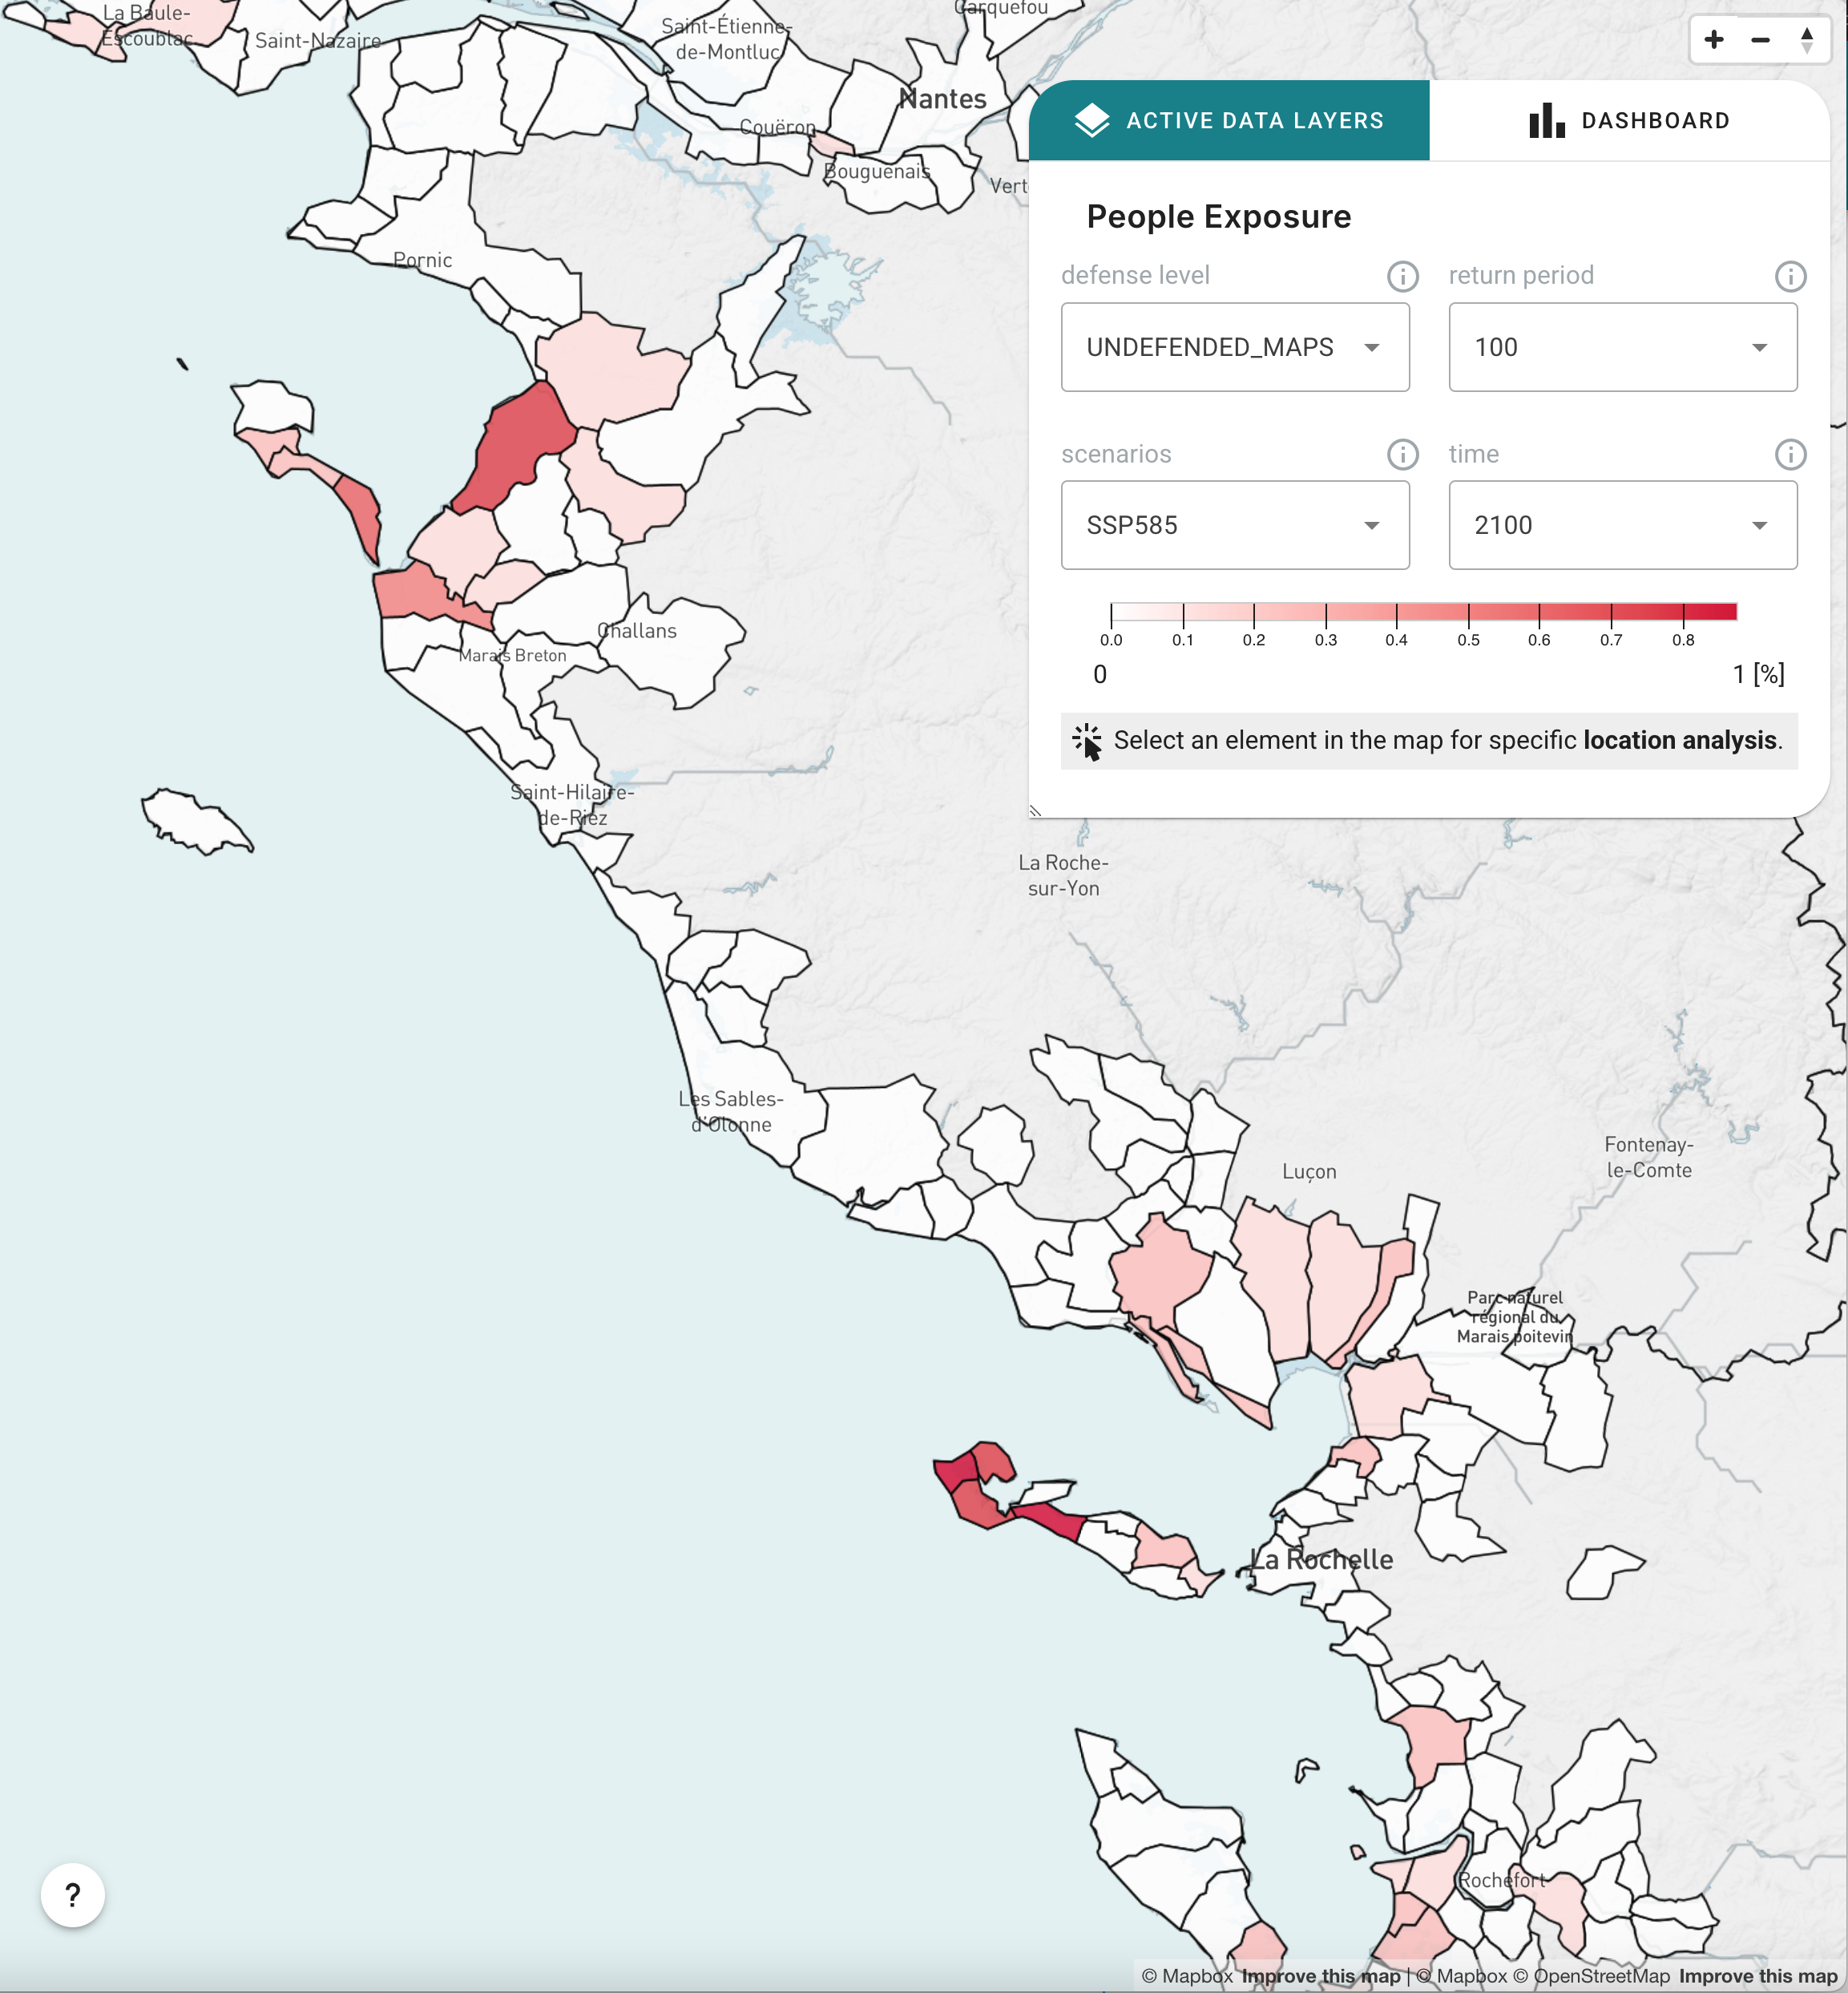
What is at risk from sea level rise in Europe?
"I need information of the development of exposed population in the future for different combinations of climate and socioeconomic scenarios on a regional to national scale, so I can preliminary assess exposure to coastal flooding."

Slide 17
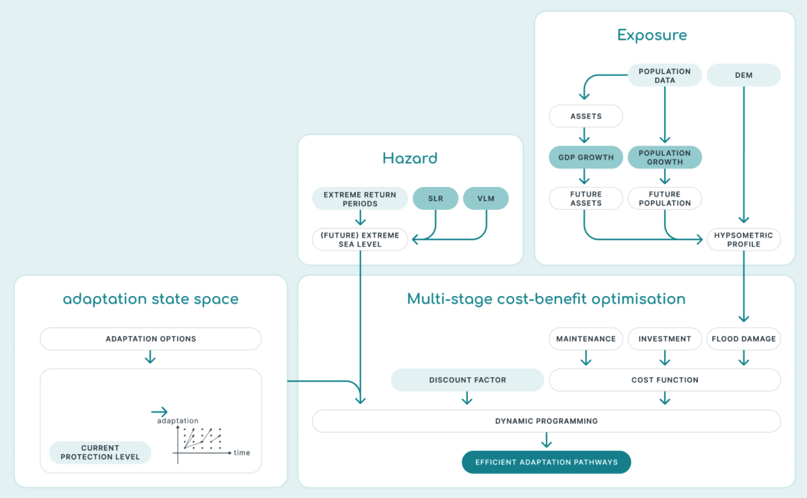
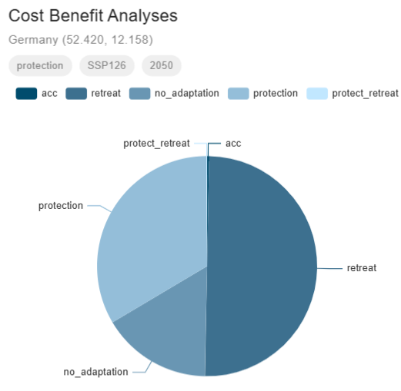
Adaptation: Cost-benefit analyses
"I want to see economically optimal coastal adaptation options both today and, in the future, as well as the expected investments in coastal adaptation and the potential costs of flood damages"

Slide 18
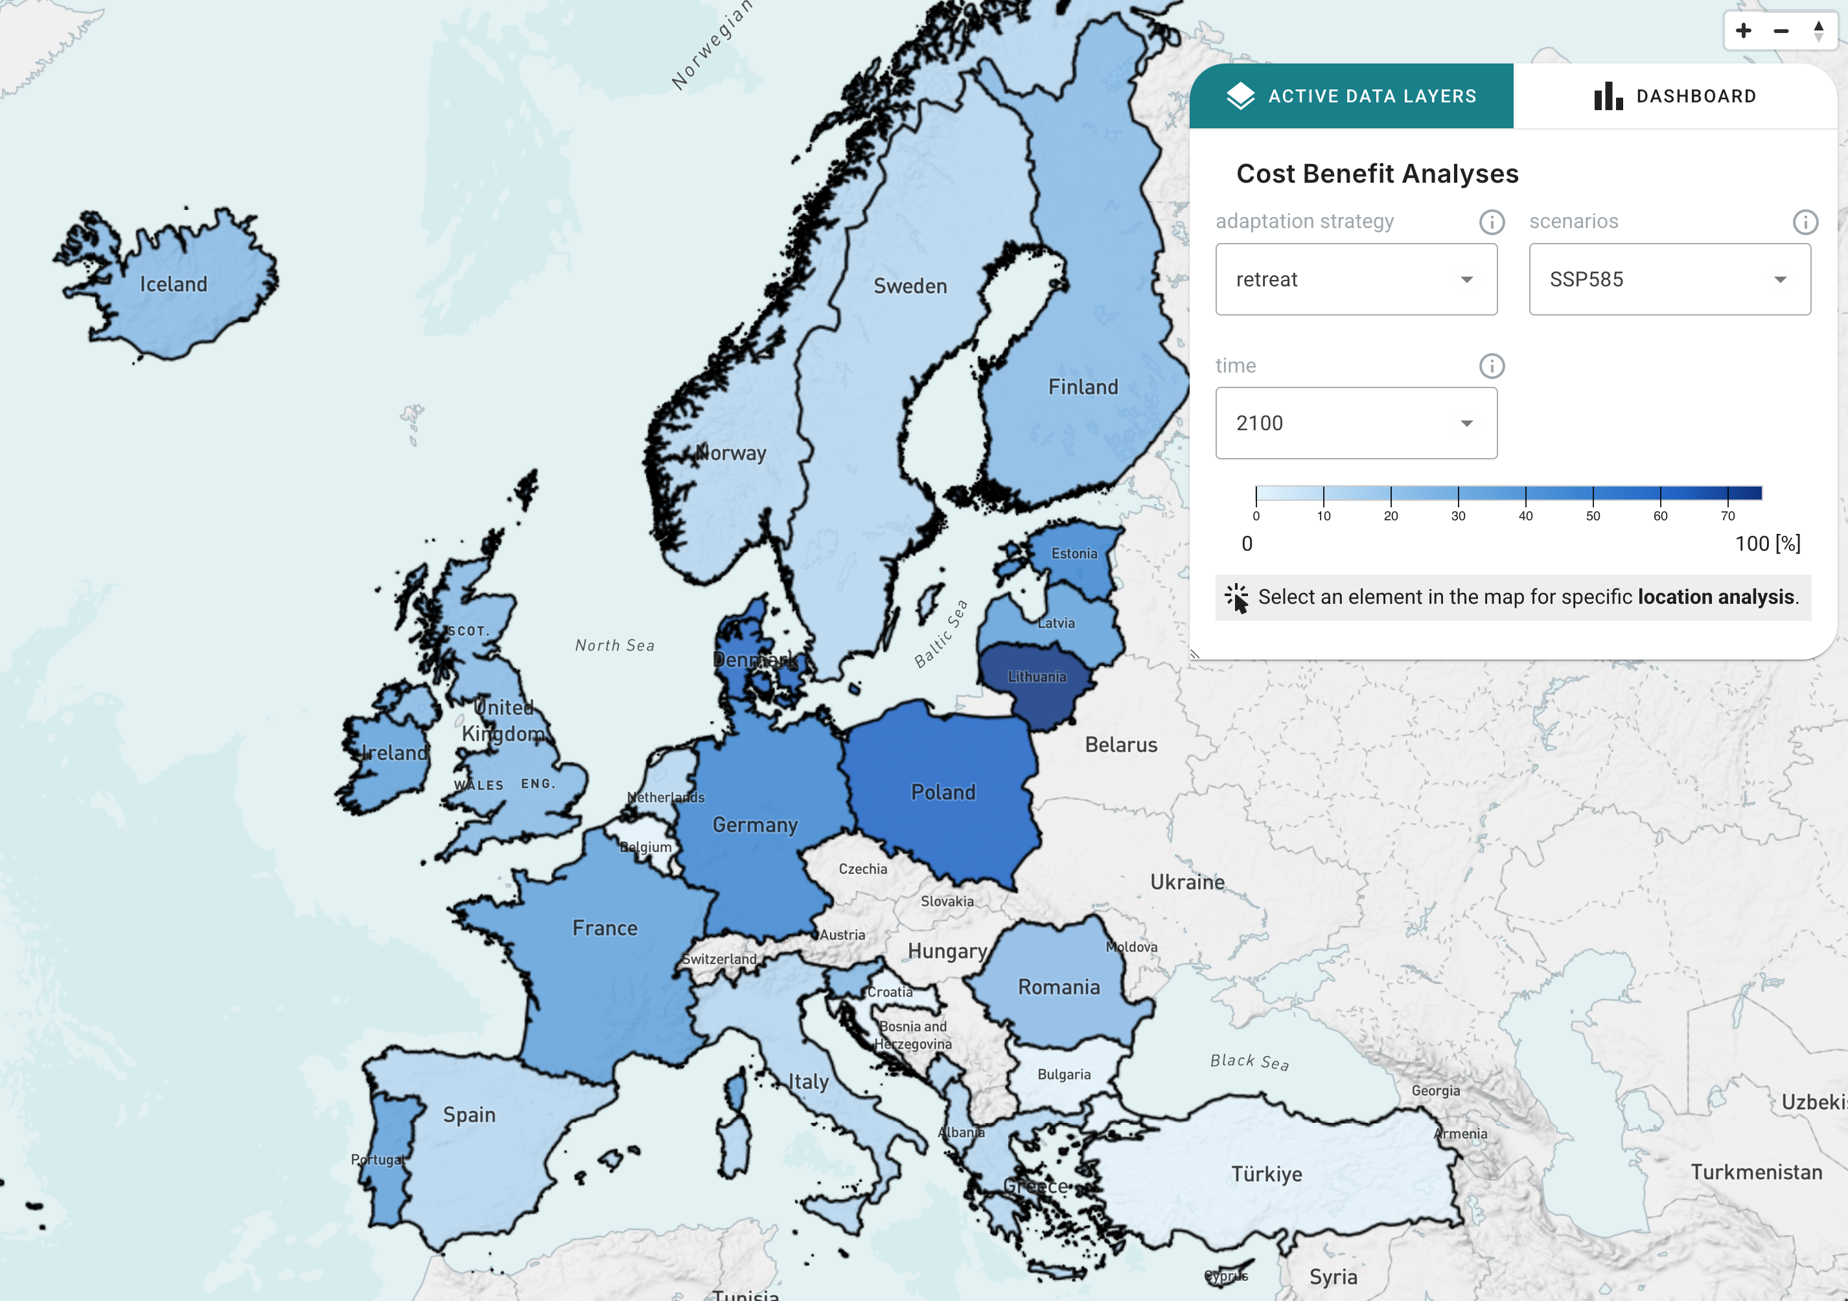
Adaptation: Cost-benefit analyses
"I want to see economically optimal coastal adaptation options both today and, in the future, as well as the expected investments in coastal adaptation and the potential costs of flood damages"

Slide 19
Adaptation: Cost-benefit analyses
"I want to see economically optimal coastal adaptation options both today and, in the future, as well as the expected investments in coastal adaptation and the potential costs of flood damages"

Slide 20
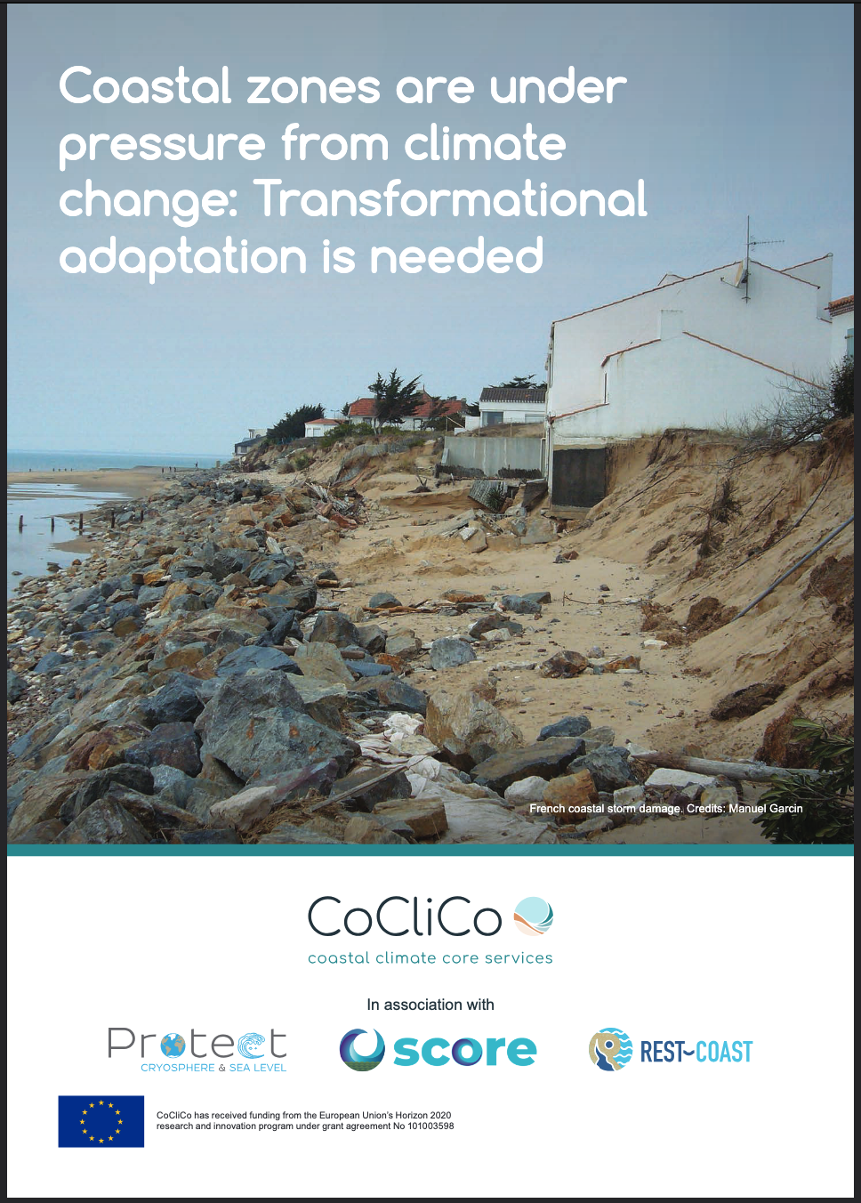
Key message:
Recommendation:
A European core climate service is needed to support timely coastal adaptation to sea-level rise. Integrating CoCliCo into the European Digital Twin of the Ocean initiative would provide a significant step towards this goal
Future:
CoCliCo could be a new service in the European Digital Twin of the Ocean / Copernicus Marine
Policy brief
The science is clear, but the response is a choice
Notes:
1. Prepare the ground for adaptation – raise awareness, create or reinforce institutions and governance, engage with coastal communities at risk
2. Assess risks and vulnerabilities
3. Assess adaptation options
4. Implement adaptation
5. Monitor adaptation progress

Slide 21


Thank you ! Want to know more ?
Platform going live for all
🗓️ Wednesday, 4 June 2025 🕑 14:00-15:30 CET 🌐 Online
Demonstration &
policy recommendation
🗓️ Wednesday, 11 June 2025 🕑 10:30-13:30 CET 🌐 EU Digital Ocean Pavilion, The Whale + Online
WEBSITE:
https://coclicoservices.eu
TWITTER:
https://twitter.com/CoCliCoServices
LINKEDIN:
https://www.linkedin.com/company/coclicoservices

Slide 22
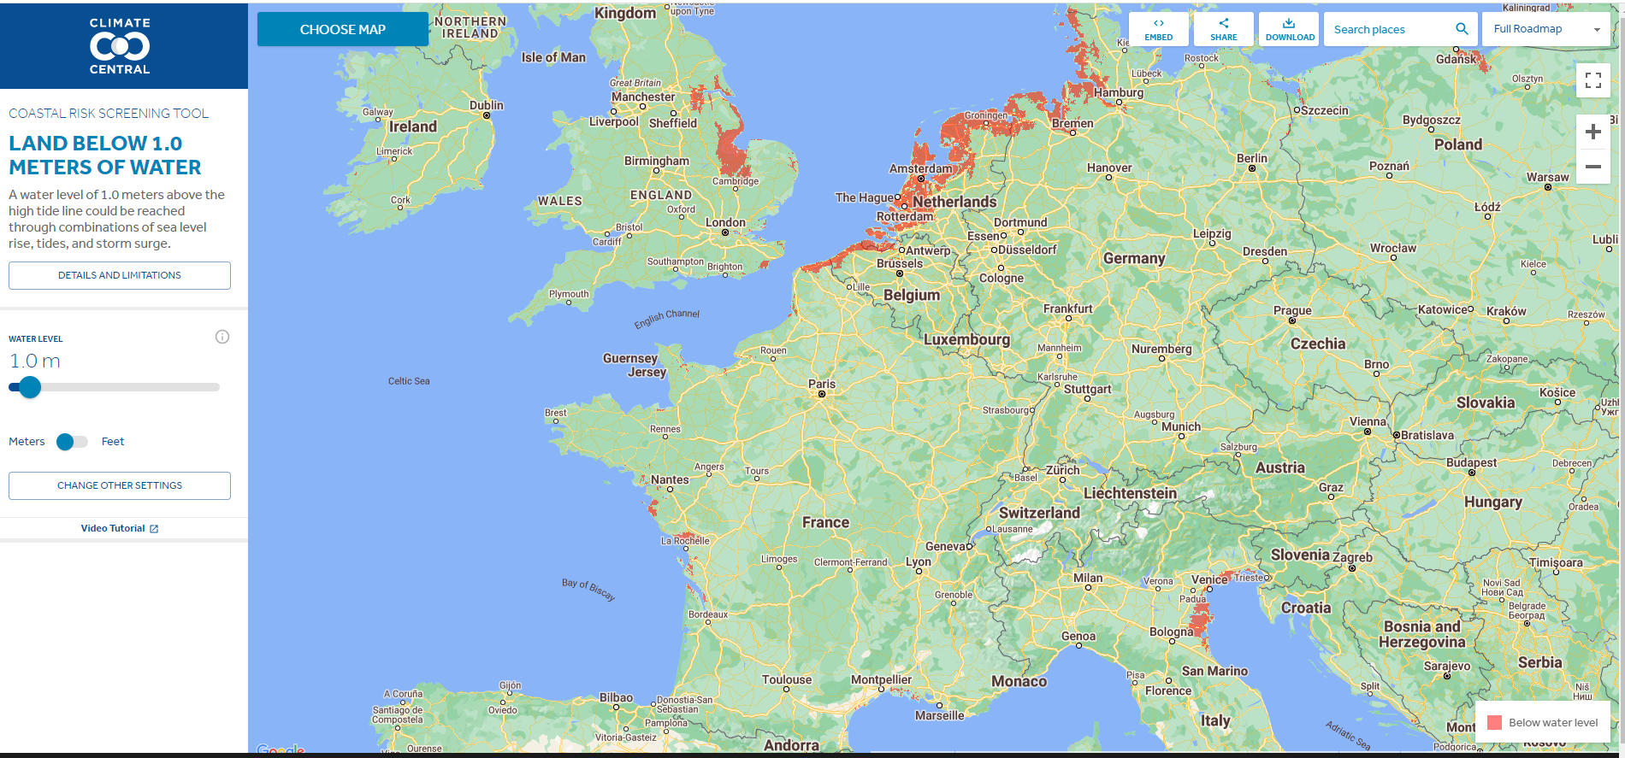
Existing broad scale tools to assess future impacts of sea-level rise
Marine flooding without protection - 1:100
Flood plain

Slide 23
Existing broad scale tools to assess future impacts of sea-level rise
Coastal risks: high exposure, adaptation costs and implementation times
Coastal ecosystem decline, economic and social development
Climate change and sea-level rise
Marine flooding without protection - 1:100
Flood plain

Slide 24
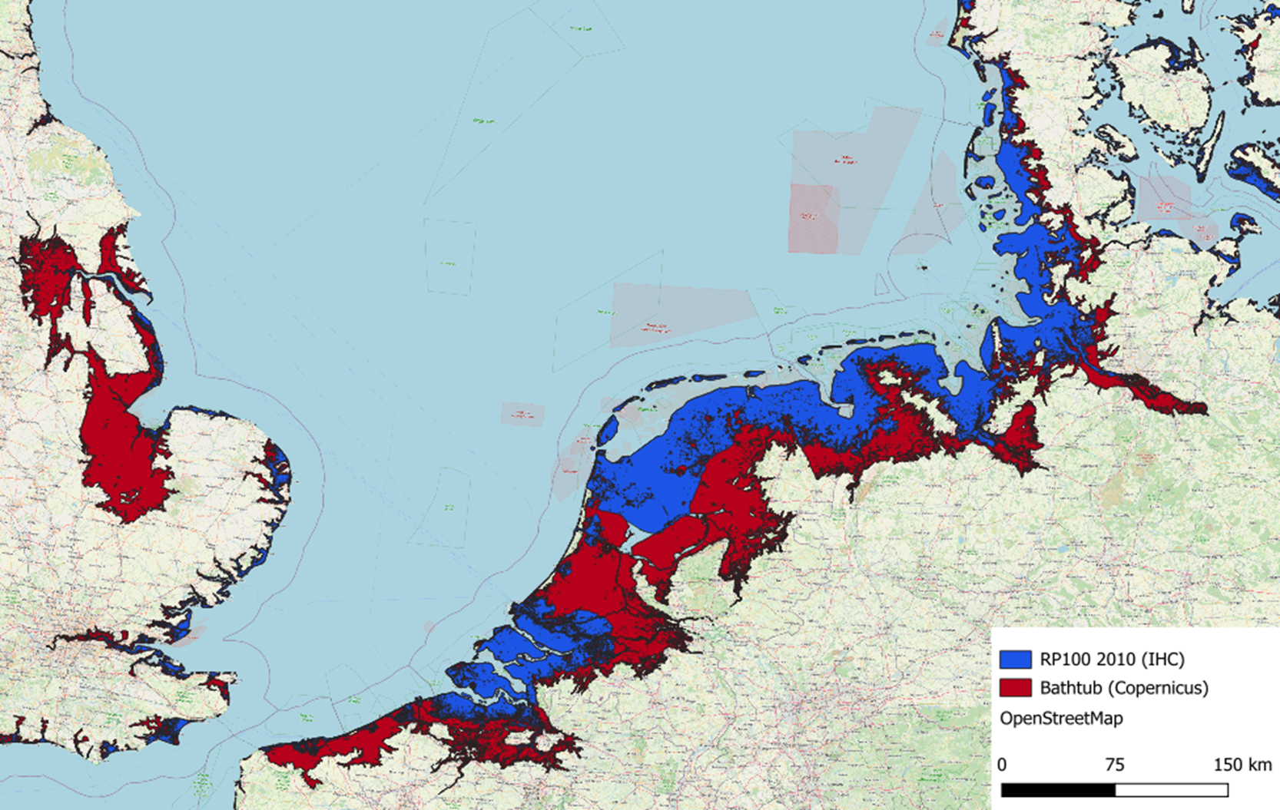
Existing broad scale tools to assess future impacts of sea-level rise
Marine flooding without protection - 1:100
Coastal risks: high exposure, adaptation costs and implementation times
Coastal ecosystem decline, economic and social development
Climate change and sea-level rise
Flood plain
Marine flooding without protection - 1:100
Flood plain

