Slide 1
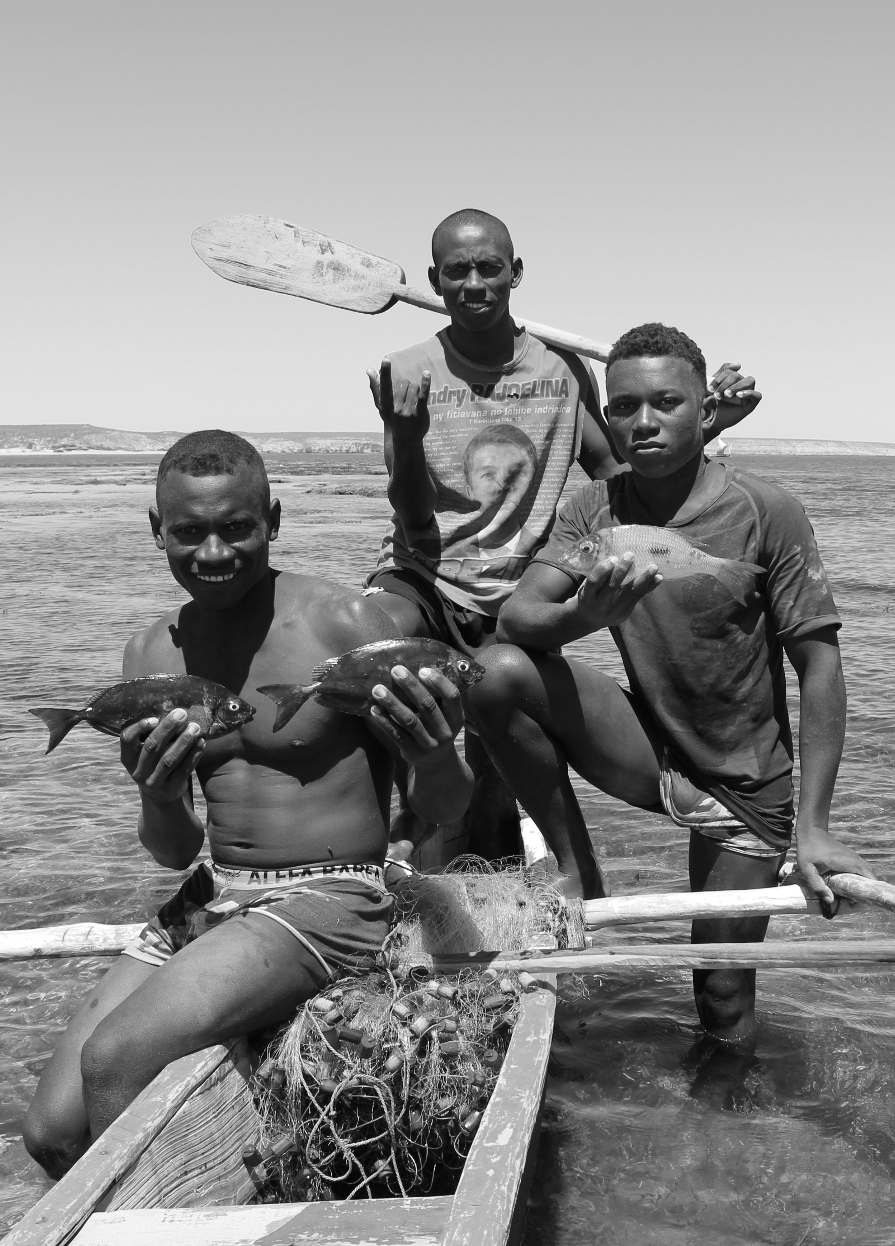


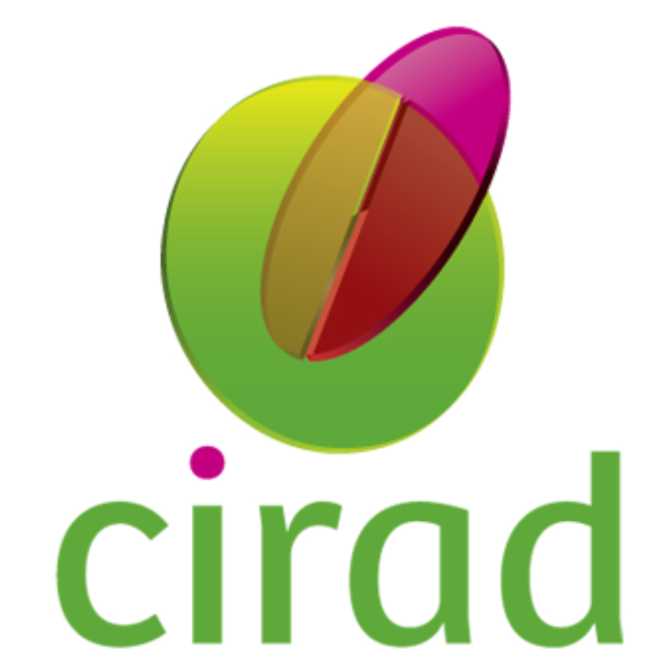




The hidden side of the co-production of small-scale fishery policy instruments in the South
Nina Razafimalala, Jérôme Queste,
Thierry Razanakoto, Zo Hasina Rabemananjara, and Marc Léopold

Slide 2

1. Introduction
2/10
SSFs have frequently been marginalized by centralized governance mechanisms.
Participation of stakeholders in the design of fisheries policy instruments is key.
Is the production of SSF policy instruments really inclusive?
How do power asymmetries shape participation?
Notes:
SSF Guidelines further encourage participatory governance
The participation of stakeholders in the design of fisheries policy instruments is a good governance practice
Influential actors
growing involvement of environmental non-governmental organizations (NGOs) since the 1990s

Slide 3
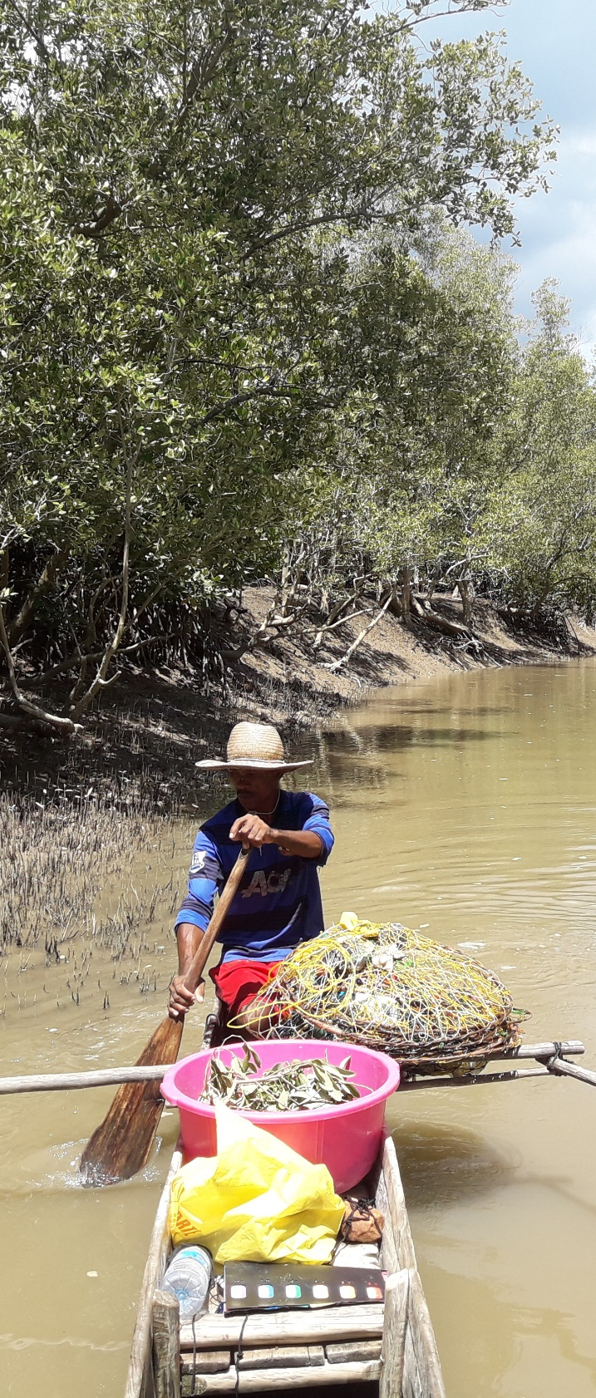
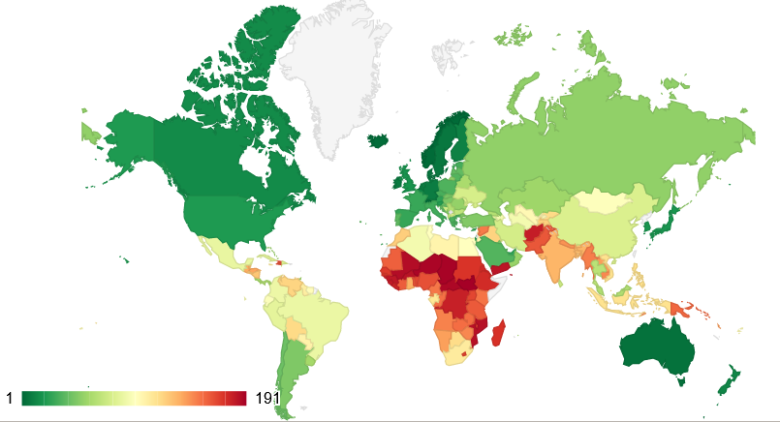
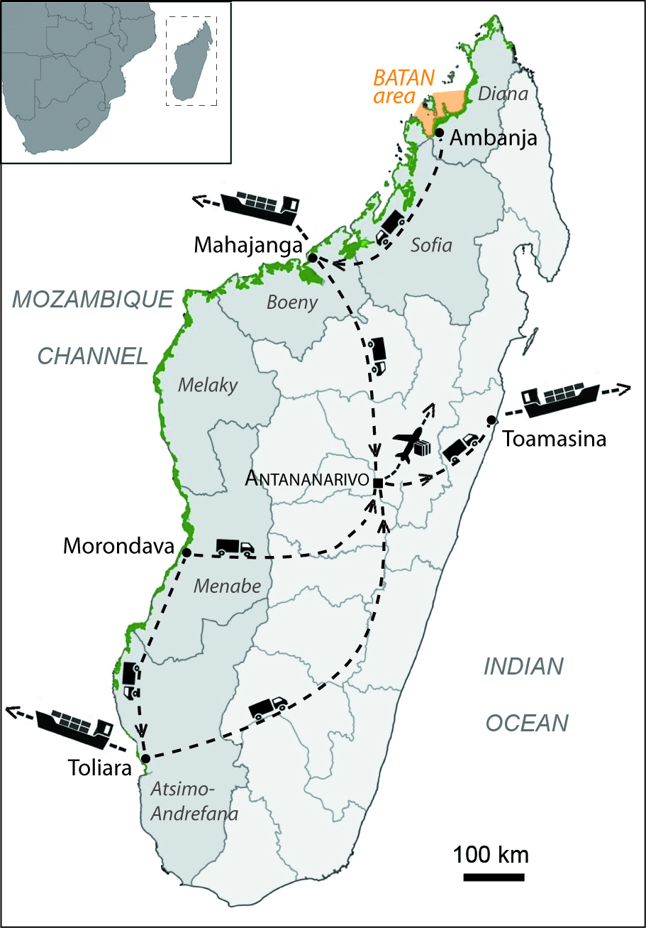
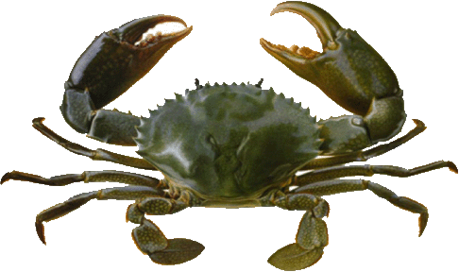
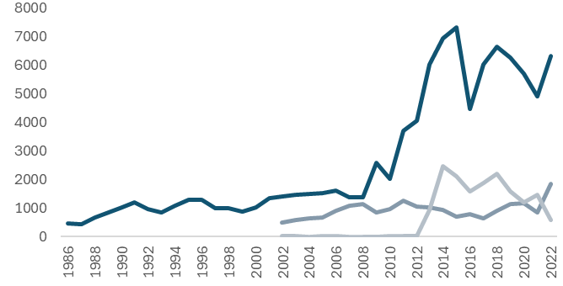
2. Case study in Madagascar
3/10
Mud crab small-scale fisheries and value chain
Export-oriented
~ 8,000 fishers ~ 6,000 t
Few major exporting firms
Ex-vessel price 0,5-1 $/kg
Human Development Index 2021
Madagascar
Tons
Catch
Exports
Frozen crabs
Live crabs
Shift in markets
Notes:
Atomistic nature of SSF

Slide 4
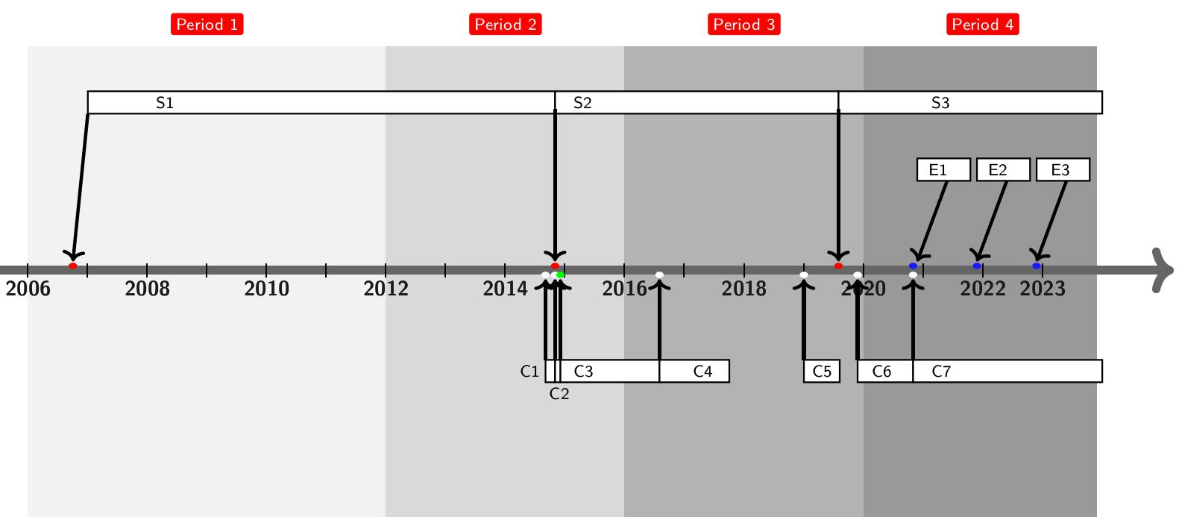
2. Qualitative interdisciplinary study of policy instruments
1/7
4/10
A] Diachronic analysis: policy instruments since the 1980s & drivers of change
Slow development of exports
Shift in markets
Restructuration of the value chain
Disruptive effects (COVID-19…)
Minimum size
Export
quotas
National closure
Total maximum catch limit
Total maximum export limits

Slide 5
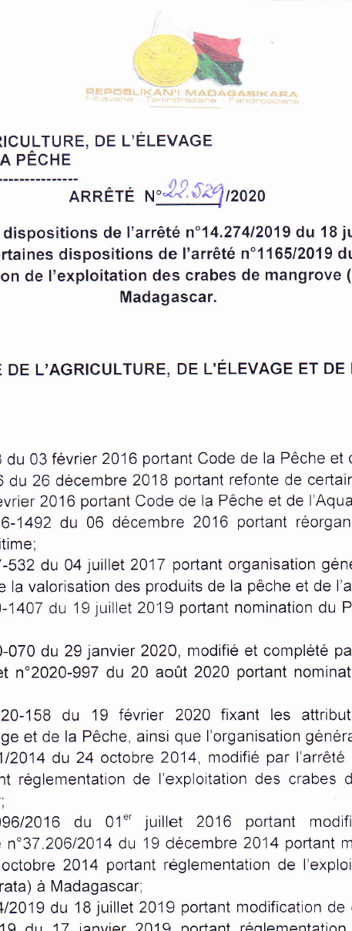
2. Qualitative interdisciplinary study of policy instruments
5/10
B] Contribution of non-state stakeholders at each step ?
Data collection methods (2021-2022)
- 90 secondary sources (technical reports, workshop reports, media…)
- 21 semi-structured interviews

Slide 6
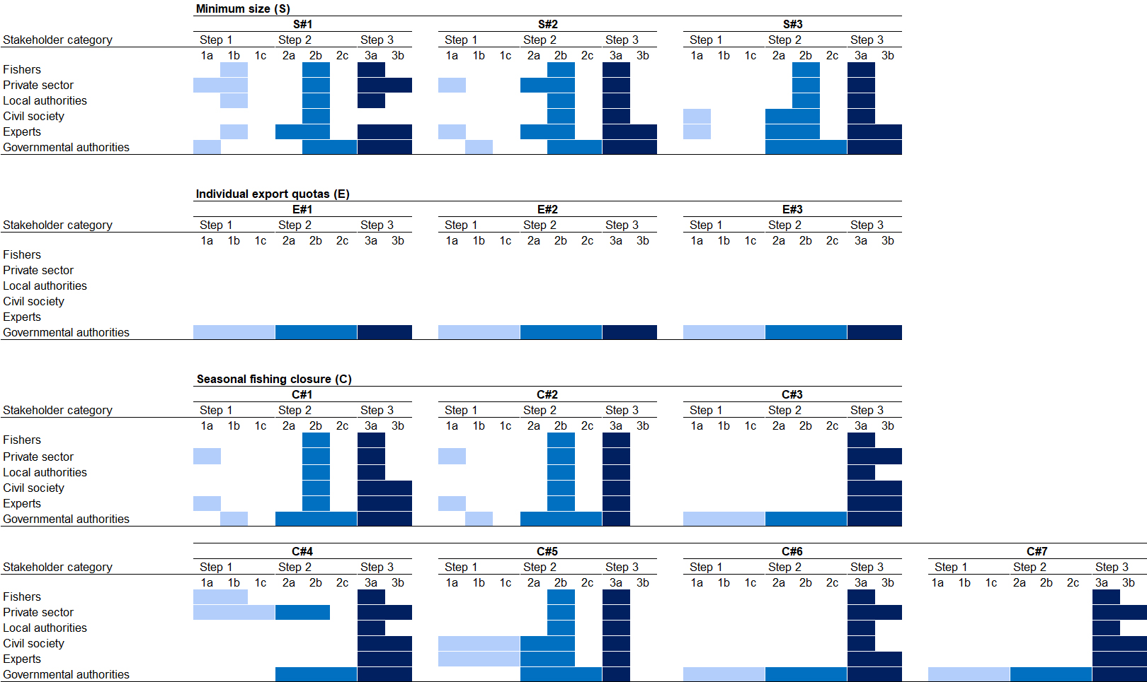
3. Main findings
6/10
Minimum size
1 2 3 Number of instruments
Actors
Government
Export quotas
1 2 3 Number of instruments
Actors
Government
National closure
1 2 3 Number of instruments
Actors
Government
4 5 6 7
Government

Slide 7
3. Main findings
7/10
Minimum size
1 2 3
-Non-state actors contributed primarily in the initial and implementation phase of fishery instruments
Government
Export quotas
1 2 3
Government
National closure
1 2 3
-Power asymmetries
Government
4 5 6 7
Government
Notes:
The participation of non-state stakeholders was significant primarily in the initial policy conception phase
(design, early development) and implementation of fishery instruments

Slide 8
3. Main findings
8/10
Minimum size
1 2 3
The final content was changed with limited participation
decision
decision
decision
Government
Export quotas
1 2 3
Government
National closure
1 2 3
decision
decision
Government
4 5 6 7
decision
decision
Government

Slide 9
3. Main findings
9/10
Minimum size
1 2 3
Government
Export quotas
1 2 3
Lack of transparency
No participation
Government
National closure
1 2 3
No participation
Government
4 5 6 7
No participation
No participation
Government

Slide 10
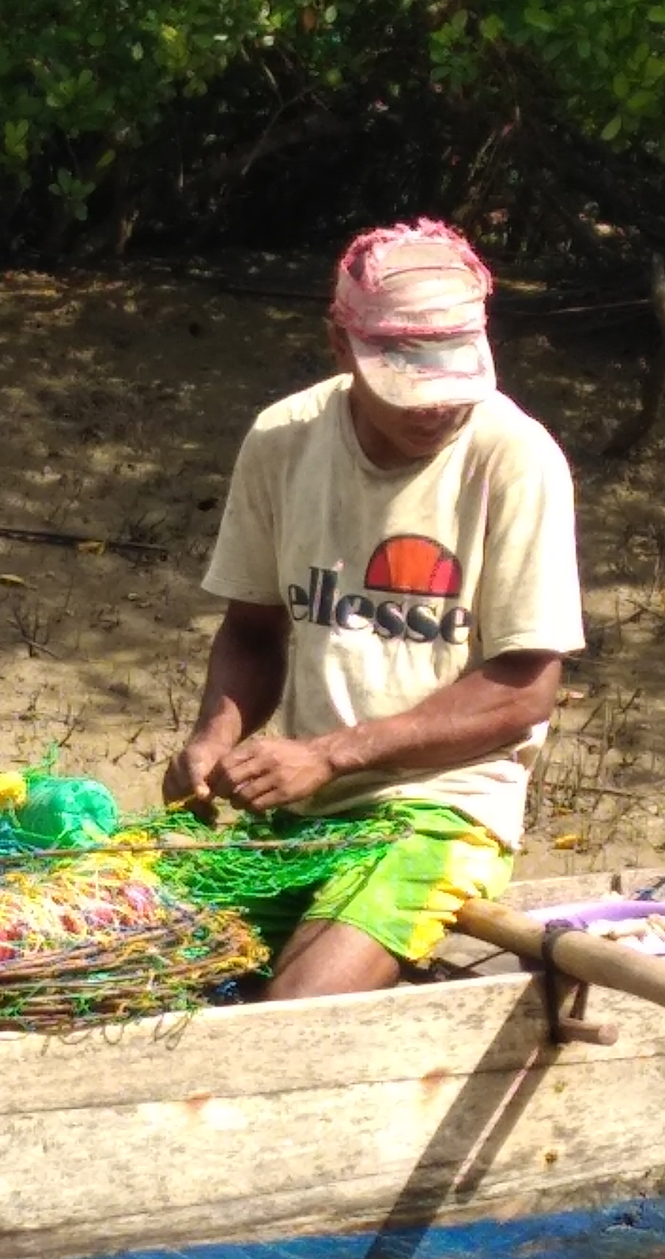
4. Key lessons learnt
1/7
10/10
The hidden side…
Fishers and local communities made
a smaller contribution than other influencial agents (i.e., NGOs, experts, exporting companies)
2. The governance of the small-scale fisheries was apparently inclusive
The way forward…
3. Transparent institutions are needed
for a meaningful contribution
of local communities
Notes:
to make co-production of fishery instruments effective
(local knowledge and interests)

Slide 11


The hidden side of the co-production of small-scale fishery policy instruments in the South
(2017 – 2023 http://corecrabe.ird.fr/)
Nina Razafimalala razafynina@gmail.com
Jérôme Queste jerome.queste@cirad.fr
Thierry Razanakoto thierry.razanakoto@gmail.com
Zo Hasina Rabemananjara rabemazohasina@gmail.com Marc Léopold marc.leopold@ird.fr
Notes:
(10s)
J’ai repris ici le titre comme indiqué dans le programme IPOS et ajouté un sous-titre plus dans l’idée que nous souhaitons développer, mais qui peut être modifié évidemment.
L’image peut être modifiée également.

