Slide 1
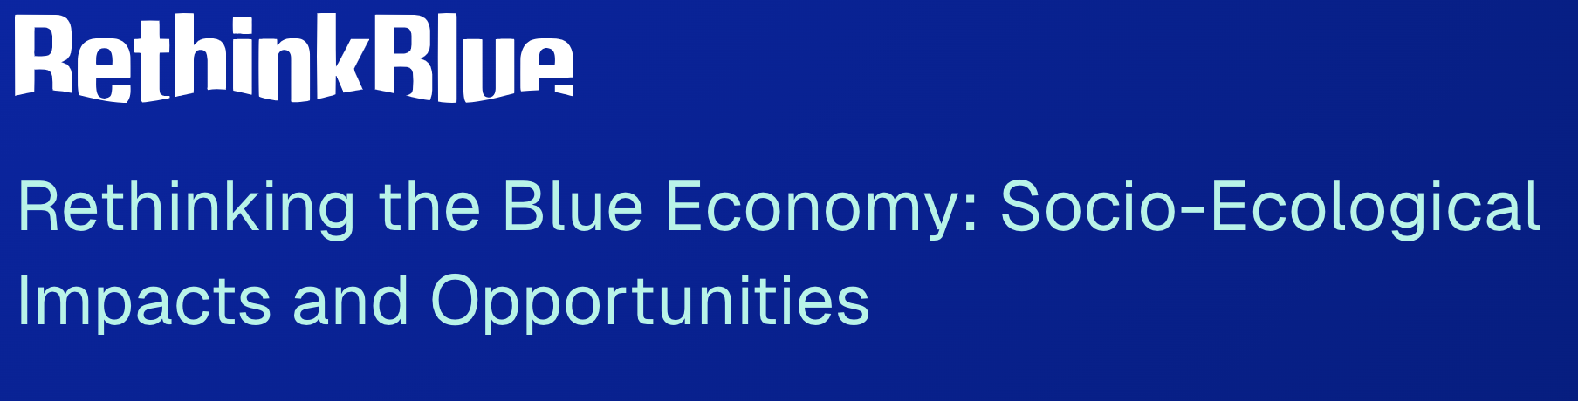

Rethinking the Blue Economy for Sustainability and Justice
Jerneja Penca, Science and Research Centre Koper, Koper, Slovenia, jerneja.penca@zrs-kp.si
Irmak Ertör, The Ataturk Institute for Modern Turkish History, Bogazici University, Istanbul, Turkey.
Marta Ballesteros, Spanish Institute of Oceanography (IEO-CSIC), Vigo, Spain.
Michael Briguglio, University of Malta, Malta.
Maciej Kowalewski, Institute of Sociology, UNESCO Chair for Social Sustainability, University of Szczecin, Poland.
Birgit Pauksztat, Nordland Research Institute, Bodø, Norway.
Dražen Cepić, Institute for Social Research in Zagreb, Croatia.
Cristina Piñeiro-Corbeira, BioCost Research Group, Universidad de A Coruña, Spain.
Natasa Vaidianu, Faculty of Natural Sciences and Agricultural Sciences, Ovidius University of Constanta, Romania; CICADIT Center, University of Bucharest, Romania.
Sebastian Villasante, EqualSea Lab-CRETUS, University of Santiago de Compostela, Spain.
José J. Pascual-Fernández, Instituto Universitario de Investigación Social y Turismo, Universidad de La Laguna, Tenerife, Spain.

Slide 2
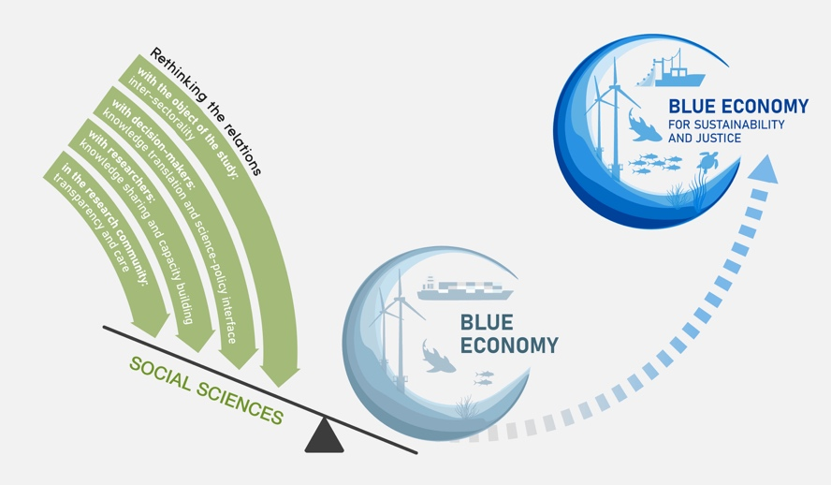

Slide 3
Context
The innovative, emancipatory and ecosystem-based potential of the Blue Economy concept seems to not be materialising today.
Alternative frameworks can inadvertently widen the gap between science and policy.
The Blue Economy concept has an appeal both among policy makers and private sector.

Slide 4
Rethinking the Blue Economy and the Role of the Social Sciences
The social sciences are instrumental in building a more just and sustainable Blue Economy through:
understanding, holistically and critically, the impacts of the Blue Economy in specific contexts;
designing alternative visions of the future and pathways that enable more just and sustainable decision-making;
supporting the science-policy interface to enact justice and sustainability.
All of these bring direct benefits to decision-makers.

Slide 5
The Strategy for Rethinking the Blue Economy
Rethinking the Relations
with the Object of the Study: Societal anchoring
with Sea Users: Co-Creation
With Decision-Makers: Science-Policy Interface
among Researchers: Knowledge Integration
in the Research Community: Accountability and Care

