Slide 1
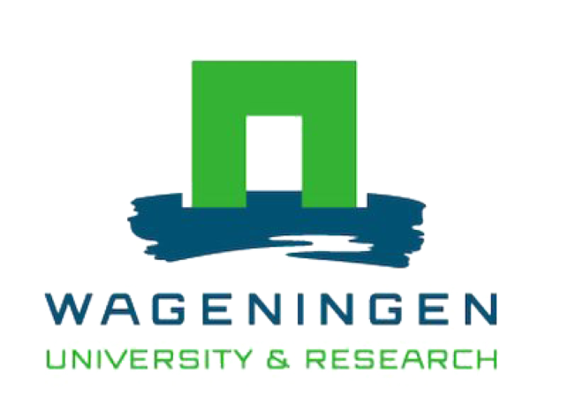
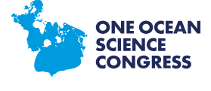


Three gaps in international mesopelagic fisheries governance
Laura G. Elsler, Maartje Oostdijk, Lisa Levin, Andries Richter, Christopher Golden
June 2025

Slide 2
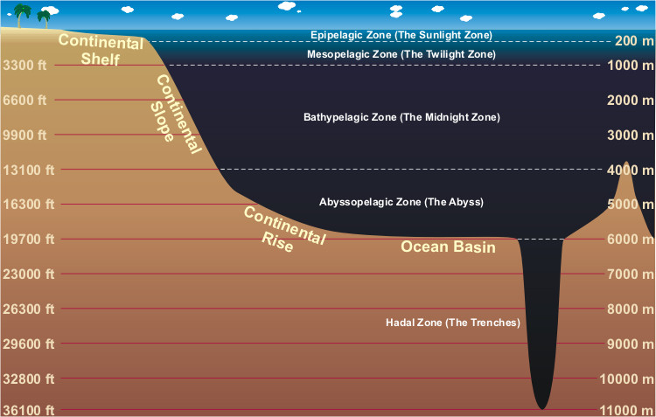
What and where is the mesopelagic zone?
The mesopelagic zone:
  ~60% of the world’s surface area and occupying
  ~20% of oceans total volume
This zone could contain 2,000-16,000 million tonnes of fish biomass (Proud et al. 2019) (global fish production is ~ 100 million tonne)
International waters
Image: NOAA
Notes:
The mesopelagic zone, also called the twighlight zone is a zone in the pelagic ocean between 200 and a 1000 meters. This zone occurs in around 60% of the world’s surface area and occupies 20% of the oceans volume.
You can see the mesopelagic on this figure, just below the epipelagic zone. The twilight zone of the ocean gets a small amount of light—enough for some animals to see, but not enough for plants to grow through photosynthesis.
This zone is well known for it probably containing an enormous amount of fish biomass. Between 2000 and 16000 million tonnes!. Compared to 100 million tonnes of global fisheries production, this is of course a very large and to date almost completely unexploited amount of fish.
Large shares of the mesopelagic in international waters.

Slide 3
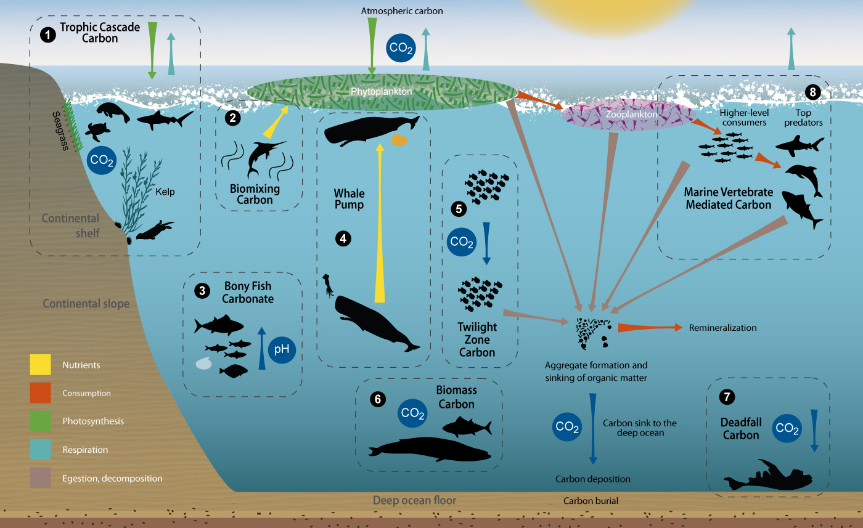
What and where is the mesopelagic zone?
Crucial for climate regulation
Interest harvesting among some countries/companies
Fish species rich in lipids and fatty acids, potential fish oil and meal for aquaculture feed (Olsen et al. 2020)
Image: Lutz and Martin (2014)
Notes:
The mesopelagic zone plays a key role in the global carbon cycle.
Many organisms migrate vertically and actively transport carbon from surface waters to deeper layers, known as the biological carbon pump.
This helps store carbon in the deep ocean for hundreds to thousands of years, buffering atmospheric CO₂ levels and mitigating climate change.
There's growing attention on mesopelagic fish as a potential new marine resource.
Some countries and private companies are exploring commercial harvesting, driven by demand for fish protein and bio-based products.
However, ecosystems in this zone are poorly understood, raising concerns about overexploitation and unintended impacts on carbon cycling and food webs.
Mesopelagic species such as those in the lanternfish family are nutrient-rich, especially in omega-3 fatty acids and lipids.
This makes them attractive for use in fishmeal and fish oil, particularly in the aquaculture industry.
Olsen et al. (2020) highlighted the nutritional value and industrial potential, but also the need for careful management and ecological assessment before exploitation.

Slide 4

Governance Gaps Approach: policy text analysis, nutrition analysis
How can mesopelagic fish contribute to nutrition?
Is the mesopelagic part of international ocean policy making?
How does it feature compared to other ocean zones?
Nutrition: Analysis on nutrient profile using the Aquatic Food Composition Database (meta-analysis on nutrients) (Golden et al., 2021)
Governance: Ocean policy data set contains 2,700 binding and non-binding policies (Elsler et al., 2022)
Notes:
To better understand how the mesopelagic zone fits into global governance and nutrition strategies, we used mixed methods: focused on nutrition data, and policy texts.
We asked: Can mesopelagic fish contribute meaningfully to human nutrition? To explore this, we used the Aquatic Food Composition Database (Golden et al., 2021), which compiles nutrient profiles from thousands of aquatic species globally."
This data allows us to evaluate their nutritional potential in and compare it to profiles of other aquaculture species.
We also wanted to know: Is the mesopelagic zone included in ocean governance, and how does it compare to other zones?"
Using a dataset of 2,700 international ocean policies , both binding and non-binding (Elsler et al., 2022), we performed a text-based policy analysis.
We looked for references to the mesopelagic zone, its species, or related terms to assess how well it is represented in policy frameworks.
This approach helps identify governance gaps, areas where policies may overlook this ecologically and nutritionally important zone.

Slide 5
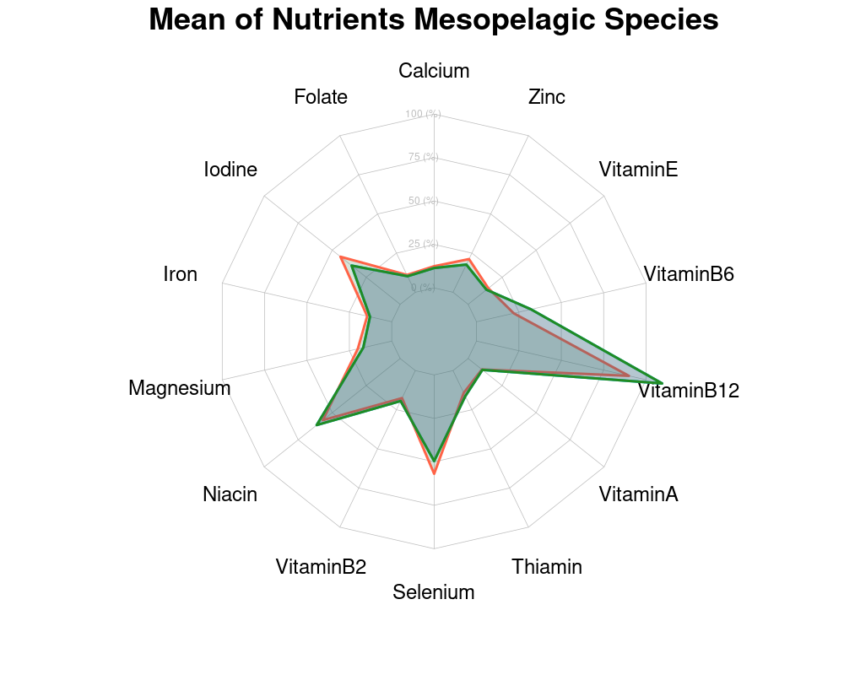
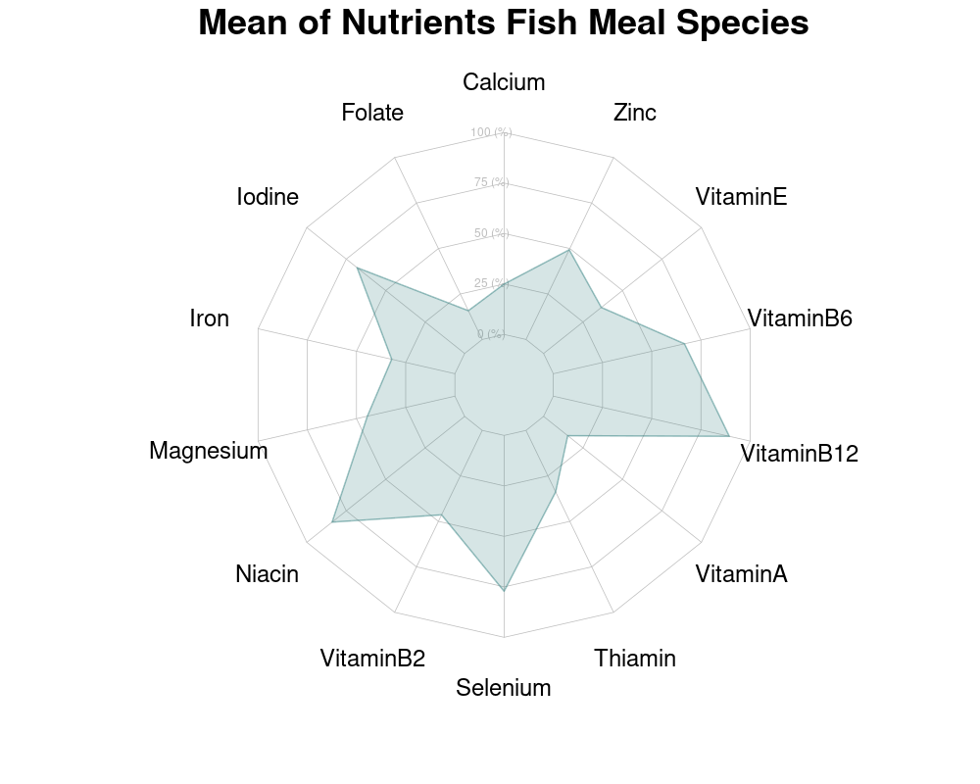
Finding 1: Nutrient profile of mesopelagic species shows similarity to other fish meal species
Notes:
This side-by-side comparison shows that mesopelagic species offer comparable, and in some cases higher, concentrations of key micronutrients when compared to fish species currently used in fishmeal.
The radar chart on the left shows the average nutrient content across mesopelagic species. Notably, they are particularly high in:
Vitamin B12: an essential nutrient for neurological function.
Magnesium and Iron: both crucial for muscle and blood health.
Selenium and Niacin: important for immunity and metabolism.
This does not give a complete picture. The high fat content probably requires development of new onboard processing technology, which are large up front investments, and many challenges are still to be faced with regards to harvesting (fuel intensity, large by catch, varying levels of fish density in the ocean). A part of the fat in some mesopelagic fish species is indigestible for aquaculture species. However, when looking at the nutritional profile, there is potential and new fisheries would require careful balancing of all trade-offs involved and an analysis of suitable governance frameworks, including in international waters.

Slide 6
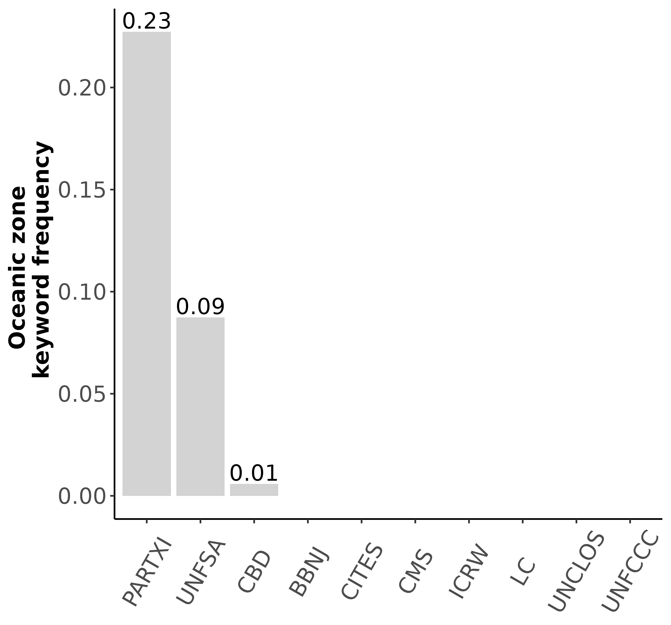
Finding 2: mesopelagic barely features in policy documents
Mesopelagic or twilight zone is mentioned 30 times in all screened policy documents
Coastal is mentioned 9359 times, benthic 641 times
Other deep-sea zones are also infrequently mentioned (abyss: 105, bathypelagic:22)
Notes:
Across all 2,700+ policy documents, the mesopelagic zone is mentioned only 30 times. That’s quite low when you consider its ecological and potential nutritional potential.
In contrast, coastal zones are mentioned nearly 9,400 times, and even the benthic zone appears over 600 times. This highlights a strong coastal bias in ocean governance.
This pattern isn't unique to the mesopelagic. Other deep-sea zones like the abyssal and bathypelagic layers are also rarely referenced, with 105 and 22 mentions respectively.
PARTXI (related to the deep seabed under UNCLOS) and UNFSA (Fish Stocks Agreement) lead in keyword frequency, but still at low absolute levels.

Slide 7
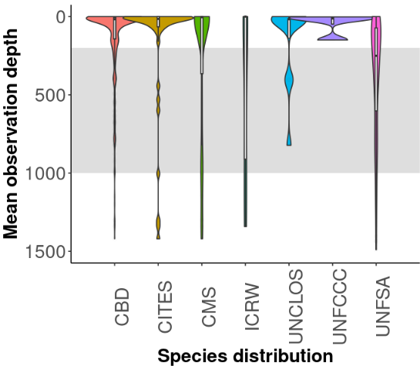
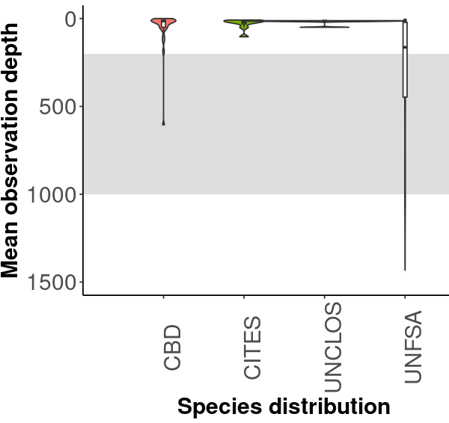
Finding 3: mesopelagic species mentioned less than epipelagic/demersal species in policy documents
epipelagic
mesopelagic
All species
Pelagic species only
Notes:
These two violin plots show the mean observation depth of species mentioned in key international ocean policy documents. The plots illustrate how deep in the ocean these species typically occur.
On the left, we see the distribution of species by observation depth across several international agreements.
The colored violins represent the range and concentration of species depth for each policy framework.
Most of the mentions are clustered near the surface (0–200m), the epipelagic zone.
Only a few extend into the mesopelagic zone (200–1,000m), shown in grey, and even fewer into deeper waters.
"This shows a clear bias: shallow-water species dominate policy references, with mesopelagic and deep-sea species largely absent.
This plot narrows the focus to only pelagic species — those living in the water column rather than on the seafloor.
Again, the vast majority of mentions are for epipelagic species (e.g. sharks).
The mesopelagic zone remains sparsely referenced, despite its massive biomass and ecological importance.

Slide 8
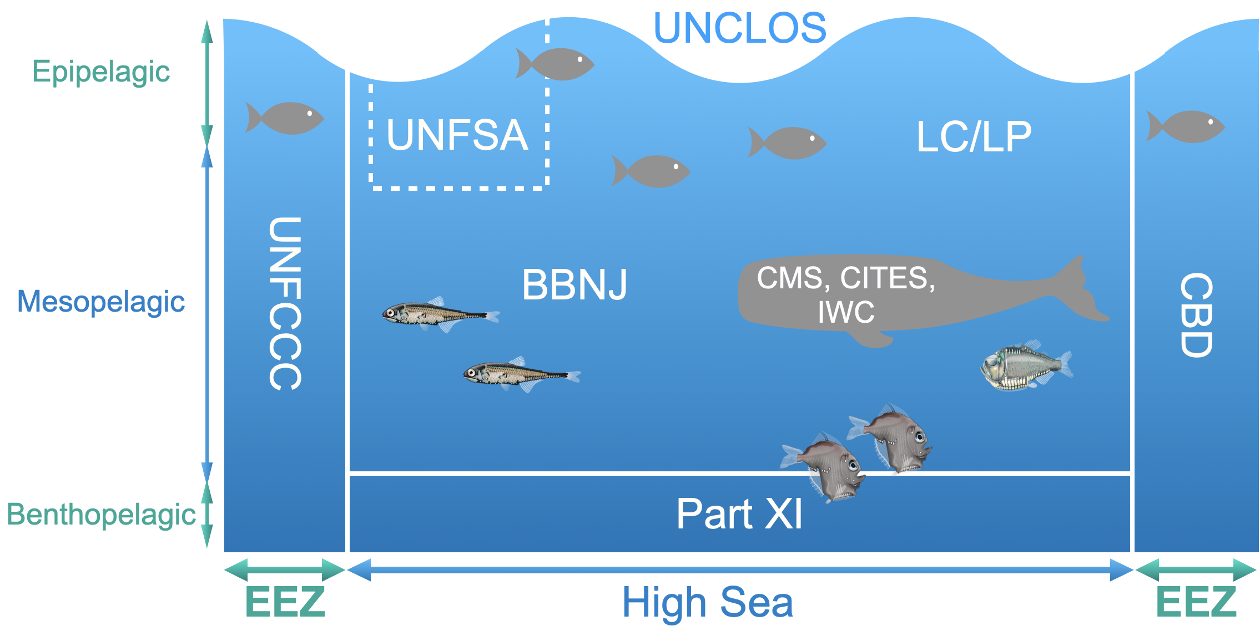
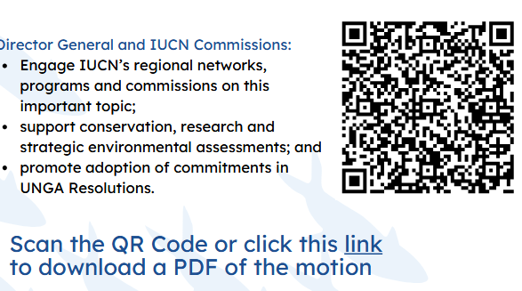
Finding 4: International treaties cover little of the mesopelagic zone
UNFSA (pelagic) RFMOs might be important areas for potential mesopelagic fishing in international waters
BBNJ Agreement "best available science" for EIAs, mesopelagic zones large knowledge gaps
IUCN motion to protect mesopelagic 035:
LC/LP
Notes:
This slide highlights a major governance gap: international treaties and frameworks offer very limited coverage of the mesopelagic zone
The UN Fish Stocks Agreement (UNFSA) and associated Regional Fisheries Management Organizations (RFMOs) mostly address epipelagic species like tuna. But as interest grows in mesopelagic fishing on the high seas, these may become important frameworks, even though they weren’t designed with the mesopelagic in mind.
The new BBNJ Agreement includes important tools like Environmental Impact Assessments (EIAs) and the use of best available science, but it also highlights how poorly studied the mesopelagic zone still is. There's a big mismatch between potential exploitation and scientific knowledge.
Motion 035, introduced at the IUCN World Conservation Congress, calls for a precautionary pause on the expansion of mesopelagic fisheries and other industrial activities until comprehensive scientific assessments and governance frameworks are established

Slide 9
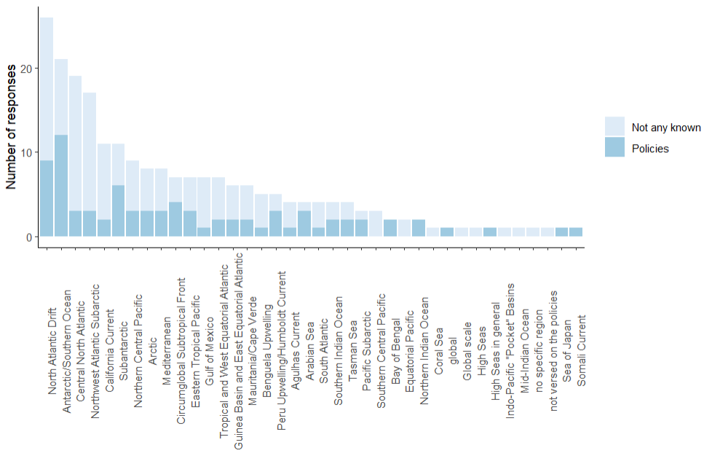
Finding 4: International treaties & local policies cover little of the mesopelagic zone
Recent survey among experts of mesopelagic confirmed little awareness of local and international policies (Iglesias et al., in progress)
Notes:
A recent survey conducted among mesopelagic researchers and practitioners (Iglesias et al., in progress) shows that there is very limited awareness of both local and international policies relevant to the mesopelagic zone.
This bar plot visualizes the number of respondents who named or recognized policies related to the mesopelagic.
The dark blue bars represent how many participants explicitly named a policy relevant to the mesopelagic.
The light blue bars ("Not any known") show how many respondents couldn’t name a single policy.
Oceanic areas are listed along the x-axis, many bars are extremely low or even absent.
You can clearly see that most participants either didn’t know any policies, or could only mention one or two, typically more general agreements like UNCLOS.

Slide 10
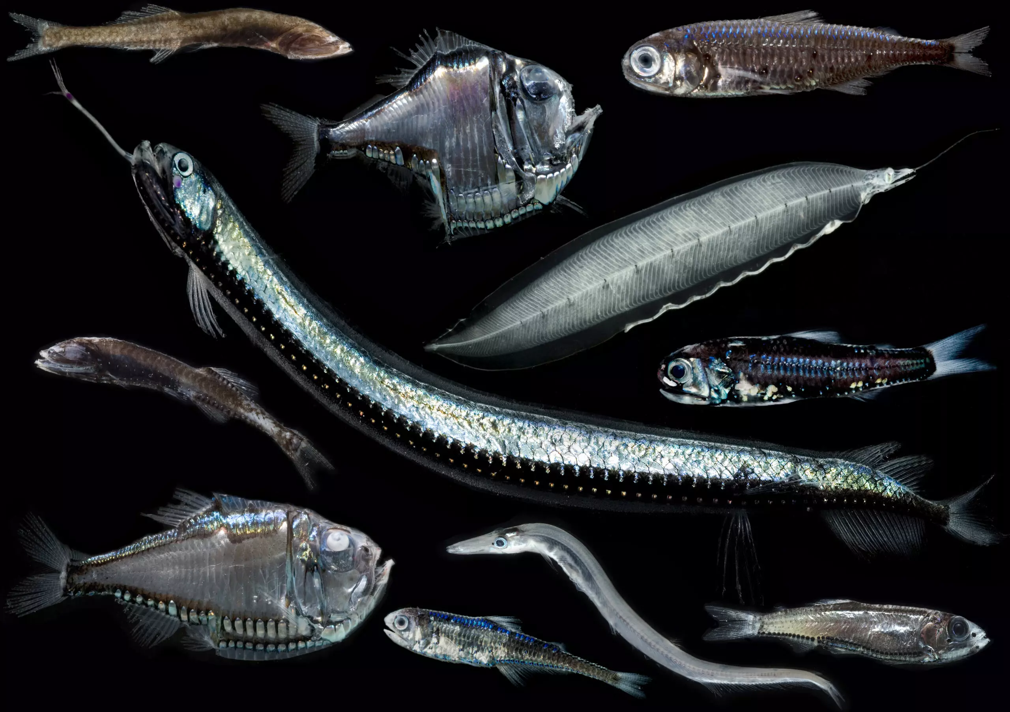
Conclusions
Mesopelagic species might be suitable for aquaculture feed
Mesopelagic features little in international ocean policies (nor do other zones of the deep ocean)
Future activities need baselines for monitoring and responsible management (fisheries → assessment, mining → EIA with sufficient knowledge)
Proactive policies needed to protect mesopelagic zone and establish baselines
PHOTO: NEIL BROMHALL/SHUTTERSTOCK
Image: Blue marine foundation

Slide 11
Bibliography
Elsler, L. G., Oostdijk, M., Levin, L. A., Satterthwaite, E. V., Pinsky, M. L., Crespo, G. O., & Wisz, M. S. (2022). Protecting ocean carbon through biodiversity and climate governance. Frontiers in Marine Science, 9. https://doi.org/10.3389/fmars.2022.880424
Golden, C. D., Koehn, J. Z., Shepon, A., Passarelli, S., Free, C. M., Viana, D. F., Matthey, H., Eurich, J. G., Gephart, J. A., Fluet-Chouinard, E., Nyboer, E. A., Lynch, A. J., Kjellevold, M., Bromage, S., Charlebois, P., Barange, M., Vannuccini, S., Cao, L., Kleisner, K. M., … Thilsted, S. H. (2021). Aquatic foods to nourish nations. Nature, 598(7880), 315–320. https://doi.org/10.1038/s41586-021-03917-1
Iglesias, I., Kaikkonen, L., Yang, N., Woodstock, K., Oostdijk, M., Elsler, L., Annasawmy, P, Victorero L., Amaro, T., Escobar-Briones, E., Auster, P.J., Martins, I., Gianni, M., Seoane, E.G., van der Grient, J., Prellezo, R., Vastenhoud, B., Johnson, A.F., Science-policy gap analysis for mesopelagic fishes, fisheries and ecosystems, In Preparation
Olsen, R. E., E. Strand, W. Melle, et al. 2020. “Can Mesopelagic Mixed Layers be Used as Feed Sources for Salmon Aquaculture?” Deep-Sea Research Part II: Topical Studies in Oceanography 180: 104722. https://doi.org/10.1016/j.dsr2.2019.104722
Proud, R., N. O. Handegard, R. J. Kloser, M. J. Cox, and A. S. Brierley. 2019. From siphonophores to deep scattering layers: Uncertainty ranges for the estimation of global mesopelagic fish biomass. ICES J. Mar. Sci. 76: 718–733. https://doi.org/10.1093/icesjms/fsy037

