Slide 1
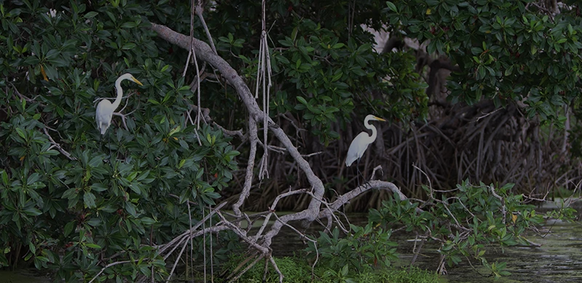

Nature-based solutions in coastal cities and island systems in Colombia
Osorio, AF ^{1,2}., Torres-Toro J.D ², Zapata-Ramírez, P.A ⁵, Mancera J.E ⁴, Osorio-Cano, J.D ³, Puin B. ², Zapata N. ², Maya M.F ⁶, Lowe L. ¹, Rojas-Laserna M⁷
¹ Corporation Center of Excellence in Marine Sciences – CEMarin , ² National University of Colombia Medellín Campus, ³ National University of Colombia Caribbean Campus, ⁴ National University of Colombia Bogotá Campus, ⁵ Univerisdad Pontififica Bolivariana, ⁶ Blue Indigo Foundation,
⁷ Delegate of the Colombian national team of the European Commission
Photo: Agenda del Mar

Slide 2
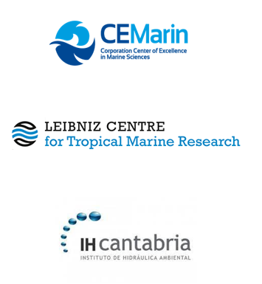
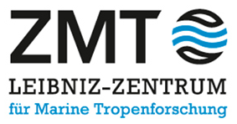
Nature-based Solutions on coastal cities and insular systems in Colombia
Strengthen Colombia's capacities in NbS with respect to climate change adaptation and mitigation and the vulnerability of coastal and island settlements.
Objective
Consortium
Colombia-Germany academic consortium to address current problems in marine-coastal sciences.
Germany's only institute dedicated to the study of tropical marine ecosystems and their ecosystem services.
Spanish research center for marine-coastal environments and their adaptation to climate change.

Slide 3
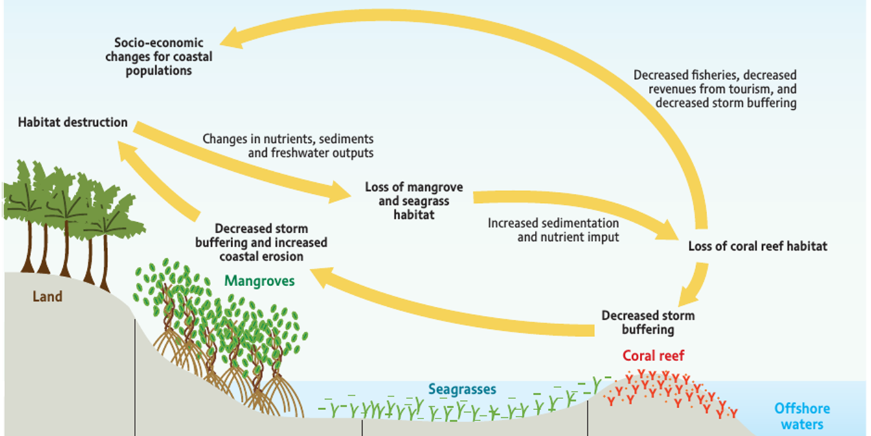
Ecosystem Services and Socio-Ecological Systems
(Silvestri et al., 2010)

Slide 4
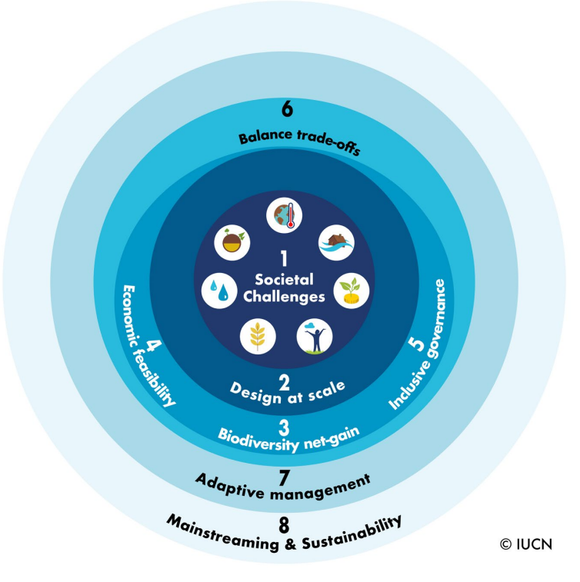
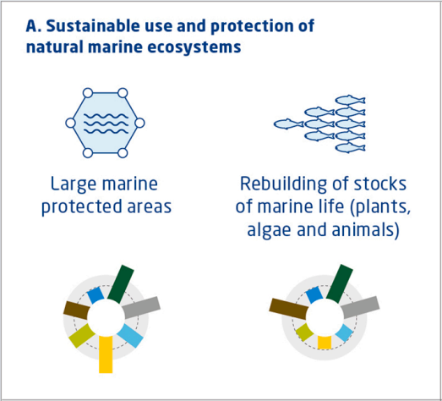
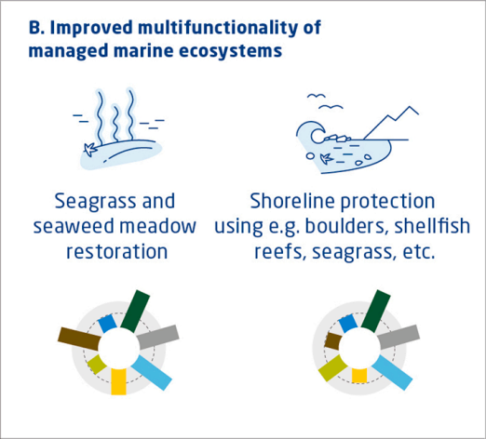




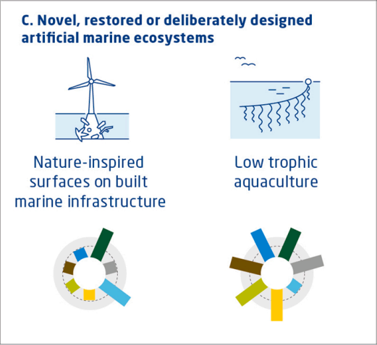
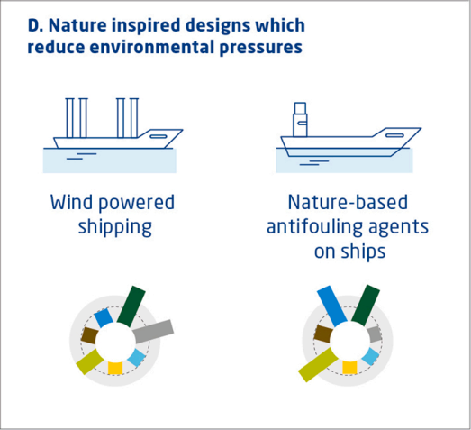




What are the Nature-based Solutions (NbS)?
IUCN Criteria for NbS
NbS Types
Social Challenges
Climate Change Adaptation
Disaster Risk Reduction
Economic and Social Development
Human Health
Food Safety
Water Safety
Environmental and biodiversity degradation
(Riisager-Simonsen, 2022)
Notes:
“These are actions to protect, conserve, restore, sustainably use and manage natural or modified terrestrial, freshwater, coastal and marine ecosystems that address social, economic and environmental challenges effectively and adaptively, while providing human well-being, ecosystem services, resilience and biodiversity benefits” (UNEA, 2022).

Slide 5
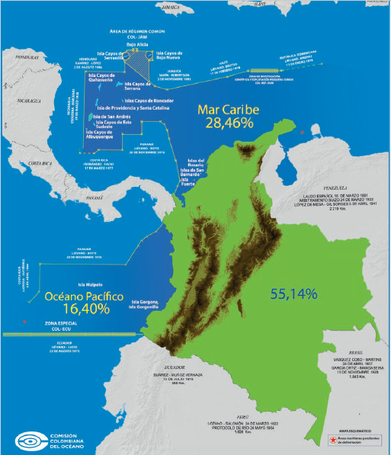


NbS in Colombia marine-coastal environments
Colombia as a marine country
Climate hazards and risks
Extreme weather events
Coastal erosion
Climate change:
Sea level rise and coastal flooding
Lost of biodiversity
Global alignment
International agreements
NbS recognition on NDCs
National environmental policies update
Photo: CCO

Slide 6
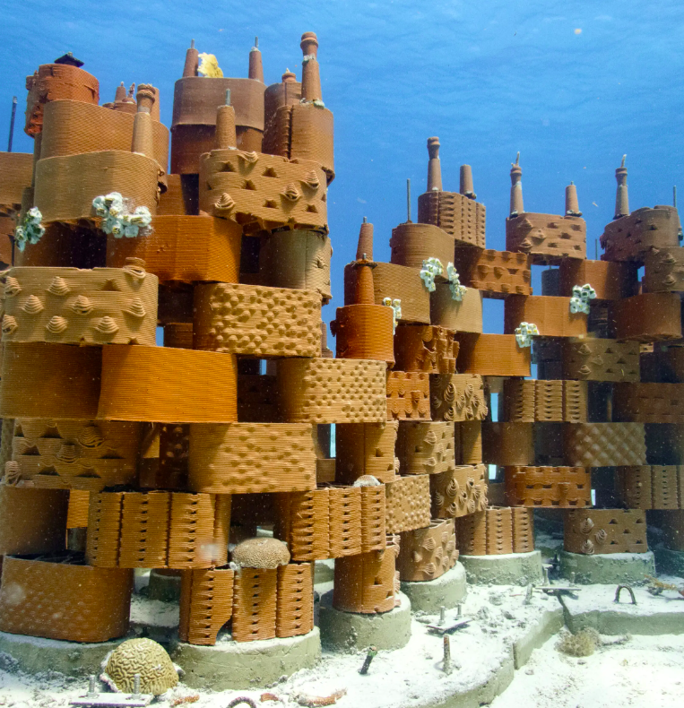
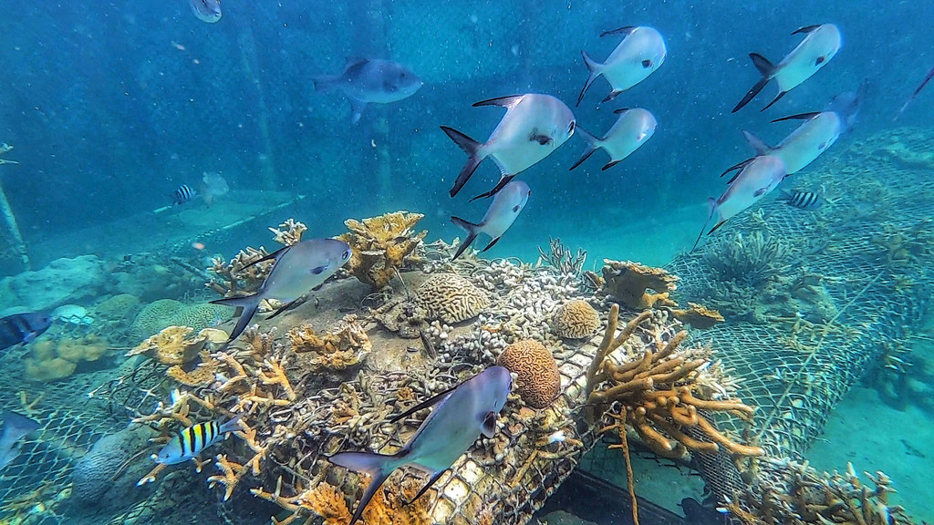
Experiences with Nature based Solutions
RRReefs San Andrés Island (2021)
One Million Corals (2021-2022)
Construction of a clay and cement structure
Increase on restoration actions of coral reefs
Photo: rrreefs
Photo: ONU News/ Laura Quiñones
Acuario del Rodadero, Blue Indigo Foundation, CEINER/Oceanario, CORALINA, ECOMARES, Fundación Malpelo, Masbosques, Parque Nacional Natural Corales del Rosario, Parque Nacional Natural Gorgona, Parque Nacional Natural Mc Bean Lagoon, Parque Nacional Natural Utría, y la Pontificia Universidad Javeriana Cali; Consejos Comunitarios.
RRREEFS, Corales de Paz, Ministerio de Ambiente y Desarrollo Sostenible, CORALINA, Armada Nacional, Conservación Internacional Colombia, CEMarin y Holcim Colombia.

Slide 7
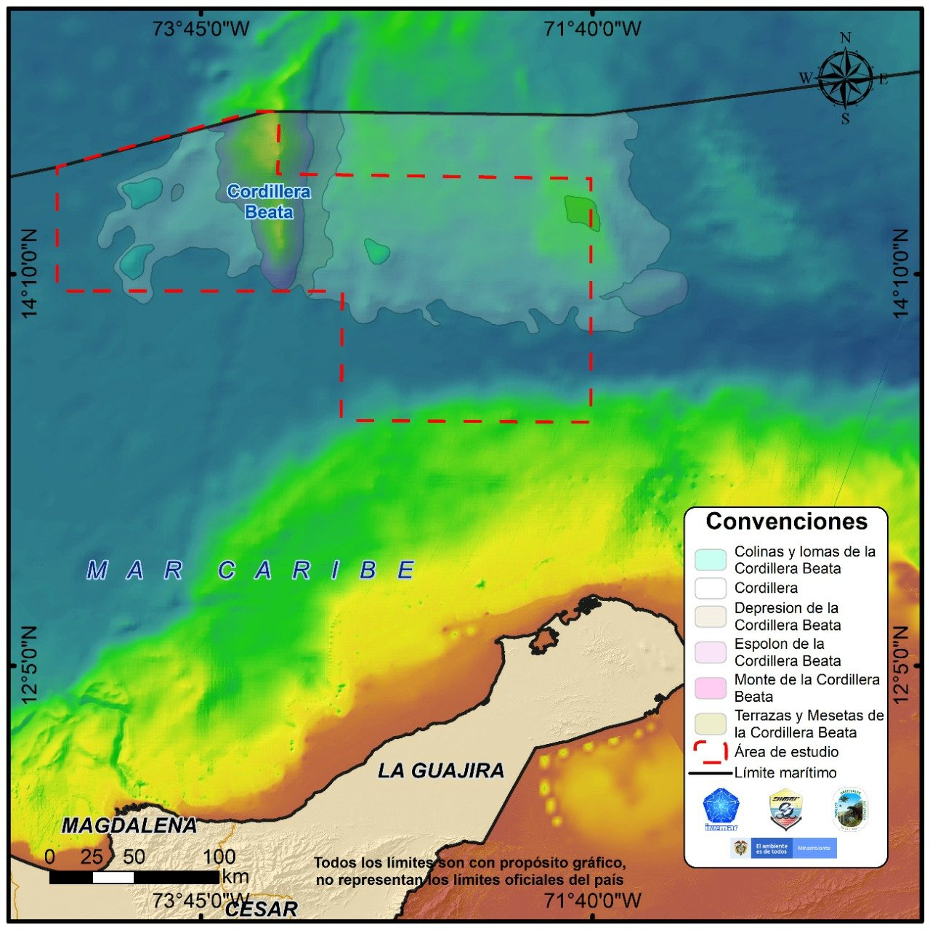
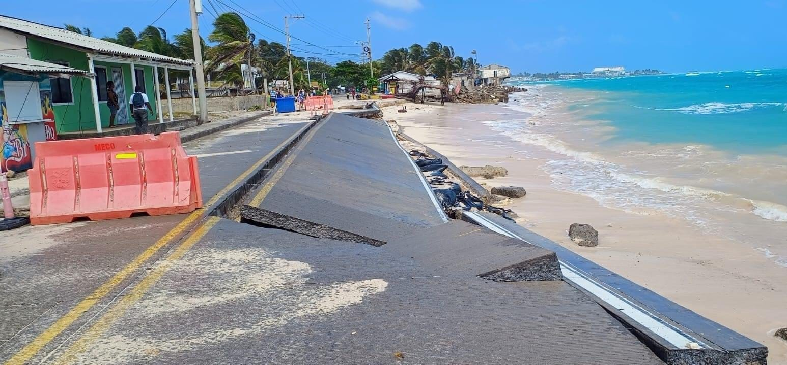
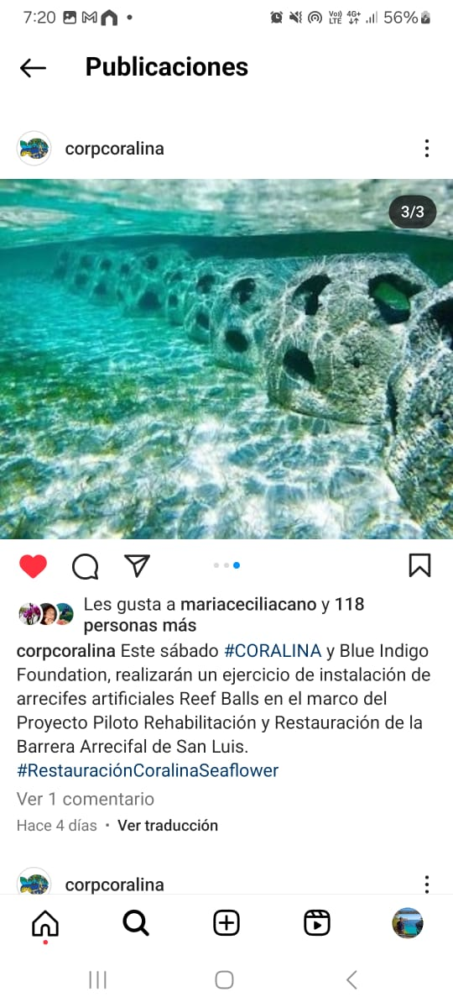
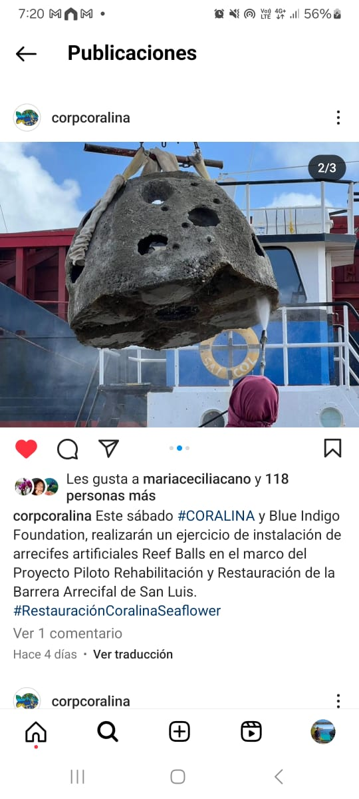
Experiences with Nature based Solutions
Reef Balls against erosion on San Andrés Island
Extension of Marine Protected Areas
New MPAs and expanded existing ones.
NbS for the recovery of the barrier reef
Image: @MinAmbienteCo
Blue Indigo Foundation, IUCN, CORALINA, Sound bay association for the development of the Raizal people, Universidad Nacional de Colombia Sede Caribe, Universidad de Guadalajara, University of North Carolina Wilmington.

Slide 8
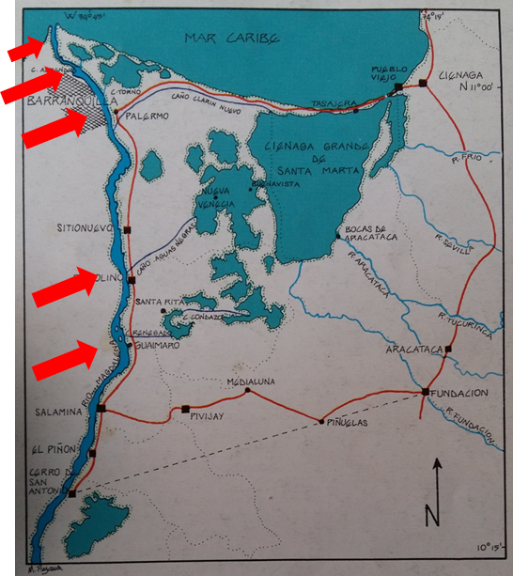
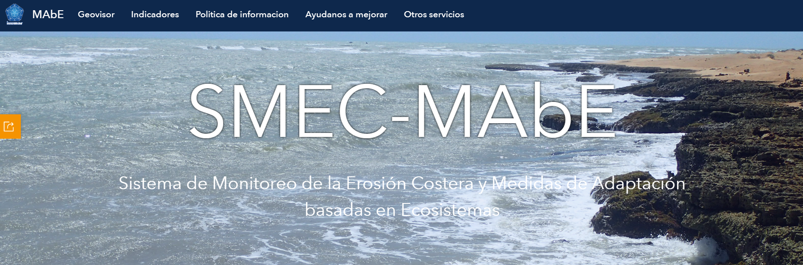
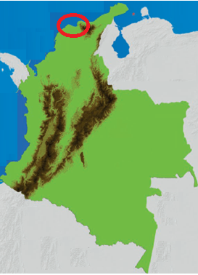
Experiences with Nature based Solutions
PROCIENAGA: Colombian-German Mangrove Rehabilitation Project
Ecosystem-based Adaptation for Protection against Coastal Erosion in a Changing Climate
Reconnecting the Magdalena River with its old delta.
The Coastal Erosion Monitoring System and Ecosystem-based Adaptation Measures (SMEC-MAbE)
Red Colombiana de Estuarios y Manglares, CORPAMAG, CORPES, INVEMAR, GTZ
Image: INVEMAR
Ministerio de Ambiente y Desarrollo Sostenible de la República de Colombia, Ministerio Federal de Ambiente de Alemania, Banco de Desarrollo Estatal de Alemania, CORPOGUAJIRA, CORPAMAG, CVS, CORPOURABÁ, GFA Consulting Group, Fondo Acción, INVEMAR
Image: Mancera, JE

Slide 9
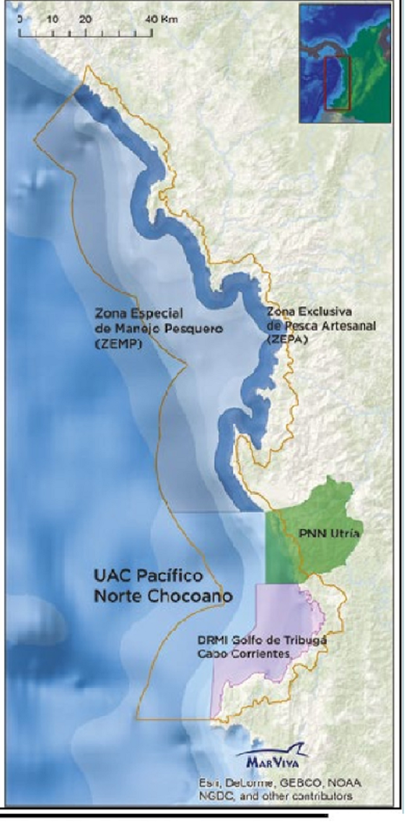
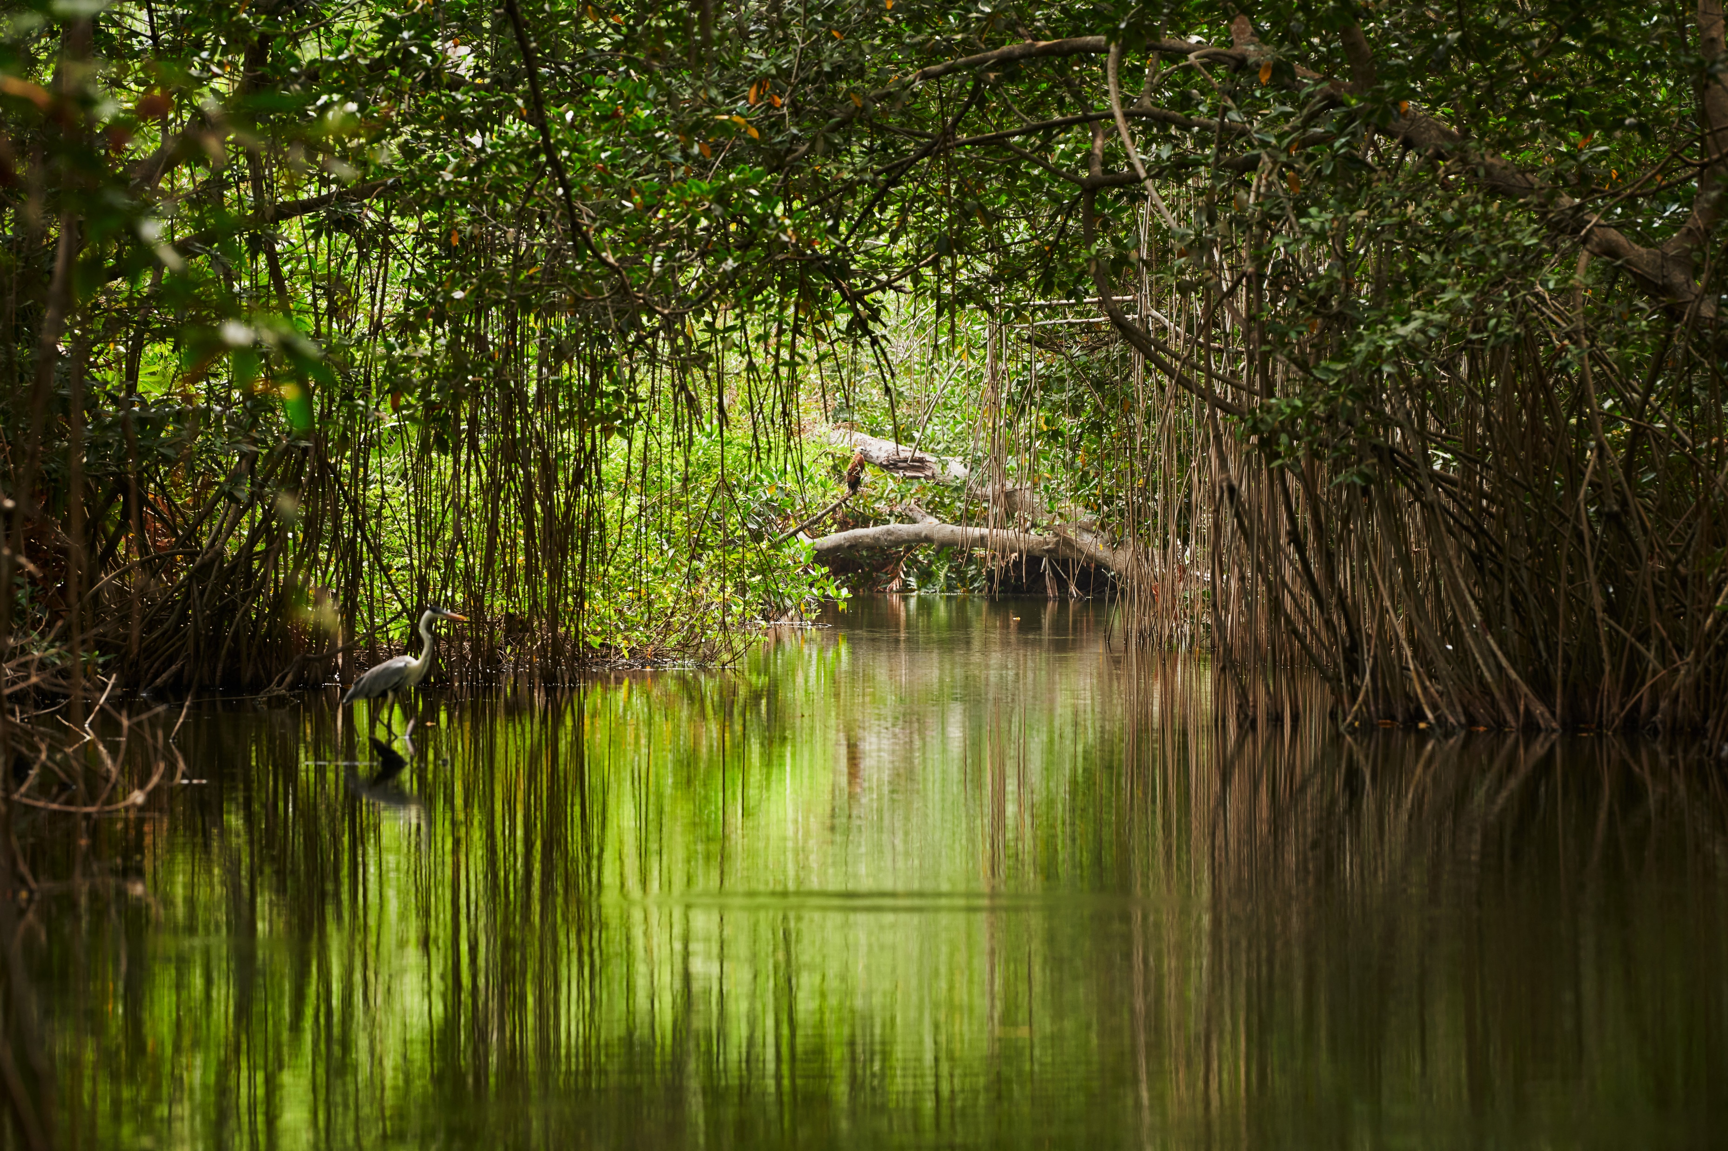
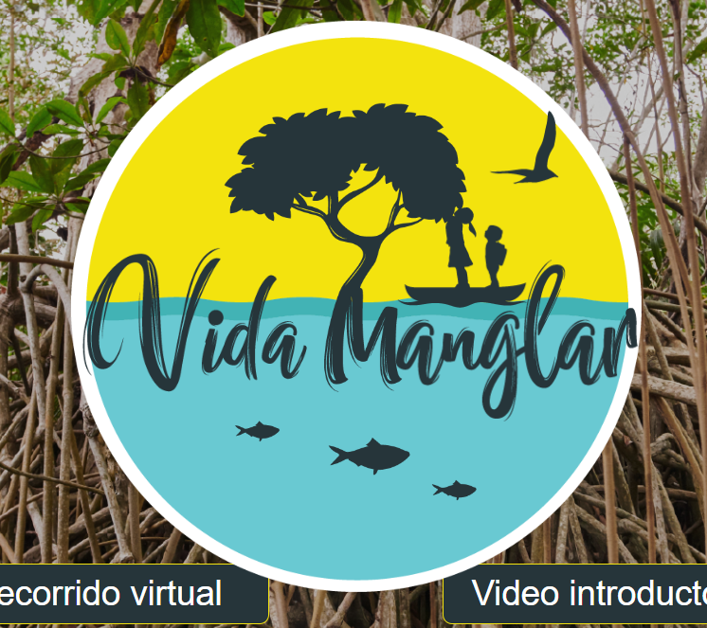
Experiences with Nature based Solutions
VidaManglar
Fisheries planning, Choco Department
Avoid the emission of approximately 939,296 tons of CO2 into the atmosphere over the next 30 years by mangrove restoration.
Image: VidaManglar
Notes:
Management models for fisheries ordinance due to conflicts between industrial and artisanal fishing. Preserve local fisheries resources, economy and culture

Slide 10
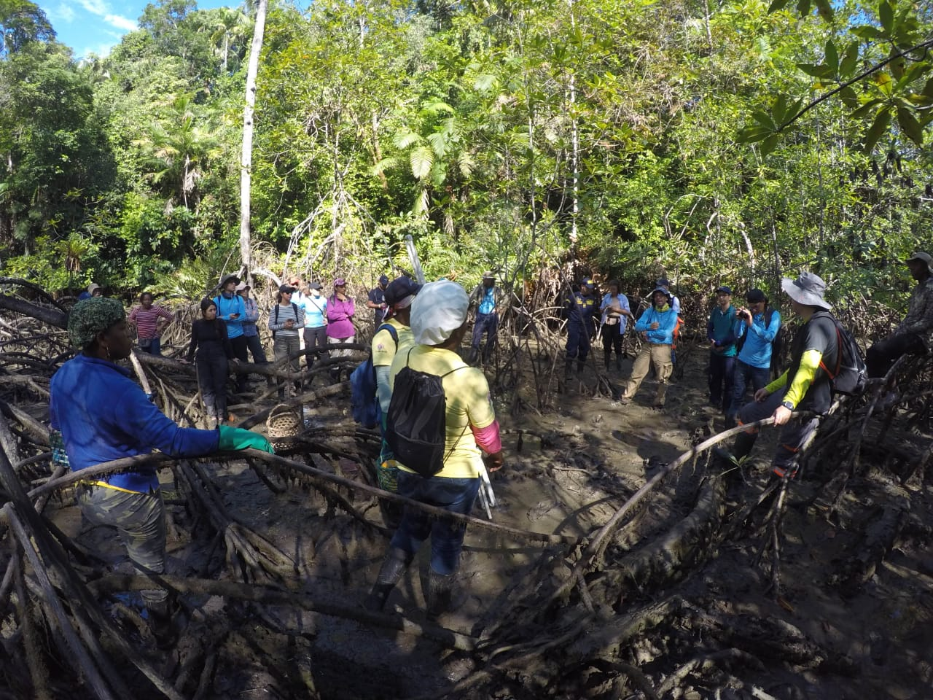
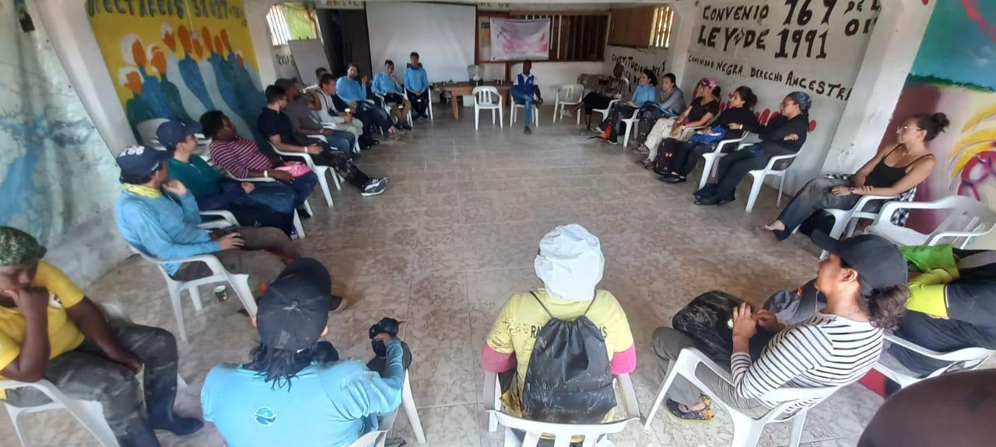
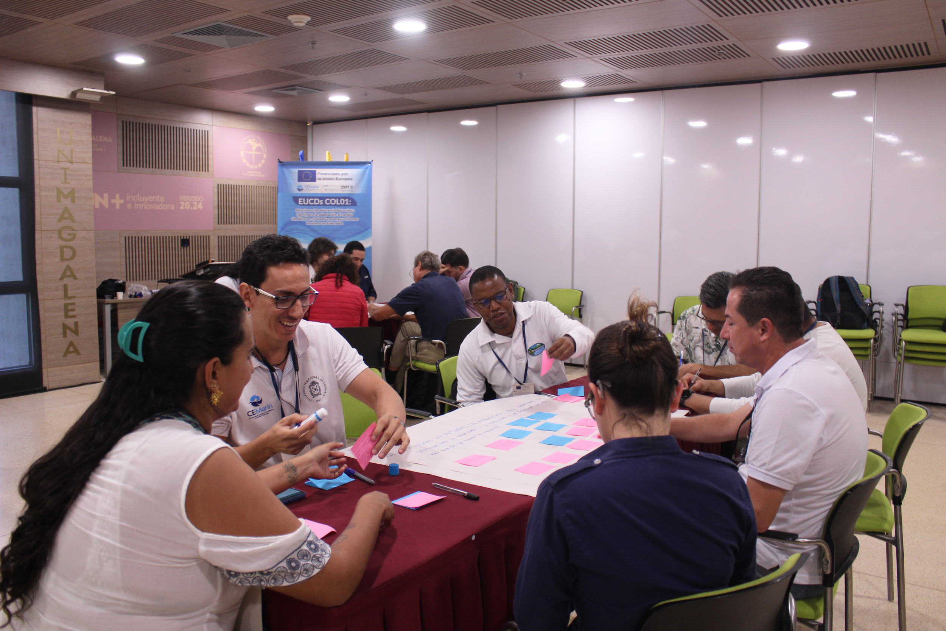
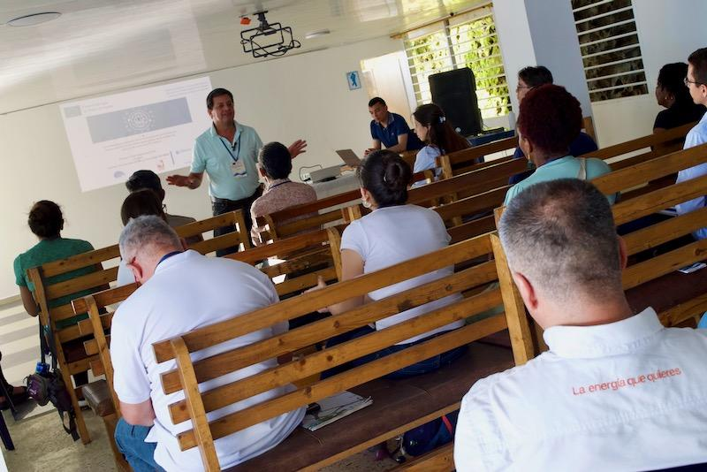
The approach
Activity 1: Field tours
Recognize experiences, lessons and next steps.
Activity 2: Worldwide panels
Context of NbS, and the most recent advances and experiences.
Activity 3: Lightning talk
Share experiences of the participating institutions.
Activity 4: World Café
Intersectoral dialogue to identify challenges and opportunities.

Slide 11
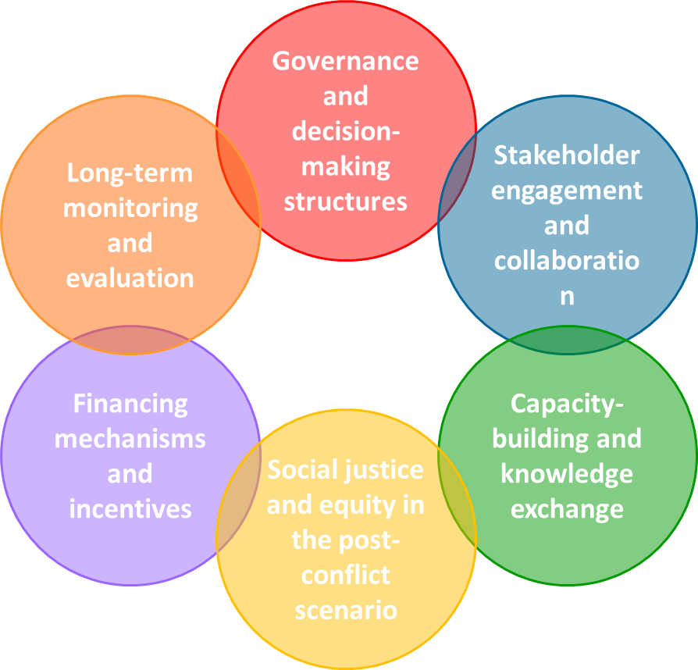






Attendees Key aspects for NbS success
65
17
Internationals
Nationals
180 Attendees
97
Men
83
Women
By workshop
72
44
64

Slide 12
Main findings
Locally Led, Context-Specific NbS Adaptive, scalable solutions co-developed with communities to suit Colombia’s diverse coastal ecosystems (e.g., mangroves, reefs, seagrasses).
Strong Governance Unified national NbS framework with long-term, cross-sectoral stakeholder collaboration.
Transparency & Participation Use digital tools and inclusive platforms; prioritize dialogue over punitive enforcement.
Effective M&E
Simple, adaptive systems aligned with SNICC; reactivate national M&E roundtable.
Knowledge Sharing Create a national NbS knowledge hub; promote research and mutual learning.
Sustainable Financing Prioritize NbS for risk prevention; attract investment via incentives and partnerships.

Slide 13




Thank you
Learn more at:
www.cemarin.org
We also invite you to follow us on our networks
@cemarin_org
@CorpoCEMarin
Corporación CEMarin

