Slide 1
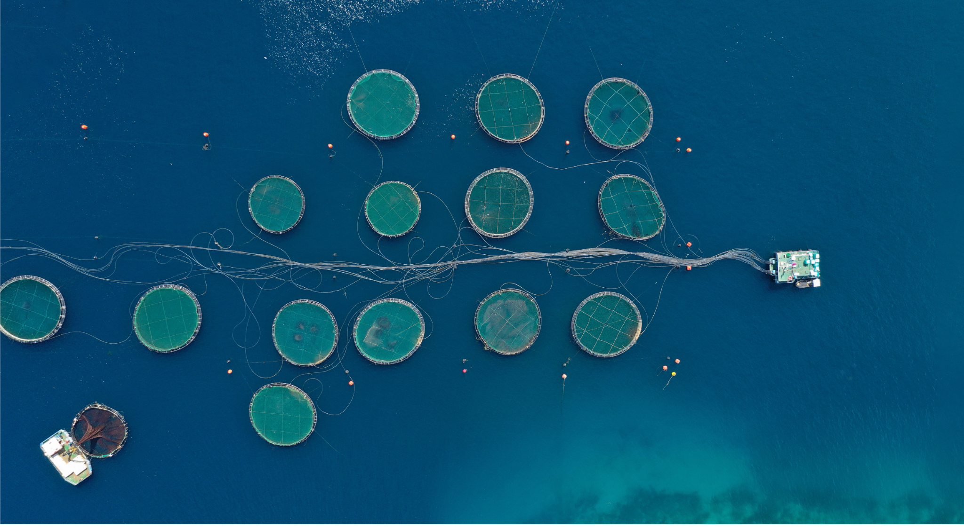






Supplementary Plots
Continued transitions from fish meal and oil in aquafeeds require close attention to biodiversity trade-offs
Gage Clawson*, Julia L. Blanchard, Marceau Cormery, Elizabeth A. Fulton, Benjamin S. Halpern, Helen A. Hamilton, Casey C. O’Hara, Richard S. Cottrell
Notes:
I’ve mapped the environmental impact in terms of habitat loss associated with the production of salmon aquaculture feed ingredients.

Slide 2
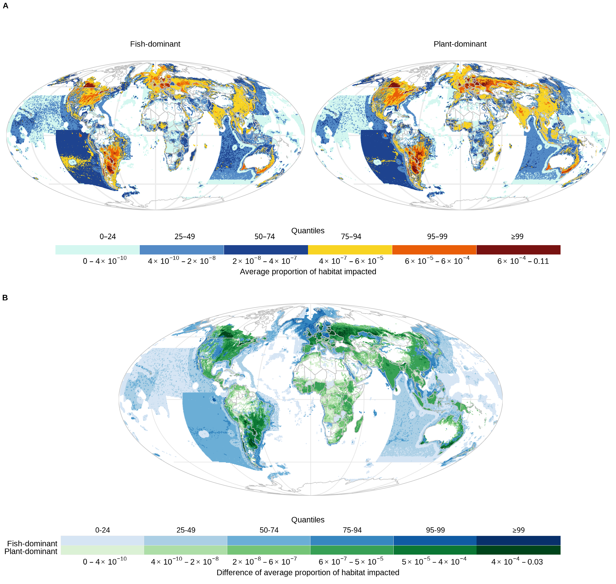
Figure 1. Global map of proportion of habitat impacted in each cell. (A) Map of mean proportion of habitat area impacted across species. Impacts are split by quantile group and aquafeed formulation. (B) Map of differences in mean impact between the feed formulation scenarios. The magnitude of the difference is split into quantile groups, where darker shades indicate larger differences.

Slide 3
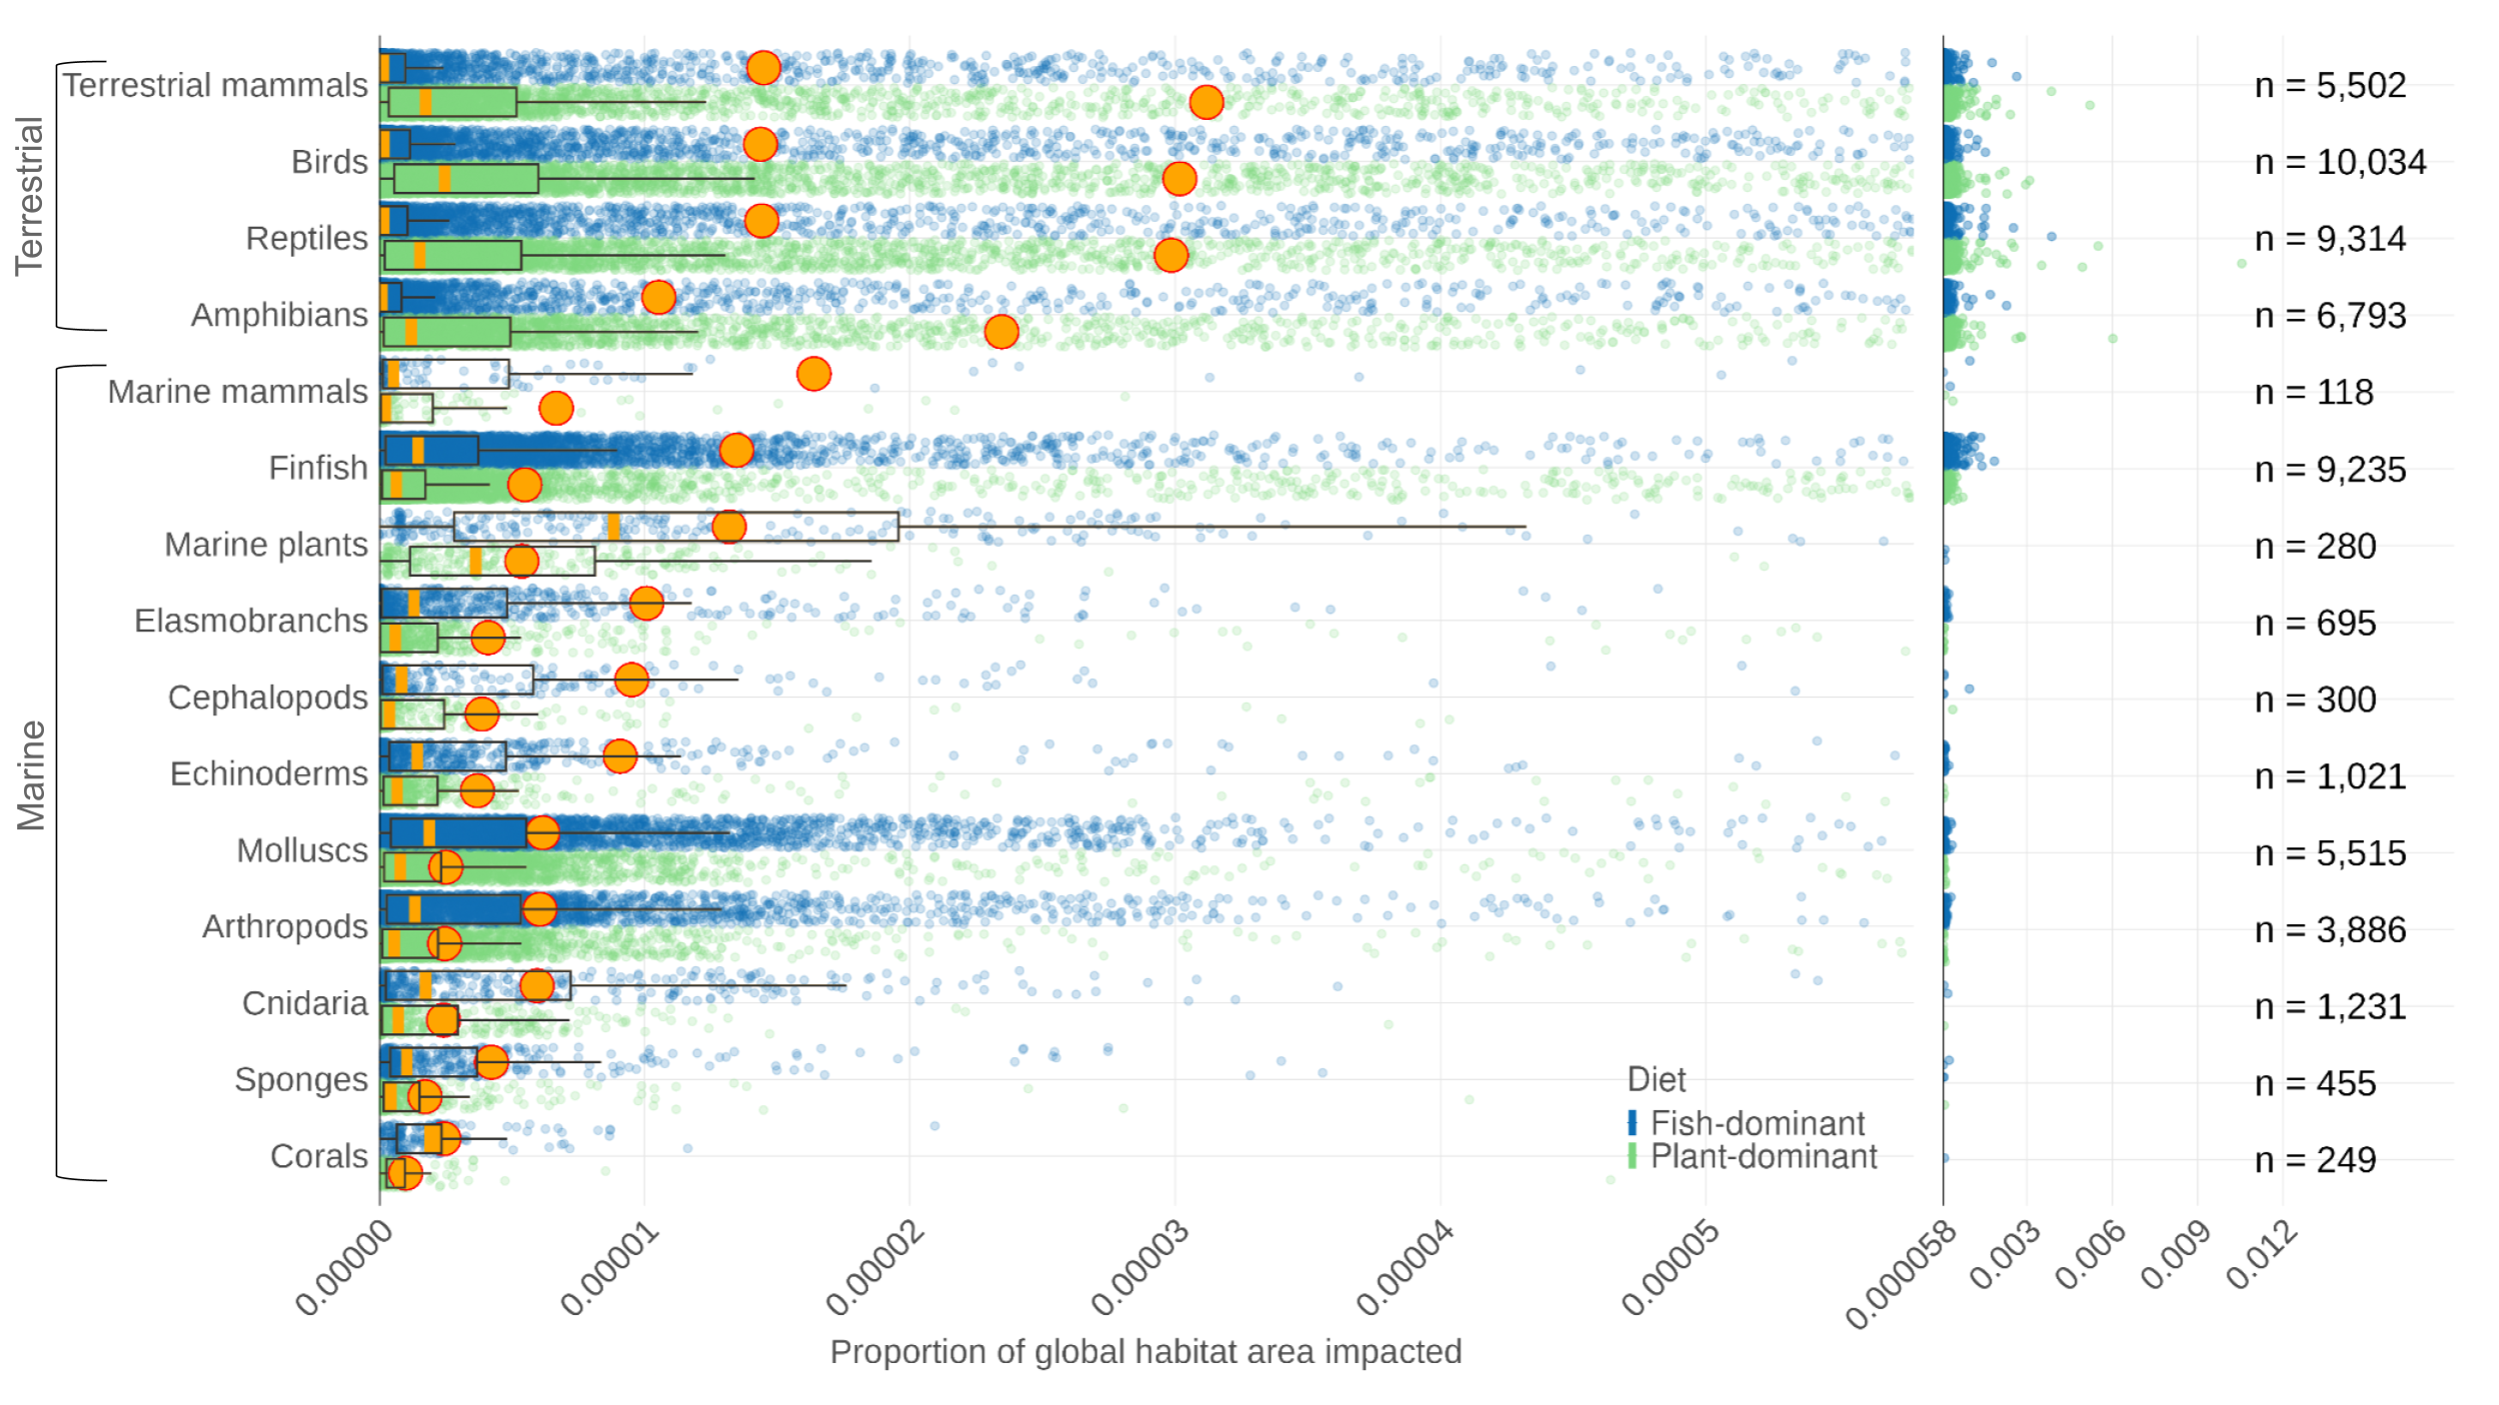
Figure 2. Distribution of proportion of global habitat area impacted for species. Each point is a species. Only impacted species are shown in the plot. Orange points indicate mean across species within the taxa and scenario and orange lines indicate the median. Boxes represent the interquartile range (IQR, quartile Q1 to Q3); whiskers indicate observations 1.5x IQR below (above) Q1 (Q3) the box. The panel on the right shows points >95th percentile, and total number of assessed species per taxa.

Slide 4
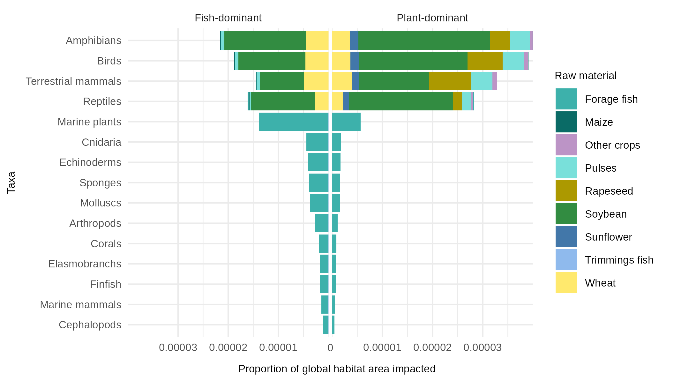
Figure 3. Proportion of each taxa’s global habitat area which is impacted by raw material for each aquafeed scenario.

Slide 5
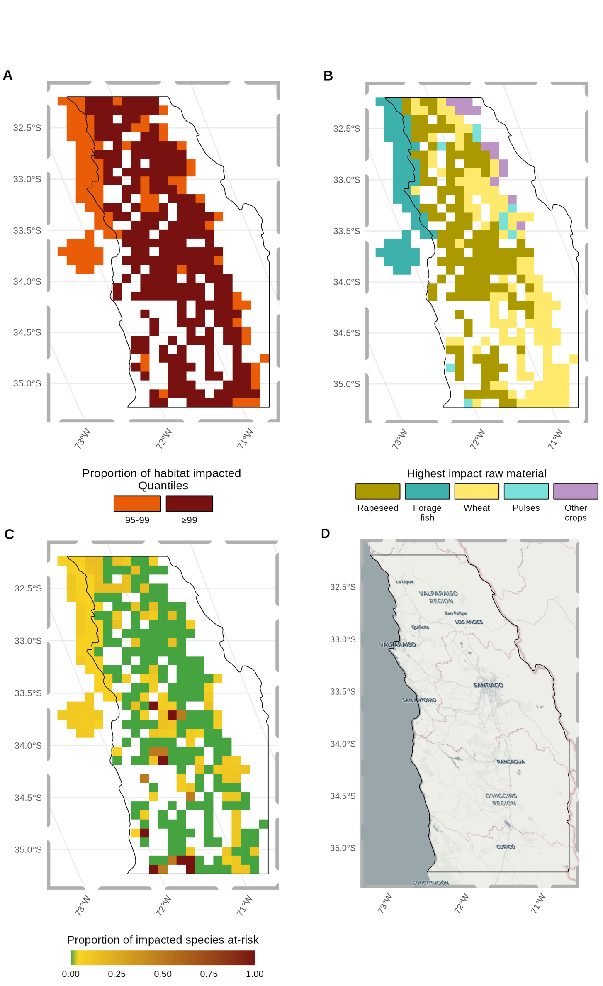
Figure 4. Impact hotspot map of central Chile, under the plant-dominant feed scenario. (A) Cells with average impacts greater than or equal to the 95th quantile. (B) The raw material which contributes most to the impact in each hotspot cell. (C) The proportion of impacted species in each cell which is at-risk of extinction. (D) Reference map, using Open Street Map (https://www.openstreetmap.org/).

Slide 6
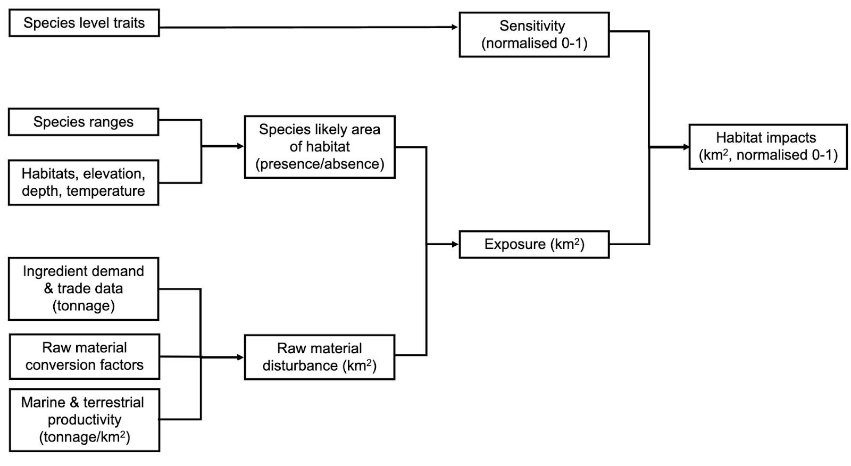
SI Figure 1. Methodological diagram of data processing needed to calculate biodiversity impacts.

Slide 7
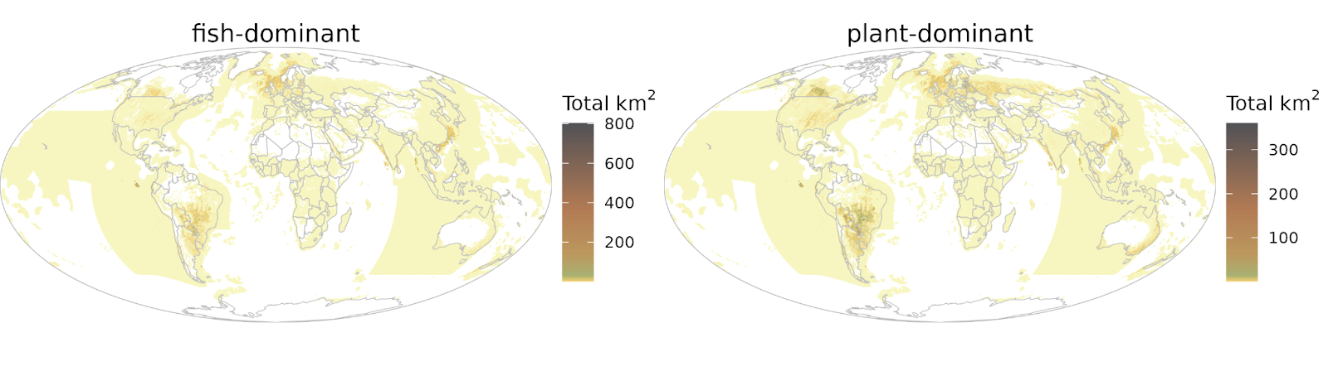
SI Figure 4. The total km² of impacted habitat in each cell. White areas represent areas with no impacted habitat or production of materials. Related to Figure 1.

Slide 8
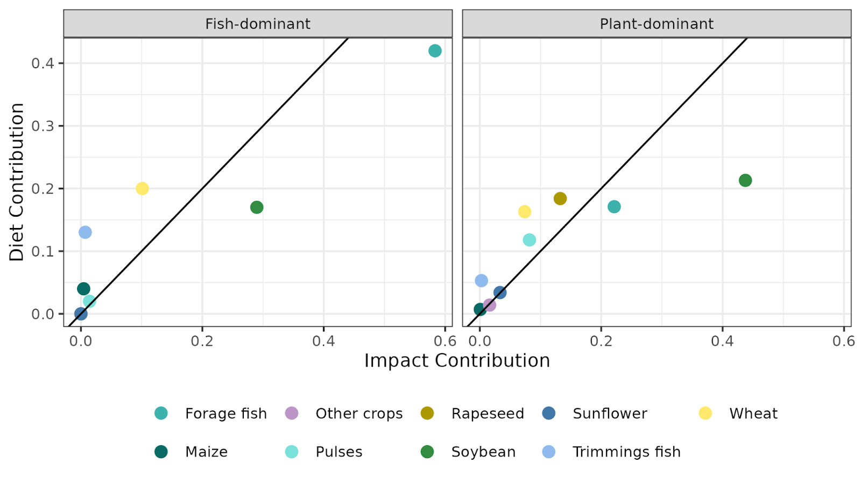
SI Figure 7. Comparison of raw material contribution to diet formulation vs. total impacts. Related to Table 1 and Figure 3.

