Slide 1

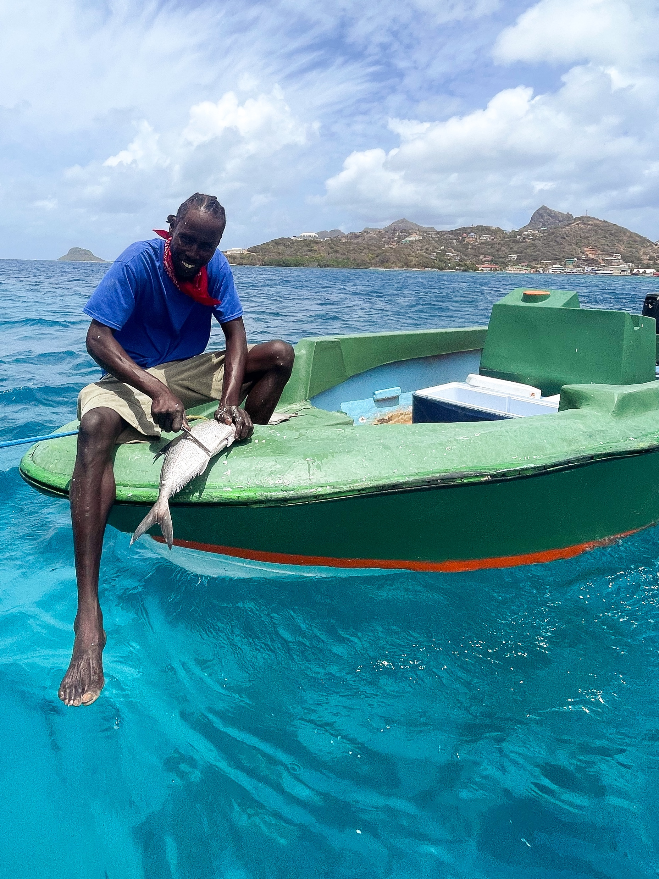
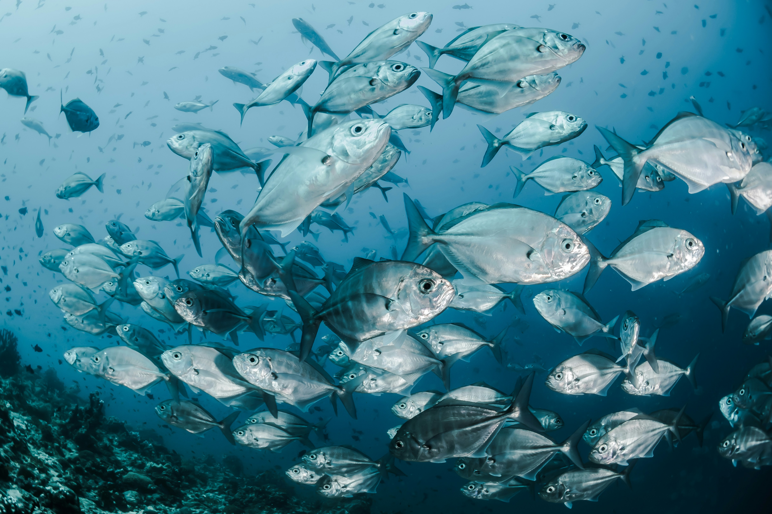




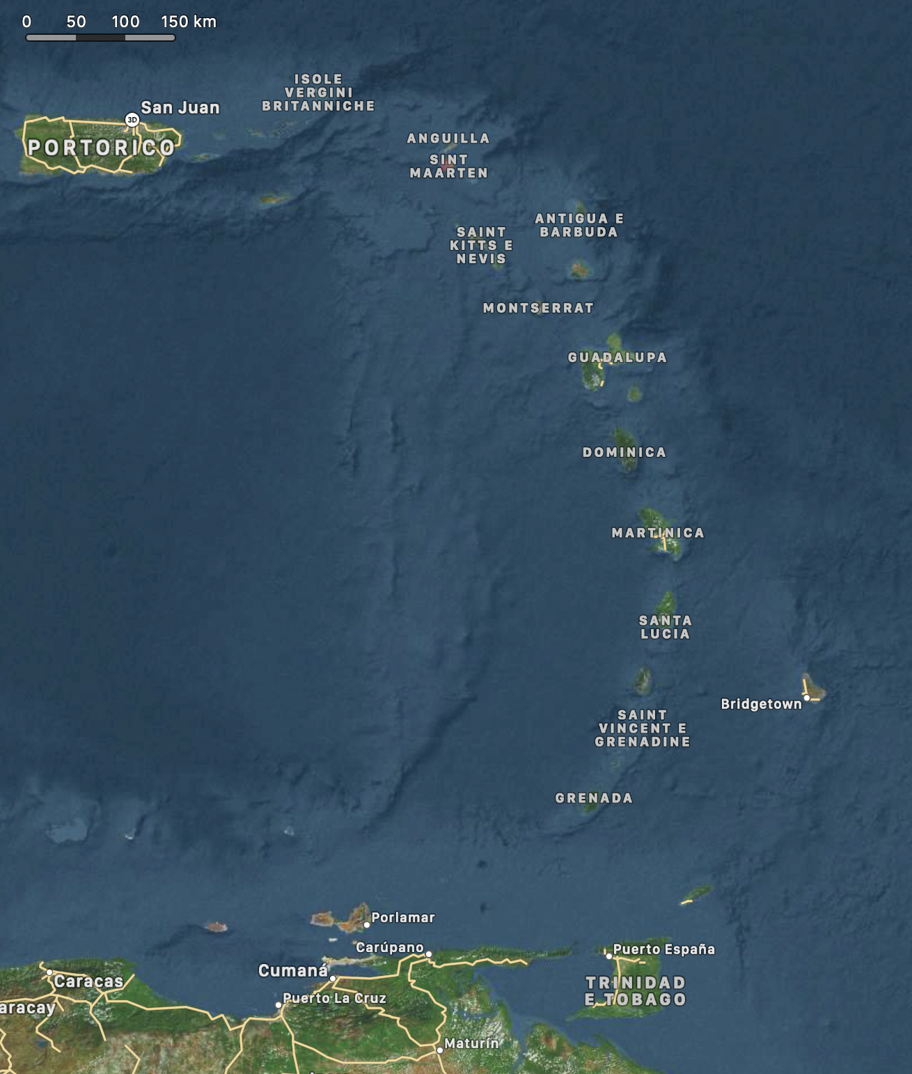
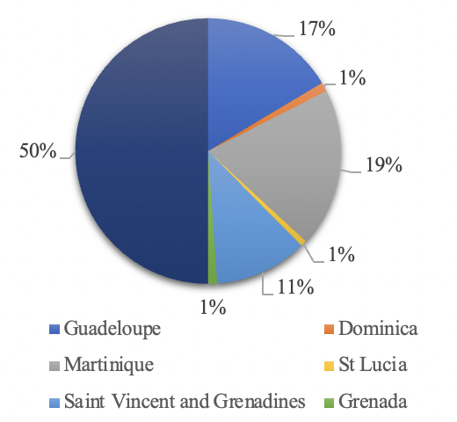

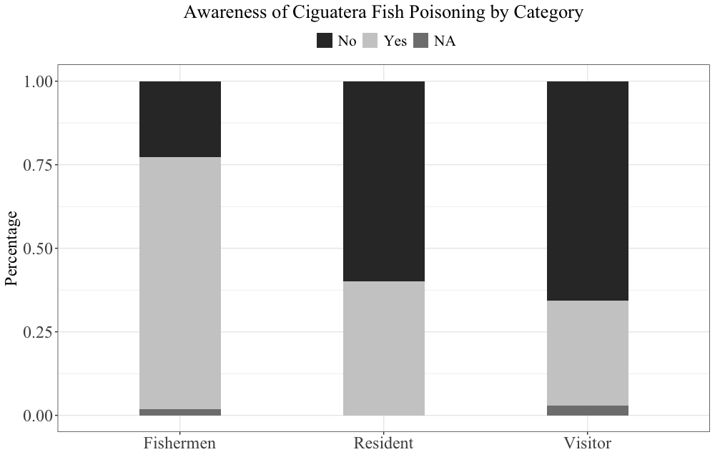






CIGUATERA POISONING:
an assessment of the current level of awareness among
islanders and visitors on six Caribbean islands
Morsella A., Perilli A., Ricciardi W., Cadeddu C.
Introduction
Visuals
Fisherman | non-fisherman locals | tourists
137 responses
Large heterogeneity in willingness to respond
Ciguatera Poisoning (CP) is the most prevalent seafood intoxication globally, caused by ciguatoxins that bioaccumulate in marine food webs and pose significant health risks, including persistent gastrointestinal, cardiovascular, and neurological symptoms.
Moreover, ciguatoxin presence is found to be intensified by anthropogenic disturbances.
Despite such clinical and ecological significance,
underreporting rates are high while public awareness of CP remains scarce, particularly in vulnerable coastal communities.
Awareness gradient decreases
Methods
A total of 137 responses were
collected on-site and online via structured questionnaires and semi-structured interviews between February and July 2023, to investigate:
understanding of Ciguatera relevant to respondents’ island;
personal or family experiences with Ciguatera;
general knowledge about Ciguatera’s clinical and managerial implications;
individual and community risk perception and concern levels.
Descriptive and inferential statistics, along with multivariable logistic models, were used to analyze associations with covariates like age, gender, category, and location.
The aim of this study was to assess the levels of knowledge and awareness of CP among three. demographic groups— local fishermen, local non-fishermen, and visitors—across six Small Island Developing States (SIDS) in the Caribbean Lesser Antilles, namely Guadeloupe, Dominica, Martinique, Saint Lucia, Saint Vincent and the Grenadines, and Grenada
Results
The analysis revealed significant variability in CP awareness, with 76% of fishermen, 40% of local residents, and 32% of visitors reporting familiarity with the condition.
Geographical disparities were also pronounced, with higher awareness levels observed in the northern French overseas territories of Guadeloupe and Martinique, compared to a more limited awareness in the southern archipelagos.
Fishermen demonstrated the most extensive knowledge of CP risks and mitigation strategies, whereas residents and visitors exhibited critical gaps in understanding, particularly regarding clinical features and risk mitigation measures.
32 locations - February to May 2023:
Largest fishing villages, markets, and fishmongers; popular tourist locations; local markets; public gathering sites.
Location | OR¹ | 95% CI¹ | p-value
Guadeloupe | — | —
Martinique | 0.20 | 0.06, 0.58 | 0.004
Saint Vi&Gre | 0.08 | 0.02, 0.30 | <0.001
Lower odds of awareness were identified in
Martinique and St Vincent compared to Guadeloupe
Conclusions
The findings underscore an urgent need to increase food safety, through targeted public health strategies, health education campaigns and improved surveillance systems which bridge knowledge gaps and address the underreporting of CP cases. Strengthening community-based public health strategies, particularly in regions dependent on fisheries for sustenance and economic stability, is paramount. Furthermore, integrating environmental monitoring with health governance can enhance risk mitigation and resilience in SIDS increasingly impacted by climate change and ecological disruptions.
Correspondence to:
alisha.morsella@gmail.com

