Slide 1


Settling and alon-isopycnal subduction of small microplastics
into the intermediate layer of the North Pacific
Atsuhiko ISOBE & Mao KURODA
Research Institute for Applied Mechanics
Kyushu University
Kuroda, Isobe, Hagita, & Uchida (Env. Sci& Tech., in revision)

Slide 2
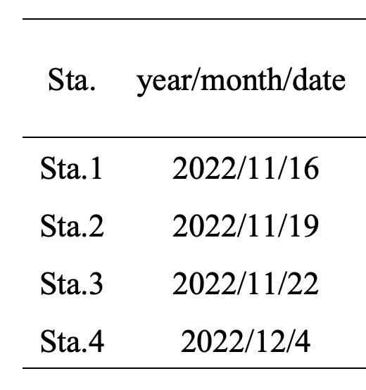
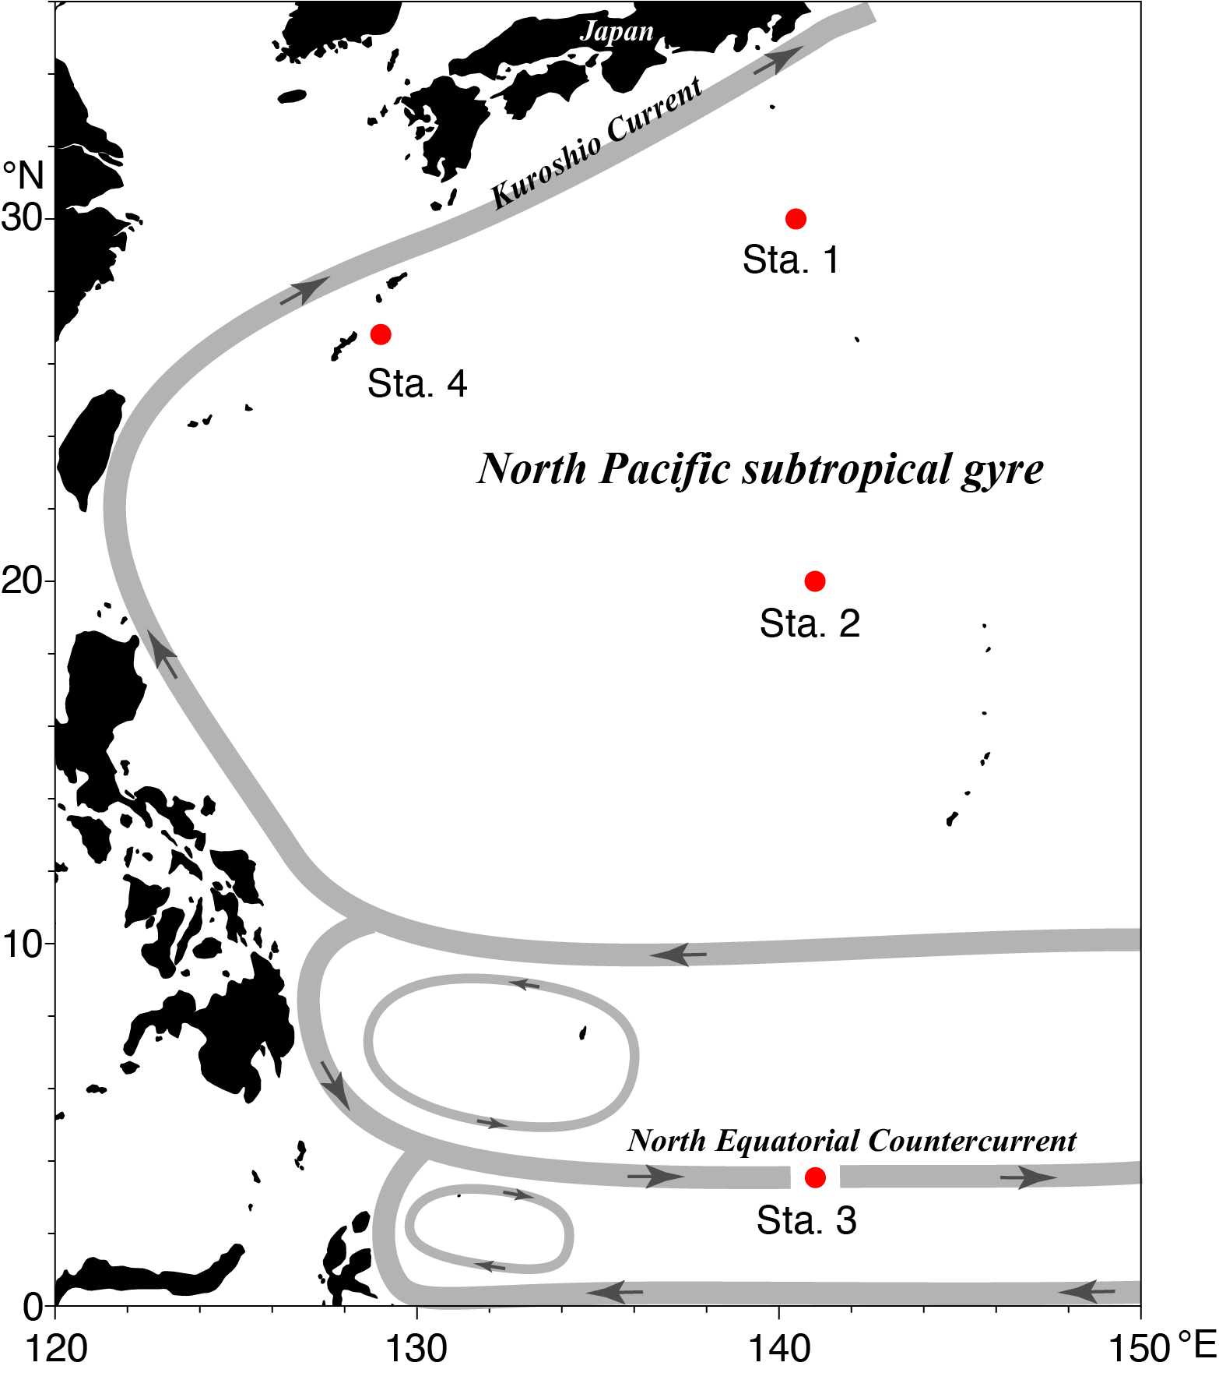
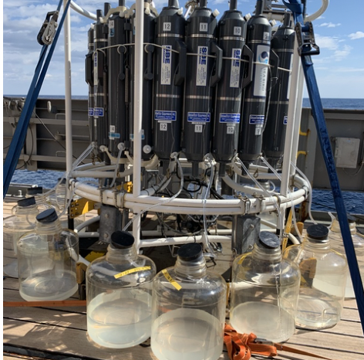
Umitaka-maru (TUMSAT)
Niskin bottles (8L×2 = 16L/each depth)
Sta. 1+ Sta. 2 + Sta. 3 = 48L
12 layers (0, 10, 20, 30, 50,100, 150, 200, 400, 600, 800, 1000 m)

Slide 3
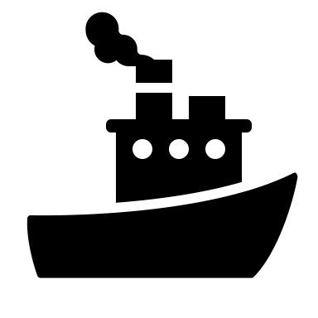
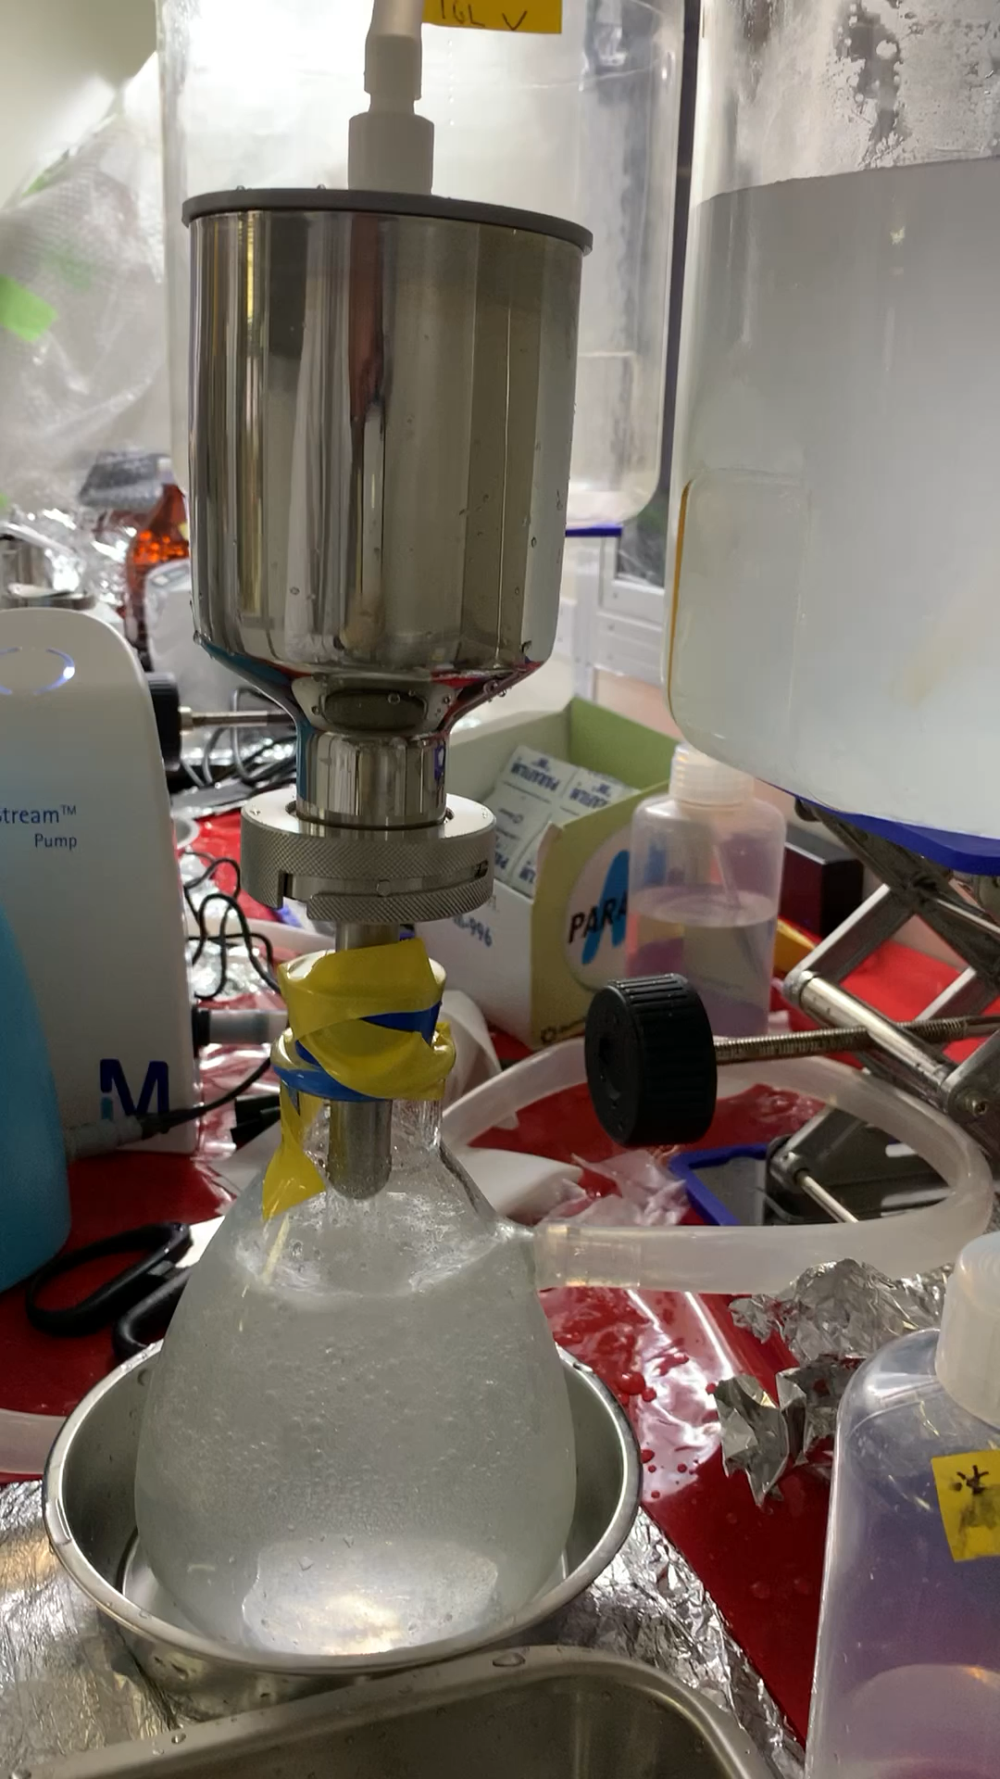
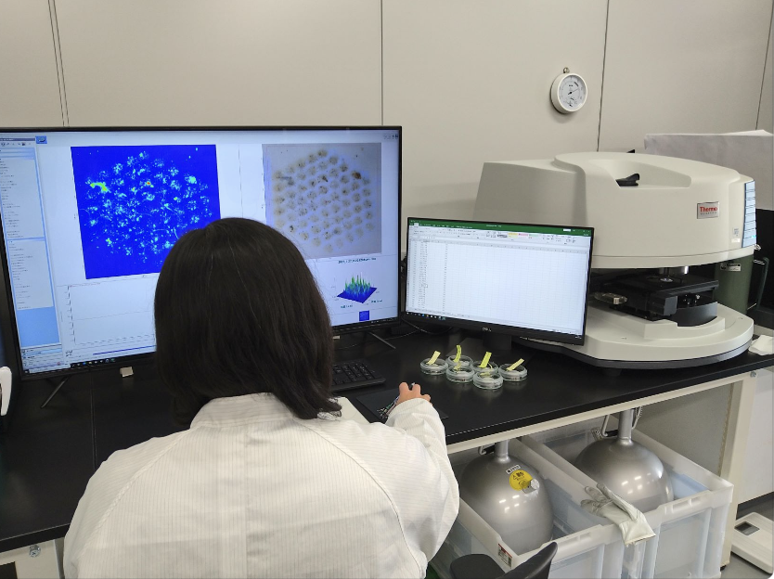

Samling & analyzing
Shipboard processing
CTD & seawater sampling
(16L per each 12 layer)
Filtration onto a 10-um steel filter in the clean booth installed in the ship
Laboratory processing
Blank tests to remove contamination
Check the breaking rate in lab processes
Check recovery rate in lab processes
Remove plastics used in the processes (e.g., PVC, PC,….)
Remove fiber PET, PA
Two-step digestion (Alfonso et al., 2021)
(KOH + Fenton R)
]
Identification using micro-FTIR

Slide 4
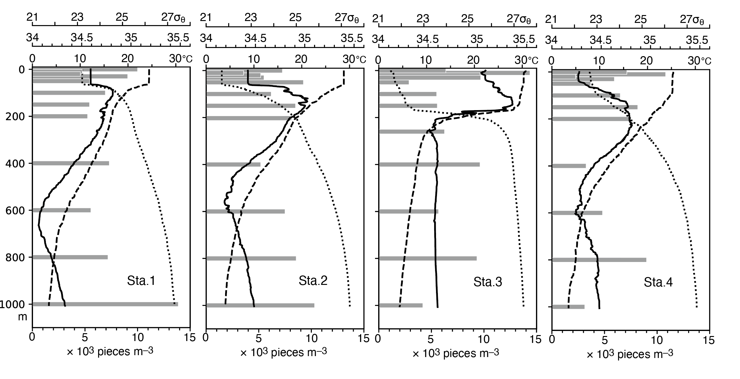
SMPs concentrations at depths
NPIW
NPIW
NPIW
Isopycnal layers below the North Pacific Intermediate Water (NPIW) never outcrop at the sea surface , where SMPs initially floated.
These deep SMPs settling from the upper layer (diapycnal transport)

Slide 5
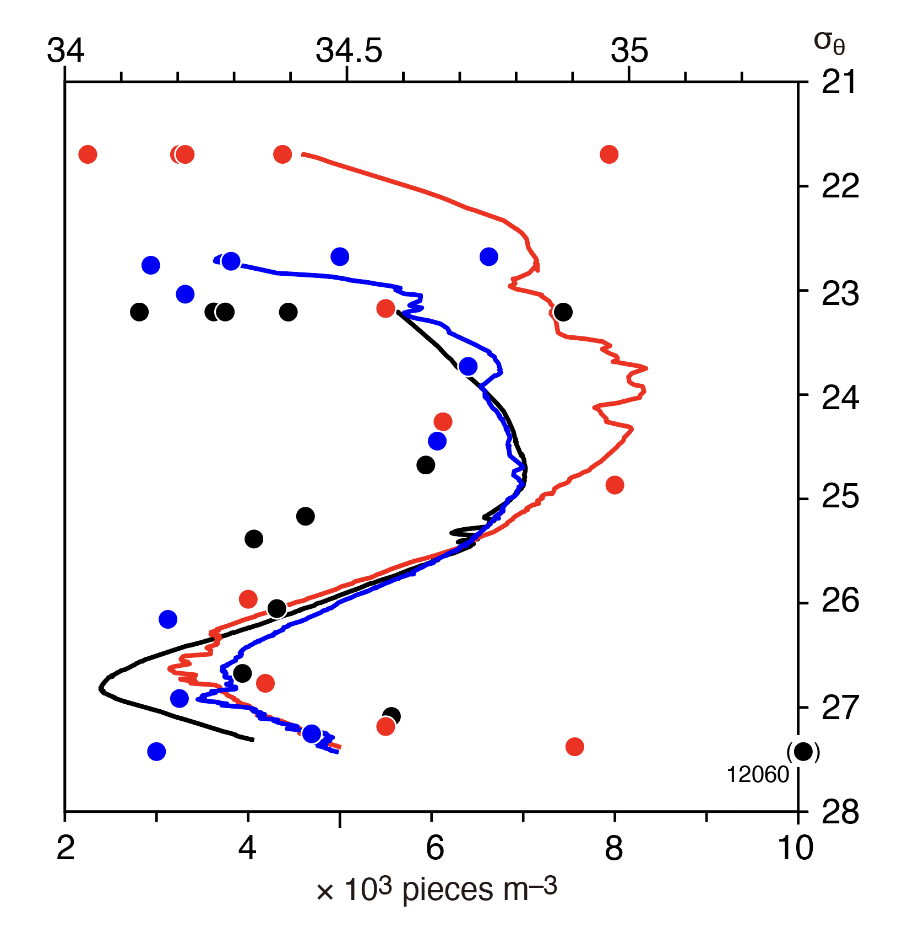
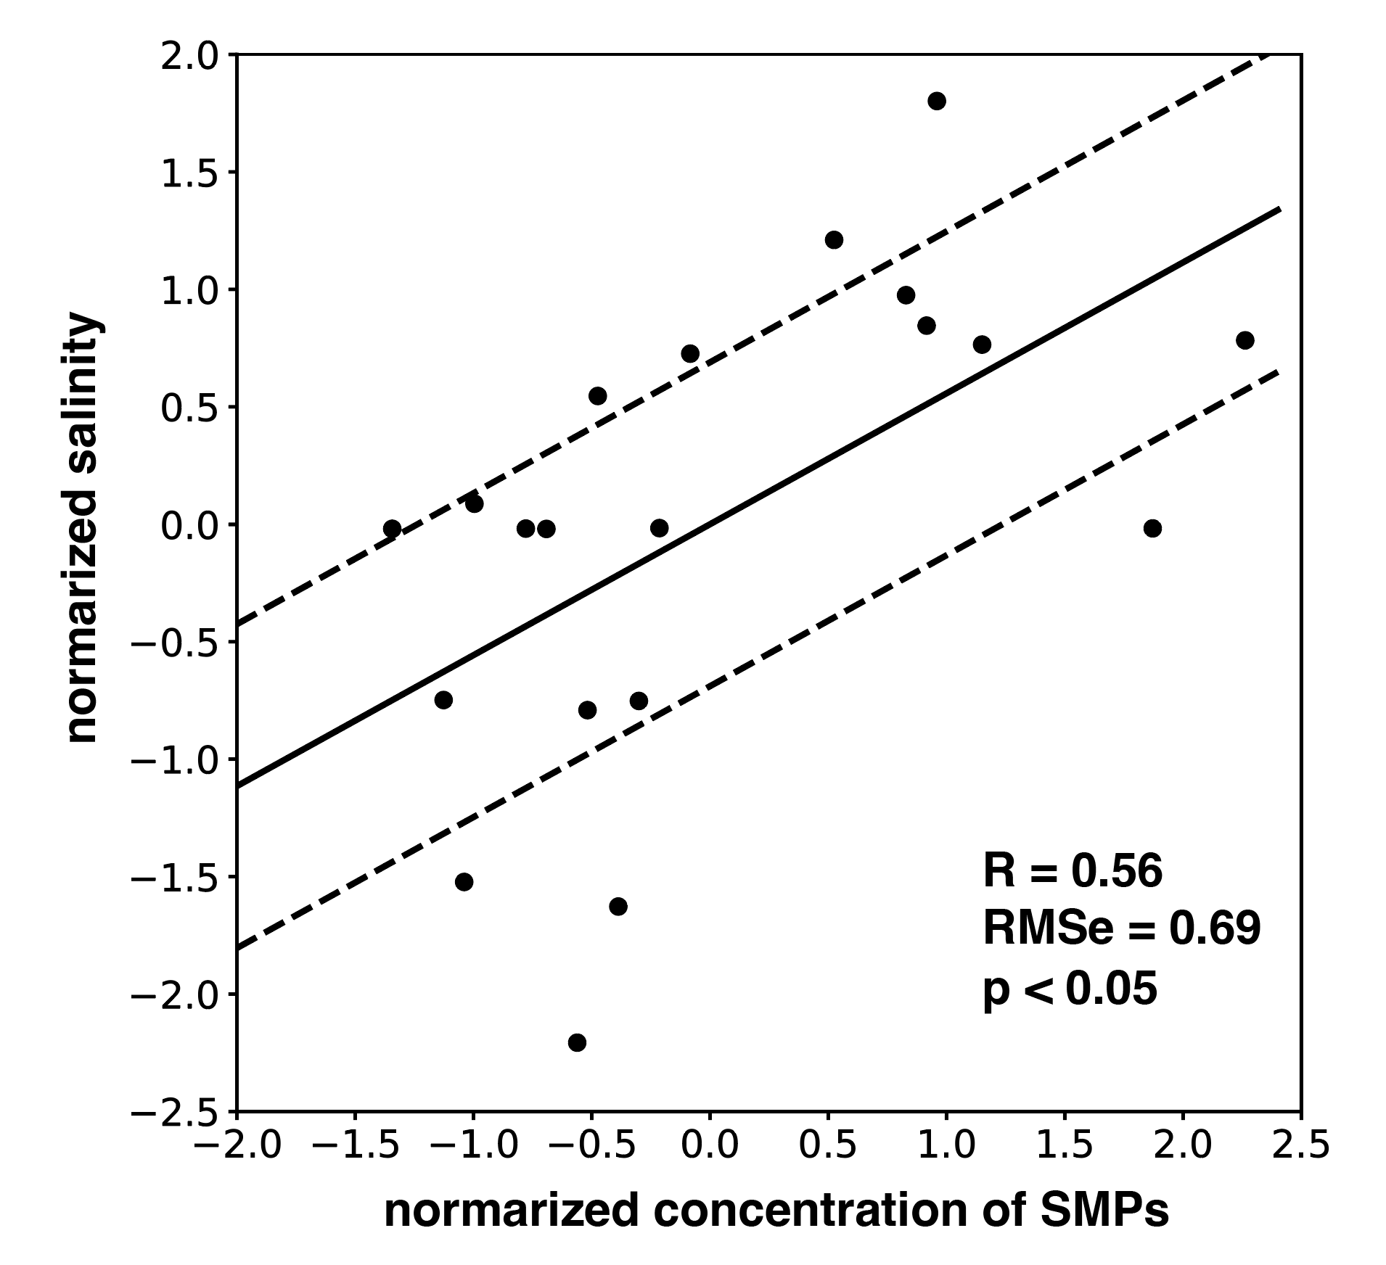
SMPs concentrations in isopycnal layers
(Stas. 1, 2, and 4 in the subtropical gyre)

Slide 6
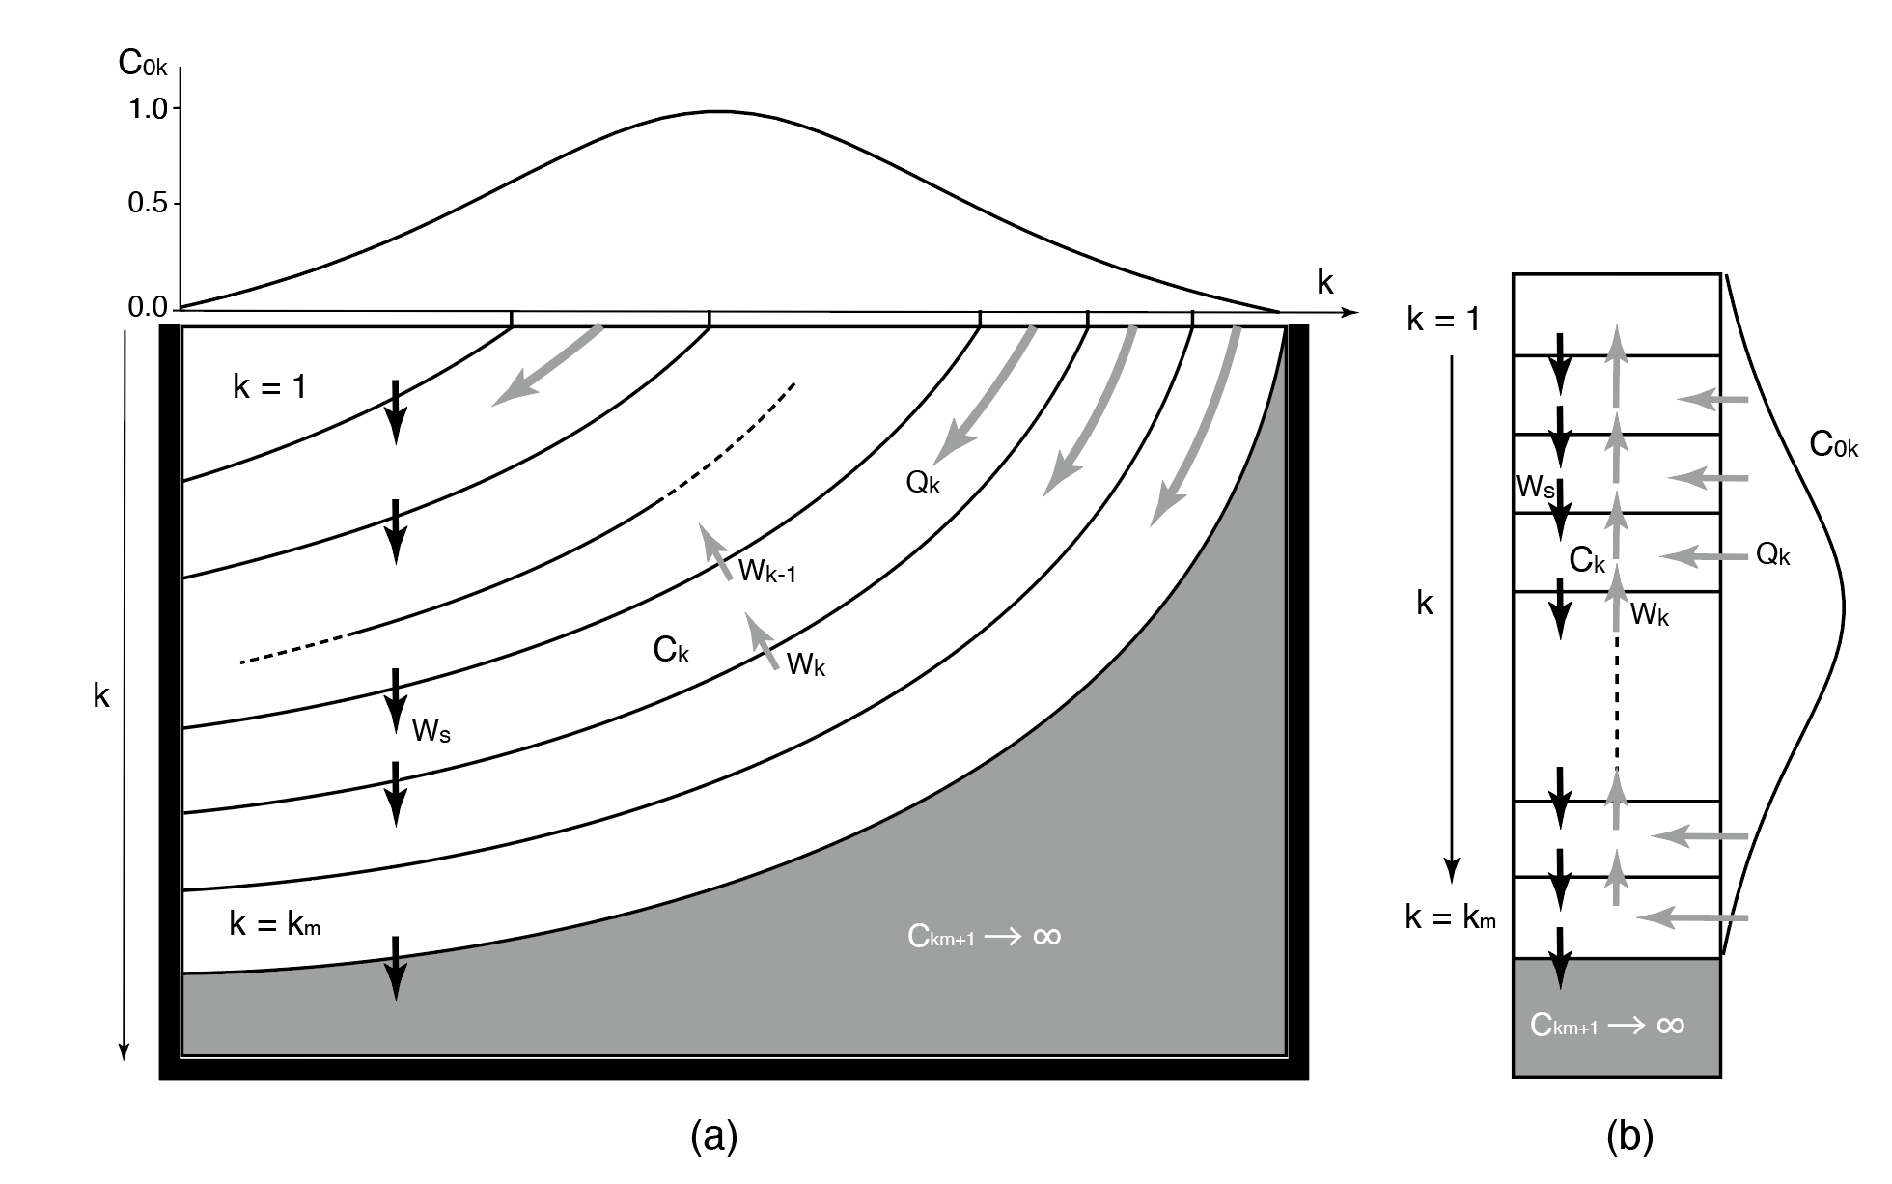
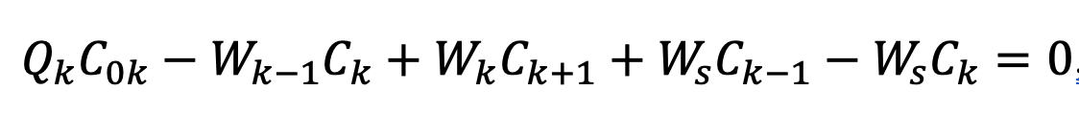



How the surface distribution of SMPs is transformed to the vertical profile via along-isopycnal transport?
C, SMP concentration
W_{k}, Vertical velocity due to divergence/convergence
Ws, Settling velocity
Strong settling via biological processes
Weak settling comparable with surrounding vertical motion
Near-neutral buoyancy

Slide 7
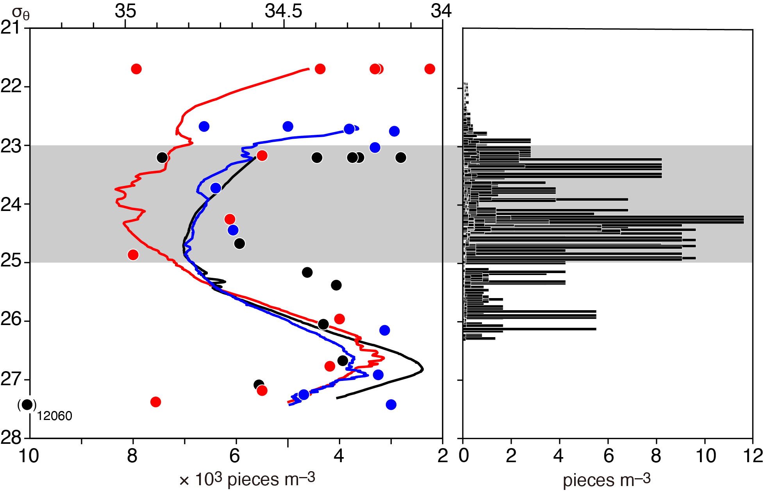
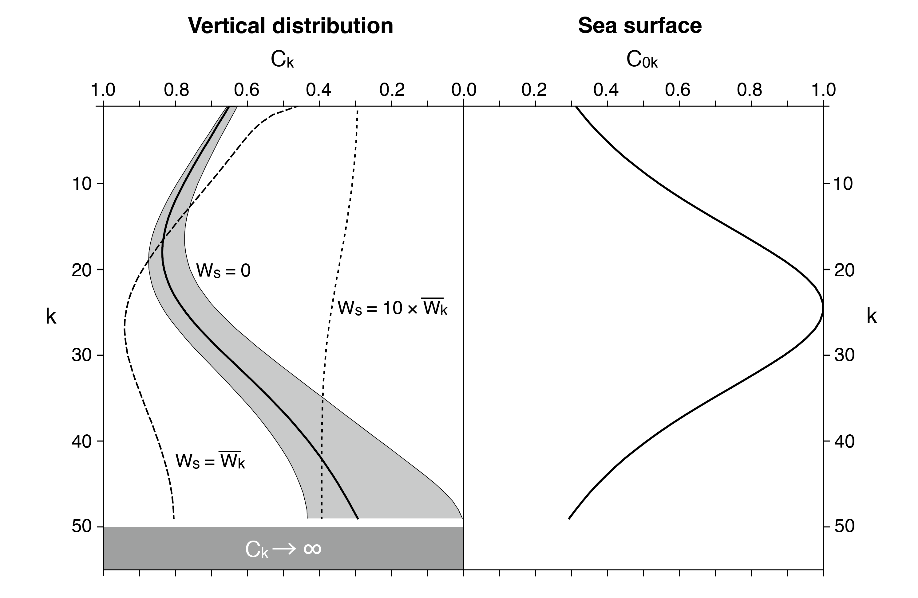
Along-isopycnal transport (subduction) of SMPs is sensitive to the settling velocity
–10%
+10%

Slide 8
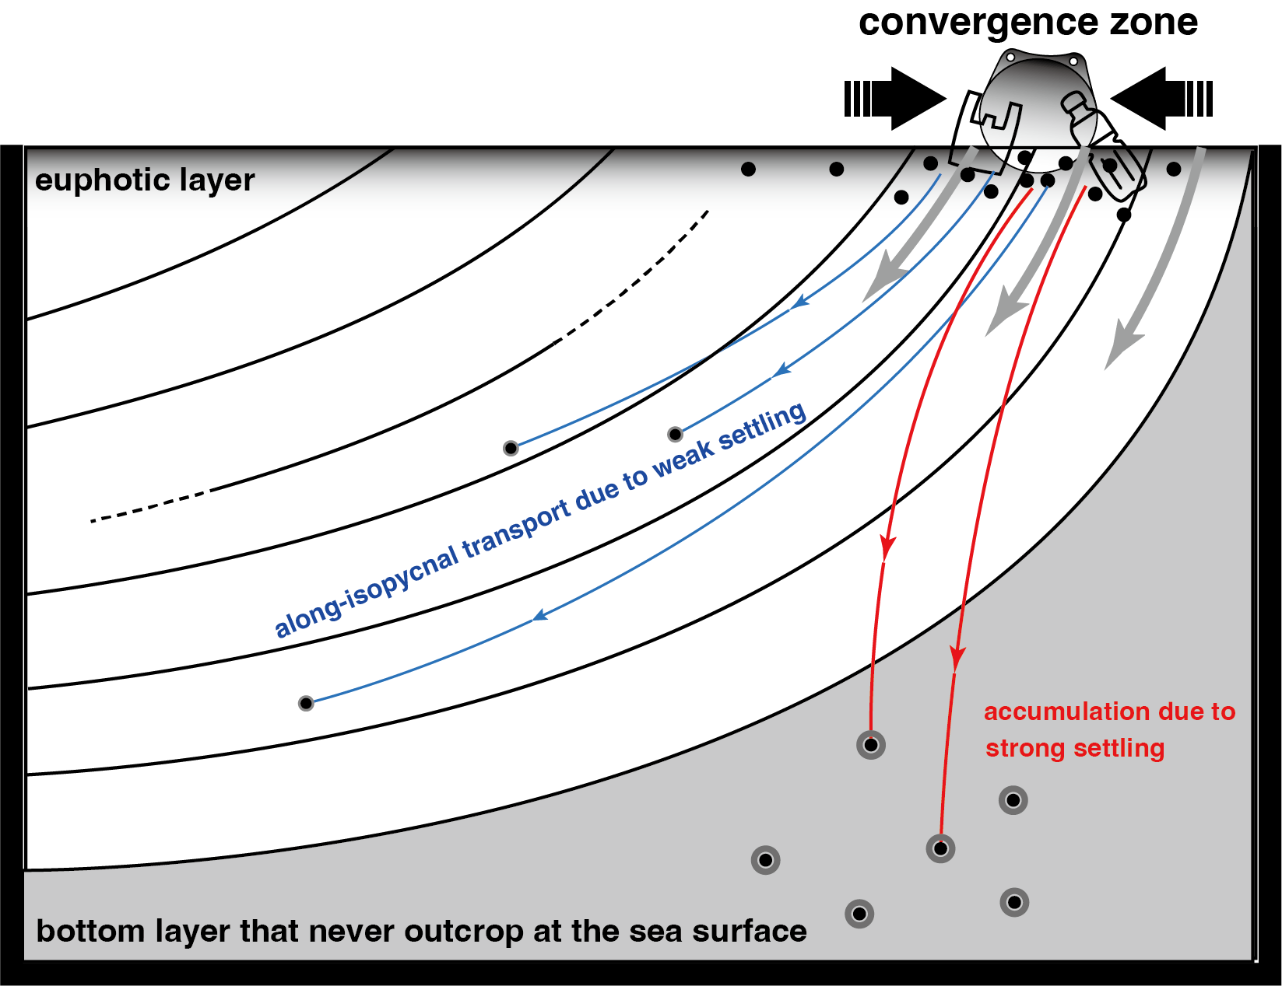
Two pathways for SMP subsurface transport
The global inventory of near-neutral SMPs with weak settling is expected to be large in subsurface layers

