Slide 1
www.DLR.de • Chart 1
The GOME-type Total Ozone Essential Climate Variable – the first 20 years of an accurate global ozone data record (1995-2015)
M. Coldewey-Egbers ^{DLR}, D. Loyola ^{DLR}, M. Dameris ^{DLR}, P. Braesicke ^{KIT}, M. van Roozendael ^{BIRA}, C. Lerot ^{BIRA}, M. Koukouli ^{AUTH}, D. Balis ^{AUTH}, and C. Zehner ^{ESA}

Slide 2
Outline
Motivation
GOME-type Total Ozone – Essential Climate Variable
Total Ozone Trends
GTO-ECV CCI
Comparison with other satellite-based data records
Comparison with Dobson ground-based data
Comparison with EMAC Model Simulation
Summary and Outlook

Slide 3
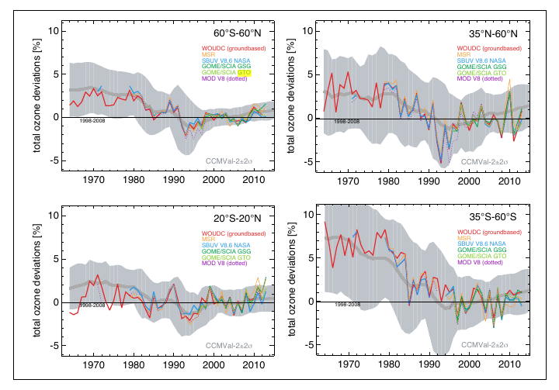
Motivation
Montreal Protocol (1987) + Amendments
ODSs have peaked in the late 1990s
Ozone levels remain stable since ~2000
Recovery is expected but masked by large interannual variability in the middle and high latitudes → dynamically induced
Complicated attribution in the tropics
Need to create consistent, global, long-term satellite data records
→ ESA Climate Change Initiative - Ozone_CCI Project
Monitor the long-term behaviour of total ozone
Analyse ozone variability and trends on global and regional scales
Evaluate Chemistry Climate Model simulations
Fig. 2-2, WMO Report, 2014

Slide 4
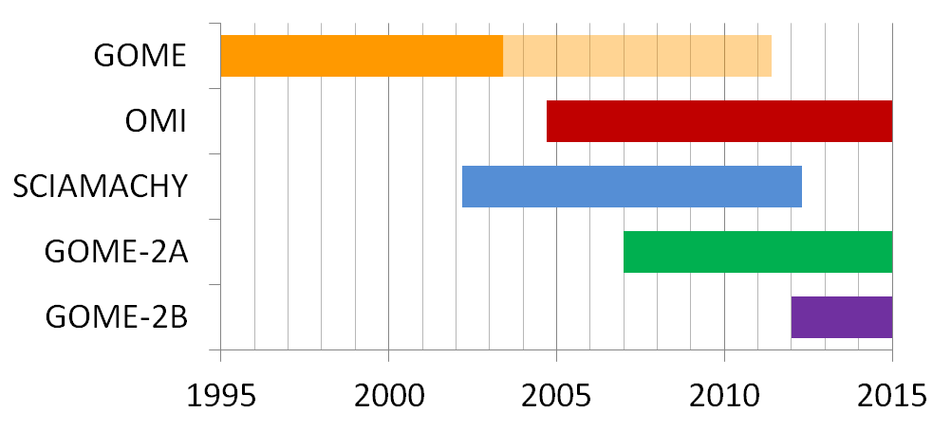
GTO-ECV CCI Total Ozone Data Record
Combination of GOME/ERS-2 (1995-2011), SCIAMACHY/ENVISAT (2002-2012), GOME-2/MetOp-A (2007-present), and OMI/AURA (2004-present)
UV and visible wavelength range
Sun-synchronous near-polar orbits
Level 2 based on GODFIT ozone retrieval version 3 → Poster P223, Lerot et al. (Lerot et al., JGR, 2014 and Koukouli et al., JGR, 2015)
Ground-pixel size:
40 x 320 km²
13 x 25 km²
30 x 60 km²
80 x 40 km²

Slide 5
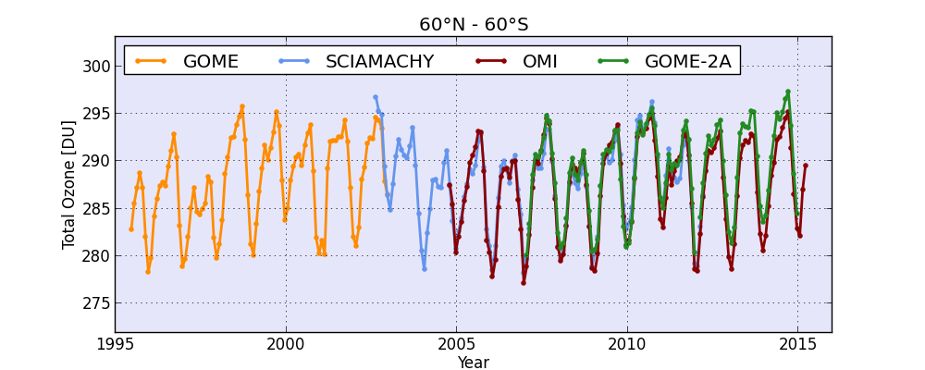
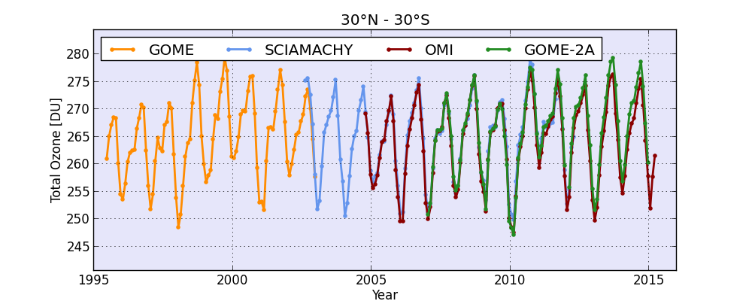
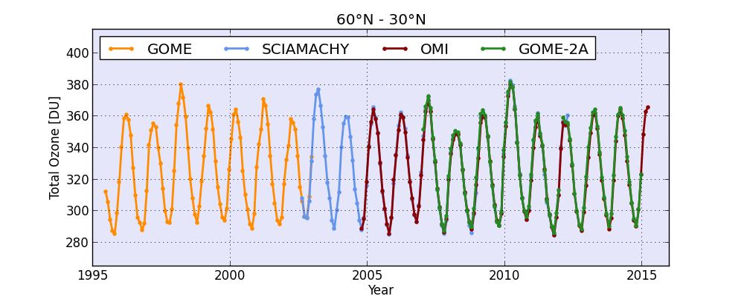
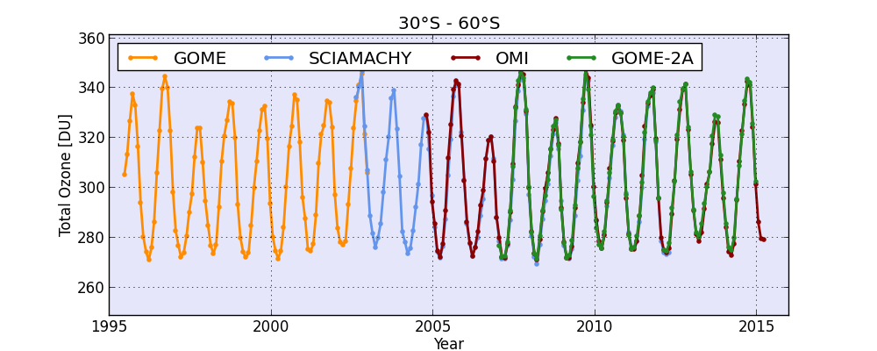
GTO-ECV CCI Total Ozone Data Record
Use one instrument as reference and apply inter-sensor correction factors to the other sensors

Slide 6
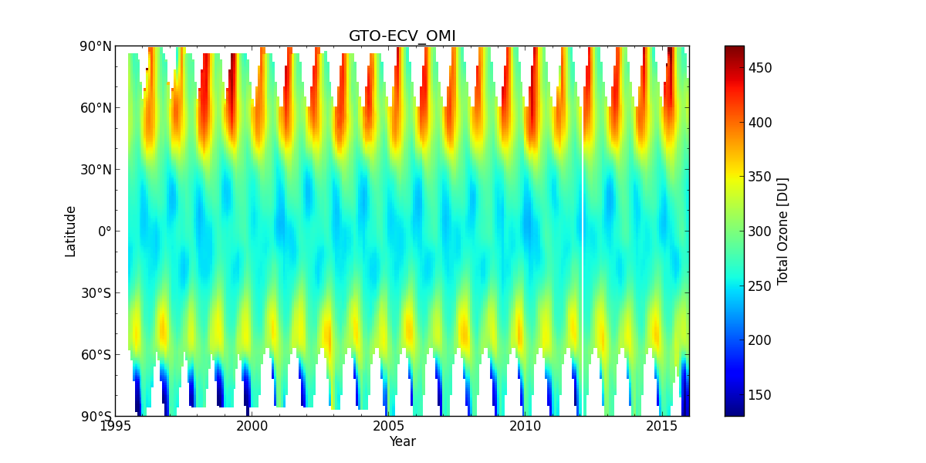
Extended GTO-ECV CCI Total Ozone Data Record
Data record contains 1°x1° monthly means from July 1995 to December 2015.
GTO-ECV CCI Version 1 (1996-2011): algorithm description and extensive ground-based validation in AMT, Coldewey-Egbers et al., 2015.
Data freely available via http://www.esa-ozone-cci.org

Slide 7
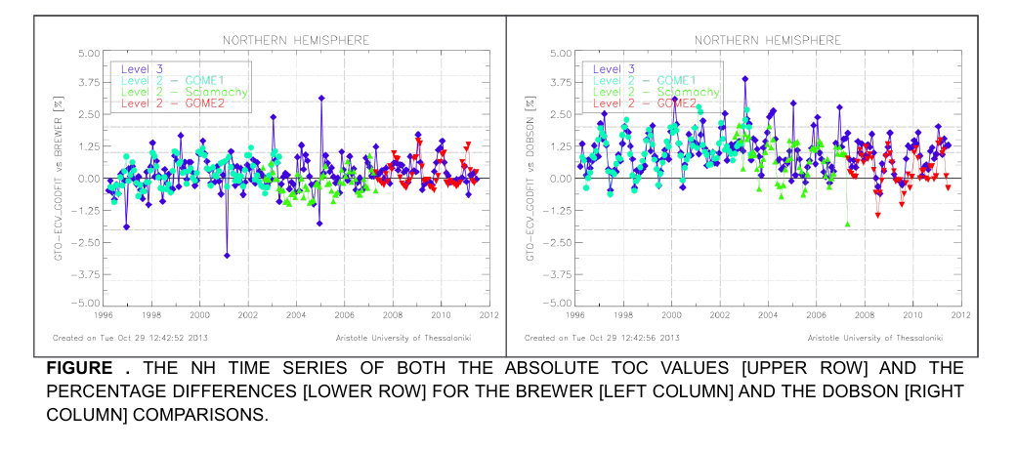
GTO-ECV CCI_v1 Ground-Based Validation (AUTH)
NH Brewer NH Dobson
Courtesy of M. Koukouli, AUTH
Coldewey-Egbers et al., AMT, 2015
→ Level 3 merged product is of the same high quality as the individual level 2 products that constitute it; except for a few outliers mostly related to sampling differences.

Slide 8
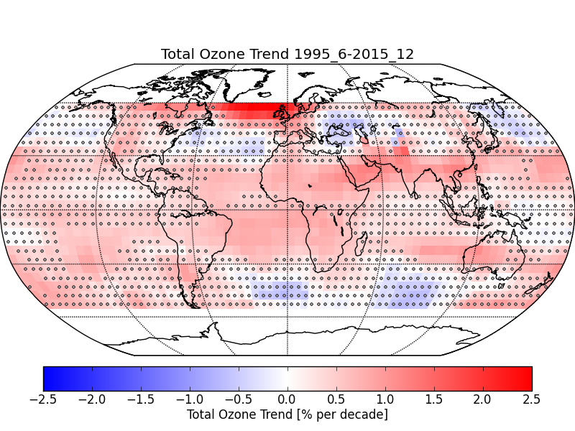
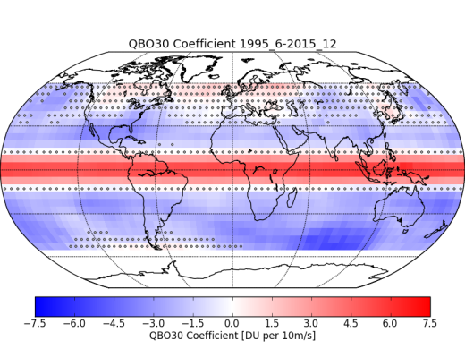
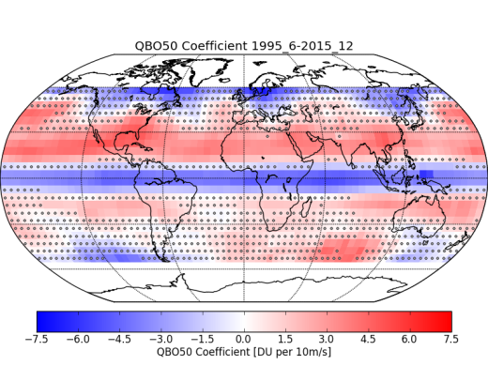
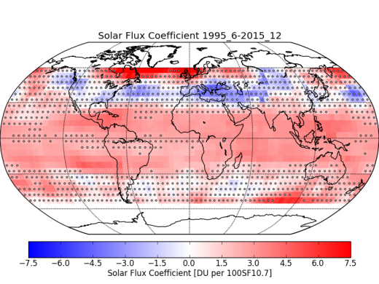
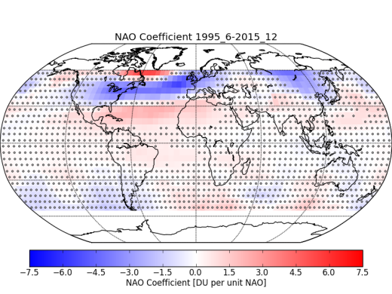
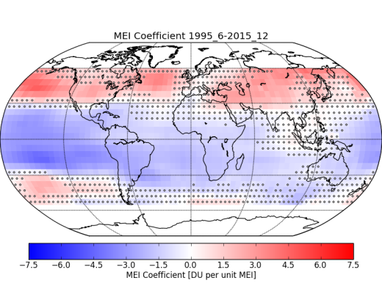
Total Ozone Trends and Variability
O₃(m) = A + B·m + C·SF(m) + D·QBO30 +
E·QBO50(m) + F·MEI(m) + X(m)
Update of Coldewey-Egbers et al., GRL, 2014
Linear trend is not significant in the middle latitudes due to strong natural variability that masks expected ozone recovery
Solar cycle, QBO, and ENSO impact ozone in the tropics
QBO30 QBO50 SolarCycle ENSO
NAO - Index

Slide 9
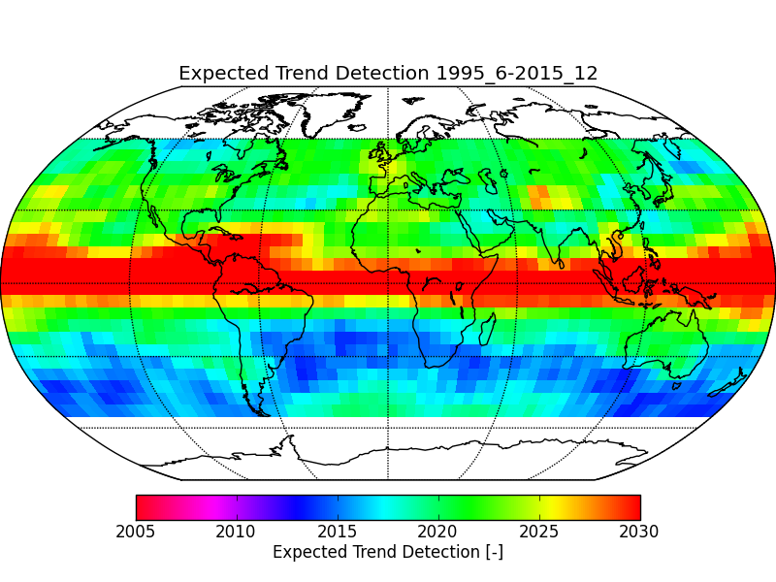
Expected Trend Detection
Weatherhead et al., JGR, 2000:
Number of years → n* ~ (σ / |B|)^{2/3}
Additional 5-10 years of observations are required

Slide 10
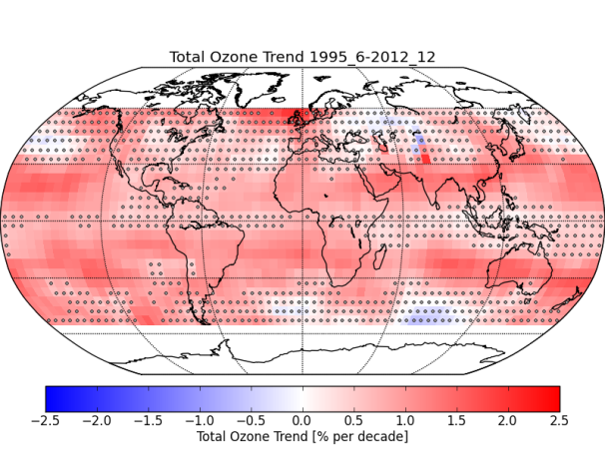
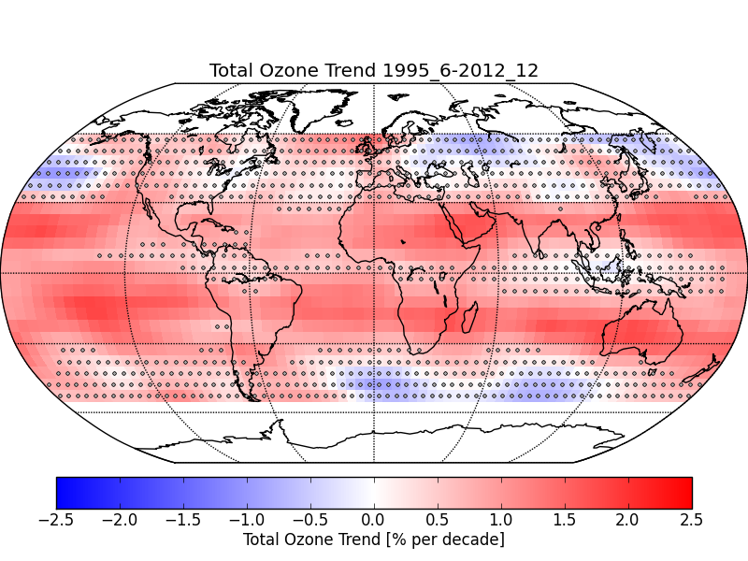
Comparison with other satellite-based data records
GTO-ECV Multi Sensor Re-analysis v2
http://www.temis.nl/protocols/O3global.html
Reference: van der A, R. J., Allaart, M. A. F., and Eskes, H. J., Extended and refined multi sensor reanalysis of total ozone for the period 1970-2012, Atmos. Meas. Tech., 8, 3021-3035, doi:10.5194/amt-8-3021-2015, 2015.

Slide 11
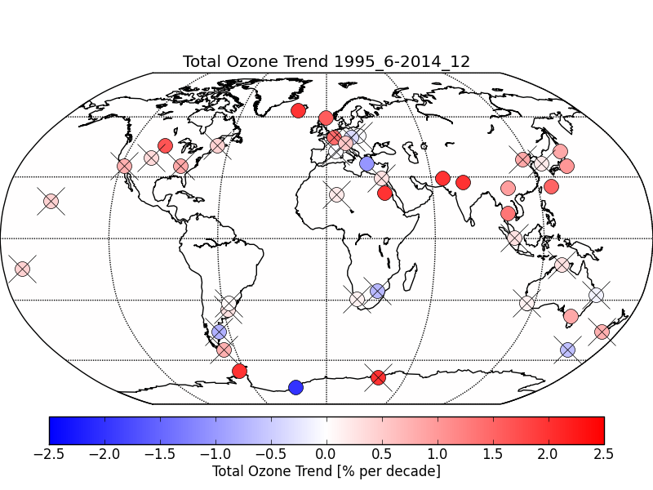
Ground-Based Trends: Dobson Stations
42 Dobson stations have been selected (www.woudc.org)
Some stations confirm the results from the satellite data record
Trends not significant (crosses) in middle latitudes (North and South America, Europe)

Slide 12
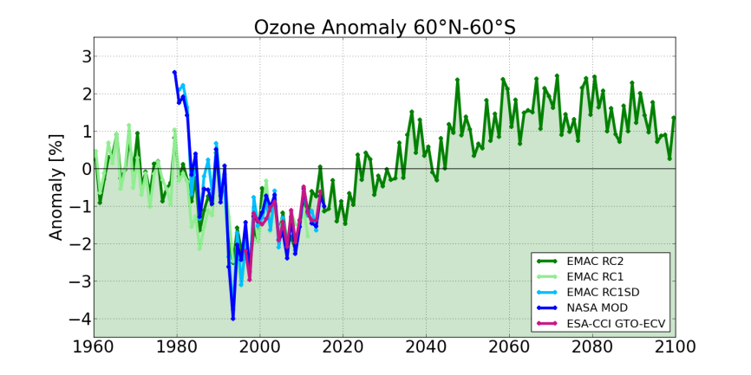
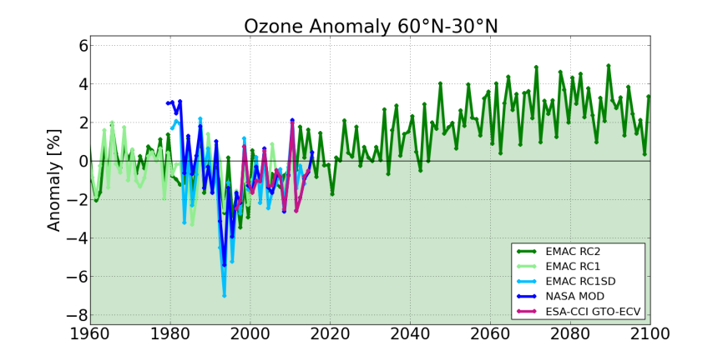
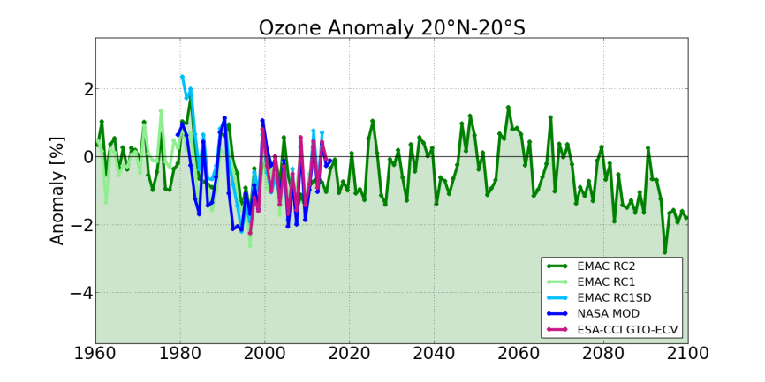
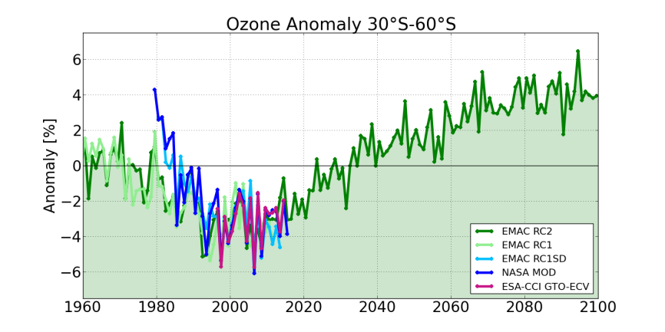
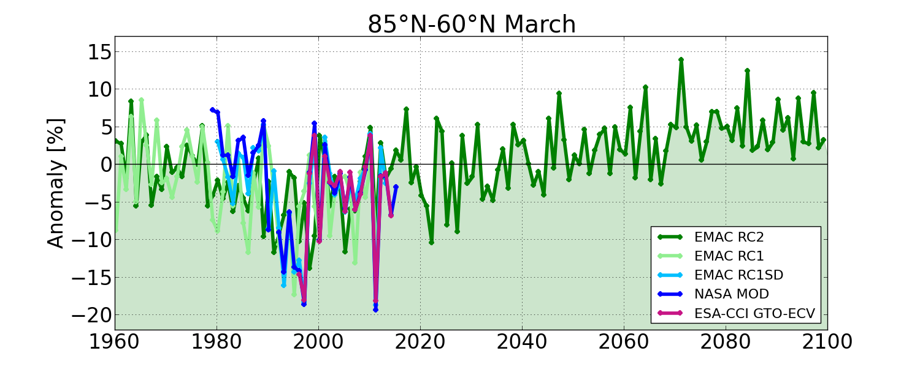
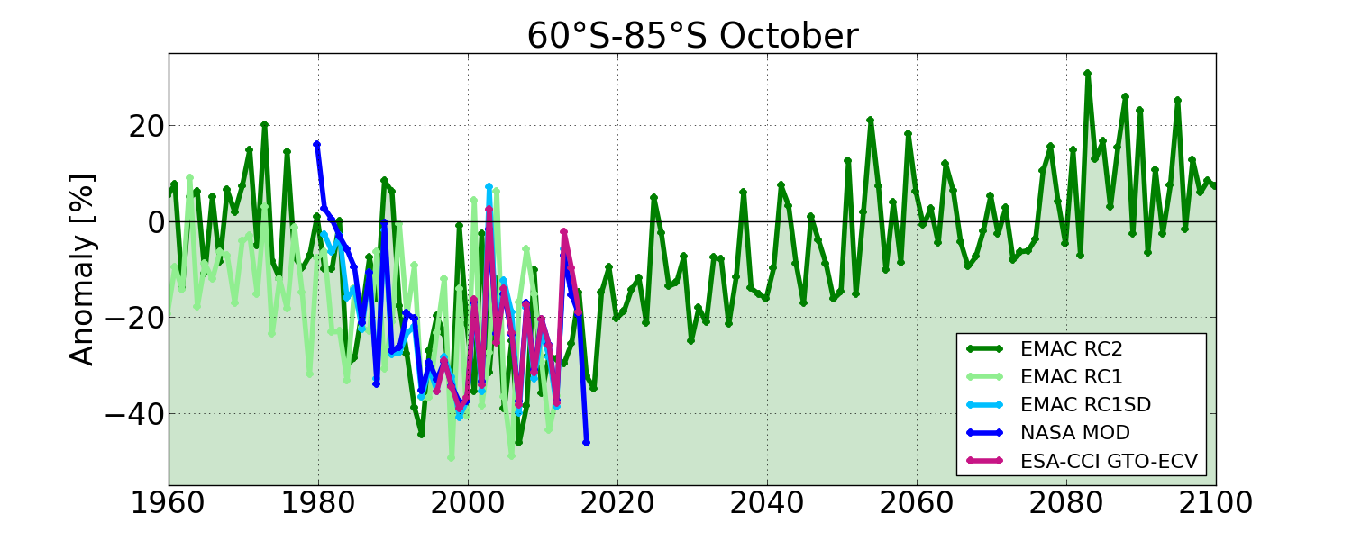
Comparison with EMAC Simulation (RC1+RC2)

Slide 13
Summary and Outlook
GTO-ECV CCI data record (1995-2015) is suitable for monitoring the long-term evolution of total ozone
Ground-based validation (V1) confirmed the high quality and stability of combined level 3 data record
Linear total ozone trend is positive in major parts of the globe, but statistical uncertainty is still large due to strong interannual variability
Trend patterns agree well with other long-term data records
GTO-ECV data record valuable to evaluate Chemistry-Climate Model simulations

Slide 14
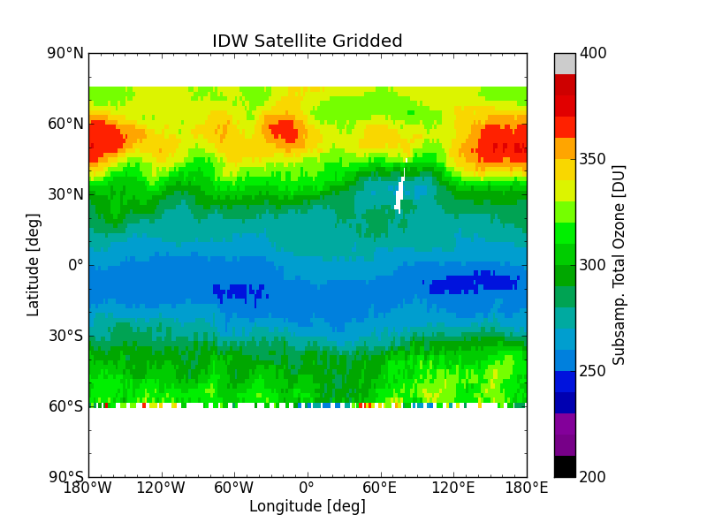
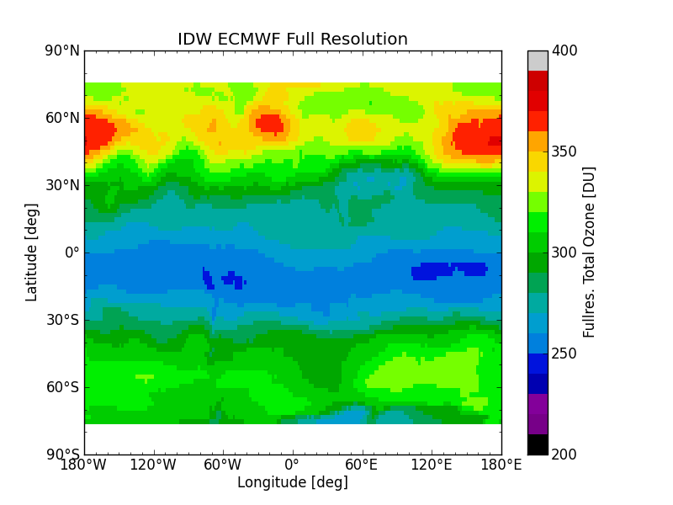
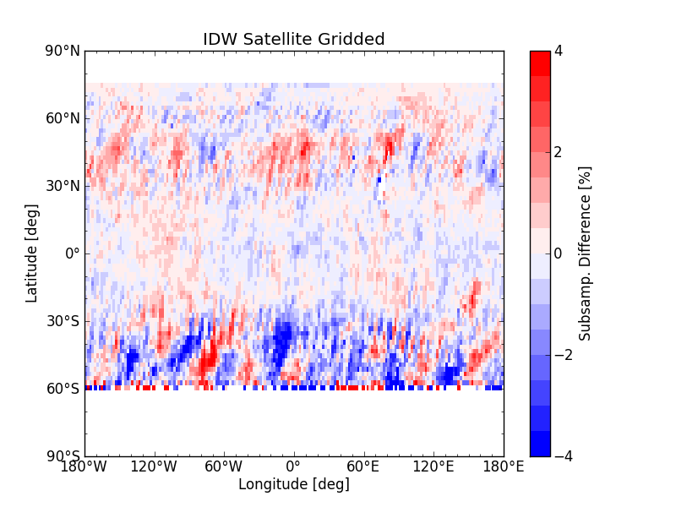
Outlook
Reduce sampling errors using spatio-temporal statistical tools
Create a similar data record for tropical (20°N-20°S) tropospheric ozone retrieved using the CCD method (Heue et al., AMT, in review)
Calculate trends and evaluate model simulations
Extend the data records using GOME-2/MetOp-B/C and the Sentinel series

Slide 15
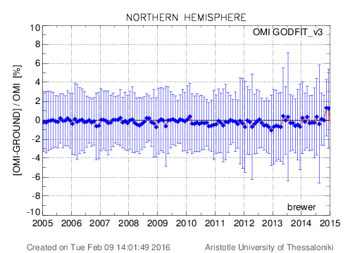
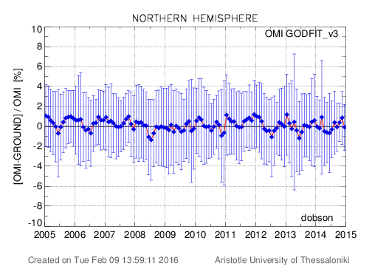
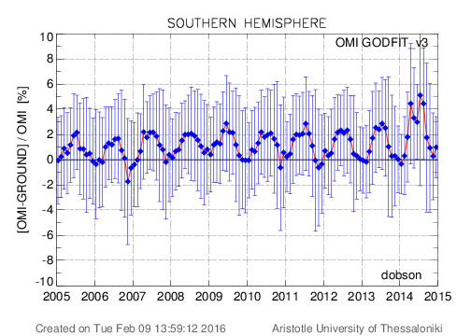
OMI/AURA ozone compared to ground-based data
Dobson Brewer
Courtesy of M. Koukouli, AUTH

Slide 16
Temperature and Pressure Trend

Slide 17
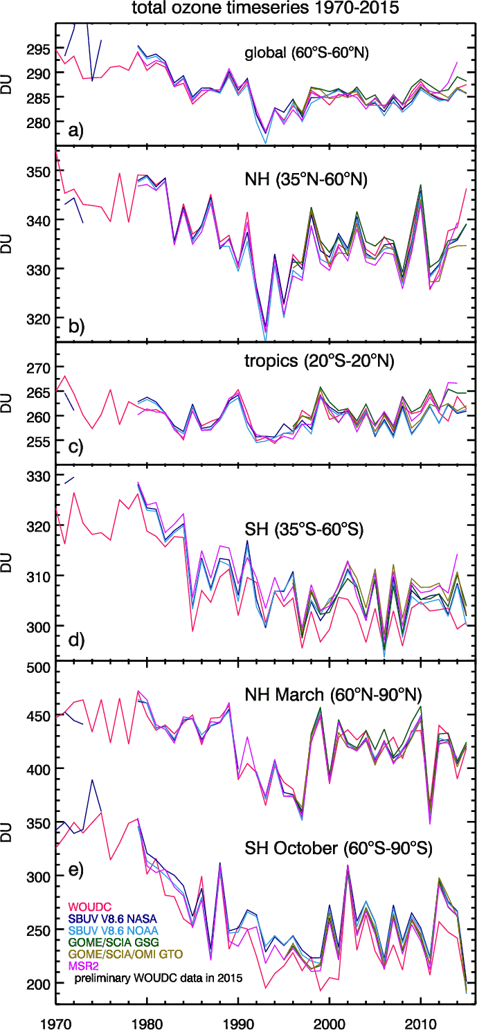
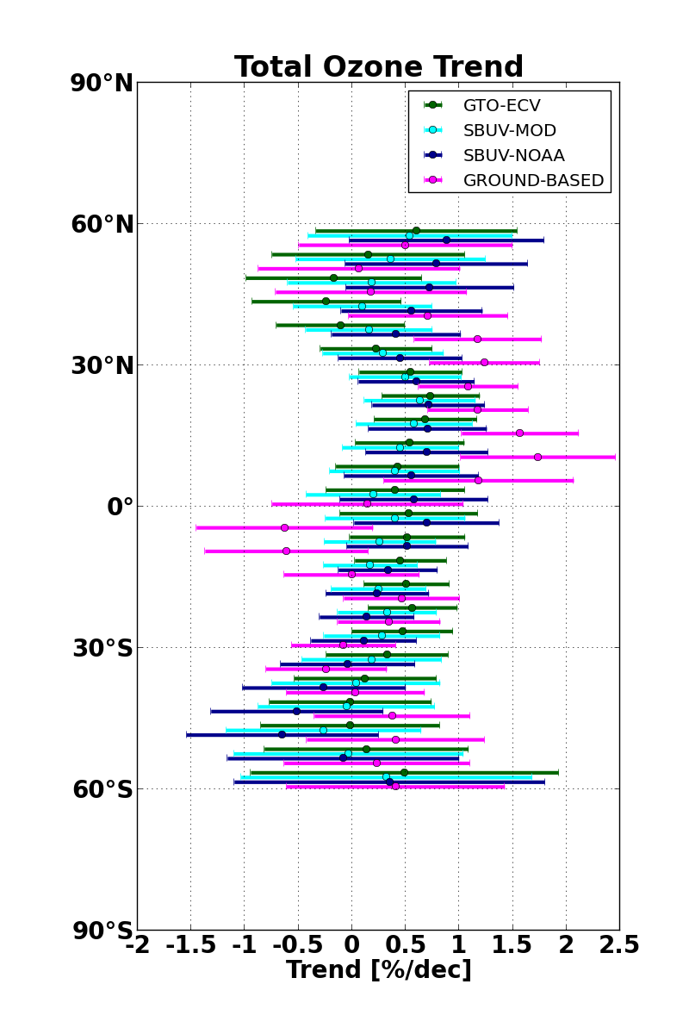
Comparison with other satellite-based data records
Zonal mean anomalies agree well
Zonal mean satellite-based trends 1995-2015 agree very well
Trends statistically not significant
SBUV-MOD provided by S. Frith, NASA; SBUV-NOAA provided by J. Wild, NOAA; GB zonal means provided by V. Fioletov, EC
Weber et al., Fig. 2-46, BAMS State of the Climate in 2015

Slide 18
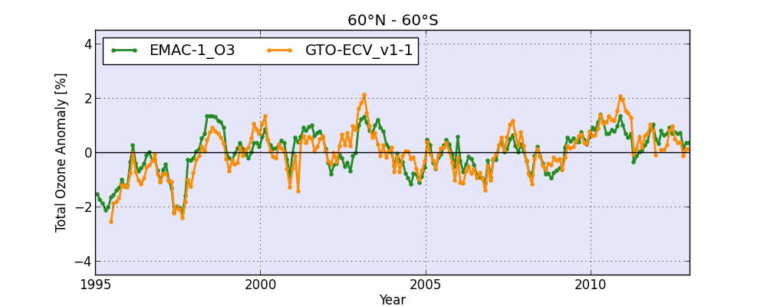
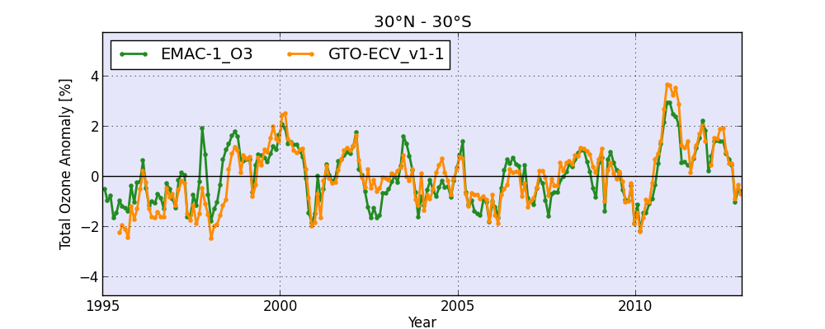
Comparison with EMAC Simulation
Provided by the Institute for Physics of the Atmosphere / DLR
ECHAM / MESSy Atmospheric Chemistry, a global atmosphere-chemistry model
Jöckel et al., GMD, 2016
Nudged mode: meteorology constrained to (re-) analysis data.
Monthly mean total ozone; resolution ~2.8° x 2.8° ; „RC1SD-base-10“ from 1980-2012.
Total ozone columns: positive bias of ~15DU in Northern Hemisphere and ~15-25DU in Southern Hemisphere compared to GTO-ECV CCI data record
Ozone anomalies w.r.t. mean (1995-2012) seem well captured by the model

Slide 19
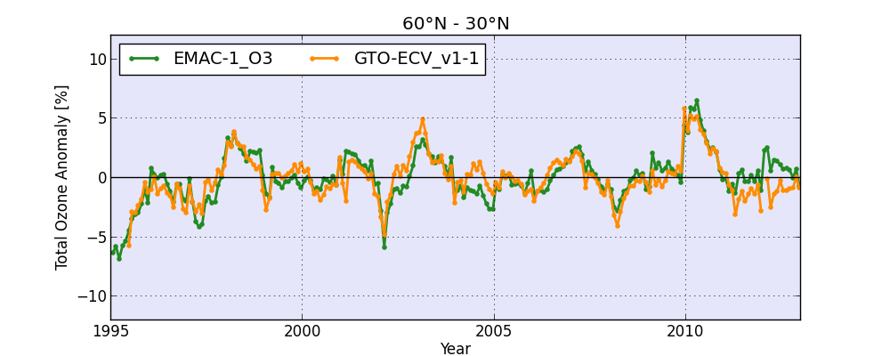
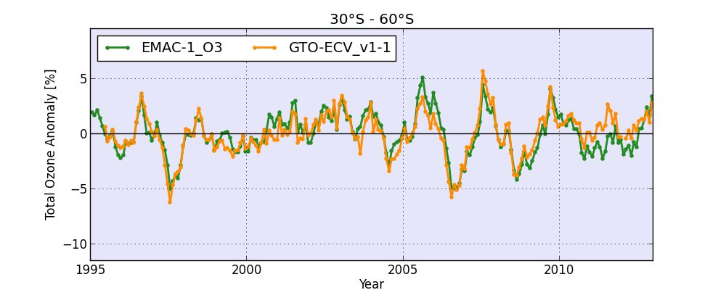
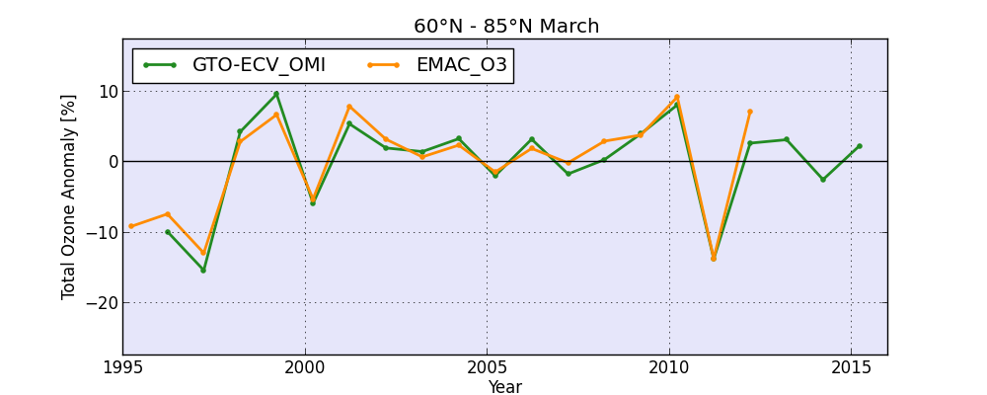
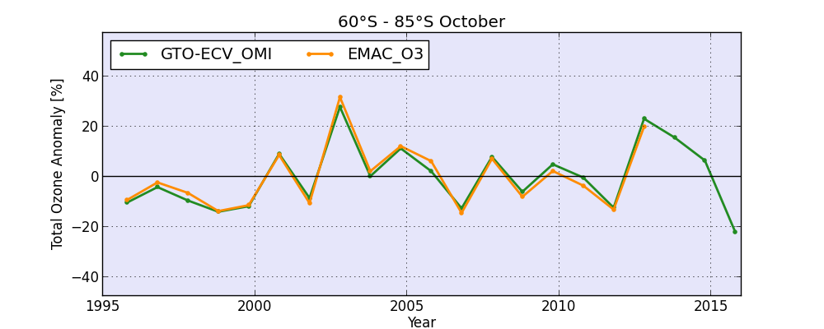
Comparison with EMAC Simulation (SD)
60°N – 30°N 30°S - 60°S
March 60°N – 85°N October 60°S - 85°S

Slide 20
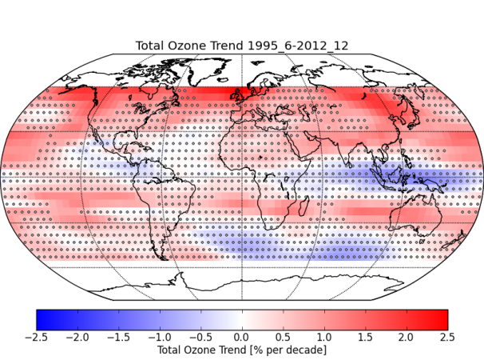
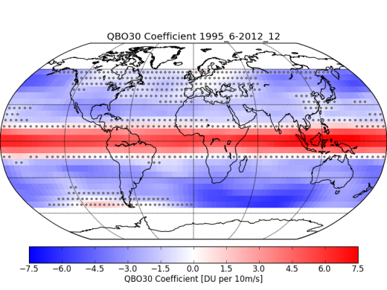
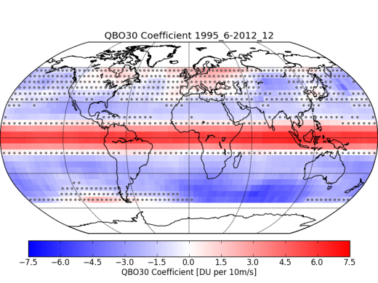
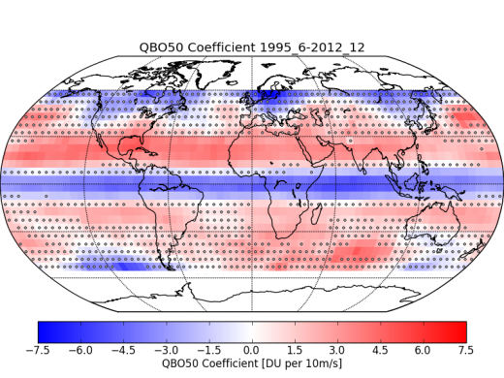
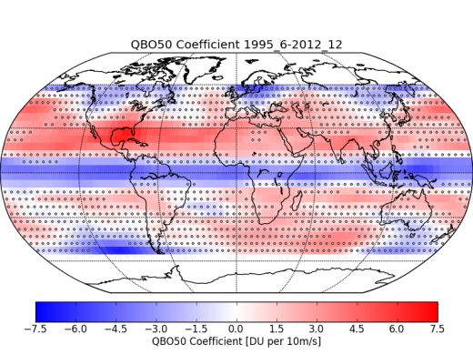
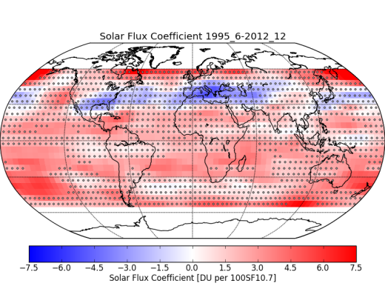
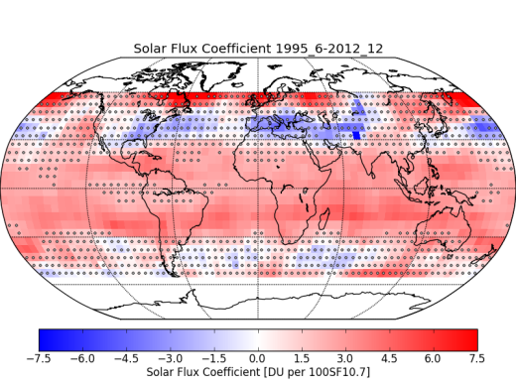
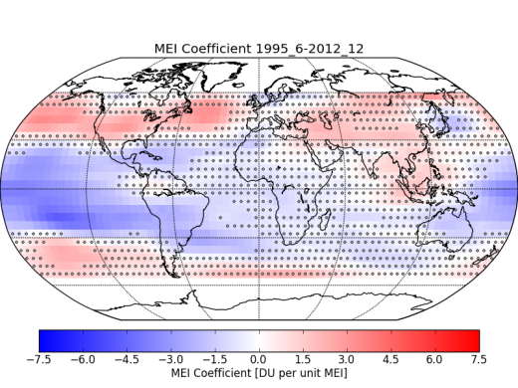
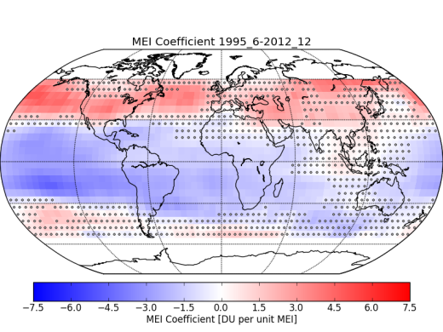
GTO-ECV and EMAC Total Ozone Trends 1995-2012
Total Ozone Trend
EMAC
GTO-ECV CCI
QBO 30
QBO 50
Solar Cycle
MEI

