Slide 1


GOMOS measurements of O₃, NO₂, and NO₃ compared
to model simulations
by the specified dynamics WACCM-model
E. Kyrölä, M. E. Andersson, P. Verronen, M. Laine
Finnish Meteorological Institute, Earth Observation Unit, Helsinki, Finland
D. R. Marsh, A. K. Smith
National Center for Atmospheric Research, Boulder, Colorado, USA

Slide 2
Outline
Motivation
Models are widely used to analyse and
predict the state of atmosphere.
How close are model simulations to measurements?
WACCM and GOMOS
Method
WACCM-GOMOS O₃, NO₂ ,NO₃
WACCM-D in Arctic
Summary

Slide 3
Community Earth System Model (CESM)
WACCM validated version 4 (CESM 1.0.5)
Specified dynamics mode (SD): MERRA up to 50 km
Enhanced by Medium Energy Electrons (MEE): 30-300 keV
From surface up to 150 km, 88 levels
Neutral chemistry model for the MA
Ion chemistry in the MLT
Auroral processes, SPEs
EUV and non-LTE long wave radiation
Imposed QBO, based on winds
Volcanic aerosol heating
Gravity wave drag deposition
Molecular diff. and constituent separation
WACCM
A
T
M
O
S
P
H
E
R
E
COUPLER
LAND
SEA ICE
OCEAN

Slide 4
GOMOS 2002-2012
880 000 measurements
000 night occs.
430 000 day occs. (not used here)
+self-calibration
+coverage (180 stars)
+vertical resolution
+night
-S/N low
-GOMOS CCD: sensitive to protons
Sirius, the brightest star in the sky

Slide 5
Method
Because of non-uniform distribution (time-space) of
GOMOS measurements a climatological comparison leads to problems.
Instead we compare every GOMOS (night) profile to the nearest latitude-longitude-time cell of WACMM. This eliminates the sampling problem. Latitude difference <0.9 deg., longitudinal difference <1.25 deg. and time difference <15 min. Excellent co-location.
Comparisons in mixing ratio on pressure grid of WACCM. GOMOS number densities transformed by the WACCM neutral density. GOMOS altitudes linked to WACCM grid by WACCM geopotential.

Slide 6
Mid-latitude and global O₃ and NO₂

Slide 7
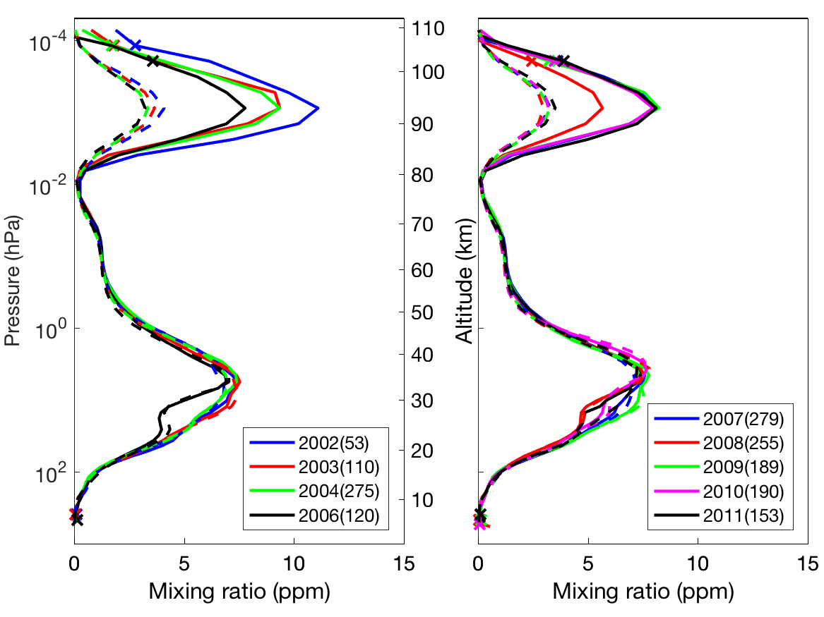
WACCM vs GOMOS ozone 2002-2011
Sirius occultations 40S-60S (September)
GOMOS
WACCM

Slide 8
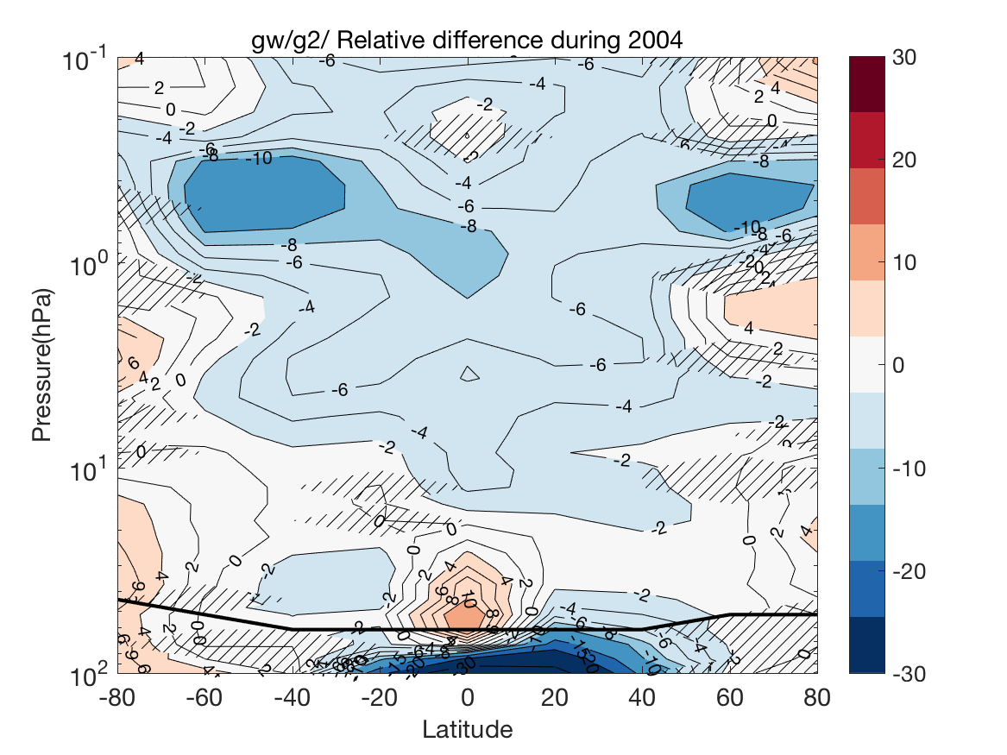
<WACCM-GOMOS>/<GOMOS> (%):
O₃ in Stratosphere
Gomos
required
range:
20-100 km
GOMOS well-know positive bias problem in UTLS (Sofieva, AMT, 2016)

Slide 9
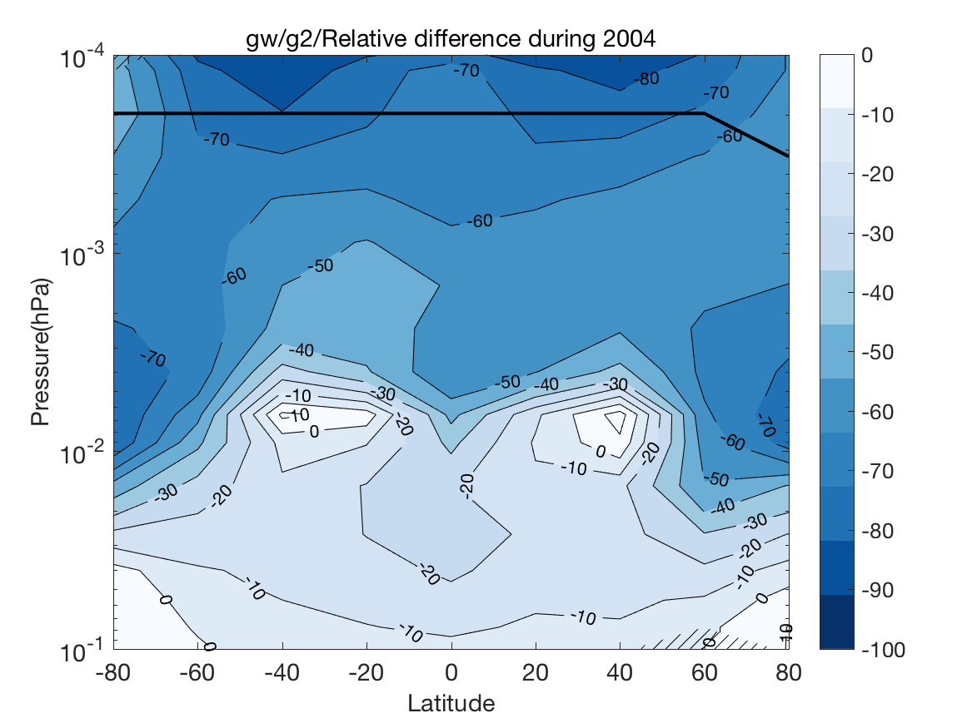
(WACCM-GOMOS)/GOMOS (%):
O₃ in Mesosphere
Gomos
required
range:
20-100 km

Slide 10
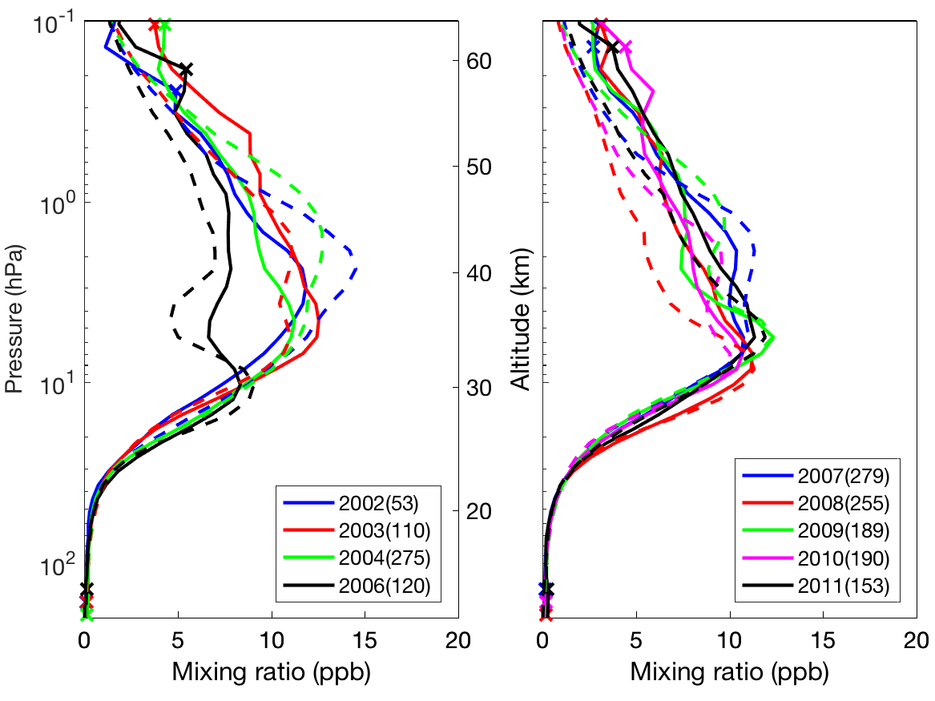
WACCM vs GOMOS NO₂ 2002-2011
Sirius occultations 40S-60S (September)

Slide 11
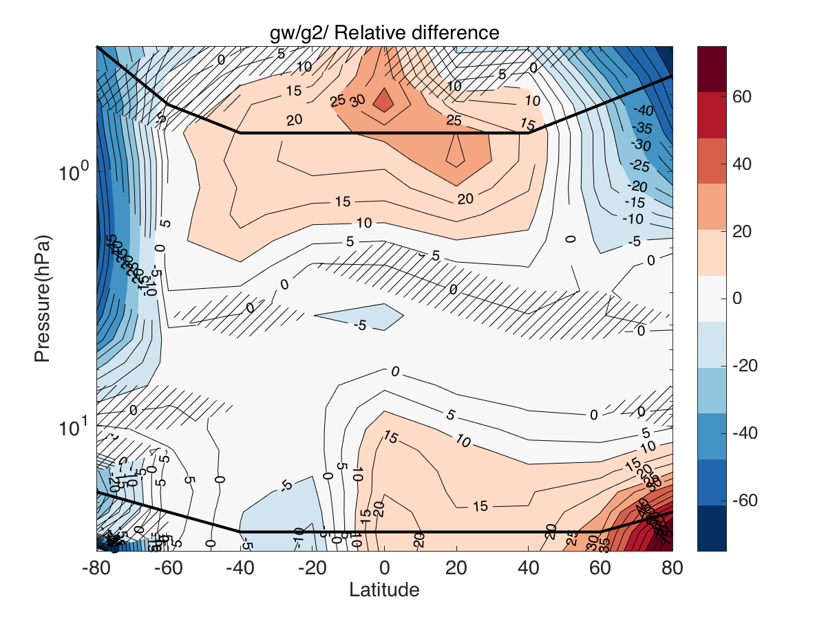
<WACCM-GOMOS>/<GOMOS> (%):
NO₂ in Stratosphere
Gomos
required
range:
25-50 km

Slide 12
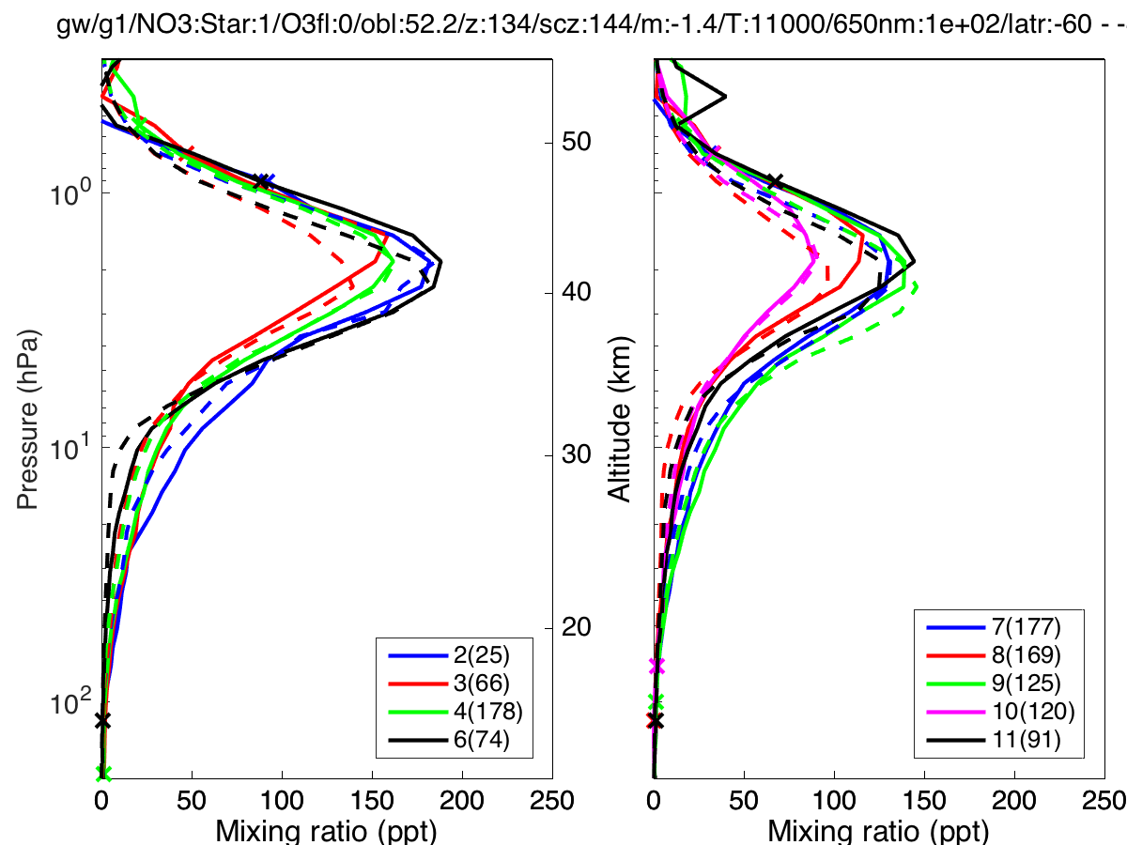
WACCM vs GOMOS NO₃
2002-2011
Sirius occultations 40S-60S (September)

Slide 13
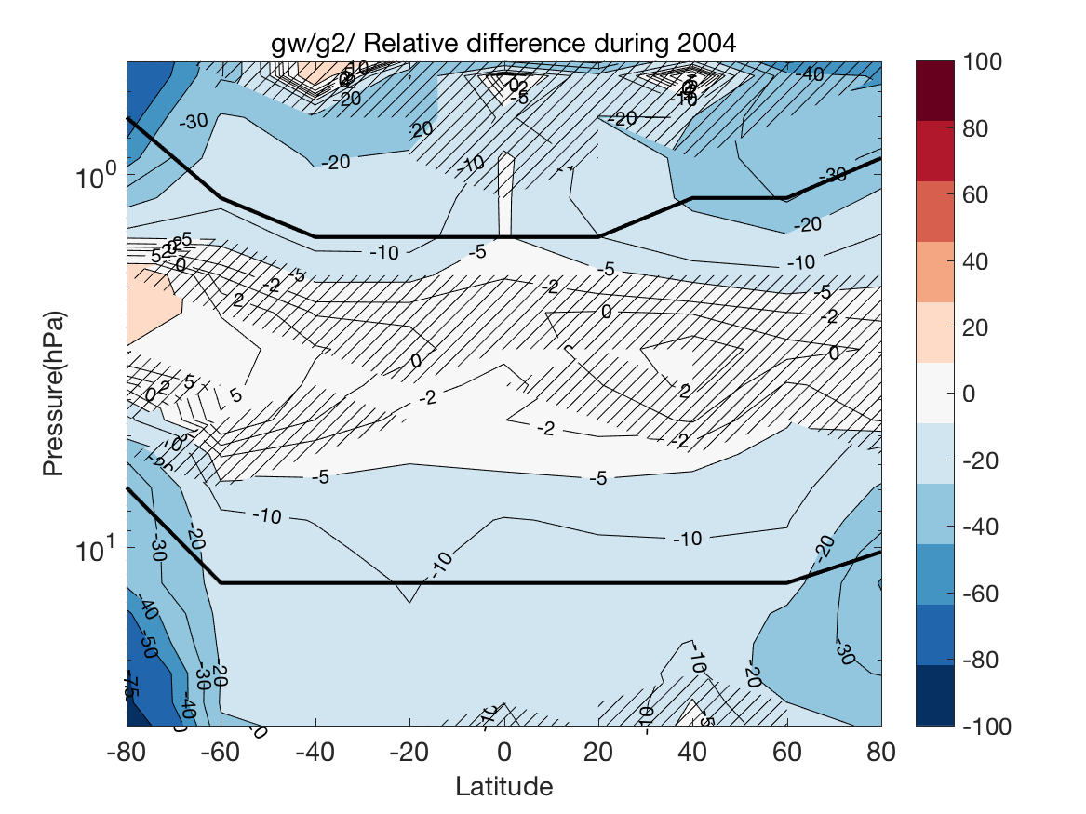
<WACCM-GOMOS>/<GOMOS> (%):
NO₃ in Stratosphere

Slide 14
WACCM-D: Halloween event in Arctic: O₃ and NO₂
WACCM-D: Ionospheric
D-region chemistry:
307 reactions,
20 positive ions,
21 negative ions
See Verronen et al., JAME, 2016
Andersson et al., JGRD, 2016

Slide 15
SD-WACCM-D versions
Verronen et al., JAMES, 2016
Andersson et al., JGR, 2016
WACCM-D: D-region ion chemistry: 307 new reactions, 22+20 ions
BASIC: SD-WACCM (v. 4)
MEE: SD-WACCM + medium energy electrons (POES)
D-MEE: SD-WACCM+ D ion chemistry + MEE (POES)

Slide 16
2003 Halloween storm: O₃
November 15-30, 70N-90N
Similar to the mid-latitude result

Slide 17
2003 Halloween storm: NO₂
November 15-30, 70N-90N

Slide 18
Strong mesospheric descent: NO₂
25.1.-5.2. 2004, 75N-85 N

Slide 19
Summary
GOMOS and WACCM O₃ compare well in stratosphere.
WACCM values are 2-6 % smaller than GOMOS.
In the mesosphere WACCM fails to produce the strength of the
second ozone peak.
GOMOS and WACCM NO₂ compare well in the stratosphere
outside the polar areas. GOMOS is 5-15 % smaller than WACCM.
GOMOS and WACCM NO₃ compare well in the stratosphere.
GOMOS is 0-20 % smaller than WACCM.
In the polar areas standard WACCM fails to reach the elevated NO₂ amounts.
WACCM-D provides better NO₂ comparisons during particle events in polar regions.
During the strong downdraft event January 2004 the huge NO₂ values are not simulated by WACCM.

