Slide 1
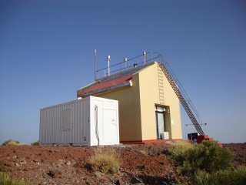
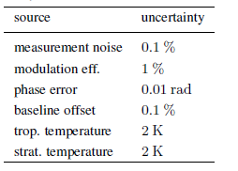
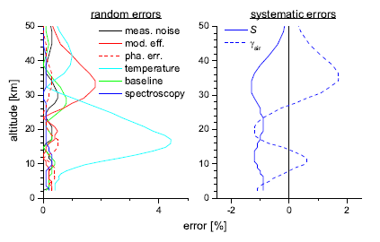
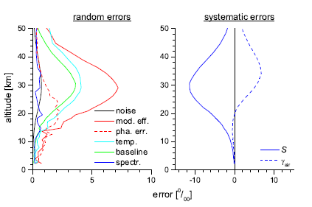
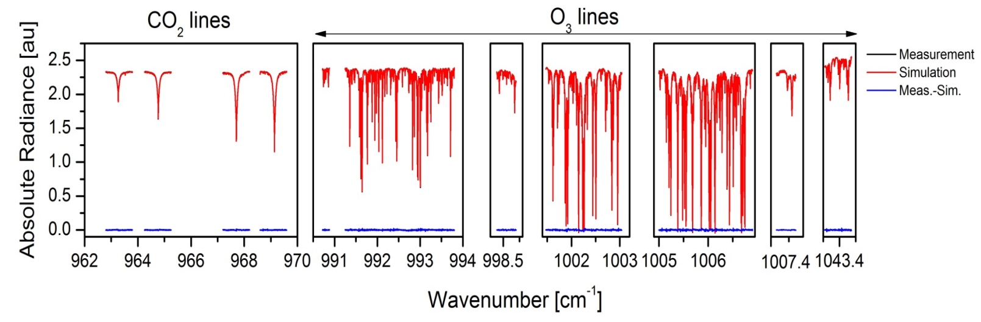
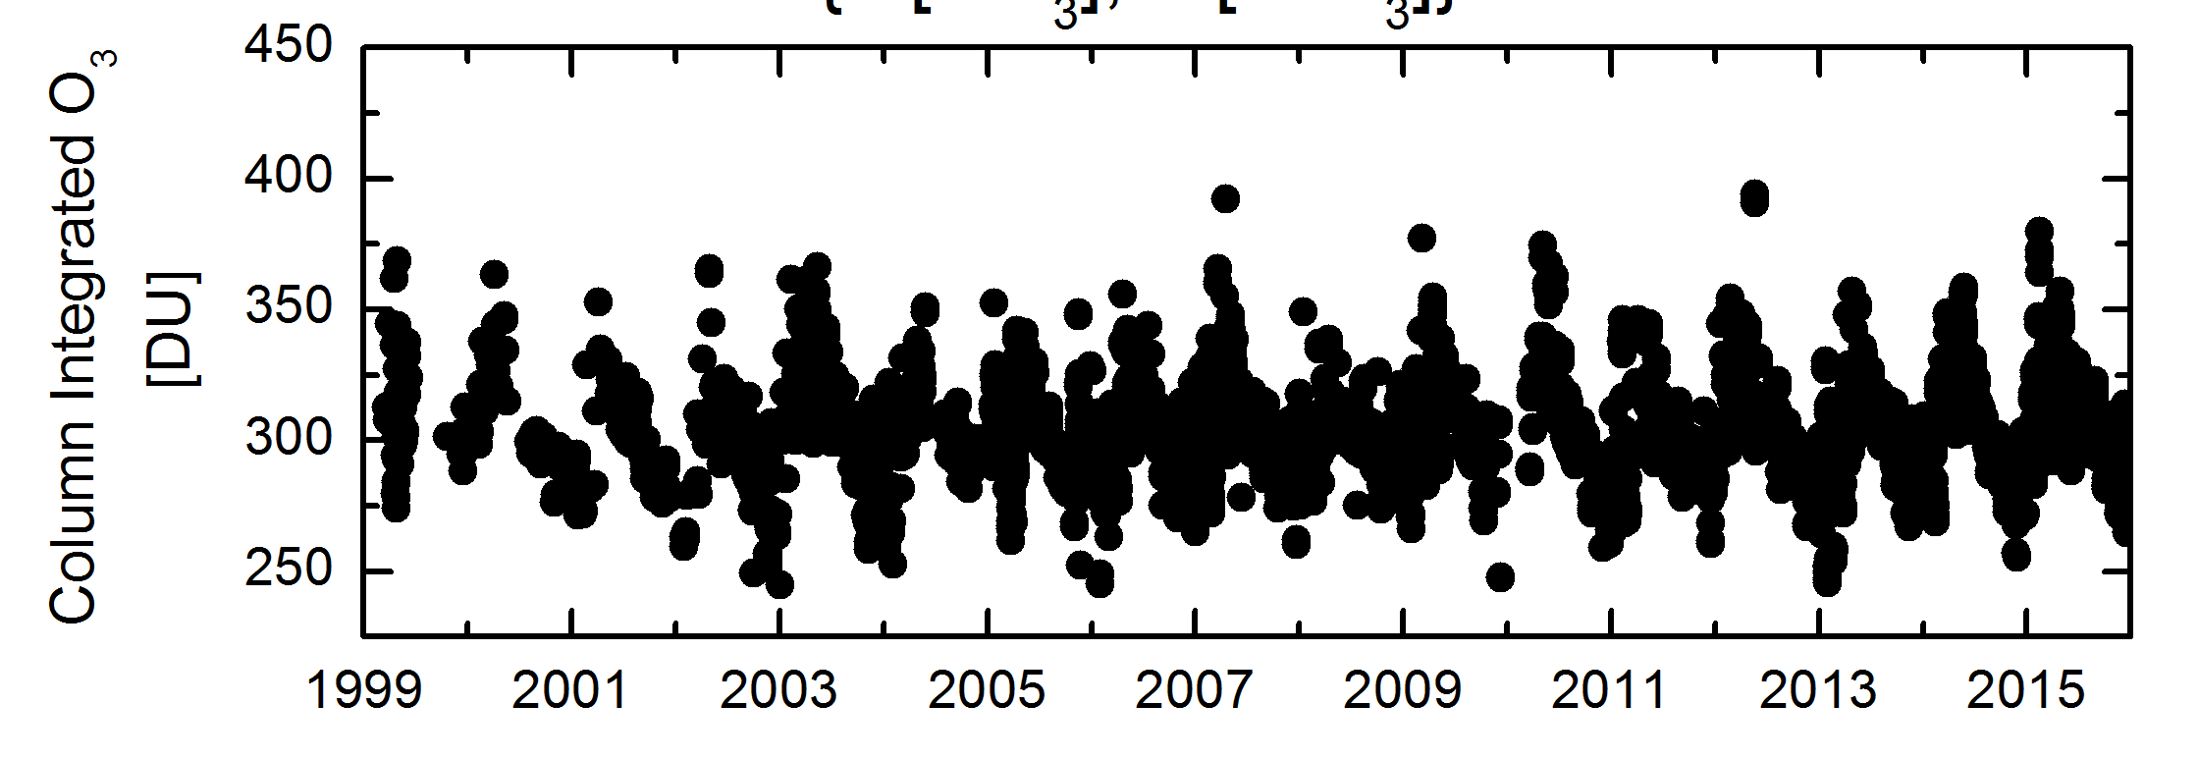
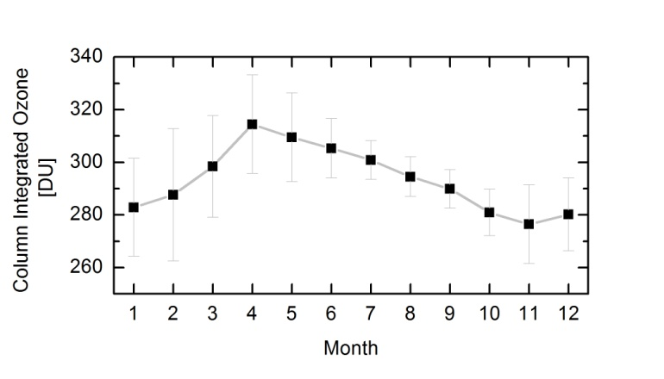
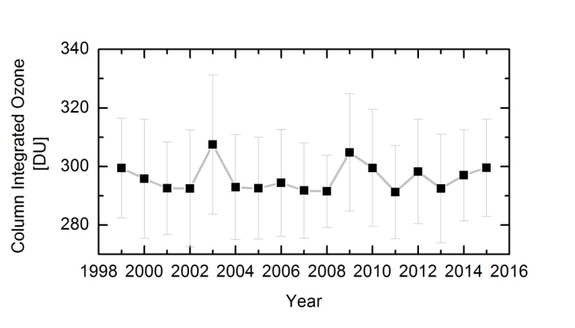
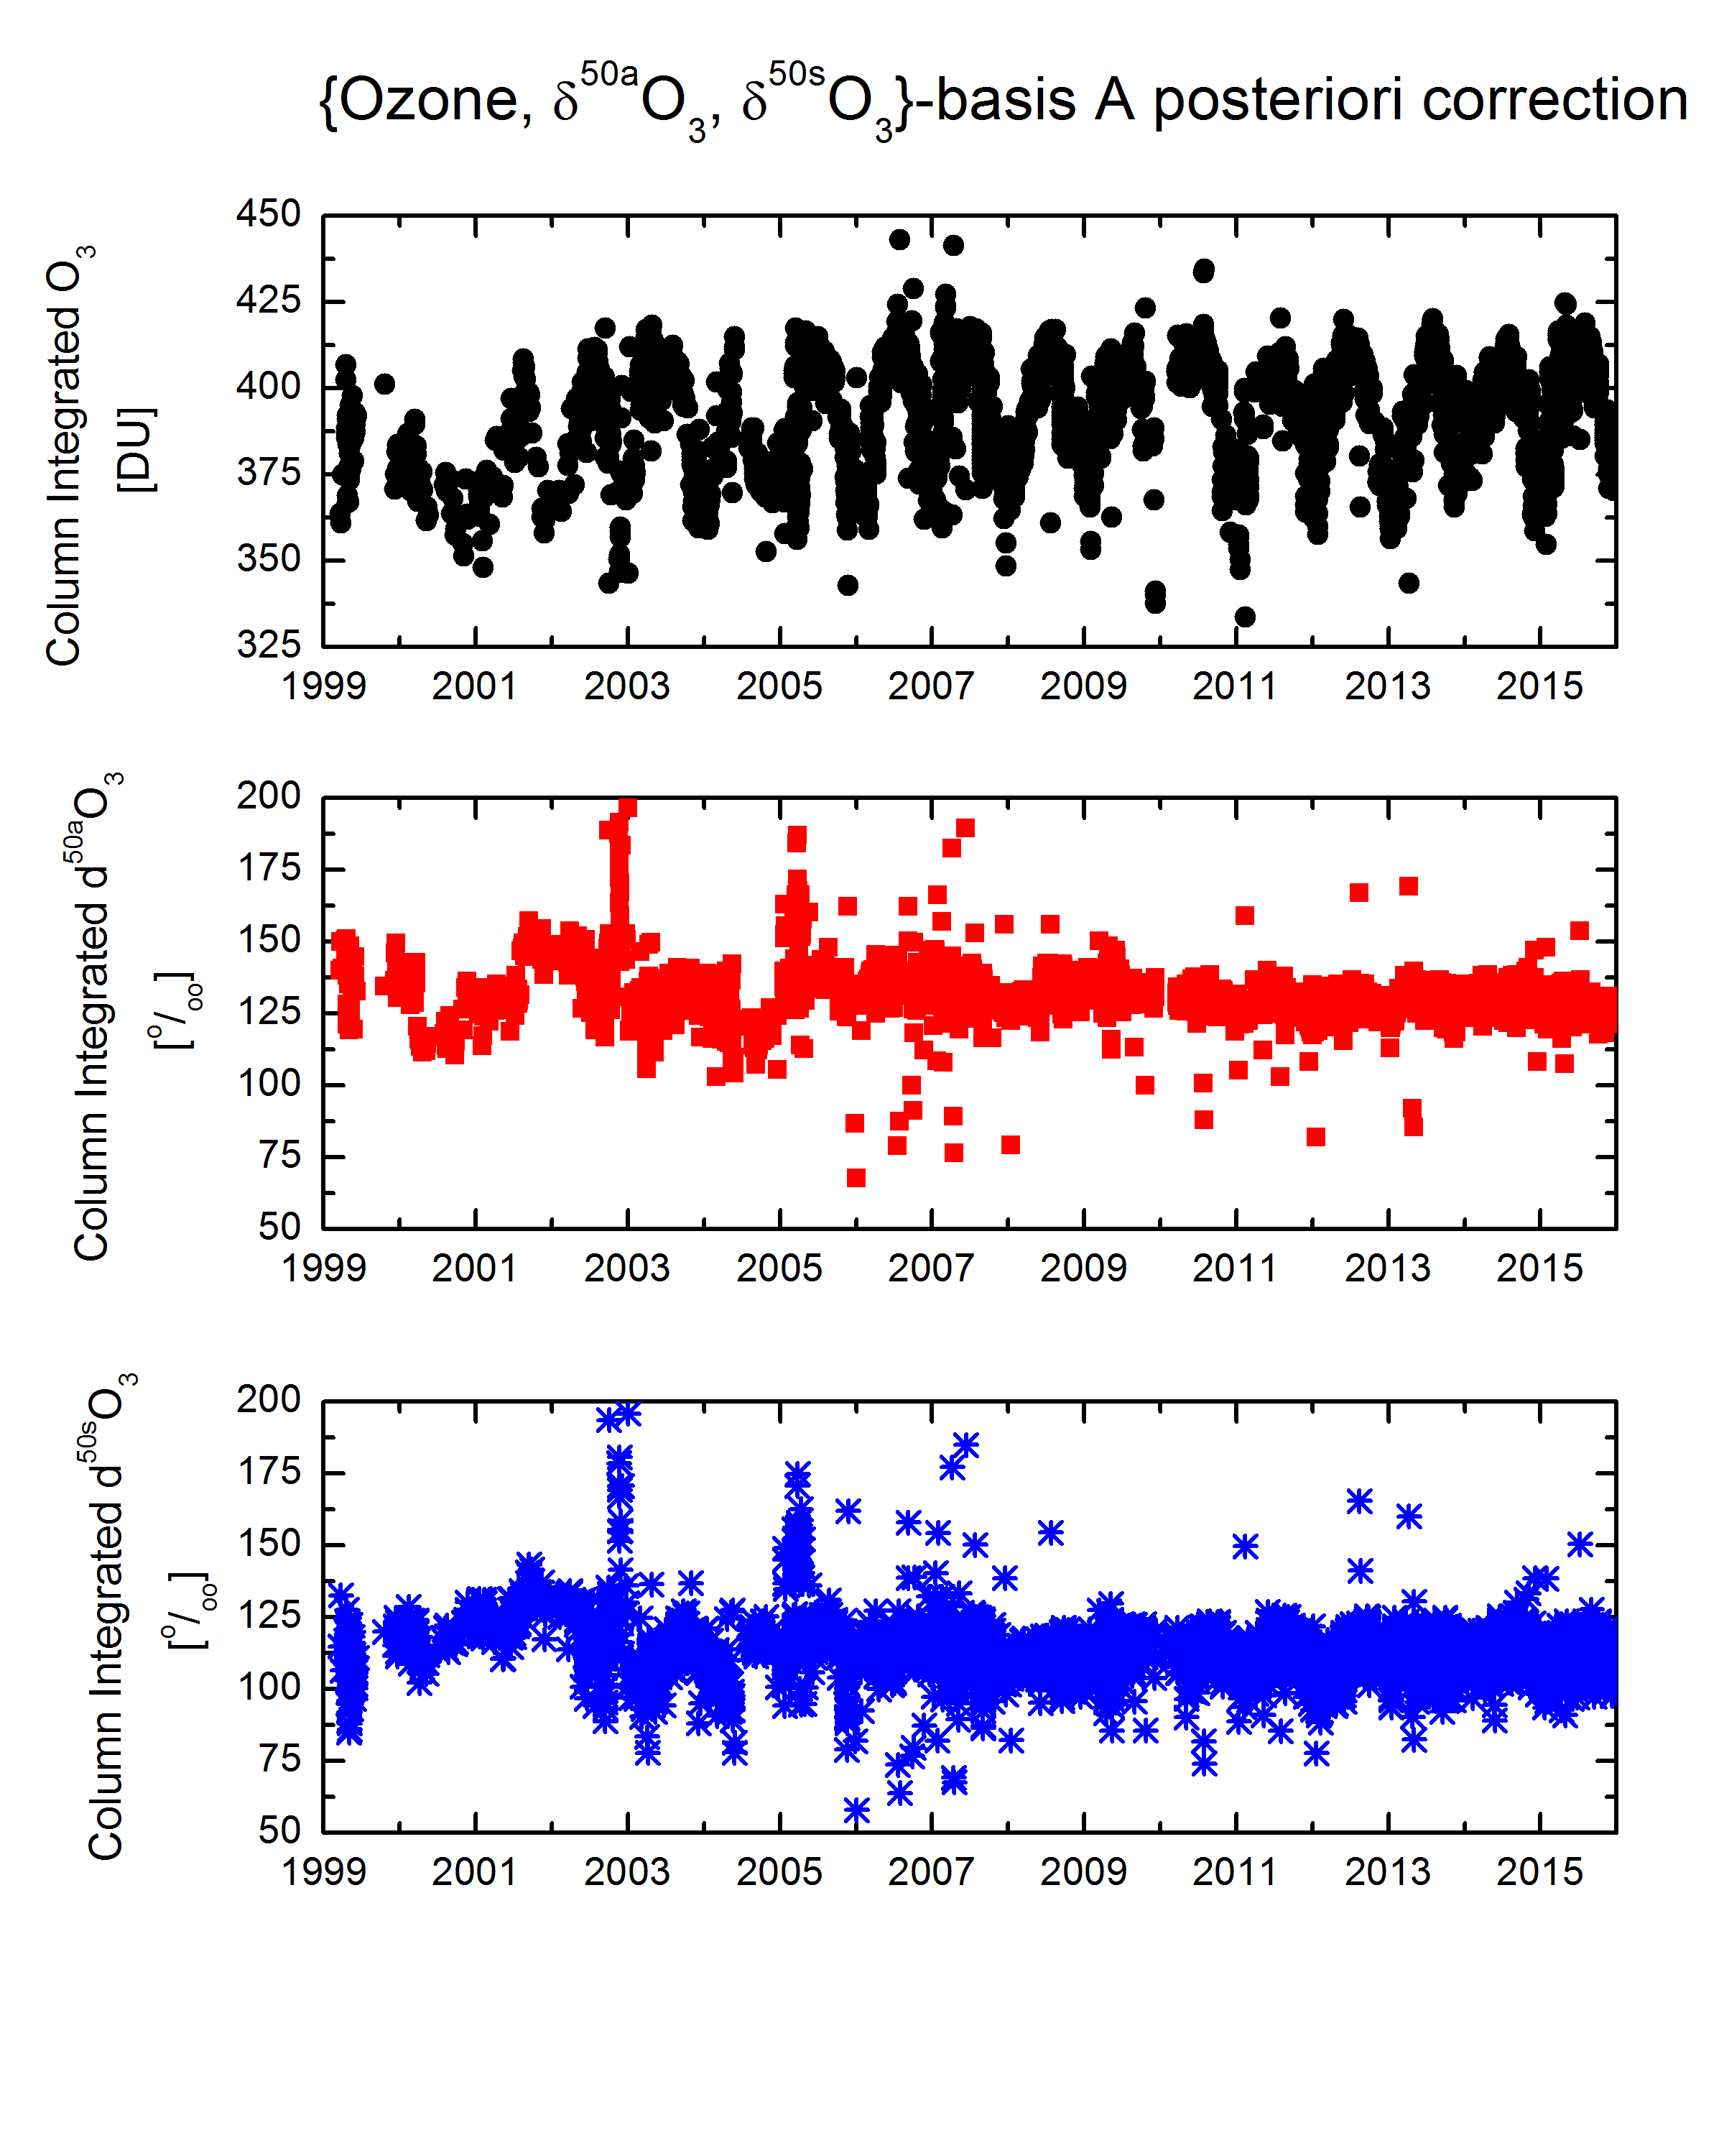
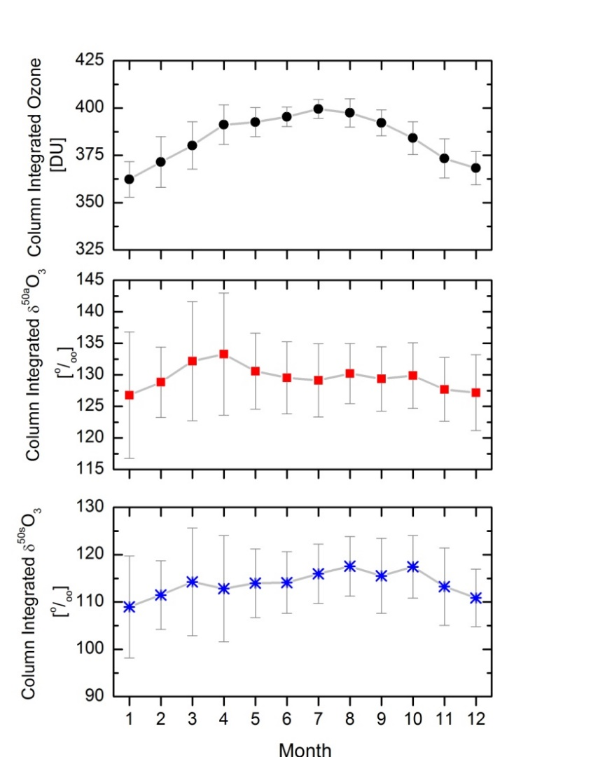
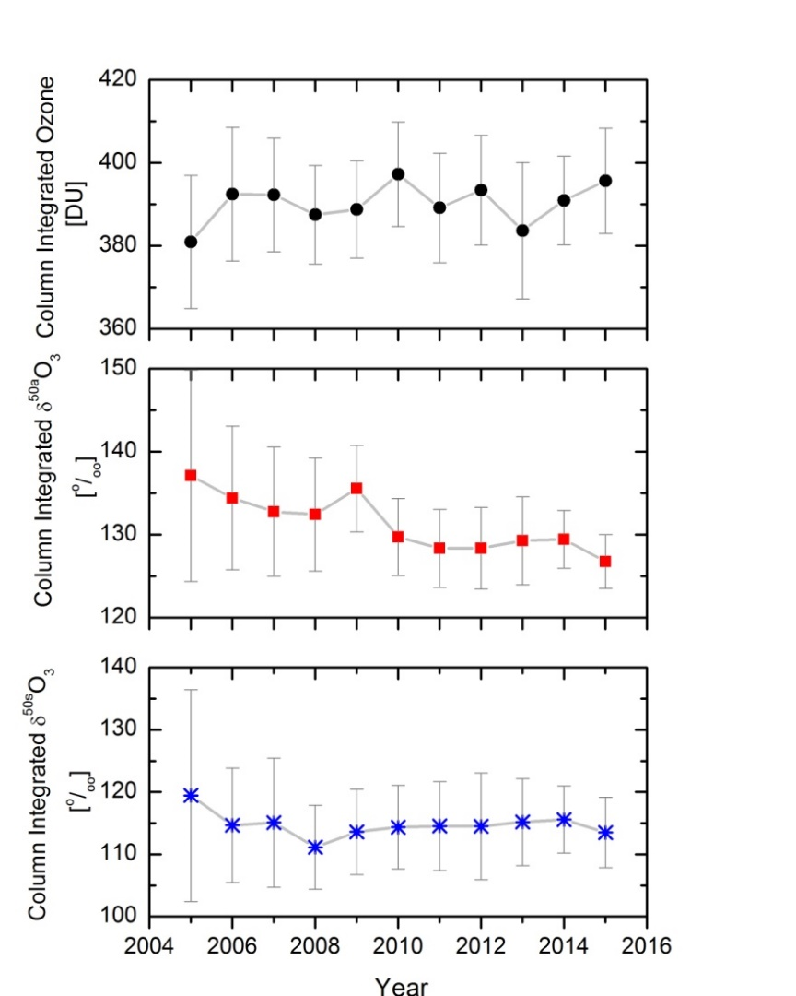
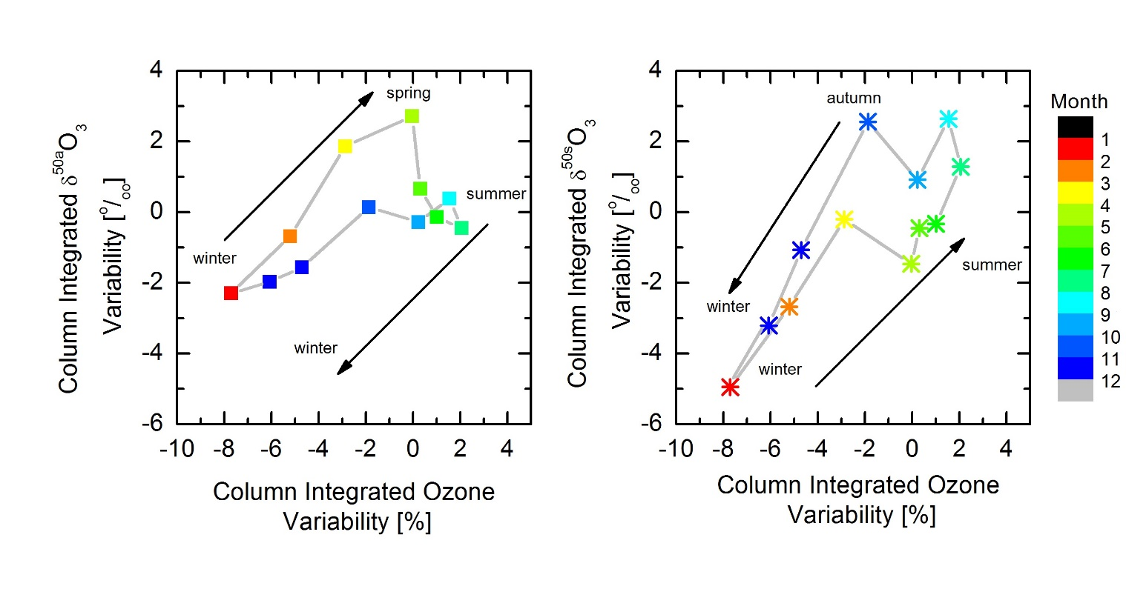
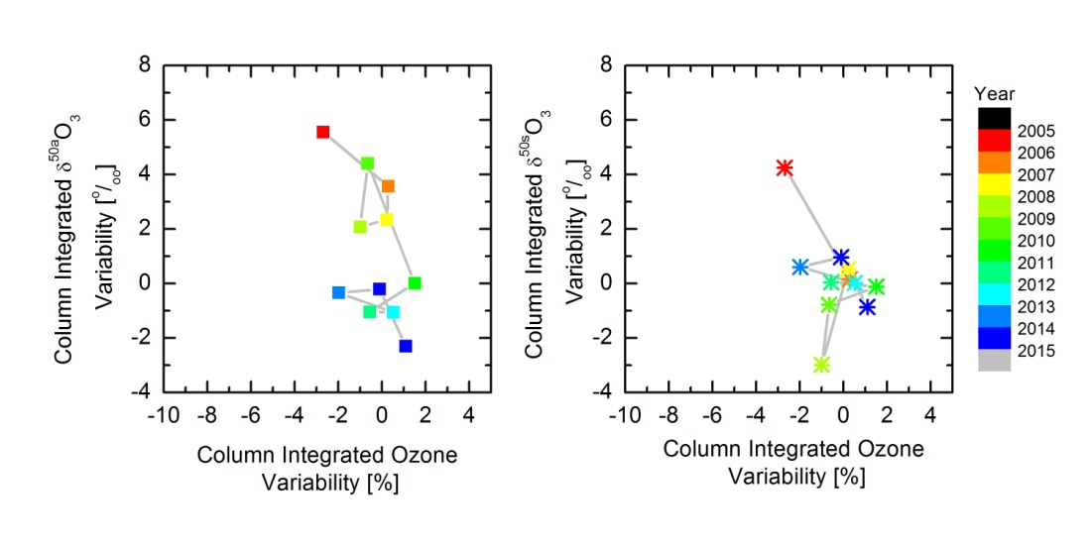
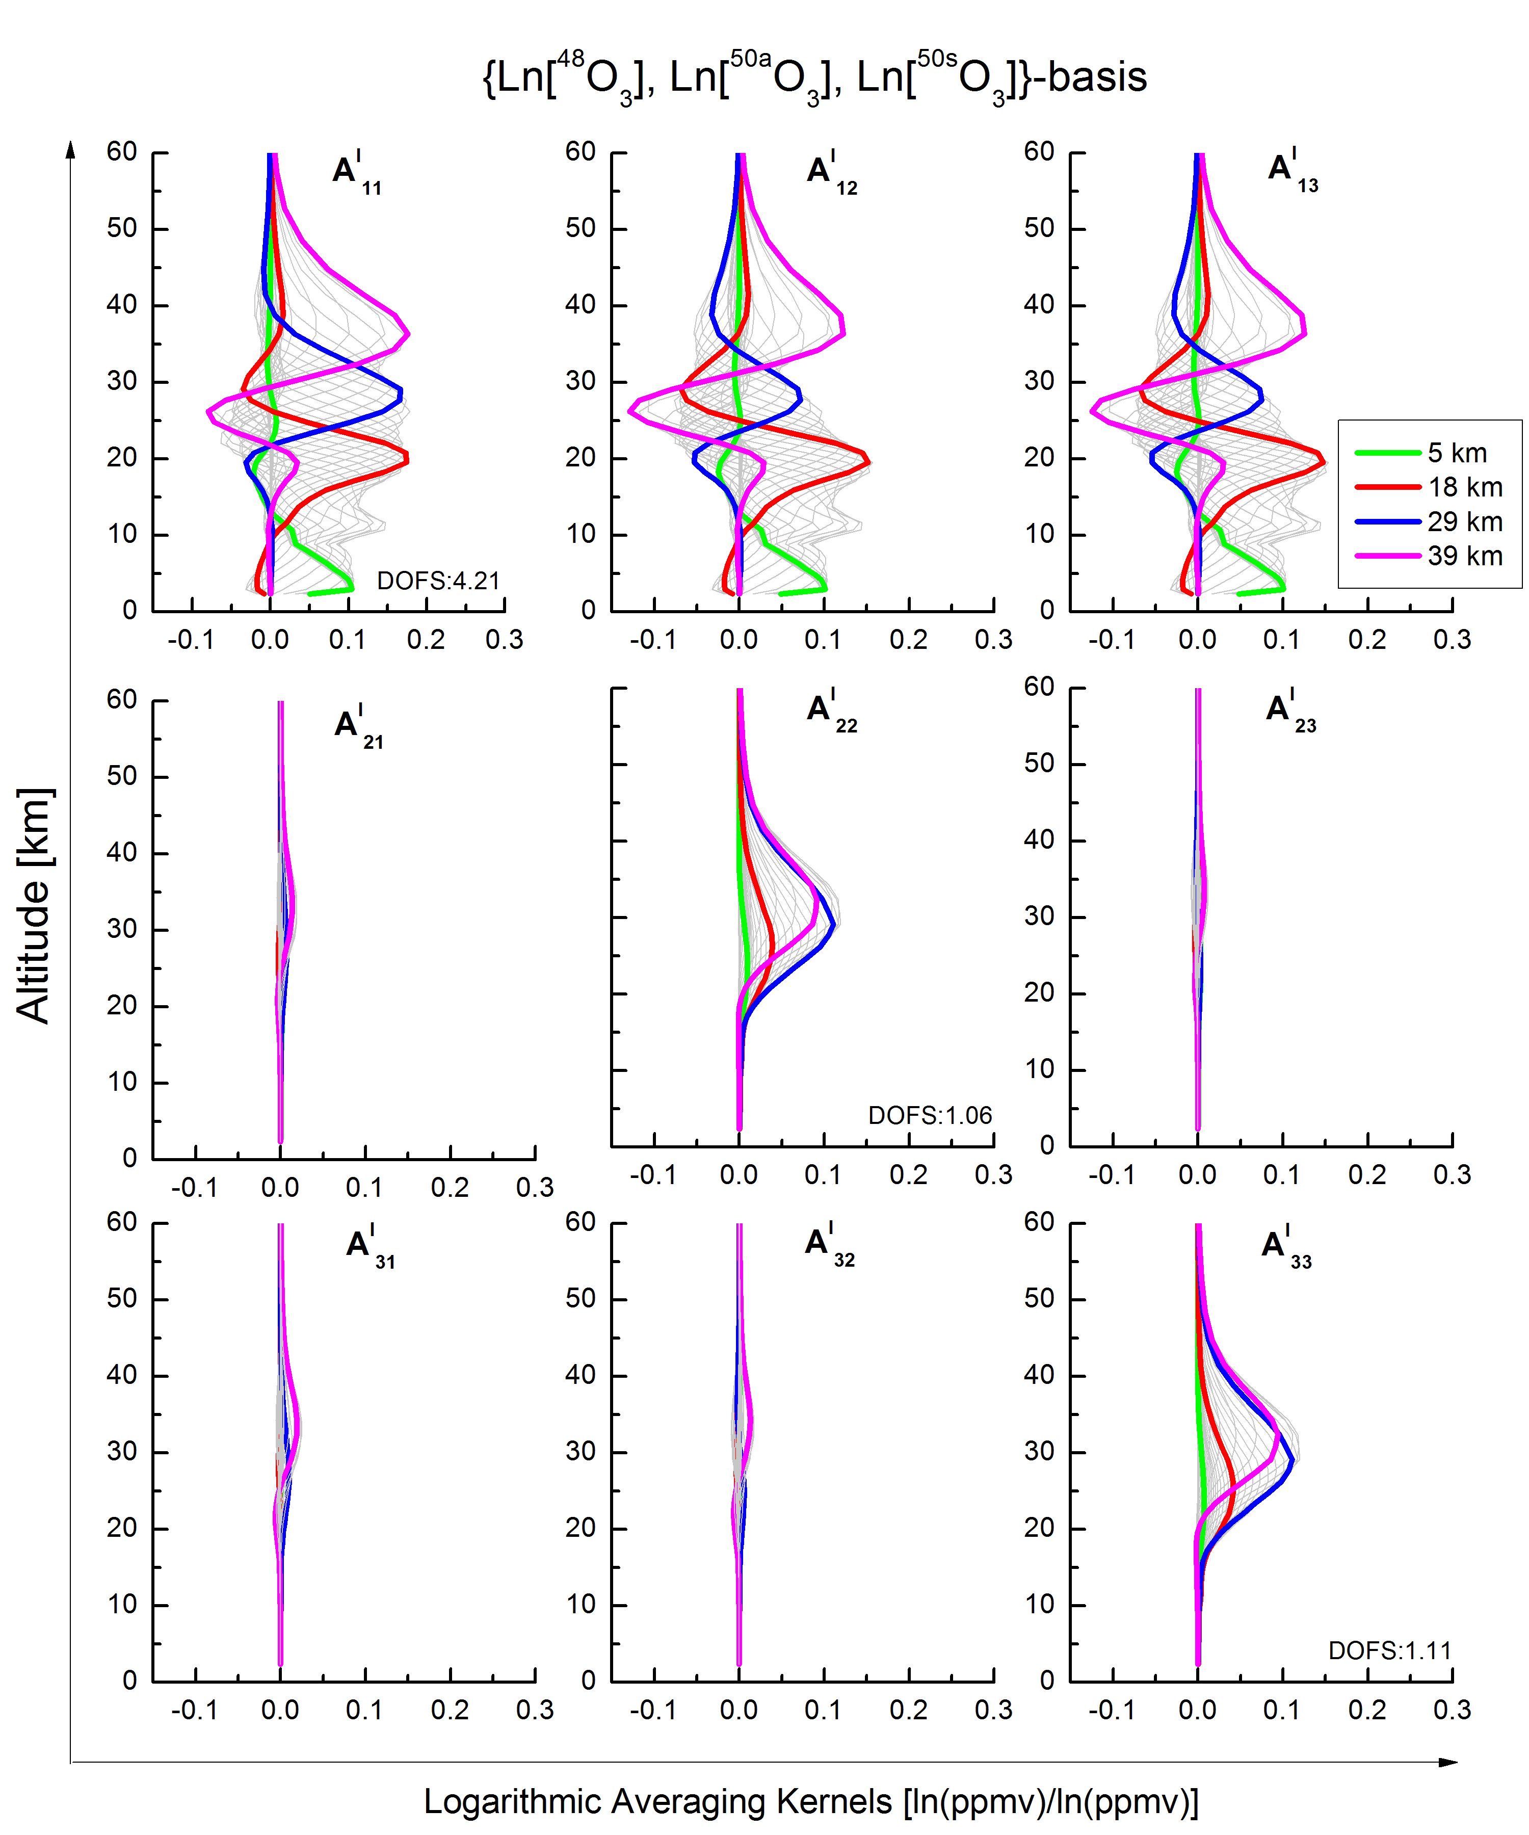
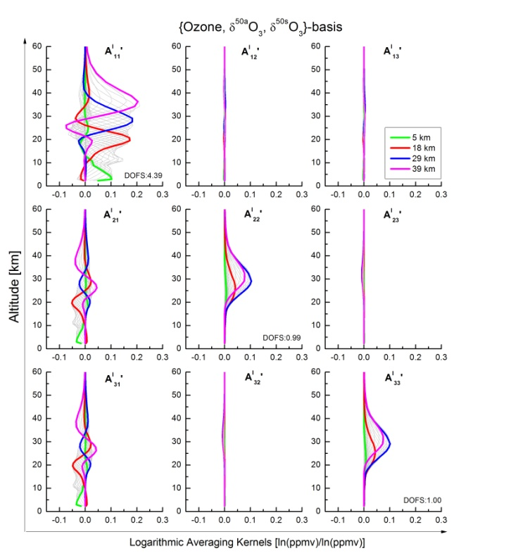
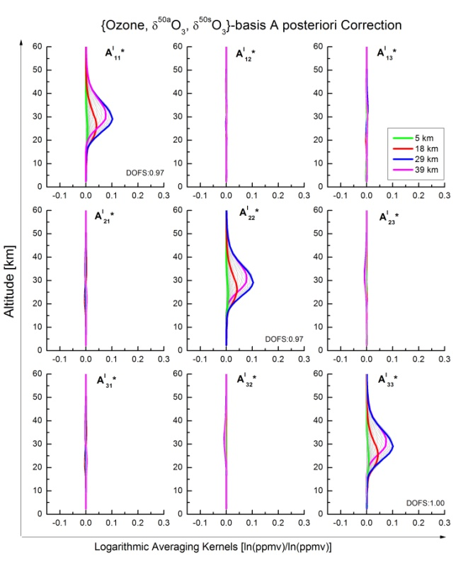
P46
QOS2016-27
Ozone Isotopologue Monitoring from Ground-based FTIR Spectrometry
E. Sanromá¹, O.E. García¹, M. Schneider², F. Hase², T. Blumenstock² , E. Sepúlveda^{3,1}
(1) Izaña Atmospheric Research Centre, Agencia Estatal de Meteorología (AEMET), Santa Cruz de Tenerife, Spain; (2) Institute for Meteorology and Climate Research (IMK-ASF), Karlsruhe Institute of Technology (KIT), Karlsruhe, Germany;(3) Optic Applied Group, University of Valladolid, Spain.
Contact e-mail: msanromar@aemet.es
Atmospheric ozone (O₃) is affected by an interplay of chemical reactions and atmospheric dynamics that makes difficult to precisely predict its long-term evolution. Monitoring and investigating the O₃ isotopologue composition can help us to disentangle this complex scenario, giving us novel insights into the current ozone recovery and its link to global warming. In this context, this work examines the potential of the ground-based FTIR (Fourier Transform InfraRed) spectrometry to monitor the main O₃ isotopologues (⁴⁸O₃, symmetric and asymmetric ⁵⁰O₃, symmetric and asymmetric ⁴⁹O₃). The isotopic composition is usually presented in delta notation as $δ^{k}\text{O}\text{3}=\left({\text{k}\text{O}\text{3}\text{/}\text{48}\text{O}\text{3}}/{SMOW}\right)−1$ where k= 49, 50 and SMOW stands for Standard Mean Ocean Water. If the isotopologue data have been normalized with respect to their natural isotopologue abundances, $δ^{k}\text{O}\text{3}$ can be directly calculated as $\text{k}\text{O}\text{3}\text{/}\text{48}\text{O}\text{3}$-1. Here, we present for the first time the long-term series of the stratospheric ⁵⁰O₃/⁴⁸O₃ isotopologue ratios as observed from mid-infrared solar absorption spectra at the ground-based FTIR site of the subtropical Izaña Atmospheric Observatory (28.3ºN, 16.5ºW, Tenerife, Spain). By analysing this long-term series at different time scales, we explore the intra-annual variability and the long-term evolution of ⁵⁰O₃/⁴⁸O₃ ratios at subtropical latitudes.
Site Description and FTIR Programme
Uncertainty sources and assumed values for the error estimation, based on Schneider et al. (2012) and Garcia et al. (2012), following to Rodgers (2000):
Error Estimation
The IAO (Izaña Atmospheric Observatory) is a high-mountain observatory located in Tenerife at 2370m a.s.l.. Its strategic location with clear-sky conditions during most part of the year makes this station an ideal site for in-situ and remote sensing observations.
The IAO FTIR programme has been gathering high resolution solar absorption spectra within NDACC by using a Bruker IFS 120M spectrometer since 1999. In 2005 this instrument was replaced for a Bruker IFS 120/5HR, which is one of the best performing FTIR spectrometers commercially available. Within NDACC activities, the IAO FTIR spectrometer records direct solar spectra in the mid-infrared spectral region (between 740 - 4250 cm⁻¹) at a spectral resolution of 0.005 cm⁻¹.
IAO, Izaña:
Sub-tropical
Below it is shown an example of the error estimation, where it can be observed that the temperature profile and the instrumental line shape (ILS) are the leading random errors. The spectroscopic parameters dominate the systematic errors.
Estimated error for O₃ profiles
Estimated error for δ^{50a}O₃ profiles
Retrieval Strategy
Temporal Analysis of Product Type 1
We apply the retrieval code PROFFIT (Hase et al., 2004) and fit the spectral regions as shown in the figure on the right. We consider spectroscopic signatures of ⁴⁸O₃ and asymmetric and symmetric ⁵⁰O₃ and ⁴⁹O₃. As a main interfering absorber we also consider water vapour, whose cross-interference is reduced by applying a pre-fit of H₂O.
The ozone product type 1 allows us to analyze separately the main layers contributing to the atmospheric ozone variability. An example of the retrieved ozone profile and the time series of the total DOFS can be observed in the figure on the right. It shows the variability and the drifts in the DOFS time series:
We also perform a simultaneous optimal estimation of temperature by using four CO₂ lines to reduce errors in ozone retrievals. The different O₃ isotopologues are retrieved on a logarithmic scale, thereby allowing for an optimal estimation of the isotopologue ratios. The a priori mean O₃ profiles and covariances (Sa^{l}_{ozone}) are estimated from ECC sonde climatology calculated between 1999 and 2014. Beyond 30 km they are extended using WACCM data. As a priori for the O₃ isotopologue ratios (Sa^{l}_{d50a} and Sa^{l}_{d50s} as well as a priori mean profiles) we assume the values reported by Johnson et al. (2000) and Mauersberger et al. (2001).
1) The apparent drift between 1999 and 2004 means that trends estimated for this time period have to be treated with care. 2) The DOFS time series also shows some kind of annual cycle, which is strongly anti-correlated with the annual cycle of the ozone slant column amounts.
a)
{ln[⁴⁸O₃], ln[^{50a}O₃], ln[^{50s}O₃]}-basis
Multi-year annual cycle
Annual Averages
Optimal Estimation of the Ozone Isotopoloques State
b)
c)
The O₃ isotopologue state can be expressed in the basis:
{ln[⁴⁸O₃], ln[^{50a}O₃], ln[^{50s}O₃]} 1-basis
However, since these 3 isotopologues do not vary independently, we need a new basis to characterize the isotopologue state:
{(ln[⁴⁸O₃]+ln[^{50a}O₃]+ln[^{50s}O₃])/3, ln[^{50a}O₃]-ln[⁴⁸O₃], ln[^{50s}O₃]-ln[⁴⁸O₃]} ≡ {Ozone, δ^{50a}O₃, δ^{50s}O₃} 2-basis
This basis allows us to have a better documentation of the sensitivity, vertical resolution, and error characteristics of both ozone and isotopic ratios.
To transfer 1-basis into 2-basis we use the transformation P:
By using P, the state vectors and the covariance matrices in the different basis are related by the expressions:
Hence, the a-priori covariance matrix in the 2-basis is:
Above it is shown the time series of the IAO FTIR total O₃ amounts from 1999 to 2015, as an example of one of the products type 1. The well-known seasonal variation of O₃ is seen in Fig. a and b with peak values in spring and minimum in autumn–winter. The annual averages shown in Fig. c suggest a non-significant recovery in the total O₃ amounts at subtropical latitudes as it has been reported by Vigouroux et al. (2015).
Figure on the right depicts the DOFS time series of the retrieved column-integrated δ^{50a}O₃ and δ^{50s}O₃ as well as an example of the δ^{50a}O₃ and δ^{50s}O₃ vertical profiles. The DOFS time series shows similar patterns to product type 1.
Temporal Analysis of Product Type 2
These nine matrix blocks have the dimension (n x n), where n is the number of levels of the radiative transfer model, and I stands for the identity matrix.
Below are shown the time series of the column-integrated O₃, δ^{50a}O₃ and δ^{50s}O₃:
δ^{50a}O₃ and δ^{50s}O₃ show different intra-annual patterns: for δ^{50a}O₃ there is a maximum of the heavy ozone enrichment in spring and a minimum in winter, while for δ^{50s}O₃ the annual maximum is reached during the summer.
The isotopologues show different long-term patterns. δ^{50a}O₃ show a subtle decreasing trend, while δ^{50s}O₃ is more stable.
x^{l} and x^{l}’ are the state vectors expressed in the 1 and 2-basis, respectively
Thereby the Sa^{l} used to constrain the optimal estimation retrieval of the ozone isotopologue state can be calculated as:
Multi-year annual cycle
Annual Averages
An a posteriori correction (C) is also applied to adapt the vertical resolution and sensitivity of the ozone product to the poorer vertical resolution and sensitivity of the isotopologue ratio products.
The A blocks correspond to the averaging kernel matrices (please see the characterization section)
Applying this method allow us to obtain two products:
Product Type 1: ⁴⁸O₃ profiles aiming at maximal vertical resolution and best possible sensitivity from troposphere to the upper stratosphere.
Product Type 2: Stratospheric profiles of the isotopic composition of ozone aiming at the best possible degree of consistency between ⁴⁸O₃ and δ^{50a}O₃ and δ^{50s}O₃ profiles and a maximal quality of δ^{50a}O₃ and δ^{50s}O₃ data.
Since δ^{50a}O₃ , δ^{50s}O₃ are considerably affected by the instrumental stability, for the following analysis we have only used the IFS 120/5 HR period.
Figures below show O₃- δ⁵⁰O₃ plots for monthly (a) and annual (b) averages of column-integrated data:
Both a) panels show an evident closed cycle: the transition from summer-to-winter and from winter-to-summer are different. However, the behaviour of this cycle is different for δ^{50a}O₃ and δ^{50s}O₃ (inverse of each other) because of their different annual cycles.
However, the O₃- δ⁵⁰O₃ plots of the inter-annual variability do not show any clear pattern.
Averaging Kernel in the 1-basis on logarithmic scale (A^{l})
Characterization of Product Type 1 & 2: Vertical Sensitivity and Resolution
Intra-annual variability of monthly averages
By using P, the averaging kernels are transformed into the 2-basis (A^{l}’)
A posteriori correction, by using the operator C, for a quasi optimal estimation of
{Ozone, δ^{50a}O₃, δ^{50s}O₃}
a)
b)
Inter-annual variability of annual averages
Summary & Outlook
We have presented the IAO FTIR long-term series of ozone and for the first time that of ^{50a}O₃/⁴⁸O₃ and ^{50s}O₃/⁴⁸O₃ isotopologue ratios.
Since the variations of the main ozone isotopoIogues are correlated, it is necessary to apply a data transformation in order to obtain proper information regarding sensitivity and error assessments when aiming at isotopologue ratios information.
An a-posteriori correction is also needed in order to ensure that the retrieved ozone, δ^{50a}O₃ and δ^{50s}O₃ are sensitive to the same atmospheric air mass. Moreover, this correction minimize the cross-correlation between the different isotopologues.
We have shown that δ^{50a}O₃ and δ^{50s}O₃ present different intra-annual and long-term patterns and that ⁴⁸O₃- δ⁵⁰O₃ plots of the intra-annual variability show closed cycles.
Further analysis is needed to better understand the temporal variability of the isotopic composition of stratospheric ozone.
Product Type 1: optimally estimate ⁴⁸O₃ profiles
Product Type 2: quasy optimal estimation of {Ozone, δ^{50a}O₃ , δ^{50s}O₃}
Retrieved Ln[⁴⁸O₃] is affected by variations in Ln[⁴⁸O₃], Ln[^{50a}O₃] and Ln[^{50s}O₃].
Retrieved ozone is now slightly affected by variations in δ^{50a}O₃ and δ^{50s}O₃. However, retrieved δ^{50a}O₃ and δ^{50s}O₃ is affected by variations in real atmospheric ozone.
The three retrievals are now sensitive to the same atmospheric air mass and the cross dependence between them is minimized.
REFERENCES:
Cuevas et al., WMO/GAW Report No. 219, 2015.
García et al., AMT, 5, 2917-2931, 2012.
Hase et al., J. Quant. Spectrosc. Radiat. Transf., 87, 25-52, 2004.
Johnson et al., J. Geophys. Res., 105, 9025-9031, 2000.
Mauersberger et al., Geophys. Res. Lett., 16, 3155-3158, 2001.
Rodgers, World Scientific, 2000.
Schneider et al., Atmos. Chem. Phys., 811-830, 2006.
Schneider et al., AMT, 5, 3007-3027, 2012.
Sepulveda et al., AMT, 5, 1425-1441, 2012.
Vigoroux et al., Atmos. Chem. Phys., 15, 2915-2933, 2015.
WACCM-V6 provided by NCAR, J. Hannigan, personal communication, 2014.
ACKOWLEDGEMENTS: The research leading to these results has received funding from the Ministerio de Economía y Competitividad of Spain through the projects CGL2012-37505 (NOVIA project) and CAS14/00282 (Estancia de Movilidad José Castillejo), and from EUMETSAT under its Fellowship Programme (VALIASI project). E. Sanromá enjoys a fellowship from the Agencia Estatal de Meteorología. Furthermore, M. Schneider is supported by the European Research Council under FP7/(2007-2013)/ERC Grant agreement nº256961 (MUSICA project).
Four layers are well distinguished (DOFS∼4) with a FWHM of about 10 km: troposphere, tropopause, lower stratosphere and middle-upper stratosphere.
Only one layer is well distinguished (DOFS∼1) with a FWHM of about 10 km: the middle stratosphere (the range with a good sensitivity is 25–35 km). The FTIR system can only observe stratospheric δ^{50a}O₃ and δ^{50s}O₃.

