Slide 1
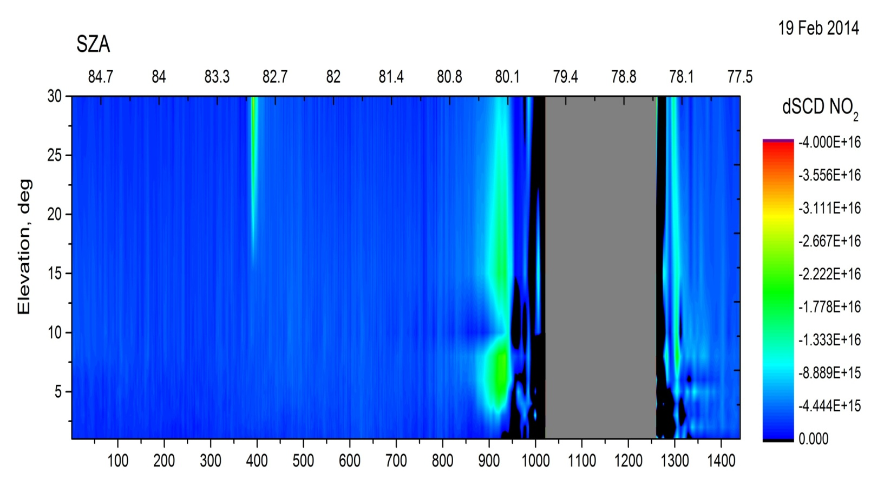
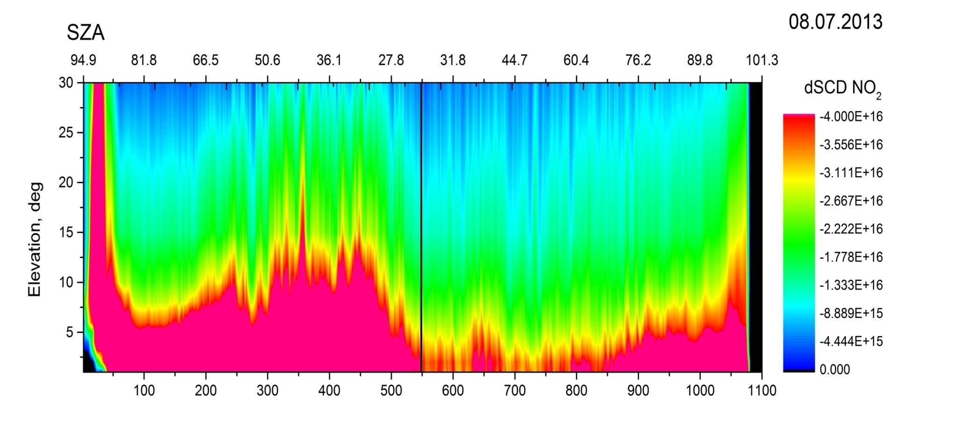
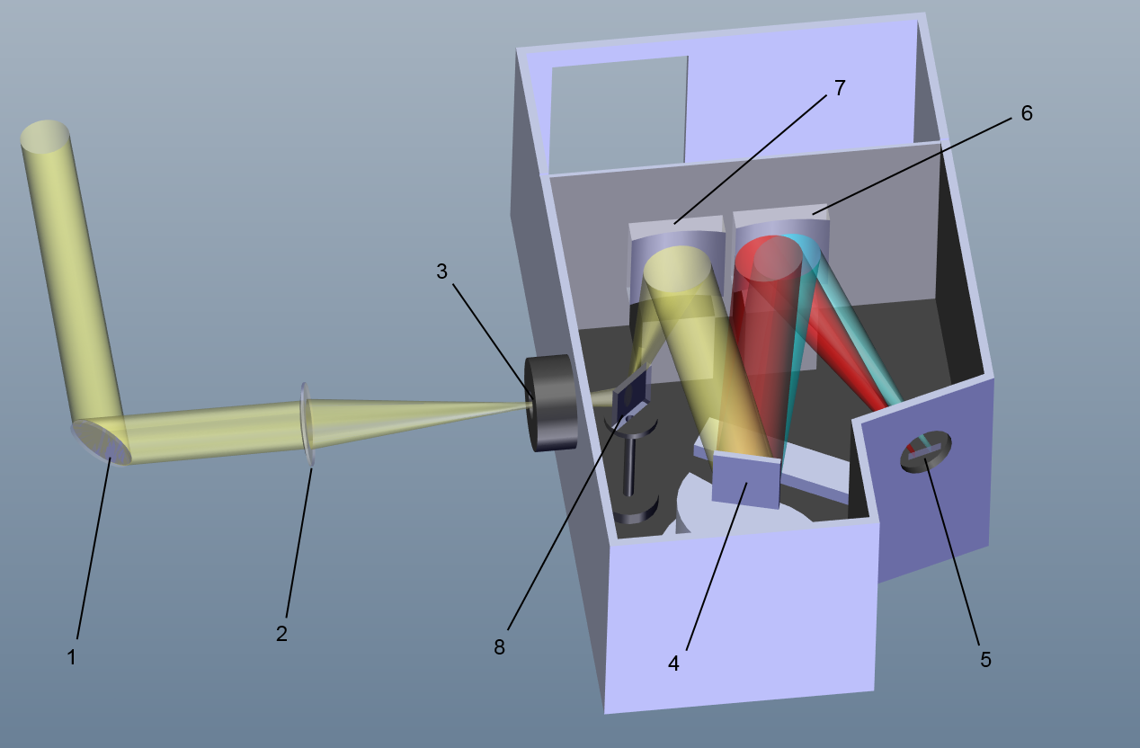
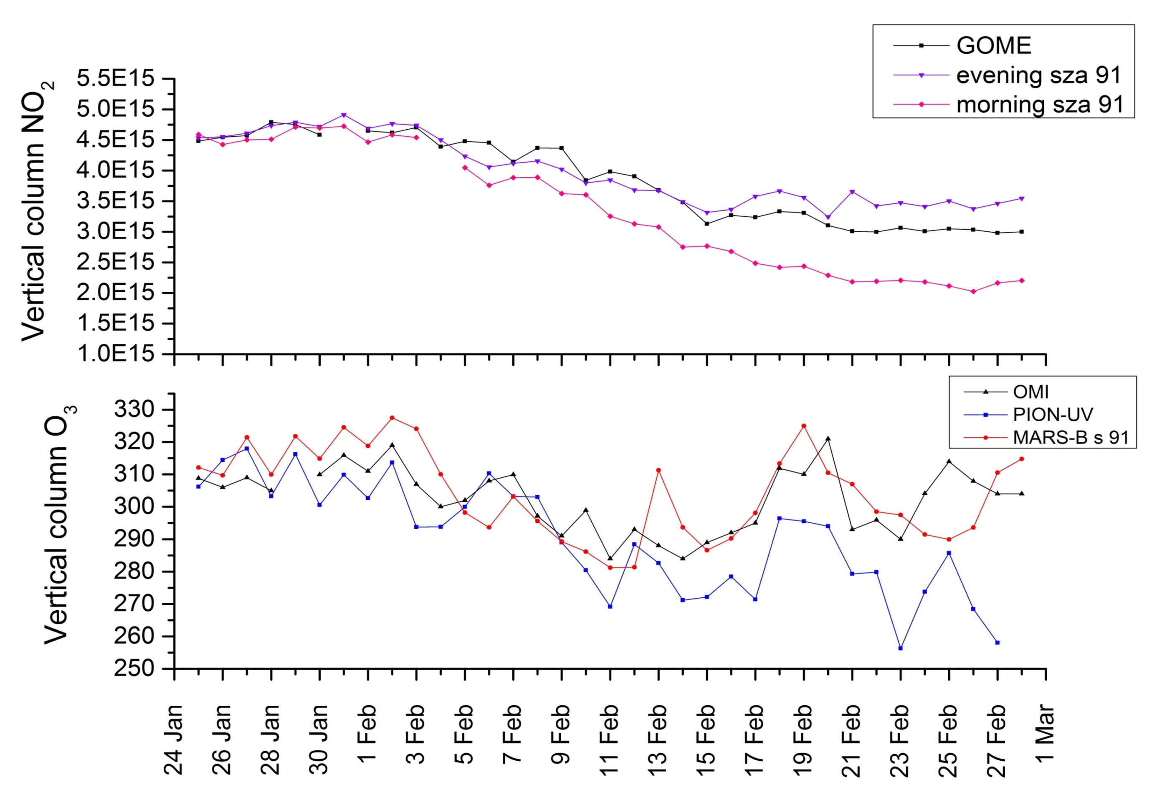
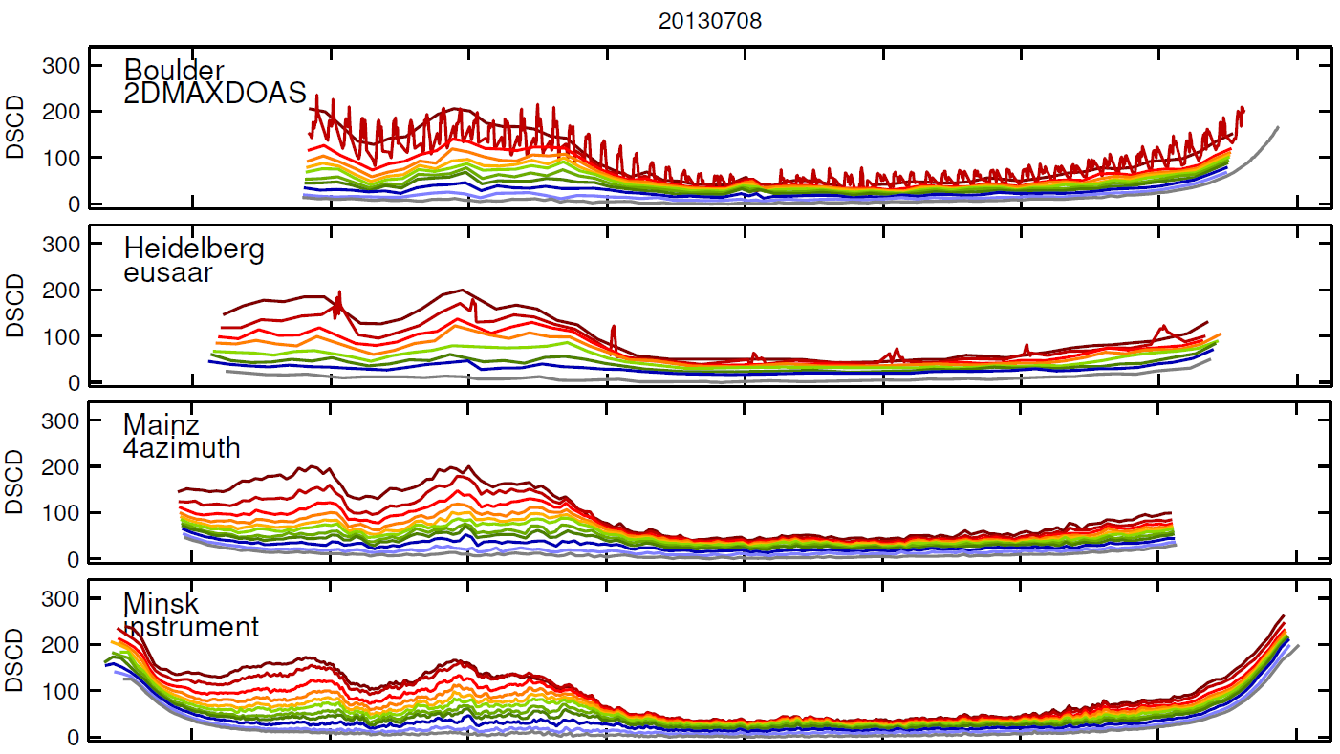
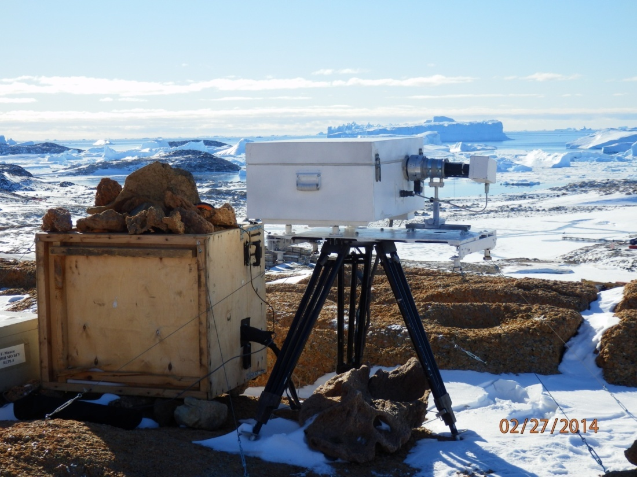
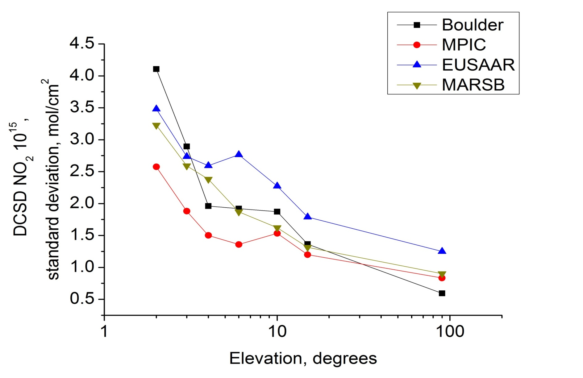
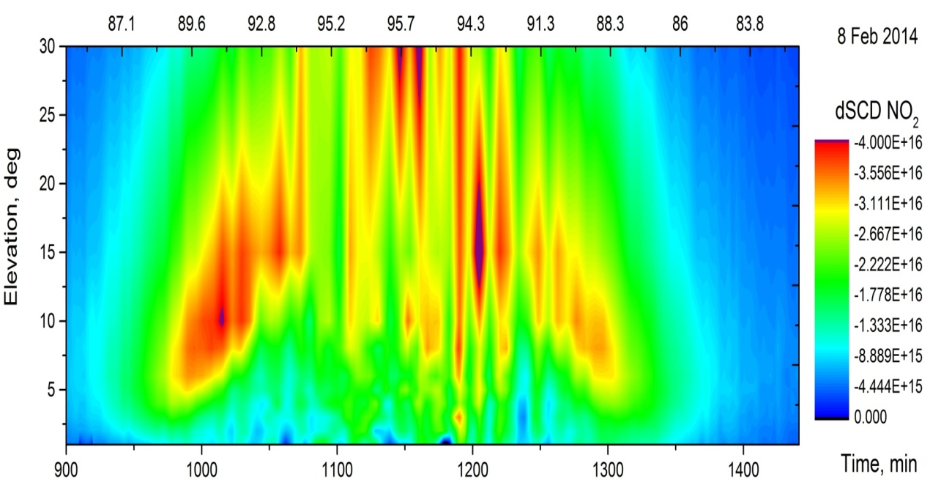
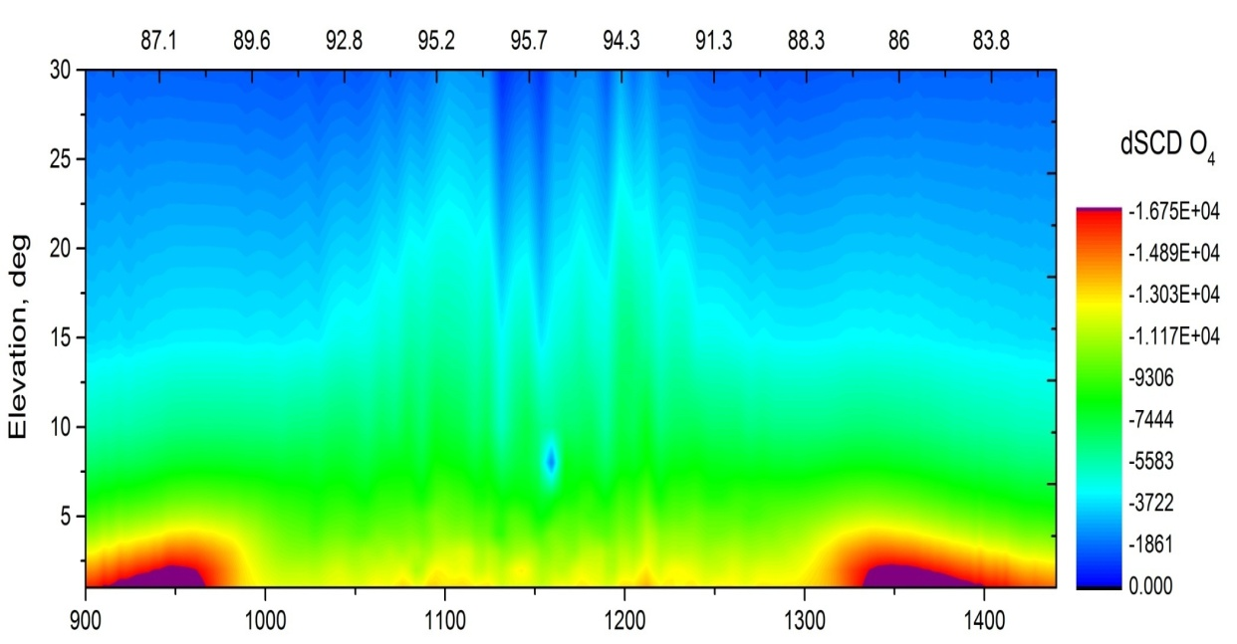
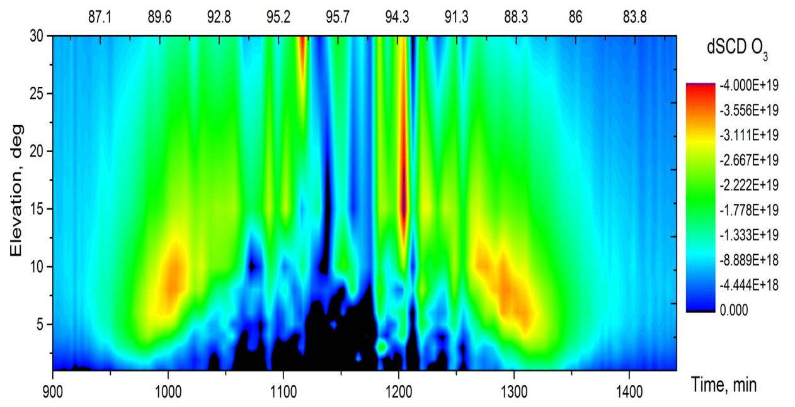
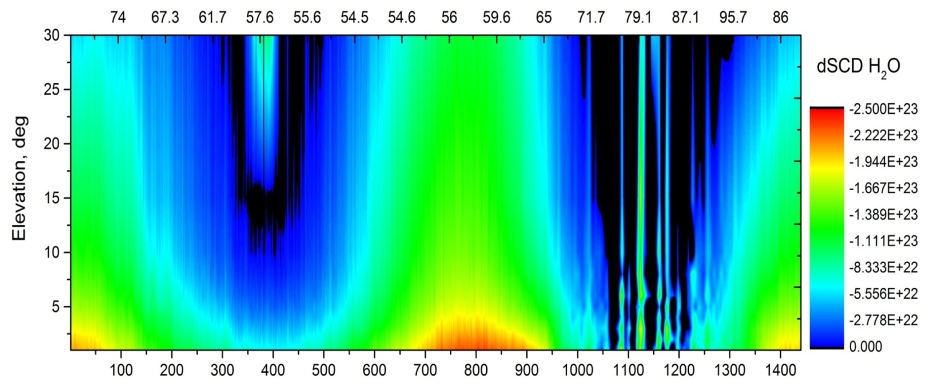
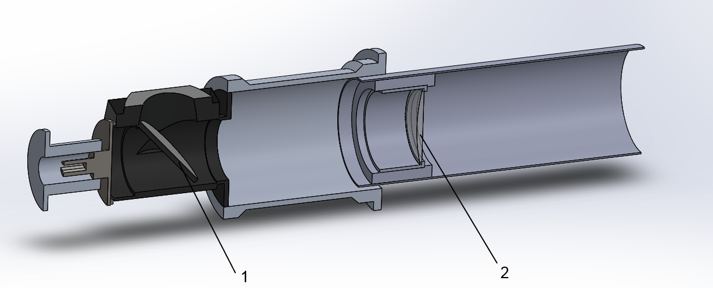
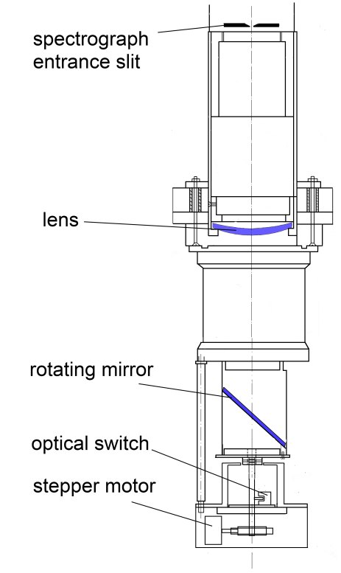
Employing DOAS procedure for the study of stratospheric ozone and nitrogen dioxide in Antarctica
Bruchkouski I., Krasouski A., Dziomin V., Svetashev A.G., Turishev L.N., Barodka S.
National Ozone Monitoring Research & Education Center BSU, Minsk, Belarus (nomrec@bsu.by)
1. INTRODUCTION
2. INTER-COMPARISON CAMPAIGN
3. ANTARCTIC MEASUREMENTS AND RESULTS
In this work the results of several years of the instrument design and obtained data investigation are presented.
For atmospheric trace gases monitoring MARS-B instrument (Multi Axis Recorder of Spectra) has been originated in NOMREC BSU.
MARS-B has been built on the base of lab imaging spectrograph ORIEL MS257. Its main feature is as follows: second element of the telescope is the entrance mirror of the spectrograph. Therefore, the entrance slit of the spectrograph is the view angle diaphragm, because of vignetting off-axis beams. Also, the instrument theoretically able registering polarization effects in atmosphere.
International inter-comparison campaign MAD-CAT 2013 took place in Max Planck Institute for Chemistry (Mainz, Germany) in summer 2013. Selective data analysis of data obtained by MARS-B instrument and three other similar instruments within a clear (golden) day 08.07.2013 has been carried out. Azimuth direction: 51° from north. Employed elevation angles: 0˚, 1˚, 2˚, 3˚, 4˚, 5˚, 6˚, 8˚, 10˚, 15˚, 30˚, 90˚.
Wavelength range for analysis: 425 - 490 нм. Noon reference spectrum; cross-sections: NO2 Vandaele, 298K (Io-correction at SCD of 1e17 mol/cm²) NO2 Vandaele, 220K (no2a_220p298K_vanDaele_vis.xs); O3 Bogumil, 223K; O4 Hermans et al H2O HITEMP (Rothman et al., 2010) Ring Ring_NDSC2003. Polynomial degree 5; Intensity offset: constant.
At the Russian Antarctic station “Progress” (S69˚23’, E76˚23’) simultaneous measurements of trace gases using the MARS-B (Multi-Axis Recorder of Spectra) instrument and PION-UV spectro-radiometer for the time period from 25.01.2014 to 28.02.2014 have been performed. At the pictures below measured values of dSCD NO₂ in small European city (Mainz, Germany) and Antarctica are presented for comparison.
Fig. 6. dSCD NO₂ at “Progress” station
Fig. 7. dSCD NO₂ at MPI roof, Mainz
Fig. 1. Schematic view of light path inside spectrograph : 1 – rotating mirror; 2 – quartz lens; 3 – spectrograph entrance slit; 4 – grating; 5 – detector plane; 6 – focusing mirror; 7 – entrance mirror; 8 – flat mirror.
Fig. 4. NO₂ DSCD values registered at
08.07.2013 (golden day), MPI, Mainz
Fig. 8. Retrieved total columns of nitrogen dioxide (top) and ozone (below) and compared with satellite data. "Progress" station.
Fig. 2. MARS-B instrument in Antarctica, “Progress” station (69.23˚S, 76.23˚E)
MAX-DOAS instrument
(MARS-B)
Optical part: imaging spectrograph ORIEL MS257
Optical scheme: Czerny-Terner
Detector: Andor Technology DV-420A-OE 256×1024
Thermostabilization: PID-controller with Pt100 temperature detector
Detector cooling: -50 ˚C
Full elevation view aperture: 1.5˚
Elevation angles: 0˚, 1˚, 2˚, 3˚, 4˚, 5˚, 6˚, 8˚, 10˚, 15˚, 30˚, 90˚
Working spectral range: 409 – 490 nm
FWHM: 0.5 nm
Weight: 102 кг
Power consumption: 300 W
Fig. 5. Standard deviations of NO2 DSCD retrieval results compared to the benchmark average, the dependence on the elevation angle of the telescope.
Fig. 9. MARS-B instrument is able to perform measurements at SZA up to 97˚. Due to NO₂ absence in Antarctic troposphere, there is possibility to obtain stratospheric dSCD scans for twilights for cloudless conditions, which can give additional information about particular trace gas distribution. Contour plots of dSCD = dSCD₉₀ – dSCD_{a} for “golden day” are presented.
Par.\instr. | Boulder | MPIC | EUSAAR | MARS-B
Measurements duration, hours | 14.141 | 14.47 | 14.67 | 16.9
SZA working range | 72.51º –91.76º | 88.21º – 79.68º | 84.85º – 84.98º | 100.3º – 85.31º
4. SUMMARY
Information about trace gas distribution can be retrieved from ground-based measurements by DOAS method in polar region atmosphere; suitable SZA range is between 90-97˚.
Twilight multi-axis measurements at cloudless conditions can provide additional information about stratospheric trace gas distribution.
Vertical column of trace gas is proportional to correspond DSCD at particular SZA. Comparison study with satellite data showed good agreement.
Evening NO₂ always exceeds morning values after coming night; it may be evidence of NO₂ decomposition during night; with increasing duration of the night the difference between morning and evening values increasing.
Information about trace gas layer height can be retrieved from DSCD-SZA dependency
The height of trace gas layer maximum concentration affects on the dependence of trace gas dCSD with SZA changing
Fig. 3. 3D model of the telescope input unit: 1 – rotating mirror; 2 – quartz lens
CONTACT
E-mail: bruchkovsky2010@yandex.ru

