Slide 1
AOTX Indices – A Tool for Assessment of Impact of Ozone on Plants
Pallavi Saxena
Young Scientist
School of Environmental Sciences
Jawaharlal Nehru University
New Delhi-110067
INDIA
Email: pallavienvironment@gmail.com
Quadrennial Ozone Symposium 2016, 4-9 September 2016, Edinburgh, UK

Slide 2
Highlights
Common Aim:
Ozone exposure to crops will reduce its yield by taking AOTX indices
Complementary research questions:
What is the expected reduction in crop yield after O₃ damage?
How AOTX indices contributes in identifying the exposure-response relationship?

Slide 3
O₂ + hν
Stratospheric ozone
STRATOSPHERE
Tropopause (8-18 km)
Complex non-linear chemistry
TROPOSPHERE
Lightning
hν
hν, H₂O
Nitrogen oxides (NO_{x})
CO, Hydrocarbons (NMHC)
Ozone (O₃)
Hydroxyl (OH)
the main atmospheric
oxidant
Haagen-Smit and Fox (1956)
Notes:
ozone is a product of chemical reactions taking place between unburnt hydrocarbons, oxides of nitrogen and related species, under the influence of sunlight (Haagen-Smit, 1952)

Slide 4
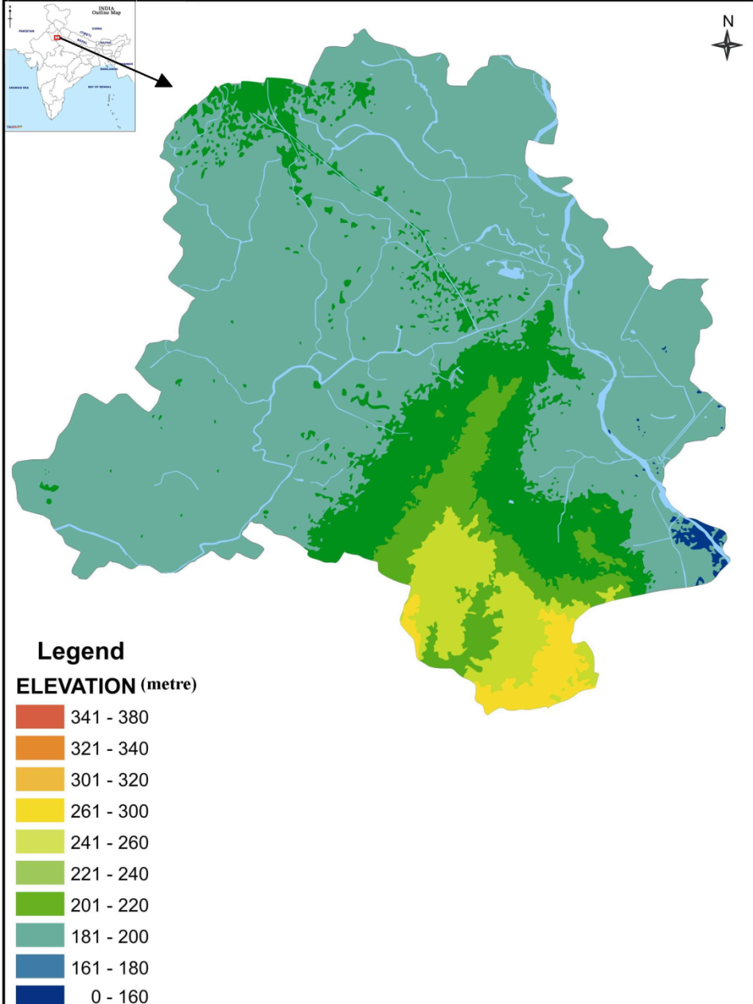
Description of Study Area- Delhi
Latitude : 28º 61’N
Longitude : 77º 23’E
Total area :1483 km²
Urban area : 891.09 km²
Rural area : 591.91 km²
Altitude : 210- 300 m
Climate : Humid Subtropical, Semi arid
Population : 16.75 millions (Census 2011)
Physical Map
Map not to scale

Slide 5
Description of Study Area- Delhi
Total forest cover: 11.91 % of the total geographical area
Scrub: 0.05 %
Open forest: 8.09 %
Mod. dense forest : 3.36%
Very dense forest: 0.46 %
Forest type: Tropical thorn Forest
Total tree cover: 8.29% of the total geographical area
Source: India State of Forest Report (2009)
Forest Map

Slide 6
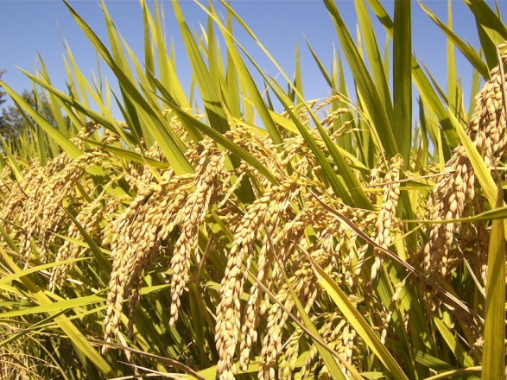
Crop Selection
Oryza sativa, rice, is a genus of perennial grass in the Poaceae (grass family) that originated in India, Thailand, and southern China, was domesticated and diversified in ancient times, and is now cultivated in wet tropical, semi-tropical, and warm temperate areas around the world for the production of its cereal grain.
Oryza sativa is generally an annual grass, although some varieties are perennial. Plants typically grow in a tuft (clump) of upright culms (stems) up to 2 m or more tall, with long, flat leaf blades. The flowers grow on broad, open terminal panicles (branched clusters). The oblong spikelets, which each contain a single flower (that develops into a single kernel of grain), are sparse along the stem rather than forming dense clusters. Beans are grown in every continent except Antarctica. Brazil and India are the largest producers of dry beans.
Rice is grown under so diverse soil and climatic conditions that it is said that there is hardly any type of soil in which it cannot be grown including alkaline and acidic soils. Rice crop has also got wide physical adaptability. Therefore, it is grown from below sea-level (Kuttanad area of Kerala) upto an elevation of 2000 metres in Jammu & Kashmir, hills of Uttaranchal, Himachal Pradesh and North-Eastern Hills (NEH) areas.
Kingdom: | Plantae
Order: | Poales
Family: | Poaceae
Genus: | Oryza
Species: | O. sativa

Slide 7
Ozone Exposure Indices
Exposure based ozone indices are a practical measure for summarizing ambient air quality and a useful tool to take appropriate measures for the potential negative effects on vegetation and human health (Paoletti et al. 2007).
It is widely used methods in USA, Canada and Europe (USEPA, 1996; ICP, 2004).
For Asian tropical climatic zone, no such directives or prescribed threshold values has yet been formulated.

Slide 8
Air Quality Data
Samples of Ozone concentrations were collected by using Ozone Analyzer, Horiba, Model: OZGU-370SE). The model uses a system based on the Beer– Lambert law for measuring low ranges of ozone in ambient air.
The records used were for 2013, which were observed hourly from 6a.m to 6p.m every day.
European benchmark was used for AOT40 values above 3000 ppb.
Nine month study from Jan-Sept, 2013.
Plant stage chosen: early to final maturity stage (fruiting stage)

Slide 9
AOTX indices
AOTX indices were calculated above threshold of 20, 30, 40, 50 & 60 ppb.
C_{O3} is the hourly ozone concentration in ppb, I is the running index, and n is the number of hours with C_{O3} greater than X ppb, during the time evaluation.
for C_{O3} > X ppb

Slide 10
%age of crop reduction
Possible occurrence of O.sativa reduction (%) for each AOT index
By taking European benchmark i.e. 3000 ppb h into consideration, estimated crop reduction is
To estimate the yield loss, by using the secondary data. According to the European benchmark, for AOT40 values above 3000 ppb, there is a 5% of yield loss occurred. Therefore, yield losses calculation was conducted by using Microsoft Office Excel 2007.

Slide 11
Results

Slide 12
Values of AOT40 for the three months period in 2013
Period | AOT40 (ppb)
January – March 2013 | 4359
February – April 2013 | 6874
March – May 2013 | 7965
April – June 2013 | 7786
May – July 2013 | 7099
June – August 2013 | 6754
July – September 2013 | 4077
Monthly AOT40 exceedance hour
Months | Hour
Jan | 197
Feb | 278
Mar | 85
Apr | 563
May | 601
Jun | 514
July | 366
Aug | 103
Sept | 52

Slide 13
Values of AOT40 for the three months period (Mar-May), 2013

Slide 14
Summary of Threshold Concentration for AOTX indices in Delhi, 2013
Period | AOT0 | AOT5 | AOT10 | AOT15 | AOT20 | AOT25 | AOT30 | AOT40 | AOT50
Jan - Mar | 6543 | 5432 | 5133 | 5043 | 5287 | 5154 | 5876 | 4359 | 3265
Feb - Apr | 7865 | 7098 | 6875 | 6654 | 6432 | 6654 | 6234 | 6874 | 6099
Mar - May | 7765 | 7234 | 7654 | 7123 | 7086 | 7006 | 6786 | 7965 | 6023
Apr - Jun | 7865 | 7345 | 7231 | 7654 | 7332 | 7354 | 7331 | 7786 | 7212
May - July | 7154 | 7223 | 7143 | 7225 | 7554 | 7231 | 7087 | 7099 | 6234
Jun - Aug | 6998 | 6954 | 6754 | 6331 | 6254 | 6155 | 6176 | 6754 | 6099
July - Sept | 6743 | 6009 | 5643 | 5116 | 5762 | 5165 | 5087 | 4077 | 4014

Slide 15
Pearson Correlation coefficient (r) results of Chlorophyll and Ascorbic Acid with ozone indices
Biochemical Parameter | Index | Coefficient of Determination (R²)
Chlorophyll | AOT0 | -0.624**
 | AOT20 | -0.636**
 | AOT30 | -0.663**
 | AOT40 | -0.643**
 | AOT50 | -0.644**
Biochemical Parameter | Index | Coefficient of Determination (R²)
Ascorbic Acid | AOT0 | 0.680**
 | AOT20 | 0.664*
 | AOT30 | 0.770**
 | AOT40 | 0.787**
 | AOT50 | 0.771**

Slide 16
Estimated Crop (O.sativa) Reduction for each AOTX index under Indian climatic conditions for 3000 ppb h ozone exposure over three months (Mar-May), 2013

Slide 17
O.sativa yield Loss, 2013 (Delhi region)
Plots | Plantation area (ha) | Actual yield (tonne/ha) | Actual yield (tonne) | Potential yield (tonne/ha) | Potential yield (tonne) | Loss (tonne) | Loss (tonne/ha)
1 | 80 | 0.176 | 1265.11 | 1499.23 | 0.32 | 234.12 | 0.144
2 | 75 | 0.112 | 945.33 | 976.3 | 0.11 | 30.97 | 0.002
3 | 93 | 0.196 | 1455.32 | 1509.32 | 0.65 | 54 | 0.45
Total | 248 | 0.484 | 3665.76 | 3984.85 | 1.08 | 319.09 | 0.59

Slide 18
Conclusion
In the period Mar-May, 2013, AOT40 reported highest values that showed large impact of ozone on selected crop.
The month of May, 2013 had got highest ozone concentration values.
Among AOTX indices, other than AOT40, AOT5 and AOT10 had reported high values of ozone concentration.
R² values were found to be highly significant in case of chlorophyll and ascorbic acid both negatively and positively correlated with AOTX indices.
Crop yield reduction was found to be high at AOT40 and AOT50.
0.29 tonnes per hectare of O.sativa yield loss had occurred particularly in Mar-May, 2013.
India strongly needs national standards for assessment of damage on crops for ozone.

Slide 19
THANKS FOR THE ATTENTION

