Slide 1
From outcrops and laboratory rock samples to three-dimensional fracture and flow pathway modelling
17.9.2025 Nikolas Ovaskainen
safeND 2025

Slide 2
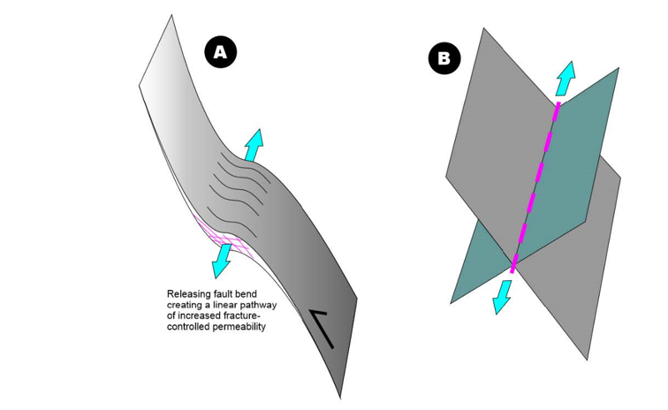
About me
PhD in brittle structural geology from University of Turku, Finland
Research scientist at the Geological Survey of Finland
I work on applying structural geology, spatial analysis and modelling to nuclear siting, nuclear waste disposal research and critical raw material studies
Personal interests also include free and open-source software, research data management and reproducibility in software installation and research analysis
A. Faults, particularly their damage zones, and B. fracture intersections are the loci of increased fracture intensity and, consequently, potential flow pathways

Slide 3
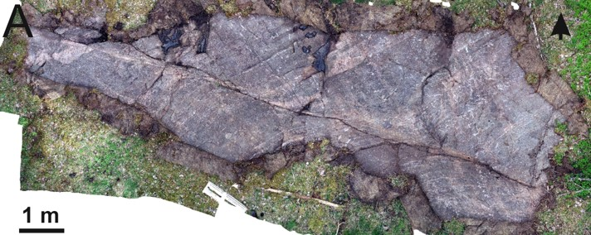
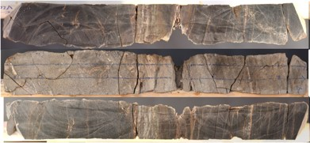
Introduction
This presentation approaches permeability and fracture network modeling primarily from a geological perspective, with the starting point in field-based structural geology.
Our work is focused on crystalline bedrock, the host rock of the Finnish nuclear waste disposal facility at Olkiluoto
Why?
Fractures in crystalline bedrock are dominant pathways for fluid flow
Matrix is mostly impermeable
We quickly found out the complexity of the problem. Now, at the end of the project we have learned some lessons which I will try to share with you!
Upper image: image of outcrop, approximately 12 m in width. Lower image: cut triangular prism shaped rock sample from an outcrop

Slide 4
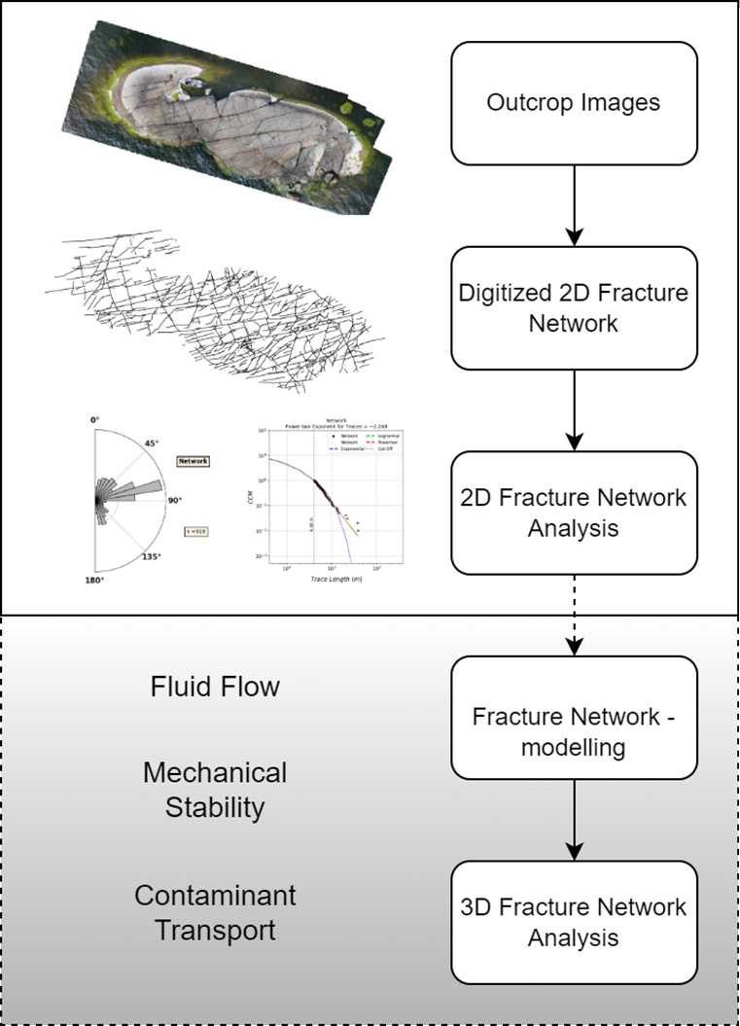
Little about the project: FLOw Pathways within faults and associated fracture systems in crystalline bedrock (FLOP)
The FLOP project focuses on understanding the 3D architecture and discontinuities of fractures and faults, including their damage zones, in crystalline bedrock
Participating organizations:
University of Turku (project lead)
Geological Survey of Finland (GTK)
University of Jyväskylä
Åbo Akademi
Funded by the National Nuclear Safety and Waste Management Research Programme 2023-2028 (SAFER 2028)
Illustration of a fracture network analysis workflow

Slide 5
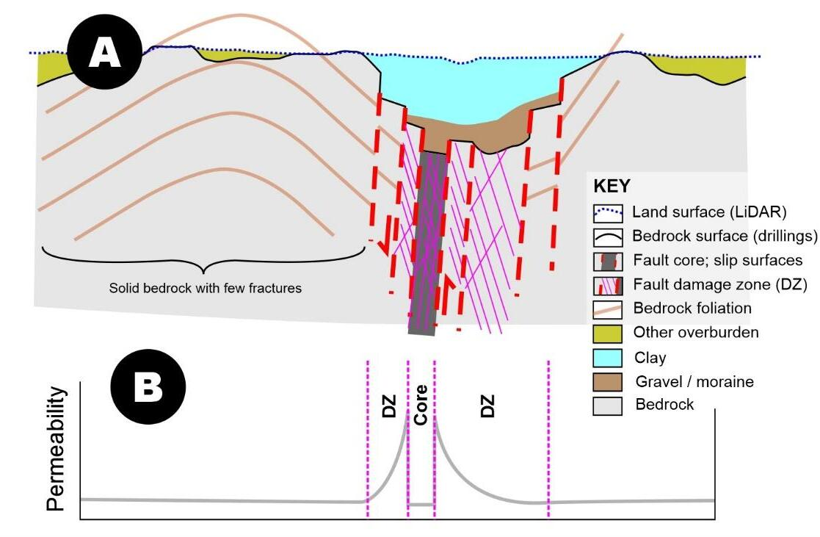
Motivation and Background
Crystalline bedrock is the host rock for deep geological repositories in Finland
The matrix in crystalline rock is largely impermeable compared to discontinuities within it (faults, fractures)
Faults and their damage zones exhibit increased fracture intensity, mineral alteration, porosity, and permeability, making them critical for geothermal energy, groundwater, and waste disposal applications
Other loci of increased fluid flow are fracture plane intersections, i.e. inherently 3D structures
Need to apply free and open-source software tools for modelling instead of proprietary ones due to research and transparency needs
A conceptual model of the fault core and the surrounding damage zone in relation to permeability

Slide 6
Research Questions
How do fracture properties and mineral alteration at the micro-CT scale relate to outcrop and regional scales?
What is the impact of fault zone architecture on porosity and permeability?
What open-source tools are available for 3D fracture analysis and flow modeling?
How can we ensure transparency and reproducibility in modeling workflows and safety assessments?
How to effectively study the channeling of flow within fracture networks?
A. Faults, particularly their damage zones, and B. fracture intersections are the loci of increased fracture intensity and, consequently, potential flow pathways

Slide 7
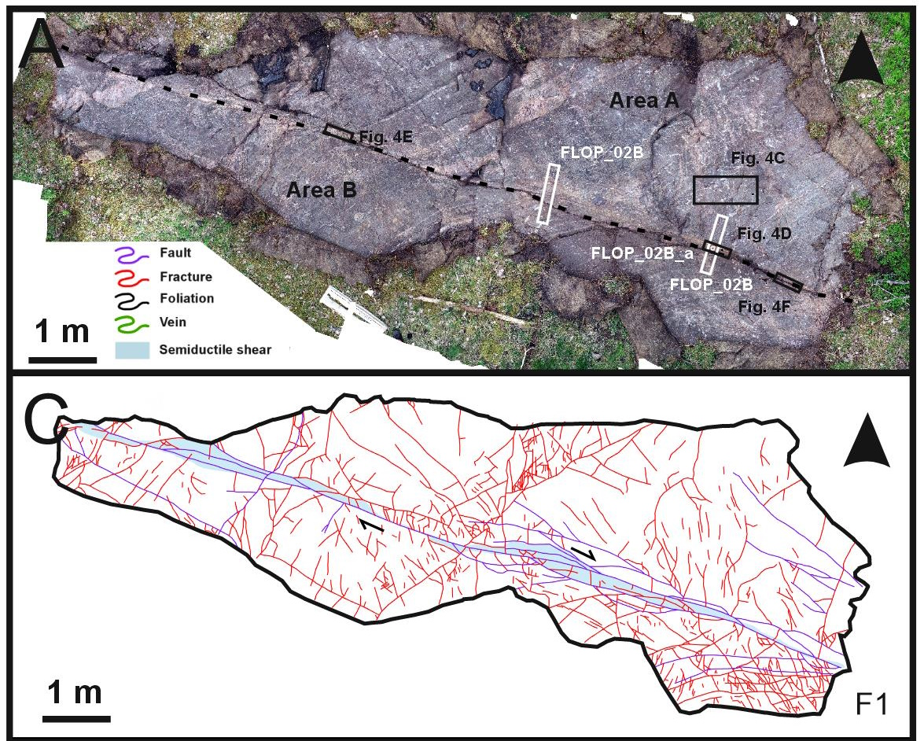
Structural Geological Field Work
Fieldwork at multiple outcrop sites near major fault zones, including drone-based photogrammetry, compass measurements, and sampling
The three main outcrops studied include: (1) layered, foliated mafic volcanic rock with a shear zone and biotite, (2) alternating biotite-rich ash and lava layers with strong foliation, and (3) homogeneous, isotropic tonalite without foliation
These lithological differences affect the localization and geometry of brittle structures in each study area
Target outcrop of FLOP which contains a ductile shear zone overprinted by a brittle fault. Lithology is alternating biotite-rich ash and lava layers with strong foliation (Mod. fig. from Jänkävaara et al., 2025)

Slide 8
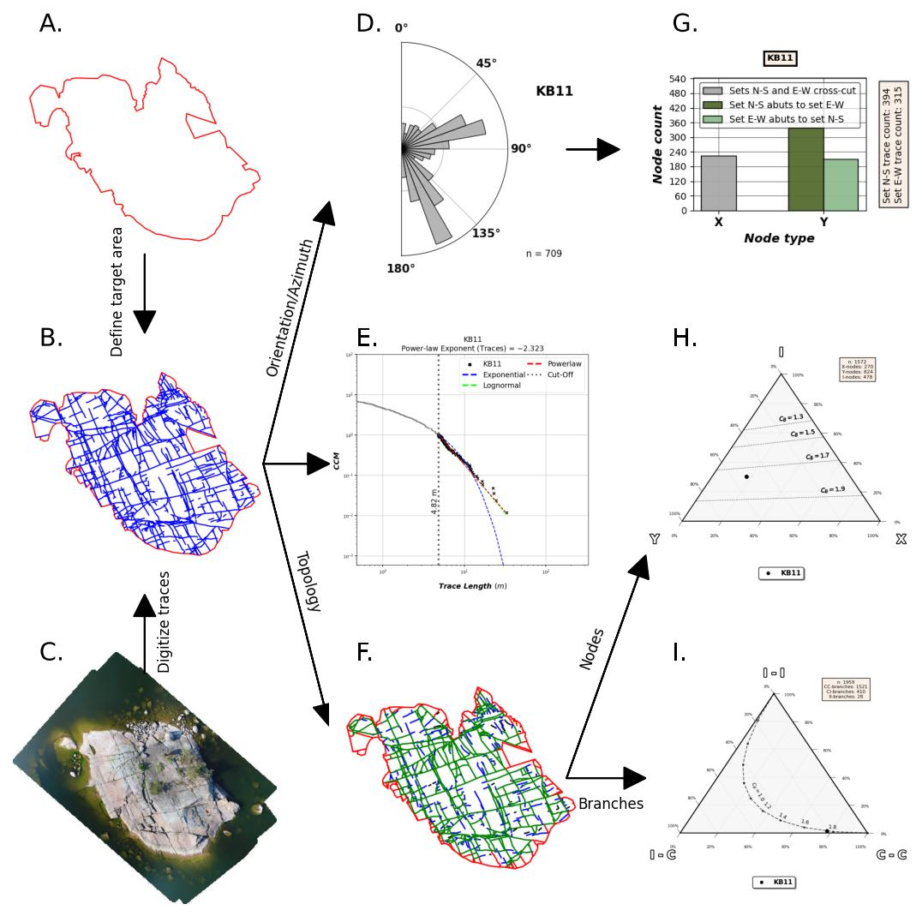
Structural Geological Field Work - analysis
For two-dimensional fracture data analysis, multiple tools already exist
FracPaq (Healy et al. 2017)
NetworkGT (Nyberg et al. 2018)
fractopo (Ovaskainen, 2023)
Outcrops were imaged using drones and the images photogrammetrically processed
Next, fractures were digitized
fractopo was used to analyze geometry and topology of the digitized fracture networks
Fracture analysis software fractopo (Ovaskainen, 2023) can be used extract two-dimensional geometric and topological characteristics of fracture networks

Slide 9
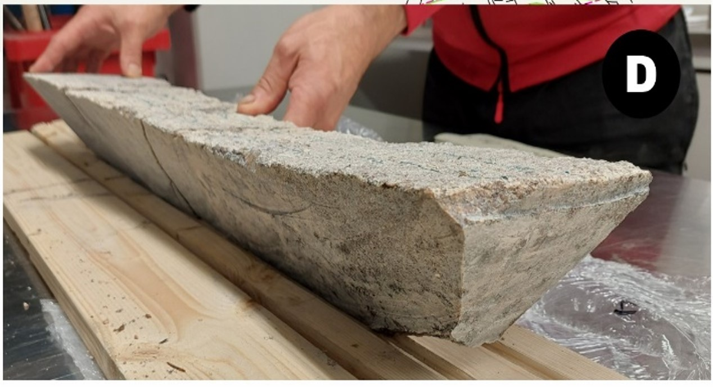
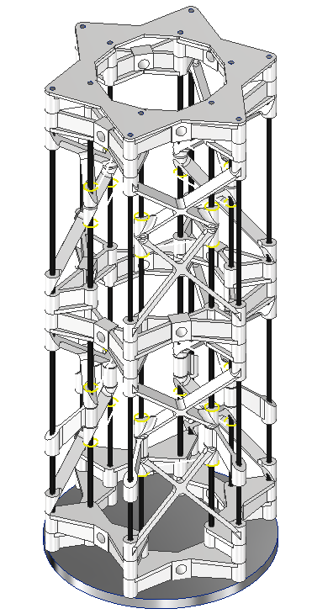
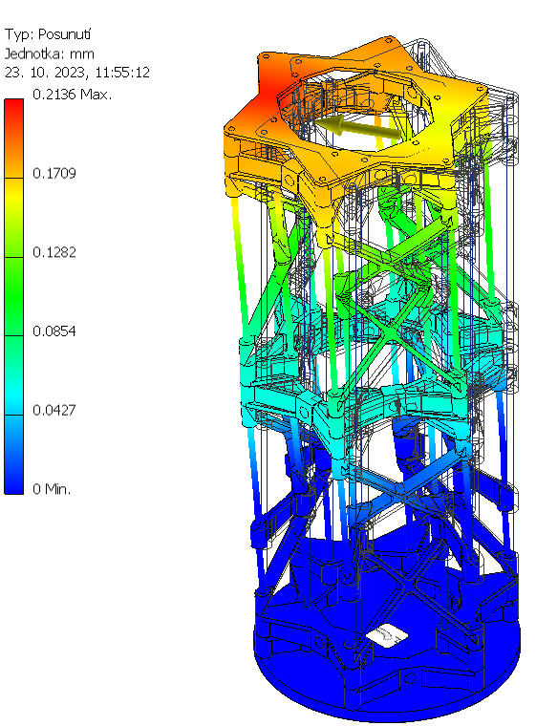
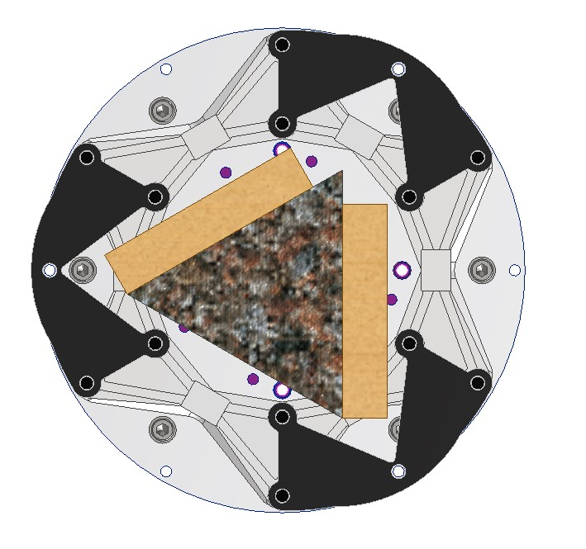
Laboratory
Laboratory micro-CT imaging for high-resolution fracture and alteration analysis
X-ray CT imaging was used to capture microscale fracture geometry and rock matrix properties, providing crucial details that complement field-scale observations
High-energy X-rays are necessary to penetrate decimeter-scale crystalline bedrock samples effectively (max. 6 MeV)
Sample set up for micro-CT imaging with rock sample and custom sample holder displayed

Slide 10
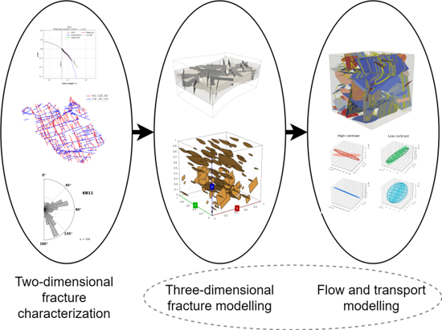
Modelling
Reviewed and tested open-source 3D fracture network (DFN) modeling tools, including:
dfnWorks (Hyman et al., 2015): Python suite for DFN generation, flow, and transport modeling; modular, well-documented, and widely used in research.
Frackit (Gläser et al., 2020): Python/C++ library for stochastic fracture network generation, focusing on geometry/topology with CAD/mesh outputs.
…
Applied MPLBM-UT (Santos et al., 2022) for Lattice-Boltzmann simulation within micro-CT scanned rock sample models
Conceptual workflow from fracture characterization to advanced flow and transport modelling (Ovaskainen, 2024)

Slide 11
How did we do?

Slide 12
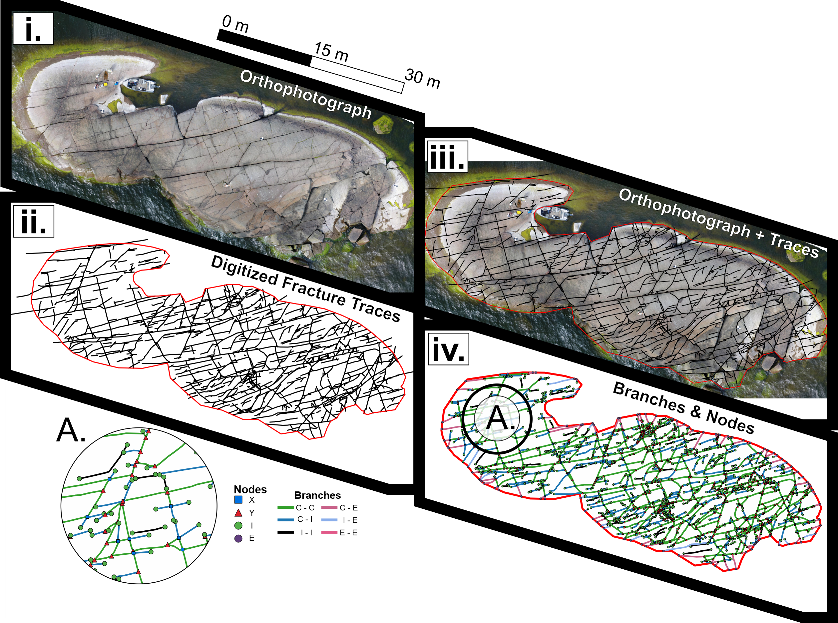
Lessons Learned: Structural Geological Field Work
What went right?
Two-dimensional fracture data collection workflows are well established, including drone imaging and subsequent fracture digitization
Structural geological field observations can be integrated into digitized fractures, foliation field lines and fault characteristics
What went wrong?
Choice of outcrop: Lithology was heterogeneous and the outcrops had ductile deformation
Allows comparison between rock types but makes interpreting brittle processes difficult
Lack of exposure, the outcrops were small and covered in lichen and moss
Workflow from drone imaging to fracture digitization and subsequent topological analysis

Slide 13
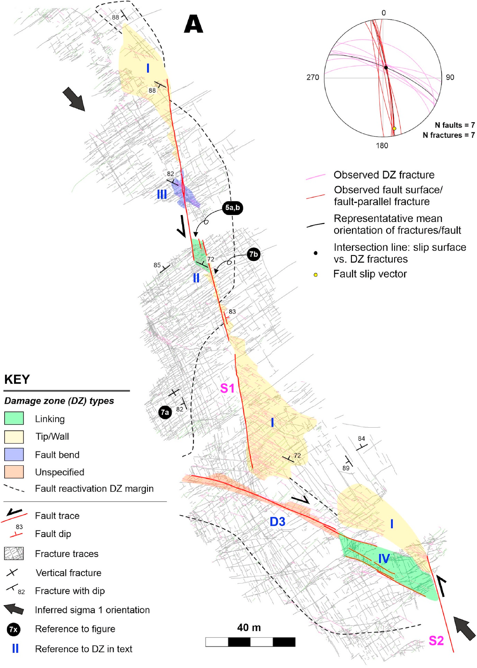
Lessons Learned: Structural Geological Field Work
Example of structural geological characterization of discrete faults (Skyttä et al., 2021)
Key takeaways:
When interested in complex phenomena such as channelling of fluid flow in fracture networks, the geological target must be simple in terms of characteristics other than the brittle deformation (if the controlling effect of brittle characteristics is the target!)

Slide 14
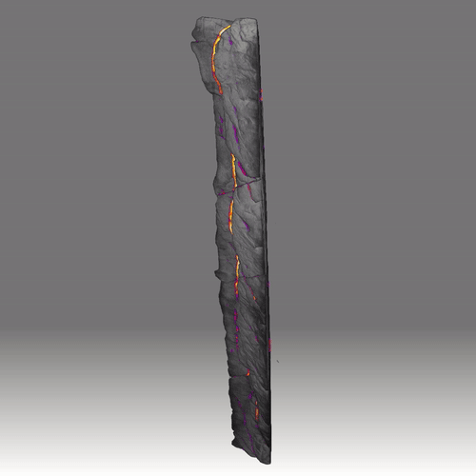
Lessons Learned: Laboratory Tests and CT-Scanning
What went right?
Unique rock sampling was performed: samples were taken as triangular prisms from the outcrops.
CT-scan of triangular prism samples was successful
What went wrong?
Most fractures were healed, i.e., they had mineral filling instead of being open
CT-scan was unable to detect the healed fractures
Large samples caused challenges with resolution and set up
Key takeaways:
How to successfully sample rock that is “broken”?
Industry has “standardized” on smaller rock samples. Going beyond will require custom set ups.
Micro-CT scan results and identified discontinuities (voids) in the rock sample

Slide 15
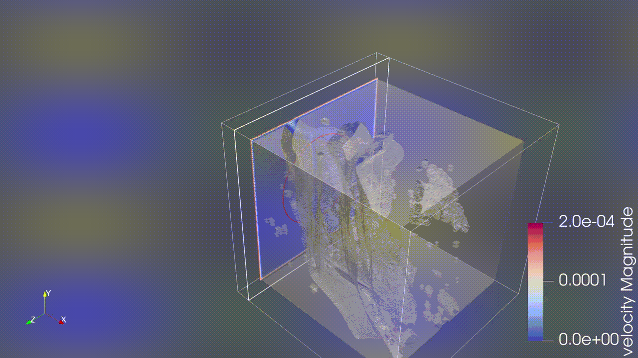
Lessons Learned: Fracture Network Generation & Flow Modelling
What went right?
The level of research in this field is extensive and many tools already exist to tackle modelling crystalline rock fracture phenomena
Tools for, e.g., modelling of channelized flow were found (Pychan3d; Dessirier et al., 2023) and for CT data (CTtoDFM; Santos et al., 2022).
What went wrong?
Generating realistic fracture networks AND modelling thermal, hydrological, mechanical and chemical processes in them is a very complex task
Key takeaways:
Many tools exist, but the barrier for entry is very high, especially from the perspective of a geologist
Instead of trying to tackle this challenge ourselves, we looked to networking and international collaboration
MPBLM-UT (https://github.com/je-santos/MPLBM-UT) Lattice-Boltzmann simulation through a small rectangular subset of FLOP_01C sample. Gray volume represents segmented CT-scan data. Moving slice shows flow velocity magnitude at the end of the simulation. Blue color = “low” velocity. Red = “high” velocity

Slide 16
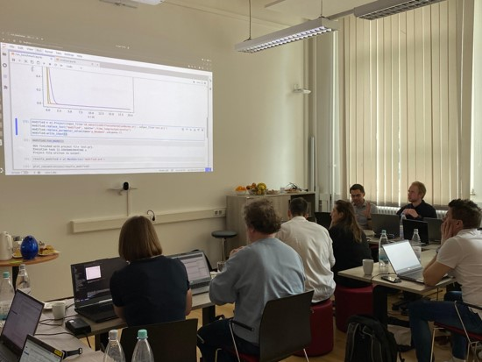
Community & Networking
A DFN Modelling Workshop was held in June 2025 in Aachen, Germany, as part of the FLOP project.
Brought together over 20 experts from academia, research institutes, and industry across Europe.
Focused on open-source software for DFN generation and THMC (thermal, hydrological, mechanical, chemical) modelling, with hands-on hackathons and live demos.
Key topics included fracture network modelling, integration of field/lab data, and challenges in software usability and data interoperability.
The workshop provided a great opportunity to test software hands-on, rather than only reading or hearing about it.
Prof. Dr. Thomas Nagel from the Freiberg University of Mining and Technology hosting a OpenGeoSys (Kolditz et al., 2012) hackathon.

Slide 17
Current and future work
Replication of laboratory contrast agent tests using, e.g., dfnWorks or OpenGeoSys
Project planning and application for a follow-up project
Mineral (titanite) alteration dating using U-Pb, possibly Lu-Hf methods
Micro-CT scanning of mineral alteration reactions that generate substantial porosity within the crystalline rock in Finland
Next iteration of DFN workshop in the middle of 2026, potentially in Forsmark, Sweden (planned location of high-level waste repository in Sweden)

Slide 18
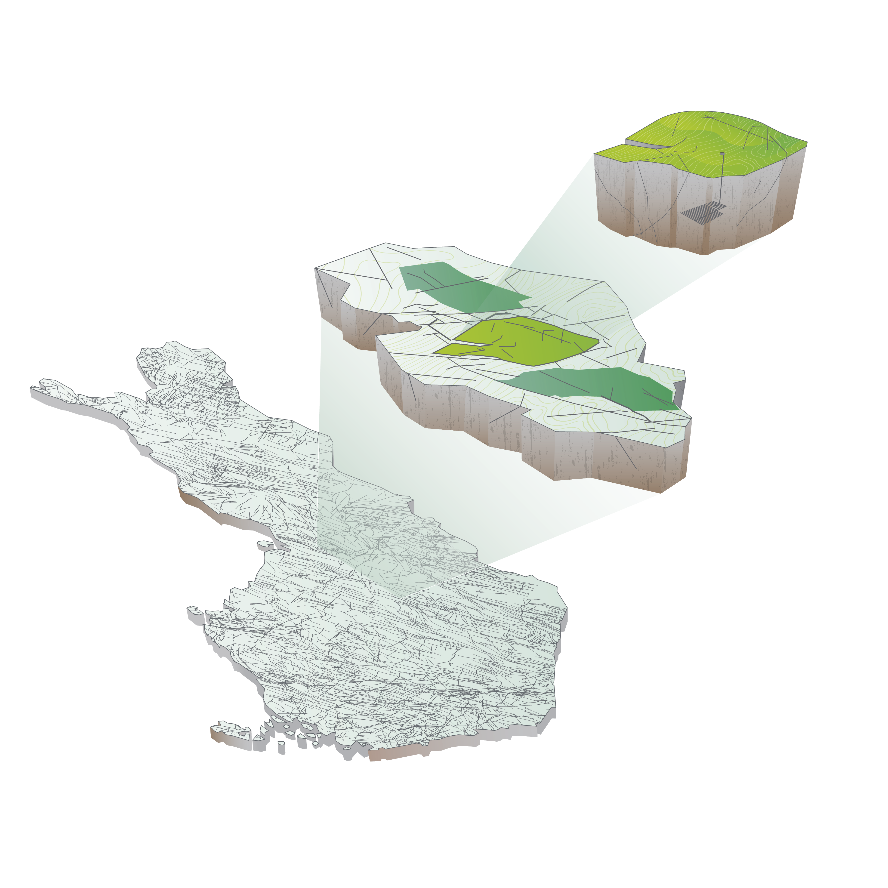
Quick advertisement of other work at GTK (regarding nuclear safety)
Siting of nuclear facilities, especially nuclear waste disposal facilities
Knowledge from the successful historical program of Finland
Integration of geology, geophysics and hydrogeology along with human aspects
Brittle tectonic interpretation of old crystalline terranes
Stability of the host rock is crucial for long-term safety
Conceptual image of siting a deep geological repository using the “block within a block” concept

Slide 19
Thanks!
Project team:
University of Turku: Esa Heilimo, Patrik Jänkävaara, Alan Bischoff
University of Jyväskylä: Arttu Miettinen, Joni Tanttu
Åbo Akademi University: Kaisa Nikkilä
Geological Survey of Finland: Nikolas Ovaskainen, Nicklas Nordbäck, Jon Engström, Evgenii Kortunov

Slide 20
References
Healy, D., Rizzo, R.E., Cornwell, D.G., Farrell, N.J.C., Watkins, H., Timms, N.E., Gomez-Rivas, E., Smith, M., 2017. FracPaQ: A MATLAB™ toolbox for the quantification of fracture patterns. Journal of Structural Geology 95, 1–16. https://doi.org/10.1016/j.jsg.2016.12.003
Hyman, J.D., Karra, S., Makedonska, N., Gable, C.W., Painter, S.L., Viswanathan, H.S., 2015. dfnWorks: A discrete fracture network framework for modeling subsurface flow and transport. Computers & Geosciences 84, 10–19. https://doi.org/10.1016/j.cageo.2015.08.001
Nyberg, B., Nixon, C.W., Sanderson, D.J., 2018. NetworkGT: A GIS tool for geometric and topological analysis of two-dimensional fracture networks. Geosphere 14, 1618–1634. https://doi.org/10.1130/GES01595.1
Ovaskainen, N., 2023. Fractopo: A Python package for fracture network analysis. Journal of Open Source Software 8, 5300. https://doi.org/10.21105/joss.05300
Ovaskainen, N., 2024. Available open source software for three-dimensional fracture characterization and modelling, GTK Open File Research Report. Geological Survey of Finland, Espoo, Finland. https://tupa.gtk.fi/raportti/arkisto/46_2024.pdf
Skyttä, P., Ovaskainen, N., Nordbäck, N., Engström, J., Mattila, J., 2021. Fault-induced mechanical anisotropy and its effects on fracture patterns in crystalline rocks. Journal of Structural Geology 146, 104304. https://doi.org/10.1016/j.jsg.2021.104304
Santos, J.E., Gigliotti, A., Bihani, A., Landry, C., Hesse, M.A., Pyrcz, M.J., Prodanović, M., 2022. MPLBM-UT: Multiphase LBM library for permeable media analysis. SoftwareX 18, 101097. https://doi.org/10.1016/j.softx.2022.101097
Jänkävaara et al. (2025) Brittle structures follow pre-existing ductile structural anisotropy and are scalable in meso-, 1 centimeter-, and microscale in crystalline rocks. Submitted to Tektonika.
Kolditz, O., Bauer, S., Bilke, L., Böttcher, N., Delfs, J.O., Fischer, T., Görke, U.J., Kalbacher, T., Kosakowski, G., McDermott, C.I., Park, C.H., Radu, F., Rink, K., Shao, H., Shao, H.B., Sun, F., Sun, Y.Y., Singh, A.K., Taron, J., Walther, M., Wang, W., Watanabe, N., Wu, Y., Xie, M., Xu, W., Zehner, B., 2012. OpenGeoSys: an open-source initiative for numerical simulation of thermo-hydro-mechanical/chemical (THM/C) processes in porous media. Environ Earth Sci 67, 589–599. https://doi.org/10.1007/s12665-012-1546-x
Gläser, D., Flemisch, B., Class, H., Helmig, R., 2020. Frackit: a framework for stochastic fracture network generation and analysis. JOSS 5, 2291. https://doi.org/10.21105/joss.02291
Dessirier, B., Sharma, K.M., Pedersen, J., Tsang, C., Niemi, A., 2023. Channel Network Modeling of Flow and Transport in Fractured Rock at the Äspö HRL: Data‐Worth Analysis for Model Development, Calibration and Prediction. Water Resources Research 59, e2022WR033816. https://doi.org/10.1029/2022WR033816

Slide 21
Nikolas Ovaskainen
Research Scientist
Puh. | Tel. +358 50 536 1171
nikolas.ovaskainen@gtk.fi
gtk.fi

