Slide 1
Time for a New Waste Category: Uranium‑waste
C. Pescatore
Linnaeus University
Claudio.pescatore.extern@lnu.se
botehtapis@gmail.com

Slide 2
Humanity’s Uranium Inventory
˜ 4.5 million tons (by 2022)
< 0.4% used-up > 99.6% left as waste
For 1 ton U in fuel there is ˜ 9 tons elsewhere
U-238 dominates the inventory
Notes:
Emphasize 30 µg/L → 0.37 Bq/L conversion; U radiological GL ~10 Bq/L.

Slide 3
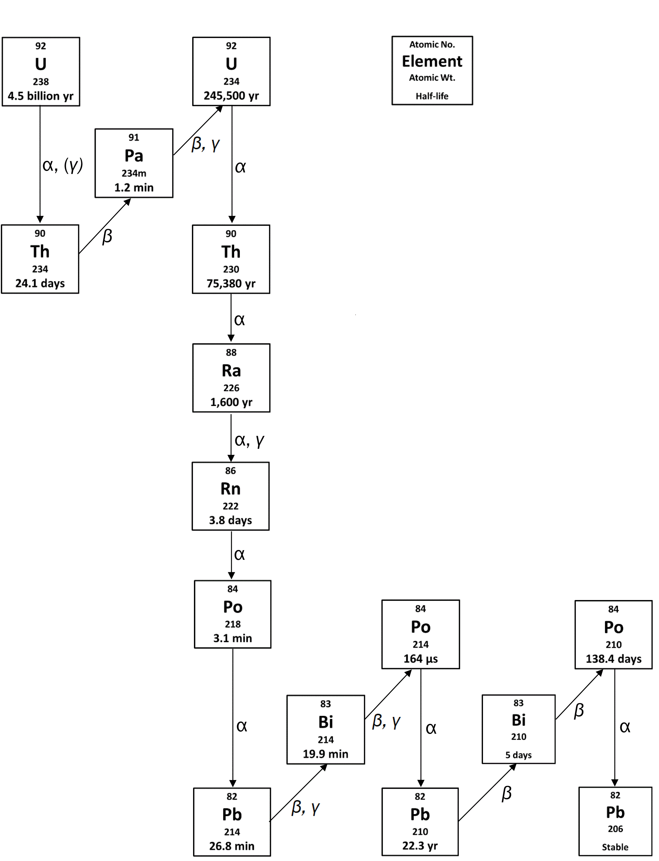
Uranium comes with family: α, β, γ

Slide 4
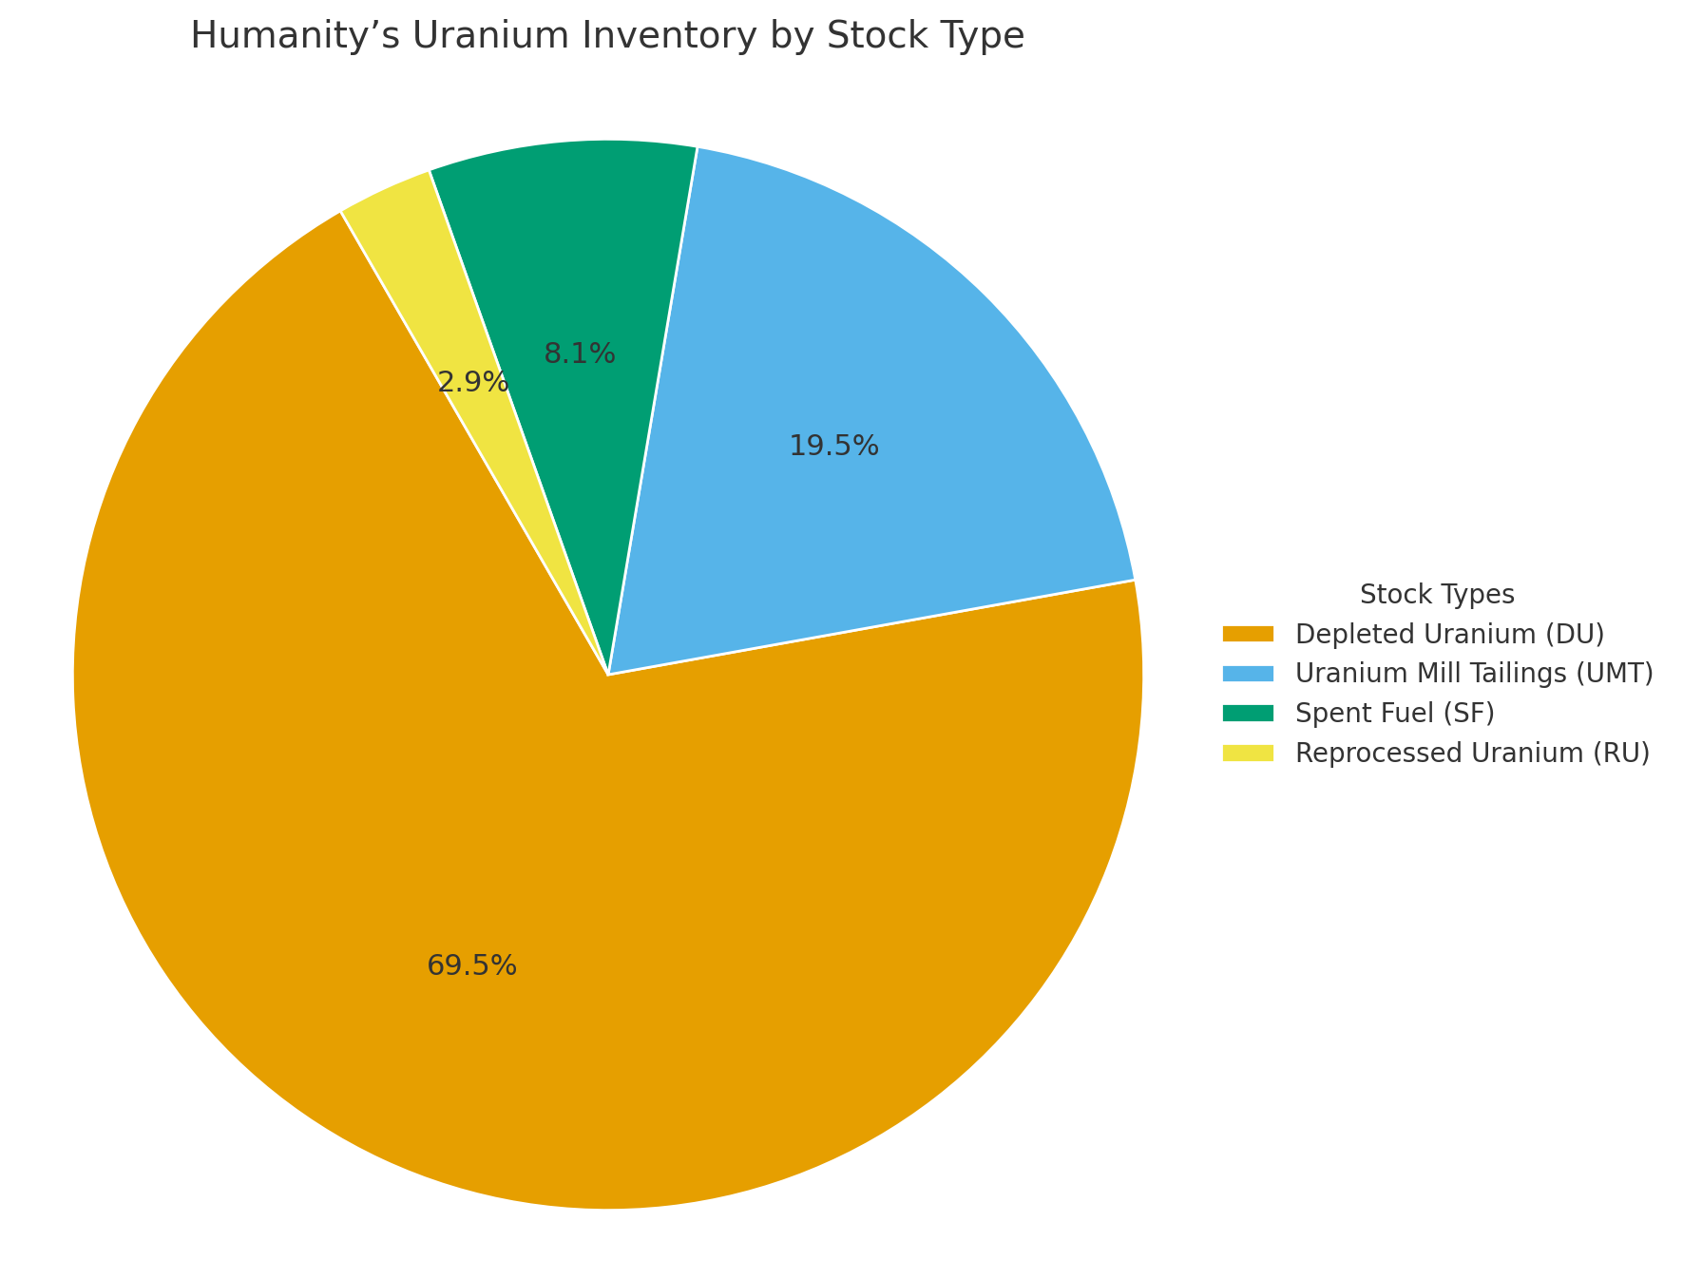
Uranium-waste by stock type
Disposal DU is pure UO2 or U3O8 in powder form
SF is 95-96% «depleted uranium » pellets
UMT is uranium and its familiy loose in sand and rocks, plus the orphaned Th-230 family.

Slide 5
UMT: The Impact is evident (1)
- Persistent gamma radiation fields - Radon gas - Radioactive and chemo-toxic dust - Groundwater contamination
Contamination plumes and radiation hotspots persist across the U-mining world: from the Navajo Nation in the United States to Mailuu-Suu in Kyrgyzstan, from abandoned mines in Portugal to the vast Wismut legacy in Germany, etc.

Slide 6
UMT: The Impact is evident (2)
Uranium plumes and exceedance of safe drinking limits are common
Once started, Uranium contamination can be hardly stopped. What we do now is NOT « hazard elimination » it is « endless exposure mitigation »
In near-surface envt’s uranium is mobile; its radium daughter sorbs. Radium compliance is NOT indicative of Uranium compliance.

Slide 7
Representative field ranges near U‑bearing materials
Radium‑226: 0.10–0.18 Bq/L (≤ 1 Bq/L Guideline) |
Uranium: 100–1,000 µg/L (≫ 30 µg/L Guideline)
Examples: DOE‑LM UMTRA sites (e.g., Moab UT; Slick Rock CO) show U in the 0.1–10 mg/L band near sources
while Ra often stays within a few pCi/L (~0.1–0.2 Bq/L). Wismut legacy sites (Germany: Culmitzsch/Königstein) report U
up to mg/L in mine/stack waters with comparatively lower Ra.

Slide 8
UMT : … Here is the gamma exposure 1 m above uncovered tailings

Slide 9
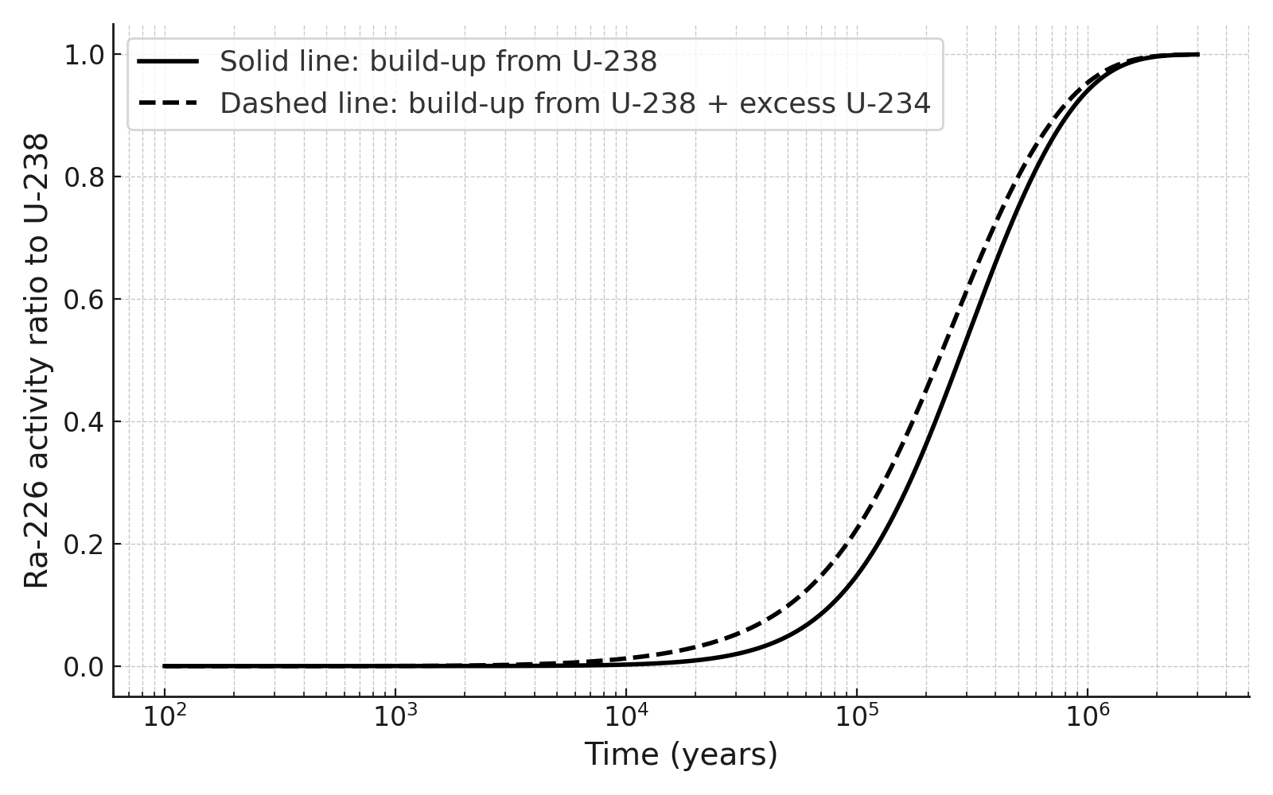
DU : It would get worse (1) – The chain reconstitutes. A pure Uranium substrate continues as well.

Slide 10
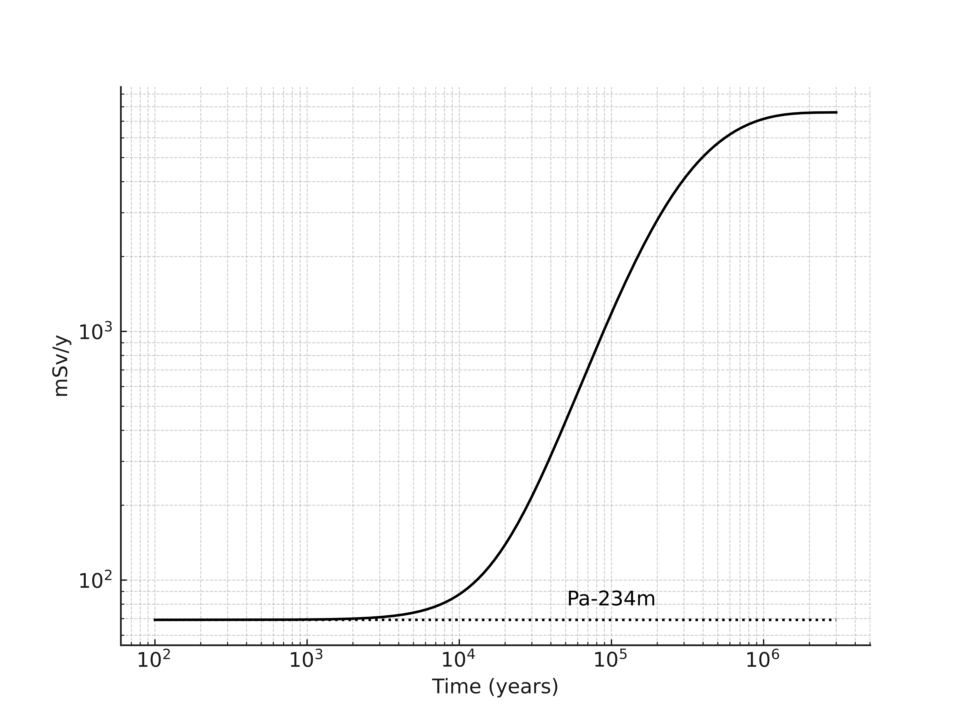
DU: It would get worse (2) … Here is the gamma exposure next to small UO2 cylinder. Btw, smaller is NOT safer

Slide 11
WE NEED NOT WAIT FOR THE FULL CHAIN
Uranium’s ingestion toxicity is primarily chemical: (nephrotoxic)
30 µg/L guideline in drinking water (WHO)
Equivalent to ≈ 0.37 Bq/L for U‑238
For context: U radiological guideline ≈ 10 Bq/L
The ecological guidelines are even smaller, e.g., 3.2 µg/L (or 0.035 Bq/L)
Notes:
Emphasize 30 µg/L → 0.37 Bq/L conversion; U radiological GL ~10 Bq/L.

Slide 12
U-waste deserves disposal away from biosphere
In 1978 and 1979 major studies observed already that, just based their Ra-226 content, UMT deserve as tight containement as HLW.
In 2025 same conclusions based on Uranium content.
By the same token, stronger reason for Depleted Uranium and Spent Fuel Uranium to go deep underground

Slide 13
URANIUM WASTE
It is WASTE
By mass and volume it DOMINATES all other Nuclear Fuel Cycle waste
It has HUGE ingestion chemical toxicity to man and aquatic biota now and forever
Radio-toxicity also important due to its decay chain, e.g., direct exposure
Deserves disposal away from biosphere
So far, Uranium has been Under the Radar
Radio-centric frameworks should adopt the Bq/L equivalent to the µg/L guidelines of ecotoxicological frameworks
Notes:
Emphasize 30 µg/L → 0.37 Bq/L conversion; U radiological GL ~10 Bq/L.

Slide 14
Details in Pescatore’s
📄 Humanity’s Uranium Inventory: A Persistent Chemical and Ecotoxicological Liability (Energy Research & Social Science, 2025) https://www.sciencedirect.com/science/article/pii/S2214629625003792?via%3Dihub
📄 Humanity’s Uranium-238 Inventory: A Significant and Enduring Gamma-Radiation Liability (Nukleonika, 2025) https://sciendo.com/article/10.2478/nuka-2025-0004
📄 Beyond a Million Years : Robust Shielding for High-Level Waste https://sciendo.com/article/10.2478/nuka-2025-0009
Beyond a Million Years : The Intrinsic Radiation Hazards of High-Level Waste (Nukleonika, 2024)
Notes:
Emphasize 30 µg/L → 0.37 Bq/L conversion; U radiological GL ~10 Bq/L.

Slide 15
Upcoming...
New paper in preparation arguing that, upon ingestion, at guideline level
Uranium (10 Bq/L) constitutes a higher radiogenic cancer risk than Ra (1 Bq/L)

